Slide 1
Extracting Building Footprints for Accurate Underwriting
Jennifer Vasi

Slide 2

Property Insurance
Property attributes are largely self-reported
  House type, roof material
  Proximity to hydrant or other improvements
Validation of attributes is limited to high value homes (> $500K)

Slide 3
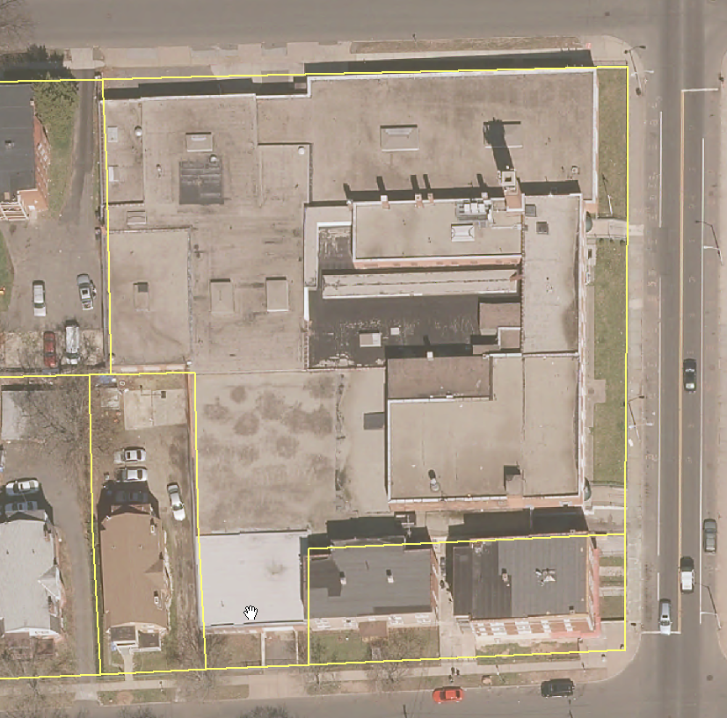
Building Location is Important Information
Where is the improvement on the parcel
What is it near
What is elevation profile of the parcel

Slide 4
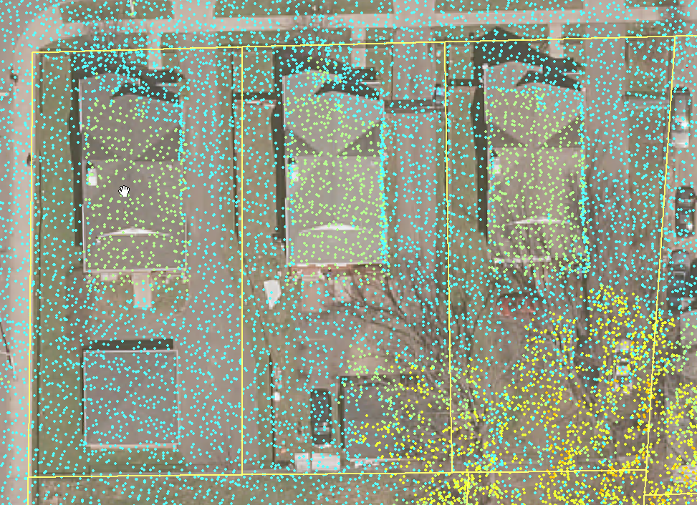
What If…
These were available
  Very high resolution imagery
  LiDAR data
  Parcel boundaries
  eCognition and ArcMap

Slide 5
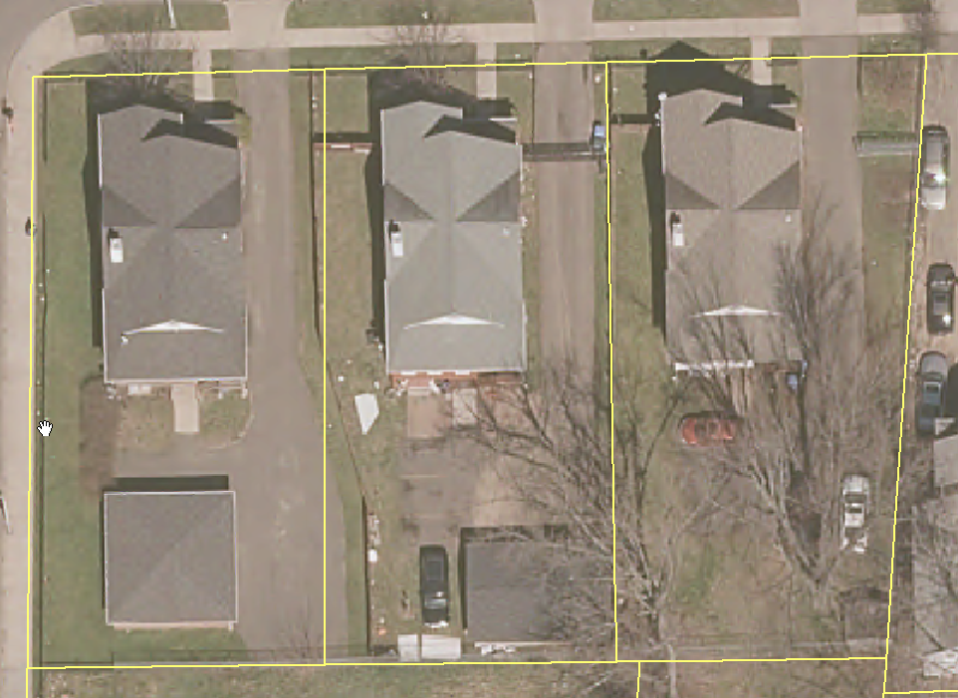
Automated Underwriting Assistance
An electronic record of improvement locations on parcels could be used to assist the underwriting process
Assists insurers in validating insured’s reported property attributes

Slide 6
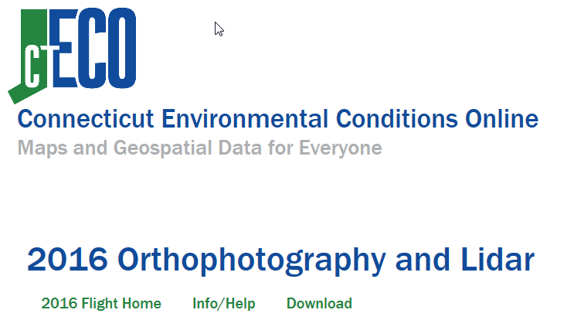
State of CT, 2016
State of CT flew mapping missions in 2016
3” resolution imagery was collected
LiDAR was collected

Slide 7
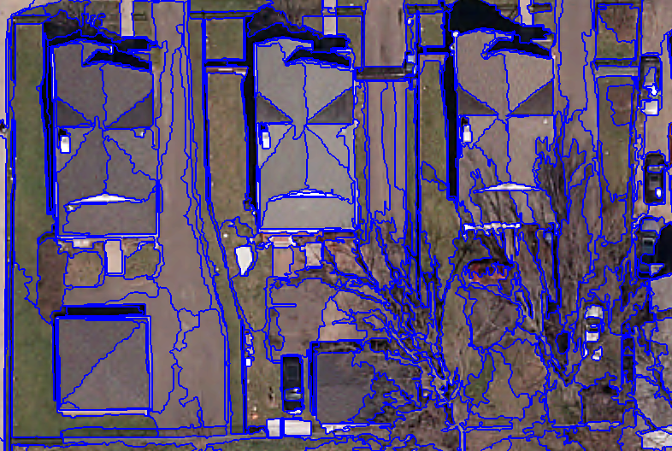
eCognition
Using imagery and LiDAR
Create ruleset to identify building footprints
Ruleset repeatable for tiles in CT
Classify building, road, water, “background”

Slide 8
ArcMap
Combine parcels with building footprints
Create master record for insurer

Slide 9
Evaluation of Value
Evaluate
  Skills/Knowledge needed by user
  Cost of system needed
  Ease of use
  Scalability
  Accuracy

Slide 10
Steps
The following steps will be executed for this project:
  Define area of interest in Hartford, CT
  Acquire imagery data from CTECO web site: 3 inch resolution, 4-band imagery
  Acquire LiDAR data from CTECO web site or NOAA web site
  Acquire parcel data from Hartford Open Data web site
  Determine eCognition segmentation settings
  Build eCognition classification ruleset
  Sample random points for accuracy
  Combine building footprints with parcels
  Create maps and data products
  Evaluate results

Slide 11
Anticipated Results
Building footprint extraction should be possible
Off-nadir, tall buildings harder to identify correctly
Automated system will prove valuable to insurer

Slide 12

Timeline
596A: Summer 2017
Processing work: Fall 2017
Presentation / 596B: ??

Slide 13

Questions

Slide 14
References
O’Neil-Dunne, Jarlath. 2014. LiDAR Magazine. Product Review: A Review of eCognition. Retrieved from http://www.lidarmag.com/PDF/LiDARNewsMagazine_OneilDunne-eCognitionReview_Vol4No5.pdf
Pender, Kathleen. July 2, 2016. San Francisco Chronicle. How to find the replacement cost of your home for insurance. http://www.sfchronicle.com/business/networth/article/How-to-find-the-replacement-cost-of-your-home-for-8337289.php
University of Connecticut (UCONN). 2016. Orthophotography and Lidar. Retrieved June 26, 2017 from http://www.cteco.uconn.edu/data/flight2016/info.htm

