Slide 1
Stormwater Runoff: A Case Study of the Correlation between Relative Hydrologic Soil Group and Imperviousness
Nancy Velez, GISP
Penn State MGIS
GEOG 596A
December 2014
Advisor: Dr. Stuart Echols

Slide 2
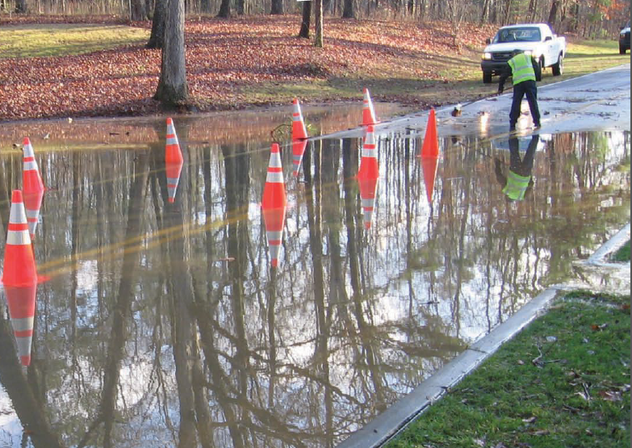
Overview
Project Background
Project Goals and Objectives
Proposed Methods
Conceptual Workflow
Anticipated Results
Project Timeline
http://www.roswellgov.com

Slide 3
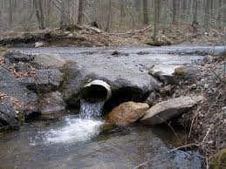
Background on Stormwater Utility
In 2011 the City of Roswell implemented a Stormwater Utility.
The stormwater system was built over 30 years ago and is failing.
The Stormwater Utility is a fee to cover the expenses of operating and maintaining the Stormwater Management program.
User fees are charged based on the impervious surface of a parcel.
The fees are charged to everyone who places a demand on the stormwater system, even tax exempt properties.
Customers can reduce their stormwater fees through appropriate credits.
http://sevenhillslake.com/stormwater.html

Slide 4
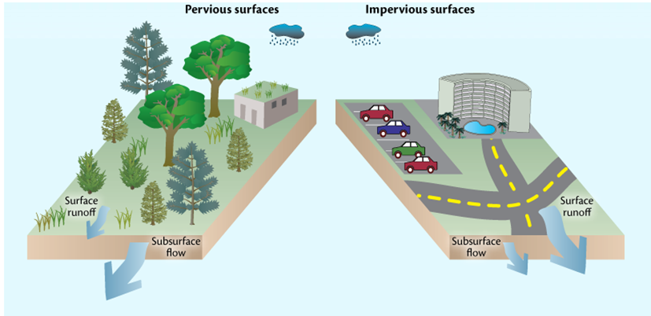
What are Impervious Surfaces?
Impervious area is defined as the areas within a developed parcel which prevent or significantly impede the natural infiltration of stormwater into the soil.
Examples would include:
Rooftops
Driveways
Sidewalks
Patios
Parking lots
Storage sheds
Swimming pools
http://www.mdcoastalbays.org/
Impervious surfaces prevent rainfall from infiltrating the ground.
As a result, additional runoff must be managed.

Slide 5
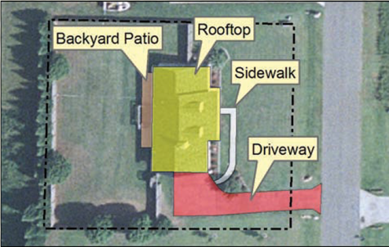
Stormwater Utility Billing
The City of Roswell has developed a rate schedule to ensure equity is reflected in the bills. All residential customers will be divided into four (4) classes based on the amount of impervious surface area on their property. Non residential customers receive a customized bill.
http://www.roswellgov.com
Computing Impervious Surface
Rooftop 2,464 square feet
Driveway 1,514 square feet
Backyard Patio 309 square feet
Sidewalk 228 square feet
Total 4,515 square feet
Monthly stormwater fee for 4,515 square feet of impervious surface are is $3.95

Slide 6
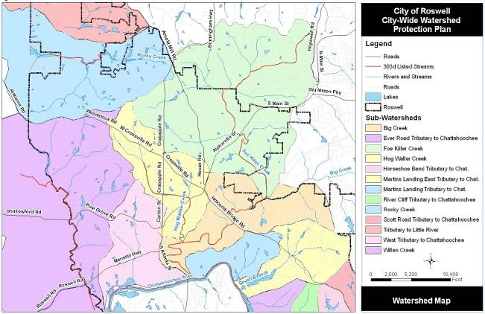
Stormwater Utility Credits
The City of Roswell provides incentives in the form of credits for practices that benefits the Stormwater Management program.
These credits reflect as a deduction in stormwater fees.
There are 6 credit opportunities for residential customers and 9 for non-residential customers.
Low Impact Development incentives
Impaired Streams

Slide 7
Goals and Objectives
This project will focus on the low-impact parcel credit. This credit applies to parcels that have a small impervious area (less than 15%) in comparison to the total parcel size.
It is currently believed that impervious area is the only characteristic that has an impact on stormwater runoff.
This project will assess whether the underlying hydrologic soil and ground cover type influences the impact of a parcel.
This project will challenge the belief that stormwater credits should be based on impervious surface alone.
This challenge will be conducted by calculating weighted curve numbers to assess a more accurate runoff of sample parcels.

Slide 8
Curve Numbers and the TR-55 Method
Curve Numbers (CN) give an infiltration number for land cover and soil type combinations.
The TR-55 (Technical Release no. 55) method is simplified by joining the runoff equation with unit hydrograph theory.
The CN displays the runoff potential after the losses through evaporation, transpiration, absorption and surface storage.
The higher the CN value the higher the runoff potential will be.

Slide 9
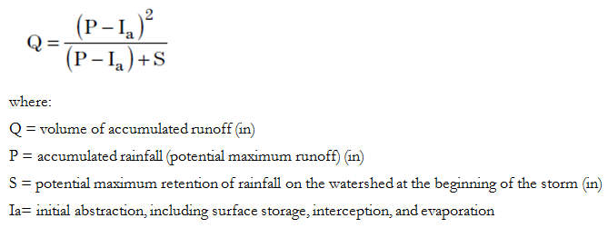
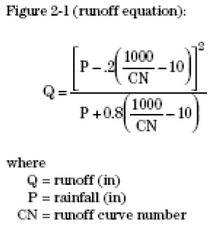
The Runoff Curve Number Equation
The results are runoff depth in watershed inches
http://www.nrcs.usda.gov

Slide 10
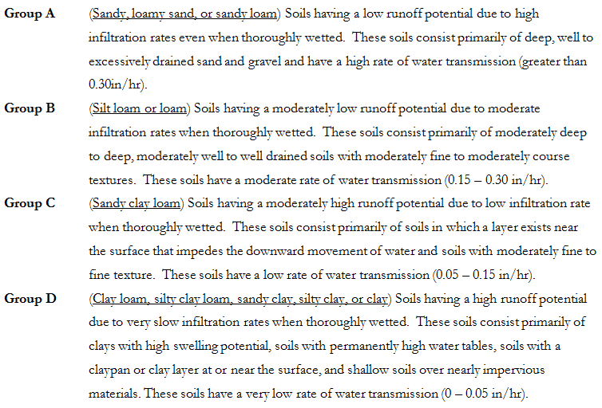
Hydrologic Soil Groups

Slide 11
TR-55 Runoff CN for Land Classifications
It is crucial to choose the most appropriate ground cover type and hydrologic condition.
ftp://ftp.wcc.nrcs.usda.gov/wntsc/H&H/training/runoff-curve-numbers1.pdf

Slide 12
Weighted Curve Numbers
Weighted CNs need to be created for each parcel that has more than one land use.
Mistakes in soil type or land classification could significantly impact the weighted curve number result.
An incorrect weighted curve number could have a serious effect on data analysis.

Slide 13
Proposed Methods
The City of Roswell will be broken down into two study areas of 1 square mile.
High resolution orthophoto and lidar imagery will be used to create land cover classification data through remote sensing.
The land cover classes will be as follows:

Slide 14
Data Preparation for Remote Sensing

Slide 15
eCognition Land Cover Extraction

Slide 16
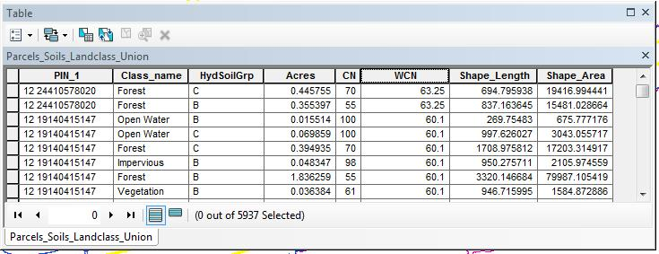
ArcMap Geoprocessing
The small, segmented features produced from the classification extraction will be merged by class.
Soil data will be used to determine the Hydrologic Soil Group.
The land class and soil data will be unioned to calculate the CN.
The land cover/soil data will be unioned with the parcel data.
The weighted CN will be determined for each sample parcel.

Slide 17
Conceptual Workflow

Slide 18
Anticipated Results
The project results will answer the question as to whether the underlying soil type combined with the land cover makes a difference on stormwater runoff.
An analysis will be made of the validity of using impervious surface information alone in issuing stormwater credits.
With the results of this project, further research could be conducted into the feasibility of developing parcels that have a high infiltration rate.

Slide 19
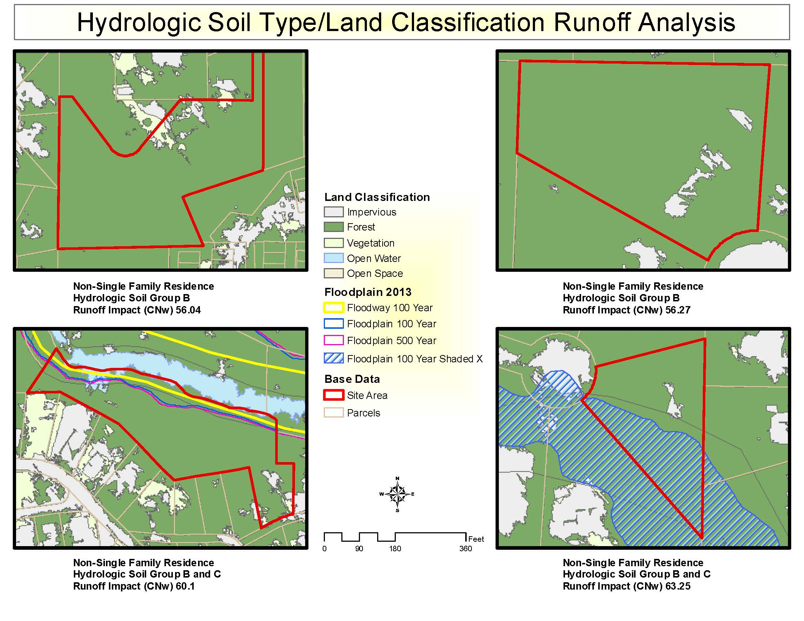

Slide 20
Project Timeline
December 2014
Complete data calculations
February – April 2015
Draft final paper and presentation
May 4-6, 2015
Present at the ESRI Southeast User Conference in Nashville, TN
January 2015
Analyze and establish data results
May 2015
Turn in final paper

Slide 21
References
Ando, A. W., & Freitas, L. P. 2009. Consumer Demand for Green Technology in an Urban Setting: The Case of Chicago Rain Barrels. Available at SSRN 1440877.
Atlanta Regional Commission (ARC). 2001. Georgia Stormwater Management Manual. Volume 2: Technical Handbook. Atlanta, GA.
City of Roswell. 2010. Roswell Stormwater Utility Credit Manual. Roswell, GA.
City of Roswell. 2011. Roswell Stormwater Utility Customer Service Manual. Roswell, GA.
Cronshey, R. 1986. Urban hydrology for small watersheds. US Dept. of Agriculture, Soil Conservation Service, Engineering Division.
Doll, A., Scodari, P. F., & Lindsey, G. 1998. Credits as economic incentives for on-site stormwater management: issues and examples. In Proceedings of the US Environmental Protection Agency National Conference on Retrofit Opportunities for Water Resource Protection in Urban Environments, Chicago, IL (pp. 13-117).
England, G. 2001. Success Stories of Brevard County, Florida Stormwater Utility. J. Water Resour. Plann. Manage. 127, SPECIAL ISSUE: MINI-SYMPOSIUM ON URBAN DRAINAGE, 180–185.
Iowa State University. 2008. Iowa Stormwater Management Manual. Version 2: 2C-5 NRCS TR-55 Methodology. http://www.ctre.iastate.edu/pubs/stormwater/documents/2C-5NRCSTR-55Methodology.pdf.
McGee, J. 2009. Calculating Pervious Curve Numbers – A custom tool built using ArcGIS Diagrammer and ModelBuilder. ArcUser, Winter 2009, pp. 54-57.
National Research Council (NRC). 2008. Urban Stormwater Management in the United States. National Academies Press: Washington, DC.
New Jersey Department of Environmental Protection, Division of Watershed Management (NJDEP). 2004. The New Jersey Stormwater Best Management Practices Manual. http://www.njstormwater.org/bmp_manual2.htm
Niemczynowicz, J. 1999. Urban Hydrology and Water Management – Present and Future Challenges. Urban Water 1:1-14.
Reese, Andrew J. 2007. Stormwater Utility User Fee Credits. J. Water Resour. Plann. Manage., Vol. 8, Issue 8, November/December 2007, pp. 49-56.
Schiariti, Paul. 2013. Basic Hydrology – Runoff Curve Numbers. New jersey Conservation District Employees Association. http://njscdea.ncdea.org/CurveNumbers.pdf
U.S. Environmental Protection Agency (EPA). 2009. Funding Stormwater Programs. http://water.epa.gov/infrastructure/greeninfrastructure/upload/FundingStormwater.pdf

Slide 22
Acknowledgements
Dr. Stuart Echols
Richard Greuel, P.E.
Alice Champagne, CFM, CPESC
Jarlath O’Neil-Dunne, Associate Professor

