Slide 1
GIS for Reservoir Management: Estimating Original Gas In Place
Jeffrey Vu, M.GIS Candidate
Dr. Patrick Kennelly, Advisor
GEOG 596A Winter 2013

Slide 2
Outline
Background
Introduction
Objectives
Data
Methods
Anticipated Results
Timeline
Future Development
References
Acknowledgements

Slide 3
Background
What is reservoir management? Use of earth sciences and petroleum engineering to forecast and manage the recovery of oil and natural gas (hydrocarbons) in place from a field or a prospect
Reservoir management plays an important role in the oil and gas industry by evaluating the greatest economic recovery from a reservoir. - Increase oil and gas production - Decrease risk - Maximize recovery and minimize costs
Reservoir Engineers typically don’t use GIS. They normally use Microsoft Excel for all sorts of modeling, including analysis.

Slide 4
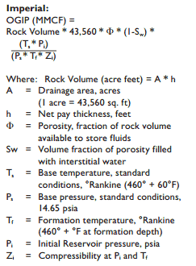
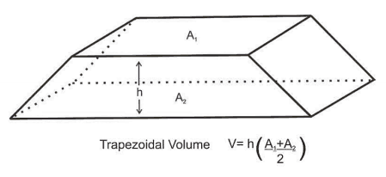
Introduction
Volumetric estimation is the common technique of the geologists to calculate hydrocarbons in place based on geologic mapping and reservoir engineering data.
OGIP: Original Gas In Place
MMCF: Million Cubic Feet
http://discoverygeo2com/Papers/Reservoir%20Eng%20for%20Geos%2032pdf

Slide 5
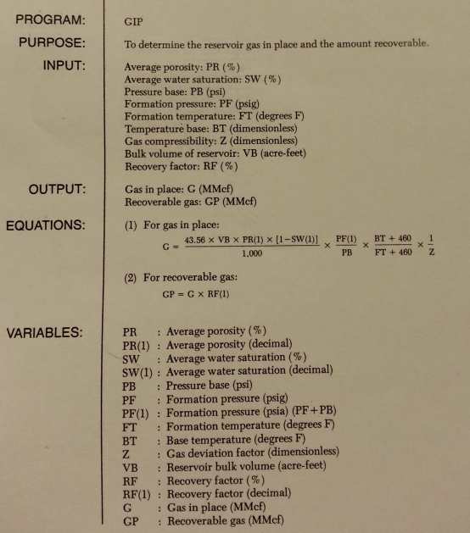
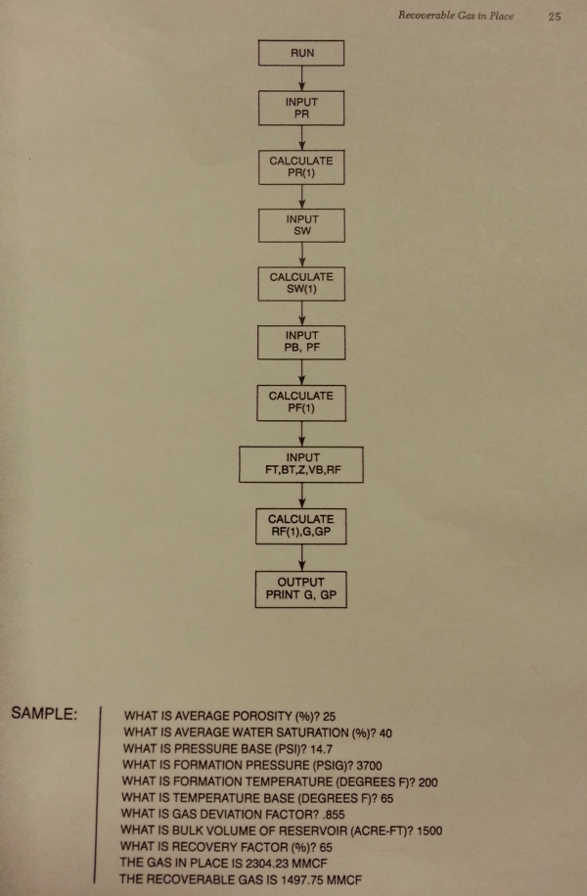
History and current process
Determine reservoir gas in place using BASIC programming language BASIC (standing for Beginner's All Purpose Symbolic Instruction Code)
Cranmer, John L.: “BASIC Reservoir Engineering Manual”, PennWell (1982) 24-25.

Slide 6
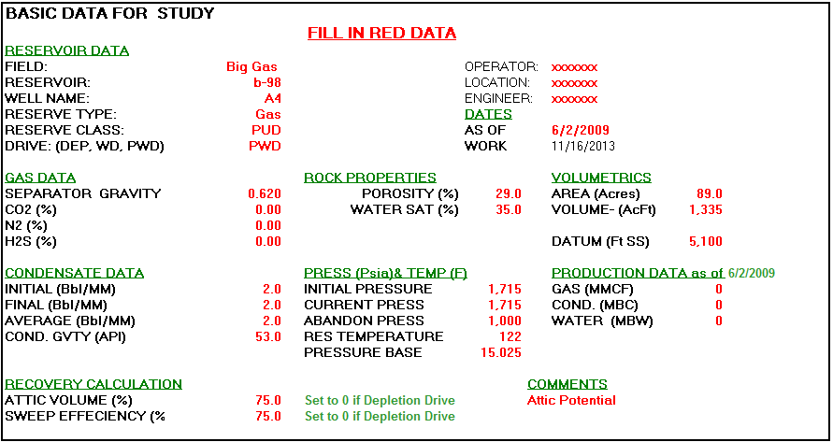
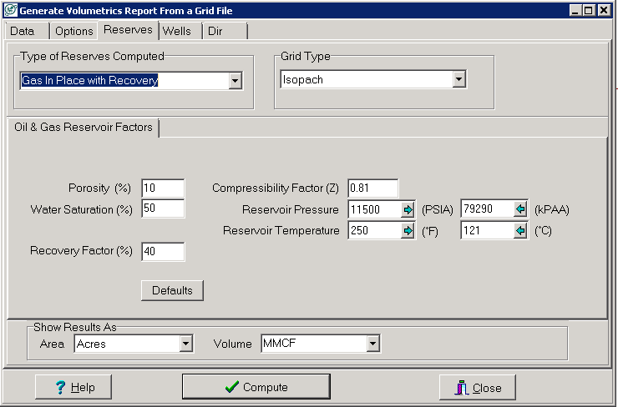
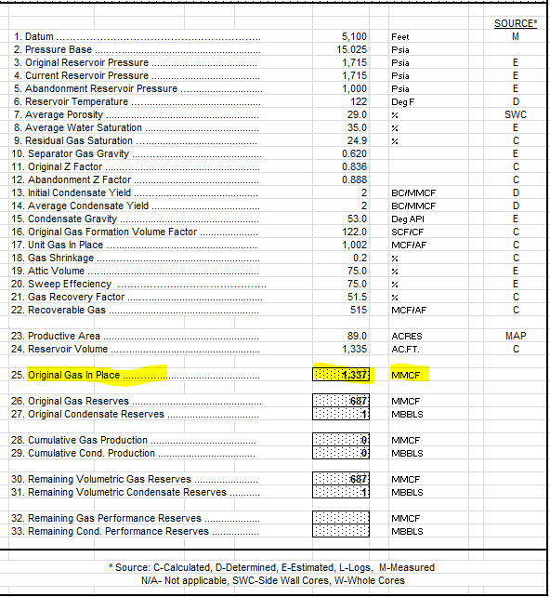
History and current process (cont.)
Calculate original gas in place using Excel
Calculate gas in place using Petra
http://petroleumsupport.com/volume-reservoir-and-gas-reserve-calculator-spreadsheet/

Slide 7
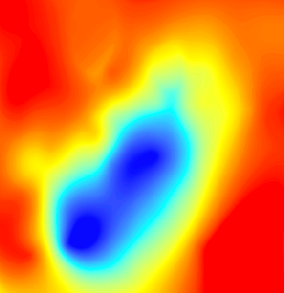
Current workflow
Petra
Geologists generate net pay, porosity, water saturation grids
ArcMap
PLSS sections
Generate centroids
Excel
Input Data
Calculate OGIP using formulas
Extract Values to Points
1320 sq.ft. x 1320 sq.ft. = 40 acres
PLSS section (640 acres)

Slide 8
Objectives
Create a workflow using out-of-the-box tools in ArcToolbox as a screening workflow to estimate the Original Gas In Place (OGIP) for the Reservoir Engineers
Streamline the workflow to avoid human error in importing and exporting data
Allow user-drawn polygon as input to increase flexible analysis of fields or prospects
Use folder structure to manage data inputs and results
Run different scenarios
Estimate the OGIP under different uncertainties and assumptions

Slide 9
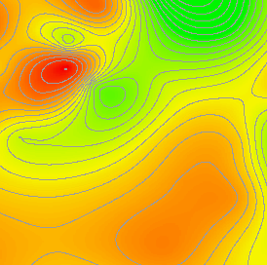
Proposed workflow (using ArcGIS)
Grids exported from Petra
Net pay
Porosity
. | . | . | .
. | . | . | .
. | . | . | .
. | . | . | .
. | . | . | .
. | . | . | .
. | . | . | .
. | . | . | .
. | . | . | .
. | . | . | .
. | . | . | .
. | . | . | .
. | . | . | .
. | . | . | .
. | . | . | .
. | . | . | .
. | . | . | .
. | . | . | .
. | . | . | .
. | . | . | .
Calculate OGIP
. | . | . | .
. | . | . | .
. | . | . | .
. | . | . | .
. | . | . | .
. | . | . | .
. | . | . | .
. | . | . | .
. | . | . | .
. | . | . | .
. | . | . | .
. | . | . | .
. | . | . | .
. | . | . | .
. | . | . | .
. | . | . | .
. | . | . | .
. | . | . | .
. | . | . | .
. | . | . | .
40-ac fishnet
. | . | . | .
. | . | . | .
. | . | . | .
. | . | . | .
Average values
. | . | . | .
. | . | . | .
. | . | . | .
. | . | . | .
Intersected
. | . | . | .
. | . | . | .
. | . | . | .
. | . | . | .
. | . | . | .
. | . | . | .
. | . | . | .
. | . | . | .
. | . | . | .
. | . | . | .
. | . | . | .
. | . | . | .
. | . | . | .
. | . | . | .
. | . | . | .
. | . | . | .
. | . | . | .
. | . | . | .
. | . | . | .
. | . | . | .
. | . | . | .
. | . | . | .
. | . | . | .
. | . | . | .
. | . | . | .
. | . | . | .
. | . | . | .
. | . | . | .
. | . | . | .
. | . | . | .
. | . | . | .
. | . | . | .
. | . | . | .
. | . | . | .
. | . | . | .
. | . | . | .
. | . | . | .
. | . | . | .
. | . | . | .
. | . | . | .
1320 sq.ft. x 1320 sq.ft. = 40 acres
. | . | . | .
. | . | . | .
. | . | . | .
. | . | . | .
. | . | . | .
. | . | . | .
. | . | . | .
. | . | . | .
. | . | . | .
. | . | . | .
. | . | . | .
. | . | . | .
. | . | . | .
. | . | . | .
. | . | . | .
. | . | . | .
. | . | . | .
. | . | . | .
. | . | . | .
. | . | . | .
OGIP map
Water saturation

Slide 10
Data
Exported grids from Petra
Net pay grid is required
All input grids must have the same coordinate systems and cell sizes
User’s parameters

Slide 11
Methods
Data management: User-defined folder structure
User-drawn polygon to increase flexibility in selecting areas of interest
Reusable workflow to run different scenarios
Python codes to check inputs (grid or constant value)
User-drawn polygon
Is a grid?
Copy to project’s folder
YES
NO
Create a grid based on user-drawn polygon
2 | 2 | 2 | 2
2 | 2 | 2 | 2
2 | 2 | 2 | 2
2 | 2 | 2 | 2
2 | 2
2 | 2
2 | 2
2 | 2
User’s input = 2
2 | 2 | 2 | 2
2 | 2

Slide 12
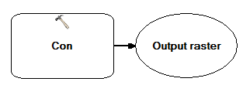
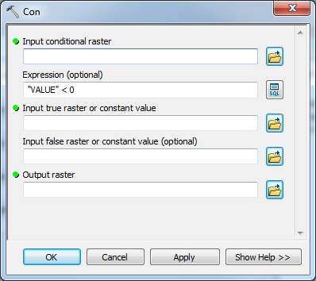
Con (Spatial Analyst)
Performs a conditional if/else evaluation on each of the input cells of an input raster
-5 | 12 | 26 | 50
34 | 19 | 44 | -10
48 | 42 | 64 | 12
2 | -15 | 24 | -47
0 | 12 | 26 | 50
34 | 19 | 44 | 0
48 | 42 | 64 | 12
2 | 0 | 24 | 0
Set raster cell to 0 when VALUE < 0

Slide 13
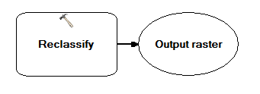
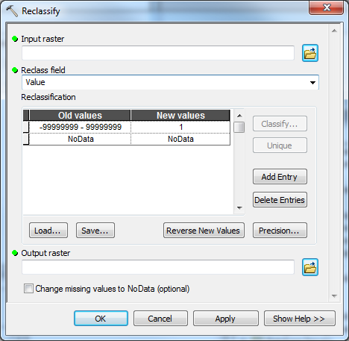
Reclassify
Reclassifies or changes the values in a raster
11 | 12 | 26 | 50
34 | 19 | 44
48 | 42 | 64 | 22
2 | -15 | 24 | 0
1 | 1 | 1 | 1
1 | 1 | 1
1 | 1 | 1 | 1
1 | 1 | 1 | 1
NoData
Set raster cells to NoData or 1

Slide 14
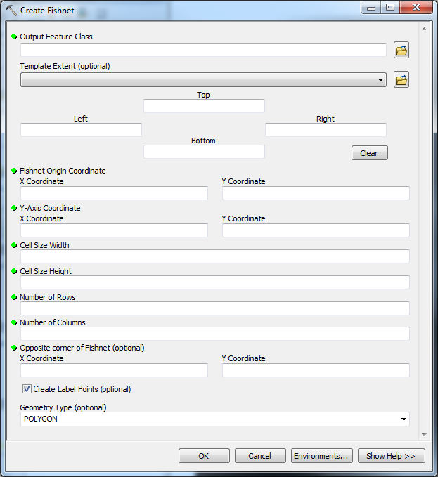
Intersect & Fishnet Polygons
Convert all raster datasets to polygon features and intersect with each other
Create 40 acre fishnet polygons in Python
Intersected fishnet polygons
Net pay
Porosity
Water saturation
1320 sq.ft. x 1320 sq.ft. = 40 acres

Slide 15
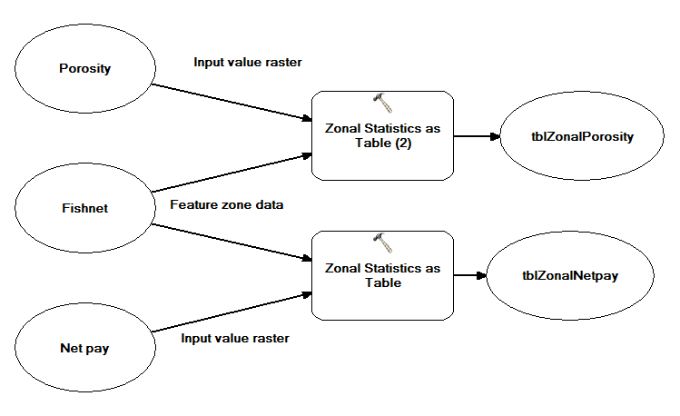
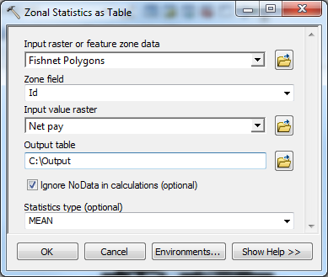
Zonal Statistics as Table
Create additional fields in the fishnet polygons feature class
Run “Zonal Statistics as Table” tool for all input grids
. | . | . | .
. | . | . | .
. | . | . | .
. | . | . | .

Slide 16
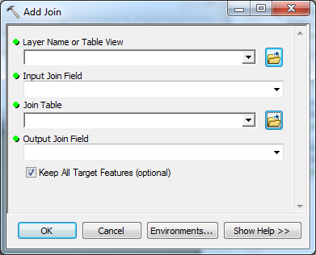
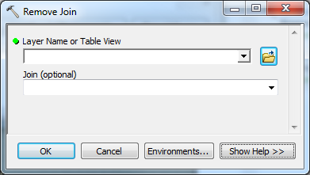
Join Tables
Join “Zonal Statistic” tables to fishnet polygons table
Remove join before joining another table

Slide 17
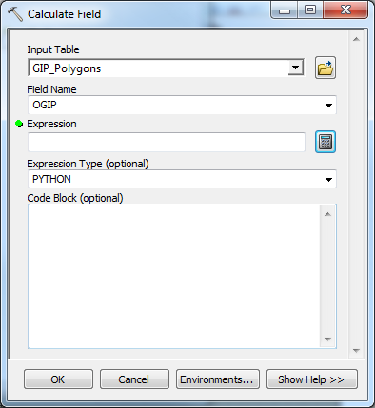
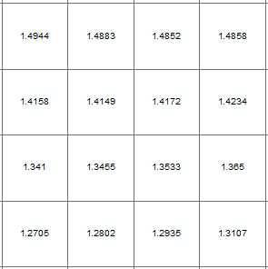
Calculate Fields
Calculate fields, including OGIP
OGIP Polygons

Slide 18
OGIP Raster
Create OGIP centroids
Generate OGIP raster grid
Create OGIP contours

Slide 19
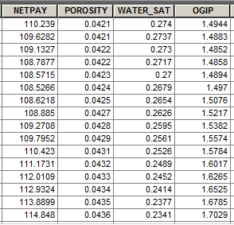
Anticipated Results
Table with calculated of OGIP
OGIP grid
OGIP contour map
bcf
(billion cubic feet)

Slide 20
Timeline
Collect Data
OGIP Formula
Python Scripts
Model Builder
Test
CalGIS
April 2014
January 2014
February 2014
March 2014

Slide 21
Future Development
Calculate remaining gas in place
Calculate net revenue interest by leases automatically

Slide 22
References
Reservoir Engineering for Geologists http://discoverygeo.com/Papers/Reservoir%20Eng%20for%20Geos%203.pdf
Cranmer, John L.: “BASIC Reservoir Engineering Manual”, PennWell (1982) 24-25.
Volume Reservoir and Gas Reserve Calculator Spreadsheet http://petroleumsupport.com/volume-reservoir-and-gas-reserve-calculator-spreadsheet
Basic Geology and Volumetric Analyses http://www.petrocenter.com/reservoir/re01.htm
ArcGIS 10.1 Help http://resources.arcgis.com/en/help/main/10.1/

Slide 23
Acknowledgements
Dr. Patrick Kennelly - Professor of Geography, Penn State University
Penn State Online Geospatial Program Instructors
David Bumbaugh – Reservoir Engineer, BP
Jacob Maggard – Geospatial Capabilities Team Lead, BP

Slide 24
Questions? Comments?

