Slide 1
GIS for Reservoir Management: Estimating Original Gas In Place
Jeffrey Vu, M.GIS Candidate
Dr. Patrick Kennelly, Advisor

Slide 2
Outline
Background
Introduction
Objectives
Data
Methods
Results
References
Acknowledgements

Slide 3
Background
What is reservoir management? Use of geology and petroleum engineering to forecast and manage the recovery of oil and natural gas (hydrocarbons) in place from a field or a prospect
Reservoir management plays an important role in the oil and gas industry by evaluating the greatest economic recovery from a reservoir.
Increase oil and gas production
Decrease risk
Maximize recovery and minimize costs

Slide 4
Reservoir Evaluation
Reserves estimation
Analogy
Material balance
Production history
Volumetric
Volumetric methods provide a static measure of hydrocarbons in place
Easiest method to estimate the reserves
Determine the original hydrocarbons in place

Slide 5
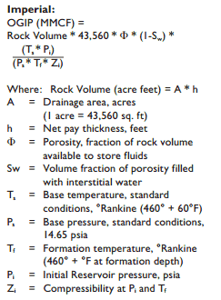
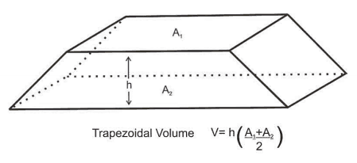
Introduction
Volumetric estimation is the common technique for geologists to calculate hydrocarbons in place based on geologic mapping and reservoir engineering data.
OGIP: Original Gas In Place
MMCF: Million Cubic Feet
http://discoverygeo.com/Papers/Reservoir%20Eng%20for%20Geos%203.pdf

Slide 6
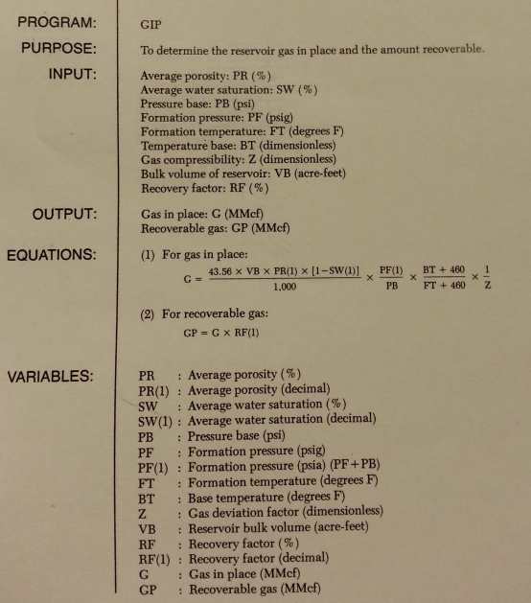
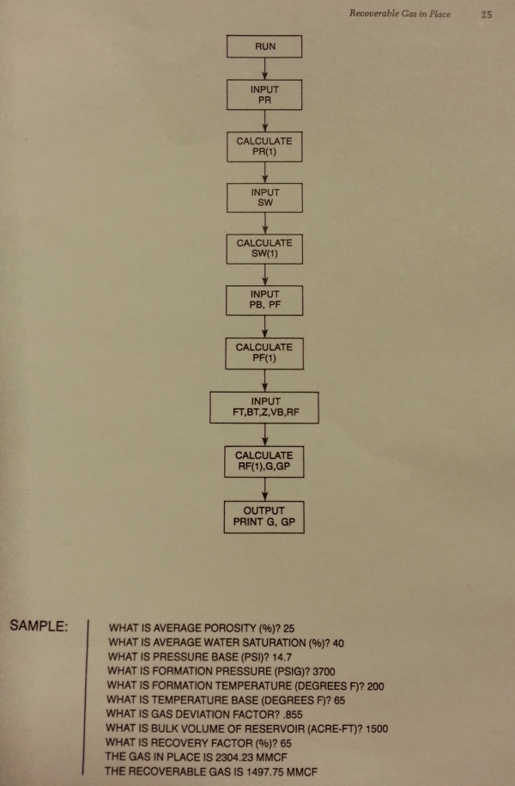
History and current process
Determine reservoir gas in place using BASIC programming language BASIC (standing for Beginner's All Purpose Symbolic Instruction Code)
Cranmer, John L.: “BASIC Reservoir Engineering Manual”, PennWell (1982) 24-25.

Slide 7
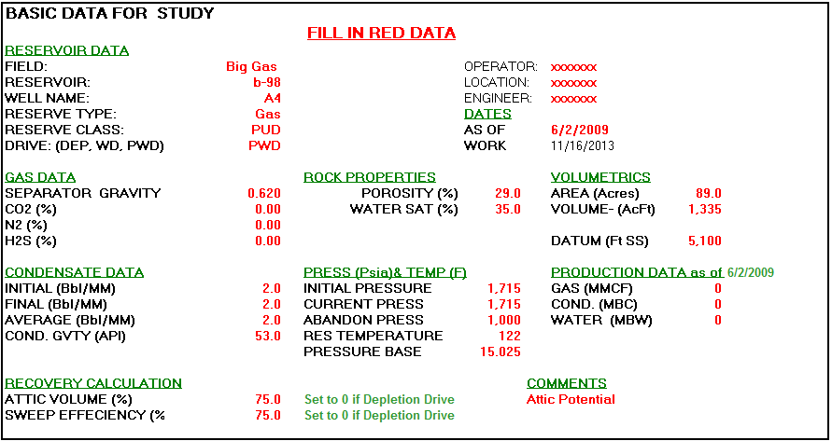
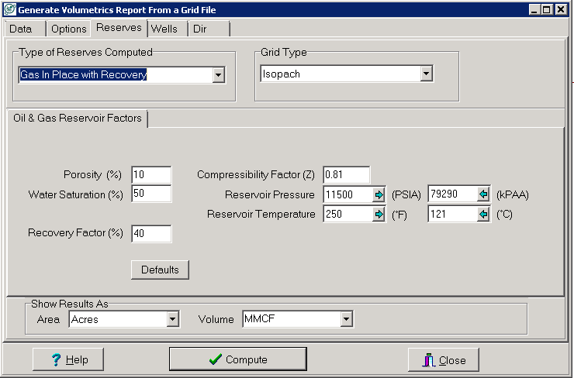
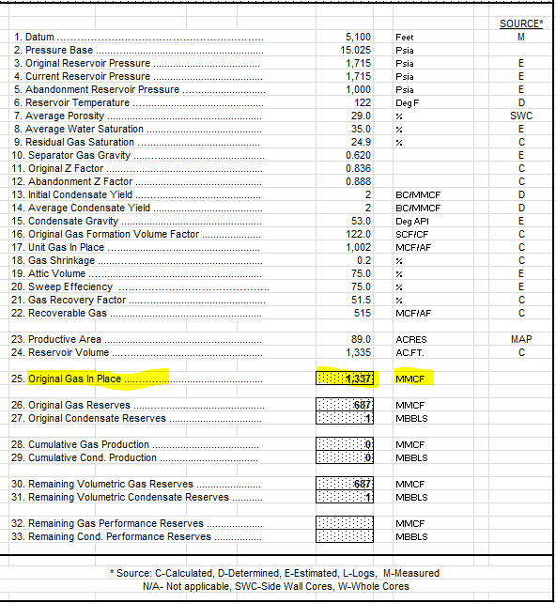
History and current process (cont.)
Calculate original gas in place using Excel
Calculate gas in place using Petra
http://petroleumsupport.com/volume-reservoir-and-gas-reserve-calculator-spreadsheet/

Slide 8
Current workflow
Petra
Geologists generate net pay, porosity, and water saturation grids
ArcMap
PLSS sections
Generate centroids
Excel
Input data
Calculate OGIP using formulas
“Extract Values to Points” tool
PLSS section (640 acres)

Slide 9
Objectives
Create a workflow using tools in ArcToolbox as a screening workflow to estimate the Original Gas In Place (OGIP) for the Reservoir Engineers
Streamline the workflow to avoid human error in importing and exporting data
Run different scenarios
Estimate the OGIP under different uncertainties and assumptions

Slide 10
Data
Exported grids from a geological software program
Net pay and porosity grids
All input grids must have the same coordinate systems and cell sizes
Users’ parameters

Slide 11
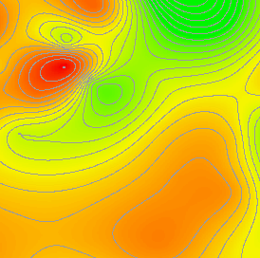
Workflow (using ArcGIS)
Grids exported from Petra
Net pay
Porosity
. | . | . | .
. | . | . | .
. | . | . | .
. | . | . | .
. | . | . | .
. | . | . | .
. | . | . | .
. | . | . | .
. | . | . | .
. | . | . | .
. | . | . | .
. | . | . | .
. | . | . | .
. | . | . | .
. | . | . | .
. | . | . | .
. | . | . | .
. | . | . | .
. | . | . | .
. | . | . | .
Calculate OGIP
. | . | . | .
. | . | . | .
. | . | . | .
. | . | . | .
. | . | . | .
. | . | . | .
. | . | . | .
. | . | . | .
. | . | . | .
. | . | . | .
. | . | . | .
. | . | . | .
. | . | . | .
. | . | . | .
. | . | . | .
. | . | . | .
. | . | . | .
. | . | . | .
. | . | . | .
. | . | . | .
Intersected
40-ac fishnet
Average values
. | . | . | .
. | . | . | .
. | . | . | .
. | . | . | .
. | . | . | .
. | . | . | .
. | . | . | .
. | . | . | .
. | . | . | .
. | . | . | .
. | . | . | .
. | . | . | .
. | . | . | .
. | . | . | .
. | . | . | .
. | . | . | .
. | . | . | .
. | . | . | .
. | . | . | .
. | . | . | .
. | . | . | .
. | . | . | .
. | . | . | .
. | . | . | .
. | . | . | .
. | . | . | .
. | . | . | .
. | . | . | .
. | . | . | .
. | . | . | .
. | . | . | .
. | . | . | .
. | . | . | .
. | . | . | .
. | . | . | .
. | . | . | .
. | . | . | .
. | . | . | .
. | . | . | .
. | . | . | .
1320 sq.ft. x 1320 sq.ft. = 40 acres
. | . | . | .
. | . | . | .
. | . | . | .
. | . | . | .
. | . | . | .
. | . | . | .
. | . | . | .
. | . | . | .
. | . | . | .
. | . | . | .
. | . | . | .
. | . | . | .
. | . | . | .
. | . | . | .
. | . | . | .
. | . | . | .
. | . | . | .
. | . | . | .
. | . | . | .
. | . | . | .
OGIP map
Water saturation

Slide 12
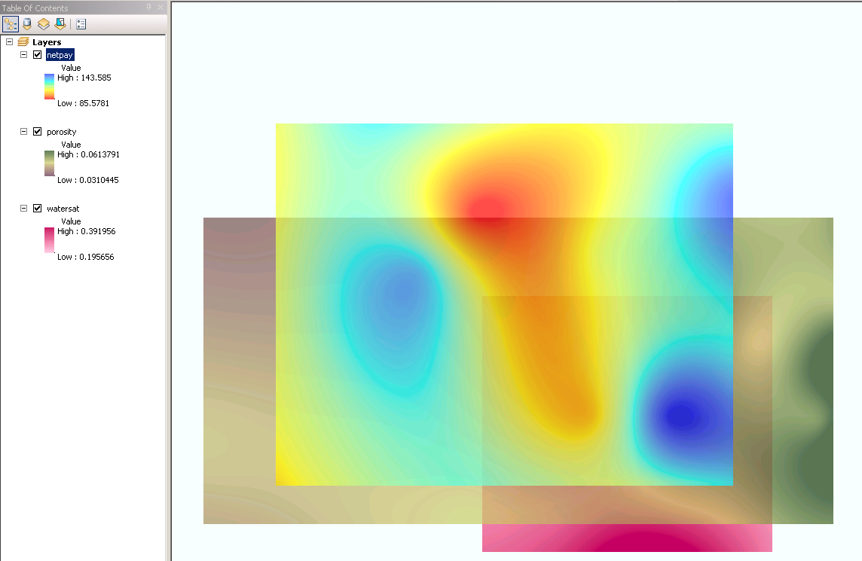
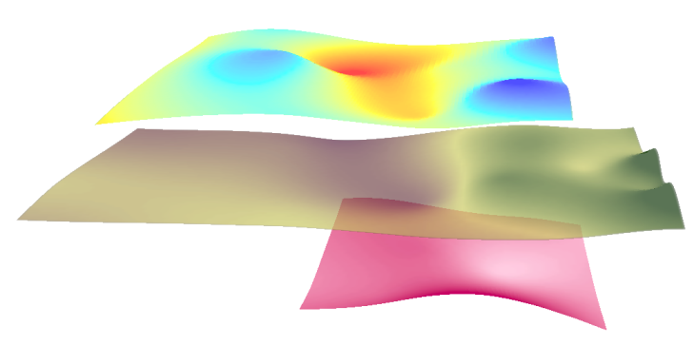
Inputs in ArcMap

Slide 13
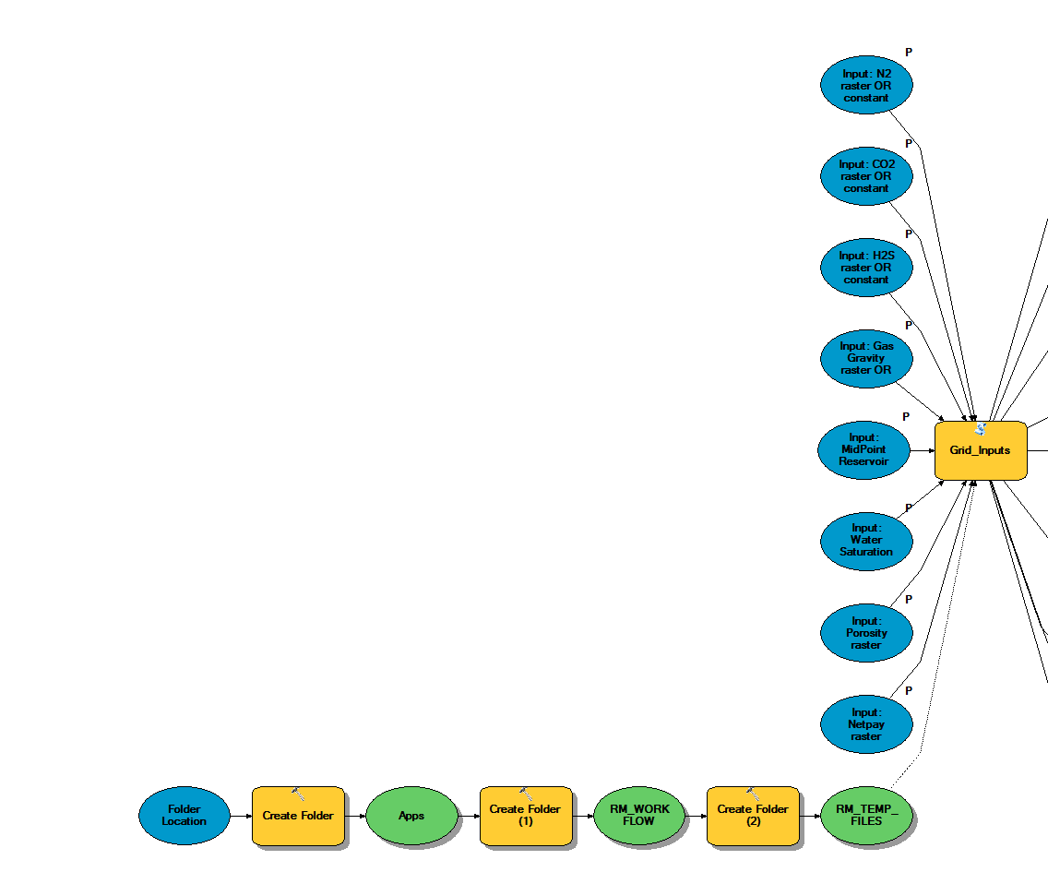
Methods
Reusable workflow to run different scenarios
Python codes to check inputs (grid or constant value)
Is a grid?
Copy to project’s folder
YES
NO
Create a grid based on net pay & porosity intersected polygon
2 | 2 | 2 | 2
2 | 2 | 2 | 2
2 | 2 | 2 | 2
2 | 2 | 2 | 2
2 | 2
2 | 2
2 | 2
2 | 2
User’s input = 2
2 | 2 | 2 | 2
2 | 2

Slide 14
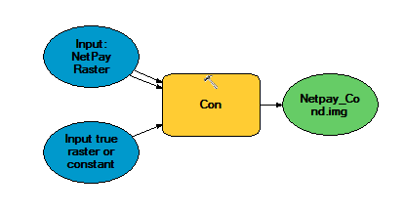
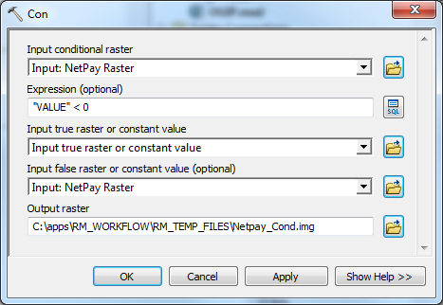
Con (Spatial Analyst)
Performs a conditional if/else evaluation on each of the input cells of an input raster
-5 | 12 | 26 | 50
34 | 19 | 44 | -10
48 | 42 | 64 | 12
2 | -15 | 24 | -47
0 | 12 | 26 | 50
34 | 19 | 44 | 0
48 | 42 | 64 | 12
2 | 0 | 24 | 0
Set raster cell to 0 when VALUE < 0

Slide 15
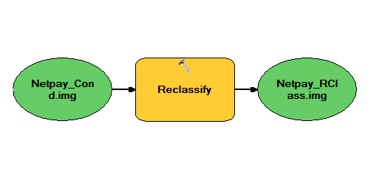
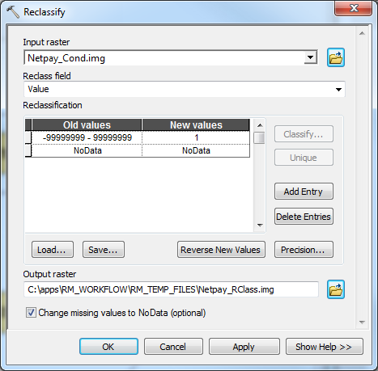
Reclassify
Reclassifies or changes the values in a raster
11 | 12 | 26 | 50
34 | 19 | 44
48 | 42 | 64 | 22
2 | -15 | 24 | 0
1 | 1 | 1 | 1
1 | 1 | 1
1 | 1 | 1 | 1
1 | 1 | 1 | 1
NoData
Set raster cells to NoData or 1

Slide 16
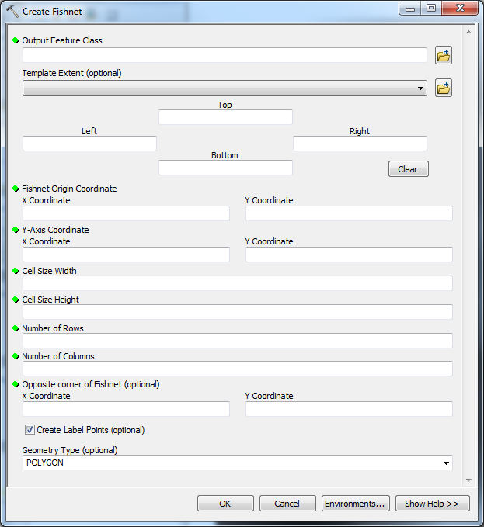
Intersect & Fishnet Polygons
Convert all raster datasets to polygon features and intersect with each other
Create 40 acre fishnet polygons in Python
Intersected fishnet polygons
Net pay
Porosity
1320 sq.ft. x 1320 sq.ft. = 40 acres
Water saturation

Slide 17
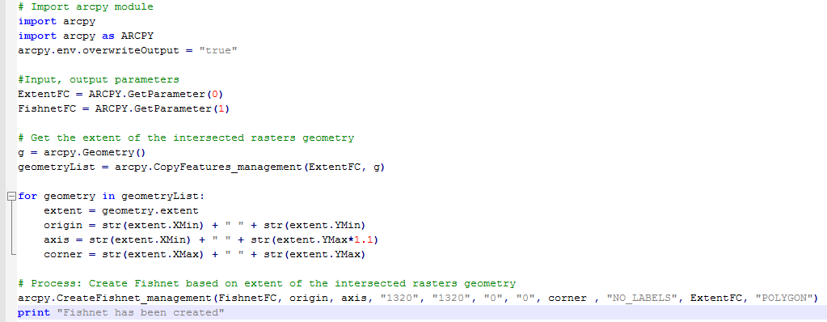
Fishnet polygons

Slide 18
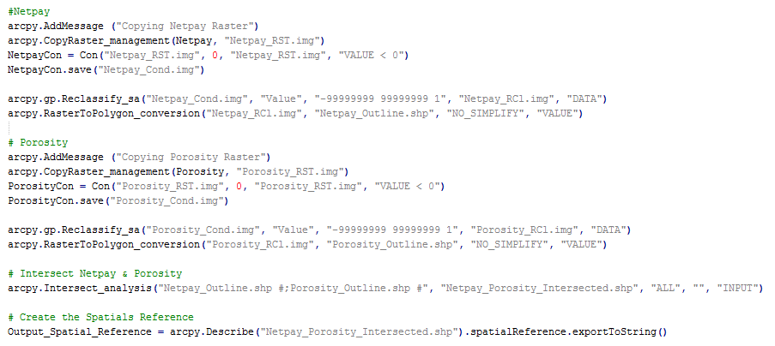
Python codes

Slide 19
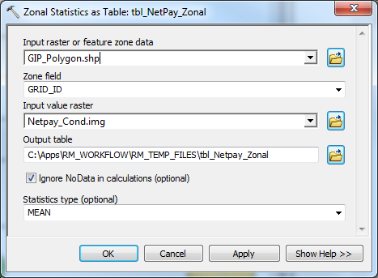
Zonal Statistics as Table
Create additional fields in the fishnet polygons feature class
Run “Zonal Statistics as Table” tool for all input grids

Slide 20
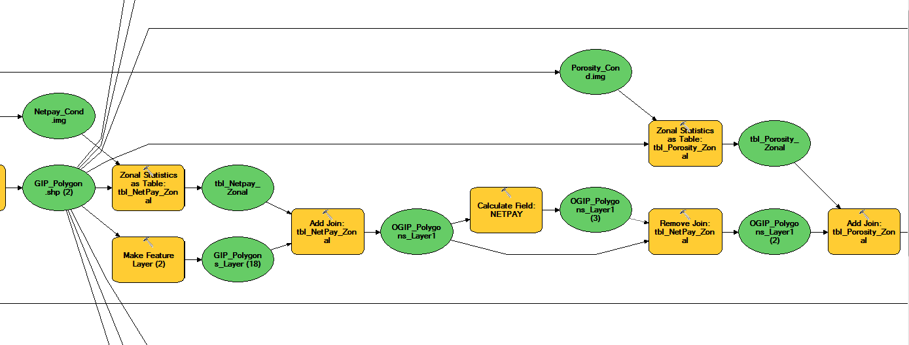
Join Tables
Join “Zonal Statistic” tables to fishnet polygons table
Remove join before joining another table

Slide 21
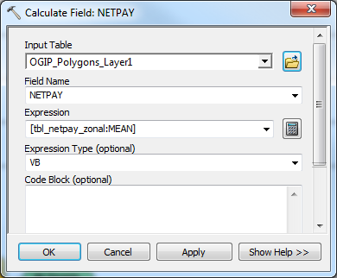
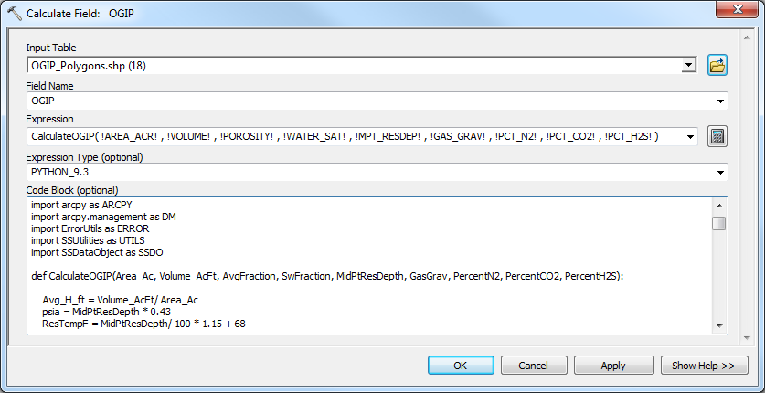
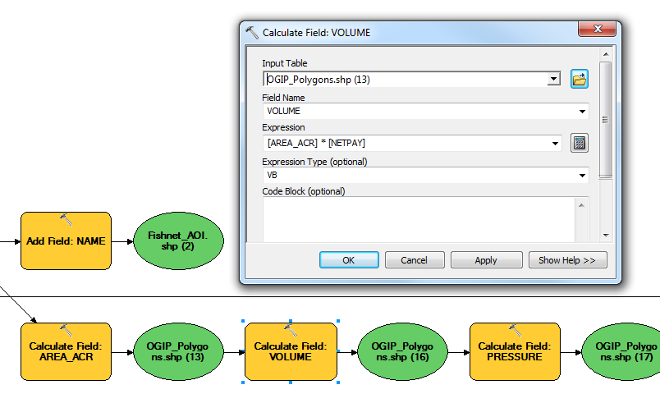
Calculate Fields
Calculate fields, including OGIP

Slide 22
OGIP Raster and Contour Lines
Create OGIP centroids
Generate OGIP raster grid
Create OGIP contours

Slide 23
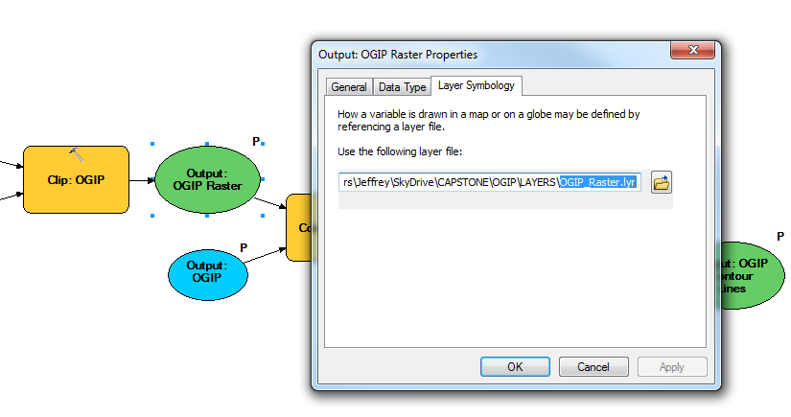
Layer Symbology
Use layer files to preserve the predefined symbologies
Notes:
When model outputs are added to the ArcMap table of contents, their symbology can be predefined by referencing a layer file (.lyr).
A layer file will also preserve Definition Queries and/or Selection Layers

Slide 24
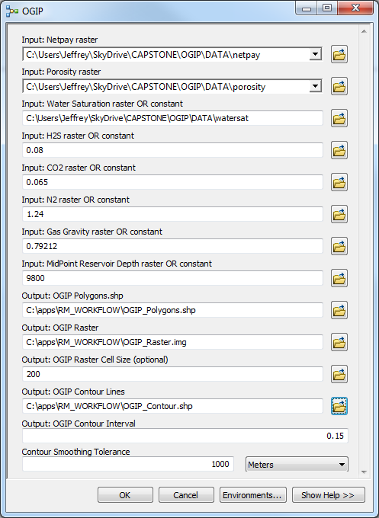
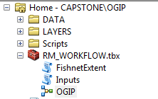
User Interface
ArcGIS Desktop Advanced license is required to run the tool

Slide 25
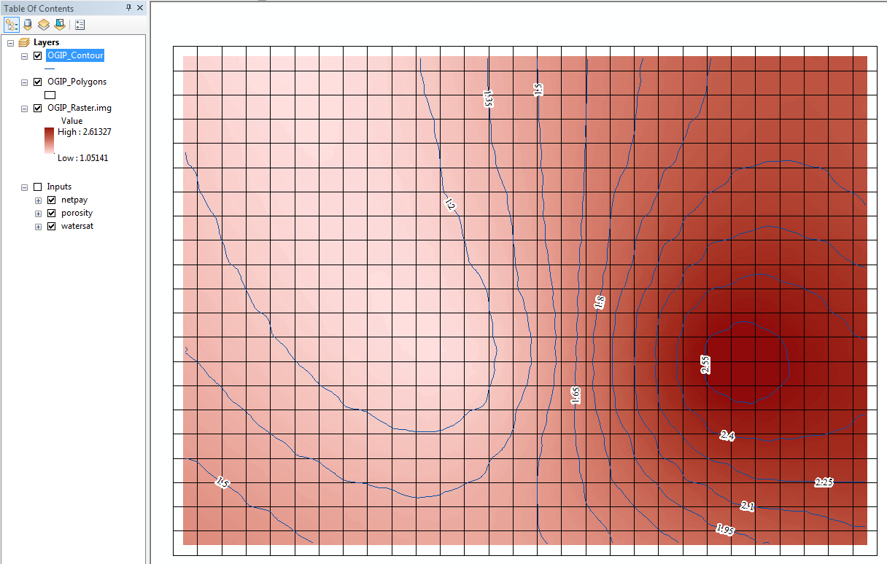
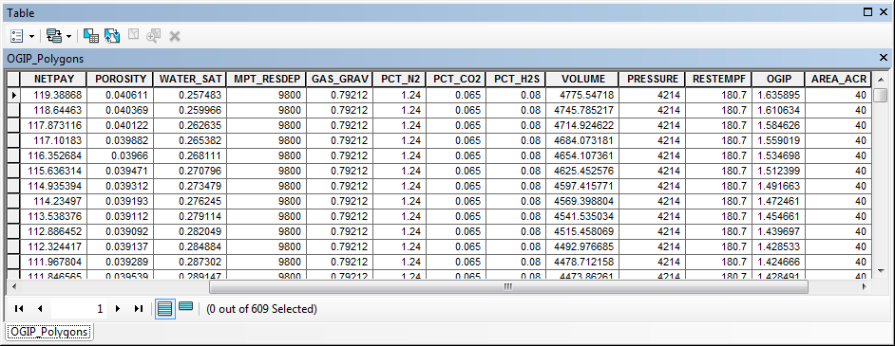
Results
bcf
(billion cubic feet)
Notes:
Table with calculated of OGIP
OGIP grid
OGIP contour map

Slide 26
Demo
Notes:
Demo.

Slide 27
Future Development
Calculate remaining recoverable reserves (Reserves at original conditions – cumulative production)
Calculate gas reserves (OGIP x Recovery factor)
Calculate future net revenue

Slide 28
References
Reservoir Engineering for Geologists http://discoverygeo.com/Papers/Reservoir%20Eng%20for%20Geos%203.pdf
Cranmer, John L.: “BASIC Reservoir Engineering Manual”, PennWell (1982) 24-25.
Volume Reservoir and Gas Reserve Calculator Spreadsheet http://petroleumsupport.com/volume-reservoir-and-gas-reserve-calculator-spreadsheet
Basic Geology and Volumetric Analyses http://www.petrocenter.com/reservoir/re01.htm
ArcGIS 10.1 Help http://resources.arcgis.com/en/help/main/10.1/

Slide 29
Acknowledgements
Dr. Patrick Kennelly - Professor of Geography, Penn State University
Penn State Online Geospatial Program Instructors
Brian Boulmay – Global Geospatial Data Lead, BP
David Bumbaugh – Reservoir Engineer, BP
Jacob Maggard – Geomatics Team Lead, BP
Tarun Chandrasekhar – Geospatial Data Team Lead, BP

Slide 30
Questions? Comments?

