Slide 1
Identifying Phragmites along the Hudson River with Remotely Sensed Data GIS Masters Capstone Project Department of Geography, The Pennsylvania State University
Daniel Waldhorn
Advisor: Robert Brooks

Slide 2
Goal
Establish an accurate baseline of the current extent of Phragmites australis invasion in the Hudson River Estuary with Object-Based Image Analysis (OBIA) of remotely sensed data.

Slide 3
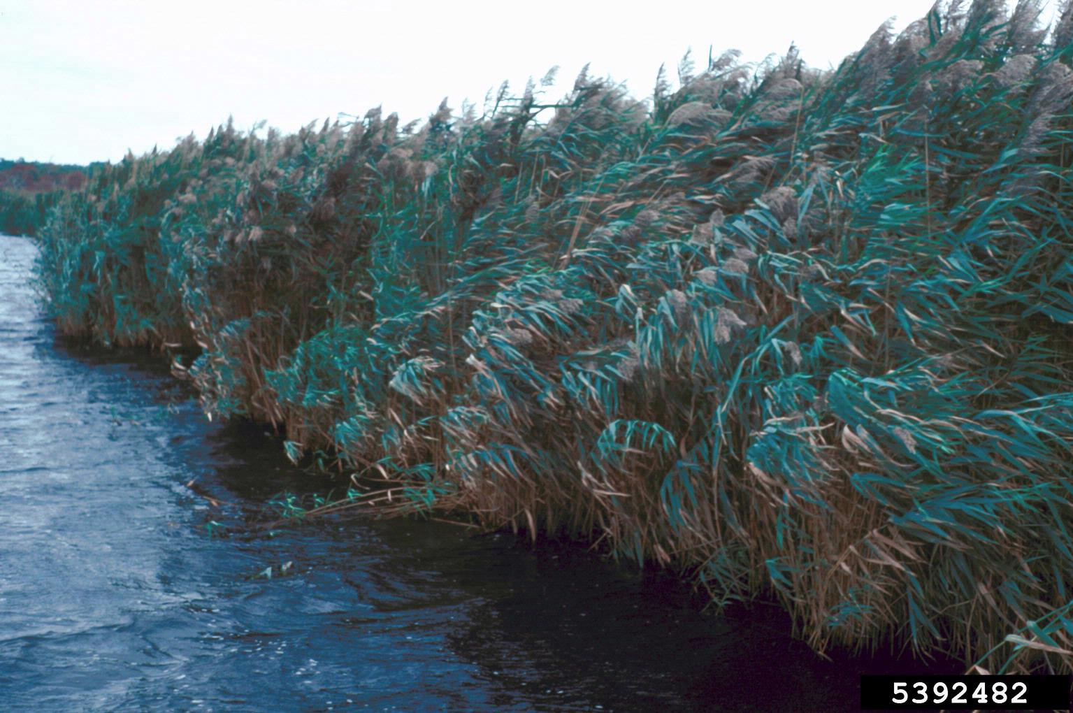
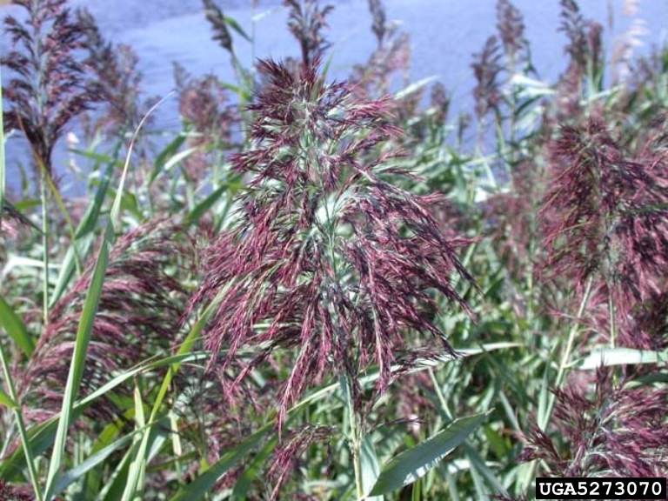
Common Reed (Phragmites australis)
A tall grass that is widely distributed across the world.
Tall hollow culm up to 6 m (20 ft) high with leaves up to 20” long.
Flowers in late summer, long panicles of purple to golden flowers that develop into fluffy white seeds.
Grows from dense mats of horizontal growing stolons and rhizomes.
Native, but an invasive, non-native form has out-competed and replaced the native form in the northeast.
Photos: http://www.nyis.info/index.php?action=invasive_detail&id=42

Slide 4
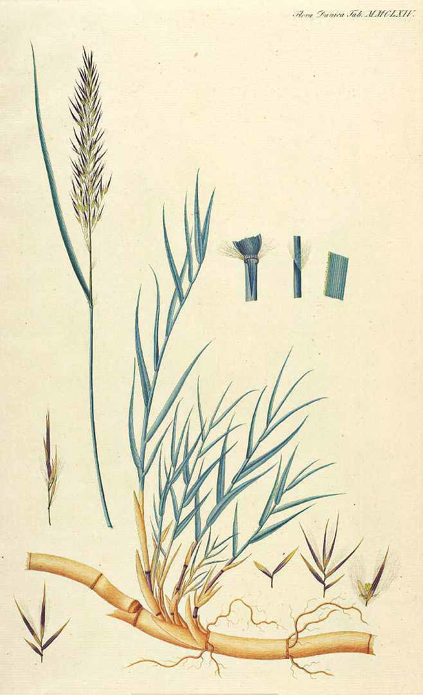
Phragmites
Forms stands that persist through the winter in shallow water, marshes, the supra-tidal zone, and poor upland soils
Reproduces from seed and vegetative/clonal growth.
Seeds have low viability, but can be dispersed long distances by wind.
Clones grow from stolons and rhizomes radiating out from a patch, which are broken off and transported by currents and disturbance.
Individual plants live up to 8 years, but clonal patches may survive for centuries.
Photo:
http://plantillustrations.org/illustration.php?id_illustration=110093

Slide 5
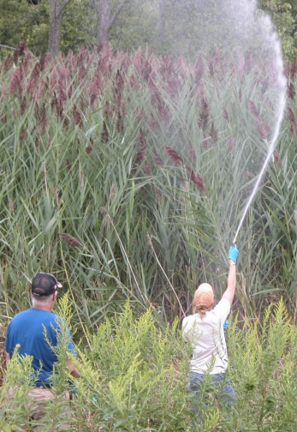
Invasive Phragmites
Most Phragmites found in New York is a non-native genotype from Europe.
Introduced in the early 19th century in ship ballast, began to dominate several marshes by the 1970’s.
Expands aggressively from a dense mat of stolons and rhizomes, shading native plants and forming “hyper-dominant” stands.
Will expand until it reaches some barrier limiting its growth, such as open water or a physical structure.
Currently dominates large areas of most of the Hudson River’s tidal marshes.
Image:
http://cipwg.uconn.edu/wp-content/uploads/sites/244/2014/10/Phragmites-control-2014.pdf

Slide 6
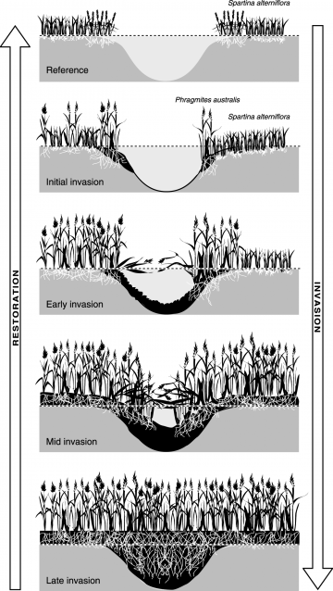
Impacts of Phragmites
Lowers plant biodiversity through physical competition.
Simplifies the physical heterogeneity of wetlands through formation of nearly monotypic stands.
Growth of rhizomes smooth the topography of wetlands, reducing heterogeneity of the habitat’s surface.
Reduces wave energy, increasing sedimentation.
Able to support many generalist species, but disrupts niche habitats utilized by habitat specialists.
Image:
http://www.globalrestorationnetwork.org/uploads/files/LiteratureAttachments/60_causes-and-consequences-of-invasive-plants-in-wetlands.pdf

Slide 7
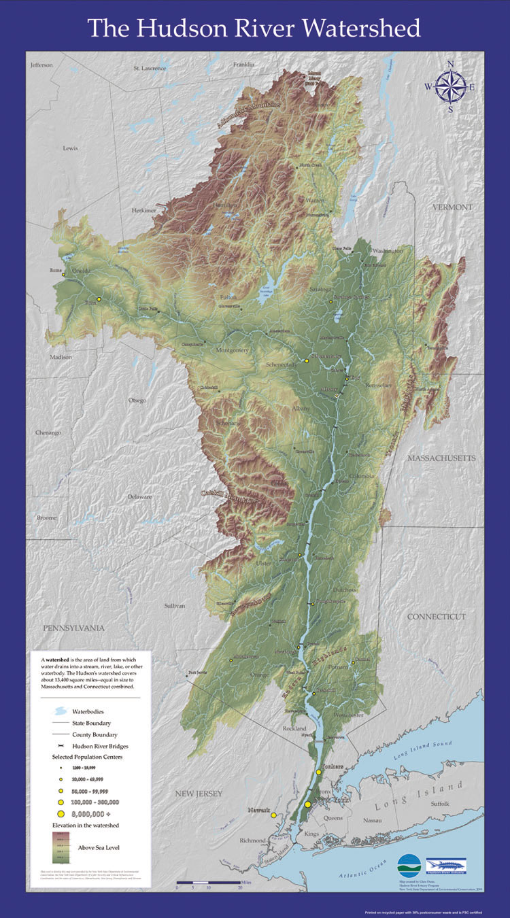
The Hudson River Estuary
Flows 506 km (315 mi) from the Adirondack Mountains to New York City.
Tidal forces push saltwater up the river, creating a tidal estuary 246 km (153 mi) long.
Brackish conditions in the southern estuary.
High levels of human disturbance in the watershed responsible for murky water.
Shoreline has been significantly historically altered by industry and transportation.
Marshes offer large patches of rich habitat for fish and wildlife and provide important ecological services for the Estuary.
http://www.dec.ny.gov/education/63069.html

Slide 8
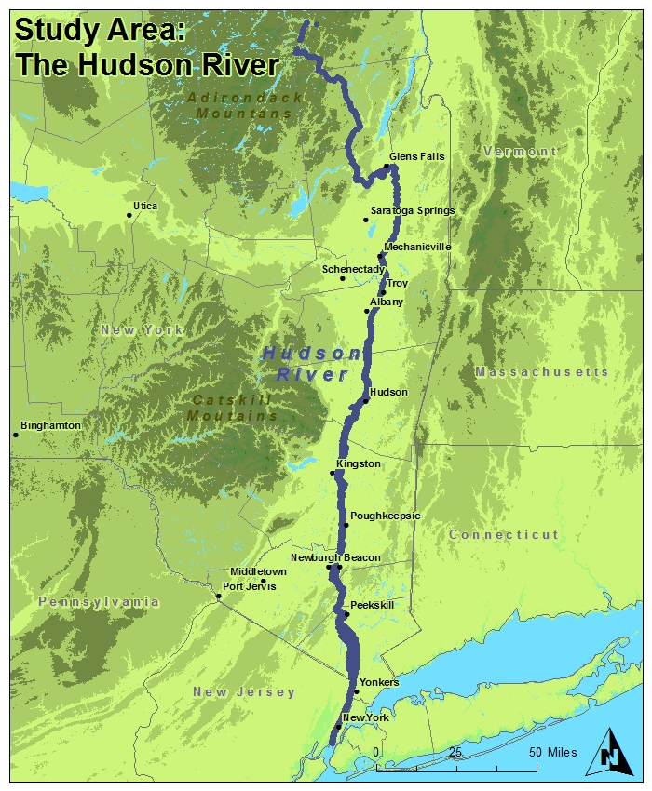

Slide 9
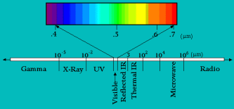
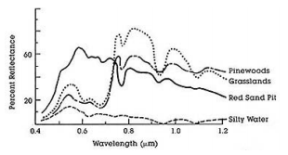
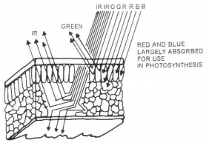
Spectral Analysis of Remotely Sensed Data
Electromagnetic energy is emitted by the sun and reaches the surface of the earth, which absorbs and reflects various wavelengths of this energy.
Remotely sensed images record the magnitude of reflected electromagnetic energy using sensors that detect specific ranges or bands of wavelengths across the spectrum.
The magnitude of spectral energy reflected across the spectrum is based on the characteristics of landcover.
Landcover can be differentiated based on “spectral signatures” or the magnitude of spectral reflectance plotted across the bands detected by a sensor.
Images:
http://www.fsa.usda.gov/Internet/FSA_File/tx_gis_infosheets.pdf

Slide 10
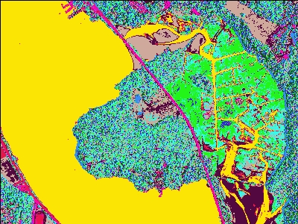
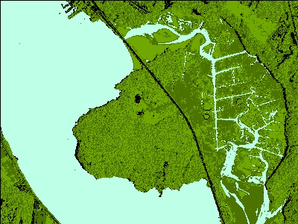
Unsupervised Classification
Classifies the pixels of an image by natural groups or clusters of plotted spectral values.
Pixels within each class are spectrally similar to each other within the context of all pixels in an image, but may not represent the informational classes the analyst has in mind.
Each of these classes are then reclassified into meaningful informational classes by the analyst.

Slide 11
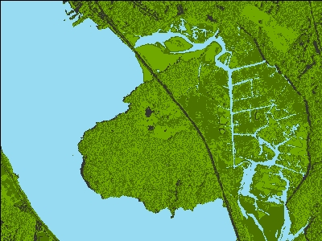
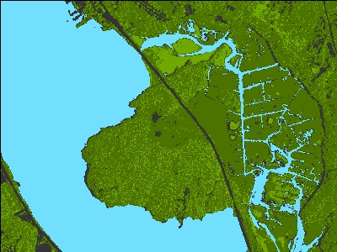
Supervised Classification
Supervised classification allows the analyst to predefine the classes that pixels in an image will be assigned to based on their spectral characteristics.
Training areas are manually selected that represent samples of the classes of interest and then
The range and average of spectral reflectance values for each band are defined for each informational class using the training areas.
Each pixel is than assigned to a class based on the fit of its spectral reflectance values.
Pixel-based methods are less effective at classifying images with high levels of heterogeneity, without sampling neighboring pixels.
Unsupervised
Supervised

Slide 12
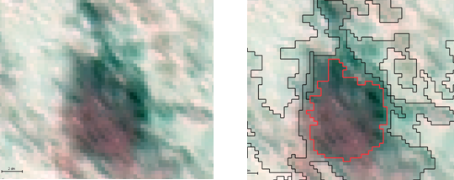
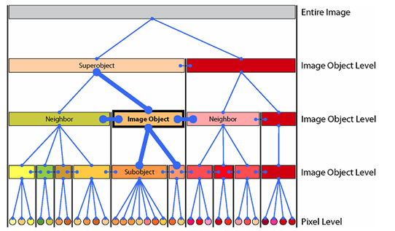
Object Based Image Analysis
Helps manage image heterogeneity in the classification process.
Multi-Resolution Segmentation creates a continuous field of objects or polygons.
Objects are defined based on thresholds for spectral heterogeneity within each object as well as object shape and size.
Multiple, hierarchical object levels.
Produces aerial units that are meaningful within the context of the analysis.
Objects are selected as training areas, information from these are used to assign each object to a class.
Images:
http://wiki.landscapetoolbox.org/doku.php/remote_sensing_methods:object-based_classification

Slide 13
eCognition Software
Produced by Trimble.
Software specially developed for Object-Based Image Analysis and image classification.
Provides high degree of control of segmentation and classification process
License provided by Department of Geography of The Pennsylvania State University.

Slide 14
Objectives
A – Obtain remotely sensed and ancillary data.
B – Identify areas of known Phragmites occurrences along the length of the estuary from ancillary data.
C – Perform field visits to 5-6 locations with Phragmites roughly every 50 km (30 mi) along the estuary in order to ground truth training data.
D – Prepare remotely sensed data for analysis and create additional intermediate datasets to be used in analysis.
E – Perform Object Based Image Analysis classification to differentiate major land cover types as well as to differentiate Phragmites from surrounding land cover.
F – Evaluate accuracy of classification through field visits and interpretation of orthophotos.

Slide 15
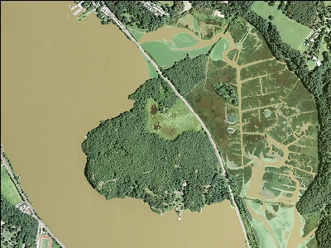
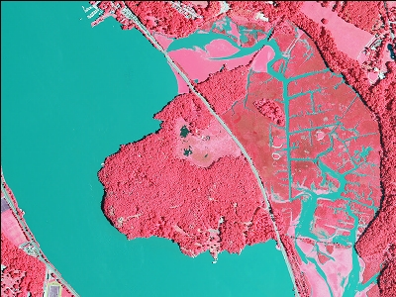
A - National Agricultural Imagery Program (NAIP)
High-resolution aerial orthoimagery taken during the growing season.
Produced by the United States Department of Agriculture (USDA) every 2-3 years.
Imagery is produced statewide with a spatial resolution of 1 m, recording 4 bands: (Blue, Green, Red, and Near-Infrared) as 8 bit data.
2015 data has improved 0.5 m spatial resolution.
Phragmites invasion are visually distinguishable.

Slide 16
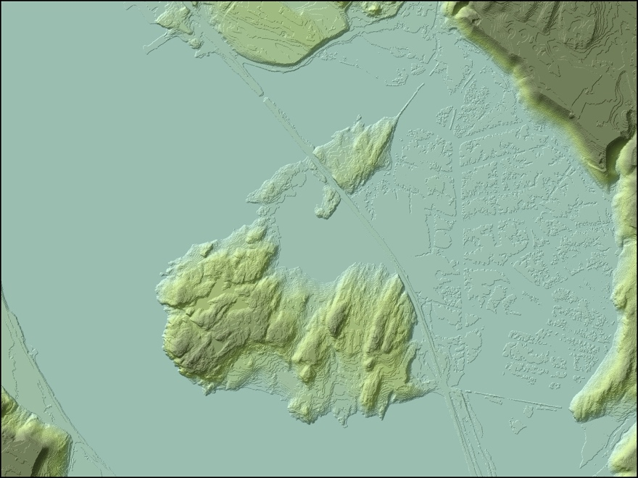
A - Coastal LiDAR
Produced by the National Oceanic and Atmospheric Administration (NOAA) and the New York State Department of Environmental Conservation (NYSDEC).
DEM and Point Cloud datasets produced from LiDAR data obtained for the length of the Hudson River estuary over the winter of 2011-2012
LAS point cloud.
1 m Hydroflattened (Mean High Water) Coastal LiDAR DEM.
Very high resolution model of the low elevation areas along the shoreline of the Hudson, which can be used to model areas suitable for Phragmites invasion.

Slide 17
A - Ancillary Data
National Hydrography Dataset, USGS – Delineation of the Hudson River and other hydrographic features.
2007 Hudson River Tidal Wetlands, NYS DEC – Delineation of Hudson River tidal marshes and Phragmites invasions circa 2007.
1 arc (30 m) and 1/3 arc (10 m) Digital Elevation Model (DEM), USGS National Elevation Dataset – Visualization of the study area, and coarse resolution modeling of suitable areas for Phragmites.

Slide 18
B,C – Field Data Collection
5-6 Sites with known Phragmites Infestations will be visited at least every 50 km (30 mi) along the river to establish ground truth verification of known Phragmites patches for establishment of training areas for the classification.
Elevation, slope, and position along the tidal zone will be noted for Phragmites invasions at all locations visited to inform modeling of suitable areas of growth.

Slide 19
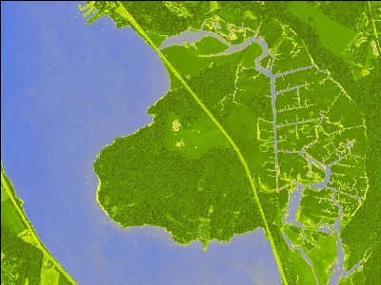
D - Data Preparation
Normalized Difference Vegetation Index will be used in the classification as an additional “Band”
(IR – R)/(IR+R) Value -1 to 1
Areas along the shoreline suitable for Phragmites will be modeled using elevation, slope and position in the tidal zone.

Slide 20
E – Object Based Image Analysis Classification of Phragmites
Iterative Process.
Segmentation of NAIP imagery.
Classify major landcover types (Forest, Non-Forest Vegetative, Water, Developed).
Differentiate Phragmites from these broader classes.
Use ancillary data to help disqualify areas that are unsuitable for Phragmites to further differentiate from landcover that have similar spectral/spatial patterns.

Slide 21
F - Accuracy Assessment
Fifty well distributed pixels will be selected within the extent of the area classified as Phragmites.
Each pixel will be evaluated for presence/absence of Phragmites through interpretation of orthophotos or field visits.
The total number of pixels with presence divided by total number of sampled pixels will provide a statistic of commission.
Smaller areas of interest will also be visually analyzed to identify any classification errors, particularly omission of Phragmites.
Visual interpretation will help determine the minimum mapable unit identified by the methodology.

Slide 22
Summary
Goal: Establish an accurate baseline of the current extent of Phragmites australis invasion in the Hudson River Estuary with Object-Based Image Analysis (OBIA) of remotely sensed data.
This will be accomplished by the segmentation and classification of NAIP imagery, using information gained from ancillary datasets and from field observations.
Modeling of areas along the shoreline suitable for Phragmites invasion will be used to reduce commission errors.
Accuracy of classification will be assessed through visual interpretation of orthophotos.

Slide 23
Sources
Campbell, Jame B., and Randolph H. Wynne. Introduction to Remote Sensing, Fifth Edition. New York: Guilford, 2011. Print.
Gucker, Corey L. 2008. Phragmites australis. In: Fire Effects Information System, [Online]. U.S. Department of Agriculture, Forest Service, Rocky Mountain Research Station, Fire Sciences Laboratory (Producer). Available: http://www.fs.fed.us/database/feis/ [2016, April 20]. http://www.fs.fed.us/database/feis/plants/graminoid/phraus/all.html
Kiviat, E. 2006. Phragmites Management Sourcebook for the Tidal Hudson River and the Northeastern States.. Hudsonia Ltd., Annandale NY 12504 USA. http://hudsonia.org/wp-content/files/j-phragmites%20sourcebook%20generic%2013-June-2010.pdf
"Common Reed." NYIS. Cornell Cooperative Extension, n.d. Web. 12 May 2016 http://www.nyis.info/index.php?action=invasive_detail&id=42
Bradley, Bethany A. "Remote Detection of Invasive Plants: A Review of Spectral, Textural and Phenological Approaches." Biol Invasions Biological Invasions 16.7 (2013): 1411-425. Web. http://link.springer.com.ezaccess.libraries.psu.edu/article/10.1007%2Fs10530-013-0578-9
USGS - Department of the Interior. LANDSAT 8 DATA USERS HANDBOOK Version 1.0. (Lsds-1574) 2015. http://landsat.usgs.gov/documents/Landsat8DataUsersHandbook.pdf
Gronemeyer, Peg. "Object-based Classification." The Landscape Toolbox. USDA, BLM, TNC, n.d. Web. 12 May 2016. http://wiki.landscapetoolbox.org/doku.php/remote_sensing_methods:object-based_classification
“NAIP factsheets.” USDA, N. d. Web. 12 May 2016 http://www.fs.usda.gov/Internet/FSE_DOCUMENTS/stelprdb5366383.pdf

