Slide 1
Shooting Range Remediation
Using kriging to delineate the extent of lead contamination in soil from an uneven sample pattern
Notes:
Hi Everyone, thank you for taking the time to listen to my capstone proposal presentation tonight. My project is on shooting range remediation, and it uses kriging to delineate the extent of lead contamination in soil from an uneven sampling pattern.

Slide 2
Study Area
Southwest PA sporting clay shooting range and immediate surrounding areas
About 275 acres
Shot – hundreds of tiny lead balls
Client privacy – exact site location must be kept anonymous
Notes:
The study area for this analysis is a sporting clay shooting range and the immediate surrounding areas in southwest Pennsylvania. It is approximately 275 acres in size. The shotguns used for sporting clay courses typically contain shot with hundreds of tiny lead balls, which when shot disperse in the air to create multiple projectiles.
This data comes from my place of employment, and to keep client privacy I am required to keep the exact location of the site anonymous.
The picture shown on this slide is not from the study location, but it is an example of the shooting stands used at sporting clay shooting ranges.

Slide 3
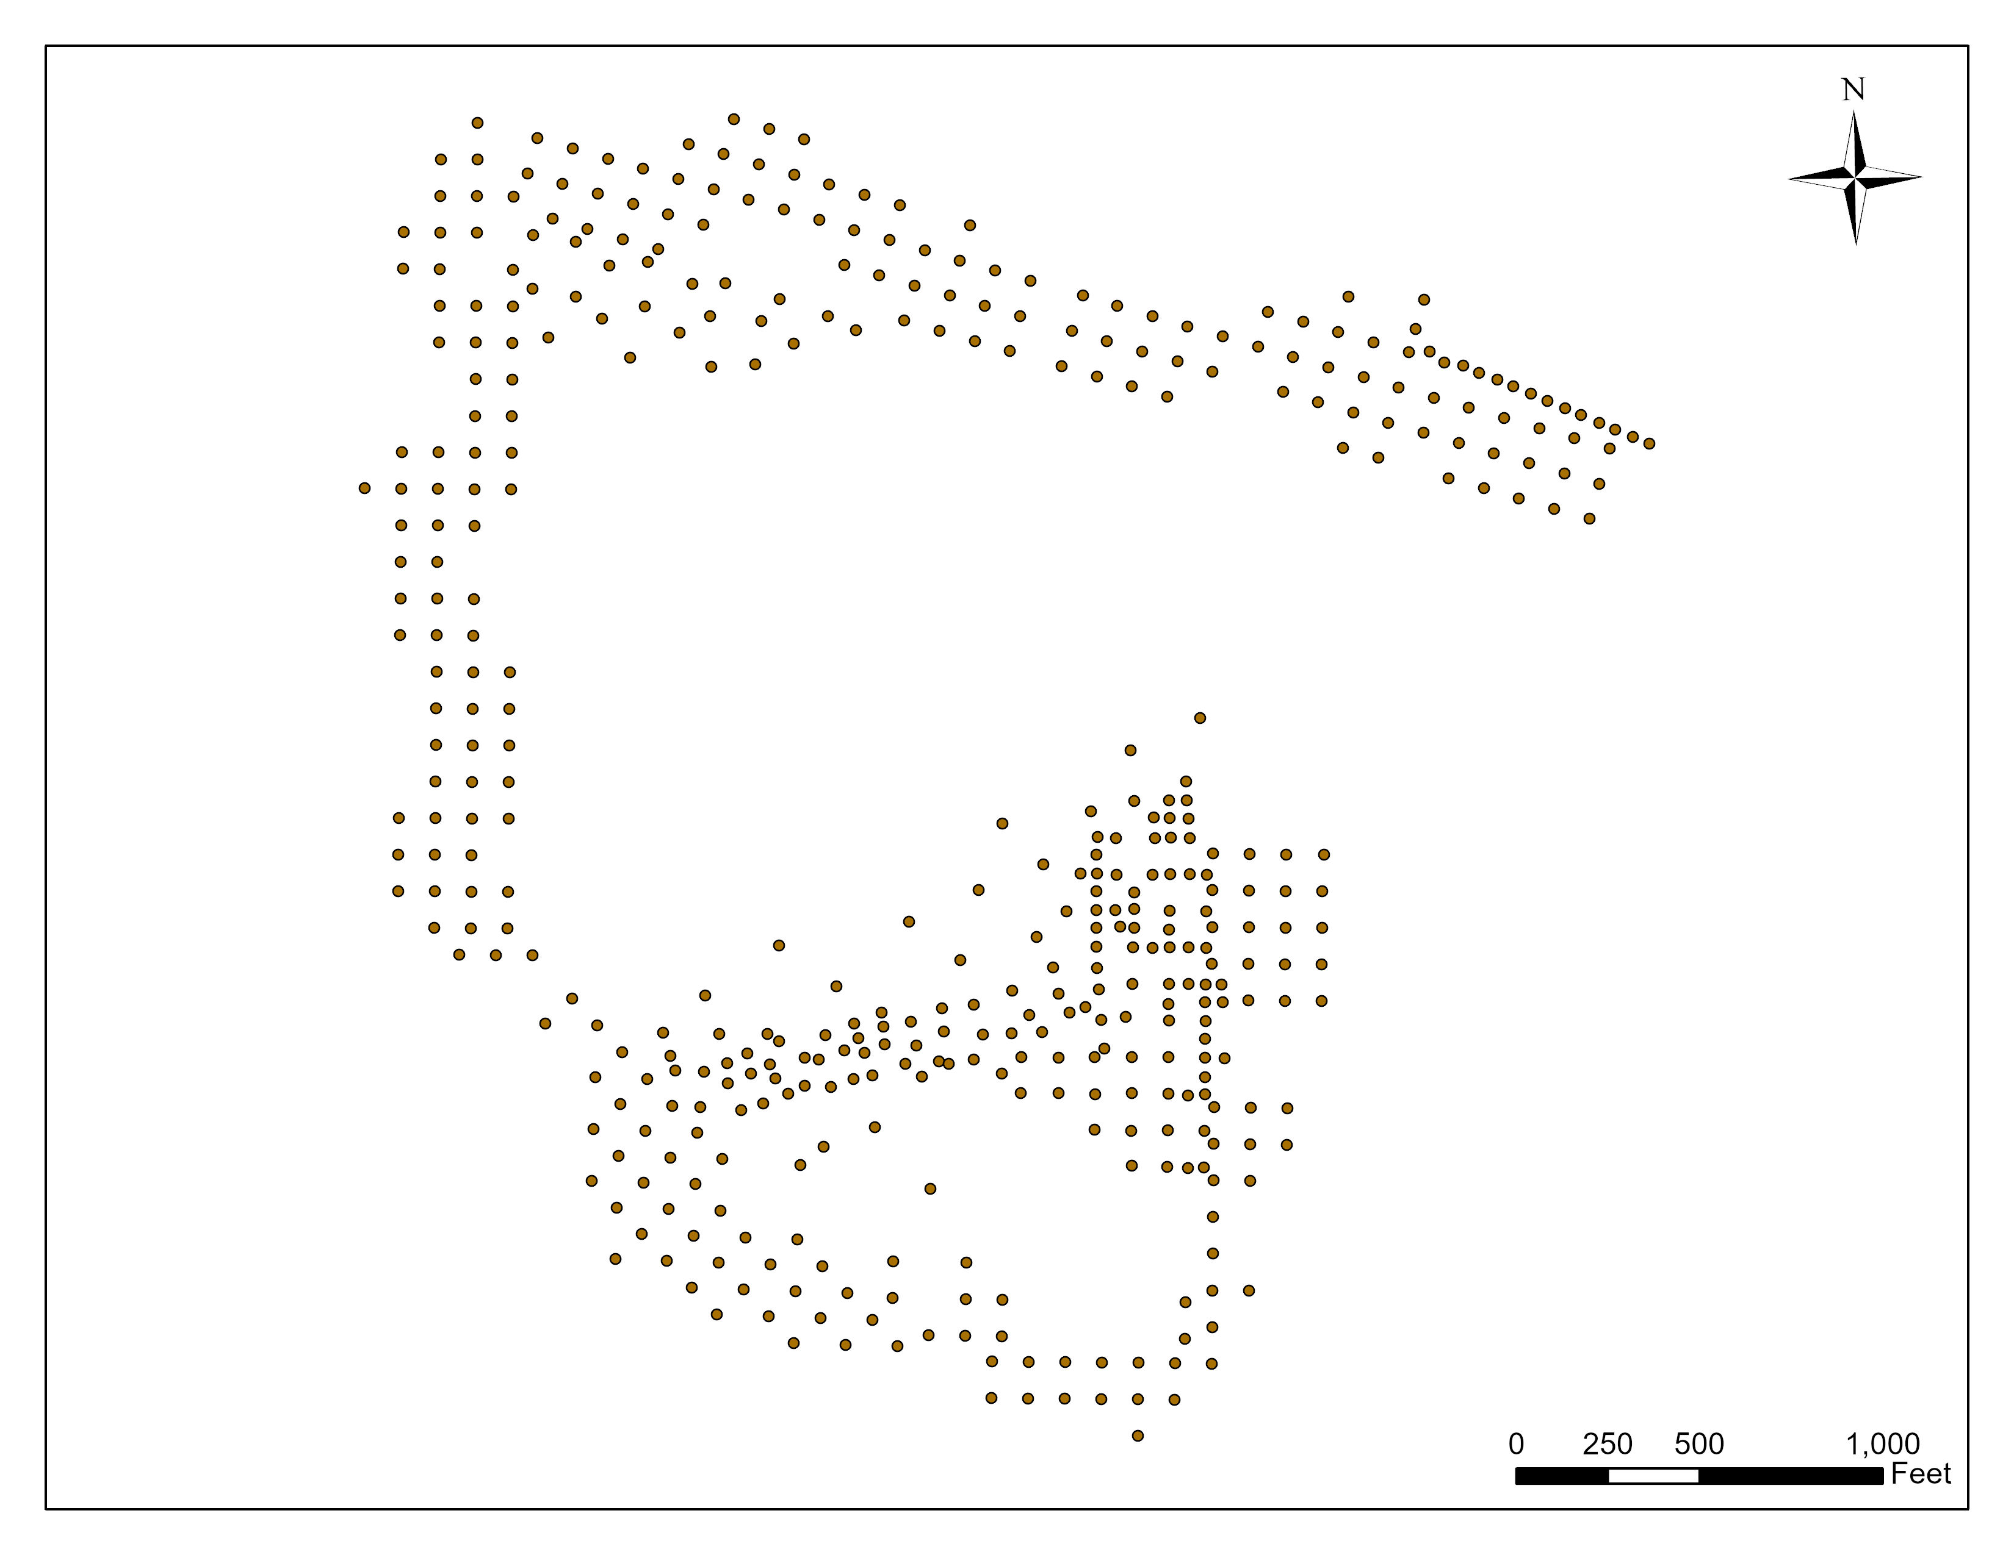
Data
442 points
Uneven sampling distribution
Most samples 100 feet or less apart
0–6-inch samples collected between 2019 and 2022
Notes:
The main dataset that will be used is a set of 442 points that represent soil sample locations. The distribution of these sample locations is not even across the extent of the study area. You can see in the map of the samples that there are big gaps in the middle of the dataset. Most of the samples were collected following a 100 foot grid pattern, but many of them did not follow this pattern, especially on the shooting range itself.
One reason for this is that the property owner is less interested in the remediation of their own property, but of the offsite properties they contaminated.
All of the samples were collected between 2019 and 2022. They were collected between 0-6 inches below the ground surface.

Slide 4
Goals and Objectives
Transform the sample points into a surface to delineate lead concentrations
450 mg/kg – PA DEP Statewide Health Standard
Assess which kriging method is best for the data
Notes:
There are two goals for this project.
We need to define the extent of contamination, but the challenge is that lead values are only known for a limited number of sample points within the study site. To determine extent we first need to generate a surface of lead levels for the site as a whole, which requires spatial interpolation. The delineation will be to 450 mg/kg, which is the Pennsylvania Department of Environmental Protection’s (PA DEP) Statewide Health Standard for Medium Specific Concentrations of Inorganic Regulated Substances for the Direct Contact Value of Soil for lead.
Because several methods exist to spatially interpolate data, different kriging approaches will be examined to determine the approach that best reflects the underlying spatial structure and results in minimal estimation error.

Slide 5
Anticipated Results
Two surfaces for each kriging method
Predicted lead surface
Error surface
GISGeography, 2013
Notes:
The anticipated results of this analysis are the predicted lead surface for each kriging method and the accompanying error surface. The image on this slide shows an example of a prediction surface and its accompanying lead surface.

Slide 6
Background

Slide 7
Lead in Soil
Lead levels in soil have been increasing
Potential impacts on humans
Shooting ranges contribute to this increase in soil
Lead management is necessary
Notes:
Lead levels in soil have been increasing due to human activity for decades. This is a growing concern as high lead levels lead to many adverse health effects, with almost every organ and system in the human body being affected by high levels. When lead gets into soil, it does not breakdown, so it stays there. It can impact humans in a couple of ways. For example, food grown in lead contaminated soil makes the food itself toxic as well. And for children especially, playing or touching bare contaminated soil can lead to exposure to lead.
Shooting ranges are one source of large lead accumulations in the environment. The picture shown on the screen is an example of what the lead shot can look like in the soil at a shooting range. Up until 1993, there was very little regulation on shooting ranges from the federal government. That changed when a U.S. Court of Appeals ruled that soil contaminated by lead shot could be considered hazardous waste if unclaimed. Because of this most shooting ranges have adopted lead management plans. This usually involves preventing lead from getting into or migrating within soil, but in cases where lead is present in the soil, it is necessary to treat it to prevent further spread.

Slide 8
Environmental Remediation
Removing or minimizing of lead hazard
Expensive
Characterization through samples
Interpolation
Notes:
This is where environmental remediation comes in, and for this case environmental remediation involves the removal or minimization of the lead hazard.
This is often very expensive and costs can easily increase drastically at large sites, especially if the scope of the work changes.
Because of this it is crucial to characterize the extent of the lead contamination as accurately as possible.
This usually involves taking samples and submitting them to laboratories to determine the level of the contaminant of concern at that sample location
These samples are not a continuous representation of the contamination though, and that’s where interpolation methods are often utilized.

Slide 9
Kriging
IDW – Deterministic interpolation method
Kriging - Stochastic interpolation method
Honor the structure of the data
Statistical significance and error can be calculated
O'Sullivan and Unwin, 2010.
Notes:
IDW is one common and widely used spatial interpolation method. It is a deterministic method, which means that the data points being input are exact and a deterministic mathematical equation is used to carry out the interpolation. IDW assumes that the influence of a sample point on the estimate of an unknown location declines with distance and this distance-based relationship is controlled by the selection of a single parameter.
This is in contrast with kriging, another widely used interpolation method that is a common approach in soil, geology, and environmental science applications. It is a stochastic interpolation method, which considers the spatial dependence between points. A key difference between kriging and IDW is that kriging honors the underlying structure of the sampled data by fitting a semivariogram model. Estimates at unknown locations are based on the semivariogram describing the spatial structure of the data and the spatial arrangement of the sample points. A second benefit is that because a model is fit to describe spatial dependence in data, kriging can quantify the uncertainty in the predicted value and returns not just the predicted surface but also a measure of accuracy of the predicted surface.
The maps on the screen show an example of data that has been spatially interpolated using IDW, on the left, and ordinary kriging, on the right.

Slide 10
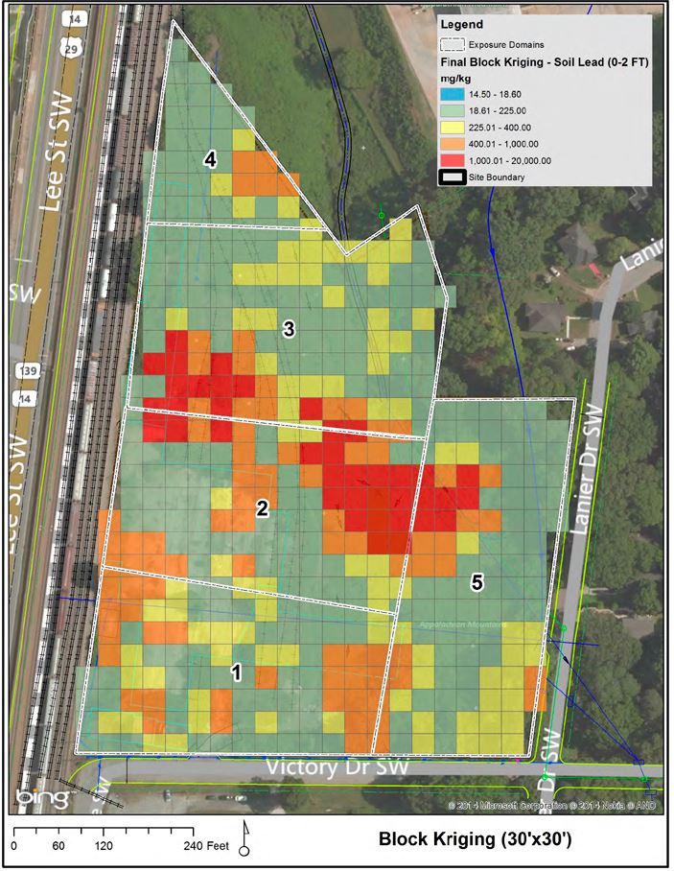
Kriging
Multistep process:
Variogram
Mathematical model
Interpolation weights
Many variations
Block Kriging (Alexander, 2016).
Simple Kriging (Francos et al., 2022).
Ordinary Kriging (Miryousefiaval et al., 2020)
Kriging with External Drift
Alexander, 2016.
Notes:
Kriging is a multistep process. When using kriging you first create a variogram, which describes the spatial dependence of the variable of interest.
Then a mathematical equation is fit to the data in order to summarize this variation in the data.
And last the model in consideration with the spatial arrangement of the sample points in the local neighborhood is used to determine the interpolation weights. The result of this is an interpolated surface and the means to estimate prediction error.
There are many variations of kriging, which reflect differences in the assumptions made with regards to the underlying surface. Many different types of kriging have been used for lead in soil, including block kriging, simple kriging, ordinary kriging, and kriging with external drift.
The images on the slide show steps from the block kriging method used by Alexander. The variogram and fitted model are on the left chart, and the interpolated surface is on the right map.
My methodology will employ Ordinary Kriging, one of the most commonly used kriging approaches. Ordinary kriging uses the sample points that fall within the local neighborhood to estimate the mean used in the kriging equation. It is less restrictive than simple kriging which assumes the mean is known exactly.
Kriging with external drift is another common method that uses ordinary kriging combined with an underlying trend modeled using a secondary variable that is found to be correlated to the data. In the case of lead levels, topography has been found to influence lead levels and this trend can be incorporated using kriging with an external drift.

Slide 11
Proposed methodology: Statistical Analysis
Notes:
To start my methodology section, I am next going to go over the statistical analysis that was done to assist in the formation of the proposed methodology.

Slide 12
Statistical exploration
Done to confirm data is suitable for kriging
Is data distribution normal?
Is there spatial autocorrelation?
Notes:
To determine if kriging is suitable for this dataset, I conducted a statistical analysis. I asked two questions: Is the data distribution normal and is there spatial autocorrelation present.

Slide 13
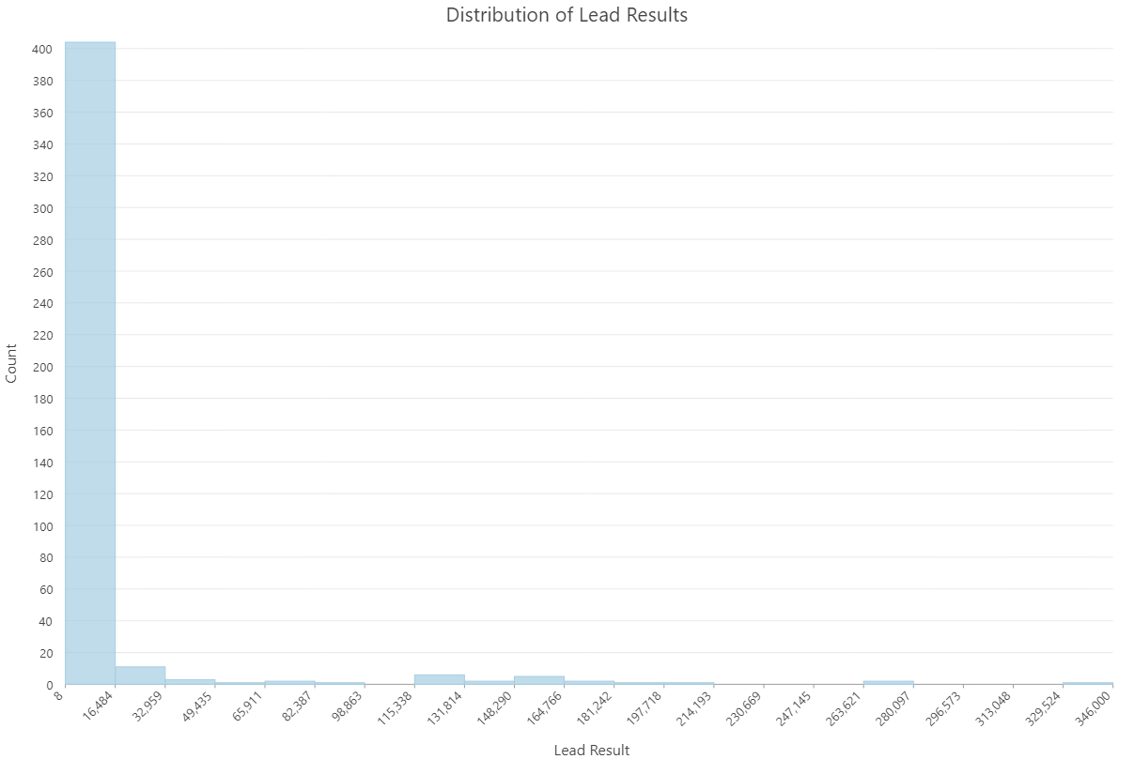
Notes:
To start, I made a histogram with the lead result values to see if the data was normally distributed, and this is the result.
The lead values are shown on the x axis, and the count of samples is shown on the y axis.
This graph shows that the data is not normally distributed, but skewed to the right. This is a common occurrence in environmental data, which often conforms to a log-distribution because it is bounded at 0, and tends to be positively skewed like we see in this graph. Because of this, I log transformed the data to see if it would then follow a normal distribution….

Slide 14
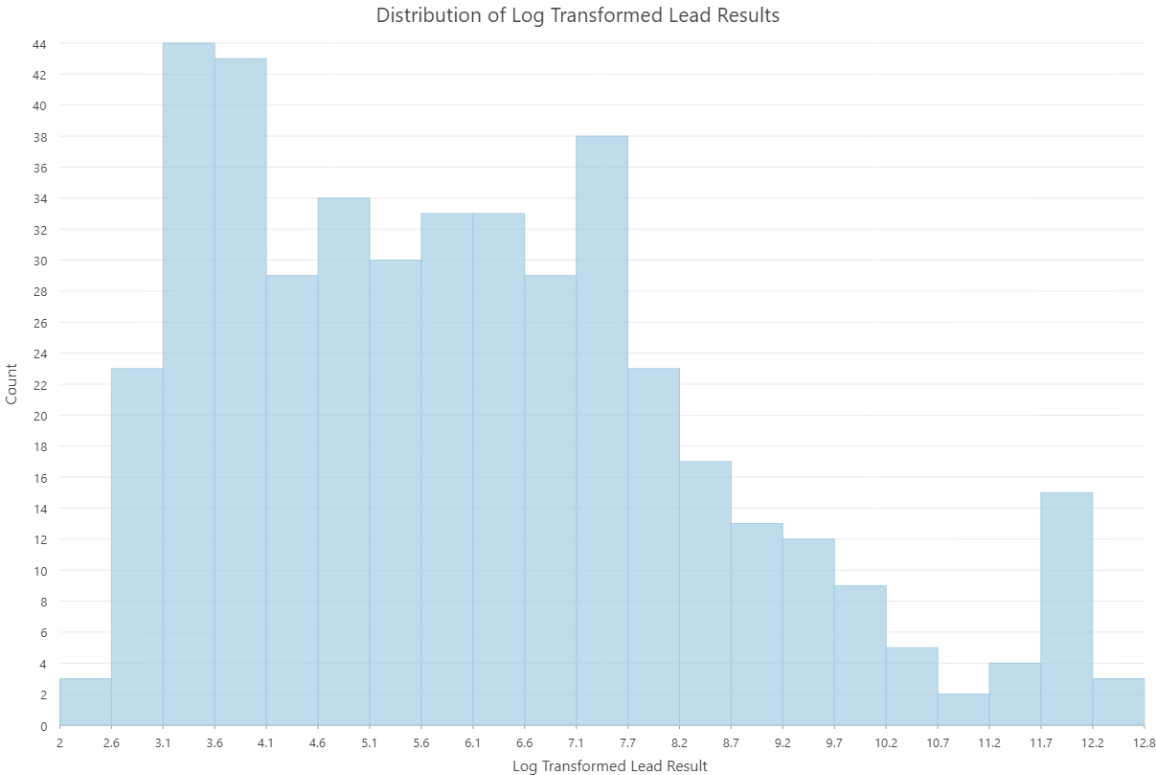
Notes:
… and this is the histogram of the lead data after it was log transformed. This graph shows that the data now follows a much more normal distribution. It is much less skewed and better approximates a normal curve.

Slide 15
Moran’s I
Global Moran’s I tool in ArcGIS Pro
Distance Band set to 150 feet
Moran’s I value = 0.398805 p ≈ 0
Log transformed show positive spatial autocorrelation
Notes:
Next, I calculated the Global Moran’s I value using ArcGIS Pro. This was done to get an idea for what the spatial autocorrelation is between the soil samples. The default values were used, with the exception of the distance band. This was set to 150 feet because the majority of the samples were collected on a 100 foot grid, and the value of 150 encompasses the diagonal distances between these sample locations. The resulting value was 0.398802. This shows that the log transformed dataset has positive spatial autocorrelation in lead values for the dataset and confirms the suitability of spatial interpolation in this study. From this result it was determined that all kriging Methods will be carried out using the log-transformed data.

Slide 16
Proposed Methodology: Methods
Notes:
Next I will talk about the methods I will be using to complete the rest of this project.

Slide 17
methods
Method 1
Ordinary Kriging - the entire site
Method 2
Ordinary kriging - break up site into sections
Method 3
Kriging with external drift – topography as second variable
Interpolated Surface comparison
RMSE and overall distribution of errors across the methods
Calculated remediation area
Notes:
Three kriging models will be examined to account for the gap in the sample data at the center of the site.
Method one will assume that the spatial structure estimated using all samples applies uniformly across the study area, including the gap. One semivariogram model will be fit using all the sample points and ordinary kriging will be used to create the estimated lead surface.
Method two will assume that the spatial structure varies across the study area, including within the gap. The study area will then be broken into sections, each covering a sampled area. Individual semivariogram models will be fit using the samples location in each section. Ordinary kriging will be employed in each section, resulting in multiple interpolated surfaces.
Previous research has suggested a possible relationship between elevation and lead levels. this relationship can be incorporated by using kriging with an external drift; which is the third model I will examine. In this kriging method a trend surface based on elevation would be incorporated into the prediction. Given the topography of the site, shown on the map, the observed relationship between lead levels and elevation will be used to update ordinary kriging estimates. To determine that Kriging with external drift is a suitable method to interpolate the data, an exploration of the relationship between lead levels and elevation will be quantified
The final piece of this analysis will be to compare the interpolated surfaces. The RMSE and overall distribution of errors across the methods will be evaluated, and the final calculated remediation areas will be considered.

Slide 18
Project Timeline
Will work on analysis during Fall 2023 and Spring 2024 semesters
596B Spring 1 2024
Present in Spring 2024
NAEP annual conference: Early May
AEHS West Coast conference: Late March
PA GIS conference: Early April
Notes:
I plan to work on the bulk of my analysis furing the Fall 2023 and Spring 2024 semesters. I also plan to tak ethe next capstone class in Spring 1 of 2024
I have three conference I am interested in for next spring.
National Association of environmental professions annual conference: Early May
Association for Environmental Health and Science Foundation - West Coast conference: Late March
PA GIS conference: Early April

Slide 19
Possible Presentation Value
For stakeholders
Property owners, colleagues, scientists
For myself
Credibility, knowledge, confidence
Notes:
Numerous stakeholders can benefit form this research.
The surrounding property owners affected by this shooting range will greatly benefit from having an accurate delineation of the extent of contamination on their properties
My colleagues and other environmental consultants will benefit from the potential for time and money savings from better understanding of the choices made to define lead contamination.
Scientists will also benefit because there will be an additional kriging methodology for uneven sample distributions of lead.
I myself will also greatly benefit from this project. As an environmental consultant, I will have work that is much more defendable, and I will have greater knowledge of how to solve this common problem. It will help me move forward in my career by increasing my credibility, knowledge, and confidence.

Slide 20
Questions?

