Slide 1
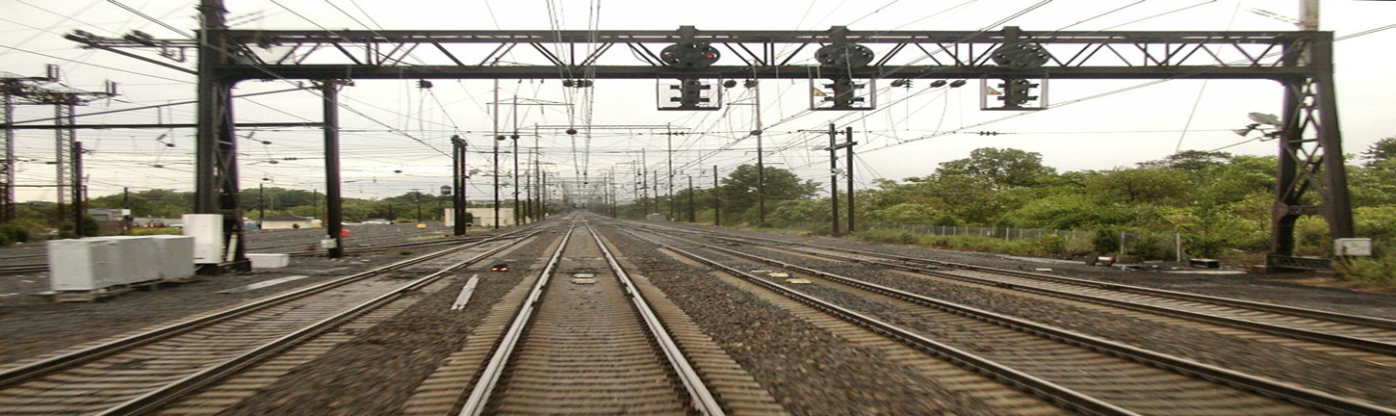
Bridget Ward
Advised by Dr. Guangqing Chi , Pennsylvania State University World Campus MGIS Program
Image Source: Creative Commons; Creative Commons Attribution-Share Alike 3.0
An Evaluation of
Multiple-Criteria Decision Making
with GIS:
The "DC2RVA" Case Study

Slide 2
Table of Contents
Background
  GIS And Multiple Criteria Decision Making/Analysis (MCDM/A) As Decision Support Tools
  “DC2RVA” High Speed Rail Case Study
Research Objective
  Exemplify Synergy Of GIS And MCDM/A
  Increase Awareness And Facilitate Use Of GIS And MCDM/A
Methodology/ Analysis/ Results
  Criteria Sum And Weighting: ArcGIS, TerrSet
  Least Impact Alternative
Q&A

Slide 3
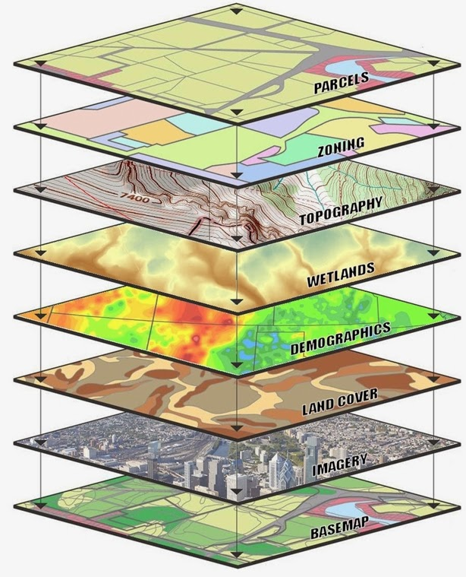
GIS: Spatial Decision Support System(SDSS)
Emerged In The 1960s
  Ian Mcharg, Originator Of The Overlay Technique
GIS For Decision Analysis Modeling
  Methodological Approach (Jankowski 1995)
    GIS In The “Rational Model Framework”
      1. Problem Definition
      2. Search For Alternatives And Selection Criteria
      3. Evaluation Of Alternatives
      4. Selection Of Alternatives
Image Source: http://www.gis-consultants.com

Slide 4


Multiple Criteria Decision Making/Analysis
“MCDM/A is primarily concerned with how to combine the information from several criteria
To form a single index of evaluation.”
(Chen, Yu, Khan 2010)
Image Source: http://img.socialbeta.com/wp/2014/03/Decision-Making-Strategies-590x400-560x379.jpg
Image Source: http://www.pixabay.com

Slide 5
GIS & MCDM/A Integration
“…GIS-MCDM/A can be thought of as a collection of methods and tools for transforming and combining geographic data and preferences (value judgments) to obtain information for decision making.”
(Malczewski, Rinner 2015)
MCDM/A
Provides Methodology/ Framework For “Argumentation Maps”
Systematic And Defensible Approach
GIS
“Unique Capabilities For Storing, Managing, Analyzing, And Visualizing Geospatial Data For Decision Making.” (Maclzewski, Rinner 2015)

Slide 6
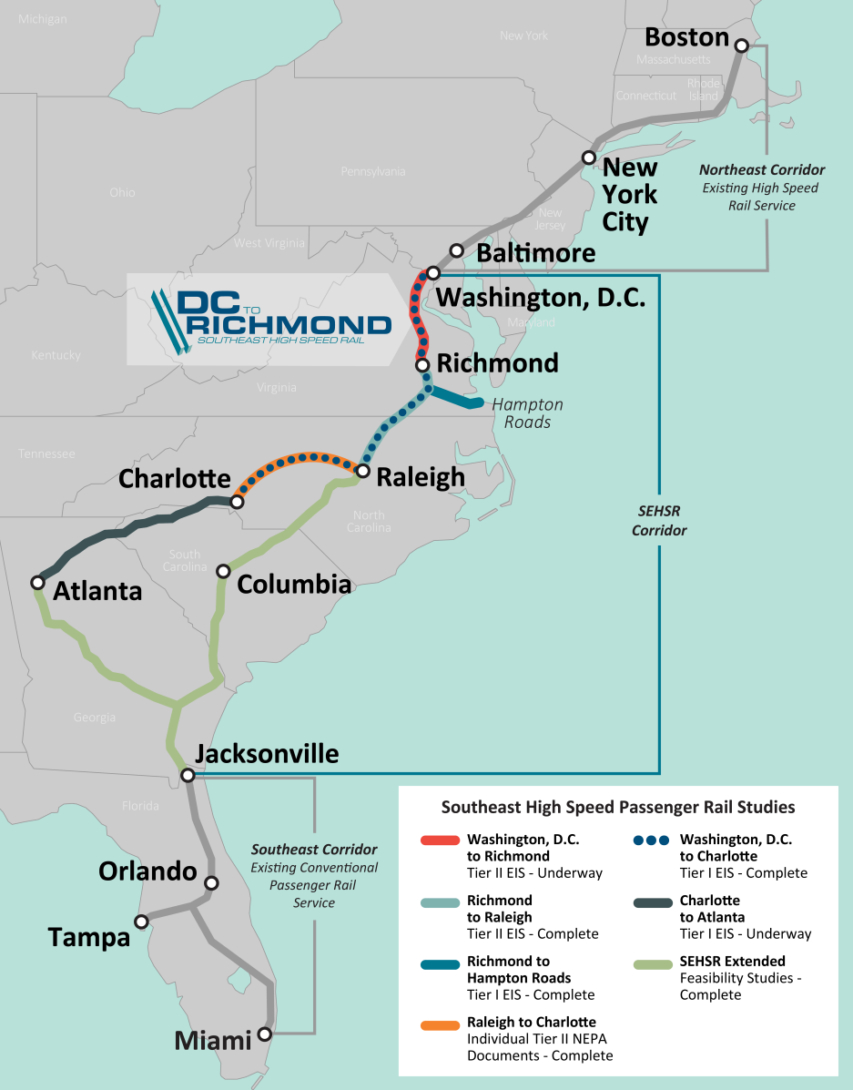
Case Study
Washington, D.C.
to Richmond
Southeast High Speed Rail
“DC2RVA”
Tier II Environmental Impact Statement
http://www.dc2rvarail.com
Image Source: Property of HDR, Inc. 2016.
Notes:
3.5 year accelerated timelines – typically 8 years
Began in Fall of 2014. currently in final stages of release of DRAFT EIS
Tier II EIS:
Summarize broader issues from Tier I EIS
Focus on site-specific impacts, and mitigation for individual elements of the larger study
Quantify impacts and analyze potential mitigation measures
Aims in to end in record of decision (referred to as ROD) by 2017.

Slide 7
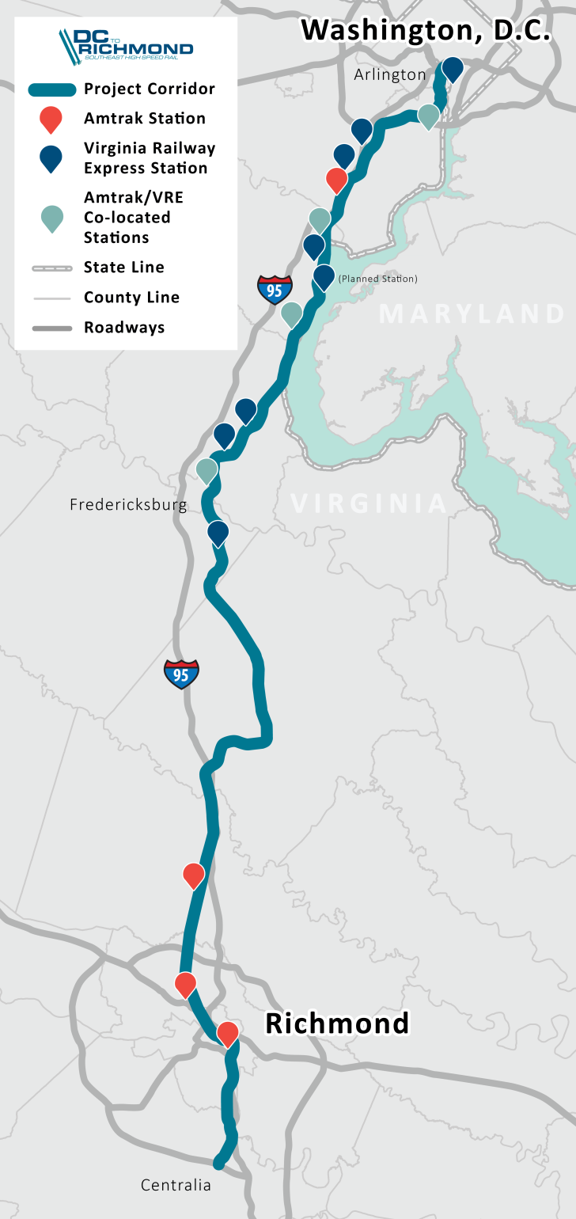
Corridor Overview
123-mile corridor
Follows CSX’s rail line
Shared freight rail and passenger rail corridor
Amtrak provides intercity passenger rail service
Virginia Railway Express provides commuter rail service
Image Source: Property of HDR, Inc. 2016.
Notes:
The purpose of the project is to develop an intercity passenger rail service between Washington, D.C. and Richmond that will provide a competitive transportation option for travelers in the corridor and beyond.
Improve Reliability
Increase Frequency of round trips
Reduce Travel Time

Slide 8
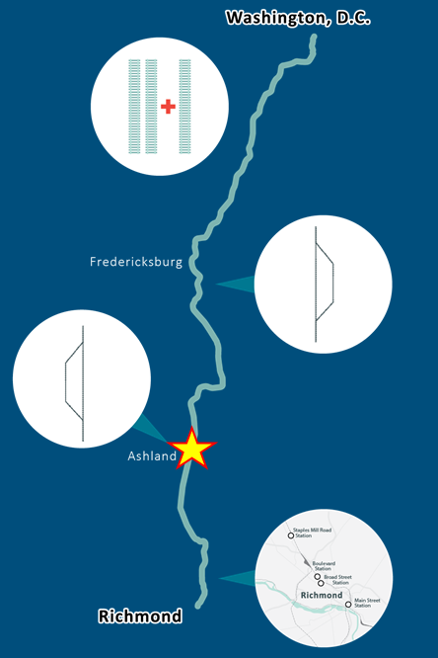
Focus:
Hanover County,
Town of Ashland
Summary of Alternatives Carried Forward
Image Source: Property of HDR, Inc. 2016.
Notes:
Northern and Central Sections
Add third track and realign existing track to improve speed
Add double-track bypass connecting to Dahlgren spur east of Fredericksburg
Add double-track bypass to the west of Ashland
Just because we’re looking at bypasses in Fredericksburg and Ashland, there are other alternatives that would add a third track through this two locations. If we selected these alternatives, the third track would be added to the east side of the track.
Richmond Section
Main Street Station & Staples Mill Road Station Full Service
(S-Line)
Main Street Station & Staples Mill Road Station Split Service
(A-Line)
Main Street Station & Staples Mill Road Station Shared Service
(S-Line & A-Line)
Main Street Station Only (S-Line)
Boulevard Street Station Only (A-Line)
Broad Street Station Only (A-Line)
Staples Mill Station Only (A-Line)

Slide 9
Research: Proposal & Objective
Proposal
GIS-MCDM/A As An Effective Technique For Land Suitability Analysis For Rail Transportation
GIS-MCDM/A Provides Increased Access And Decision Support For Non-Specialists;
  Wide Utilization = High-level Decision Making And Detailed Criteria Evaluation
Objective
To Identify And Evaluate The Synergistic Relationship Of GIS And MCDM/A Through The Analysis Of A Specific Alternatives Portion Of The “DC2RVA” Project.

Slide 10
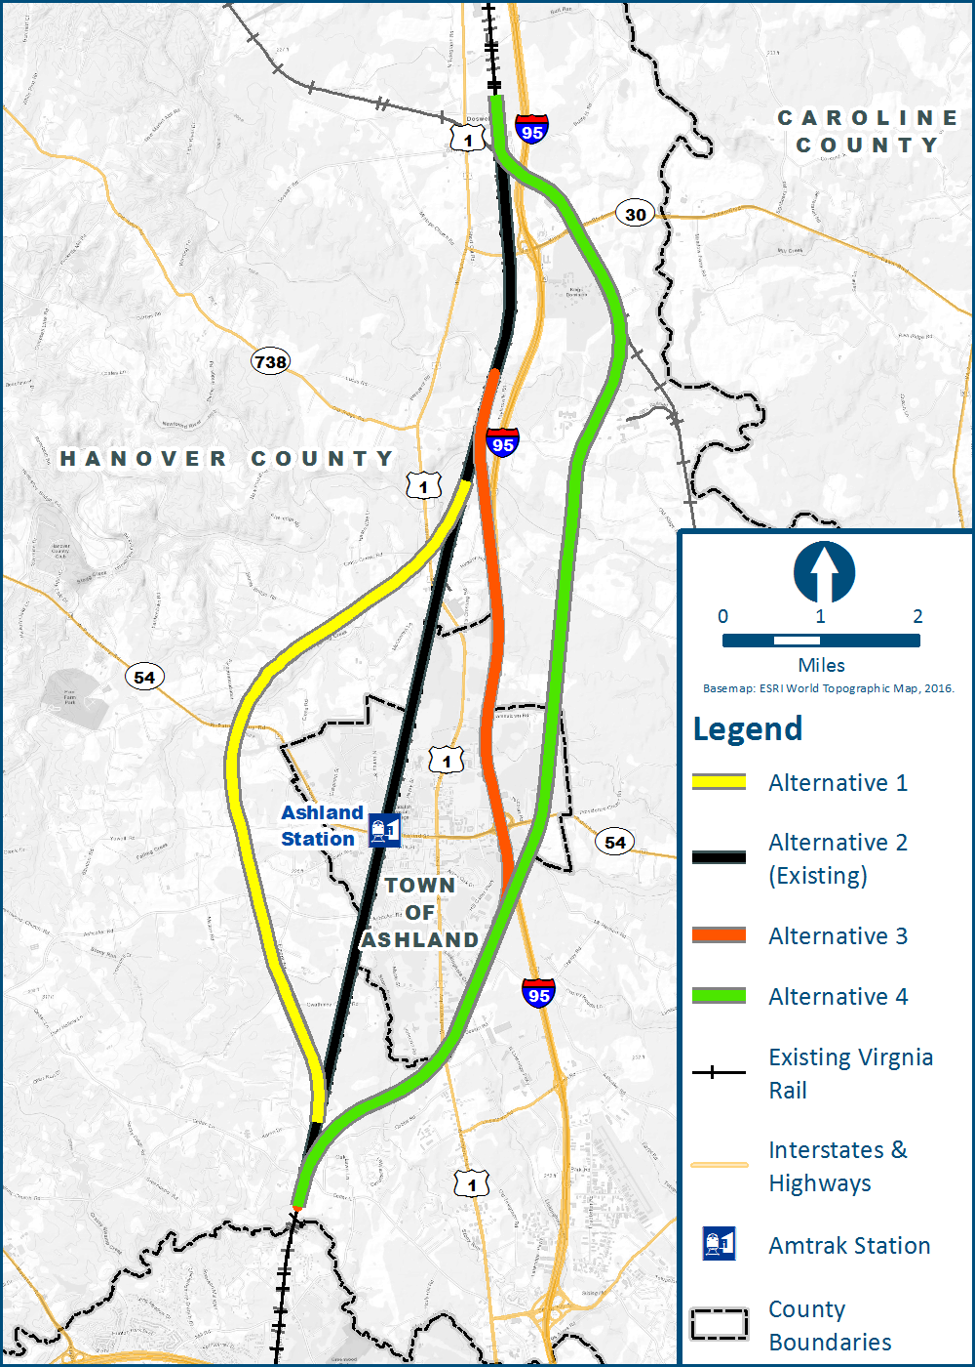
Methodology: Base Data
Three (3) Possible Bypass Options In Screening Simulation
  Approximate 11-mile Linear Corridor
  Existing Line Included For Base Comparison
  Parallel Rail Alignment Options
  Combination Of Suburban, Urban, Rural/Agricultural Land Uses (Developed And Greenfield Areas)
Screening For Community, Environmental And Resource Impacts Against Approximate Alternative Impact Area (Average Rail ROW)

Slide 11
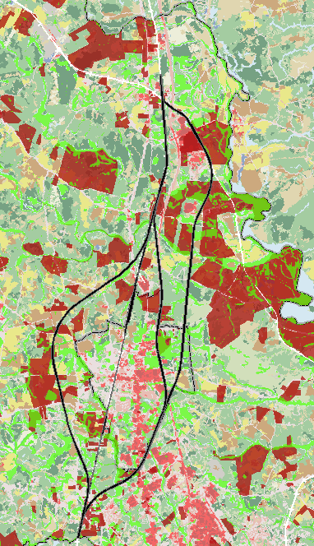
Methodology: Screening Data
Cultural
  Hanover County GIS Data – Historic Sites
Schools
  Municipality, ESRI
Parks
  Virginia Department of Conservation & Recreation (VDCR), ESRI
Agricultural & Forestal Districts
  Virginia Department of Forestry (VDOF)
Wetlands
  National Wetlands Inventory (NWI)
Wildlife Corridors
  VDCR – Natural Landscape Assessment (NLA)
Land Use
  National Land Cover Database (NLCD)

Slide 12
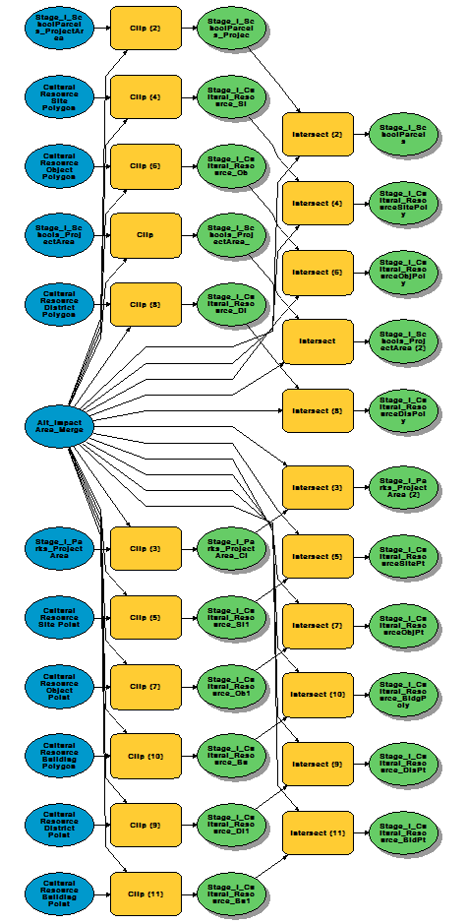
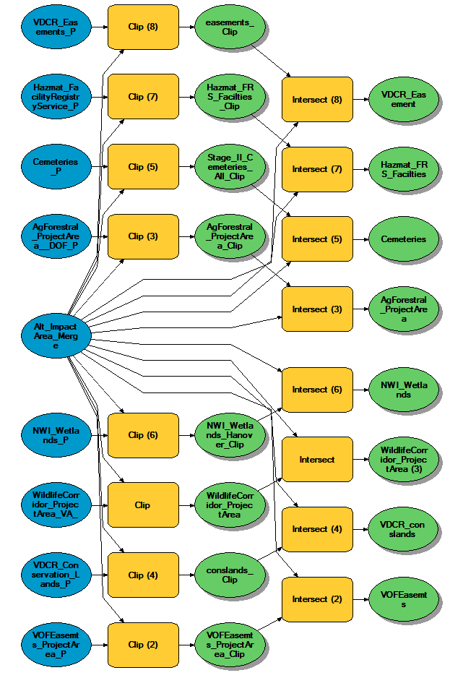
Screening Process
Initial
Revised

Slide 13
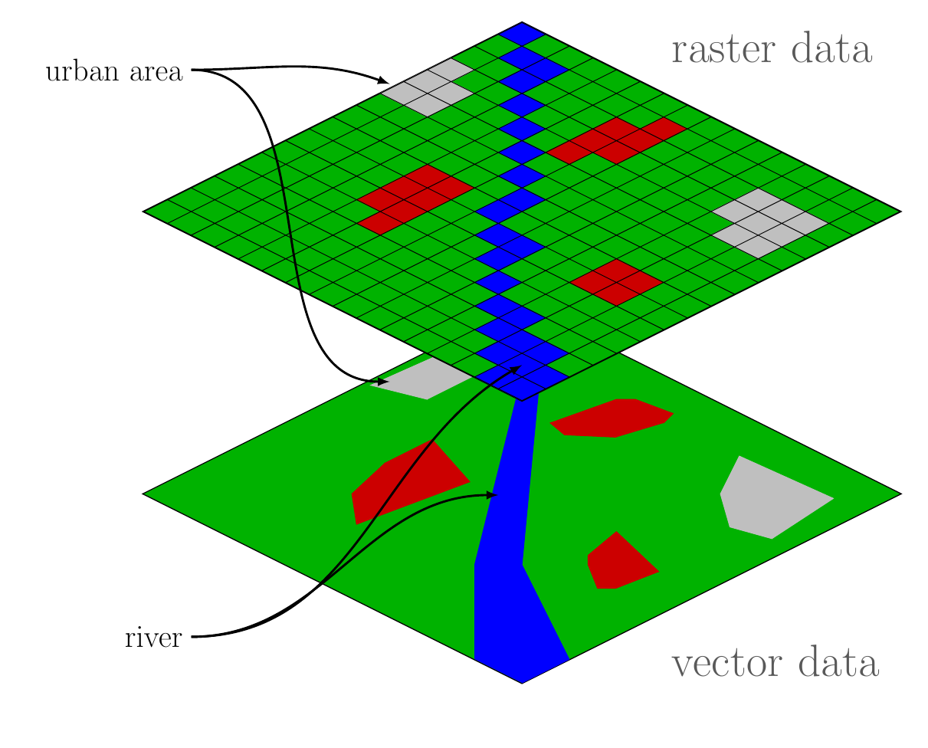
Methodology: Conversion, Standardization
By Wegmann (Own work) [CC BY-SA 3.0 (http://creativecommons.org/licenses/by-sa/3.0) or GFDL (http://www.gnu.org/copyleft/fdl.html)], via Wikimedia Commons

Slide 14
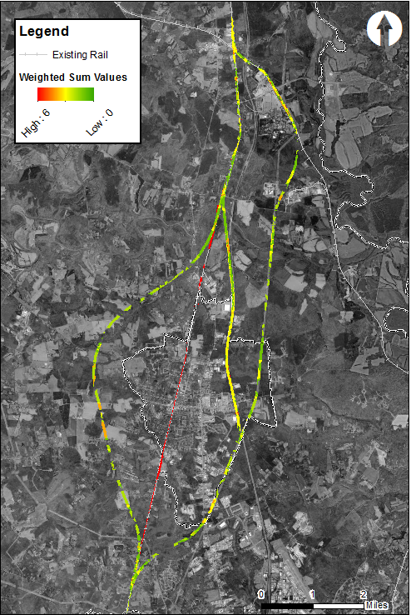
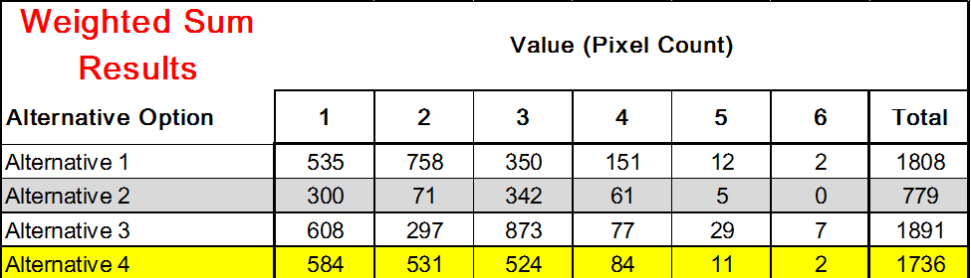
Analysis & Results #1
ArcGIS: Weighted Sum

Slide 15
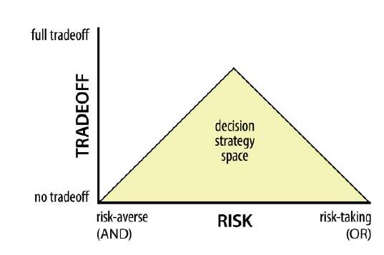
Analysis & Results #2: TerrSet
Decision Support Tools Developed by Clark Labs
    Multi –Criteria Evaluation (MCE)
        Ordered Weighted Average (OWA)
          Weighted Linear Combination (WLC)
J. Ronal Eastman, TerrSet Manual. Clark University 2017.

Slide 16
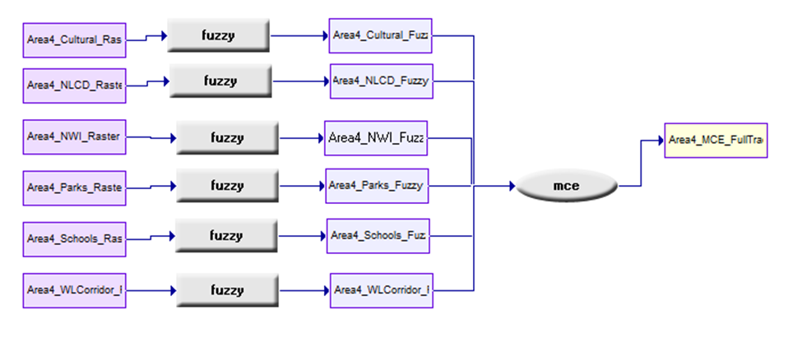
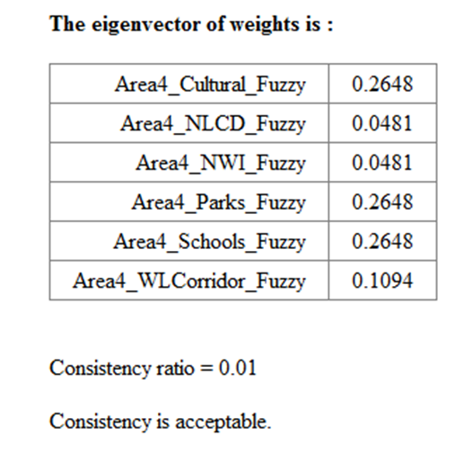
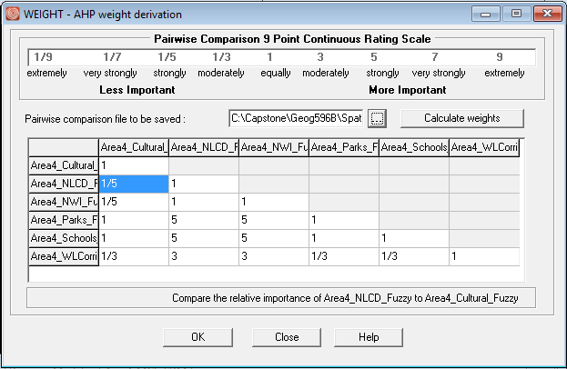
Analysis & Results #2: TerrSet
MCE
Spatial
Decision
Modeler (SDM)
WEIGHT Module (Saaty, 1977)

Slide 17
Analysis & Results #2: TerrSet
Criteria Weighting Results
Base Weight Property
0 < w_{k} < 1

Slide 18
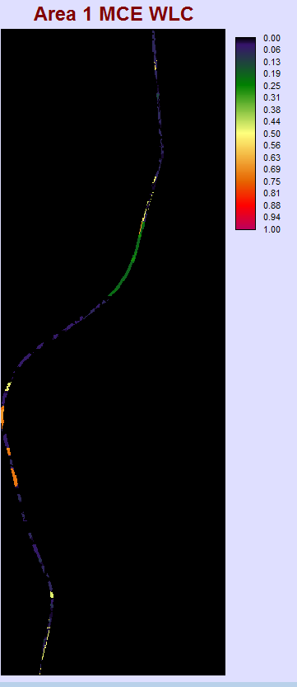
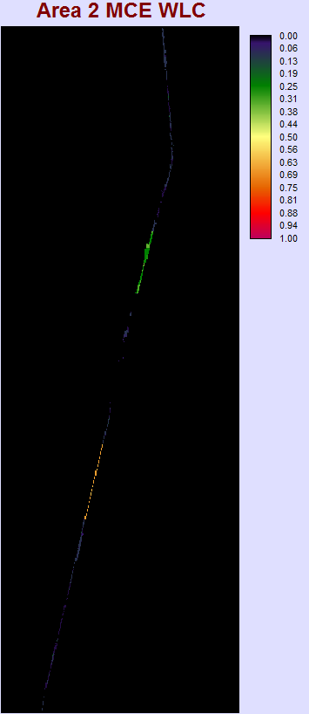
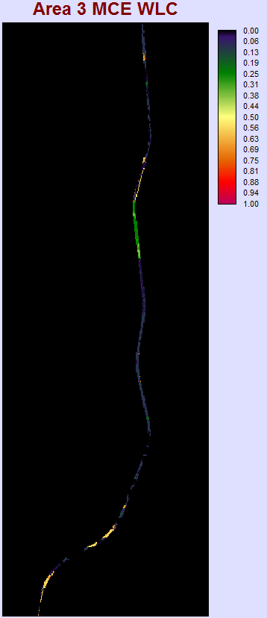
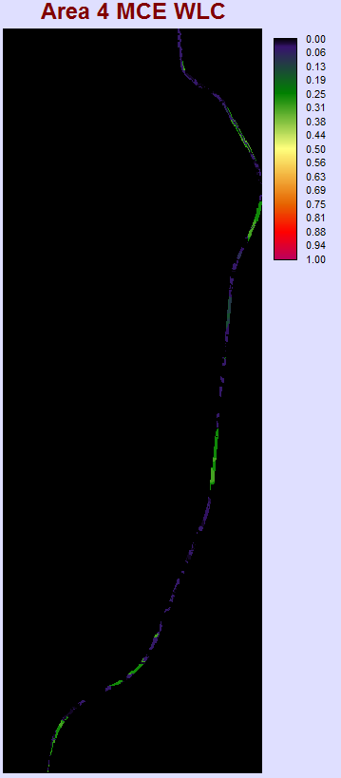
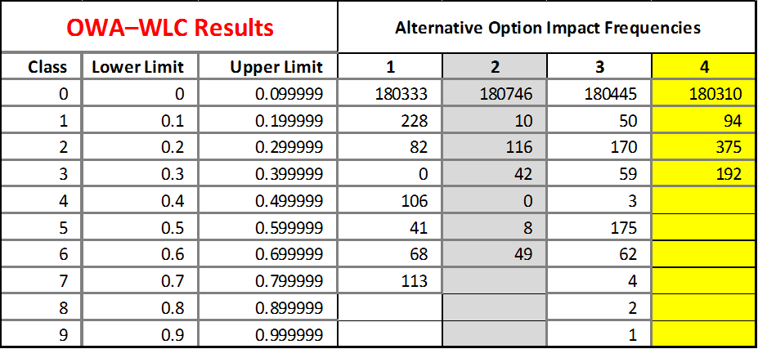
Analysis & Results #2: TerrSet
Alt. 1
Alt. 2
Alt. 3
Alt. 4

Slide 19
Conclusions
  Alternative 4 identified as most feasible option in both ArcGIS and TerrSet simulation
    Limited data availability
    Abbreviated study area
    “Snapshot” analysis overview of impacts
GIS + MCDM/A is an effective approach for Rail Alignment Suitability Analysis
  Complimentary processes in spatial and statistical modeling
Decision maker/stakeholders need to be engaged in the process
  Facilitates hierarchal structure; identification of priorities
  Collaborative method– bigger picture to finer detail
Notes:
Flexible & dynamic for land suitability
Fundamental MCDM approaches

Slide 20
Future Recommendations
Incorporate More Variables – Quantitative & Qualitative
  Demographics
  Property
  Vetted Historical Resources
  Train: Speed, Curve, Slope
Simulate Additional Corridor Areas
  110 Miles Remain
  Potentially More Bypass Options

Slide 21

Thank you!
Questions?
By Notas de prensa (Notas de prensa) [CC BY-SA 2.5 (http://creativecommons.org/licenses/by-sa/2.5)], via Wikimedia Commons

Slide 22
References
Bouyssou, D. Evaluation and Decision Models with Multiple Criteria: Stepping Stones for the Analyst. New York: Springer Science Business Media, 2006.
"D.C. to Richmond Southeast High Speed Rail :: Home." D.C. to Richmond Southeast High Speed Rail ::Home. Accessed November 27, 2016. http://dc2rvarail.com/.
"IDRISI GIS Analysis | Clark Labs." Clark Labs. Accessed December 02, 2016. https://clarklabs.org/terrset/idrisi-gis/
Jankowski, Piotr. "Integrating Geographical Information Systems and Multiple Criteria Decision-making Methods." International Journal of Geographical Information Systems 9, no. 3 (1995): 251-73. Accessed October 13, 2016. doi:10.1080/02693799508902036.
Keeney, Ralph L. "On the Foundations of Prescriptive Decision Analysis." Utility Theories: Measurements and Applications Studies in Risk and Uncertainty, 1992, 57-72. Accessed October 10, 2016. doi:10.1007/978-94-011-2952-7_3.15
Luca, Mario De, Gianluca Dell’Acqua, and Renato Lamberti. "High-Speed Rail Track Design Using GIS And Multi-Criteria Analysis." Procedia - Social and Behavioral Sciences 54 (2012): 608-17. Accessed October 11, 2016. doi:10.1016/j.sbspro.2012.09.778.
Malczewski, Jacek, and Claus Rinner. "Multicriteria Decision Analysis in Geographic Information Science." Advances in Geographic Information Science, 2015. doi:10.1007/978-3-540-74757-4.
Saaty, T.L. (1977). A scaling method for priorities in a hierarchical structure. Journal of Mathematical Psychology, 15, 234–281.
Stich, B., and J. H. Holland. "Using a Multiple Criteria Decision-Making Model to Streamline and Enhance NEPA and Public Participation Processes." Public Works Management & Policy 16, no. 1 (2011): 59-89. Accessed October 13, 2016. doi:10.1177/1087724x10390227.
Zak, Jacek. "The Methodology of Multiple Criteria Decision Making/aiding in Public Transportation." Journal of Advanced Transportation 45, no. 1 (2010): 1-20. Accessed October 11, 2016. doi:10.1002/atr.108.

