Slide 1
Investigating Sage-grouse Population Trends amid Intense Energy Development in the Powder River Basin
Nyssa Whitford
Pennsylvania State University

Slide 2
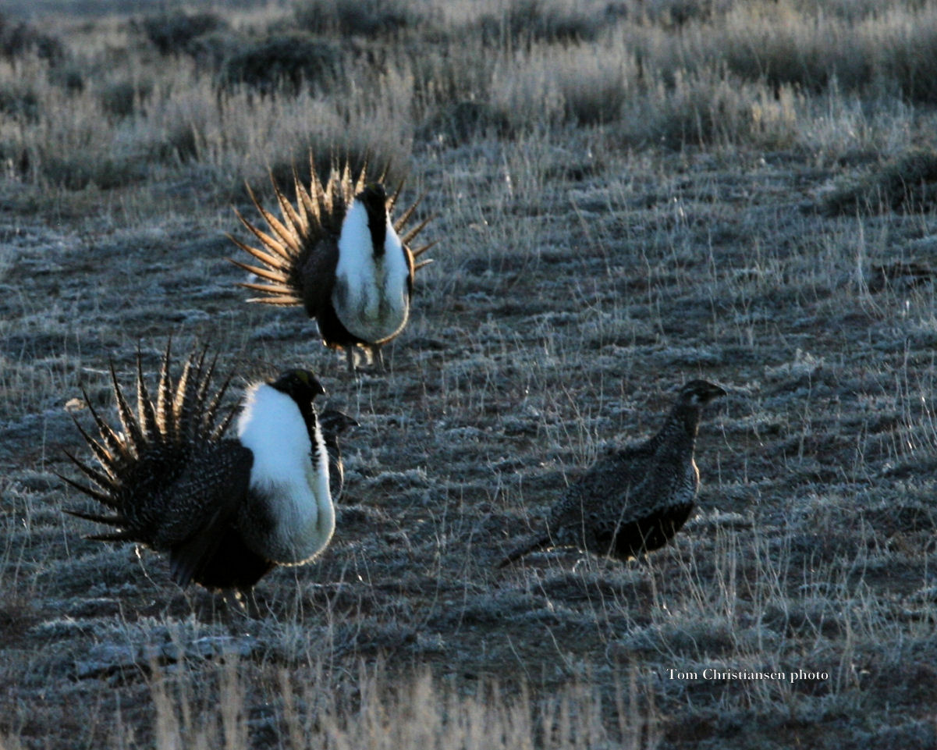
Outline
Introduction to Sage-Grouse and Overview of Management
Goals and Objectives
Methods
Anticipated Results
Management Implications
Project Timeline
Acknowledgements
References
Notes:
That is me on the right with my husband, Rio, and our dog Aspen. Just so you can put a name with a face while I am presenting.
I am going to introduce you to sage-grouse and the current management strategy.
Go over my goals and objectives and the methods to reach those.
Discuss my anticipated results and the possible management implications .
Review my overall project timeline.
Give thanks to those making my project possible.
At the end, there will hopefully be time for questions.
There is a list of references for anyone wanting to dig deeper into sage-grouse and the figures cited in my presentation.
Photo credit: Tom Christiansen of Wyoming Game and Fish Department.

Slide 3
What is a Sage-Grouse?
Chicken Sized
Sagebrush Obligates
Mate, Nest, and Raise Young in Sagebrush Sea
Sagebrush Only Diet in Winter
Notes:
Sage-grouse are a chicken sized bird found in the sagebrush ecosystem. They are sagebrush obligates, which means they depend on the shrub for their entire life cycle. They mate, nest, raise their young, and live their lives in the sagebrush sea. In the winter sagebrush is about the only edible thing on the landscape. Sage-grouse actually gain weight in the winter since they are gorging on sagebrush.
Photo credit: Tom Christiansen of Wyoming Game and Fish Department.

Slide 4
Current and Historic Range
Iconic Western Bird
Occupy 56% of Historic Range
Populations in 11 States and 2 Provinces
70% of Wyoming is Occupied Sage-Grouse Habitat
Notes:
Sage-grouse are an iconic bird of the American west with populations in 11 western states and 2 Canadian provinces as shown on the map. They currently occupy 56% of their historic range, shown in dark green, and current range shown in light green.
Almost 70% of Wyoming is covered by occupied sage-grouse habitat and supports approximately 37% of the range wide population.

Slide 5
Sage-Grouse Population Declines
Notes:
Over the last 50 years, sage-grouse populations have declined steeply mostly due to habitat fragmentation. Sage-grouse need large, unfragmented blocks of sagebrush and respond negatively to any disturbances including human presence and excessive noise.
In 2010 the USFWS announced sage-grouse were warranted but precluded for endangered species status. This means sage-grouse met the threshold for an endangered species but are precluded by other species classified a higher priority by the Fish and Wildlife Service. This decision is currently under review with a final determination due out this fall.
Available from: http://ecos.fws.gov/speciesProfile/profile/speciesProfile.action?spcode=B06W

Slide 6
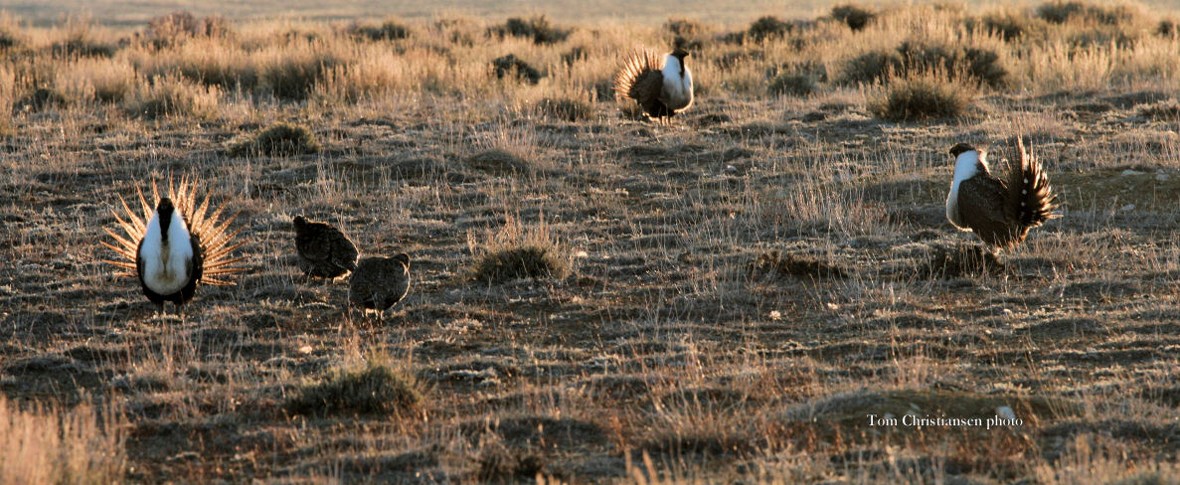
Leks and Population Estimates
Lek is Mating or Breeding Ground
Populations Estimates Based on Male Lek Attendance
90% of Leks Monitored on Annual Basis
Notes:
Sage-grouse mate at a location known as a lek. This is generally a more open spot surrounded by sagebrush. The breeding season runs from March to May in most parts of the state. There are just over 1900 occupied leks sites in Wyoming. Sage-grouse have high site fidelity which means they mostly attend the same lek from year to year.
Population estimates are based on male lek attendance. Males attend the lek and display for the entire season while females show up, mate, and then leave to find suitable nesting habitat which is usually within 5.3 miles of the lek location. This picture shows male sage-grouse with their tail feathers fanned out, blue arrow, and the smaller, less showy females, purple arrow.
The Wyoming Game and Fish Department, along with many other agencies and volunteers, monitor close to 90% of all occupied leks every year.
Photo credit: Tom Christiansen of Wyoming Game and Fish Department.
For a really cool video of male sage-grouse strutting check out:
https://www.youtube.com/watch?v=m0M8pZnNlnI

Slide 7
Sage-Grouse Core Areas
Steps Taken to Stem Population Decline
Core Areas Established in 2008
Three Core Area Updates Based on New Science and Data
Notes:
In 2008, to help slow or stop sage-grouse population declines in Wyoming, core area boundaries were delineated by then Governor Freudenthal based on the recommendations of his Sage-Grouse Implementation Team, or SGIT, which is a group of stakeholders with representatives from various energy industries, conservation groups, and wildlife management agencies. The SGIT consulted a lek population density map when outlining their recommendations.
In 2010, Governor Freudenthal asked for the sage-grouse core areas to be updated through a collaborative analysis of current information including: sage-grouse breeding density, lek locations, current and pending energy development, habitat conditions, seasonal movements and concentrations, migratory and non-migratory movements, and connectivity to neighboring states. The result of that effort are the green polygons on the map. Governor Freudenthal recommended these boundaries be revisited in 5 years using new science and data.
Matt Mead, the current Governor of Wyoming, is now reviewing the sage-grouse core area boundaries and management policy again using a process similar to the one undertaken in 2010. The goal of the core area strategy is to delineate the best and least fragmented sage-grouse habitat and protect the densest populations of birds within the least amount of acres.

Slide 8
Sage-Grouse Breeding Density
Breeding Density of 65%-85% of Grouse
Same Analysis Used for All Core Area Versions
Updated with New Lek Data and Counts
Notes:
This map represents the breeding density polygons used in the current core area revision process. Kevin Doherty of the US Fish and Wildlife Service developed this analysis based on kernel density of peak male grouse counts at leks. It has been updated and consulted for all versions of the sage-grouse core areas. The warmer coolers represent denser grouse populations while the cooler colors represent less dense populations. The more dense polygons are inclusive of the less dense polygons, basically they are stacked on top of each other. A range of years, in this case five, is used to calculate maximum male density at leks and ensures that most leks have an associated value as not every lek is checked every year for a variety of reasons.
Research also suggests that sage-grouse experience multiyear population cycles. Using the maximum male count at leks for more than one year helps control for these population cycles.
When viewed at a statewide scale, the large populations in the center and western portion of Wyoming, the red areas, tend to dominate the results and the increasingly isolated populations in the northeast and extreme northwest of the state tend to appear less dense and thus less important. These populations are just as important when you consider genetic connectivity, the overall health of the population, and factors considered by the U.S. Fish and Wildlife Service for an endangered species listing.

Slide 9
Sage-Grouse in Northeast Wyoming
Lower Density of Sagebrush
Historic Habitat Conversions
Lots of Energy Development
Special Concern for USFWS
Notes:
With respect to sage-grouse, Northeast Wyoming is very different from the rest of the state. So different that the Fish and Wildlife Service places the grouse in northeast Wyoming in management zone 1 with the smaller Montana, North Dakota, and South Dakota populations. The rest of Wyoming is in management zone 2 with which has the densest grouse numbers.
The sage-grouse in northeast Wyoming subsist on a lower density of sagebrush and live with a higher density of energy development, compared to the birds in central Wyoming which enjoy a lower amount of disturbance and a less fragmented landscape.
Historic, large scale habitat conversions on private land have lowered the abundance of sagebrush across the Powder River basin. These habitat conversions include mowing and tilling sagebrush and large scale application of herbicides. This has occurred mainly for agricultural reasons. The Powder river runs through the middle of northeast Wyoming and you will hear this region referred to both ways.
Land ownership in northeast Wyoming is primarily private with 75% of known leks occurring on those lands and only 25% occurring on state or federal lands. The high occurrence of leks on private lands makes state management challenging requiring cooperation with private landowners.
Compared to other disturbed populations in Wyoming, there is a relatively dense population of sage-grouse that are persisting despite being surrounded by oil and gas development . This population, which is now circled in blue, will be the focus of my study.

Slide 10
Project Area in Powder River Basin
Relatively Dense Population of Grouse
Intense Oil and Gas Development
Why is this Population Persisting?
Notes:
The small blue dots represent producing oil and gas wells and you can see level of intense development within my circled study area. This area is an anomaly in the state.
There has been a lot of research done on sage-grouse response to energy development. Many researchers have documented a multi year lag time between when development occurs and grouse response. Research conducted in northeast Wyoming by Kevin Doherty in 2010 showed that occupied leks can persist in areas of heavy development if they have sufficient open space around the lek . This usually means the development was clustered to one side or another.
The goal of my project is to see if this population of sage-grouse in northeast Wyoming is performing consistently with these results and why this population is persisting where others, facing a similar or lesser level of development, have faltered.

Slide 11
Goal and Objectives
Goal: To determine if this population of sage-grouse has sufficient open space around their leks to persist in the face of heavy development.
Objective 1: Measure the level of population persistence by analyzing sage-grouse lek densities in northeast Wyoming.
Objective 2: Examine the temporal aspect of oil and gas development on this population.
Objective 3: Measure the amount and pattern of undeveloped space within this area to determine the pattern’s importance to developed space.
Notes:
Goal: To determine if this population of sage-grouse has sufficient open space around their leks to persist in the face of heavy development. I want to understand this population of birds in the central Powder River basin.
Objective 1: Measure the level of population persistence by analyzing sage-grouse lek densities in northeast Wyoming. Remember the density polygons used in the core area process a few slides back? I am going to recreate those but focus on areas just in the Powder River basin where 25%, 50%, 75%, and 100% of the grouse population reside.
Objective 2: Examine the temporal aspect of oil and gas development on this population. Measuring the amount of development through time as compared to grouse population densities for the same time period will reveal correlations between the timing of energy development and the density of grouse populations. Comparing densities of well development to grouse densities might forecast the lag-time between development and grouse population numbers that other research on sage-grouse population response to energy development has shown.
Objective 3: Measure the amount and distribution of undeveloped and developed space within this area. The pattern of open space around theses leks could explain why this population has endured where others have faltered.

Slide 12
Objective 1: Measuring the Level of Population Persistence
Peak Male Counts at Leks from 2005-2015
Rolling Three Year Analysis
Not Every Lek Visited Every Year
Kernel Density Analysis
Notes:
To measure the level of population persistence for northeast Wyoming I am going to analyze peak male counts from occupied leks from 2005-2015. A peak male count is the highest amount of birds observed that year. Most leks are visited 2-3 times during the lek season. The most males observed during those visits is the peak male count.
The peak male counts from 2005-2015 will be split into rolling three year increments. This means a kernel density analysis derived from peak male counts from 2005-2007 will be created and then the density analysis will be created again using 2006-2008 peak male counts. Sage-grouse populations are cyclical and not every lek is visited every year. Running the kernel density analysis on a rolling three year time frame will give the most accurate picture of the population trends.

Slide 13
Objective 1: Measuring the Level of Population Persistence
Targeted Density Analysis:
25%, 50%, 75%, and 100%
Population Polygons
Generalized Density Analysis:
65%, 70%, 75%, 80%, 85%
Population Polygons
Notes:
The kernel density analysis will be used to delineate polygons that represent 25%, 50%, 75%, and 100% of the grouse population for each of the rolling three year time frames from 2005-2015. An example of this is on the left. The sage-grouse core areas were based on running the density analysis and then delineating polygons that represent a percentage of the population. Using an analysis similar to the core area policy helps my project conform with established science that many in the state are familiar with. The core areas were based on a more generalized density analysis, of five categories where 65%-85% of the grouse reside, shown on the right.
The larger population percentages cover the whole grouse population spectrum while the core areas were focused on protecting the most grouse in the least amount of area. This targeted density analysis categories I chose are consistent with the Western Association of Fish and Wildlife Agencies analysis to represent sage-grouse population range wide at the request of US Fish and Wildlife Service.
A 5.3 mile neighborhood will be the basis for the kernel density analysis. Research has shown that close to 90% of grouse nest within 5.3 miles of a lek. This neighborhood was also used in the density polygons that guided core area delineation. There is a python script and R code for me to consult on the specifics of this analysis. I can also ask Kevin Doherty himself to clear up any confusion I may have. I will build a model in ArcGIS’s Modelbuilder to help automate this process.

Slide 14
Study Area Boundary Delineation
Compare Completed Density Analysis
Area based on 2013-2015 Density Analysis
Reflects Current Conditions
Notes:
After all the density analysis are complete, nine in all, I will use the most recent data, 2013-2015 to narrow down a study area for objectives two and three. Comparing the dense area through time will illustrate how this population may have shifted and changed but it will ultimately be defined by the current density polygons as this boundary is most likely to have future management implications and it reflects current grouse numbers and habitat conditions.

Slide 15
Objective 2: Examine the Temporal Aspect of Oil and Gas Development
Yearly WOGCC Well Data
Surface Disturbance Data from WyGISC
Some Extrapolation of Surface Disturbance Data
Lag Effect Evident?
Notes:
The image on the slide shows well pads with associated roads near a lek, indicated by purple dot. The yellow arrow points at an well pad, there are about 75 well pads on this image with a road linking each pad back to a main road.
Oil and Gas well location data from the Wyoming Oil and Gas Conservation Commission will be used to examine the temporal aspect of oil and gas development on this population. A producing well file will be created for each year of the study, 2005-2015.
To measure the level of development that occurred each year, acreages of disturbance will be calculated using surface disturbance data from the Wyoming Geographic Information Science Center. Complete surface data will be available within four miles of each occupied lek.
The remaining, unmapped, surface disturbance will be extrapolated based on average well pad size of those digitized within my study area. Buffering producing wells to simulate the average well pad size will provide the best estimate of past and present surface disturbance.
Many researchers have documented a multi-year delay in sage-grouse population response to increased drilling activity. By charting the lek density and wells from 2005 to 2015, any change in sage-grouse population relative to drilling activity should become apparent.

Slide 16
Objective 3: Examine the amount of Undeveloped Space within Study Area
Calculate Open Space within 5.3 miles of Leks
What is the Amount of Open Space needed?
2015 Lek and Disturbance Data
Notes:
The amount of open space within 5.3 miles of each occupied lek within the study area will be calculated. Comparing the amount of open space available to each lek within 5.3 miles, the area 90% of the females from that lek nest, to the amount of current surface disturbance should provide insight into the amount of undeveloped land each lek needs for its population to persist.
This objective will be limited to 2015 lek locations, peak male values, and current surface disturbance. The surface disturbance visible on 2012 NAIP imagery within 4 miles of occupied leks will be mapped by August 2015. For this area that means I will be extrapolating more recent development based on the buffering techniques discussed in objective 2.
The image on the left is raw, without any surface disturbance digitized with the C-Brown Ranch lek in the middle. The right image shows the same lek with the current surface disturbance digitized. There are nine categories of surface disturbance with multiple sub categories. This area only contains disturbance from the transportation and energy development categories. This is an example of the data I will have for my study area.

Slide 17
Anticipated Results
Validate previous research: leks closest to development decline the most.
The birds on these leks have a refuge.
Persistence a combination of development direction and drilling timeline?
Notes:
The most likely outcome is that occupied leks closest to the development, with little to no open space, will show the steepest declines and positively correlate with an increased amount of wells. This finding will likely align with previous research that found a steep decline in male lek attendance when wells were drilled within a quarter mile or greater distance from occupied sage-grouse leks.
Another anticipated result is that leks surrounded by the least amount of development have enough of a retreat from the drilling activity to persist. This would be consistent with 2010 Kevin Doherty findings; birds persisted with greater than 40 wells within a 5 mile radius of the lek if the development was clustered to one side and left an open space near the lek site. Hopefully measuring the amount of the retreat and comparing it to the level of development will provide insight and lead to management implications to protect non-core area sage-grouse better. This could lead to a new way to locate wells in an oil and gas field or demonstrate current management actions in this area of the Powder River Basin are helping, or at least not hindering, this population of birds.
Perhaps the orientation of the wells is less important to sage-grouse persistence than the time frame that the wells were drilled. Sage-grouse persistence in this area could be a combination of development direction and drilling timelines. Hopefully this analysis will answer these questions.
Photo credit: Tom Christiansen of Wyoming Game and Fish Department.

Slide 18
Management Implications
State and Federal Agencies
Stakeholder Advisory Groups
Adaptive Management
Balance Multiple Use Mandates
Notes:
The results of this analysis will be directed toward state and federal agencies with regulatory authority or management oversight. The results would also be beneficial to groups that advise governmental agencies on management policies such as the Sage-Grouse Local Working Groups or the Sage-Grouse Implementation Team. The Sage-Grouse Implementation Team is who advises the Governor on all matters relating to sage-grouse.
Basing regulation and policies on better data and science is how we deal with an ever changing landscape. Adaptive management policies are important to the federal and state plans in Wyoming dealing with sage-grouse. The timeline for many state and federal land management plans is at least 10 years. Being able to incorporate new science and data into those plans is very important.
State and Federal agencies have to manage for many land uses such as energy development, recreation, and wildlife. Providing more data and studies, with possible management implications, could provide better balance to the multiple uses the sagebrush habitat in Wyoming must sustain.
Photo Credit: Mark Gocke of Wyoming Game and Fish Department. http://www.markgocke.com/

Slide 19
Project Timeline
August
Objective 1: Density Analysis
September
Objective 2 : Development Timeline
October
Objective 3: Amount of Undeveloped Space
November
Finish Paper and Presentation
December
Present at Conference
GRADUATE!
Notes:
August: Objective 1: Measure the level of population persistence by analyzing sage-grouse lek densities in northeast Wyoming where 25%, 50%, 75%, and 100% of the grouse population reside.
September: Objective 2: Examine the temporal aspect of oil and gas development on this population. Comparing densities of well development to grouse densities might forecast the lag-time between development and grouse population numbers that other research on sage-grouse population response to energy development has shown.
October: Objective 3: Measure the amount and distribution of undeveloped and developed space within this area. The pattern of open space around theses leks could explain why this population has endured where others have faltered.
November: I will be reassessing my goal based on my results to see if I determined that this population of sage-grouse has or does not have sufficient open space around their leks to persist in the face of heavy development. I will be finishing up my final paper and creating a presentation.
December: I will present at the joint Wyoming Wildlife Society and Wyoming Landscape Conservation Initiative Conference in Lander, WY December 1-3. After the conference I will incorporate any suggestions into my paper and analysis and then hopefully graduate in mid December.
Photo credit: Stan Harter of Wyoming Game and Fish Department.

Slide 20
Acknowledgements
Dr. Joseph Bishop
Advisor
Tom Christiansen
Sage-Grouse Program Coordinator, Wyoming Game and Fish Department
Nicholas Graf
DDCT Data Steward, Wyoming Geographic Information Science Center
Dr. Kevin Doherty
Spatial Ecologist, U.S. Fish and Wildlife Service
Numerous WGFD Biologists
Their time in the field makes my analysis possible.

Slide 21
Questions?
Nyssa Whitford
nyssa.whitford@wyo.gov
Notes:
Photo credit: Tom Christiansen of Wyoming Game and Fish Department.

Slide 22
References
Connelly, J. W., K.P. Reese, and M.A. Schroeder. (2003). Monitoring of Greater Sage-Grouse Habitats and Populations. College of Natural Resources Experiment Station. University of Idaho, Moscow Idaho. Retrieved from: https://wgfd.wyo.gov/web2011/Departments/Wildlife/pdfs/SG_MONITORINGHABITAT0000687.pdf
Christiansen, T.J. (2012). Chapter 12: Sage-grouse (Centrocercus urophasianus). In S.A. Tessmann (Ed.), Handbook of Biological Techniques: third edition (pp. 12-1 to 12-51). Cheyenne, WY: Wyoming Game and Fish Department.
Bureau of Lander Management. (2008). Record of Decision Final Supplemental Environmental Impact Statement for the Pinedale Anticline Oil and Gas Exploration and Development Project. Pinedale, WY: Pinedale Field Office. Retrieved from: http://www.blm.gov/wy/st/en/info/NEPA/documents/pfo/anticline/seis.html
Doherty, K.E. (2008). Sage-grouse and Energy Development: Integrating Science with Conservation Planning to Reduce Impacts (Doctoral dissertation). Paper 855. Retrieved from: http://scholarworks.umt.edu/cgi/viewcontent.cgi?article=1874&context=etd
Doherty, K. E., J. D. Tack, J. S. Evans, and D. E. Naugle. (2010a). Mapping breeding densities of greater sage-grouse: a tool for range-wide conservation planning. Completion Report for U.S.D.I. Bureau of Land Management.
Doherty, K.E., Naugle, D.E., and Evans, J.S. (2010b). A Currency for Offsetting Energy Development Impacts: Horse-Trading Sage-Grouse on the Open Market. PLoSONE 5(4): e10339.doi:10.1371/journal.pone.0010339
Doherty, K.E., N.E. Naugle, H.E. Copeland, A. Pocewicz, and J.M. Kiesecker. (2011). Energy Development and Conservation Tradeoffs: Systematic Planning for Greater Sage-Grouse in their Eastern Range. Pp. 505-516 in S.T. Knick and J.W. Connelly (editors). Greater Sage Grouse: ecology and conservation of a landscape species and its habitats. Studies in Avian Biology (vol. 38), University of California Press, Berkeley, CA.
Environmental Systems Research Institute. (2012). What is ModelBuilder? Retrieved from ArcGIS Help 10.1 Resource Center: http://resources.arcgis.com/en/help/main/10.1/index.html#//002w00000001000000
Environmental Systems Research Institute. (2015). Independent Report Highlights Esri as Leader in Global GIS Market. Retrieved from: http://www.esri.com/esri-news/releases/15-1qtr/independent-report-highlights-esri-as-leader-in-global-gis-market
Evans, J. S. (2015). spatialEco: Spatial Analysis and Modeling. Comprehensive R Archive Network. Retrieved from: http://cran.r-project.org/web/packages/spatialEco/index.html
Gregory, A.J. and Beck, J.L. (2014). Spatial Heterogeneity in Response of Male Greater Sage-Grouse Lek Attendance to Energy Development. PLoS ONE 9(6). Retrieved from: http://journals.plos.org/plosone/article?id=10.1371/journal.pone.0097132
Fedy, B. C. and K. E. Doherty. (2010). Population Cycles are Highly Correlated over Long Time Series
And Large Spatial Scales in Two Unrelated Species: Greater Sage-grouse and Cottontail Rabbits. Oecologia 165:915-924.
Freudenthal, D. D. (2009, March 9). Letter to Sage-grouse Implementation Team. Cheyenne, WY: Office of the Governor.
Harju, S.M., Dzialak, M.R., Taylor, R.C., Hyden-Wing, L.W., and Winstead, J.B. (2010). Thresholds and Time Lags in Effects of Energy Development on Greater Sage-grouse Populations. Journal of Wildlife Management, 72(3), 437-448.
Holloran, M.J., and S.H. Anderson. (2005). Spatial distribution of greater sage-grouse nests in relatively contiguous sagebrush habitats. Condor 107:742-752.
Holloran, M.J., Kaiser, R.C., and Hubert, W.A. (2010). Yearling Greater Sage-Grouse Response to Energy Development in Wyoming. Journal of Wildlife Management, 74(1), 65-72.
National Wildlife Federation. (2010). Frequently Asked Questions about Greater Sage-grouse and the Endangered Species Act. Retrieved from: https://www.nwf.org/pdf/Wildlife/Sagegrouse_FAQ_nwf_2010.pdf
Sage-Grouse Implementation Team. (2010). Wyoming Sage-Grouse Core Area Revision Process 2010: Guidelines to Local Working Groups. Cheyenne, WY.
Sage-Grouse Implementation Team. (2015). Wyoming Sage-Grouse Implementation Team acts ahead of deadline and will take public input [Press release]. Cheyenne, WY.
Simpson, D.A. (2008). Official Letter to Governor Freudenthal. Cheyenne, WY: Bureau of Land Management.
State of Wyoming Executive Order. (2008). Greater Sage Grouse Core Area Protection (Executive Order 2008-2). Cheyenne, WY: U.S. Executive Department. Retrieved from: http://will.state.wy.us/sis/wydocs/execorders/WS-GOV-EO-2008-02.pdf
State of Wyoming Executive Order. (2010). Greater Sage Grouse Core Area Protection (Executive Order 2010-4). Cheyenne, WY: U.S. Executive Department. Retrieved from: http://will.state.wy.us/sis/wydocs/execorders/WS-GOV-EO-2010-04.pdf
State of Wyoming Executive Order. (2011). Greater Sage Grouse Core Area Protection (Executive Order 2011-5). Cheyenne, WY: U.S. Executive Department. Retrieved from: http://governor.wy.gov/Documents/Sage%20Grouse%20Executive%20Order.pdf
United Nations Economic Commission for Europe. (2009). Making Data Meaningful Part 2: A Guide to Presenting Statistics (UNECE Publication No. 2009/3). Geneva: Switzerland. United Nations. Retrieved from: http://www.unece.org/fileadmin/DAM/stats/documents/writing/MDM_Part2_English.pdf
United States Fish and Wildlife Service. (2010). Beginner’s Guide to Greater Sage-grouse. Notes from the Lek: Greater Sage-grouse Conservation Primer Series, Primer 1. Retrieved from: http://www.fws.gov/greatersagegrouse/factsheets/Primer1-SGBeginnersGuide.pdf
United States Fish and Wildlife Service. (2010). Sage-grouse Mapping and Priority Habitats. Notes from the Lek: Greater Sage-grouse Conservation Primer Series, Primer 3. Retrieved from: http://www.fws.gov/mountain-prairie/species/birds/sagegrouse/Primer3SGMapping&PriorityHabitats1.2%20(2).pdf
Walker, B. L. (2008). Greater Sage-grouse Response to Coal-bed Natural Gas Development and West
Nile Virus in the Powder River Basin, Montana and Wyoming (Doctoral dissertation). University
of Montana. Paper 499. Retrieved from: http://www.cas.umt.edu/facultydatabase/FILES_Faculty/1136/Walker2008Dissertation.pdf
Wyoming Game and Fish Department. (2007). 2004 Greater Sage-grouse Completion Report. P18. Wyoming Game and Fish Department. Cheyenne, WY.
Wyoming Game and Fish Department. (2014). Greater Sage-Grouse Job Completion Report. Wyoming Game and Fish Department. Cheyenne, WY. Retrieved from: https://wgfd.wyo.gov/web2011/Departments/Wildlife/pdfs/JCR_SAGEGROUSE_20130006611.pdf
Wyoming Game and Fish Department. (2015). Sage-grouse lek locations [Data file]. Retrieved from: https://wgfd.wyo.gov/web2011/wildlife-1000811.aspx
Wyoming Geographic Information Science Center. (2015). Wyoming Density and Disturbance Calculation Tool. Laramie, WY. Retrieved from: https://ddct.wygisc.org/
Wyoming Oil and Gas Conservation Commission. (2015). Well Header [Data file]. Retrieved from: http://wogcc.state.wy.us/urecordsMenu.cfm?Skip=%27Y%27&oops=ID75918
Notes:
Connelly, J. W., K.P. Reese, and M.A. Schroeder. (2003). Monitoring of Greater Sage-Grouse Habitats and Populations. College of Natural Resources Experiment Station. University of Idaho, Moscow Idaho. Retrieved from: https://wgfd.wyo.gov/web2011/Departments/Wildlife/pdfs/SG_MONITORINGHABITAT0000687.pdf
Christiansen, T.J. (2012). Chapter 12: Sage-grouse (Centrocercus urophasianus). In S.A. Tessmann (Ed.), Handbook of Biological Techniques: third edition (pp. 12-1 to 12-51). Cheyenne, WY: Wyoming Game and Fish Department.
Bureau of Lander Management. (2008). Record of Decision Final Supplemental Environmental Impact Statement for the Pinedale Anticline Oil and Gas Exploration and Development Project. Pinedale, WY: Pinedale Field Office. Retrieved from: http://www.blm.gov/wy/st/en/info/NEPA/documents/pfo/anticline/seis.html
Doherty, K.E. (2008). Sage-grouse and Energy Development: Integrating Science with Conservation Planning to Reduce Impacts (Doctoral dissertation). Paper 855. Retrieved from: http://scholarworks.umt.edu/cgi/viewcontent.cgi?article=1874&context=etd
Doherty, K. E., J. D. Tack, J. S. Evans, and D. E. Naugle. (2010a). Mapping breeding densities of greater sage-grouse: a tool for range-wide conservation planning. Completion Report for U.S.D.I. Bureau of Land Management.
Doherty, K.E., Naugle, D.E., and Evans, J.S. (2010b). A Currency for Offsetting Energy Development Impacts: Horse-Trading Sage-Grouse on the Open Market. PLoSONE 5(4): e10339.doi:10.1371/journal.pone.0010339
Doherty, K.E., N.E. Naugle, H.E. Copeland, A. Pocewicz, and J.M. Kiesecker. (2011). Energy Development and Conservation Tradeoffs: Systematic Planning for Greater Sage-Grouse in their Eastern Range. Pp. 505-516 in S.T. Knick and J.W. Connelly (editors). Greater Sage Grouse: ecology and conservation of a landscape species and its habitats. Studies in Avian Biology (vol. 38), University of California Press, Berkeley, CA.
Environmental Systems Research Institute. (2012). What is ModelBuilder? Retrieved from ArcGIS Help 10.1 Resource Center: http://resources.arcgis.com/en/help/main/10.1/index.html#//002w00000001000000
Environmental Systems Research Institute. (2015). Independent Report Highlights Esri as Leader in Global GIS Market. Retrieved from: http://www.esri.com/esri-news/releases/15-1qtr/independent-report-highlights-esri-as-leader-in-global-gis-market
Evans, J. S. (2015). spatialEco: Spatial Analysis and Modeling. Comprehensive R Archive Network. Retrieved from: http://cran.r-project.org/web/packages/spatialEco/index.html
Gregory, A.J. and Beck, J.L. (2014). Spatial Heterogeneity in Response of Male Greater Sage-Grouse Lek Attendance to Energy Development. PLoS ONE 9(6). Retrieved from: http://journals.plos.org/plosone/article?id=10.1371/journal.pone.0097132
Fedy, B. C. and K. E. Doherty. (2010). Population Cycles are Highly Correlated over Long Time Series
And Large Spatial Scales in Two Unrelated Species: Greater Sage-grouse and Cottontail Rabbits. Oecologia 165:915-924.
Freudenthal, D. D. (2009, March 9). Letter to Sage-grouse Implementation Team. Cheyenne, WY: Office of the Governor.
Harju, S.M., Dzialak, M.R., Taylor, R.C., Hyden-Wing, L.W., and Winstead, J.B. (2010). Thresholds and Time Lags in Effects of Energy Development on Greater Sage-grouse Populations. Journal of Wildlife Management, 72(3), 437-448.
Holloran, M.J., and S.H. Anderson. (2005). Spatial distribution of greater sage-grouse nests in relatively contiguous sagebrush habitats. Condor 107:742-752.
Holloran, M.J., Kaiser, R.C., and Hubert, W.A. (2010). Yearling Greater Sage-Grouse Response to Energy Development in Wyoming. Journal of Wildlife Management, 74(1), 65-72.
National Wildlife Federation. (2010). Frequently Asked Questions about Greater Sage-grouse and the Endangered Species Act. Retrieved from: https://www.nwf.org/pdf/Wildlife/Sagegrouse_FAQ_nwf_2010.pdf
Sage-Grouse Implementation Team. (2010). Wyoming Sage-Grouse Core Area Revision Process 2010: Guidelines to Local Working Groups. Cheyenne, WY.
Sage-Grouse Implementation Team. (2015). Wyoming Sage-Grouse Implementation Team acts ahead of deadline and will take public input [Press release]. Cheyenne, WY.
Simpson, D.A. (2008). Official Letter to Governor Freudenthal. Cheyenne, WY: Bureau of Land Management.
State of Wyoming Executive Order. (2008). Greater Sage Grouse Core Area Protection (Executive Order 2008-2). Cheyenne, WY: U.S. Executive Department. Retrieved from: http://will.state.wy.us/sis/wydocs/execorders/WS-GOV-EO-2008-02.pdf
State of Wyoming Executive Order. (2010). Greater Sage Grouse Core Area Protection (Executive Order 2010-4). Cheyenne, WY: U.S. Executive Department. Retrieved from: http://will.state.wy.us/sis/wydocs/execorders/WS-GOV-EO-2010-04.pdf
State of Wyoming Executive Order. (2011). Greater Sage Grouse Core Area Protection (Executive Order 2011-5). Cheyenne, WY: U.S. Executive Department. Retrieved from: http://governor.wy.gov/Documents/Sage%20Grouse%20Executive%20Order.pdf
United Nations Economic Commission for Europe. (2009). Making Data Meaningful Part 2: A Guide to Presenting Statistics (UNECE Publication No. 2009/3). Geneva: Switzerland. United Nations. Retrieved from: http://www.unece.org/fileadmin/DAM/stats/documents/writing/MDM_Part2_English.pdf
United States Fish and Wildlife Service. (2010). Beginner’s Guide to Greater Sage-grouse. Notes from the Lek: Greater Sage-grouse Conservation Primer Series, Primer 1. Retrieved from: http://www.fws.gov/greatersagegrouse/factsheets/Primer1-SGBeginnersGuide.pdf
United States Fish and Wildlife Service. (2010). Sage-grouse Mapping and Priority Habitats. Notes from the Lek: Greater Sage-grouse Conservation Primer Series, Primer 3. Retrieved from: http://www.fws.gov/mountain-prairie/species/birds/sagegrouse/Primer3SGMapping&PriorityHabitats1.2%20(2).pdf
Walker, B. L. (2008). Greater Sage-grouse Response to Coal-bed Natural Gas Development and West
Nile Virus in the Powder River Basin, Montana and Wyoming (Doctoral dissertation). University
of Montana. Paper 499. Retrieved from: http://www.cas.umt.edu/facultydatabase/FILES_Faculty/1136/Walker2008Dissertation.pdf
Wyoming Game and Fish Department. (2007). 2004 Greater Sage-grouse Completion Report. P18. Wyoming Game and Fish Department. Cheyenne, WY.
Wyoming Game and Fish Department. (2014). Greater Sage-Grouse Job Completion Report. Wyoming Game and Fish Department. Cheyenne, WY. Retrieved from: https://wgfd.wyo.gov/web2011/Departments/Wildlife/pdfs/JCR_SAGEGROUSE_20130006611.pdf
Wyoming Game and Fish Department. (2015). Sage-grouse lek locations [Data file]. Retrieved from: https://wgfd.wyo.gov/web2011/wildlife-1000811.aspx
Wyoming Geographic Information Science Center. (2015). Wyoming Density and Disturbance Calculation Tool. Laramie, WY. Retrieved from: https://ddct.wygisc.org/
Wyoming Oil and Gas Conservation Commission. (2015). Well Header [Data file]. Retrieved from: http://wogcc.state.wy.us/urecordsMenu.cfm?Skip=%27Y%27&oops=ID75918

