Slide 1
A QGIS attribute table plugin to describe shapes
By Philip Whitten
Supervisor James O’Brien

Slide 2
Data Warehouse
A large store of data accumulated from a wide range of sources within a company and used to guide management decisions*
A database structured to recognize relations between stored items of information*
Relational database
Specifies how some object is located in space in relation to some reference object⁺
Spatial Relation
*Oxford Living Dictionaries, Oxford University Press ⁺Wikipedia
Notes:
Where I work, we also use data to regulate development and to verify compliance with regulations.

Slide 3

Problem
I get a lot of spatial data sets from a lot of sources that I store in relational databases.
I spend a lot of time looking for spatial relations with relational databases, and, I have found that graphical user interfaces like QGIS or ArcMap occasionally inhibit the study of spatial relationships.

Slide 4

Solution
Make QGIS more receptive to relational databases
Relational Datasets
QGIS
Problems
Progress
Conference

Slide 5
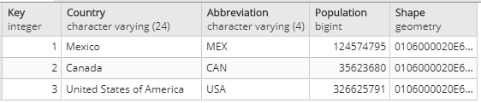
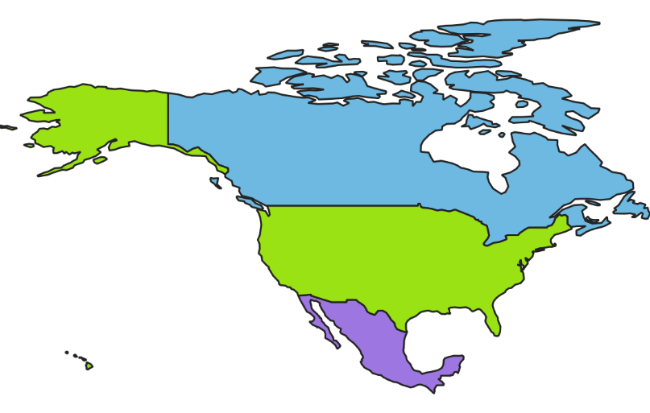
Spatial Datasets - Sets
Relational Datasets

Slide 6
Spatial Datasets - Relationships
Relational Datasets

Slide 7
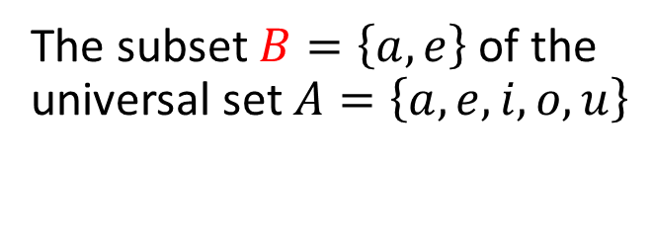

Sets
Relational Datasets
The subset $B=\left\{a,e\right\}$ of the universal set $A=\left\{a,e, i, o, u\right\}$
A
B
i
a
o
u
e
$$Country=\left\{Mexico, Canada, United States of America\right\}$$
$$Key= \left\{1, 2, 3\right\}$$

Slide 8
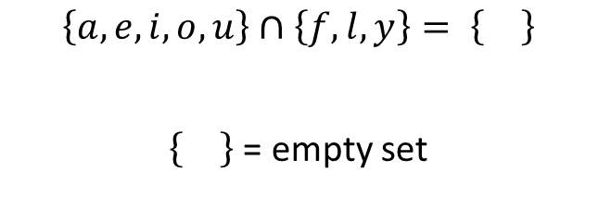
Set Intersection
Relational Datasets
$$\left\{a,e,i, o, u\right\}∩\left\{h,e, l,p,g,i,s\right\}= \left\{e,i\right\}$$
a
h
e
l
o
u
i
g
p
$$\left\{a,e,i, o, u\right\}∩\left\{f,l,y\right\}= \left\{\right\}$$
= empty set
a
l
e
o
f
u
i
y

Slide 9
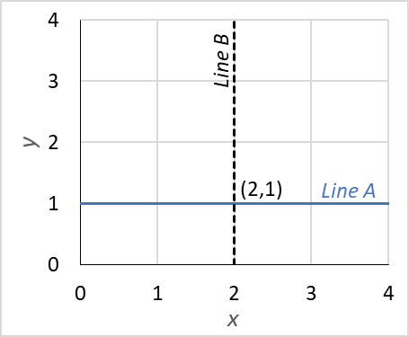
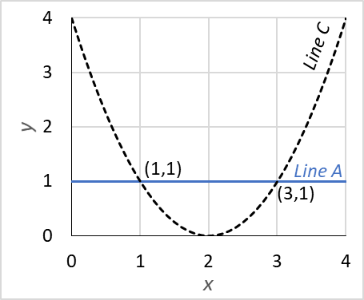
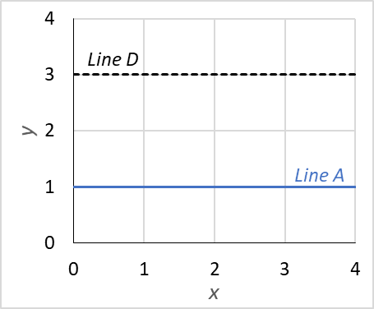
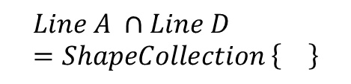
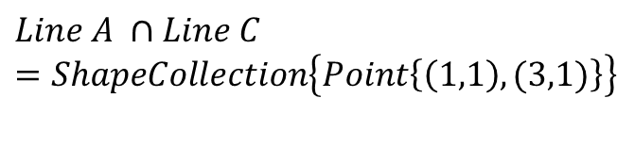
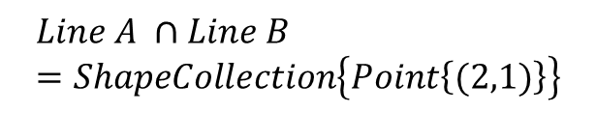
Empty shapes occur whenever the set operation or topology means that no geometry exists
$$Line A ∩Line B=ShapeCollection\left\{Point\left\{(2,1)\right\}\right\}$$
$$Line A ∩Line C=ShapeCollection\left\{Point\left\{\left(1,1\right),(3,1)\right\}\right\}$$
$$Line A ∩Line D=ShapeCollection \left\{\right\}$$
Relational Datasets

Slide 10

Many GIS datasets are constrained to a single shape column
You can’t show a spatial relationship in a single dataset without multiple shape columns!
Relational Datasets

Slide 11
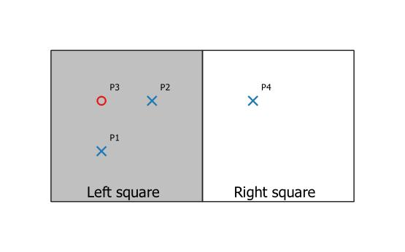

Empty shapes enable spatial relationships in a single dataset
$$Points ∩Squares$$
Relational Datasets

Slide 12
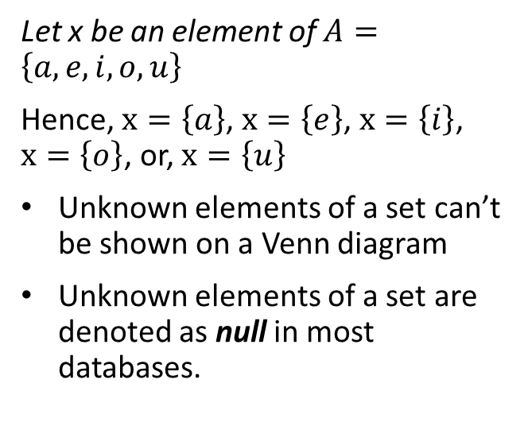
Set variables
Relational Datasets
Let x be an element of $A=\left\{a,e, i, o, u\right\}$
Hence, $x=\left\{a\right\}$, $x=\left\{e\right\}$, $x=\left\{i\right\}$, $x=\left\{o\right\}$, or, $x=\left\{u\right\}$
Unknown elements of a set can’t be shown on a Venn diagram
Unknown elements of a set are denoted as null in most databases.
A
i
a
o
u
e

Slide 13
null’s in datasets = unknown
Relational Datasets

Slide 14
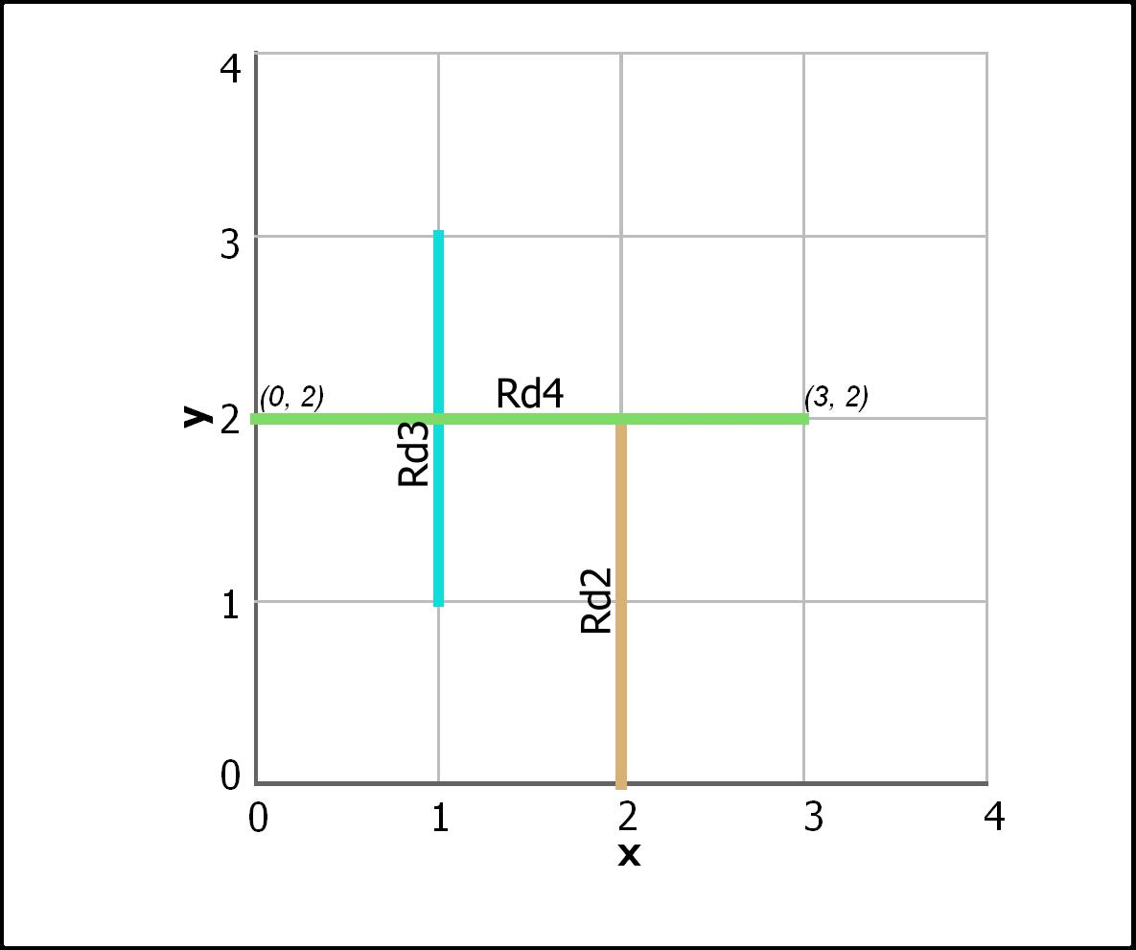
null’s are always about

Slide 15
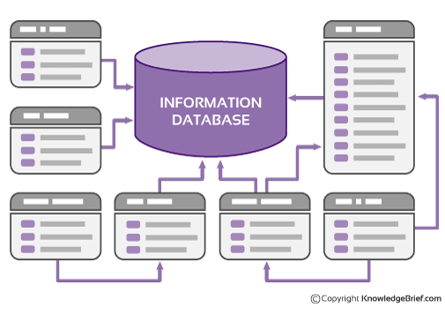

Database hold multiple datasets and can have multiple users
Image downloaded on July 20 2018 from: https://www.kbmanage.com/concept/information-database-idb

Slide 16
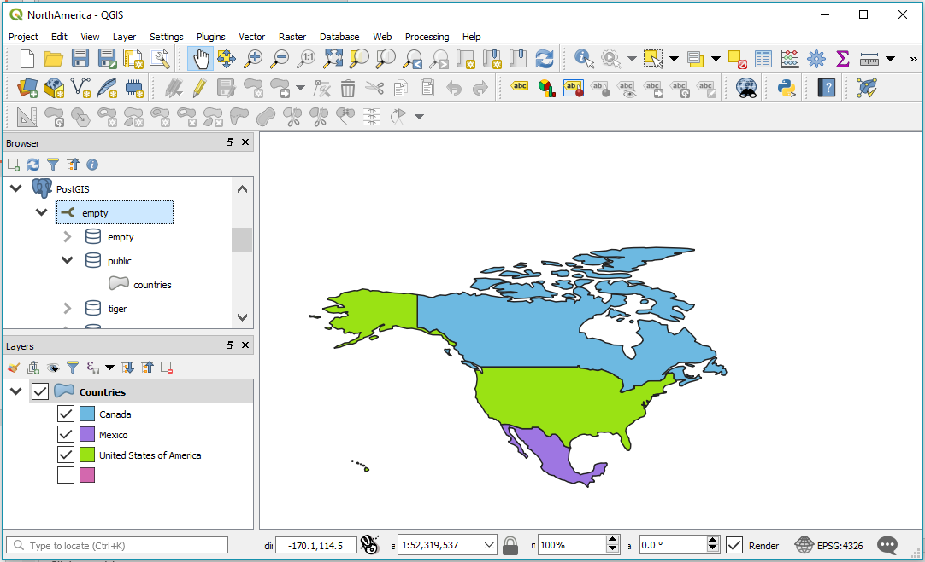
QGIS: a user interface for spatial datasets
QGIS

Slide 17




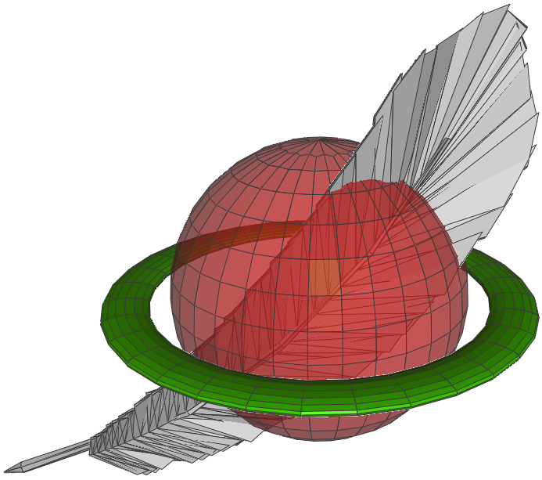
WITHOUT CONFIGURATION PARAMETERS, INDEXES OR CONSTRAINTS!!!!
QGIS
Notes:
QGIS is pretty cool in that it can pass data to and from different databases

Slide 18
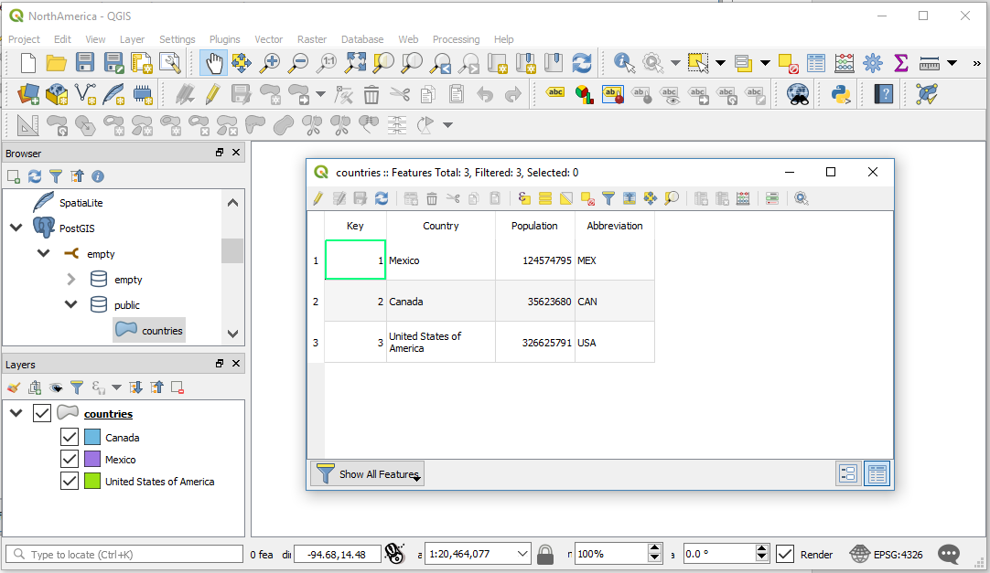
QGIS

Slide 19
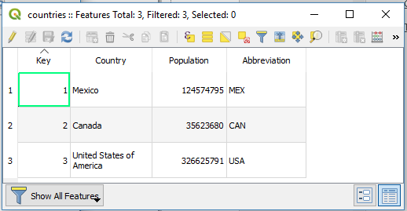
The attribute table in QGIS hides the Shape attribute!
QGIS
?

Slide 20
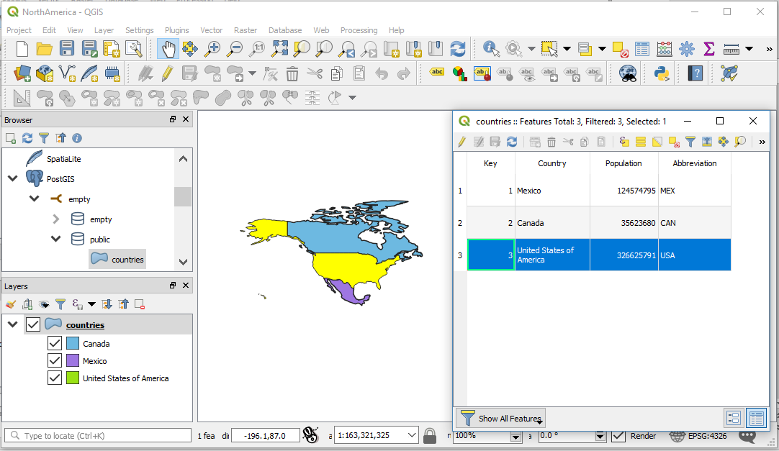
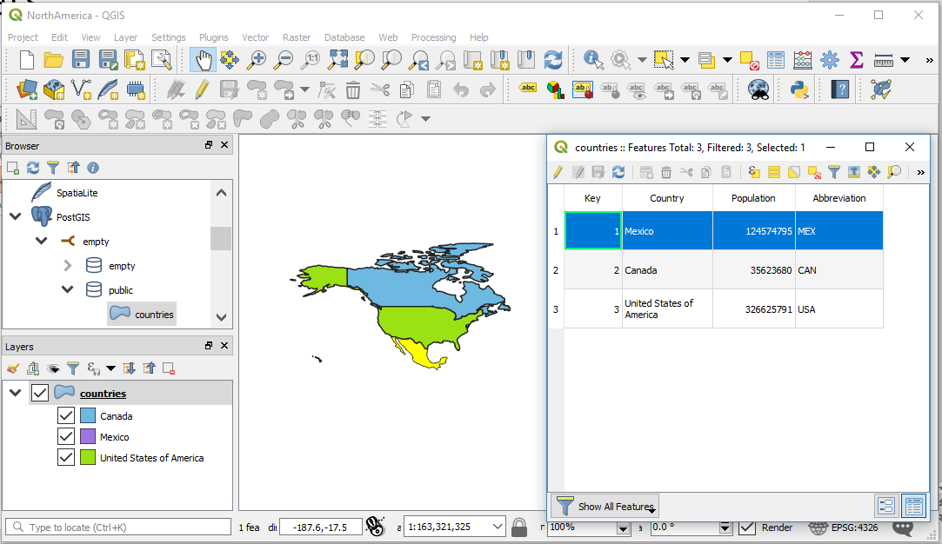
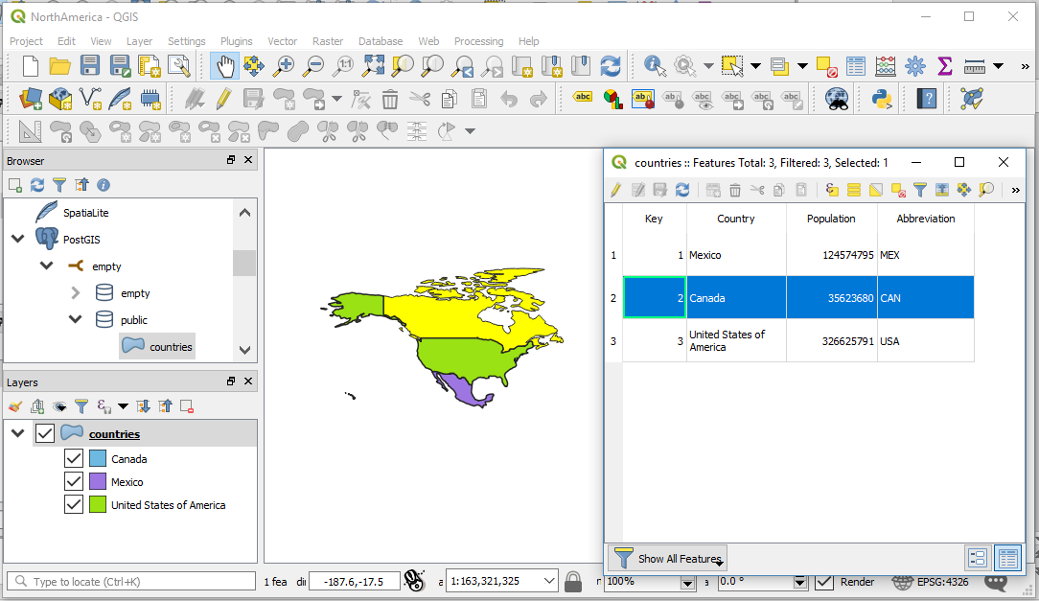

Slide 21
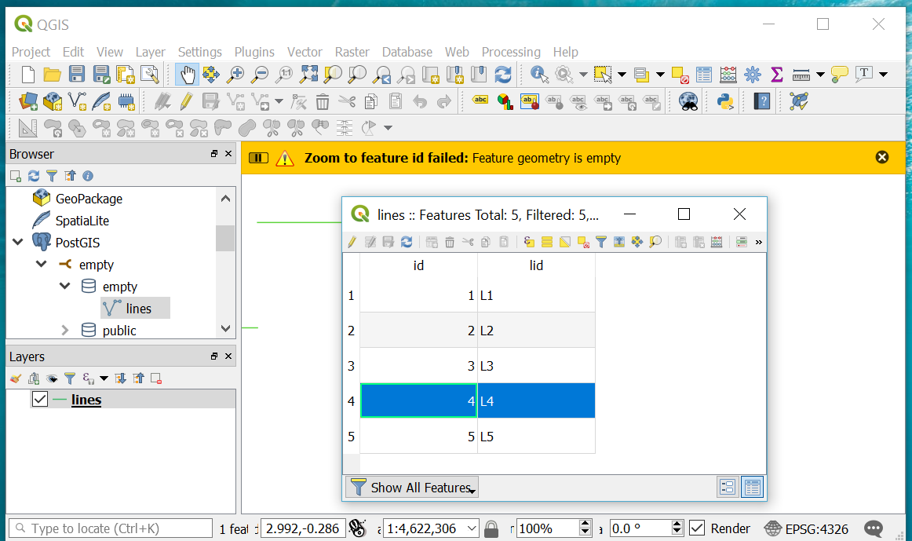
The Attribute Table Shows Records That Don’t Have a Shape!!
QGIS
Notes:
The attribute tables presentation in both QGIS and ArcMap make no attempt to describe the shape.

Slide 22
Identified Problems
Problems
Null and empty shapes are passed differently by different QGIS data providers
There isn’t a published QGIS plugin that highlights those records that have null or empty shapes
Many GIS professionals don’t anticipate or check for null or empty shapes
Empty shapes were excluded from the original QGIS and GDAL specifications
The QGIS attribute table hides the shape column/s.

Slide 23
Why would a GIS dataset contain null or empty shapes?

Slide 24
Proposed Attribute Table
Key | Name | Shape | Number of Points | Valid
1 | Blue Crosses |  | 3 | ✓
2 | Red Circles |  | 1 | ✓
3 | Green Stars | Empty | 0 | ✓
4 | Yellow Triangles | null | null | ✓
Contains regular attributes
Uses icons to represent number of features for multipart features.
Identifies Empty and null features
Performs rudimentary validation checks
Attributes depend on shape type (e.g. LineString, CircularString)
Includes summary table
Type | Empty or null | All Valid | Number of records | Number of parts | Dataprovider
MultiPoint | Yes | Yes | 4 | ≥4 | mssql
Progress

Slide 25
Professional Awareness
Problems
Null and empty shapes are treated as invalid by ESRI software
Many GIS users work in a constrained environment where null and empty values are prohibited

Slide 26
Progress
Progress
Create model line datasets in QGIS, Microsoft SQL Server and PostGIS
Inspect model datasets using script in the QGIS Python Console.
Learn how to make a QGIS plugin (Python v3.x)
Learn how to make tables and windows with PyQT5
Create and populate attribute table via plugin and PyQT5
Present at conference
Submit final report
✓
✓

Slide 27
Passing of empty and null well known text shapes to QGIS
Geometry | Postgis |  | Sql Server
 | Empty | null | Empty | null
Point | Invalid | null | Invalid | null
Line | Empty | null | null | null
Polygon | Empty | null | null | null
CurvePolygon | ? | ? | No | No
QGIS is unable to instantiate empty Point shapes
Progress

Slide 28

Free and Open Source Software for Geospatial (FOSS4G)
"Open Source for Sustainable Development“
December 2-5, 2018
Conference

