Slide 1
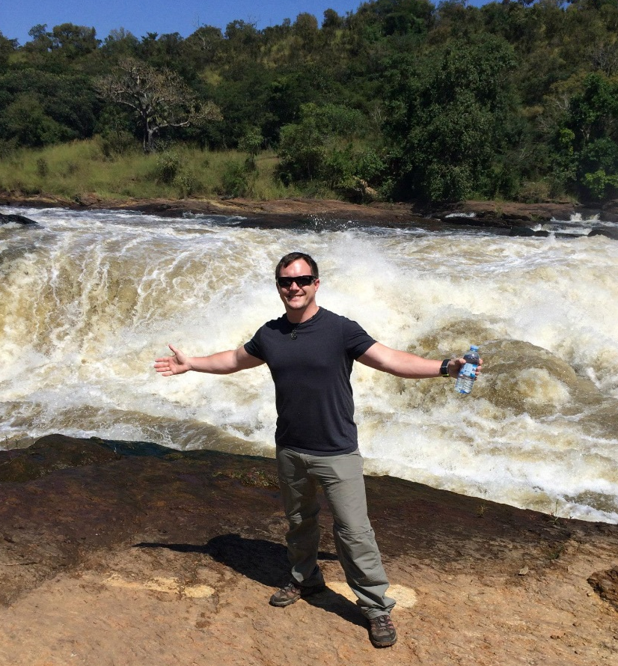
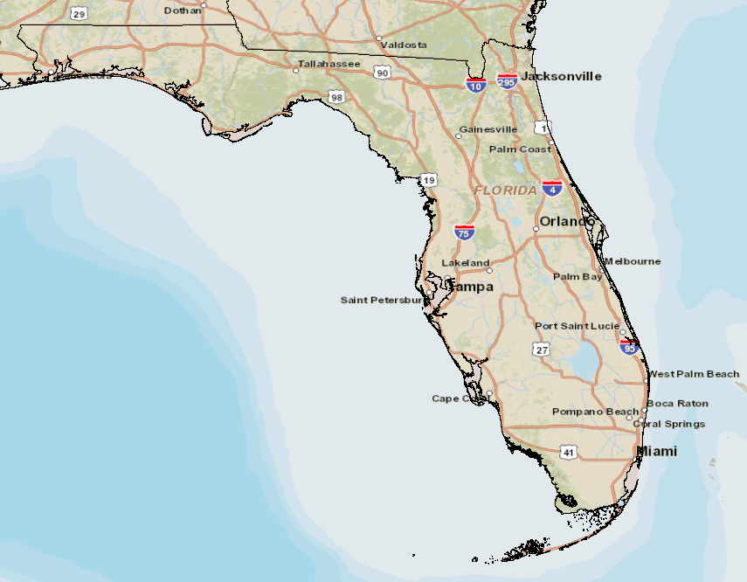
Enhancing Coastal Conservation Planning
Using LiDAR and Terrain Analysis
National Geographic Esri. DeLorme, NAVTEQ UNEP-WEMC, USGS, NASA, ESA, METI, NRCAN, GEBCO, NOAA, IPC
Matthew Wight
Pennsylvania State University
- Master of Geographic Information Systems
- GEOG 596A – Fall 2014
0
KILOMETERS
200
Notes:
NOTES:
Image Sources: Esri, HERE, DeLorme, USGS, Intermap, increment P Corp., NRCAN, Esri Japan, METI, Esri China (Hong Kong), Esri (Thailand), TomTom, MapmyIndia, © OpenStreetMap contributors, and the GIS User Community. Accessed via ESRI ArcMap 14 December 2014.
- This image is intended as reference only.

Slide 2
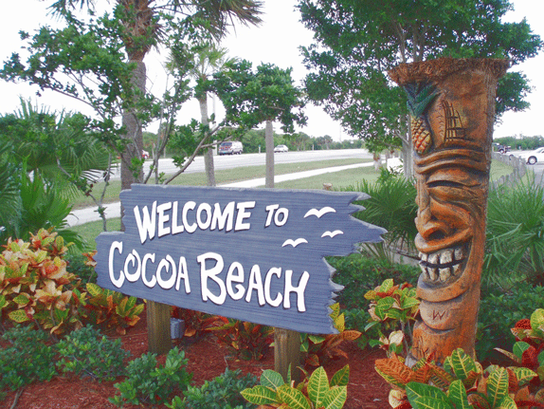
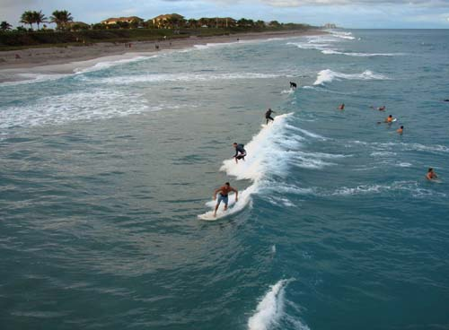
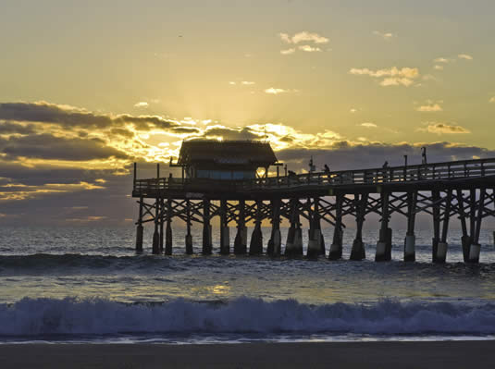
Table of Contents
The Problem
The Solution
Goals and Objectives
Methodology
Study Area
Land Use Classification
Landsat Spectral Classification
2CMV Change Detection
Elevation Analysis
Digital Elevation Models
3D LiDAR Change Detection
Project Timeline
Acknowledgements
Notes:
NOTES:
None

Slide 3
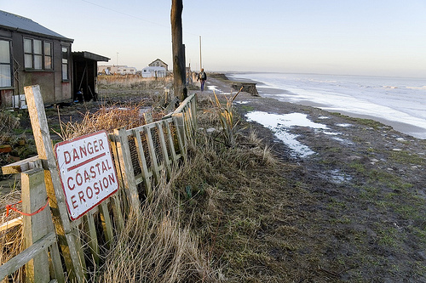
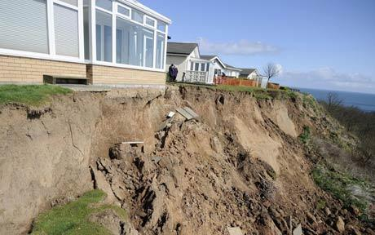
The Problem
Erosion is a major hazard to natural coastal environments
Study area is prone to hurricanes and tidal surges
Protected habitats and conservation areas can be irreversibly damaged by severe erosion
Erosion threatens stability of urban infrastructure
Cocoa Beach relies heavily on tourism. Damage to urban infrastructure could devastate local economy.
Coastal homes are prone to damage from erosion.
Coastal conservation planning requires accurate measurements
Manual surveying techniques can be costly and time consuming
Surveying was the only option in the past
Notes:
NOTES:
[1] http://www.csc.noaa.gov/crs/tcm/ldartdat/metatemplate/fdem2007_brevard_template.html. Accessed 08 July 2014.
The State of Florida is a peninsula in the southeastern corner of the United States that borders the Gulf of Mexico on the west and the Atlantic Ocean on the east. The coastal terrain is comprised of approximately 2,276 statute miles of tidal coastline and 663 miles of usable beaches. The extensive coastline, as well as the geographic position of Florida in relation to the Gulfstream currents of the Atlantic Ocean, contributes to an increased hazard of coastal flooding and erosion caused by severe weather, natural tidal movements, and human activity.
One area of the coast that is routinely vulnerable to flooding is the urban area between Jetty Park and the Cocoa Beach Pier located in Cocoa Beach, Florida. This popular tourist destination is located on the eastern shore of Florida at approximately MGRS 17RNM3895537998 and routinely suffers the annual hurricane season, which spans roughly from June 1st – November 30th. The combined impact of severe weather, natural tidal movements, and human activity in this area contributes to coastal erosion and impacts the accuracy of flood hazard assessments. Additionally, urban development within the area further alter the flood hazards present within the area.
A number of different revitalization efforts have been undertaken to preserve and rejuvenate the coastline of Florida to protect against flood hazards and harmful erosion. For example, the Florida Department of Environmental Protection (FDEP) partnered with the National Oceanic and Atmospheric Administration (NOAA) in 2007 in a combined effort to preserve beaches and waterfronts in Florida using federal grant money [1]. Efforts such as these, combined with areas of coastal urban development, often drastically change the physical dynamic and shape of the coastline and alter the vulnerability nodes along the coastline for flood hazard areas.
This assessment proposes to determine updated flood hazard nodes through comparative analysis of collected LiDAR, Landsat, and commercial imagery from 2004 and 2010. This process utilizes change detection of urban development and shoreline elevation to assess significant changes in flood hazard areas and vulnerable nodes. This gains further significance in regards to the impact of events such as Hurricane Ivan, which made landfall in the area in 2004.

Slide 4
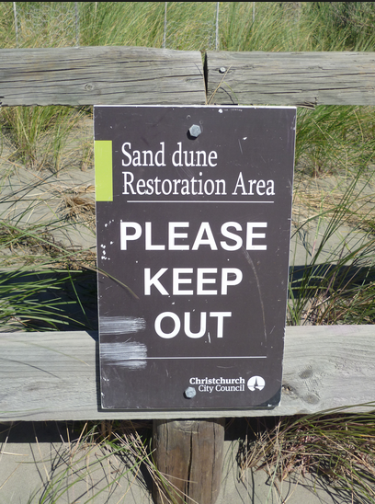
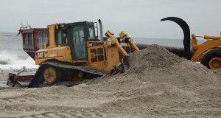
The Solution
Analyze and predict areas at high risk of erosion and coastal change
Apply analytical results to coastal plans and policies
Evaluate remotely sensed datasets to measure variables
Characterize land use changes from 2004 to 2010
Measure trends in erosion and coastal change from 2004 to 2010
Identify areas at high risk of damage from erosion
Increase efficiency of conservation planning
Enable predictive erosion analysis methodology
Develop targeted conservation plans
Reduce analytical and operating costs
Notes:
NOTES:

Slide 5
Goals and Objectives
Goal:
Develop a workflow that assesses coastal erosion by analyzing multiple remotely sensed datasets to improve efficiency and accuracy of coastal conservation projects.
Objectives:
1. Identify significant locations within study area (i.e., sea turtle nests, protected habitats, critical infrastructure, etc.).
2. Query GIS datasets from USGS EarthExplorer and NOAA Data Access Viewer from 2004 and 2010.
3. Use spatial analysis software to analyze GIS data to measure, visualize, and compare changes in topography and land use from 2004 and 2010.
4. Assess high risk areas of erosion and coastal change.
5. Apply findings and prioritize target areas within coastal conservation planning.
Notes:
NOTES:

Slide 6
Methodology
Query and download available Landsat, LiDAR, and commercial imagery from USGS Earth Explorer and NOAA Data Access Viewer.
Process and classify LiDAR data and construct bare earth Digital Elevation Models (DEM) to assess terrain using the LAS Dataset extension with ArcGIS.
Analyze elevation values and possible vulnerable flood hazard nodes along coastline with ArcGIS.
Conduct a change detection (2CMV) analysis of Landsat data to determine areas of significant coastal change utilizing ENVI 5.0.
Perform spectral classification of Landsat Natural View images to classify the scene for comparative analysis utilizing ENVI 5.0.
Cross reference the processed datasets to derive vulnerable water breach locations along dunes.
Notes:
NOTES:

Slide 7
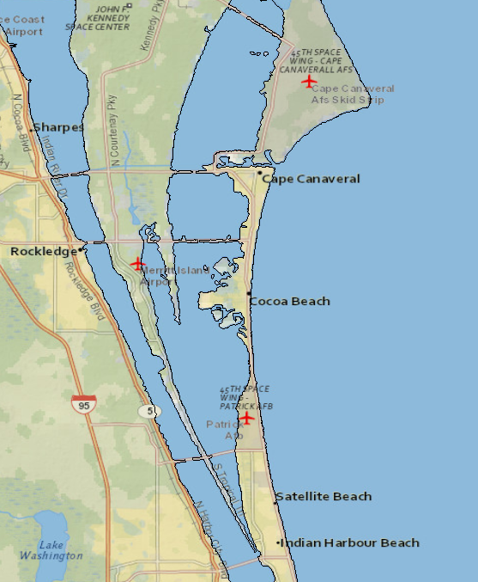
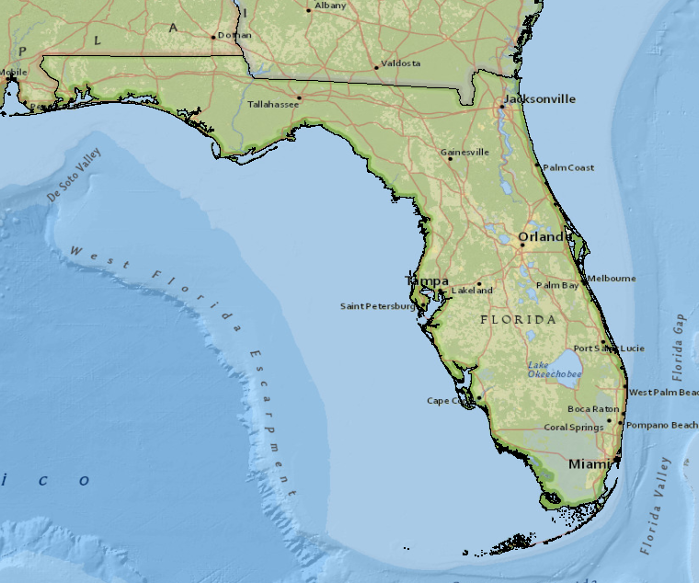
Study Area – Cocoa Beach, FL
TALLHASSEE
JACKSONVILLE
ORLANDO
TAMPA
COCOA BEACH
MIAMI
National Geographic Esri. DeLorme, NAVTEQ UNEP-WEMC, USGS, NASA, ESA, METI, NRCAN, GEBCO, NOAA, IPC
National Geographic Esri. DeLorme, NAVTEQ UNEP-WEMC, USGS, NASA, ESA, METI, NRCAN, GEBCO, NOAA, IPC
0
KILOMETERS
200
0
KILOMETERS
10
Notes:
NOTES:
National Geographic, Esri, DeLorme, HERE, UNEP-WCMC, USGS, NASA, ESA, METI, NRCAN, GEBCO, NOAA, increment P Corp.
- These images are intended as reference only.
Bordering the Gulf of Mexico on the west and the Atlantic Ocean on the east, the peninsula of Florida boasts the third largest coastline of any U.S. state. Florida has an assessed 2,276 statute miles of tidal coastline and 1,197 statue miles of terrestrial coastline according to the Florida Department of Environmental Protection [4].
The overall terrain of Florida is fairly level and low-lying with a maximum elevation of only 345 ft. (105 m) above sea level. The lowest elevation is at mean sea level. The highest points in the state are man made features such as buildings and communication towers.
The Cocoa Beach area of Florida (red box inset) is relatively flat (mean sea level). Coastal dunes comprise the only notable natural elevation changes. The shape and composition of the shoreline is in a constant state of change due to weather, tidal movements, and human activity.
Cocoa Beach is susceptible and prone to flooding and erosion due to the elevation being nearly sea level, proximity to major ocean currents, events such as seasonal storms and hurricanes, and natural tidal movements.

Slide 8
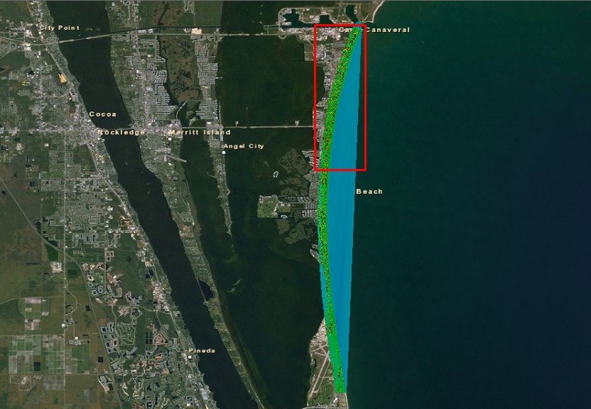
Study Area – North Reach Overview
JETTY PARK
CAPE
CANAVERAL
The analyzed area of interest, referred to as North Reach, focuses on the northern 5 miles of the collected data. The outlined area encompasses the Cocoa Beach Pier and Jetty Park (two of the more heavily traveled sections of the coastline) which are consistently monitored for flood hazards and erosion control.
COCOA BEACH PIER
LORI WILSON PARK
COCOA
BEACH
LiDAR
ELEVATION
170 ft.
PATRICK
AIR FORCE
BASE
-35 ft.
0
KILOMETERS
6.0
Notes:
NOTES:
Image Source: Background imagery accessed via ESRI ArcGIS Raster Imagery, iCubed eSAT Satellite, Date of Imagery 19990115, Resolution 15m, Accuracy 50m. Accessed 15 November 2014.
- This image is intended as reference only.
- The ArcGIS Online services in this group layer present satellite imagery and aerial imagery for the world. The map includes NASA Blue Marble: Next Generation 500m resolution imagery at small scales (above 1:1,000,000), i-cubed 15m eSAT imagery at medium-to-large scales (down to 1:70,000) for the world, and USGS 15m Landsat imagery for Antarctica. The map also includes i-cubed Nationwide Prime 1m or better resolution imagery for the contiguous United States, Getmapping 1m resolution imagery for Great Britain, and GeoEye IKONOS 1m resolution imagery for Hawaii, parts of Alaska, and several hundred metropolitan areas around the world. i-cubed Nationwide Prime is a seamless, color mosaic of various commercial and government imagery sources, including Aerials Express 0.3 to 0.6m resolution imagery for metropolitan areas and the best available United States Department of Agriculture (USDA) National Agriculture Imagery Program (NAIP) imagery and enhanced versions of United States Geological Survey (USGS) Digital Ortho Quarter Quad (DOQQ) imagery for other areas.

Slide 9
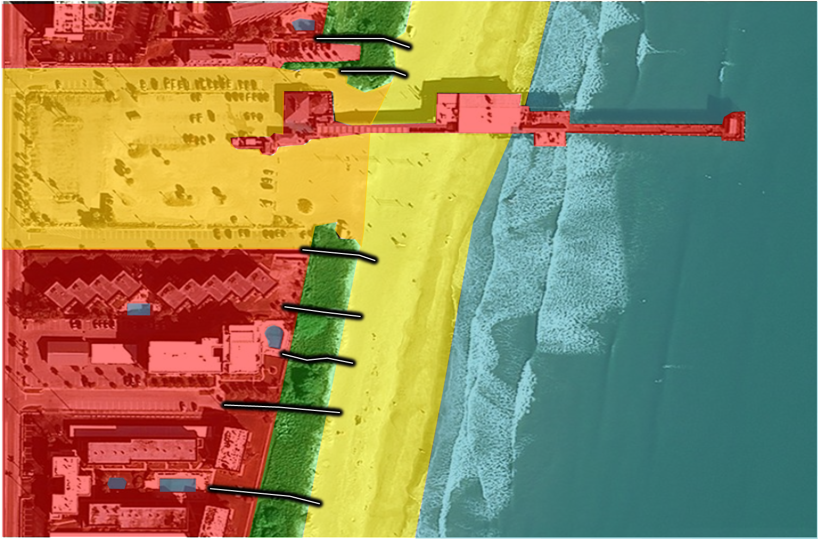
Land Use Classification - Example
Terrain along the Cocoa Beach region of Florida is relatively flat with gently sloping dunes, and vegetation present along the edge of coastal dunes.
LEGEND
BEACH ACCESS
VEGETATION / DUNES
WATER
TIDAL SHORELINE
BARE EARTH
URBAN BUILDUP
0
METERS
80
Notes:
NOTES:
Image Source: ESRI World Imagery WMS Server; Aerials Express Commercial Imagery, 0.5 m resolution, DOI: 20090115
(Esri, i-cubed, USDA, USGS, AEX, GeoEye, Getmapping, Aerogrid, IGN, IGP, and the GIS User Community). Accessed 12 December 2014.
- This image is intended as reference only.

Slide 10
Land Use Classification
2004 – LANDSAT Data
Date of Collect: 06 June 2004
Provider: USGS Earth Explorer
Projection: UTM Zone 17N
Datum: WGS-84
Resolution: 15 Meters
Resampling: Cubic Convolution
USGS LANDSAT
Verify whether land use be classified accurately with Landsat data for the scale of this study
Achieved through spectral classification processes
Classification produces 15 meter resolution results
Accuracy assessed by comparing against commercial imagery
Data Source: USGS EarthExplorer [3].
2010 – LANDSAT Data
Date of Collect: 09 July 2010
Provider: USGS Earth Explorer
Projection: UTM Zone 17N
Datum: WGS-84
Resolution: 15 Meters
Resampling: Cubic Convolution
Notes:
NOTES:
[2] Data Source: http://csc.noaa.gov/dataviewer/#. Accessed 15 November 2014.
[3] Data Source: http://earthexplorer.usgs.gov/. Accessed 15 November 2014.

Slide 11
USGS Landsat – Spectral Classification - 2004 vs. 2010
2004 - UNSUPERVISED K-MEANS CLASSIFICATION
20 Classes
20 Iterations
9 Bands
5% Change Threshold
LEGEND
VEGETATION
WATER
BARE EARTH
URBAN BUILDUP
2010 - UNSUPERVISED K-MEANS CLASSIFICATION
20 Classes
20 Iterations
9 Bands
5% Change Threshold
LEGEND
VEGETATION
WATER
URBAN BUILDUP
BARE EARTH
Notes:
NOTES:

Slide 12
USGS Landsat - 2CMV Change Detection, 2004 to 2010
Two Color Multi-View (2CMV) analysis identifies physical changes between two timeframes (represented by a red-blue color differential) to indicate where physical changes to a location occurred over time.
The 2CMV process quickly creates a visually simplistic representation that can be useful in assessing land use or change. I will verify the accuracy of change detection results by comparing against commercial imagery.
SHORELINE ELEVATION CHANGE
CHANGE
NO CHANGE
0
KILOMETERS
1.4
Notes:
NOTES:

Slide 13
Elevation Analysis
2004 – LiDAR Data
Date of Collect: 06 June 2004
Provider: USACE JALBTCX Program
Projection: NAD83 / Florida East (US Survey Foot)
Mean: 12.9538
Std Dev: 13.3380
Vertical Accuracy: 15 cm
Horiz.Accuracy: 80cm
LiDAR
Identify critical areas of erosion by measuring elevation changes
Digital Elevation Models
3D Change Detection Models
Classification produces 75-80 centimeter resolution results
Data Source: National Oceanic and Atmospheric Administration (NOAA) Coastal Services Center (CSC) data viewer [2].
2010 – LiDAR Data
Date of Collect: 09 July 2010
Provider: USACE JALBTCX Program
Projection: NAD83 / Florida East (US Survey Foot)
Mean: 12.8122
Std Dev: 13.1643
Vertical Accuracy: 15 cm
Horiz.Accuracy: 75cm
Notes:
NOTES:
[2] Data Source: http://csc.noaa.gov/dataviewer/#. Accessed 29 November 2014.
[3] Data Source: http://earthexplorer.usgs.gov/. Accessed 29 November 2014.
Collected by the United States Army Corps of Engineers National Coastal Mapping Project through the Joint Airborne LiDAR Bathymetry Technical Center of Expertise (JALBTCX) using the Compact Hydrographic Airborne Rapid Total Survey (CHARTS) system. Data from 2004 was collected prior to Hurricane Ivan (02Sep04).

Slide 14
Digital Elevation Model, Bare Earth Terrain – 2004
- Possible Flood Breach Nodes
The majority of the yellow to red shaded area along the coastline corresponds to coastal dunes of higher elevation than the adjacent shoreline.
I identified six vulnerable water breach nodes based on elevation changes and gaps in the dunes using LiDAR measurements collected in 2004. These would likely be the first locations for water breaches in the event of a tidal surge.
1
2
3
4
5
6
ELEVATION
45 ft.
-40 ft.
0
KILOMETERS
1.4
Notes:
NOTES:
The displayed overview and inset depict the northern portion of the area of interest as a Bare Earth DEM. This was produced within ArcGIS using the LP360 extension, with LiDAR data filtered by year, displayed by elevation, restricted to bare earth classification (Classes 2 and 8), and then generated as a Triangulated Irregular Network (TIN) view. The resulting display distinctly highlights the dunes that parallel the shoreline, as well as the areas where the surface elevation begins to slope downward underwater towards the continental shelf.
Image Source: Background imagery accessed via ESRI ArcGIS Raster Imagery, iCubed eSAT Satellite, Date of Imagery 19990115, Resolution 15m, Accuracy 50m. Accessed 15 November 2014.
- The ArcGIS Online services in this group layer present satellite imagery and aerial imagery for the world. The map includes NASA Blue Marble: Next Generation 500m resolution imagery at small scales (above 1:1,000,000), i-cubed 15m eSAT imagery at medium-to-large scales (down to 1:70,000) for the world, and USGS 15m Landsat imagery for Antarctica. The map also includes i-cubed Nationwide Prime 1m or better resolution imagery for the contiguous United States, Getmapping 1m resolution imagery for Great Britain, and GeoEye IKONOS 1m resolution imagery for Hawaii, parts of Alaska, and several hundred metropolitan areas around the world. i-cubed Nationwide Prime is a seamless, color mosaic of various commercial and government imagery sources, including Aerials Express 0.3 to 0.6m resolution imagery for metropolitan areas and the best available United States Department of Agriculture (USDA) National Agriculture Imagery Program (NAIP) imagery and enhanced versions of United States Geological Survey (USGS) Digital Ortho Quarter Quad (DOQQ) imagery for other areas.

Slide 15
Digital Elevation Model, Bare Earth Terrain – 2010
- Possible Flood Breach Nodes
The majority of the yellow to red shaded area along the coastline corresponds to coastal dunes of higher elevation than the adjacent shoreline.
I identified eight vulnerable water breach nodes based on elevation changes and gaps in the dunes using LiDAR measurements collected in 2010. These would likely be the first locations for water breaches in the event of a tidal surge.
1
2
3
4
5
6
7
8
ELEVATION
45 ft.
-40 ft.
0
KILOMETERS
1.4
Notes:
NOTES:
The displayed overview and inset depict the northern portion of the area of interest as a Bare Earth DEM. This was produced within ArcGIS using the LP360 extension, with LiDAR data filtered by year, displayed by elevation, restricted to bare earth classification (Classes 2 and 8), and then generated as a Triangulated Irregular Network (TIN) view. The resulting display distinctly highlights the dunes that parallel the shoreline, as well as the areas where the surface elevation begins to slope downward underwater towards the continental shelf.
Image Source: Background imagery accessed via ESRI ArcGIS Raster Imagery, iCubed eSAT Satellite, Date of Imagery 19990115, Resolution 15m, Accuracy 50m. Accessed 15 November 2014.
- The ArcGIS Online services in this group layer present satellite imagery and aerial imagery for the world. The map includes NASA Blue Marble: Next Generation 500m resolution imagery at small scales (above 1:1,000,000), i-cubed 15m eSAT imagery at medium-to-large scales (down to 1:70,000) for the world, and USGS 15m Landsat imagery for Antarctica. The map also includes i-cubed Nationwide Prime 1m or better resolution imagery for the contiguous United States, Getmapping 1m resolution imagery for Great Britain, and GeoEye IKONOS 1m resolution imagery for Hawaii, parts of Alaska, and several hundred metropolitan areas around the world. i-cubed Nationwide Prime is a seamless, color mosaic of various commercial and government imagery sources, including Aerials Express 0.3 to 0.6m resolution imagery for metropolitan areas and the best available United States Department of Agriculture (USDA) National Agriculture Imagery Program (NAIP) imagery and enhanced versions of United States Geological Survey (USGS) Digital Ortho Quarter Quad (DOQQ) imagery for other areas.

Slide 16
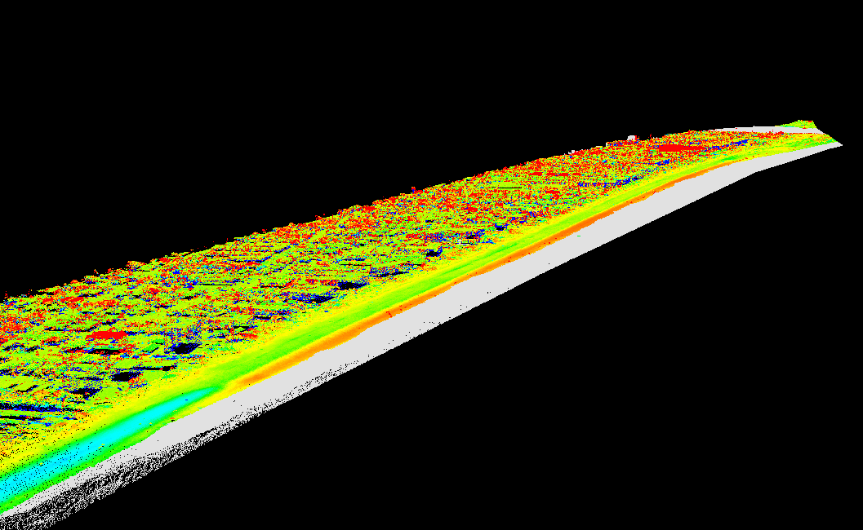
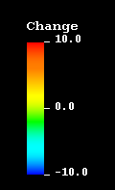
Elevation Change Detection – North Reach, Area 1
2004 to 2010, LiDAR
The northern coastline evidenced a rise in elevation compared to 2004 data. This change is likely due to factors including the northern circulating current depositing sand and sediment and storms that alter the contours of the shoreline.
Elevation values suggest that sand and sediment are being deposited in this area at a faster rate than it is being eroded. This is likely due to the slight NNE curvature of the coastline that collects sand deposits from north moving tidal currents.
JETTY
PARK
2,650 ft.
(ft.)
Notes:
NOTES:
- The displayed change detection was generated within Quick Terrain Modeler by comparing 2010 LiDAR data against the 2004 comparison model. The display was set to Continuous Color with Min and Max values of -10 and 10 feet respectively. Turning off the 2010 elevation coloring (earth colors) further highlighted the specific areas of coastline that experienced the most drastic changes in elevation. The original intent was to export the file into a GEOTiff format in order to overlay onto ArcGIS Raster Imagery. Due to processing errors, the generated change detection was unable to be exported from QTM. Due to this difficulty, subsequent screenshots display only a black background with no image. This had the unintended effect of being able to distinguish color differences in greater detail.

Slide 17
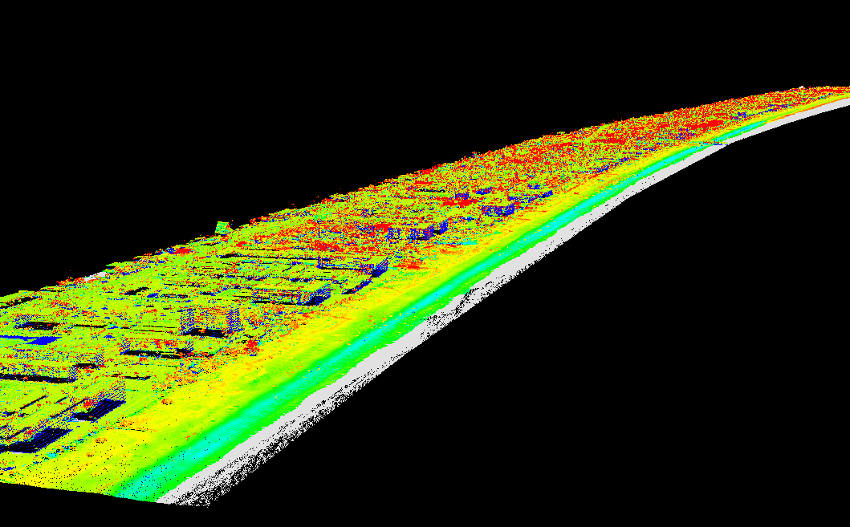
Elevation Change Detection – North Reach, Area 2
2004 to 2010, LiDAR
The southern area of North Reach evidenced a drop in elevation in comparison to 2004 data. This is likely due to the northern current and riptide that constantly erodes sand at a slightly faster rate than it is deposited. Eddy currents and seasonal storm surges can also create sharp changes in elevation depending on tidal conditions.
14,400 ft.
(ft.)
Notes:
NOTES:
- The displayed change detection was generated within Quick Terrain Modeler by comparing 2010 LiDAR data against the 2004 comparison model. The display was set to Continuous Color with Min and Max values of -10 and 10 feet respectively. Turning off the 2010 elevation coloring (earth colors) further highlighted the specific areas of coastline that experienced the most drastic changes in elevation. The original intent was to export the file into a GEOTiff format in order to overlay onto ArcGIS Raster Imagery. Due to processing errors, the generated change detection was unable to be exported from QTM. Due to this difficulty, subsequent screenshots display only a black background with no image. This had the unintended effect of being able to distinguish color differences in greater detail.

Slide 18
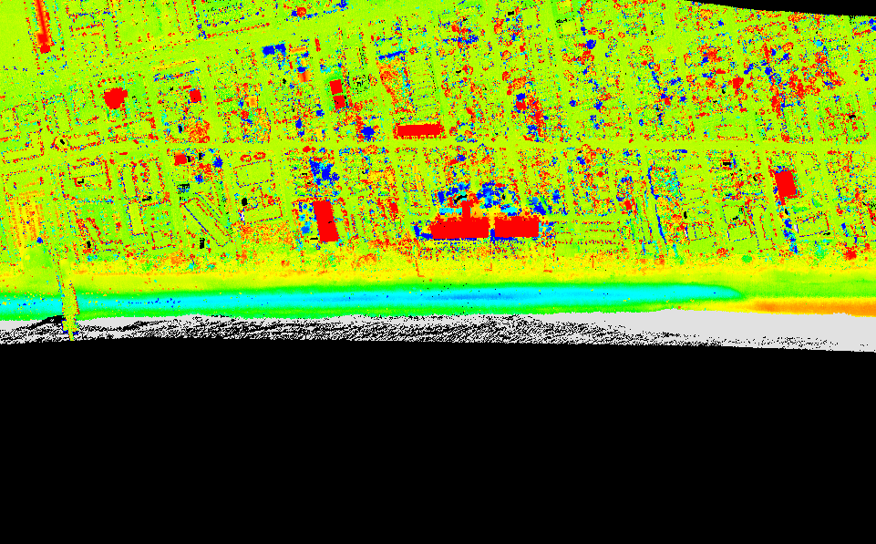
Elevation Change Detection – Significant Areas
2004 to 2010, LiDAR
AREA 1 – This area depicts significant decrease in shore elevation at an average of 8 feet, separated from Area 2 by an elevated sandbar section.
AREA 2 – This area depicts significant decrease in elevation at an average of 10 feet.
AREA 3 – This area highlights the terrain transition where the shore elevation begins to rise significantly. Since 2004 this section rose an average of 7.8 feet.
1
2
3
PIER
(ft.)
Notes:
NOTES:
- The annotated areas of interest are based upon visual and numerical analysis of change detection results. The pier is displayed as a point of reference. Though the majority of the southern coastline of the analyzed area exhibited a decrease in elevation, Areas 1 and 2 highlight two of the more significant areas of elevation decrease that may indicate a need to focus conservation efforts within the respective locations. Area 3 highlights the transition in height of the terrain where the shore elevation begins to rise significantly.

Slide 19
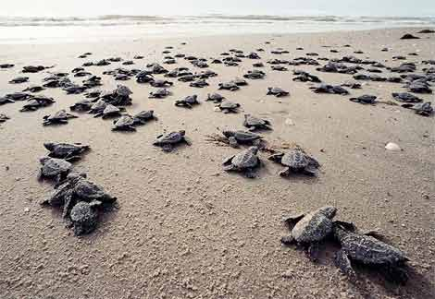
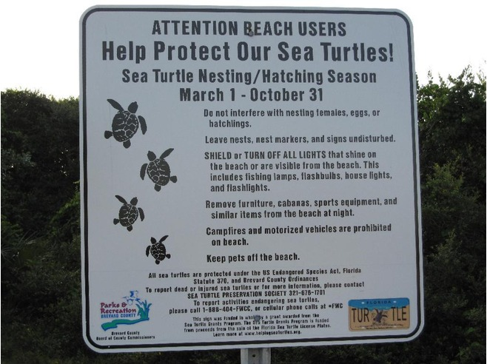
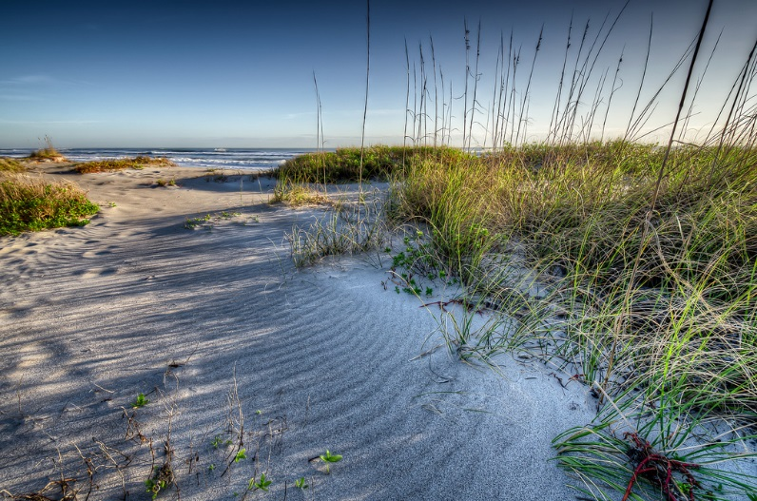
Project Timeline
Take GEOG 487 – Environmental Applications of GIS in Spring 1 term
Take GEOG 596B in Spring 2 Term
Expand analysis and update layers for complete data set
January – March 2015
Conduct additional literature review of similar projects and studies
January – March 2015
Investigate and contact possible journal or organization for publication
February 2015
Brevard County Natural Resources Management Department
The Conservation Planning Institute
Coastal Conservation Association
Refine paper to meet journal standards
March 2015 – May 2015
Submit article
May 2015

Slide 20
Acknowledgements
MGIS peers and professors
Joseph Bishop
Anthony Robinson
Coastal Conservation Organizations
Brevard County Natural Resources Management Department
Friends and family
Questions?

