Slide 1
Leveraging GIS to Enhance the Study of Rights-of-Way Ecology
In Conjunction With:
The Pennsylvania State Game Lands 33 (SGL33) Research Project
Grant Wills - The Pennsylvania State University
Advisor: Dr. Carolyn Mahan

Slide 2
Presentation Overview
Pennsylvania State Game Lands 33 (SGL33) Rights-of-Way Study
Origin and Development of the Study
Current Efforts of the Study
Identifying the Need for GIS Support
Identifying Deficiencies With Current GIS
Identifying Areas That GIS Can Assist
Plan for Development of GIS Products
Identification and Description of GIS Support Areas
GIS Products to be Developed and Delivered
Summary and Conclusion

Slide 3
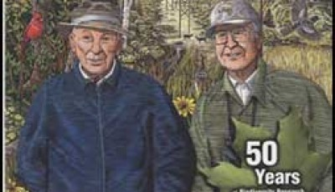
SGL33 ROW Study: History
The study formed in 1952 and began conducting research in 1953 with a focus on Vegetation. In 1987 the study increased its scope to include Wildlife research¹.
The study began with efforts from several parties, to include: The State Game Commission, DuPont, Penelec, and Penn State University¹.
The driving figure behind the development of the study was Penn State’s Forestry Professor: William Bramble and his (at the time), research assistant: W.R. Byrnes¹.
Dr. William C. Bramble (left), Dr. William R. Byrnes (right)¹

Slide 4
SGL33 ROW Study: Site Description
The original Study area was a 3.5 mile section of ROW within State Game Land 33, of Centre County Pennsylvania, that was divided into 6 Treatment (Tx) Zones¹.
In 1982 the study site adopted and applied the Wire Zone-Border Zone vegetation management approach¹.
Vegetation Management Approach Graphical Cross-section.¹

Slide 5
SGL33 ROW Study: Goals (Then & Now)
Compare the effectiveness of commonly used vegetation management practices on controlling trees incompatible with management objectives for right-of-way function;¹
Developing tree-resistant plant cover types; ¹
Determine the effect of vegetation management practices on wildlife habitat and select wildlife species of high public interest. ¹

Slide 6
SGL33 ROW Study: Current Efforts
In 2015 the researchers began looking at the effects the different vegetation management treatments have on Birds, Vegetation, and Hymenopteran (bees, wasps).¹
In 2016, for the first time in the study’s 60+ years¹, the study site boundary information was entered into a GIS².
With the incorporation of GIS in 2016, a new door of data analysis has opened. Data collected in 2016 for: Birds, Vegetation, and Hymenopteran can now be spatially assessed².

Slide 7
SGL33 ROW Study: The Need For GIS
Prior to the efforts of this report there has not been an active use of GIS during any SGL33 ROW study. Without the aid of GIS the study has 2 basic deficiencies, these deficiencies are my primary focus:
Researchers cannot adequately assess/account for, spatial factors within their data.
Communication/dissemination of their results lack graphic impact for their audience.

Slide 8
SGL33 ROW Study: Highlighting the Deficiencies
The following series of slides will highlight the identified deficiencies by first providing a written description of some data concerning the location of the SGL33 study site. Followed by a graphical, and in this case spatial representation of the data.

Slide 9
SGL33 ROW Study: The Need For GIS cont...
Example 1: Understanding Location
The following quote is found in various resources associated with the SGL33 ROW Study. It is the primary description of the study site that any reader would receive.
“The Pennsylvania State Game Lands 33 (SGL33) research project in central Pennsylvania...¹”
1. Duncan, Celestine. (2014). Biodiversity Research, Plant and Animal Community Response to Long-Term Vegetation Management Practices On Rights-of-Way. Helena, MT.

Slide 11
SGL33 ROW Study: The Need For GIS cont...
Example 2: Adding Context Enriches Meaning
To continue with the quote from the last example. Given the stimulus behind the selection of this study site, partnering it with a related map provides impact to the audience.
“...began in 1953 in response to public concern—particularly from hunters—about the impact of vegetation management practices on wildlife habitat within electric transmission rights-of-way.¹”
1. Duncan, Celestine. (2014). Biodiversity Research, Plant and Animal Community Response to Long-Term Vegetation Management Practices On Rights-of-Way. Helena, MT.

Slide 13
SGL33 ROW Study: The Need For GIS cont...
Example 3: Rapid Spatial Expression of Data
Most research studies are saturated with complex, and or redundant data. This can limit the researchers ability or willingness to communicate information that could assist in the understanding of a study and or its results.
For example: Although it is stated that the SGL33 study site is 3.5 miles long, and consists of various zones based on 6 different treatment types. At no point is the location of each zone described, furthermore at no point are any spatial influences assessed, i.e. topography, slope, or aspect.

Slide 15
SGL33 ROW Study: Plan for GIS Support
In order to alleviate the identified current GIS deficiencies, as well as establish a solid foundation for future GIS work, I plan on providing the following support. My plans for support fall into 3 categories:
Data Management.
Data Processing.
Data Dissemination.

Slide 16
-Data Management
SGL33 ROW Study: Plan for GIS Support cont...
Being that this is the first implementation of GIS for the SGL33 ROW Study, requires that a flexible GIS data management plan be established. The following items will control how the GIS data are managed:
Data will be stored in an ESRI File Geodatabase (FGDB), broken into related feature datasets. – Ease of reference
A separate and dedicated ‘working’ FGDB will be maintained for all data processing. – Data security
Data will be maintained as to not limit the temporal expansion or isolation of data. – Temporal analysis
Supporting documentation of data standardization methods and terminology, as well as individual metadata will be created. – Data standardization and security

Slide 17
-Data Processing
SGL33 ROW Study: Plan for GIS Support cont...
Large amounts of tabular data are collected in support of SGL33 ROW studies, which makes drawing actionable information from the data a challenge. By leveraging ESRI’s ArcPy module I will write Python scripts to do the following:
Convert tabular data into actionable feature class data, that obeys all data standardization determined in the data management plan.
Design add-in ArcGIS application(s) that will allow for the future assessment of Species: Diversity, Richness, and evenness
Design add-in ArcGIS application to summarize species location by environmental condition. i.e. number of X-species per soil type.

Slide 18
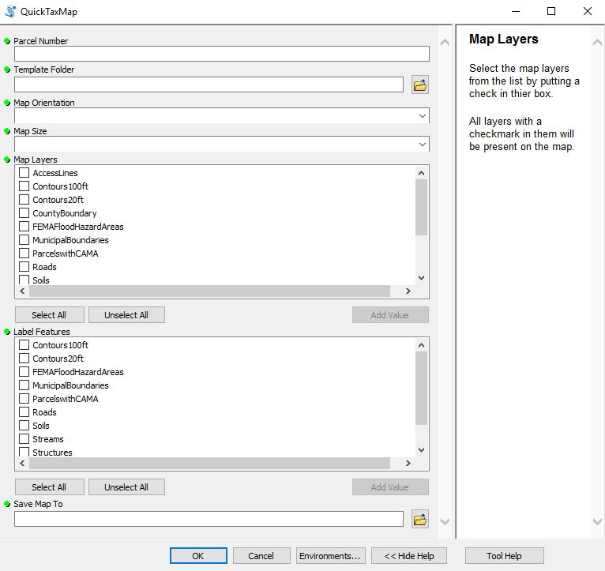
-Data Dissemination
SGL33 ROW Study: Plan for GIS Support cont...
Just as it is important for a farmer to get their product to market, researchers need to get their results to their audience. The following items summarize my plan for delivering those goods:
By direction of the researchers, various static maps will be created for their immediate use as research aids and status updates for investors and the public.
Using Python script writing, I intend on creating an add-in ArcGIS application that will allow members of the research team, that are not as fluent in GIS to generate maps on a standardized template.
Example Map Maker Interface

Slide 19
SGL33 ROW Study: Summary of Deliverables
Data Management
Documentation describing data standardization
Minimum of 2 File Geodatabases (FGDB).
1 - ‘working’ or ‘scratch’ FGDB
1+ - FGDB for finalized data storage
Data Processing
Add-in ArcGIS application(s) to convert tabular field data into standardized GIS data
Add-in ArcGIS application(s) to conduct spatial analysis
Data Dissemination
Static Maps for current research project update
Add-in ArcGIS application to allow for the quick map creation

Slide 20
SGL33 ROW Study: Factors for GIS Support
Being that this project is the inaugural GIS project for the SGL33 ROW Study site, there is a long list of things to accomplish. To deliver on my plans the following items need special attention:
Scope Creep – this will be a constant struggle
Data Management – a solid foundation here stabilizes all other components
Simple & Flexible Application Design – usability is key, but is not always understood by the developer
Help Documentation – critical component as product support is unlikely to continue, the end user should be able to maintain and repair any product.

Slide 21
SGL33 ROW Study: Project Completion Plan
Project completion must be no later than May of 2018.
Tentative plan for final presentation is during the 2018 PA State GIS Conference typically held during the month of May in State College Pennsylvania.

Slide 22
Presentation Overview
Pennsylvania State Game Lands 33 (SGL33) Rights-of-Way Study
Origin and Development of the Study
Current Efforts of the Study
Identifying the Need for GIS Support
Identifying Deficiencies With Current GIS
Identifying Areas That GIS Can Assist
Plan for Development of GIS Products
Identification and Description of GIS Support Areas
GIS Products to be Developed and Delivered
Summary and Conclusion

Slide 23
Questions?
Grant Wills - The Pennsylvania State University

