Slide 1
Retrofitting GIS to Enhance A Longstanding/Non-GIS Study
In Association With:
Utility Rights-of-Way Wildlife Research at Penn State
Grant Wills - The Pennsylvania State University

Slide 2
Presentation Overview: 3-Step Process
Background - customer’s needs and their desired outcome
Learn The History & The Current Efforts
Become Familiar With Existing Data
Data - Retrofitting existing data into a gis
Data Processing
Data Management
GIS Products - Information dissemination
Products That Meet Current Objectives
Products That Promote Future Actions
Summary and Conclusion
1.
2.
3.

Slide 3
Who
Case Study Synopsis:
Utility Rights-of-Way Wildlife Research at Penn State
Research is currently being lead by Penn State faculty member Dr. Carolyn Mahan.
What
The research is focused on understanding how different vegetation management techniques affect the ecology of utility rights-of-way (ROW).
Where
There are two different study sites, the Pennsylvania State Game Lands 33 site (SGL33) located in Centre County, and the Green Lane Research and Demonstration area (GLR&D) located in southeastern Pennsylvania.
When
Research has been ongoing at the SGL33 site since 1953, however the current round of study has been underway since 2015.
Why
To maximize the ecological benefits ROW offer, and reduce vegetation management costs of the ROW.

Slide 4
Purpose
Background: Subject matter
Why bother
To understand your client’s needs.
To prevent duplication of effort.
To understand the data so that it can be coherently communicated to the target audience.
To establish accepted key resources.
When entering a project long after it was devised and implemented, understanding how GIS can be retrofitted relies on your understanding of the project.
Background is the most important step in the process because it is foundational information. Any misconception in the projects history could propagate as actions are taken that build off of the misconceived information.
Understanding is not empirical so there is no guarantee of direct feedback. Often, being slightly off mark is not noticed until product delivery.
Image: iStock/Bogdanhoda

Slide 5
Example
Background: Practical Example
Result
Conducted a literature review on other similar Rights-of-way (ROW) ecological studies. (win)
During initial phases of the project I accepted name values provided to me for treatment zones at face value, and did not include all of the stakeholders in the conversation, despite seeing some inconsistencies across study reports. (fail)
Allowed me to understand many of the key concepts involved in a ROW study. Helped me translate the intent of the researchers into GIS functions.
Near the end of the project one of the stakeholders voiced a concern dealing with inconsistencies with the names of treatment zones through various reports from the study. After a discussion among all of the stakeholders treatment zone names were finalized, which resulted in me having to fix many of my ‘finalized’ data.

Slide 6
What to Expect
Background: project specific
How to Sort
Expect that the data will not be ready to be consumed by a GIS (low quality).
Expect that the data will have little spatial information.
Expect there to be an overwhelming amount of data to sort through.
Start simple – standardize the file naming conventions in a manner that helps determine its relevance to your current efforts.
ex format: Data originator_date_Content.file extension PSU_2016_BeeData.xlsx
Do not delete any data until the end of the project. Especially if it was difficult to retrieve the data.
Instead make copies and sort the data into separate folders. A folder for consumable data, and a folder for unusable/reference data.
+
Good
Best
Quality
Most
Likely
* Not Difficult Just Work Intensive*
Worst
-
Amount
+

Slide 7
Background: existing Data Assessment
After sorting through existing data, and before advancing to another phase, identify any data gaps and data overlaps. Redundancies and holes are best to address early before manipulating the data into a GIS consumable format
After identifying any gaps, check with the data originators to see if they have any data that can fill those gaps, or depending on the project timeline request that they generate data to fill those gaps.
Reducing overlapping data can help simplify the data, making it easier to process.
Image: Pinterest/freeenglishlessonplans.com

Slide 8
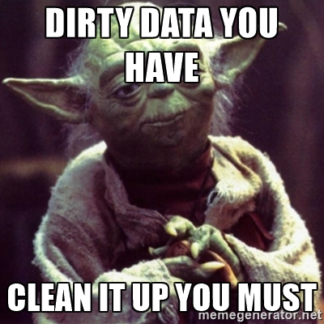
Purpose
Data Processing: Raw → GIS
Tasks Involved
To convert raw data into GIS consumable data
To establish standardized data manipulation processes
Hand digitizing and attributing points, lines, and polygons.
Modifying tabular data to be joined to existing data.
Modifying tabular data to be convertible into GIS format
Downloading supporting data from an online clearing house
Modifying existing GIS data
Difficulty
Image: www.kindful.com

Slide 9
Purpose
Data Management: Forward thinking
Tasks Involved
To store clean data in a logical manner, so that others can find the data in the future.
To provide information about the data so that future users can determine its suitability/credibility.
To provide a simple structured data storage format so that future users will maintain standards.
Documentation of Metadata for all included data.
Group feature classes into logical feature datasets i.e. Infrastructure.
Create space for future development by not over specifying your data structure.
Provide a ‘sand box’ or two to accommodate complex workflows.
Create pre-made processing tools for common tasks that emulate desired data processing procedures , i.e. models to clip data to study area.
Learn more about metadata in general at: http://nometadata.org/

Slide 10
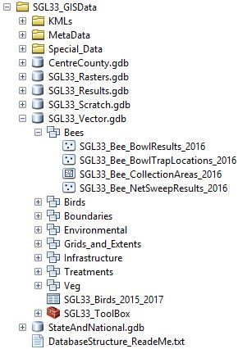
Data Management: Example
Pointers/Pitfalls
Keep structure as general as possible. There will be times you want to make it too specific.
The feature class name should provide useful information about the data.
Provide a ‘ReadMe’ that explains the data structure and its intended use.
Keep in mind how the data will be edited in the future. Does your structure make it cumbersome?

Slide 11
What to Produce
GIS Products
Measures of Success
What does the customer want? Help the customer define the desired products by answering these basic questions:
What level of understanding does the audience have of the research material?
What medium will information be shared, print or electronic?
Do the products need to be tiered? In other words, is there a stratified audience that could benefit from both simple and complex products?
Do the products help the researchers understand their data spatially?
Can an audience member with little understanding of the research project understand the product?
Are the products easily maintained and updated?
Does the product compliment other non-GIS products associated with the research project?
Does the product contain enough information to be beneficial to well informed audience members?

Slide 15
Web Map

Slide 16
Presentation Summary
Background - customer’s needs and their desired outcome
Learn The History & The Current Efforts
Become Familiar With Existing Data
Data - Retrofitting existing data into a gis
Data Processing
Data Management
GIS Products - Information dissemination
Products That Meet Current Objectives
Products That Promote Future Actions
Summary and Conclusion

Slide 17
Questions Now? Questions Later: gtw5016@gmail.com
Grant Wills - The Pennsylvania State University

