Slide 1
GIS-Based Site Suitability Analysis for an Artificial Surf Reef on Delaware’s Atlantic Coast
Samuel Wilson, MGIS Candidate
Advisor: Dr. Joseph A. Bishop
The Pennsylvania State University
GEOG 596A – Fall 2015

Slide 2
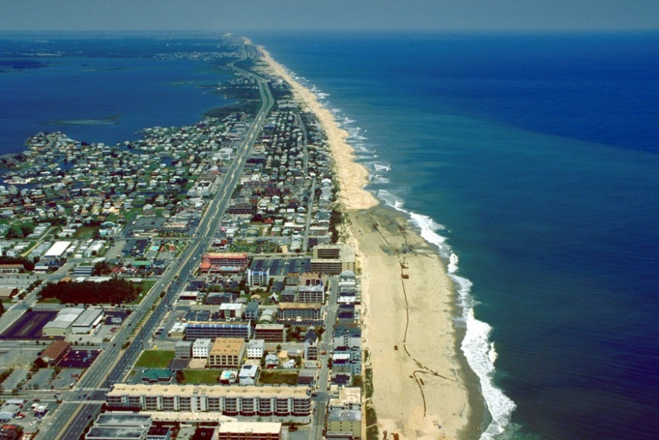
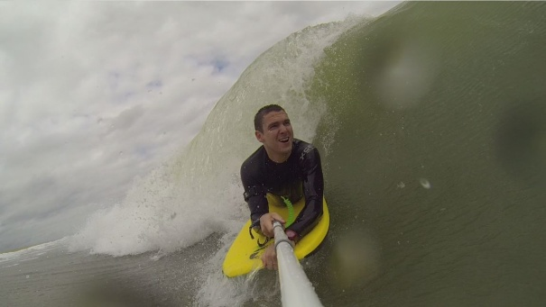
Overview
Background
Goals & Objectives
Proposed Methods
Anticipated Results & Implications
Project Timeline
Maryland/Delaware state line looking north into Delaware.
Source: Goista.com, 2014
Me bodyboarding in Fenwick Island, DE. 2014

Slide 3
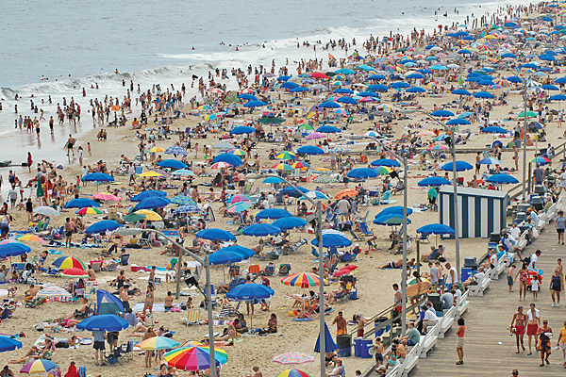
Background
Coastal regions are important places
Delaware, 2013 (VisitDelaware.com, 2013):
7.5 million visitors
$2.9 billion GDP from tourism
Surfing a popular activity
Significant global industry
~$130 billion annually (Martin, 2013)
Non-economic value of surfing
environmental activism (Martin, 2013)
Summer crowd in Rehoboth Beach, DE. Source: UDaily, 2012
Source: Surfrider Foundation, 2010
Notes:
Coastal regions are amongst most important/valuable places in world. In U.S., approx. 54% of population lives within 50 miles of coastline; every year approx. 189 million people travel to coastal areas for tourism purposes
Delaware, 2013:
approx. 7.5 million people visited Delaware
Fiscal Year 2013, GDP from tourism totaled estimated $2.9 billion, generating $451 million in state and local taxes/fees (VisitDelaware.com, 2013)
Recreational watersports have become popular activities, one watersport that has become a mainstream activity is surfing, defined as “the activity or sport of riding ocean waves on a special board (called a surfboard),” or other type of board such as a bodyboard. In U.S. alone, estimated over 3.5 million participate in surfing every year (Lazarow et al., 2009), and this number seems to increase every year
Global industry of surfing (sectors of surfcraft manufacturers, clothing retailers (i.e., Quiksilver, Billabong), sporting events, and domestic and international surf tourism) estimated to generate up to $130 billion annually (Martin, 2013)
Besides economic value in surfing, can be argued many people value surfing for the connection it allows between person and marine environment. Connection can be seen as spiritual by some, for others a way of life (Lazarow et al., 2009). Found that surfers are “frontline to environmental activism” for marine-related issues, given growth of organizations like Surfrider Foundation (Martin, 2013). Many coastal states/cities in U.S. have own Surfrider Foundation chapters, including Delaware

Slide 4
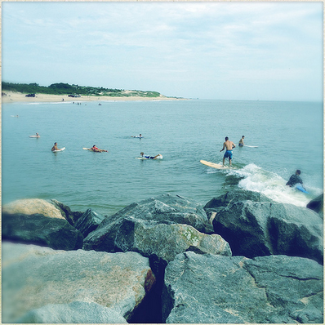
Surfing in Delaware
Began in 1960’s
Mainstream recreational activity
surf videos
ESA contests
Surfrider Foundation chapter
Surfers at Herring Point, Cape Henlopen, DE.
Source: Kozlowski on flickr.com, 2012
2013 survey: 66.7% participated in surfing (Surfrider Foundation, 2014)
Increase in participation ≠ increase in surfable conditions
Notes:
Beginning in early ‘60s, surfing in Delaware evolved into mainstream recreational activity (DE SRF, 2014)
Although state only has approximately 25 miles of Atlantic Ocean coastline, an established surf community in Delaware. State featured in surf videos, hosted Eastern Surfing Association (ESA) contests, and has growing Surfrider Foundation chapter actively involved with regional surfing events, environmental issues, and coastal policies (Warshaw, 2005)
Survey conducted in 2013 by Surfrider Foundation and other private and educational organizations found 66.7% of respondents participated in surfing while in Delaware (Surfrider Foundation, 2014)
As participation in surfing has increased since ‘60s, availability of “surfable” conditions has not, and certain beach management activities have decreased this availability (DE SRF, 2014)

Slide 5
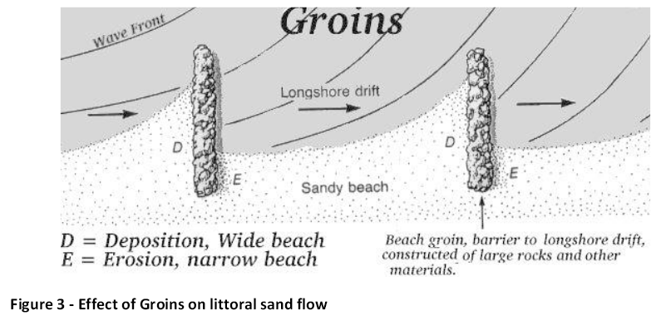
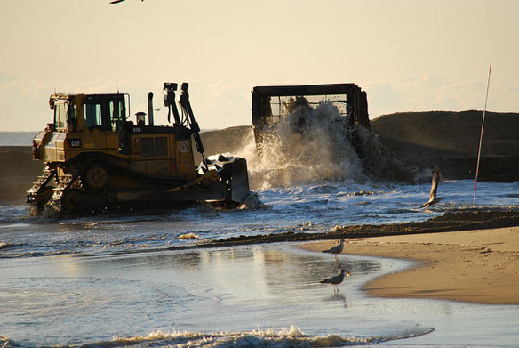
Traditional Shoreline Management in Delaware
Essential to control shoreline erosion in Delaware
Hard stabilization
Jetties
Groins
Surfable conditions
Soft stabilization
Beach replenishment
Source: DE SRF, 2014
Source: DE SRF, 2014
Beach replenishment.
Source: CoastalCare.org, 2012
Source: DE SRF, 2014
Notes:
Coastal erosion a natural process, but need to manage its impact is essential in Delaware (Daniel, 2001). Intensifies as result of storms, such as hurricanes and nor’easters in eastern U.S., causing mass-movement of sand and removal from beaches, but since humans built infrastructure so close to shoreline, natural degradation poses significant socio-economic threat (Daniel, 2001)
To mitigate negative effects of coastal erosion, coastal engineers in Delaware considered two different responses. First is “hard stabilization,” where physical structures (jetties and groins) placed on beaches or the nearshore zone of ocean to reduce energy of crashing waves and interrupt longshore transport of sand (Daniel, 2001). Stone jetties and groins a popular choice in ‘70s, most surfable conditions in Delaware located adjacent to these structures (DE SRF, 2014)
As sand accumulates against structures, “wedge” feature created, and as wave converges on jetty/groin feature, peak in wave height created, causing wave to break in peeling manner along wedge feature. Table 1 lists type of shoreline management structure found at historical Delaware surf breaks, where majority of breaks associated with hard structures
These structures have negative outcomes for beaches where located. Jetties and groins have blocking effect, where sand accumulates on updrift side of structure, widening beach, but also exaggerates erosion of sand on downdrift side, affecting recreational function and aesthetics of beaches (Daniel, 2001)
Second response is “soft stabilization,” with major technique being beach replenishment, also nourishment (Daniel, 2001). This technique involves pumping sand from ‘borrow’ area onto beach to create a wider buffer of sand between water and property lines (Daniel, 2001). Beach replenishment most preferred method in recent years. Table 2 lists many years beach replenishment undertaken at Delaware beaches

Slide 6
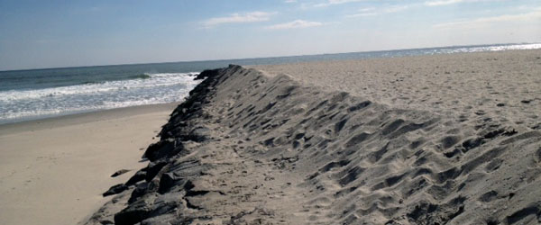
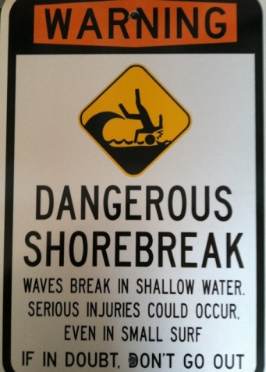
Effects of Beach Replenishment
Negatively affects surfing
Buries jetties/groins
Steepens shoreline slope
Reduction in natural sandbars
Dangerous water conditions
Ocean City, MD: 2006 – 87 injuries; 2007 – 345 injuries (Chesler, 2013)
Temporary solution
1 – 3 year beach life spans (Daniel, 2001)
Jetty buried by beach replenishment. Source: Ashbury Park Sun, 2014
Source: Surfrider Foundation
Notes:
Quick response to beach erosion, but negatively affects surf conditions. Pumping of sand onto beaches buries jetties/groins in sand, increases height of beaches, and steepens shoreline slopes causing waves to break directly on shore (DE SRF, 2014). As sand pumped onto beaches and width of beach increases seaward, troughs between naturally occurring sandbars and shoreline become filled in, and these sandbars are what create surfable conditions on beaches with little or no “hard” beach management structures, such as Ocean City, MD and Fenwick Island, DE
Normally sandbars reduce wave energy farther offshore, though after replenishment eliminates sandbars, waves breaking near shore pack more energy, creating dangerous conditions for swimmers and surfers (Chesler, 2013). Data collected by United States Lifesaving Association (USLA) showed increases in major medical beach injuries same year or year following a beach replenishment project, suggesting replenishment caused increases (Chesler, 2013). 2006 - beach replenishment in Ocean City, 87 surf-related major medical injuries; following year 345 injuries (Chesler, 2013)
Along Delaware coastline, coastal erosion rates historically ranged from 2 to 4 feet of sand eroded per year, and traditional beach preservation methods (expensive beach replenishment) only able to produce 1 to 3-year beach life spans before beaches lose storm protection/recreational functions (Daniel, 2001)
Combined effect of beach replenishment reducing beach surf-enhancing features and only serving as temporary solution to coastal erosion makes it seem ineffective as sole solution

Slide 7
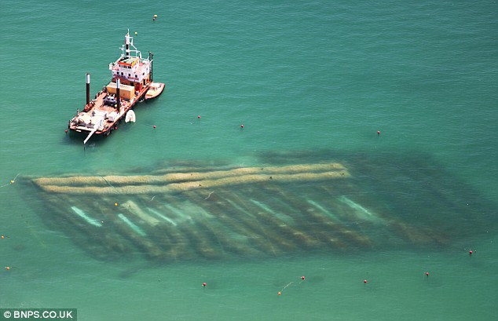
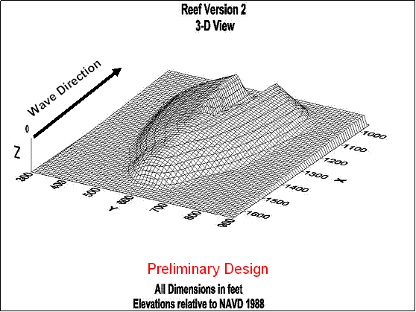
Artificial Surfing Reefs (ASR)
Submerged breakwater
Primary purpose of improving surf conditions
Boscombe ASR in England. Source: dailymail.co.uk, 2009
Secondary benefits
Reducing coastal erosion
Habitat formation
Other recreation
No reduction in beach amenity/aesthetics
Brevard County ASR 3D Design. Source: sworlandoblog.com, 2007
Notes:
Moving forward, coastal management efforts in Delaware should consider addition of structures that can have positive effect on surfing. One such structure is an artificial surfing reef (ASR)
ASR - submerged breakwater structure, primary purpose of improving surf conditions; provides secondary benefits: reducing coastal erosion, marine habitat, other recreation (Ranasinghe et al., 2006)
Most notable ASR projects completed to date constructed of geotextile sand-filled containers/bags. Materials such as rocks/boulders & air-filled structures used or proposed
Unlike emergent beach management structures (groins/jetties), ASRs provide similar erosion control effects without reducing aesthetics (Ranasinghe et al., 2006)

Slide 8
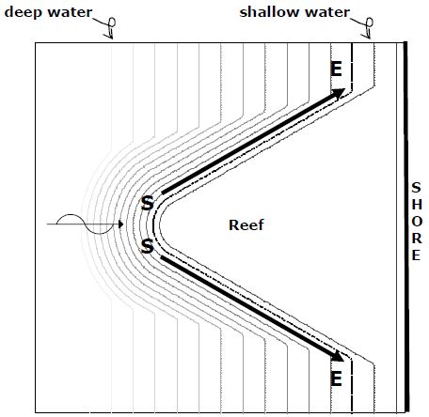
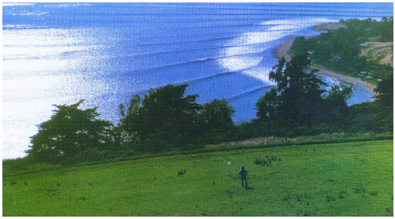
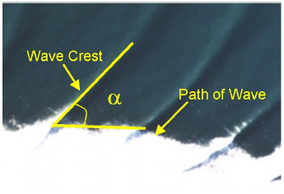
Ocean Wave Mechanics & ASRs
Shoaling/Breaking
Refraction
Peel Angle
ASRs create optimally peeling waves
Wave interaction w/ nearshore bathymetry. Source: Hyndman & Hyndman, 2006
Concept of surfing an ASR. Source: Van Ettinger, 2005
Wave refraction on California shoreline. Source: Phillips et al., 2003
Wave Peel Angle. Source: Scarfe et al., 2003
Notes:
To understand how ASRs function in creating surfable waves, necessary to understand how waves form and break when approaching shoreline. As approaching, waves begin to ‘feel bottom,’ where energy in wave crest moves forward faster than wave base’s energy that’s dragging on seafloor, resulting in wave crest curling forward and breaking (Hyndman & Hyndman, 2006)
Refraction occurs when wave crests bend as result of passing over seafloor with varying depths; section of wave moving across shallower water slows down and breaks before deeper water section, causes deep water section to catch up and become parallel with shoreline (Phillips et al., 2003). Common when waves approach shoreline at angle, such as at headlands
Refraction changes wave peel angle (α), “defined as the angle between the trail of the broken whitewater and the crest of the unbroken wave as it propagates shoreward” (Scarfe et al., 2003). Ranging from 0° to 90°, lower peel angles create faster breaking waves and higher angles create slower breaking waves; peel angle of 0° is called a ‘closeout,’ or a wave that breaks all at once across entire along-shore length (Scarfe et al., 2003).
Peel angle argued to be most important wave parameter for distinguishing surfable from non-surfable wave. Waves of good surfability break in “peeling manner,” where breaking section of wave translates “laterally across wave crest,” and best position for surfer is area adjacent to breaking crest of wave, called “pocket”, allowing surfer to ride wave for longest possible time
ASRs create peeling wave conditions, “increasing peel angles to within surfable limits” (Scarfe et al., 2003). ASR design most widely employed is V-shape, where apex points seaward and two ‘arms’ of V create left- and right-peeling wave (Black & Mead, 2009)
Apex of ASR functions as focus feature, drawing wave energy onto reef, causing peak in wave height (easier take-off for surfers). Arms of the ASR act as wedge features, causing waves to break in peeling manner causing wave refraction (Scarfe et al., 2003)
‘Concept of surfing an ASR’ diagram: S is surfer take-off point, E the end of ride, dashed line the breaker line (approx. line wave peels along) (Van Ettinger, 2005)

Slide 9
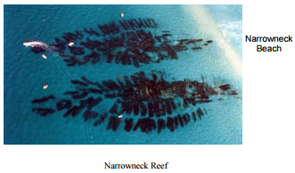
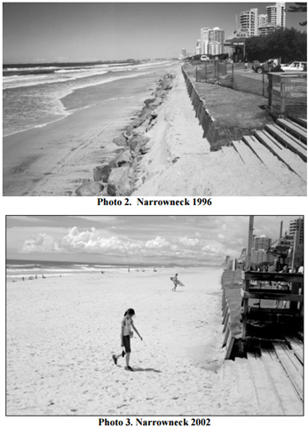
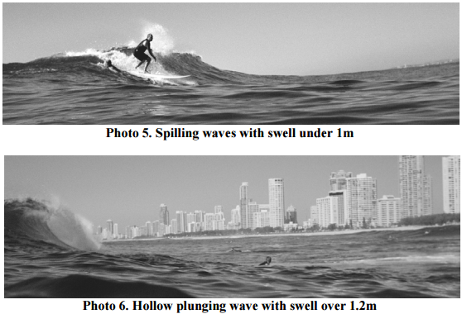
Case Study: Narrowneck Reef
Gold Coast, Queensland, Australia
Primary purpose: erosion control
Secondary purposes
Enhance surfing
Habitat, fishing, diving
Site-specific design & continuous monitoring
Results (Jackson et al., 2002):
20 – 30m beach widening
Improved surf conditions
Diverse habitat
Informed design = successful results
Source: Jackson et al., 2004
Source: Jackson et al., 2002
Source: Jackson et al., 2002
Notes:
One ASR project was at Narrowneck beach on Gold Coast of Queensland, Australia (Jackson et al., 2002)
Reef structure constructed of large geotextile containers filled with sand, installed with primary purpose of coastal erosion control for recently nourished beaches, also designed to enhance surfing conditions, other recreation, and to establish marine habitat conditions (Jackson et al., 2002)
Prior to design, site-specific assessment and modeling undertaken, and reef continuously monitored, starting during installation to several years after installation, for purposes of informed design and deployment, and assessing performance to facilitate improvements in design (Jackson et al., 2002)
Goals for reef achieved:
- 20-30m widening of the beach (Photos 2 & 3 show beach prior to beach nourishment/reef installation ‘96, and several years after in ’02)
- improvement in surfing conditions, surf conditions favored by range of board types/rider skill levels produced (Jackson et al., 2002)
- establishment of marine habitat
Take-away: informed design and site assessment leads to successful implementation of reef meeting need of multiple stakeholders

Slide 10
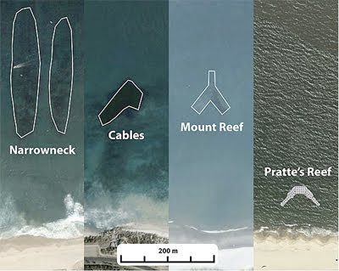
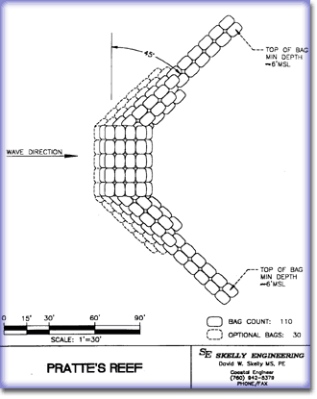
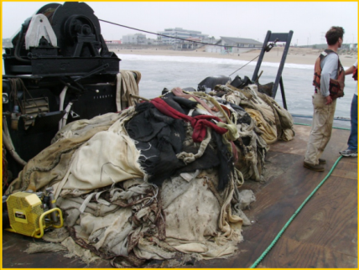
Case Study: Pratte’s Reef
ASR footprints.
Source: Surfrider Foundation
El Segundo, California, USA
First A – ‘S’ – R …and smallest
V-shape selected through general wave modeling
Deemed a failure
Reef elevation not maintained
Deterioration of installed bags
Surf conditions poor
Pratte’s removal. Source: Richmond et al., 2011
Pratte’s Reef engineer drawing. Source: EasyReader, Inc., 2010
No site-specific assessment prior to design (Slotkin et al., 2008)
ASR design must be site-specific (Black & Mead, 2009)
Poor planning = goals not achieved
Notes:
Pratte’s Reef (El Segundo, California) constructed to mitigate loss of quality surfing conditions present in area prior to Chevron constructing “El Segundo Groin” (Slotkin et al., 2008). Groin built to protect Chevron facility from coastal erosion
First Artificial Surfing Reef
Constructed of 4’x7’x10’ sand-filled bags, size significantly smaller than Narrowneck and other ASRs
Through general, non-site-specific wave modeling, determined best design for reef a V-shape structure, with two arms at 45 degree angles from apex
Reef deemed a failure, post-construction monitoring:
elevation not maintained
deterioration of sand-filled bags
surf conditions poor compared to adjacent surf spots on same days
Co-author of study describing monitoring of reef indicated no site-specific numerical modeling, wave climate analysis, other site assessment conducted prior reef design (Slotkin et al., 2008). Black and Mead (2009) indicate ASRs are holistic systems, each component linked to every other component, design related or location-based, for expectations to be met and maximum surfing potential realized, each ASR component must be designed for specific physical environment where placed (Black & Mead, 2009)
Poor performance led to removal, costing estimated $550,000 (US)
While mitigation for El Segundo’s loss of surfing amenity a priority, feasibility of ASR as means of mitigation maybe not best solution for specific location.
Take-away: poor suitability planning & design leads to goals not achieved

Slide 11
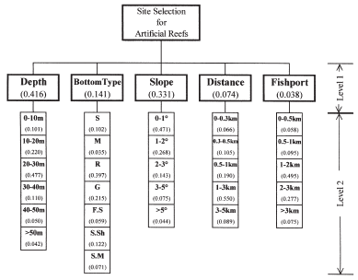
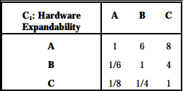
GIS in AR Studies
Site selection is vital
Studies on habitat-enhancing ARs
Assigning priority rankings & weights important
Tseng et al., 2001:
Analytic Hierarchy Process (AHP)
Map algebra
AHP decision matrix.
Source: Triantaphyllou & Mann, 2005
AHP weights hierarchy chart. Source: Tseng et al., 2001
Notes:
Adequate planning/site selection most important task in AR/ASR deployment process, as most common cause of unsuccessful reefs when insufficiently executed (Barber et al., 2009; Tseng et al., 2001). GIS a tool for this type of analysis
Literature on GIS in site selection analysis for AR siting for purposes of enhancing/creating marine habitats
Optimum/least favorable conditions distinguished using priority rankings/weights assigned to criterion. Assigning levels of priority to criterion important step in this type of analysis, any change to rankings or weights can significantly alter results. Ranking/weighting of data layer values also allows user to visualize next-best sites for proposed feature, in case most suitable sites not feasible
Tseng et al. (2001) found “weights of criteria” GIS site selection method effective for locating habitat-enhancing AR
Method employed Analytic Hierarchy Process (AHP) to calculate relative weights assigned to each criterion, or each criterion’s level of importance to overall goal of analysis. Conducted through “pair-wise comparisons” of each criterion to every other criterion (Tseng et al., 2001). Comparisons made using decision matrix, where importance values are assigned. Higher whole numbers represent more importance, reciprocal values less importance. Standardized calculations used to find weights assigned to criterion
AHP method & ArcGIS Spatial Analyst/map algebra functionality allowed them to identify optimal sites for AR deployment, where higher scores in suitability map represented more suitable sites. Found majority of existing ARs in study area coincided with higher suitability scores in map - proof of method’s effectiveness

Slide 12
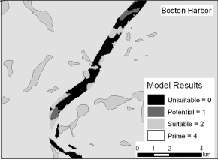
GIS in AR Studies (cont.)
Barber et al. (2009):
Exclusion mapping
Reclassed criteria to 3-point scale
Field data collection
Weights assignment & map algebra
ASR site selection
Overlay techniques (Scarfe et al., 2009)
Many criteria to consider
Barber et al. (2009) GIS-based exclusion mapping results. Source: Barber et al., 2009
Notes:
Barber et al. (2009) used exclusion mapping and criteria importance weighting
Reclassified criteria data layers to 3-point scale (2 = prime, 1 = potential, 0 = unsuitable). ArcGIS Raster Calculator tool used to produce suitability layer (Barber et al., 2009)
Barber et al. (2009) collected data in field for each identified suitable site
Barber et al. (2009) used ranking analysis to assign numerical scores to data collected. Numerical values multiplied by weights assigned to criterion. Barber et al. (2009) able to exclude 80% of study area for AR deployment
ASR site selection analysis should consider exclusion mapping and weighting overlay techniques. Scarfe et al. (2009) argue GIS overlay techniques, considering criteria such as bathymetry, bottom sediment grain size, tidal and wave data, can lead to better understanding of coastal environment where ASR placed. Other criteria considered relevant for ASR site selection, indicated by Scarfe et al. (2009):
Surfer numbers and seasonal variations
Precise location of surfing rides
Wind patterns
Number of surfable days per year or surfing wave/wind climate

Slide 13
Goals & Objectives
Goal: Identify the locations most suitable for the deployment of an ASR along Delaware’s Atlantic coastline.
Objectives:
Identify design measures and other criteria used in ASR deployment
Identify study area-specific considerations related to surfing
Apply GIS to analyze data layers representing ASR and surfing criteria
Classify GIS output and locate study area locations with highest suitability scores
Goal: Develop an informed spatial analysis approach that will be used for identifying suitable ASR sites in the study area, and that may be applicable in other domestic and international locations.
Objectives:
Identify analysis methods used in GIS-based AR and ASR site selection studies
Identify current, public data layers
Delineate approach for producing single GIS-based suitability surface
Identify advantages and limitations of applied method and data layers incorporated
Describe considerations for analysis in other domestic and international settings

Slide 14
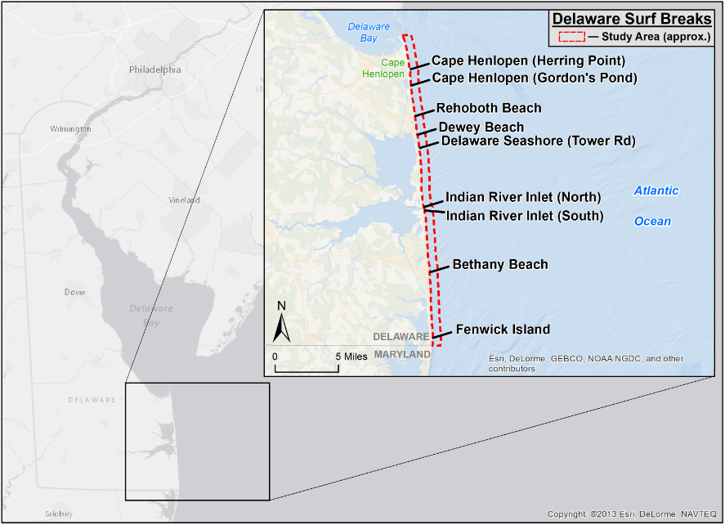
Study Area
Created with Esri ArcGIS/ArcInfo Desktop 10.2.1. Produced here for educational purposes only.

Slide 15
Analysis Criteria
Criteria
General Criteria
Depth (Bathymetry) Slope Substrate Wave Climate Wind Currents Tides Existing Surfing Breaks Surfer Numbers Parking Amenity Beach Accessibility
Study Area -Specific Criteria
Restricted Areas on Surfing Recreational Conflicts
General criteria
Study area-specific criteria
Select data layers based on criteria
ASR Site Suitability Analysis Criteria.
Notes:
Criteria need to be defined so study area locations can be classified based on how well they meet optimal conditions for each criterion
General criteria pertinent includes:
Depth ASR placed (determines how waves break over ASR; depths too great result in waves not breaking over ASR, depths too shallow may create dangerous conditions)
Near-shore slope affects surfability of waves and degree of structural support (Black & Mead, 2009)
Substrate type affects structural support for ASR materials (Barber et al., 2009; Scarfe et al., 2009; Tseng et al. 2001)
Wave, wind, ocean current/tide conditions affect surfability of waves at given location (Phillips et al., 2003; Scarfe et al., 2009) (Wave-produced and longshore currents affect how surfers reach take-off zones & ability to stay within take-off zones)
Locations where surfing is currently practiced (locations will draw highest numbers of surfers, local & visiting) (Scarfe et al., 2009)
Proximity to public parking amenity determines accessibility to ASR for general public (visiting surfers); parking options for non-residents during summer limited
Study area-specific criteria:
Regulations on watersports (restrictions on surfing during summer on certain beaches)
User group conflict on beach (surf fishing)

Slide 16
Methods
Initial GIS Processing
Data Reclassification
Weights Determination
Suitability Surface Creation
Projection/Re-projection
Determine reclassed value assignments
AHP Decision Matrix
Map
Algebra
Clip / Extrapolation
Perform Reclassification
Weights Calculation
Cartographic Evaluation
Digitize Data Not Acquired
AHP CR Calculation
Analysis Discussion
Raster Conversion
Repeat until CR is satisfactory (e.g., < 10%)
Raster Resampling
Notes:
Analysis planned is overlay spatial analysis. Raster-based representations of criteria data layers produced through GIS, then overlaid using map algebra to produce suitability surface

Slide 17
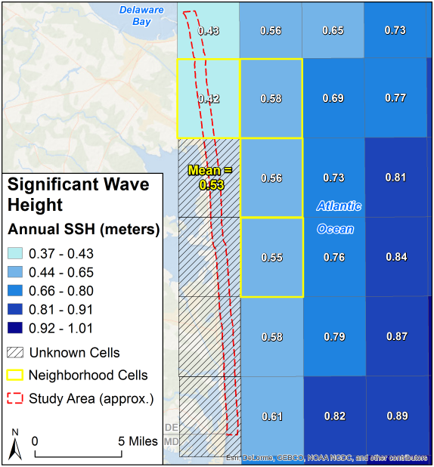
Methods
Initial GIS Processing
Projection / Re-projection
Clipping / Extrapolation
Digitize data not acquired
Raster conversion
Raster resampling
Created with Esri ArcGIS/ArcInfo Desktop 10.2.1. Produced here for educational purposes only.
Notes:
Initial GIS processing in preparation for successive suitability analysis tasks
Projection/Re-projection (if already stored as planar coordinates), into common, study-area specific projected coordinate system (Delaware’s NAD 83 State Plane)
Clipping/Extrapolation, depending on data. Significant Wave Height data layer has spatial extent falling just east of study area eastern boundary. Proposed extrapolation technique similar to Focal Statistics functionality in ArcGIS Spatial Analyst Neighborhood toolset. Polygon grid originally aggregated extended into study area boundaries. New cells populated with mean of surrounding 3x3 neighborhood. Map an example of extrapolation technique for Significant Wave Height data layer
Some analysis criterion, existing data layers not yet identified (restricted areas for surfing, beach accessibility - i.e., dune crossing locations), data layers to be digitized
Conversion of data layers to raster data format & resampling to common analysis resolution. Proposed analysis resolution a cell size equal to avg. length or width of existing ASRs - smaller of two avg. values is cell size used in analysis

Slide 18
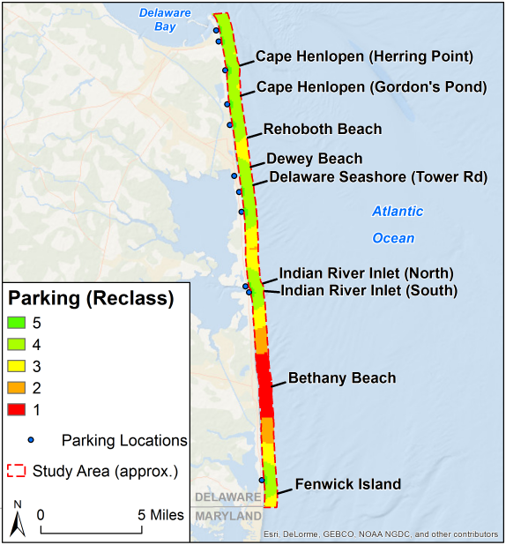
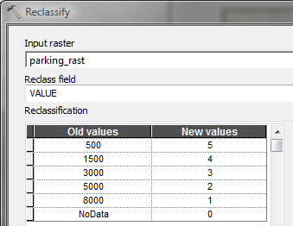
Methods
Data Reclassification
Determine reclassification value assignments (5-point scale)
Perform reclassification
ArcGIS Reclassify Tool. Created with Esri ArcGIS/ArcInfo Desktop 10.2.1. Reproduced here for educational purposes only.
Created with Esri ArcGIS/ArcInfo Desktop 10.2.1. Produced here for educational purposes only.
Notes:
Raster-based data layer values reclassified to common suitability ranking scale (will ensure meaningful comparisons between data layers). Five point scale (1 to 5), higher values (4 & 5) locations of higher suitability, lower values (1 & 2) less suitability. 0 used in cases where deployment of ASR not feasible (e.g., access to/ownership of beach private)
Example for proximity to parking amenity criterion:
Proximity to Parking Facility Value: Reclassified Value:
0 – 500 m 5
500 – 1,500 m 4
1,500 – 3,000 m 3
3,000 – 5,000 m 2
> 5,000 m 1

Slide 19
Methods
Weights Determination
AHP Decision Matrix
Weights Calculation
AHP Consistency Ratio (CR) Calculation
AHP pairwise comparison importance rating scale. Source: Eastman, 2005
Criterion | Wave Climate | Parking Amenity | Substrate
Wave Climate | 1 | 9 | 3
Parking Amenity | 1/9 | 1 | 1/5
Substrate | 1/3 | 5 | 1
∑ | 1.4444 | 15 | 4.2
AHP decision matrix example.
Criterion | Wave Climate | Parking Amenity | Substrate | Principal Eigenvector (Weight)
Wave Climate | 1/1.4444 = 0.6923 | 9/15 = 0.6000 | (3)/4.2 = 0.7143 | 0.6689
Parking Amenity | (1/9)/1.4444 = 0.0769 | 1/15 = 0.0667 | (1/5)/4.2 = 0.0476 | 0.0637
Substrate | (1/3)/1.4444 = 0.2308 | 5/15 = 0.3333 | 1/4.2 = 0.2381 | 0.2674
AHP principal eigenvector (weight) calculation example.
Notes:
To calculate weight values to signify criterion importance for goal of suitability for ASR deployment, AHP will be employed. Pairwise comparisons between criteria as to their importance to the overall goal of study. This study, goal is suitability for ASR deployment, so comparisons made between criteria essentially stating how criterion A is to some degree more or less important than criterion B for determining suitability
Importance rating scale used in AHP ranges from 1/9 to 9 (e.g., 9 – highest importance of one criterion over another towards goal; 1/9 – represents opposite). Decision matrix shows example of AHP pairwise comparison for 3 study criteria: wave climate, parking amenity, substrate. In the row substrate, 5 signifies substrate criterion is ‘strongly more important’ in determining a location’s suitability for ASR deployment than parking amenity criterion. Reciprocal value (i.e., 1/5) placed in opposing cell, meaning parking amenity criterion is ‘strongly less important’ than substrate criterion
Weight values in second matrix calculated by normalizing importance ratings (i.e., divide by column total), then the mean value of each row’s normalized values found
AHP Consistency Ratio (CR), calculated from series of standardized equations; used to evaluate how consistently importance ratings applied in decision matrix (Triantaphyllou & Mann, 1995). Pairwise comparisons deemed consistent if CR < 10%, (Triantaphyllou & Mann, 1995). CR < 10% for this example = importance ratings used in comparing criterion in decision matrix applied consistently, weight values acceptable for use in analysis

Slide 20
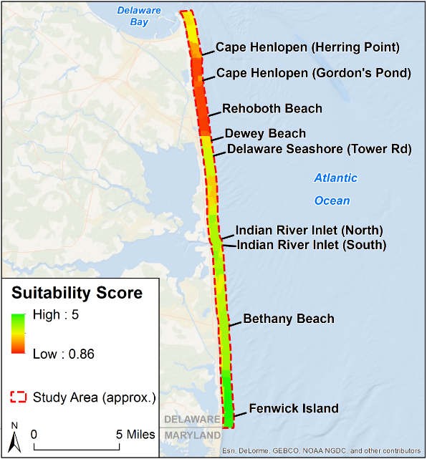
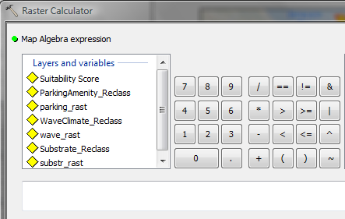
Methods
Suitability Surface Creation
Map Algebra
Cartographic Evaluation
Analysis Discussion
Map Algebra: ("ParkingAmenity_Reclass" * 0.0637) + ("WaveClimate_Reclass" * 0.6689) + (“Substrate_Reclass" * 0.2674)
ArcGIS Raster Calculator Tool. Created with Esri ArcGIS/ArcInfo Desktop 10.2.1. Reproduced here for educational purposes only.
Created with Esri ArcGIS/ArcInfo Desktop 10.2.1. Produced here for educational purposes only.
Notes:
Suitability output produced through map algebra: multiply each reclassified data layer by weight value, determined in AHP, then find sum of individual products
Suitability output analyzed in cartographic form & discussion to locate and describe study area locations suitable for ASR

Slide 21
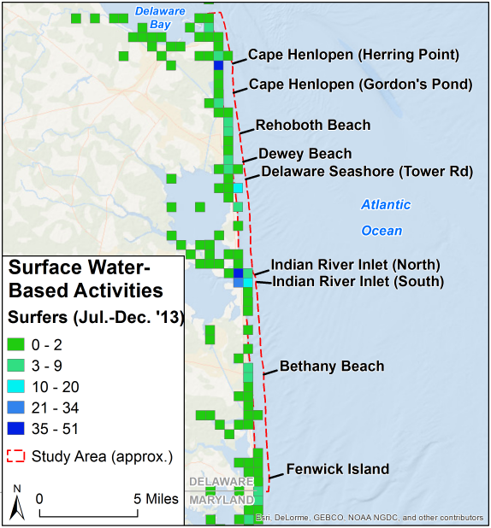
Anticipated Results & Implications
Limited locations with highest suitability
Suitability surface resolution
Informed planning for surfing
Future surf-related analysis
Reef Name and Location | Size (L) | Size (W)
Mount Maunganui (Mount Reef), NZ | 90 m | 80 m
Opunake, NZ | 99 m | 30 m
Lyall Bay, NZ | 160 m | 115 m
Cable Station, Aus | 70 m | 140 m
Narrowneck, Aus | 350 m | 600 m
Bargara, Aus | ?? | ??
Pratte's, USA | 30 m | 60 m
Oil Piers, USA | 110 m | 100 m
Cocoa Beach, USA | 175 m | 122 m
Boscombe, UK | 120 m | ~ 60 m
Kovalam, India | 110 m | 40 m
130 m
130 m
Existing and Proposed ASR Project Size Specifications.
Created with Esri ArcGIS/ArcInfo Desktop 10.2.1. Produced here for educational purposes only.
Notes:
Anticipated results:
Limited locations receiving highest suitability scores. Large number of criteria used, so it will take exceptionally unique combination of criteria to produce high suitability score. Example: surfer numbers criterion will use “Surface Water-Based Activities” data layer, containing data on how many people participated in surfing during July to December ‘13. Data in map shows only a couple of cells in polygon grid data are aggregated have values for surfing participants in 2 highest classification ranges (i.e., 21 – 34 & 35-51). Since analysis is concerned with finding suitable locations for surfing reef, surfer numbers criterion likely to have high weight value compared to other criterion, may result in limited areas of high surfer numbers having significant effect on high final suitability values
Resolution of common analysis raster surface proposed cell size equal to avg. length or width of existing, previously existing & proposed ASRs, smaller value of two avg. values used. Average length = ~130 meters, average width = ~135 meters, seen in table. Cell size of 130 meters would be used for the resampled raster used to produce final suitability surface. Leads to generalization and loss of some data. DEM data layer proposed for depth & slope criteria has resolution of 1/3 arc-second (approx. 10 meters). Using 130 meter resolution raster will result in significant loss of detail, may affect accuracy in interpreting suitable locations in final suitability surface
Implications:
Coastal planners & local surfing community may use results of analysis to make better informed decisions regarding where to enhance surfing amenity on Delaware coastline. Having locations identified as suitable may help focus efforts at only few locations, as opposed to entire coastal region. May form baseline for field data collection aimed at designing most effective ASR for specific sites. Deployment of actual ASR in study area and successful results may lead to economic benefits for local region and more opportunities for future surfing planning/research, respectively
Reflecting on study analysis & considering additional tasks/criteria important for future analyses adapting similar approach, benefitting from lessons learned, incorporating improvements in data layers used & methods employed

Slide 22
Project Timeline
Refine topic
Identify goals/objectives
Identify method/data
Form proposal
Submit abstract for TUgis & Delmarva GIS conferences
Initial GIS processing
Begin analysis tasks
Complete write-up & presentation material
Present at TUgis or Delmarva GIS
Edit write-up per conference comments
Present
TUgis (3/15)
Delmarva GIS (4/14)
Oct. – Nov. 2015
Dec. 2015
Jan. 2016
Feb. 2016
Mar. – Apr. 2016
Identify data (cont.)
Test method/data
Present proposal
Edit proposal per peer review
Form abstract for TUgis & Delmarva GIS
Finish analysis tasks
Discuss results & form conclusions
Form final write-up & presentation material

Slide 23
References
Barber, J.S., Chosid, D.M., Glenn, R.P., & Whitmore, K.A. (2009). A systematic model for artificial reef site selection. New Zealand Journal of Marine and Freshwater Research, 43, 283-297. Retrieved October 24, 2015, from: http://www.mass.gov/eea/docs/dfg/dmf/publications/26-barberhi.pdf
Black, K., & Mead, S. (2009). Design of Surfing Reefs. Reef Journal, 1(1), 177-191. Retrieved October 22, 2015, from: http://thereefjournal.com/files/14._Black_and_Mead.pdf
Chesler, C. (2013). Do Serious Beach Injuries Come in Waves? Scientific American. Retrieved October 20, 2015, from: http://www.scientificamerican.com/article/understanding-east-coast-beach-injuries/
Daniel, H. (2001). Replenishment versus retreat: the cost of maintaining Delaware’s beaches. Ocean & Coastal Management, 44, 87-104. Retrieved April 8, 2015, from: http://www.wcu.edu/WebFiles/PDFs/The_Cost_of_Maintaining_Delaware_Beaches.pdf
Delaware Chapter of the Surfrider Foundation (DE SRF). (2014). The State of Surfing in Delaware. Surfrider Foundation. Retrieved October 28, 2015, from: http://delaware.surfrider.org/wp-content/uploads/2014/01/The-State-of-Surfing-in-Delaware-2.pdf
Eastman, J.R. (2005). Multi-criteria evaluation and GIS. In P. A. Longley, M. F. Goodchild, D. J. Maguire & D. W. Rhind (Eds.), Geographical Information Systems: Principles, Techniques, Management and Applications (2nd ed. Abridged, pp. 493 – 502). Hoboken, NJ: John Wiley & Sons, Inc. Retrieved November 10, 2015, from: http://www.geos.ed.ac.uk/~gisteac/gis_book_abridged/files/ch35.pdf
Hyndman, D., & Hyndman, D. (2006). Natural Hazards and Disasters. Belmont, CA: Brooks/Cole. Retrieved October 22, 2015, from: http://www.mdhtalk.org/articles/beaches/research/WavesCoastsChapter.pdf
Jackson, L.A., Tomlinson, R., McGrath, J., & Turner, I. (2002). Monitoring of a multi-functional submerged geotextile reef breakwater. Proceedings of the 28th International Conference on Coastal Engineering, 2, 1923-1935, Cardiff, Wales, July 7-12. Retrieved October 21, 2015, from: http://www98.griffith.edu.au/dspace/bitstream/handle/10072/22853/38140_1.pdf?sequence=1
Lazarow, N., Miller, M.L., & Blackwell, B. (2009). The Value of Recreational Surfing to Society. Tourism in Marine Environments, 5(2-3), 145-158. Retrieved October 13, 2015, from: http://www.valueofwaves.org/uploads/1/1/4/2/11420190/time_2008.pdf
Martin, S.A. (2013). A Surf Resource Sustainability Index for Surf Site Conservation and Tourism Management. Prince of Songkla University. Retrieved October 12, 2015, from: http://centerforsurfresearch.org/wp-content/uploads/2012/11/Martin-2013-SRSI-PhD-Thesis-e-book.pdf
Phillips, D., Mead, S., Black, K., & Healy, T. (2003). Surf Zone Currents and Influence on Surfability. Proceedings of the 3rd International Surfing Reef Symposium, 60-82, Raglan, New Zealand, June 22-25. Retrieved October 22, 2015, from: http://citeseerx.ist.psu.edu/viewdoc/download?doi=10.1.1.489.3191&rep=rep1&type=pdf
Ranasinghe, R., Turner, I.L., & Symonds, G. (2006). Shoreline response to multi-functional artificial surfing reefs: A numerical and physical modelling study. Coastal Engineering, 53(7), 589-611. Retrieved April 8, 2015, from: http://www.sciencedirect.com.ezaccess.libraries.psu.edu/science/article/pii/S0378383906000032
Scarfe, B.E., Elwany, M.H.S., Mead, S.T., & Black, K.P. (2003). The Science of Surfing Waves and Surfing Breaks – A Review. Scripps Institution of Oceanography Technical Report. Retrieved October 21, 2015, from: http://escholarship.org/uc/item/6h72j1fz#page-1
Scarfe, B.E., Healy, T.R., Rennie, H.G., & Mead, S.T. (2009). Sustainable Management of Surfing Breaks – An Overview. Reef Journal, 1(1), 44-73. Retrieved October 20, 2015, from: http://thereefjournal.com/files/4._Scarfe_Healy_Rennie_and_Mead.pdf
Slotkin, M.H., Chambliss, K., Vamosi, A.R., & Lindo, C. (2008). Feasibility Study of Multi-Purpose Artificial Surf Reefs for Brevard County, Florida (Economic Segment). PRÆCIPIO EFS, Inc. Retrieved October 23, 2015, from: http://www.brevardcounty.us/docs/default-source/natural-resources-documents/appendix-a---praecipio.pdf?sfvrsn=2
Surfrider Foundation. (2014). Delaware Mid-Atlantic Coastal and Ocean Recreation Study. Surfrider Foundation. Retrieved October 15, 2015, from: http://www.surfrider.org/images/uploads/publications/DE_Report.pdf
Triantophyllou, E., & Mann, S.H. (1995). Using The Analytic Hierarchy Process For Decision Making In Engineering Applications: Some Challenges. International Journal of Industrial Engineering: Applications and Practice, 2(1), 35-44. Retrieved October 29, 2015, from: http://bit.csc.lsu.edu/trianta/Journal_PAPERS1/AHPapls1.pdf
Tseng, C.T., Chen, S.C., Huang, C.S., & Liu, C.C. (2001). GIS-assisted site selection for artificial reefs. Fisheries Science, 67, 1015-1022. Retrieved October, 24, 2015, from: https://www.jstage.jst.go.jp/article/fishsci1994/67/6/67_6_1015/_pdf
Van Ettinger, H.D. (2005). Artificial surf reef design – Dutch swell conditions. Delft University of Technology. Retrieved October 22, 2015, from: https://www.google.com/url?sa=t&rct=j&q=&esrc=s&source=web&cd=12&ved=0CFcQFjALahUKEwisv4TJitXIAhUD2D4KHRukAQc&url=http%3A%2F%2Frepository.tudelft.nl%2Fassets%2Fuuid%3A6d4fba4e-2868-4037-864d-f8f5da566404%2F2005VanEttinger.pdf&usg=AFQjCNHuuHaTrmZ3M1kFAO9tB5W8j6kBNQ&cad=rja
VisitDelaware.com. (2013). Delaware Tourism Statistics. Retrieved October 12, 2015, from: http://www.visitdelaware.com/industry/tourism-statistics/
Warshaw, M. (2005). The Encyclopedia of Surfing. Orlando, FL: Harcourt, Inc. Retrieved October 13, 2015, from: https://books.google.com/books?id=-DWQSYRx4MUC&pg=PA154&lpg=PA154&dq=Delaware+surfing&source=bl&ots=UchR4DPwHV&sig=0K7r3NNCx7APuhdExEAHCNYpSl4&hl=en&sa=X&ved=0CBwQ6AEwADg8ahUKEwie3sOL9LrIAhVIFz4KHWLhB1M#v=onepage&q=Delaware%20surfing&f=false

Slide 24
Questions?
Acknowledgements
Dr. Joseph Bishop
Bill Ballard
Family and friends
Hawaiian shorebreak. Source: Clark Little Photography Facebook page

