Slide 1
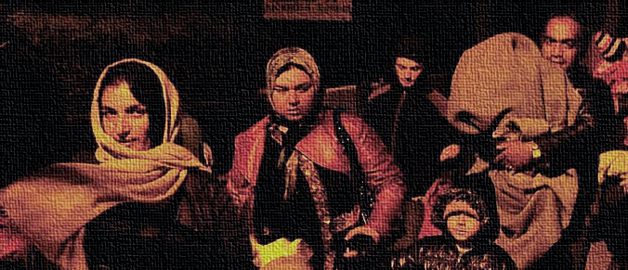
An Open Source Approach to Visualizing Refugee and Immigrant Integration Data
Student: Rachel Wong | MGIS Capstone Project Peer Review | December 14, 2016 Advisor: Jim Detwiler

Slide 2
Agenda
Background Introduction Refugees and Asylum Seekers Needs Exceed Resources Common Basic Principles (CBP) Europe 2020 European Union (EU) Immigrant Integration Indicators Integration Outcome Prior Web Map Projects
Project Goal Objectives
Proposed Methodology Research Approach - Free and Open Source Software (FOSS) Research Step - 1 to 7
Anticipated Results Map and Stacked Bar Charts Crossfilters Parallel Coordinate Plots
Timeline
Conclusion
Acknowledgment and References
Questions and Answers

Slide 3
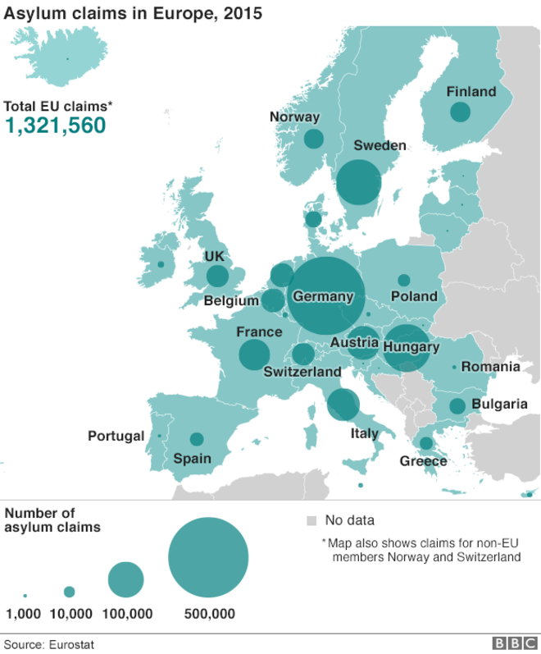
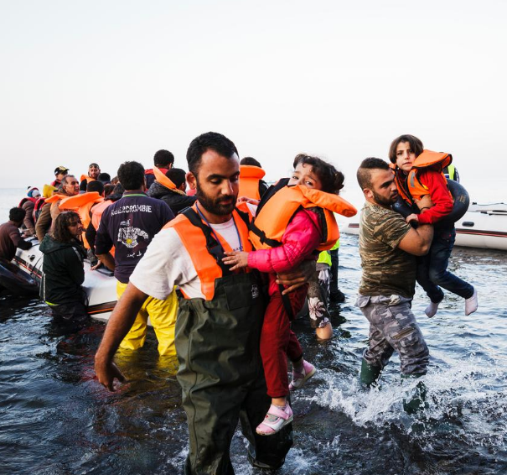
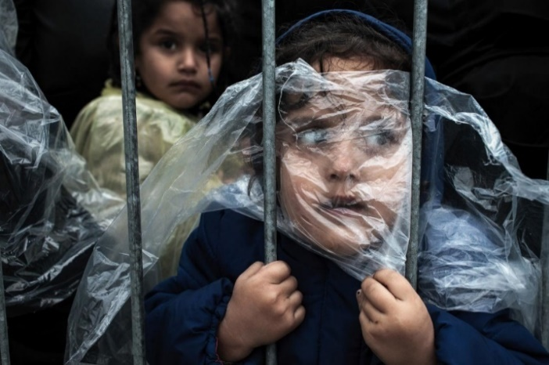
Background Introduction
UNHCR/Achilleas Zavallis
1.3 million asylum seekers surged in Europe last year.
Nearly 90,000 were unaccompanied children.
BBC News
The majority of influx arrived by sea.
More than 3,700 people died crossing the Mediterranean in 2015.
UNHCR/F.Ellul
The Independent Online

Slide 4
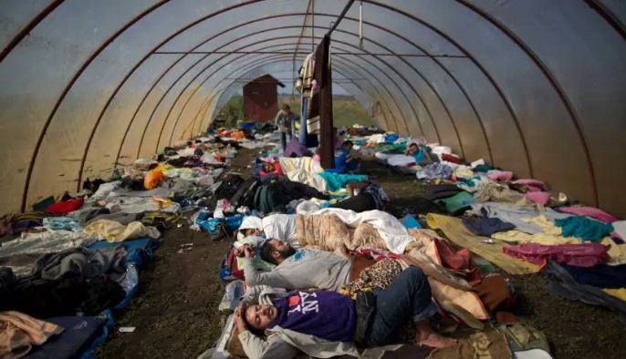
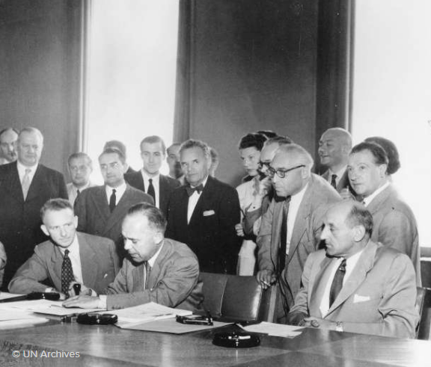
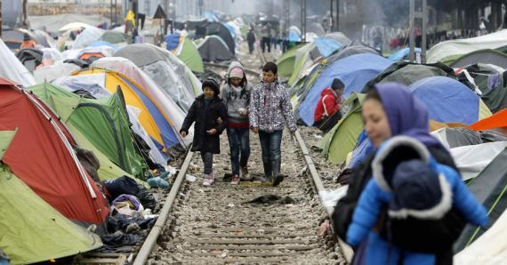
Background Refugees and Asylum Seekers
United Nations High Commissioner for Refugees. UNHCR
Syrian asylum seekers sleep inside a temporary camp. Fortune Insiders
A person with refugee status can receive legal protection, other assistance and social rights from the countries who have signed the document under Convention of 1951 and Protocol of 1967 (UNHCR, 2010).
Asylum seekers are “Individuals who have sought international protection and whose claims for refugee status have not yet been determined, irrespective of when they may have been lodged (UNHCR, 2016b).”
Temporary migrant camp in the northern Greek border. DipNote
The 1951 Refugee Convention. UNHCR

Slide 5
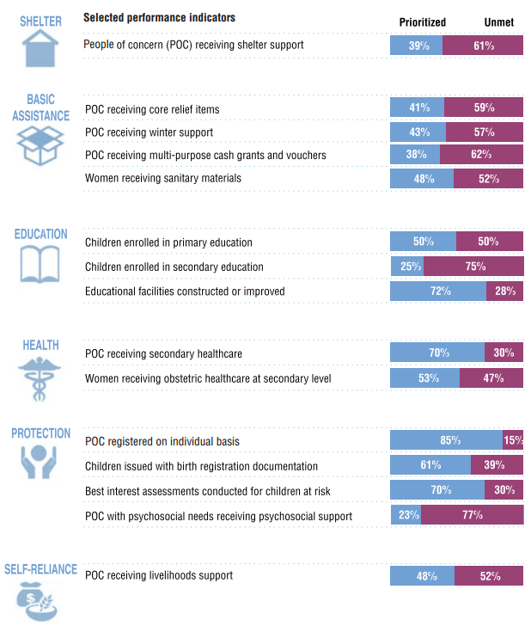
Background Needs Exceed Resources
The funding budget is insufficient to meet the needs for shelter, water and sanitation, food, medical assistance, education.
The actual funded amount is less than the budgeted (UNHCR, 2016a).
A long term sustainable solution is critically needed.
Examples of funding gaps in 2015 (as of October 2015)
UNHCR

Slide 6
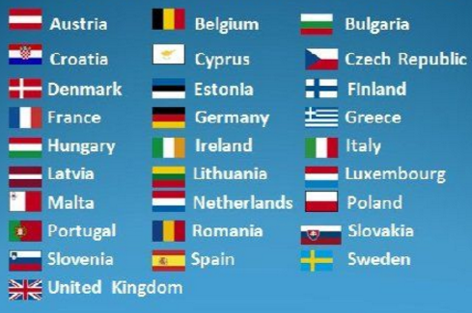
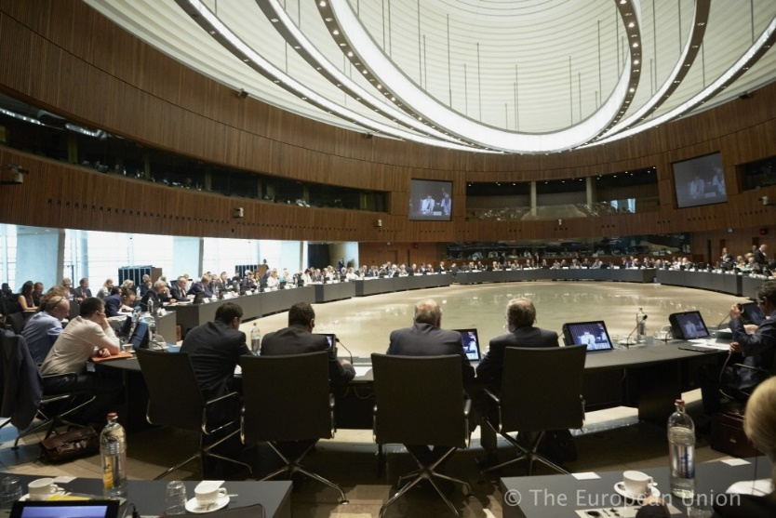
Background Common Basic Principles
European Union (EU) 28 Member States
www.emmeaservizinnovativi.it
Justice and Home Affairs Council http://migrantreport.org
In 2004, Common Basic Principles (CBP) for Immigrant Integration Policy was adopted by Justice and Home Affairs Council and became the driving force integrating the migrants (EESC, 2004).
4 of 11 Common Basic Principles
CBP 1 Dynamic, two-way process
CBP 3 Employment
CBP 4 Basic knowledge of the host society’s language, history, and institutions
CBP 5 Education
http://slideplayer.com/slide/5893925/

Slide 7
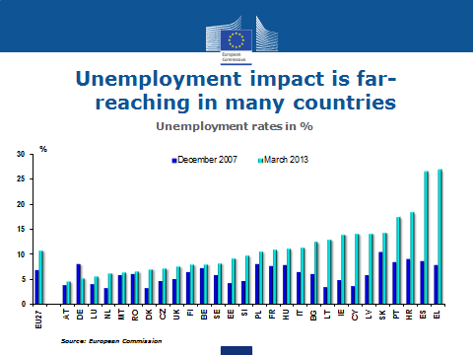
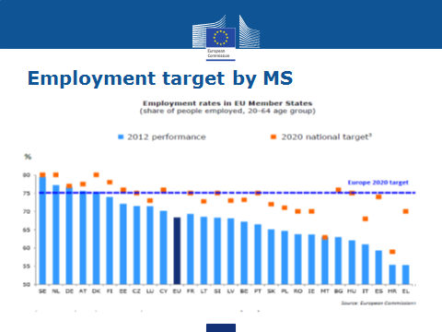
Background Europe 2020
Europe 2020
Headline Targets
Europe 2020 is the EU’s 10-year strategy for social and economic development.
European Commission
The goal is to create the conditions for smart, sustainable and inclusive growth (European Commission 2010).
Employment
75% of the 20-64 year-olds to be employed.
Education
reducing the rates of early school leaving below 10%,
at least 40% of 30-40-year-olds completing university level education.
Fighting poverty and social exclusion
at least 20 million fewer people in or
at risk of poverty and social exclusion.
Research and Development
Climate/Energy

Slide 8
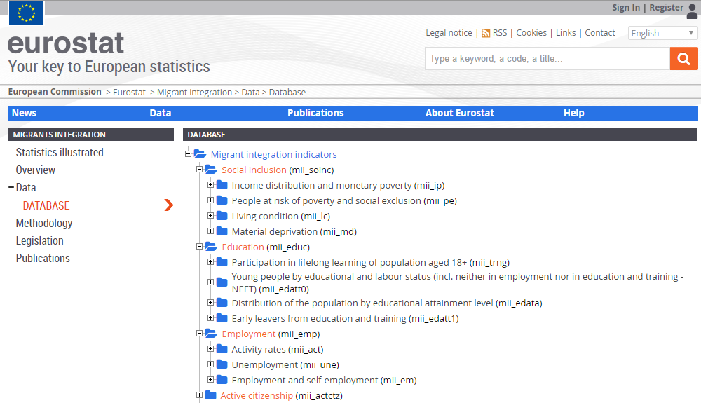
Background EU Immigrant Integration Indicators
Researchers and policy makers are advised to use the indicators for (European Commission 2013):
Understanding the national contexts for integration in a comparative way
Evaluating the results of policies
Using targets to mainstream and improve integration
European Commission

Slide 9
Background Integration Outcome
Three types of factors influence integration outcome.
Migration Population
General Policies and Factors
The characteristics of the migration population that have strong influence on the integration outcome are (European Commission 2013):
Age, gender
Time of residence
Education, job quality
Household composition
Country of origin
European Commission
Migration and Integration Policies and Factors

Slide 10
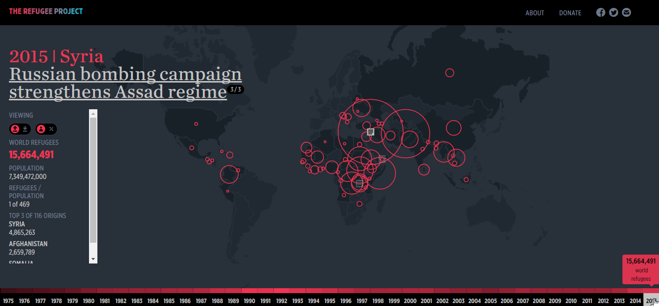
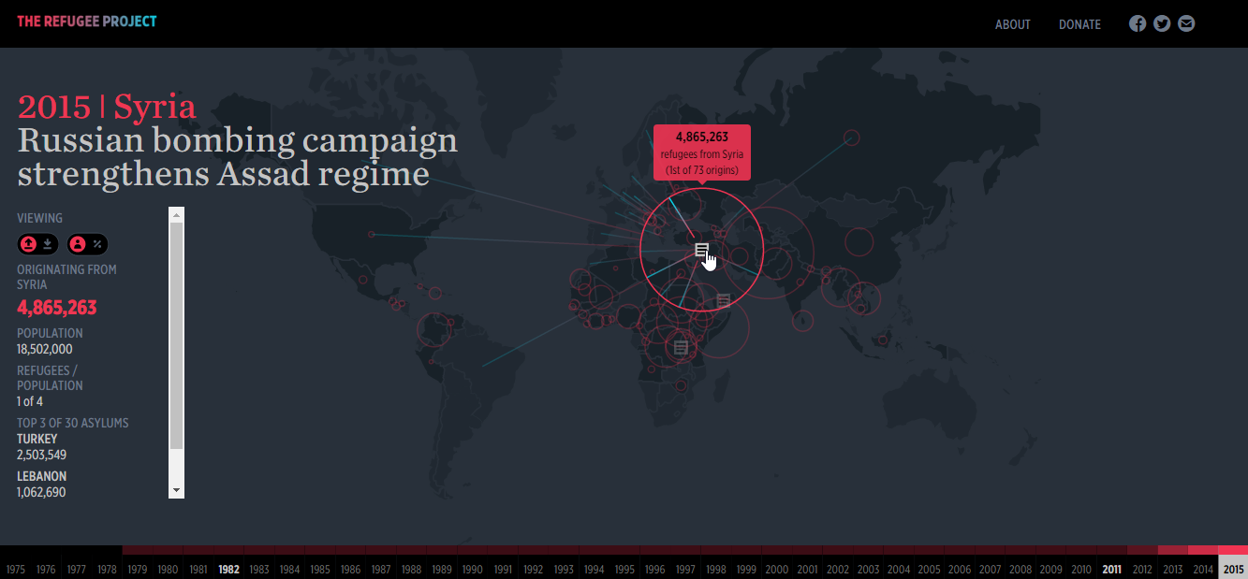
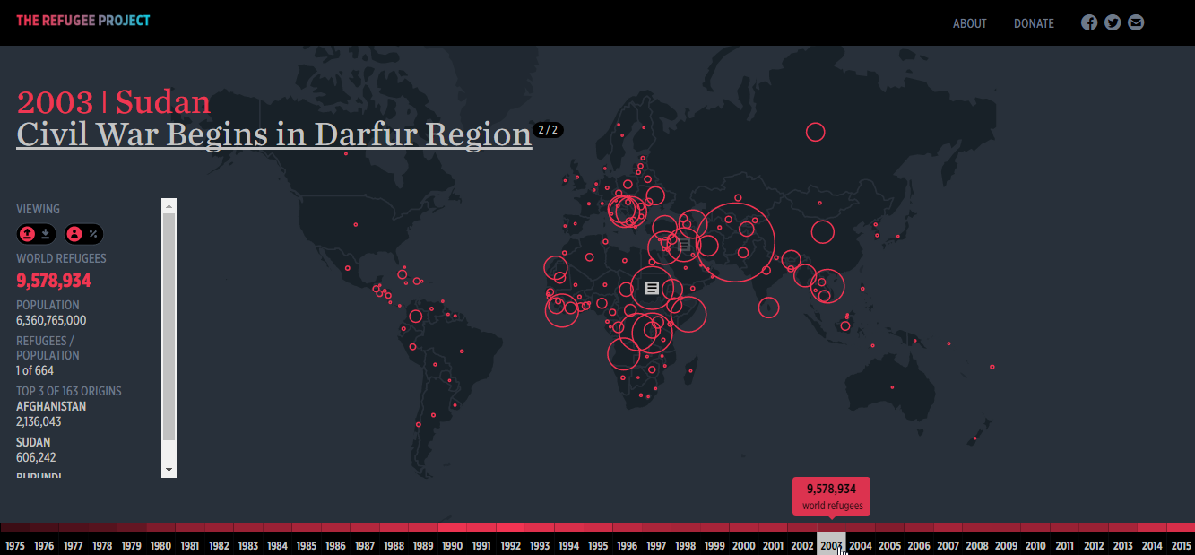
Background Prior
Web Map Projects
Refugees by volume or by percent of population
The Refugee Project
Country as destination or origin
http://www.therefugeeproject.org/

Slide 11
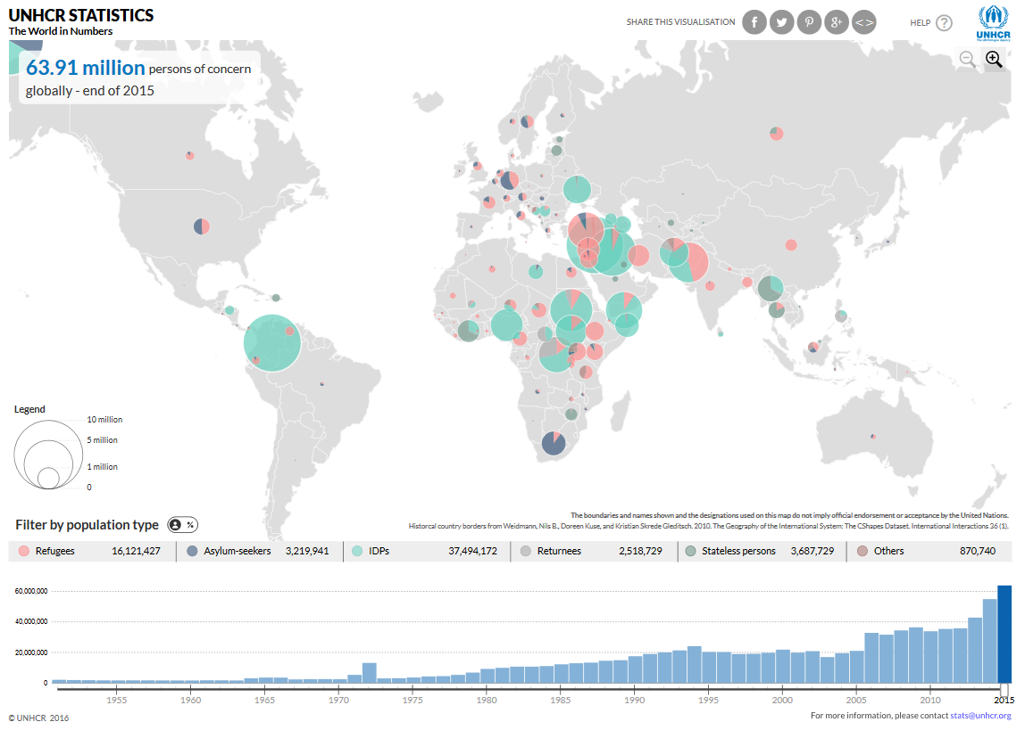
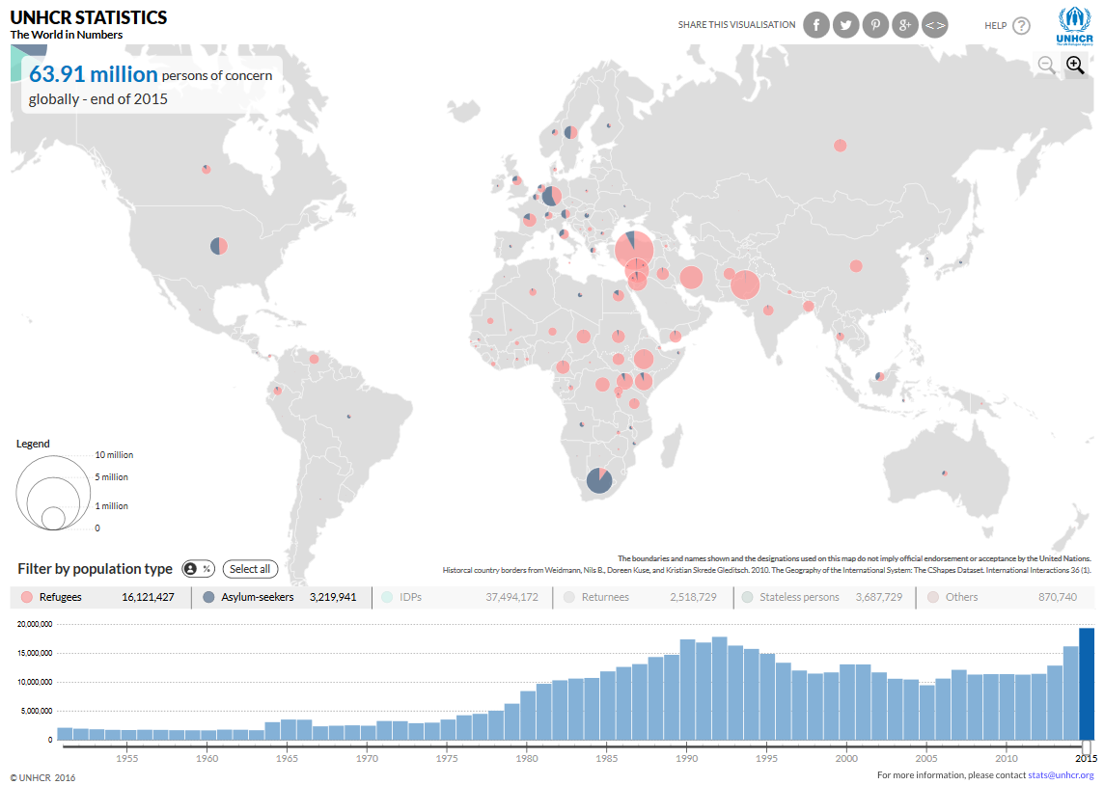
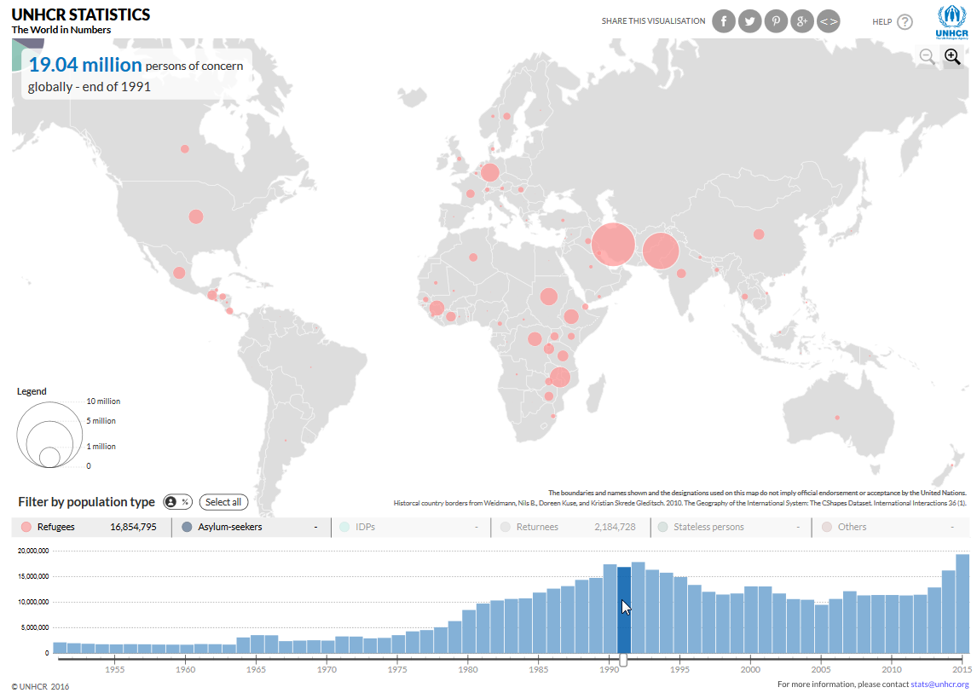
Background Prior
Web Map Projects
The UNHCR Statistics
http://popstats.unhcr.org/en/overview)

Slide 12
Project Goal Objectives
Project Goal
To develop visual analytics tools for researchers and policy makers to interactively explore the refugee and immigrant integration data in EU countries.
Objectives
To view how many of asylum seekers and refugees have entered in EU countries over the years.
To understand who the refugees are.
To identify which country and group of people need assistance the most.
To compare how well the host countries integrated the migrants in the past.
To estimate how well the host countries will integrate the migrants in the future.

Slide 13
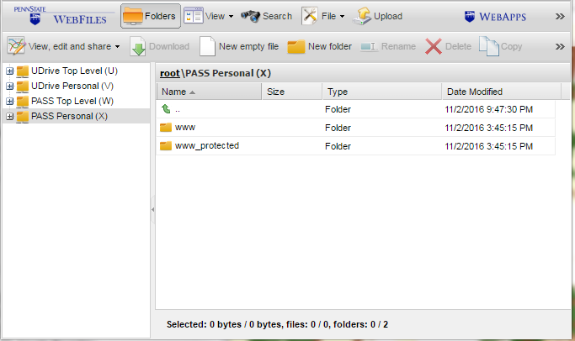
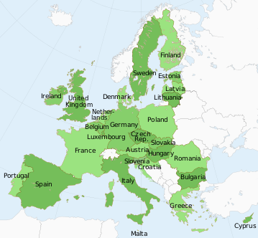
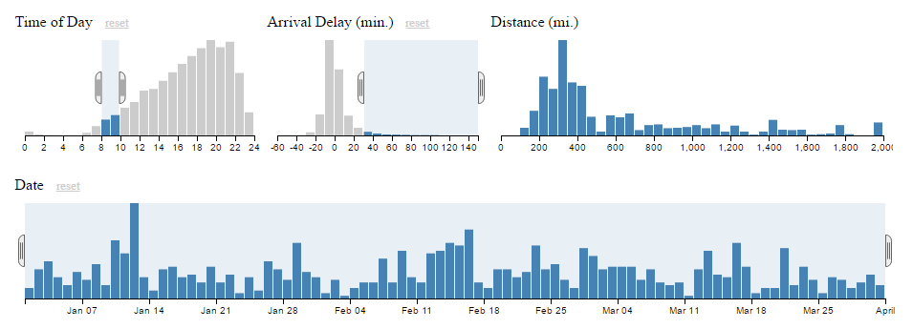
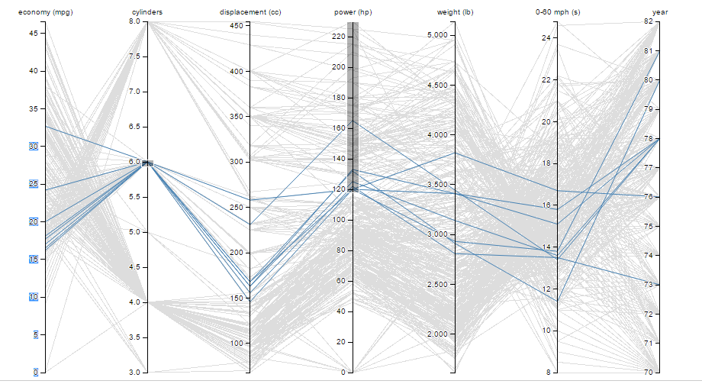
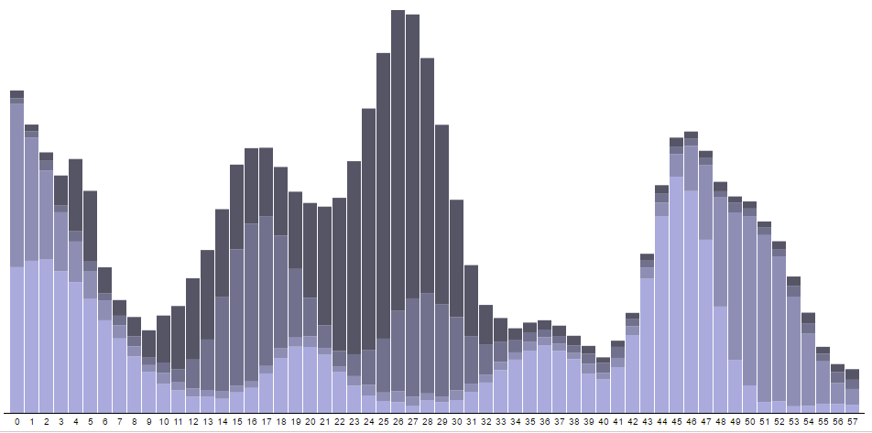
Proposed Methodology Research Approach
The Penn State Access Account Storage Space (PASS) Maximum 10GB Free http://www.personal.psu.edu/wxw5193/
Immigrant Integration Explorer 1.0
D3js.org
D3, HTML, SVG and CSS Web-based Data Visualization
FOSS Free and Open Source Software
https://webfiles.psu.edu/
Bootstrap Faster Web Development
Scripting Languages D3, HTML, Scalable Vector Graphics (SVG) and Cascading Style Sheets (CSS)
http://getbootstrap.com/
CSV files and GeoJSON/TopoJSON Simplicity and Fast Loading Time
Data Formats CSV, GeoJSON/TopoJSON
TopoJSON
Web Hosting and Data Storage PASS
Web Design Framework Bootstrap
http://geojson.org/geojson-spec.html#polygon

Slide 14
Proposed Methodology Research Step
Identify Data Source
Step 1
Download statistics from UNHCR and Eurostat Download country boundaries from
Data Storage
Step 2
CSV format
GeoJSON or TopoJSON
Web Architecture & Interface Design
Step 3
Directory structure
Prototyping
Step 4
Small part of datasets
Step 5
Evaluation
Step 6
Implementation
Step 7
Documentation

Slide 15
Anticipated Results Map and Stacked Bar Charts
A map will show the boundaries of the EU countries.
Objective
To view how many of asylum seekers and refugees have entered in EU countries over the years.
https://en.wikipedia.org/
The stacked bar chart will change when the user chooses the host country by clicking the map.
http://bl.ocks.org/mbostock/3943967/

Slide 16
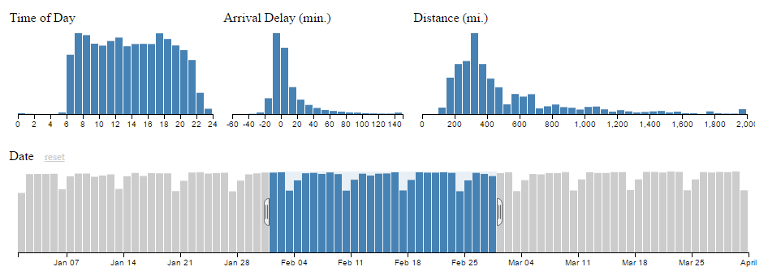
Anticipated Results Crossfilters
Crossfilter is a combination bar charts. When users alter one of the variables, all of the other bar charts will update dynamically to show counts of the records meeting the filter conditions.
Objectives
To understand who the refugees are.
To identify which country and group of people need assistance the most
http://square.github.io/crossfilter/
Five variables (refugee age group, gender, origin countries, host countries and year) will be used in the crossfilter.

Slide 17
Anticipated Results Crossfilters
Use Case Scenario Which country has higher number of female refugees from non-EU countries?
Age Group
Year
Gender
Female
Origin Countries
Host Countries
Objectives
To understand who the refugees are.
To identify which country and group of people need assistance the most
Non-EU countries

Slide 18
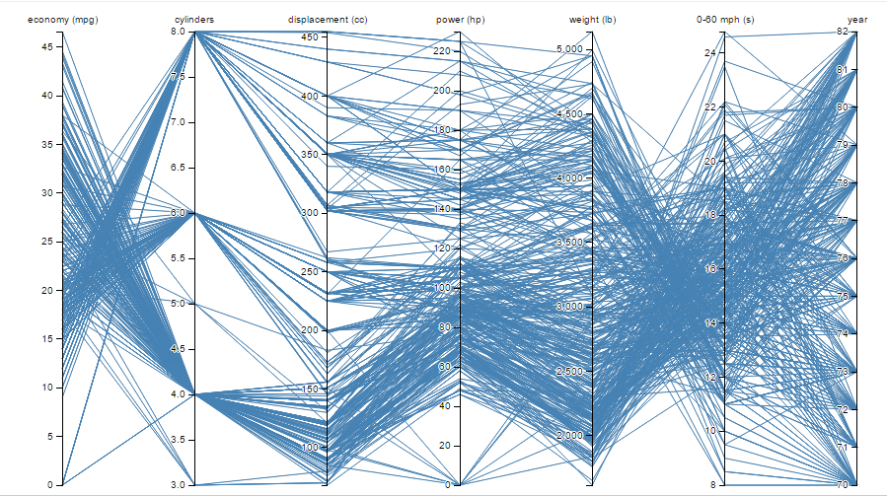
Anticipated Results Parallel Coordinate Plots
Parallel coordinate plot is a set of graphs that have multiple y axes showing a high-dimensional dataset.
Objectives
To compare how well the host countries integrated the migrants in the past.
To estimate how well the host countries will integrate the migrants in the future.
http://bl.ocks.org/jasondavies/1341281
4 parallel coordinate plots Education, employment, social inclusion and active citizenship.
Proposed y-axis from the left Host country, selected core indicators, and year.

Slide 19
Anticipated Results Parallel Coordinate Plots
Use Case Scenario Which country has better immigrant integration in employment?
Country
Employment Rate
Activity Rate
Self-employment rate
Part-time employment rate
Year
Objectives
To compare how well the host countries integrated the migrants in the past.
To estimate how well the host countries will integrate the migrants in the future.
http://bl.ocks.org/jasondavies/1341281

Slide 20
Project Timeline
Jan – Feb 2017
Mar - Jul 2017
Aug - Oct 2017
Present at FOSS4G during the week of August 14-19, 2017.
Present at SF Bay Area GIS User Group Meeting on September 19, 2017.
Evaluation
Prototyping
Presentation
Design
Implementation
Documentation
Data Preparation

Slide 21
Conclusion
4 of 11 Common Basic Principles
CBP 1 Dynamic, two-way process
Immigrant Integration Explorer 1.0
CBP 3 Employment
CBP 4 Basic knowledge of the host society’s language, history, and institutions
Europe 2020
Headline Targets
CBP 5 Education
The Europe 2020 goal is to create the conditions for smart, sustainable and inclusive growth (European Commission 2010).
Project Objectives
To view and understand
To identify
To compare
To estimate

Slide 22
Acknowledgement
Advisor: Jim Detwiler
Resources
European Commission. Europe 2020, 2010. Retrieved September 26, 2016 from http://ec.europa.eu/eu2020/pdf/COMPLET%20EN%20BARROSO%20%20%20007%20-%20Europe%202020%20-%20EN%20version.pdf
European Commission. Using EU Indicators of Immigrant Integration, 2013. Retrieved on November 16, 2016 from http://www.integration.ie/website/omi/omiwebv6.nsf/page/AXBN-A4LPWN18405825-en/$File/using%20eu%20indicators%20of%20immigrant%20integration.pdf
European Economic and Social Committee (EESC). Common Basic Principles for Immigrant Integration Policy, 2004. Retrieved October 22, 2016 from http://www.eesc.europa.eu/resources/docs/common-basic-principles_en.pdf
UNHCR. Convention and Protocol Relating to the Status of Refugees, 2010. Retrieved October 24, 2016 from http://www.unhcr.org/en-us/protection/basic/3b66c2aa10/convention-protocol-relating-status-refugees.html
UNHCR. Needs and Funding Requirements, 2016a. Retrieved November 25, 2016 from http://www.unhcr.org/564da0e20.pdf
UNHCR. Regional Refugee and Migrant Response Plan for Europe, 2016b. Retrieved October 25, 2016 from http://www.unhcr.org/partners/donors/570669806/regional-refugee-migrant-response-plan-europe-january-december-2016-19.html

Slide 23
Questions & Answers
Thank you!

