Slide 1
Image Source: (ExtremeTech, 2016)
Notes:
Good afternoon to those in attendance, I’m Gus Wright and today I’ll be presenting my Capstone proposal on Modernizing Authoritative Geospatial data creation by way of Machine Learning Algorithms. For those in attendance, Id like to thank you and I look forward to your candid feedback and suggestions afterwards.

Slide 2
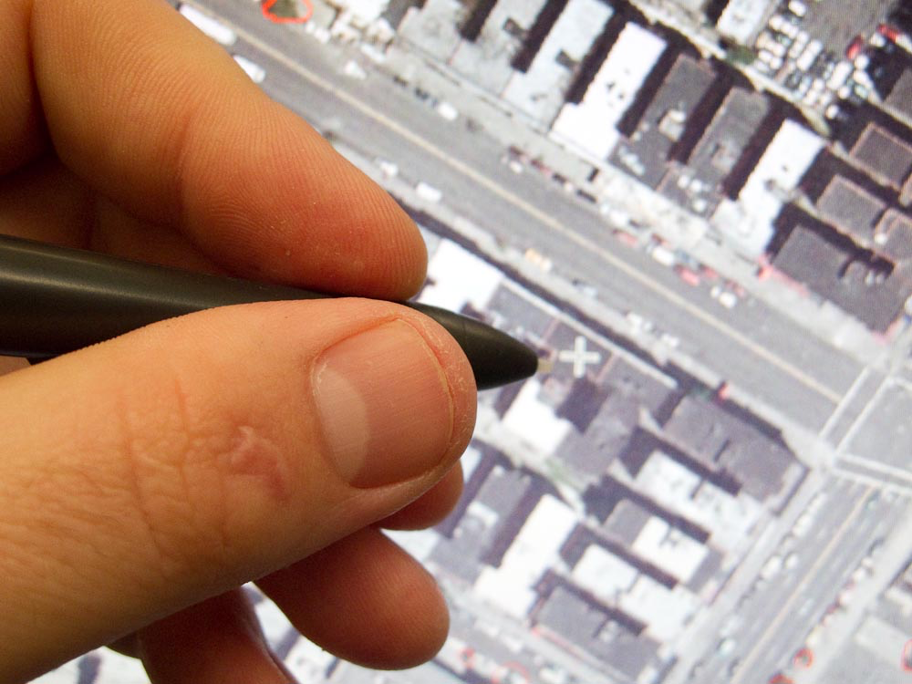
Presentation Objectives
Identify the problem
Machine learning augmentation
Research questions & approach
Anticipated outcomes
Image Source: (WACOM Digitizing, 2016)
Notes:
After attending this presentation, you should be able to identify with problems within conventional methods currently in place for authoritative vector data creation, how Machine Learning can augment these works, my research questions & approach, and the anticipated outcomes.

Slide 3
Overview
Current workflow
Limitations
Machine learning
Research questions
Approach
Anticipated outcomes
Notes:
During the presentation I’m just gonna go over the current workflow, some limitations myself and colleagues have identified. Then I’ll talk briefly about Machine Learning, what it is, some ways its currently being used and how I think it can modernize authoritative data creation. Next I’ll discuss my research questions, the approach and what I anticipate the outcomes to be along with some deliverables.

Slide 4
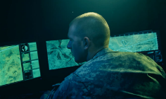
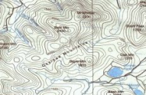
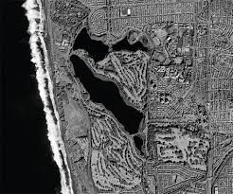
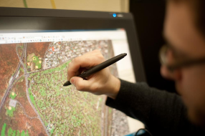
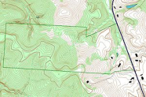
Background
Current Workflow
1
Check out map sheet
4
Geospatial Analysis
Integrity Tool (GAIT)
2
Heads-up digitize
5
Enterprise holdings
3
Edge match & topology
CURRENT WORKFLOW
GAIT
Silver dataset
4
5
Sheet Index
9
0
1
5
5
2
3
4
5
Authoritative
Gold dataset
6
7
8
9
9
…
…
3
1
Data Stewart
Digitizer(s)
2
Notes:
Geospatial Planning Cells primarily perform heads-up digitizing by hand to generate authoritative data which populates the Geospatial Enterprise. The Topographic Data Store (TDS) schema, specified by The National System for Geospatial Intelligence, is one of the commonly accepted standards for which these data are extracted, stored and managed for planning and analysis. The intent is to prevent duplication of effort by establishing a standard feature foundation dataset, which is regularly maintained. In my experience, several colleagues and I have observed a high level of inconsistency in both civilian and military digitizers due to innate human subjectivity when selecting features by hand. Through the years there have been unpredictable levels of productivity mainly in part due to diverse skill levels and experience.
Here before you, is a flow chart which generally delineates the workflow as it stands. An extraction team is generally made up of 9-15 civilian and military digitizers, a lead cartographer, a Data Stewart and sometimes an IT guru since the workflow is typically carried out in a net-centric environment tethered by enterprise geodatabases. Extraction teams are typically responsible for digitizing one specific region. For example, the last team I was a part of was the Army’s 60th Geospatial Planning Cell which was responsible for geospatial data production, analysis, management and dissemination to Europe.
The regions of responsibility are indexed into manageable sheets to support collaborative data generation.
The sheet index defines the spatial extent, the spatial reference, and other properties of the map page, as well as label adjacent pages.
In step 1 the digitizers check out an index also called an extraction package. This consists of ortho-rectified imagery and a local file geodatabase with TDS schema and topology rules. The digitizers populate the file geodatabase by heads-up digitizing.
In step 2 these data are then reconciled to an enterprise silver dataset.
Next the Data Stewart performs advanced Quality Control to include edge-matching.
These QC’d data are then either sent back to the digitizers for corrections or passed to the GAIT Tool to check TDS Schema integrity.
If data passes the GAIT it is then accepted into the Authoritative holdings for consumption for either analysis and/or production of Topographic Line Maps.

Slide 5
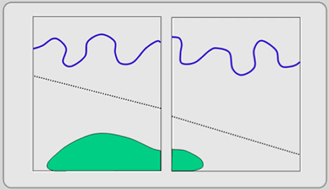
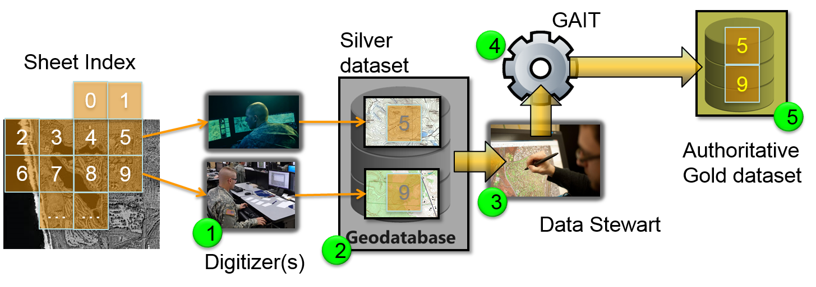
Limitations
5
Experience
disparities
Subjectivity
Man hours
Duplicated effort
Subjectivity
Compounded Man hours
9
Image Source: (GISCommons.org, 2016)
Silver dataset
5
9
3
1
Data Stewart
Digitizer(s)
2
Notes:
The limitations revolve between steps 1 and 3.
In 1979 George Hanuschak performed an empirical analysis to record the cost of digitizing crop areas by hand from LANDSAT imagery. The results of his analysis found that on average a 2.59 Square Kilometer map sheet took roughly 1 hour to digitize once the environment was set for extraction. The project comprised 298 map sheets and cost the United States Department of Agriculture $300,000 to complete over an 11 month period. Computers and software have advanced since then, but methods used, for the most part, are the same.
The name of this report is
“Obtaining timely crop area estimates using ground-gathered and LANDSAT data” for those that wish to read further in to it.
More recently, in 2010 a comrade of mine, Scott Hashagen, performed a Lean Six Sigma analysis on an Army Geospatial Planning Cell’s annual production cycle. The results determined that up to 2 man months were lost per sheet as a result of poor ergonomics and effort being duplicated at step 3 causing a backlog for the data Stewart. Inexperience, subjectivity and the need to recreate blatantly bad data from scratch also contributed to this inefficiency. It all equates to even greater labor percentage costs when salaries are taken into account.
So the main limitations in the current workflow are a result of:
Experience Disparities
Subjectivity
Duplicated Effort
Equate to:
Man hours at large
Another concern is that capability goes unleveraged.
The current workflow:
Doesn’t leverage data values:
Panchromatic Imagery: Pixel Value Multi-Spectral Imagery: Spectral Profile
Relies solely on literal interpretation:
High levels of subjectivity

Slide 6
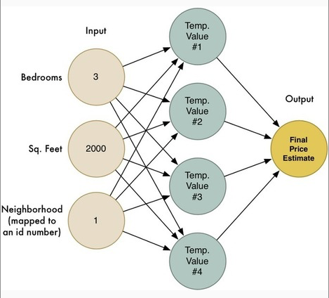
Augment the Workflow
Standardization
Less
Subjectivity
Man hours
Duplicated effort
Less
Subjectivity
Compounded Man hours
Example Neural Network (Pintado, 2016)
Silver dataset
5
9
3
1
Digitizer(s
Data Stewart
Machine Learning
2
Notes:
In my Capstone I intend to experiment with augmenting the current workflow with ML at step 1.
Machine Learning (ML) essentially involves the implementation of artificial neural networks to analyze inputs to determine what they are. A neural network is essentially a computer-coded model of the human brain. (Programmer, 2016) Neural networks, also known as artificial intelligence (ai), are not anywhere near stages of sophistication depicted in TV science fiction, although they are complex enough for tasks such as image/data classification. (M. Kanevski, 2008) .
Neural networks consist of:
input layer for data entry
one or more hidden computational layers
output decisive classifier tier
Its important to note that subjectivity remains a factor when implementing ML algorithms because humans write the code. However it is easier to code a standard into an ML algorithm than it is to enforce consistent interpretation from every individual within a group of human digitizers. The main assumption is that skill and experience disparities among digitizers will be offset with standardization and there will be a significant reduction in both subjectivity and man hours.

Slide 7
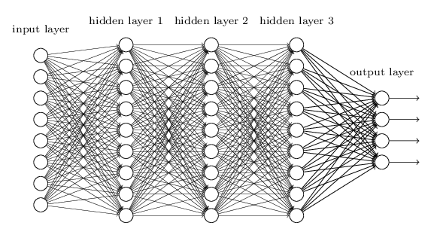
Research Questions
Example Neural Network (Nielsen, 2016)
How to best implement ML in a GIS extraction environment?
What hidden layer(s)/ statistic(s) best support the desired result?
Are the results repeatable on an adjacent sheet?
Scope Management: Tree Canopies, Open Water ONLY

Slide 8
Approach
Available ML Libraries
Implement ML in a GIS extraction environment:
Installed H2o.ai (versions must match on both)
Installed Anaconda
Running ESRI thru Python IDLE 2.7.8
MEGA
Headless
w/o GUI
Several Others
.
.
.
Notes:
There are several Free and Open Source ML Libraries as well as others that are proprietary and provided by commercial vendors. Along the right of this chart I’ve listed Google’s Tensorflow, H2O.ai, MEGA, developed by Harris Geospatial which is not open source and Open AI, just to name a few in no particular order. I first be came interested in how this technology could improve authoritative vector data creation workflows last year. From August 2015 to August 2016 I was fortunate enough to take part in a government exchange program called Training With Industry in which I spent a year at Harris Geospatial working with the team that develops ENVI software. ENVI stands for the Environment for Visualizing Imagery.
In terms of Geospatial application of ML algorithms, the team at ENVI are doing amazing things in several arenas to include agricultural. Applications include auto crop damage detection, auto anomaly detection among many others. In terms of resources and personnel, Harris Geospatial possesses a great deal of expertise in this area of research.
In my capstone I’ll be taking the FOSS approach. Initially I began trials using TensorFlow, but I ran into several compatibility issues since Tensorflow isn’t supported on Windows yet. With ESRI being my tool of choice for extraction, that was an mighty hindrance. Over the last month or so I’ve been running trials using H2O.ai and so far I haven’t encountered any major obstacles.
H2O is open-source software for big-data analysis. It is produced by the start-up H2O.ai (formerly 0xdata), which launched in 2011 in Silicon Valley. The speed and flexibility of H2O allow users to fit hundreds or thousands of potential models as part of discovering patterns in data. (H2O, 2016)
The Approach graphic in the center of this chart draws out what I’ve done so far.
Starting from the top left, I’ve downloaded H2O 3.10.0.9 for both a local install instance in a Java runtime environment as well as the associated python package. Next I’ve installed Anaconda which enables me to bridge 3rd party python packages such as H2O and numpy with ESRI’s arcpy in one environment. USGS has a very comprehensive walkthru on how this is done.
The setup also allows me to call scipy and matplotlib, which I anticipate to be useful as I develop the workflow.
The initial trials will be done 90% in Python IDLE 2.7.8 while calling the arcpy module headless of the GUI. This is because I’ve experienced problems launching H2O’s neural network from the python interface in ArcMap due to interoperability issues with java runtime which H2O requires.
This is not a concern because everything works fine in command line so far and I’ve already mapped out a work around which enables me to call Python IDLE through a ArcMap C# Addin.

Slide 9
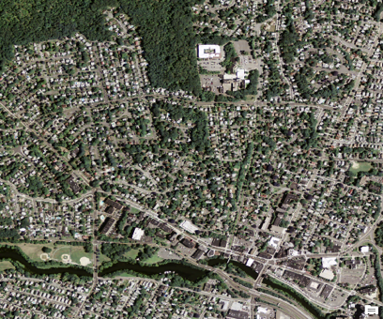
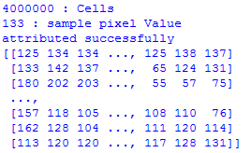
Approach
Available ML Libraries
Numpy Array:
arcpy.RasterToNumPyArray
USGS NAIP Ortho-Image
1
MEGA
Things to consider
Pixel value
Autocorrelation
Manually sample first
Determine mean
Determine median
Determine mode
Determine midrange
How many hidden layers
# Create H2o Dataframe from image Array
df = ml.H2OFrame(zip(*(myArray)))
2
Several Others
.
.
.
# Train to classify tree canopy based on Pixel Value
# Train to classify open water based on Pixel Value
3
Notes:
Now that the environment is set its time to start ingesting data. I’ve pulled down 5 or 6 adjacent 1 meter 4 band ortho-images from USGS’s National Agricultural Imagery Program via the National Map.
I’ve also written code to convert the imagery to a numpy array. This in turn enables me to ingest these data into H2O’s neural network as a dataframe.
Next I need to identify how many hidden computational layers will be needed to classify the array properly for extraction. This is where I see the bulk of the work taking place.
It’s important to note that this is an upfront labor-intensive undertaking so scope management is paramount to successful tests. Training the neural network will require numerous test iterations that eventually lead to backpropogation which I’ll discuss further on the next chart. (Programmer, 2016) Backpropagation, is shortened for "backward propagation of errors".
First I intend to manually sample spectra for the two features in question then determine some basic statistics before exploring advanced stats. I also anticipate the need to consider how autocorrelation could play a role in helping the ML algorithm make the correct decisions.

Slide 10
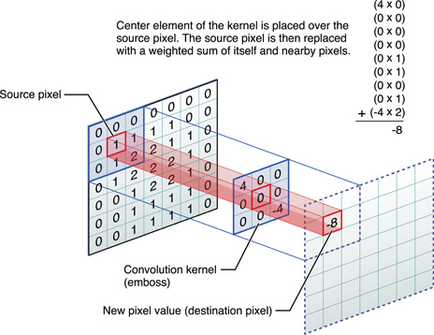
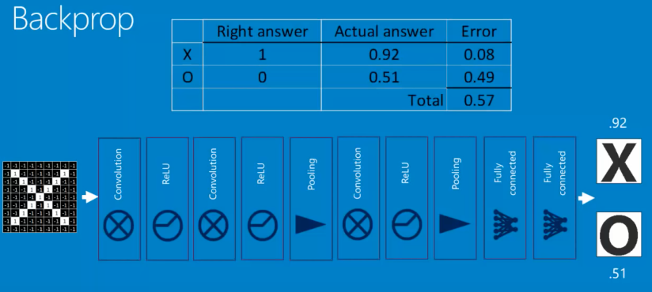
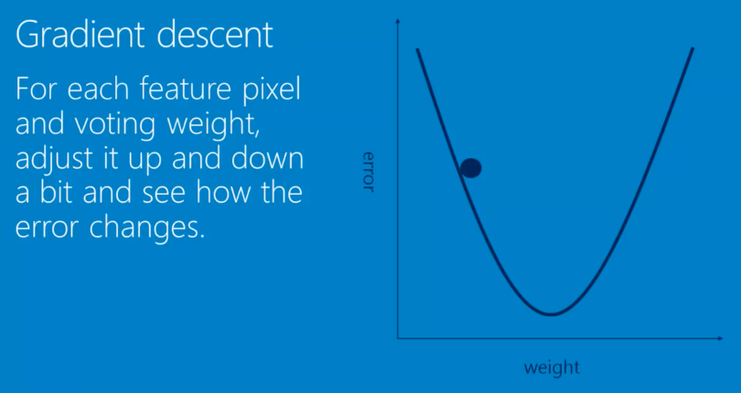
Filling the Gaps
Autocorrelation
Convolutional Neural Network (CNN)
Pooling (down-sampling)
Normalization: -# convert to 0
Gradient Descent
Backpropogation
Hyperparameters
Convolutional Neural Network (Rohrer, 2016)
Notes:
So in previous slides you were shown basic examples of neural networks. Here’s an example of a more sophisticated Convolutional Neural Network (CNN) which is the model I plan to implement as I work to augment Authoritative vector creation. CNN’s are the engines behind image classification technology such as face recognition and other image classification achievements. This technology is also commonly referred to as Computer Vision.
So what essentially happens in a CNN is a pooled sample of features are repeatedly applied as filtered iterations over an image. In other words, it is the act of comparing spectra and spatial patterns then making a classification decision, trying every possible match. The difficulty and beauty in this is that computers are far more literal than humans. This creates difficulty because explicitness is a necessity, otherwise the outcome won’t be as expected. The beauty of it is that once the labor intensive training is done, the machine will be able to discern classification to an explicitly set standard much faster and more thoroughly than human extractors without any personal subjectivity aside from that which might exist in the code.
This approach also takes into account autocorrealtion, considering the fact that things closer together tend to be more often related than things further away.
So, to the top left of this chart is a graphic example of a pooled filter being applied to an image array, resulting in a newly classified array. Filtering is basically the math behind matching parts of the image which takes place when each pixel is multiplied by the corresponding filter pixel then divided by the number of pixels.
Simultaneously, Backpropogation occurs. This is essentially a fail-safe which prevents overfitting. During backpropogation, the neural network will determine best fit parameters such as feature sample size for the convolution layer and voting weights on an image by image basis. Therefore its important to ensure these values aren’t hard coded. This ensures the neural network doesn’t learn the image versus the task. This is also known as overfitting. Overfitting will be ruled out by testing the training results on an adjacent image.
Backpropogation will lend itself to Gradient descent which is depicted in the graph at the lower right. By not hard coding parameters that require backpropogation, Best fit parameters such as voting weight is allowed to fluctuate up and down depending on changes in error computations compiled by the hidden filter layers. This is what essentially enables the machine to learn the task.
So, to the top right is a graphic labeled Backprop. This is an example of a CNN designed to classify an image as an X or an O. This model best fits what I intend to do in my research.
In this example you have an X image as an input layer and at the end/output tier you have a decision point where the Machine determines if the image is an X or an O based on the backpropgation weighting criteria decided by the multiple hidden filter convolutional layers in between.
Convolution is repeated application of a filter over and over again across an image. In other words, the act of trying every possible match. In some instances Pooling (down-sampling) helps offset the literal nature of machines by match smaller… say (2x2 pixels) parts of the image rather than the whole thing at once.
Lastly, to round out the design there are Hyperparameters.
Hyperparameters are decisions the designer gets to make. Things such as:
Number of hidden neurons
What types of layers will they be
What order should they fire
Pooling size and stride
Number of features
Research has determined that there are hyperparameters that tend to work better than others, depending on the task. However there are no steadfast or principle rules in place for the science at this time. Keeping this in mind, documentation of lessons learned along the way is one of my top priorities.
How Convolutional Neural Networks work
Brandon Rohrer
https://youtu.be/FmpDIaiMIeA

Slide 11
Anticipated Results
Training results:
75-80% accurately classified new numpy array per feature
Potential Overfitting (mitigation via trial and error)
Pass binary numpy array back into esri as a new feature class
Convert numpy using arcpy. NumPyArrayToFeatureClass
Keep 1 delete No Data 0
Deliverable:
Python Script (Tool)
Potentially ESRI C# Addin

Slide 12
Timeline
Training results:
DEC 2016 – FEB 2017: Trials and training the neural network
FEB 2017– MAR 2017: Refine outputs
MAR 2017 – APR 2017: Develop Script Tool and/or C# Addin
Deliverable:
Python Script (Tool)
Potentially ESRI C# Addin
Venue:
Army Geospatial Planning Cell Co-production WG: April 2017
NGA St. Louis Brown Bag: Summer 2017

Slide 13
References
Works Cited
D. G. Brown †*, B. C. (2000). Modeling the relationships between land use and land cover on private lands in the Upper Midwest, USA. Journal of Environmental Management. Midwest, USA: Academic Press.
Data Mining, Analytics, Big Data, and Data Science. (2016, November). Data Mining, Analytics, Big Data, and Data Science. USA.
H2oai. (2016, November 14). H2O, Sparkling Water, and Steam Documentation. USA.
Hanuschak, G. (1979). Obtaining timely crop area estimates using ground-gathered and LANDSAT data. Washington DC.
Hashagen, S. (2010). Lean Six Sigma Improve geospatial production process. Wiesbaden Germany.
Harris Visualization ENVI. (2016). ENVI Analytics Symposium Proceedings on MEGA. Boulder, CO: Harris Corporation.
M. Kanevski, A. P. (2008). Machine Learning Algorithms for GeoSpatial Data. Applications and Software Tools. Institute of Geomatics and Analysis of Risk (IGAR), Faculty of Geosciences and Environment, University of Lausanne. Lausanne, Switzerland: University of Lausanne.
MIROSLAV KUBAT, R. C. (1998). Machine Learning for the Detection of Oil Spills in Satellite Radar Images. School of Information Technology and Engineering, University of Ottawa. Boston: Kluwer Academic Publishers, Boston.
Nielsen, M. (2016, 01 01). Neural Networks and Deep Learning. Determination Press . USA.
Nitesh V. Chawla, K. W. (2002). SMOTE: Synthetic Minority Over-sampling Technique. Journal of Artificial Intelligence Research. Tampa, FL: Journal of Artificial Intelligence Research.
Ostermann, F. O. (2015). Hybrid geo-information processing: Crowdsourced supervision of geo-spatial machine learning tasks . University of Twente . AE Enschede, The Netherlands : University of Twente .
Pintado, J. H. (2016, October 01). Errors Are Imminent. Computer Science, Programming, Maths and Big Data . Somewhere, Over the Rainbow, USA.
Poulson, B. (2015, 1 1). Introduction to Data Science. State College, PA, USA.
Programmer, L. (2016). Deep Learning Fundamentals in Python. LazyProgrammer.
USGS. (2014, JAN). Using Anaconda modules from the ESRI python environment (All Users). Rolla, MO, USA.

