Slide 1
Open Web Mapping for Local Units of Government
Developing a Sustainable Framework
for
Small Townships and Villages
Howard Yamaguchi – Geog 596A – Spring 2010
Project Proposal for Peer Review
Advisor – Dr. Ian Turton
Notes:
My name is Howard Yamaguchi, and I’m really happy to see so many familiar names in the audience!
My project is called “Open Web Mapping for Local Units of Government.”
My interest in this project really started when I was one of the planners in Antrim Co., in NW part of the Michigan’s lower peninsula. There, we set up the county’s GIS-oriented website with lots of web mapping built in.
I always wondered if it would be possible to deploy similar, but more localized, web mapping applications for township and village websites
Then in the Penn program I took classes on mashups and open web mapping. And I learned that the technology DOES exists in the open-source world. It’s definitely do-able now! And furthermore, it won’t break local government budgets --- unthinkable just a few years back!

Slide 2
Project Goals
Assist small, resource-strapped Local Units of Government (LUGs) establish a basic in-house GIS capability to create local spatial information products;
Determine how such LUGs can easily and sustainably create and maintain web mapping applications created using such products (maps, databases, etc.)
2
Notes:
My project goals are twofold:
* The first is to help small townships and villages acquire in-house GIS capability;
* The second is to create web mapping apps from the maps and products created using the in-house GIS. And making these sustainable.
By “small” twps and villages, I don’t necessarily mean physically small. I actually mean low population and hence low resources --- cash-strapped!

Slide 3
Overview
Overview of Michigan LUGs
What’s in a LUG Web Map?
Open Source Strategy
Sustainability
Deliverables, Tasks, and Timeline
Notes:
This evening, my presentation will cover five topics.
1. The first is a very brief (and incomplete) overview of local government in Michigan. (bear with me, Michiganders!)
2. The second is a quick glimpse into a couple of existing web map pages
3. I’ll then briefly describe how I plan to use open-source software in this project, followed by
4. A brief discussion on making these web maps sustainable by LUGs
5. Finally, I’ll finish up by giving you an outline of the deliverables and the project timeline.

Slide 4
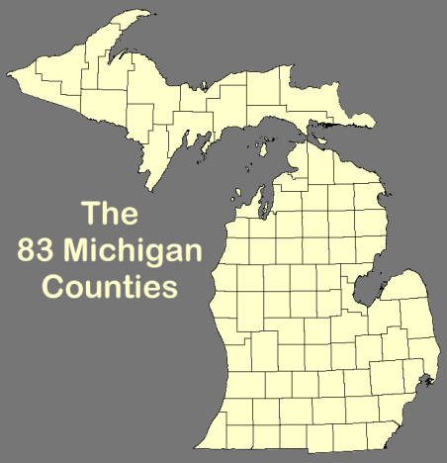
Local Units of Government
> LUG Overview
83 counties in Michigan, containing:
1,242 townships
274 cities
259 villages
Township, cities, & villages: LUGs
Population: < 100 to 910,000 (Detroit)
Notes:
We begin our civics lesson.
Michigan has 83 counties. Inside them, there are 1,242 twps, 279 cities, and 259 vlgs. That’s a lot of local governments !!!
“Local Unit of Government” (abbrev. LUG) is Michigan government-speak for townships, cities, and villages.
Local gov’t have populations as “small” as 100 souls, while the city of Detroit has an est 2009 population of 910,000. As you can imagine, there’s also a huge difference in the levels of government budgets and resources represented by what’s known as LUGs.

Slide 5
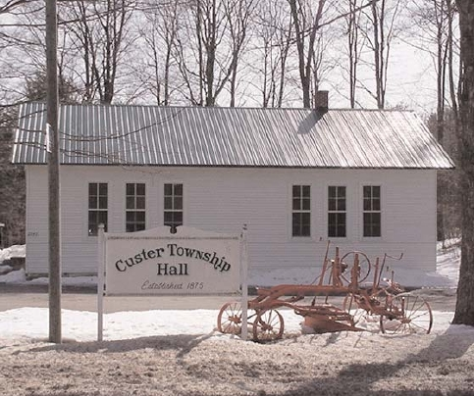
LUGs can provide …
> LUG Overview
Planning, zoning, and (property) tax assessment, property tax collection
Police and emergency mgmt services
Utilities and other services
Elections and political representation at LUG level
Custer Township Hall
Custer Twp, Antrim County, MI
Est. 2009 Pop: 1,052
Notes:
The picture here is township hall of Custer Township, one of the rural townships in Antrim County.
Townships like this can regulate land use by doing their own zoning and planning.
Township assessors evaluate property values annually to determine property taxes, and the Townships issue twice-a-year property tax bills and collect the taxes on behalf of the county and state.
They can also provide emergency management and police services and utility management, if the township is populous enough.
All townships also operate polling stations for local and national elections.
Townships (and villages and cities) all have elected officials to represent local residents at the township level.
In general, Townships deal with issues that are close to the everyday lives of their residents.

Slide 6
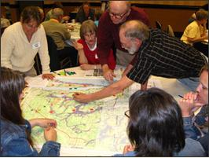
Local Units of Government
> LUG Overview
Often assume onus of local land-use planning
Depend on citizen groups to advise elected officials in planning, park and asset management, etc.
Often do not have access to planning resources such as GIS and web-based mapping
A form of “Public Participation GIS” at local township halls as part of regional transportation planning exercise, Antrim and Grand Traverse Counties, 2007-2008
Photo Source: The Grand Vision
Notes:
Townships and villages with small staffs usually depend to a great degree on local citizen participation.
Locals advise the township’s elected officials make land-use and other administrative decisions.
They do this by serving on planning commissions, parks and recreation advisory commissions, infrastructure management, and farmland preservation committees, just to give you some examples.
Many of the “smaller” townships often don’t have access to planning resources such as GIS and web-based mapping capabilities. They miss out on many opportunities to communicate important information to their residents.

Slide 7
Helping with GIS and Web-based Information Dissemination
> LUG Overview
Basis for informed decision making by LUGs and their constituent citizenry
Help establish in-house desktop GIS capabilities to create spatial data products (maps, DBs)
Disseminate such info to general public via LUG website:
Static maps and info documents (PDF files)
Interactive web mapping applications
Notes:
I feel that providing spatial information to the public via township and village websites is a fundamental service that a LUG owes its residents.
I think that providing a township or village with the means to create and disseminate spatial information products that inform local decision-making would be a major boon to our local democratic process.
My Capstone Project would, in part, provide give some local gov’ts the ability to inform the public thru interactive web mapping applications and downloadable PDF files.

Slide 8
Selecting LUGs for My Project
> LUG Overview
LUGs with populations ≥ 1,000 and < 5,000 usually have permanent office and staff, but not full-time professional planners and technical staff
LUGs with populations ≥ 5,000 tend to have professional planners and technical specialists among full-time staff, with probability being much higher for larger populations
Target LUGs for this project will have populations around 5,000: permanent office and staff, but probably no full-time technical specialists
Notes:
So which local governments to enroll for the project?
I needed to find LUGs that had some permanent staff that were interested and willing to put the time into using a GIS.
The LUG couldn’t be too small, or they wouldn’t have permanent staff. If it were too big, then they’d have gov’t departments staffed with professionals paid to do the work.
So I decided on LUGs with population of around 5,000, give or take a couple of thousand. They’d have a permanent office and staff, but may or may not have a full- or part-time planner or tech specialist.

Slide 9
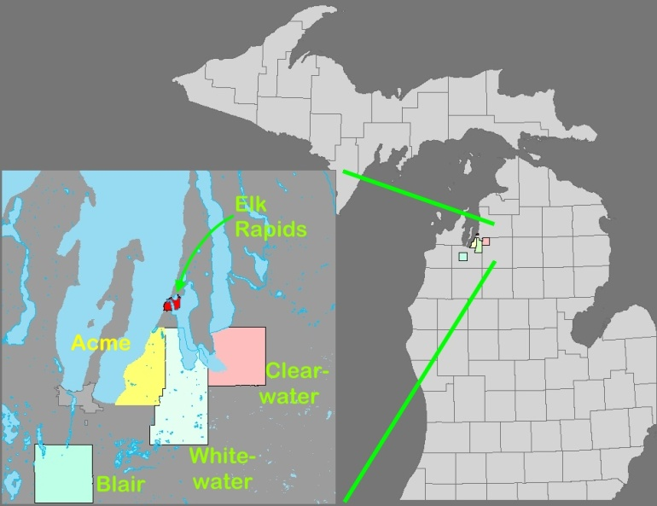
Capstone Project LUGs (Start with two, later add some more [Whitewater, Blair and Clearwater Twps?])
> LUG Overview
Acme Township
Grand Traverse County, MI
Village of Elk Rapids
Antrim County, MI
Est. 2009 Populations:
Acme Township: 4,579
Village of Elk Rapids: 1,650
Whitewater Township: 2,899
Blair Township: 6,952
Clearwater Township: 2,382
--- U.S. Census Bureau, June 2010
Notes:
I’ve had two LUGs on board now, and they have already started making maps using open-source GIS.
One is Acme Township, where I live. The township manager is the interested party there.
The other is the Village of Elk Rapids, about 10 miles to the north. The village’s zoning administrator is the main mover there.
Yesterday, two other townships signed up: Whitewater Twp, a neighbor to Acme Twp. Their part-time twp planner is the main party there.
The other is Blair township, where their brand-new, just-out-of-college planning and zoning administrator is very enthusiastic.
This young zoning administrator minored in GIS in college --- very familiar with mashups and web maps.
At the other extreme, Elk Rapids’ zoning administrator is a complete newbie to GIS, and needs to be taught the use of GIS software.
The Acme twp manager and Whitewater twp planner both have good GIS skills, so after getting them set up, my assistance there should be minimal.
This range of skill sets represented here will give me an interesting set of “lessons learnt” guidelines for web map sustainability at the LUG level!

Slide 10
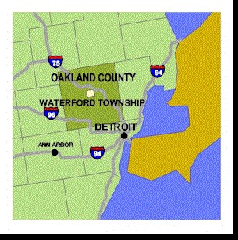
Waterford Township
> LUG Web Maps
Sophisticated system maintained by professional GIS Department
Rec facilities, political boundaries (voting and school), parcel data, aerial DOQs, educational facilities, etc.
Population 73,500
34 lakes and numerous hi-valued properties
(http://maps.twp.waterford.mi.us)
Notes:
On this slide, I thought I’d show you one of nicer web map applications I came across, by a large township with a professional GIS staff.
This is Waterford Township in Oakland County, just north of Detroit. This twp has a population of 73,500 (est 2009) , 34 lakes, and lots of hi-valued lakeside properties.
The twp has a professional GIS department who either had this sophisticated map created by consultants, or possibly created it in-house. The screen shows a parcel map with clickable parcels that would display property info upon click.

Slide 11
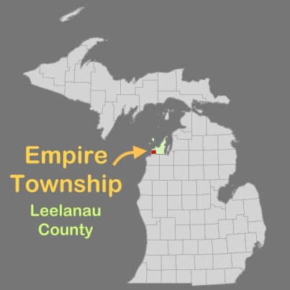
What interactive layers are in the LUG Web Maps?
> LUG Web Maps
Parcel data (tax info, assessment and sales info, ownership)
Base layers of aerial photo DOQs, USGS topos, historical maps
USDA Soil Survey use suitability layers;
FEMA flood insurance layers;
EMS, 9-1-1 street addresses, and utility lines, and zoning;
Ag land preservation and nat’l resource conservation ;
Local POIs
Just about any layer!!
Empire Township, Leelanau County, Michigan
Population 1,463 --- Sleeping Bear Dunes Nat’l Lakeshore
http://www.leelanau.cc/maps
Notes:
So what kind of info layers are typically available in web maps?
As you can see from the list, it’s just about anything that the local gov’t wishes to present to the public. The information that it deems most important should go up first.
The common thread in just about all LUG web maps is the parcel tax data. As I said earlier, LUGs assess property values and collect taxes. They also do land use regulation. This creates a demand for parcel and other land information from the public, and this is one application that all LUGs carry as web apps on their websites.
OK… so how do I plan on making these web maps ?

Slide 12
Web Map Implementation
> Open Source Web Map Strategy
Two-step Strategy
Create a GIS map/web app prototype at LUG using open source software (QGIS) --- also create static PDF for download
Create web map from QGIS project using :
Google or Bing Map Mashups, and/or
Thin web client (OpenLayers) using GIS layers served from a dedicated map server
Notes:
Web map creation is a two-step process:
The first step is for the township or village to produce a GIS map. Unless the township already has GIS software, they will be using QGIS, an open-source full-featured desktop GIS client. I will be riding herd. (Herding cats.)
The next step is to take the completed QGIS “project” and create web apps from it, either as a mashup (Google/Bing) or as a thin web client app.
I’ll elaborate more in the next couple of slides.

Slide 13
Outfitting LUGs with QGIS software (open source)
> Open Source Web Map Strategy
Huge variation degree of in PC- and GIS- savviness in LUGs, may need much (or very little) tutoring
QGIS is readily available from www.qgis.org, reasonable amount of support in forums, frequent updates
QGIS screen showing Acme Twp parcel data from attribute table
(shape file obtained from Grand Traverse County)
Notes:
So what is our open-source tool of choice?
QGIS stands for “Quantum GIS,” and is freely downloadable from qgis.org. It’s one of the projects of the Open Source Geo Foundation, and is currently at version 1.5. It’s a full-featured GIS desktop client in its own right. Support via several on-line forums.
Open-source products have little or no up-front installation costs, and no maintenance fees, but support is hard to get other than via forums. I expect to have to provide continual hand-holding to some of the LUG participants. And here I am, learning this product as we go along!

Slide 14
Two Kinds of Web Maps QGIS “projects” can be transformed into:
> Open Source Web Map Strategy
Google/Bing-type Map Mashups
OpenLayers thin client with GeoServer/QGIS-Mapserver
Geog 497J
Geog 585
Note the different Acme Twp shapes in the two maps! Google Maps uses Mercator Projection (WGS 84 datum) while the thin client in this case (using layers served by GeoServer and by a USGS map server) uses GCS (WGS 84).
Notes:
This slide shows you the two kinds of web maps that we can make: a Google/Bing Mashup and a thin web client.
A mashup is a webpage that invokes an Application Programming Interface (API) from Bing, for example. The API and code on the web page instructs Bing Maps to read and render our layer and data files onto Bing base maps, and that creates an interactive mapping app on a webpage.
A thin client is web page that calls up the OpenLayers JavaScript library. The OpenLayers commands send requests to various map servers, which then respond by sending map images and data layers to be displayed and interacted with in the browser.
It’s similar to mashup, but we have more control over the basemaps and the layers we want served and what we can do with them. But the system is somewhat more complex to set up and operate than mashups.
Both the maps are outlines of Acme Township, but the Google Map uses a Mercator projection, while the thin client uses GCS (both with WGS84 datum). What a difference in apparent shape!
The next slide shows the web map production workflow in nauseating detail.

Slide 15
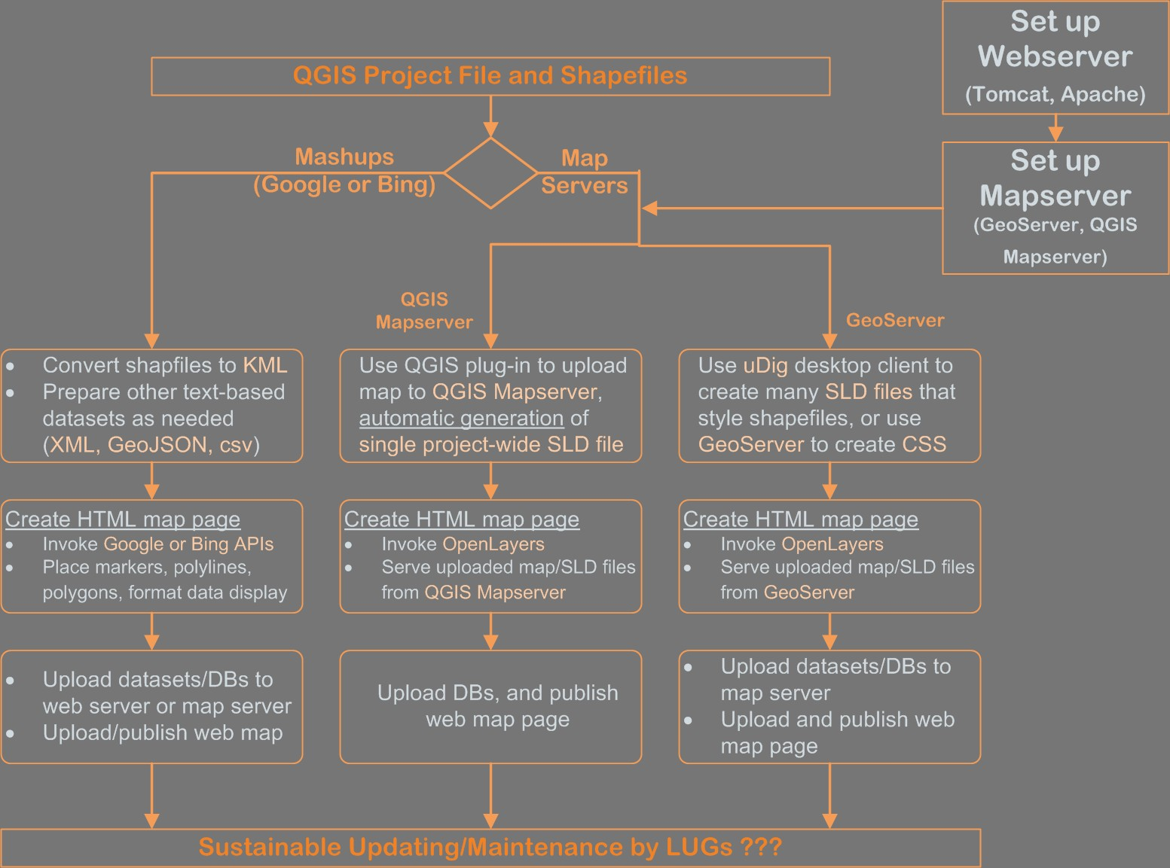
> Open Source Web Map Strategy
Web Map Workflow
Notes:
I envision three paths that a map from the LUG will take. One is the Mashup route, probably using Bing Maps (more later).
The other two are thin clients calling on mapservers for files. I anticipate trying out two mapservers, “QGIS Mapserver” and “GeoServer.” The two mapserver software packages need to be set up and maintained.
All three paths have analogous sets of tasks.
The first set contain tasks that take the QGIS project and converts the spatial and styling information therein to something that a web app can use.
For Bing Maps, we’ll need to take the shapefiles and convert them to KML files (or other text files).
For the two mapservers we can use the shapefiles directly, but we also need to take the styling information from QGIS project files to create styled layer description (SLD). (Or for GeoServer, we can also create CSS files for styling as well.)
The second row of boxes describes the creation of the web page that displays the maps. I already talked about that at length in the previous slide. All of three of these HTML pages can reach out via APIs or OpenLayers to third-party public servers on the internet to grab additional base maps and layers.
The third row of boxes just tells us that after we’ve created all these necessary files using our PCs, we have to upload them to the appropriate web and map servers so the web maps can go on-line and the public can start using them!

Slide 16
Sustainable Web Map Ideas QGIS projects – Data Files and Datastores- HTMLs
> Sustainability
Strive for simplicity, not computational efficiency or elegance --- e.g., if updating a text file is easier than updating a powerful geodatabase, go for text file
Use tools familiar to LUG staff --- word processors and spreadsheets rather than desktop databases:
VBA macros for Excel and Word
Excel concatenation functions in spreadsheet cells
available web-based tools (“Mr. Data Converter,” etc.)
Ultimately depends on computer skill level of LUG staff.
Bing API rather than Google: Michigan’s contract with MS for Bing Enterprise
Notes:
So once we have web maps, how do we keep them going sustainably?
I think that a guiding principle at this early stage would be to seek simplicity. Read first bullet.
Employing familiar tools in the care and feeding of data layers and files would be a plus. I’ve listed a few techniques that would automate some updating tasks.
In the end, depends on the GIS and computer skill level of the LUG staff. Going back to text database vs geodatabase, for our young zoning administrator that minored in GIS, maintaining a geodatabase may be more appropriate!
Also, at another level, it may be a “sustainable” practice to use Bing map mashups instead of Google because the state of Michigan has just entered into a contract with Microsoft Corp. to make Bing Maps Enterprise Version available for use by all levels of government in the state There is promise of additional state map layers and data layers that will be served via Bing Maps.
As we go into the project and start maintaining maps, we’ll start out with these principles and see how it goes.

Slide 17
Project Deliverables
> Tasks, Deliverables and Timetable
Web map applications for participating LUGs
Documentation of various methods used to effectively and simply update web map components
A “lessons learnt” document/paper at end of project for use as guidance document by LUGs --- continually update document
Present paper at FOSS4G conference
Notes:
So here are the deliverables I’ve set for the Capstone Project.
Read bullets.

Slide 18
Key Tasks and Timetable
> Tasks, Deliverables and Timetable
Task | Timetable
Creation of QGIS Projects by LUG (at least two from each LUG – one mashup, one thin client) | Ongoing, through January/February 2011
Set up, operate web servers, map servers, and datastores on PC and on Linux-based Map Server machine | Setup in October 2010, operate through project life (and possibly beyond)
Conversion of LUG QGIS Projects to Web Maps (mashup and thin client) | Oct/Nov 2010 – March 2011 (possibly beyond)
Design and operate trial “sustainable” web map update/maintenance procedures | Nov 2010 – April 2011
Compile “Lessons Learnt” guidelines for web map creation from QGIS and for map update/maintenance | April 2011
Submit conference abstract | April 2011
Complete/submit conference paper | July 2011
Present at FOSS4G Conference, Denver CO | Sept 2011
Notes:
These are the main tasks and their timelines. My conference, assuming my talk is accepted, won’t be until September next year, so I have time. Which I need, since I’m dealing with LUG officials who’ll be doing this in addition to all their regular tasks.
I expect to finish up the “Lessons Learnt” document in April in time for submitting an abstract to the conference, and God willing, I’ll be able to present at FOSS4G next year in Denver!

Slide 19
We’re done! Questions?
> Whew!
Prototype Township Parcel Data Web Map

