Slide 1
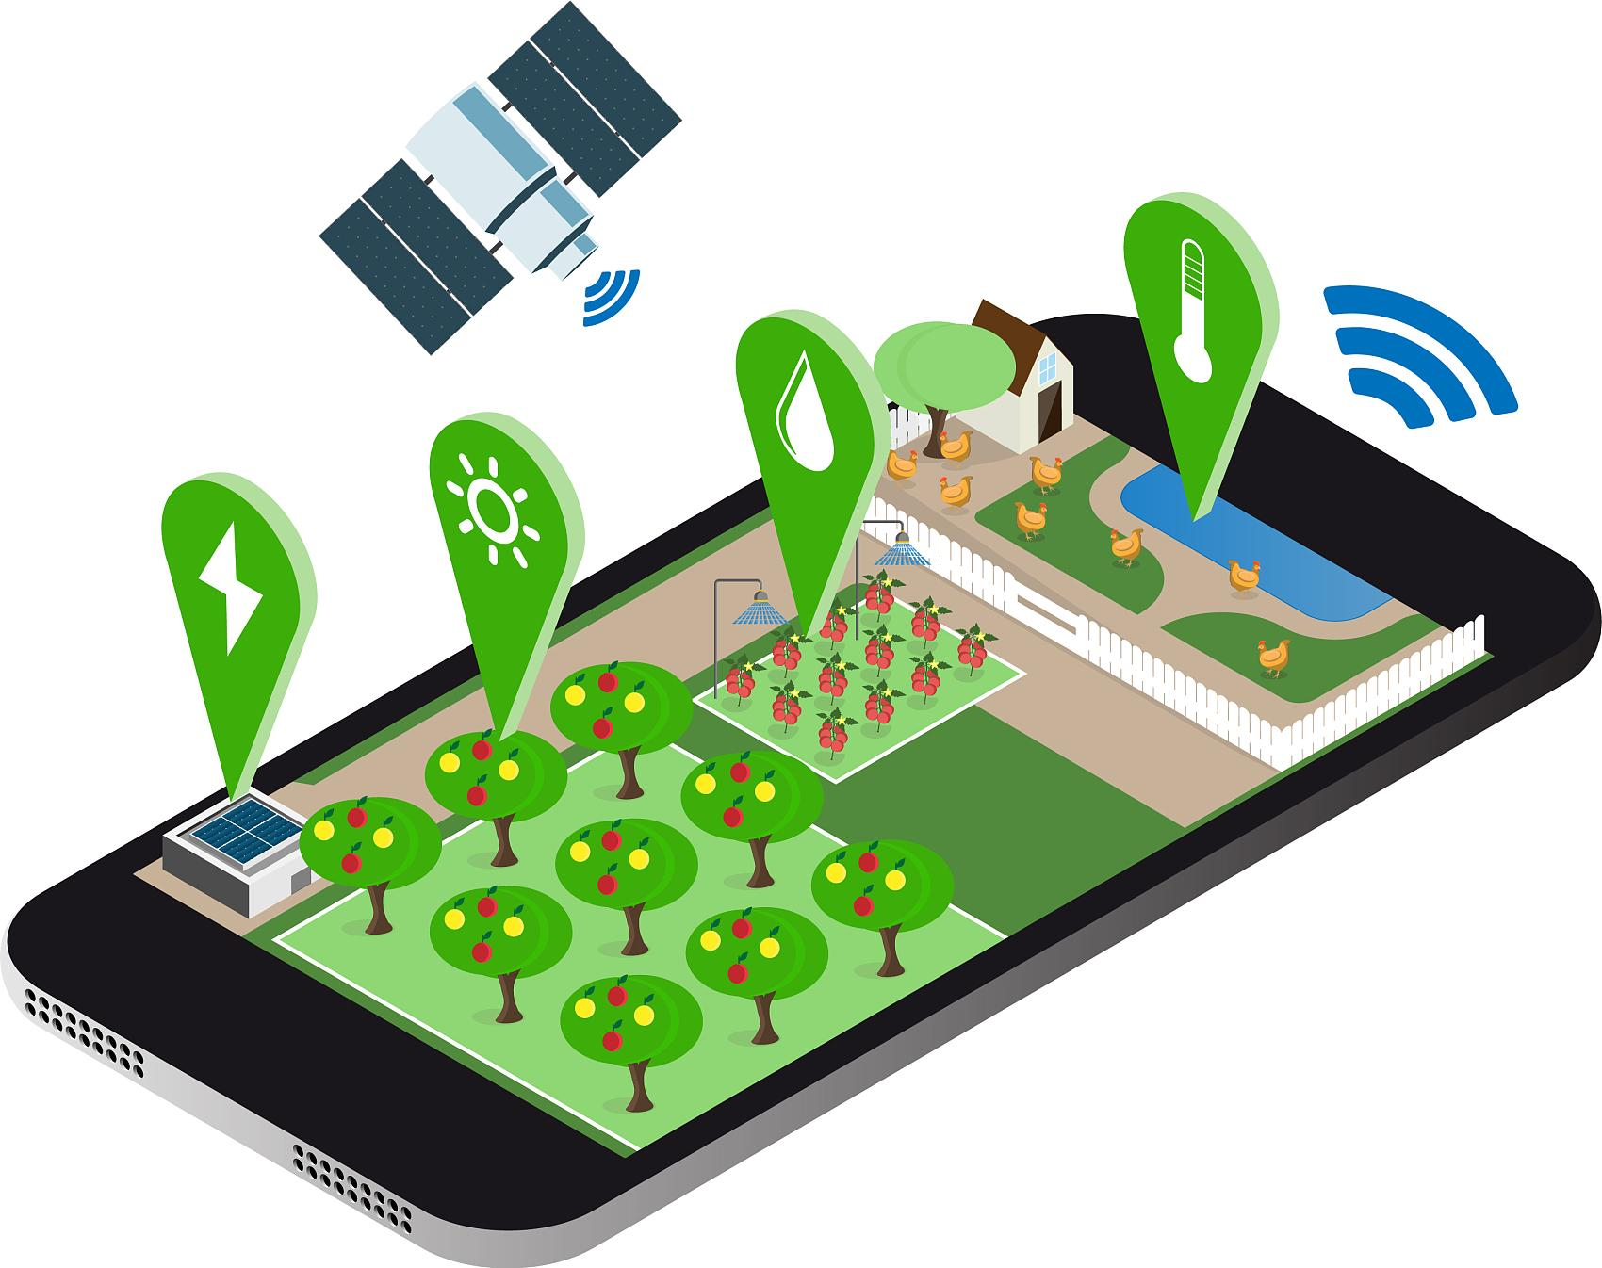
Designing a “World Co2 Emission Monitoring” Mobile Application
Dongyi Zhao
GEOG 596A Capstone Proposal Presentation
Summer 2022
Advisor：Guler, S. Ilgin

Slide 2
Agenda
01
Background
02
Objective
03
Methodology
04
Anticipated Results
Project Timeline
05
06
Reference

Slide 3
01 Background

Slide 4
Global situation
1) Greenhouse effect：Global climate warming, Glacial melting, Sea level rise, El Niño phenomenon, etc...
2) Ecosystem crisis
2) Rise in sea level
3) Natural desaster
5) Desertification
biyanicolleges.org

Slide 5
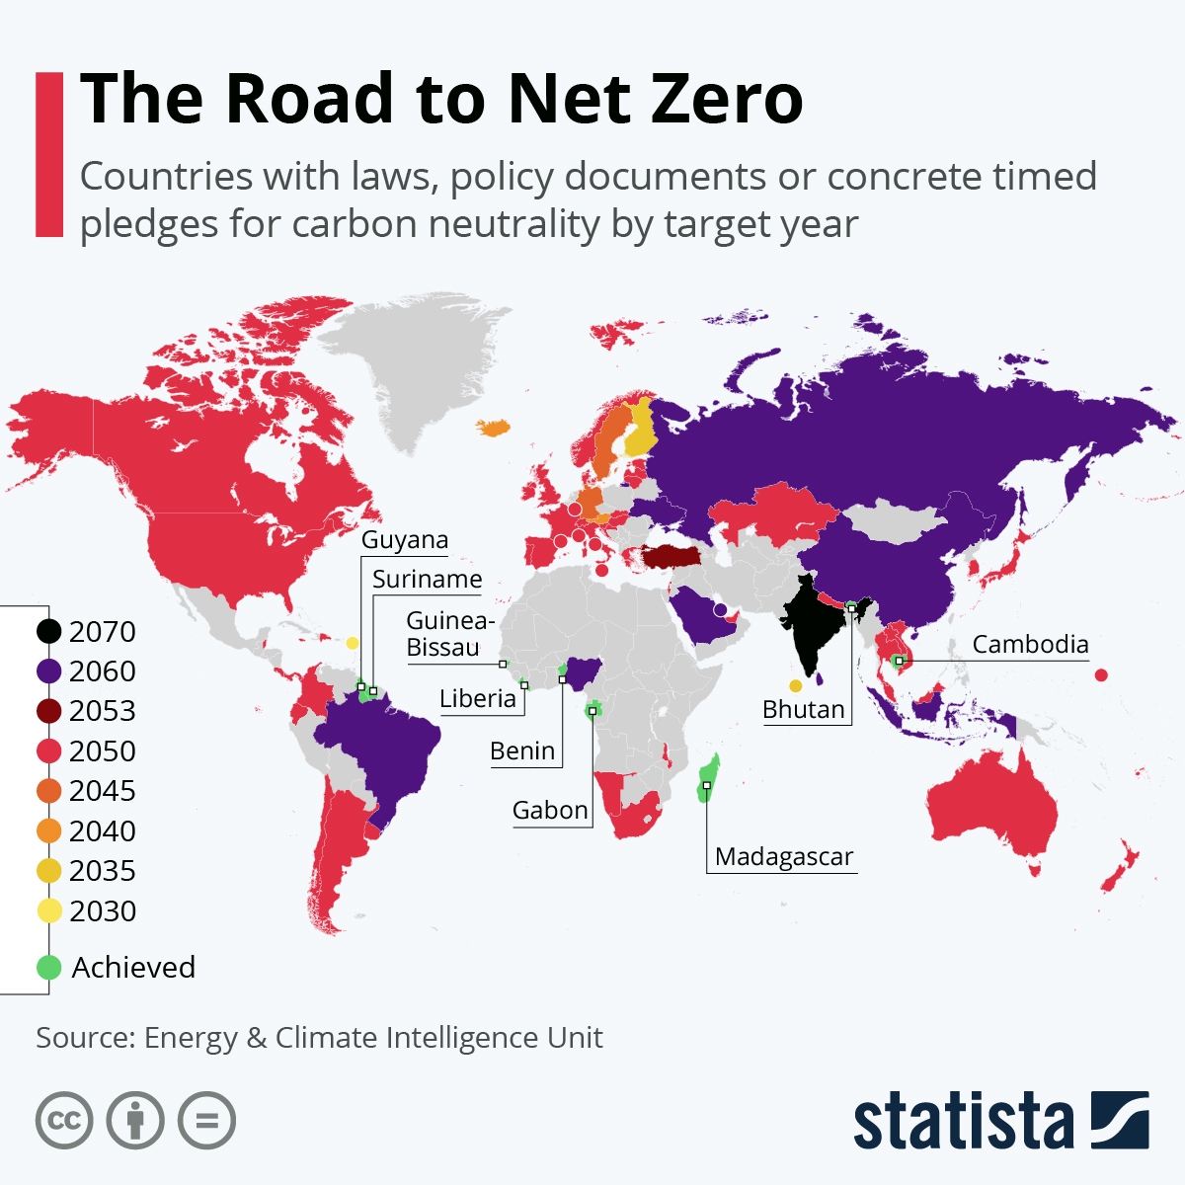
“Out of the 135 countries pledging carbon neutrality, only 66 have put a target year on their policies, laws or propositions according to data by Net Zero Tracker. ”

Slide 6
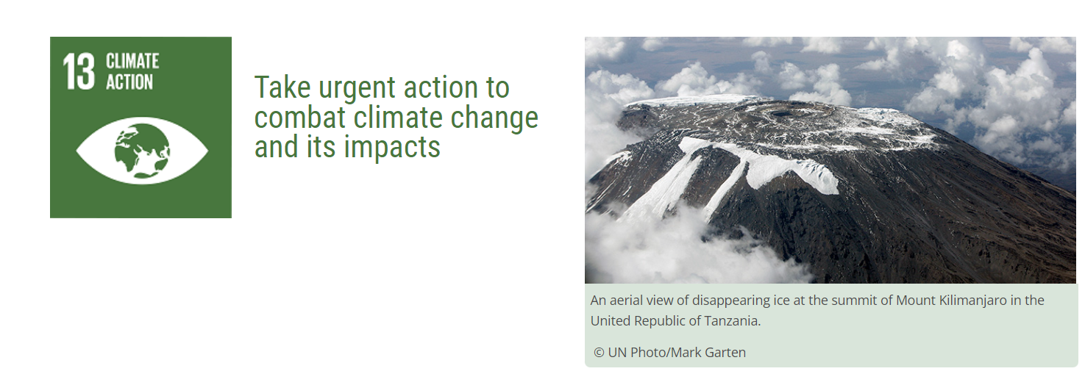
United Nation Sustainability Development Goals（UNSDG）
· greenhouse gas emissions will continue to increase without critical steps to shift economies towards carbon neutrality

Slide 7
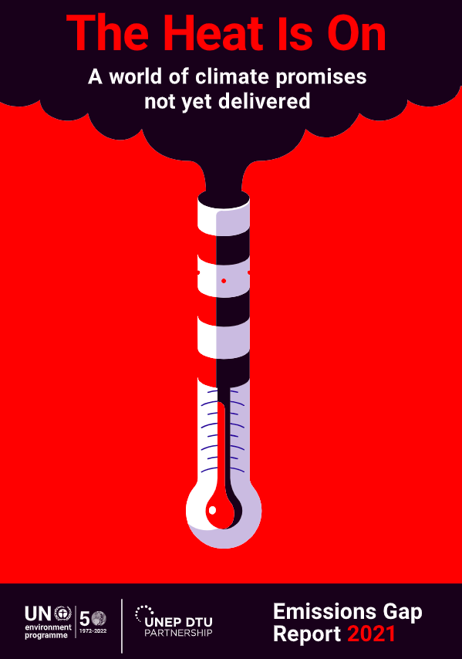
UNEP：EMISSION GAP REPORT (2021)
“...new national climate pledges combined with other mitigation measures put the world on track for a global temperature rise of 2.7°C by the end of the century. That is well above the goals of the Paris climate agreement and would lead to catastrophic changes in the Earth’s climate. ..”

Slide 8
02 Objectives

Slide 9
The primary goals and objectives of this project include the design, build-out, and testing of a user-friendly mobile application that will enable to :
a.Query, visualize, and report the effective carbon emissions status of each country and region.
b.Identify, compare and analyze the performance of carbon emissions for each area.
c. Allow users to receive essential messages related to co2 emissions and take action.

Slide 10
03 Methodology

Slide 11
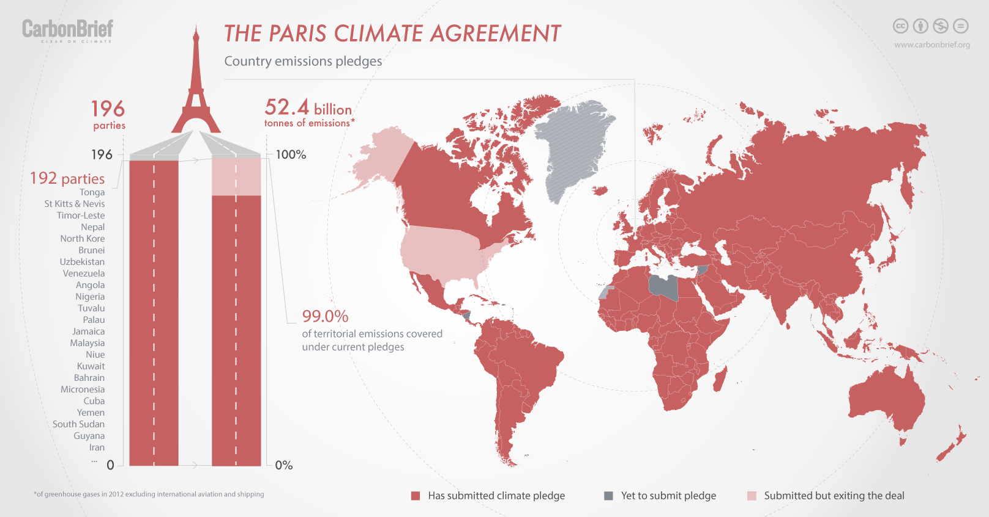
Methodology
1. Analyze and document the current available co2 information,

Slide 12
Methodology
2. Literature Review:Geog 583-geospatial system analysis and design
Needs Assessment
analyze available solutions
developing design and software architecture
finish the designing part and going todevelop process
data preparation

Slide 13
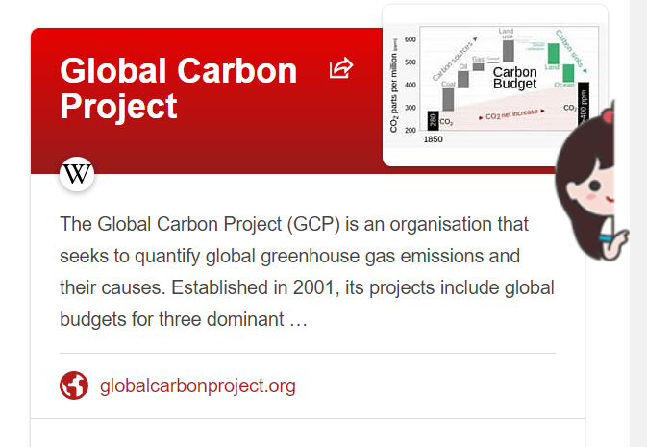
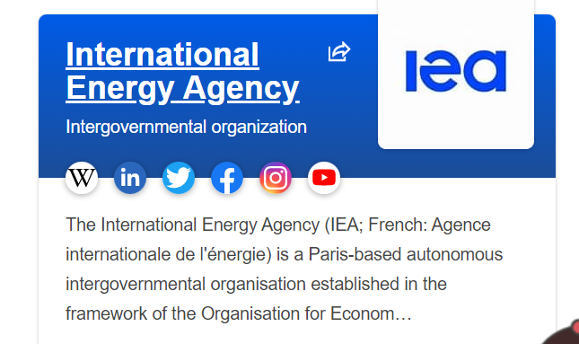
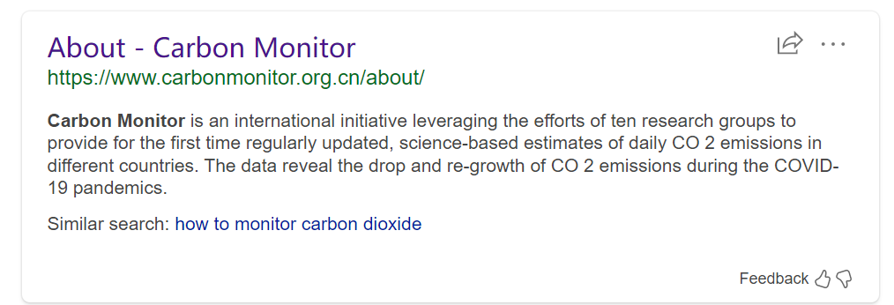
Methodology
3. identify the data; define the database tables and their relationships;
develop and implement the database in a relational database management system

Slide 14
Methodology
4. Prepare and test mockups of the user interface for field data collection application
5. Create a prototype of the application and carry out testing by using Balsamiq
6. Designing of database operation process with the mobile system architecture, complete the demo of application with full interation design.

Slide 15
04 Anticipated Results
-The complete propotyping design of co2 emission monitoring application
-The application must be able to deliver the essential information of current co2 emissions situaion and build-up the awareness to users.

Slide 16
05 Project Timeline

Slide 17
July 2022, | Complete the proposal
Week 1 | Research on the current co2 emissions acts, global situation, and similar application
Week 2 | Start writing the final project, organize all information, and start design the module of application
Week 3 | Start propotyping the interface of application, as well as prepare the final paper
Week 4&5 | Finish the mockups, organize all deliverables to final paper and create the final presentation

Slide 18
06 Reference

Slide 19
Q & A
THANKS

