Slide 1
Applying Geostatistical Analysis to Evaluate Production Trends in the Permian Basin
Lisa M. Zoellick – MGIS Candidate
Patrick Kennelly, PhD – Advisor
GEOG 596 A
December 18, 2015

Slide 2
Background – Natural Gas Facts
Besides being used as a heating fuel for more than half the homes in America, natural gas is also used in the manufacturing process for paper, fertilizer, bricks, photo film, trash bags, medicine
~ 4 million Americans employed directly or indirectly by the natural gas industry
Shale gas activity expected to generate $37 billion in government revenues by 2020 and $57 billion by 2035 (IHS Global Insights)
Revenues used for road construction and other services
Natural gas compliments renewable technologies such as wind and power, providing the necessary low-emission backup generation
Natural gas is efficient. About 90 percent of the gas produced is delivered to customers as usable energy. Greater efficiency means fewer greenhouse gas emissions
North America has more natural gas than Saudi Arabia has oil. As a nation, we must continue our focus on safely and responsibly developing this clean-burning, sustainable and versatile energy resource
*Facts taken from “Natural Gas Facts” Spectra Energy. 2015.

Slide 3
Presentation Overview
Background
Problem
Goals and Objectives
Proposed Methodology
Anticipated Results
Timeline & Logistics
Acknowledgements & References

Slide 4
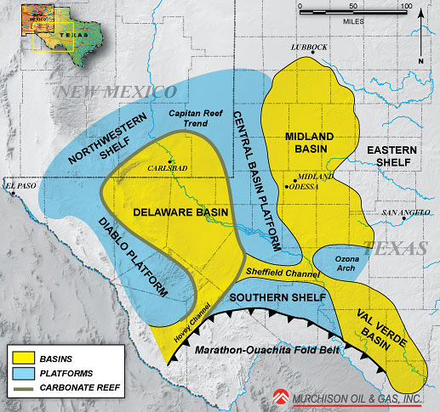
Background: Geography
The Permian Basin is a huge geologic area in western Texas and southeastern New Mexico
52 counties
75,000 square miles (48 million acres)
The Permian Basin is split into 2 main sub-basins
Midland Basin
Delaware Basin
Fig. 1. Map of Permian Basin Structural Setting. Murchison Oil and Gas. 2010. Web. 9 Oct 2015.

Slide 5
Background - Paleogeography
Late Permian 260 MYA
Permian Basin
Fig. 2. Map of Late Permian Geologic Age. Copyright Ron Blakey Colorado Plateau Geosystems Inc. 2010. Web. 9 Oct 2015.

Slide 6
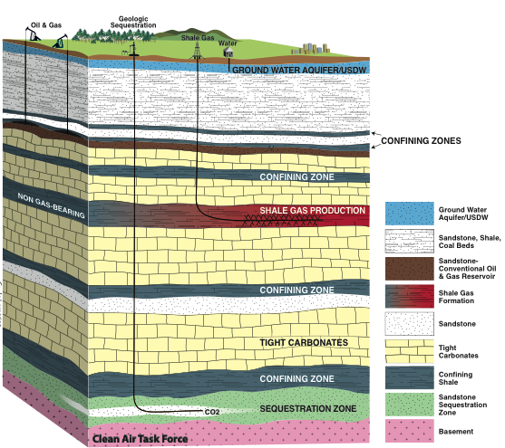
Background: Oil and Gas Industry
~23 prospective formations with up to 25,000 ft of multiple, stacked, petroleum systems
>1,000 operators
>500,000 wells
Extensive drilling, coring and geological studies since 1920s
= MASSIVE AMOUNTS OF DATA
Fig. 3. Modified image of stacked formations schematic diagram. Fossil Blog. 2012. Web. 13 Nov 2015.

Slide 7
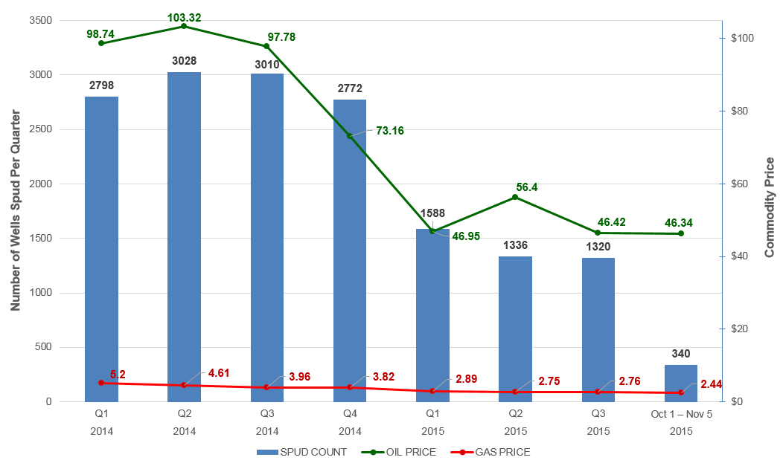
Background: Wells Spud Q1 2014 – Q4 2015
Fig. 4. Graph of Spud Wells from 2014-2015 with the average commodity price. Lisa Zoellick. 2015. Web. 5 Nov 2015.
Note: Graph created using well spud data from IHS; natural gas and oil commodity prices from the U.S. Energy Information Administration

Slide 8
Problem & Challenges
Due to the amount and complexity of data, maps showing Permian Basin production distribution are unable to capture the entire story
Gather tremendous amount of data and make it fit together
Geologic
Geophysical
Petrophysical
Production
Reservoir properties
Well log data extremely time-consuming to capture
Fig. 5. “Integration of multi-disciplinary data, including reservoir simulation, 4D seismic, seismic attribute extractions, structure model, and production data.” Dynamic Graphics. 2015. Web. 10 Dec 2015.
Data not integrated across disciplines or area, often data silos

Slide 9
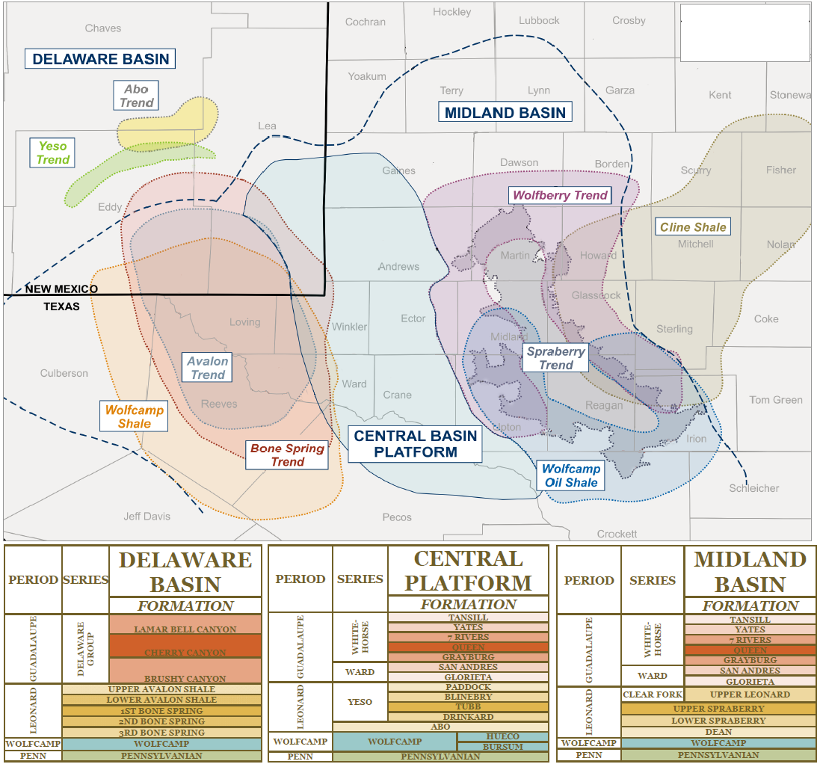
Objective
Relate production information to specific geologic horizons through quantifying existing interpretations from geologists and engineers
Use GIS to disseminate production, log data, and reservoir properties to evaluate production across an entire basin
Determine which geologic zone a well landed in
Process Improvement
Develop workflow that will improve accuracy of regional basin analysis and reduce basin evaluation time
Fig. 6. Map of Sub-Basins and stratigraphy in the Permian. Shale Experts. 2015. Web. 13 Nov 2015.

Slide 10
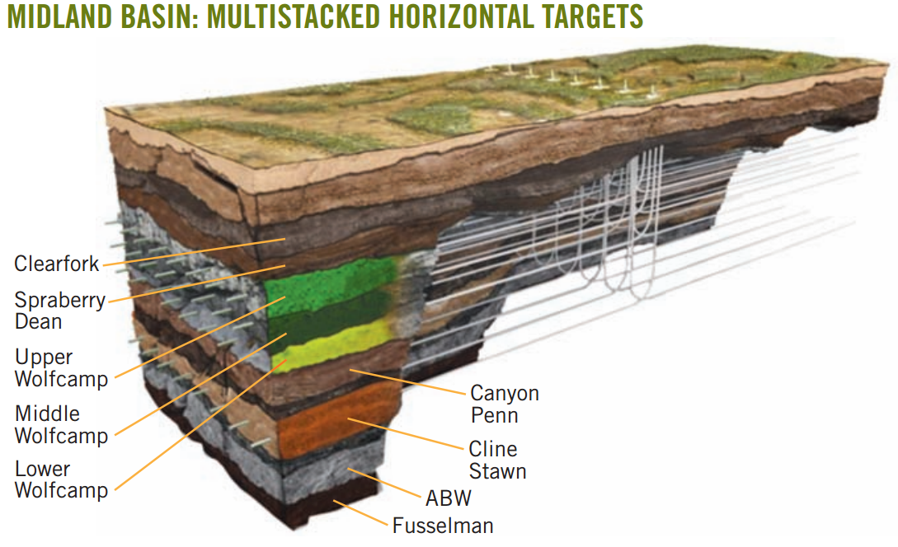
Goal
Use exploratory spatial data analysis to quality control check data and determine the best methodology to interpolate data
Geostatistical evaluation to create surfaces for geologic horizons and petrophysical parameters
Determine values for wells that have not been interpreted based off the geostatistical layers
Quantitatively rank performance of production with respect to formation rock quality
Fig. 7. Map showing stacked formations. Midland Basin: Multistacked Horizontal Targets. Oil & Gas Journal. 2015. Web. 28 Nov 2015.

Slide 11
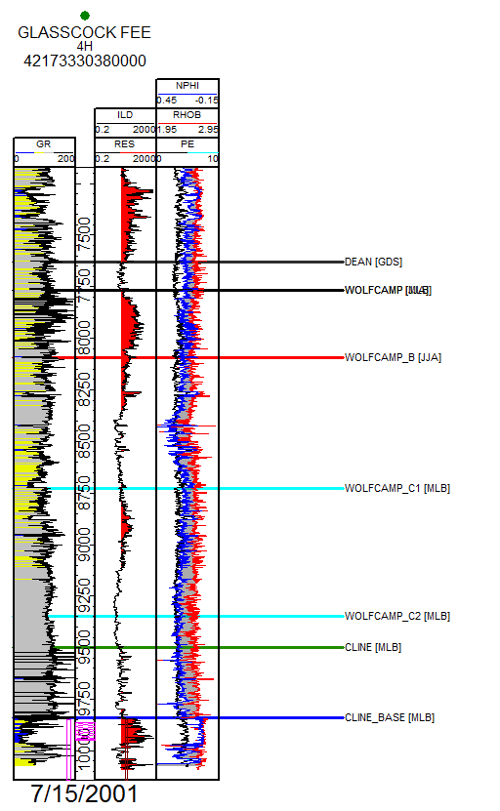
Methodology: Mapping Formations & Well Log Attributes
Obtain geologist’s interpreted data
Unique identifier (API)
Coordinates
Formation top
Total vertical depth subsea (TVDSS)
Incorporate statistics from the raw well log data provided by the geologist
Gamma intensity – measures the radioactivity of rocks to determine the amount of shale in a formation (API units)
Resistivity – measures electrical resistivity for formation evaluation; different fluids conduct different amounts of electricity - (ohm•m)
Neutron – measures the hydrogen content in a formation (porosity units)
Bulk density (g/cm3) – used in determining porosity
Evaluate data using Exploratory Spatial Data Analysis (ESDA) tools
Use Empirical Bayesian Kriging (EBK) to create interpolated surfaces for each horizon and variable
Fig. 8. Interpreted well log. Matt Boyce, PhD. 2013. Southwestern Energy. 2 Dec 2015.

Slide 12
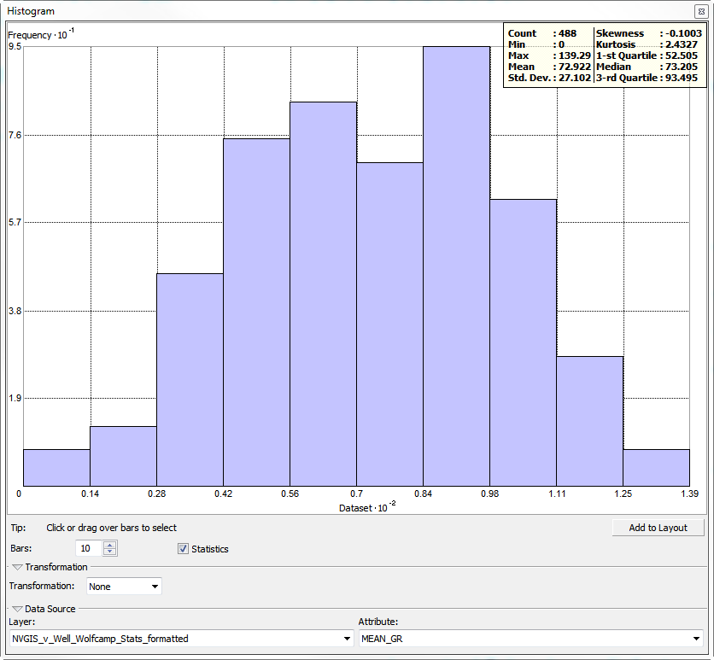
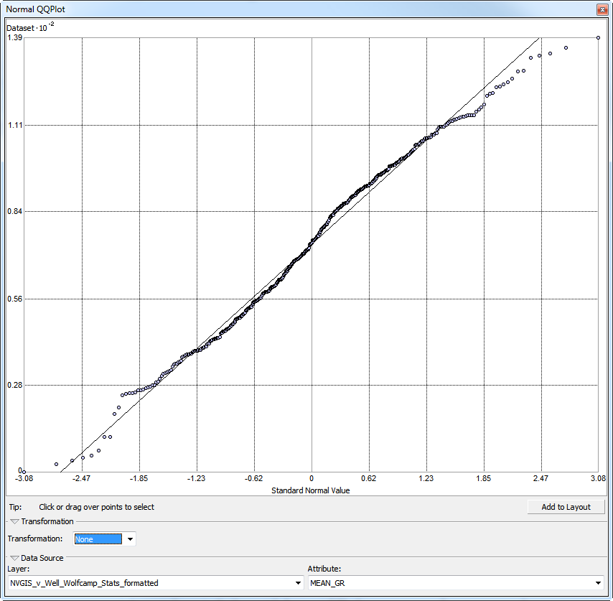
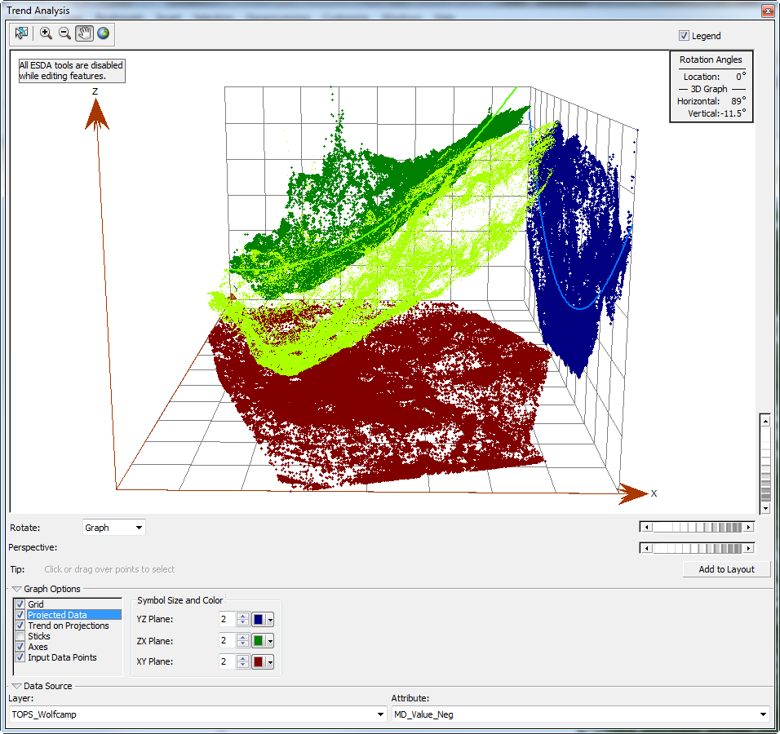
Methodology: Exploratory Spatial Data Analysis
Mean: 72.9
Median: 73.2
Skewness: -0.1
Kurtosis: 2.4
Trend Analysis
Histogram
Normal QQ Plot

Slide 13
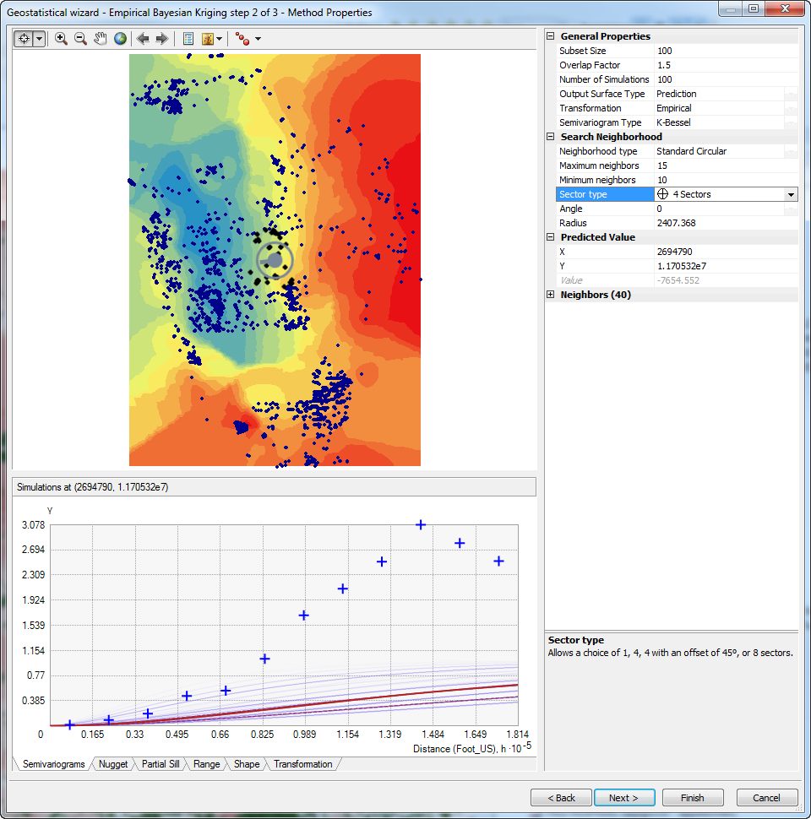
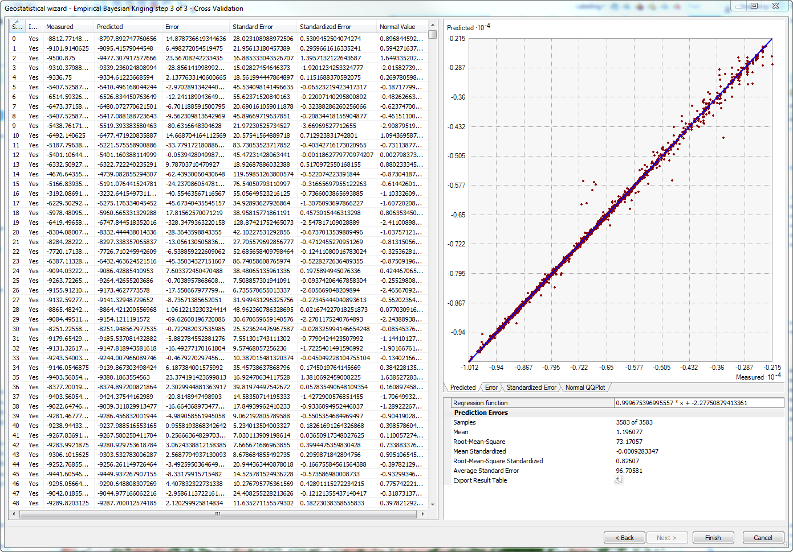
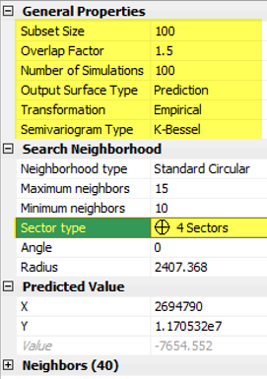
Methodology – Kriging Wizard

Slide 14
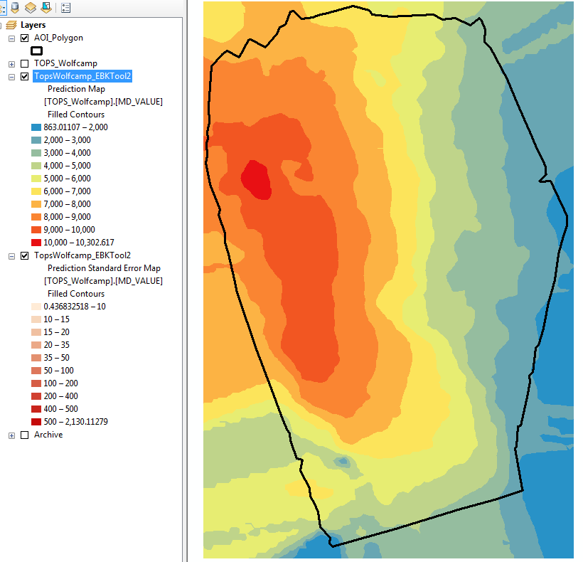
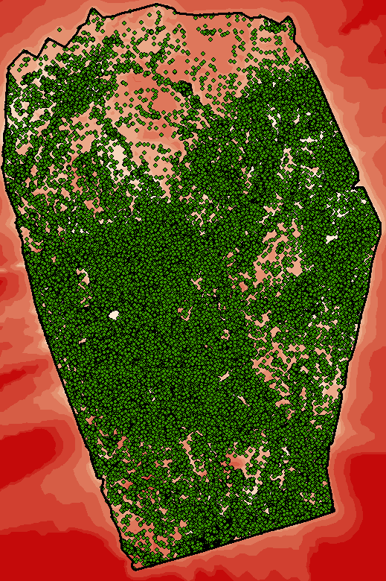
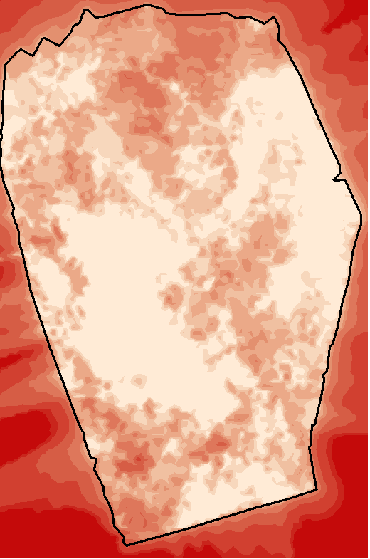
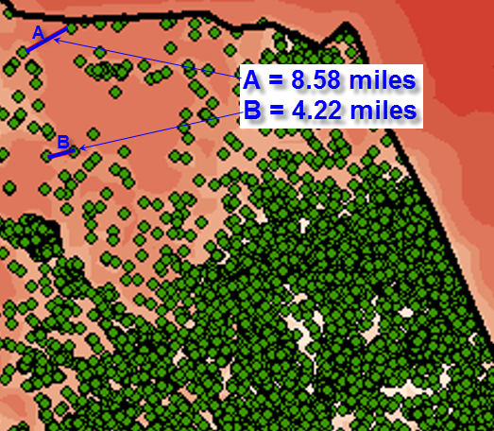
Example Results – Wolfcamp A Surface
Prediction Map
Control Points
Prediction Standard Error Map
AOI covers 21,075,775 acres

Slide 15
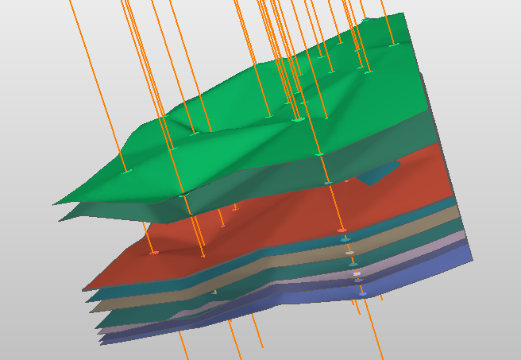
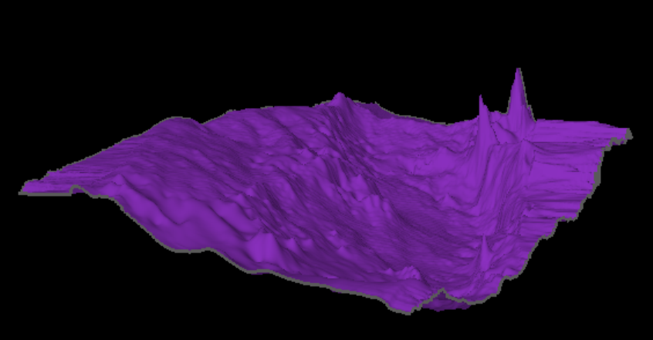
Example Results – Wolfcamp A 3D view
3D surfaces created for each geologic zone
Able to identify which zone the well produces from

Slide 16
Expected Results
20 EBK interpolated grids for:
Formation intervals
Wolfcamp A, B, C1, C2, C3
Well log attributes delineated for each formation
Gamma intensity
Resistivity
Neutron
Density
Backfill well database from interpolated values
Map production for oil and gas per formation
Examine how production has changed over time with different operators
Output geostatistical and raster layers
Identify trends in well log data compared to production data
Stacked weighted overlay analysis
Exploratory regression or regression analysis to recognize trends
Increased accuracy and efficiency in basin evaluation allowing for quick, decisive action

Slide 17
Summary
GIS will be used as a platform to interpolate grids from interpreted well log data
This methodology will allow us to use our own interpreted data instead of relying on incomplete or unreliable vendor data
Values will be extrapolated to areas without data so we will have a more complete picture of the basin
Data will be contained in a centralized database that can be distributed to the rest of the team instead of being contained in data siloes
Process will increase efficiency in basin evaluation

Slide 18
Timeline
October 2015 – Project Initiation
November 2015 – Gather and Prepare Data
December 2015 – Perform Analysis
December 18, 2015 – GEOG 596A Presentation
January 2016 – Continue Analysis
February 2016 – Finalize Presentation
March 2016 – Present at the Geological Society of America

Slide 19
Logistics
Venue
Geological Society of America - South Central Chapter - 50th Annual Meeting
March 21-22, 2016
Baton Rouge, Louisiana
Theme – Computational Geosciences and Data Visualization.
The incorporation of increasing geologic and geophysical complexity into numerical models poses a challenge for scientific computation. However, these same features can have a first order effect on tectonic processes. This session explores challenges in numerical modeling, effects of complexity in Earth systems, and visualization of large and multi-dimensional data.

Slide 20
Acknowledgements
Southwestern Energy’s Permian Basin Team
Matt Boyce, PhD – Senior Geologist & Project Advisor
Demola Soyinka – Staff Geologist
Cullen Hogan – Geophysicist
Kyle Magrini – Staff Reservoir Engineer
Penn State Advisor
Dr. Patrick Kennelly

Slide 21
References
Blakey, Ron. (2010). Paleogeography Library Late Permian. Colorado Plateau Geosystems. Retrieved October 9, 2015, from http://cpgeosystems.com/globaltext2.html
Boyce, Matt. Interpreted well log: Glasscock Fee 4H. Matt Boyce, PhD. 2013. Southwestern Energy. 2 Dec 2015.
CoViz. (2015). 4D Quantitative Analysis. Retrieved December 10, 2015, from http://www.dgi.com/coviz/cvmain.html
Curth, P., Courtier, J., Smallwood, G., Mauro, R., & Evans, S. (2015). Earth model assists Permian asset valuation. Oil & Gas Journal. Retrieved November 28, 2015, from http://www.halliburton.com/public/consulting/contents/Papers_and_Articles/OGJ- Earth-model-assists-Permian-asset-valuation.pdf
Ewing, B., Watson, M., McInturff, T., & McInturff, R. (2014, August 1). Economic Impact Permian Basin's Oil & Gas Industry. Retrieved November 14, 2015, from http://www.depts.ttu.edu/communications/media/downloads/PermianBasin.pdf
Hill, B. (2012, June 18). Fossil Blog | Seismic Risk Won't Threaten the Viability of Geologic Carbon Storage. Retrieved November 13, 2015, from http://www.fossiltransition.org/pages/fossil_blog/162.php
Krivoruchko, K. (2012). Emperical Bayesian Kriging Implemented in ArcGIS Geostatistical Analyst. Retrieved October 10, 2015, from http://www.esri.com/news/arcuser/1012/empirical-byesian-kriging.html
Murchison Oil and Gas. (2010). Geographic Footprint. Retrieved October 9, 2015, from http://www.murchisonoil.com/about/permian-basin.html
Permian Basin. (2015). Shale Experts. Retrieved November 13, 2015, from http://www.shaleexperts.com/plays/permian- basin/Overview
Ross, J. (2014, July 8). Permian Period | Geochronology. Retrieved November 28, 2015, from http://www.britannica.com/science/Permian-Period
Spectra Energy (2015). Natural Gas Facts. Retrieved December 14, 2015, from http://www.spectraenergy.com/natural-gas- 101/natural-gas-facts/fun-facts-on-natural-gas

Slide 22
Thank You
Questions?

