Slide 1
Geostatistical Analysis of Production Trends in the Permian Basin
Lisa M. Zoellick, GISP
Southwestern Energy, Senior GIS Analyst
Penn State University, MGIS Candidate
Geological Society of America
South Central Chapter
50th Annual Meeting
Baton Rouge, Louisiana
March 21, 2016

Slide 2
Presentation Overview
Background
Problem and Challenges
Goals and Objectives
Methodology
Results
Summary
Acknowledgements & References

Slide 3
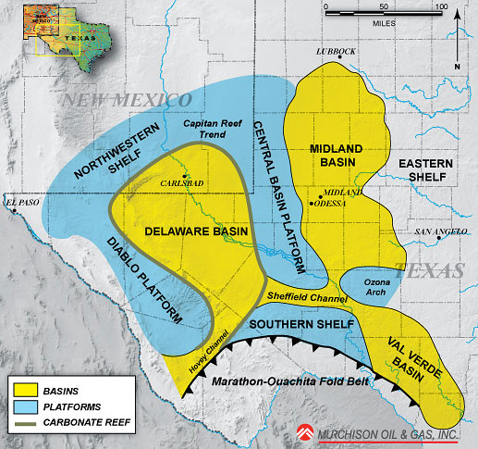
Background: Geography
The Permian Basin covers a huge area in western Texas and southeastern New Mexico
  52 counties
  75,000 square miles (48 million acres)
  The Permian Basin is split into 2 main sub-basins
    Midland Basin
    Delaware Basin
Fig. 1. Map of Permian Basin Structural Setting. Murchison Oil and Gas. 2010. Web. 9 Oct 2015.

Slide 4
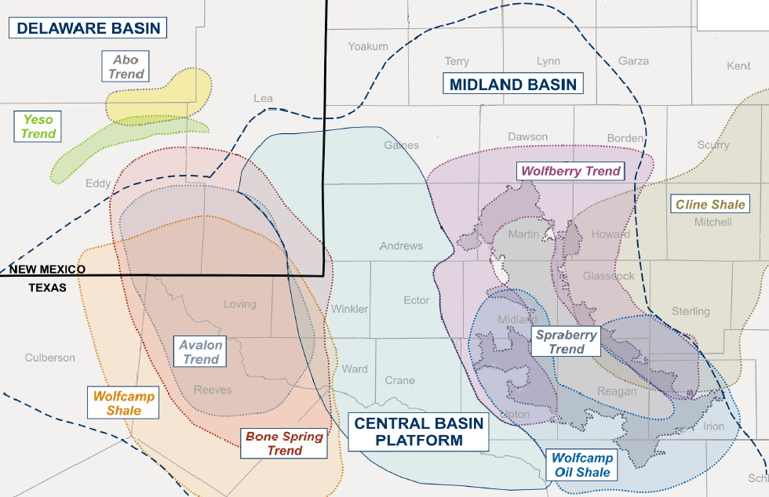
Background: Oil and Gas Industry
  23 prospective formations with up to 25,000 ft of multiple, stacked, petroleum systems
  Extensive drilling, coring and geological studies since 1920s
>1,000 operators
>500k wells
Cumulative production
  >29 BBO
  >75 Tcf of gas
Fig. 2. Map of Sub-Basins in the Permian. Shale Experts. 2015. Web. 13 Nov 2015.

Slide 5
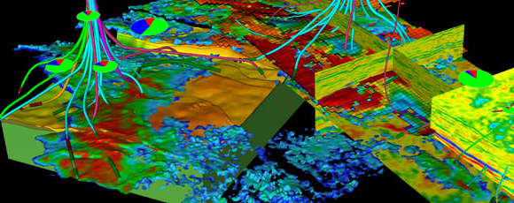
Problem & Challenges
Operator reported producing formation not specific enough
Analyzing individual well log data time-intensive to capture
Visualizing production data on 2D map does not offer perspective of stacked play
Integrating large volumes of data
Fig. 3. “Integration of multi-disciplinary data, including reservoir simulation, 4D seismic, seismic attribute extractions, structure model, and production data.” Dynamic Graphics. 2015. Web. 10 Dec 2015.

Slide 6
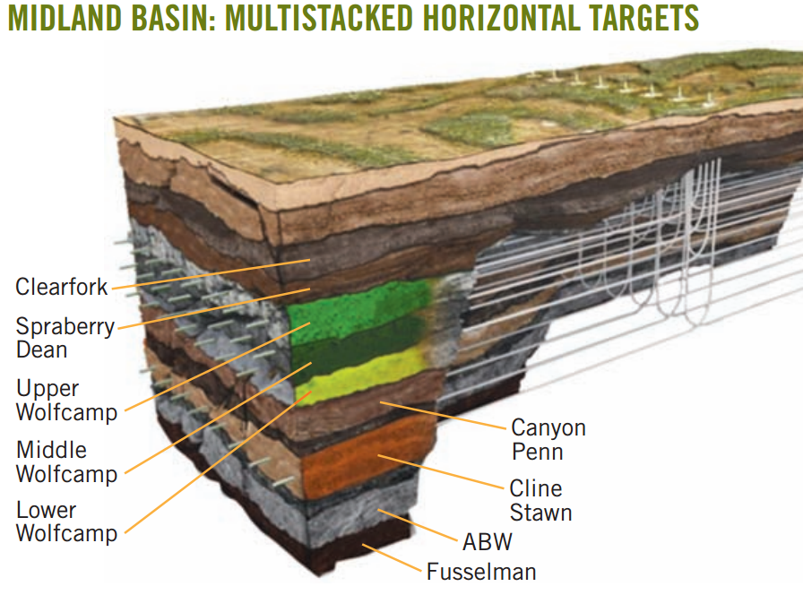
Goals & Objectives
Develop workflow to improve efficiency of regional basin analysis
Interpolate well log data to sub-delineate formations into contiguous producing horizons
Specify completion and production from productive horizons
Create surfaces for petrophysical parameters
Interpolate well log metrics from control locations to wells that have not been interpreted
Fig. 4. Map showing stacked formations. Midland Basin: Multistacked Horizontal Targets. Oil & Gas Journal. 2015. Web. 28 Nov 2015.

Slide 7
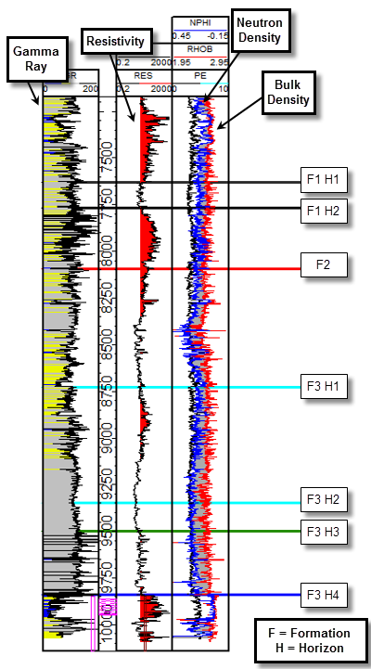
Methodology: Mapping Formations & Well Log Attributes
Obtain text file of geologist’s interpreted data
  Unique identifier (API)
  Coordinates
  Horizon name
  Total vertical depth subsea (TVDSS)
  Metrics from raw well log data
    Gamma intensity (API units)
    Resistivity (ohm•m)
    Neutron (porosity units)
    Bulk density (g/cm3)
Fig. 5. Interpreted well log. Matt Boyce, PhD. 2013. Southwestern Energy. 2 Dec 2015.

Slide 8
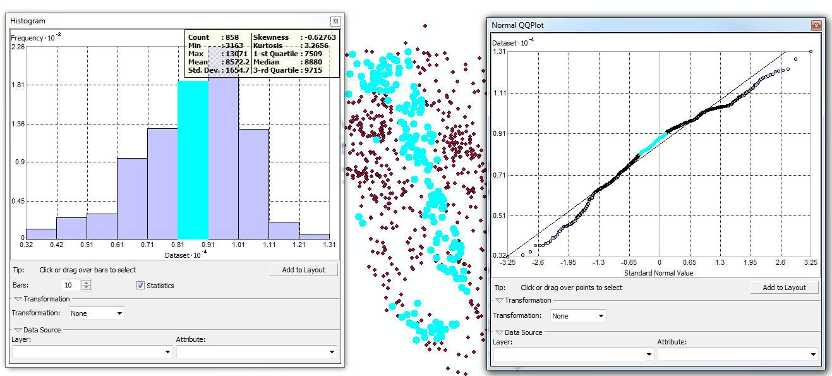
Methodology: Exploratory Spatial Data Analysis
Evaluate data using Exploratory Spatial Data Analysis (ESDA) tools
Mean: 8572
Median: 8880
Skewness: -0.63
Kurtosis: 3.27
Histogram
Normal QQ Plot

Slide 9
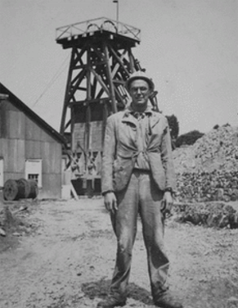
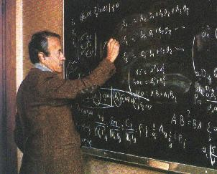
Methodology: Kriging
Kriging Origins
  Danie Gerhardus Krige – South African Mining Engineer (1951)
  Georges Matheron – French mathematician and geologist, formalized Krige’s work and founded mathematical morphology
  Lev Gandin – meteorologist (1959)
Used in meteorology, mining, forestry, hydrology, soil sciences, geology
Accounts for distance and direction of the data
Ability to generate prediction, quantile, and standard error maps
Includes cross-validation
D. G. Krige
Fig. 6. Danie Gerhardus Krige (1939). Royal Society of South Africa. 2013. Web. 17 Feb 2016.
G. Matheron
Fig. 7. Georges Matheron (1939). MINES ParisTech - Centre de Géosciences. Web. 17 Feb 2016.

Slide 10
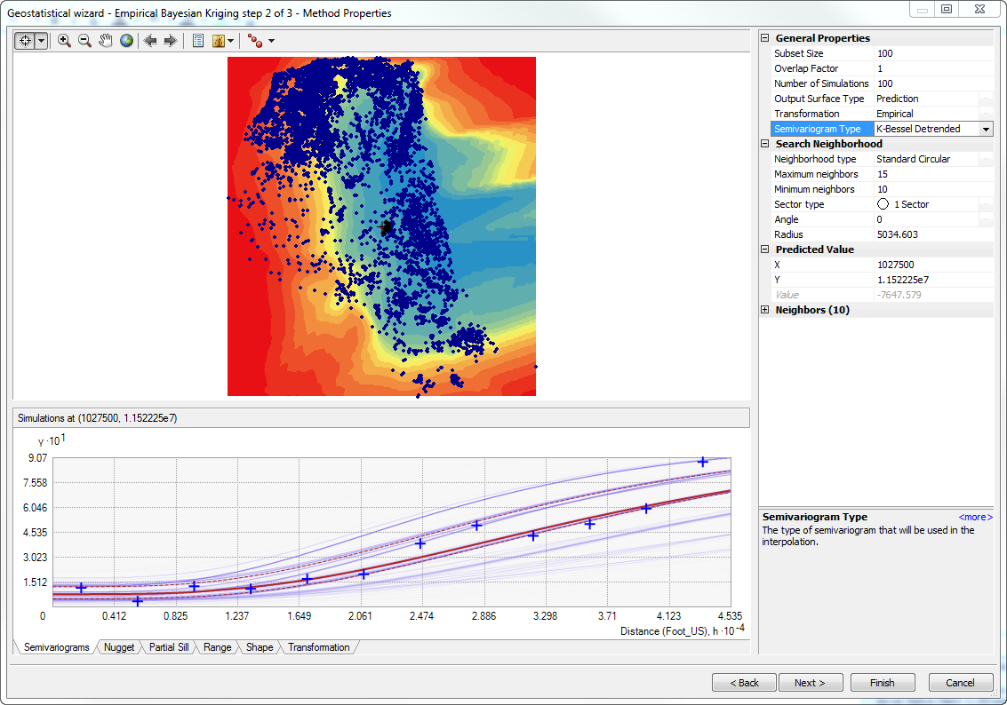
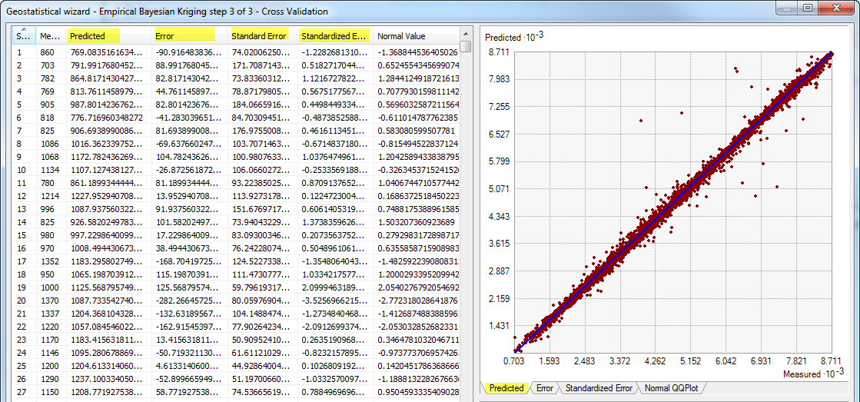
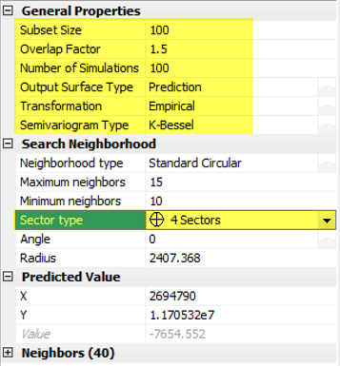
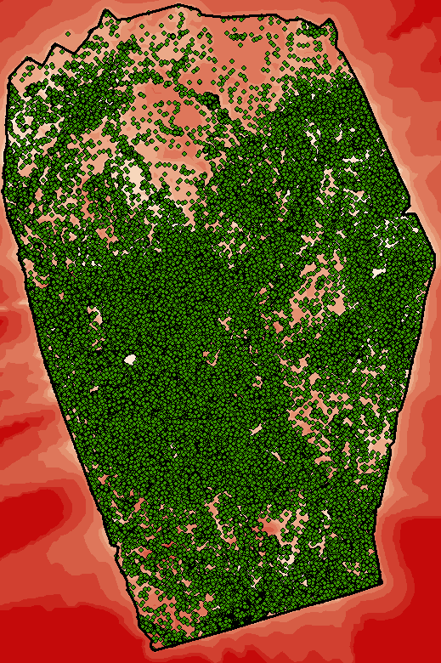
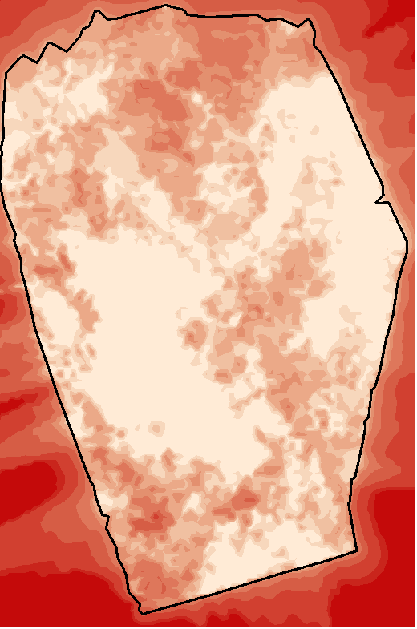
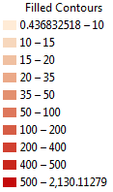
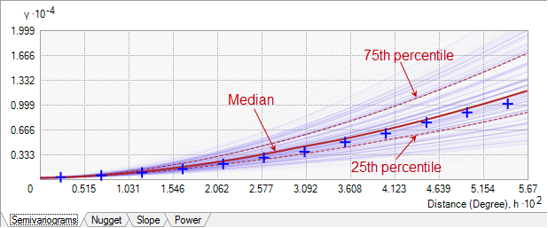
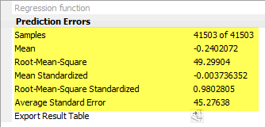
Methodology – Empirical Bayesian Kriging
Prediction Standard Error Map
Control Points
- Use prediction standard error map to determine confidence levels, perform quality control, and refine results
- Use EBK to generate interpolated surfaces for each horizon and variable
- Optimize results to obtain most precise grid

Slide 11
Results – Well Horizon Classification
Internal Sub-delineation – Formation 1a
Internal Sub-delineation – Formation 1b
Internal Sub-delineation – Formation 1c
State Data – Formation 1
Internal Sub-delineation – Formation 1d
Internal Horizons – Formation 1a-d

Slide 12
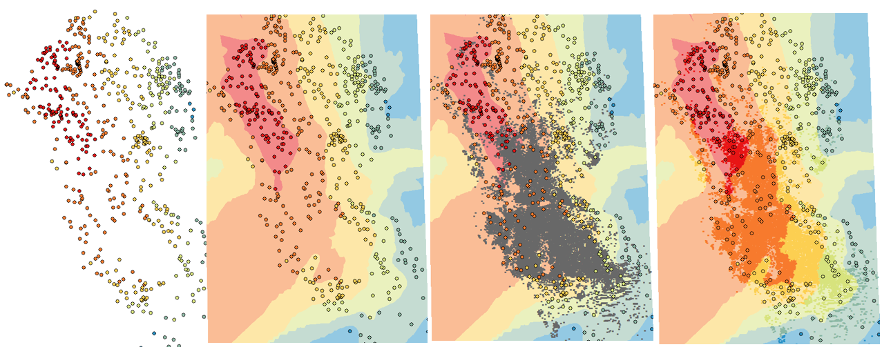

Results – Well Log Attribute Classification
Interpolated grids for well log attributes for each formation
Extracted petrophysical well log attributes from interpolated grids and applied to all wells in the horizon
Well control points with interpreted petrophysical property are shown symbolized from a low-to-high value
Grids are created from control points for petrophysical parameter using EBK
Wells producing from the same horizon that have not been evaluated are shown in grey
Extract value from EBK grid to State’s well dataset; the values for each of the petrophysical properties was extracted to the well bore
Shallow
Deep

Slide 13
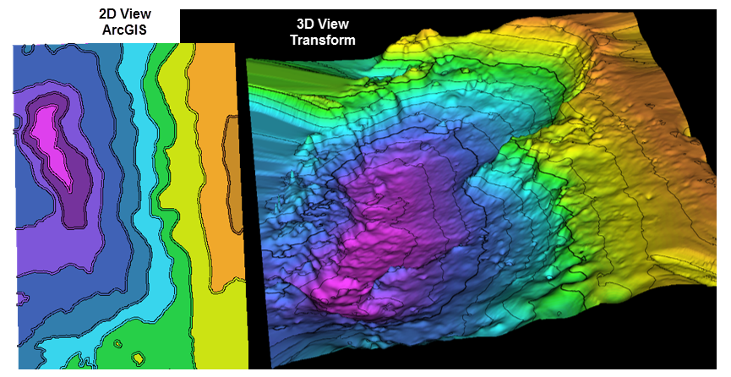

Results – 3D Grids
EBK interpolated grids for each horizon (SSTVD)
Fig. 8. Screenshot of geologic horizon shown in 2D view in ArcMap (left) and in 3D view in Transform software (right). Horizon generated using EBK process in GIS. Transform screenshot provided by Cullen Hogan, January 6, 2016.

Slide 14
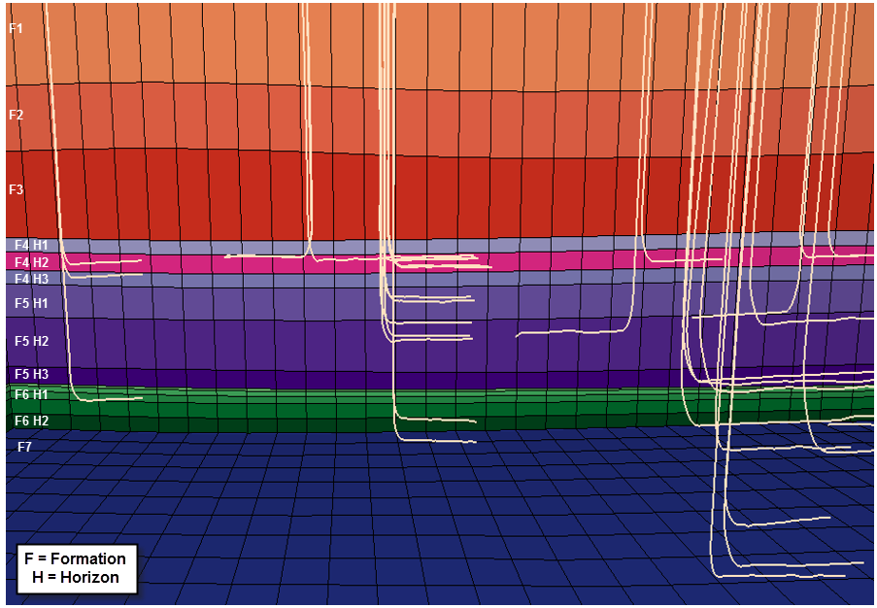
Results – Well Landing Zone Classifications
Provide geophysicist grids for use in 3D model
Integrate data
Visualize and classify producing horizons
Fig. 9. Screenshot of structural model in JewelSuite software displaying wells intersecting target formations. Screenshot provided by Cullen Hogan, February 4, 2016.

Slide 15
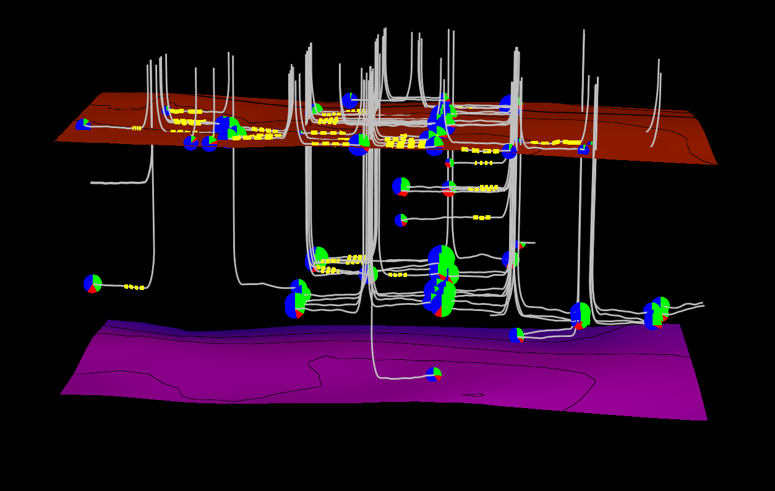
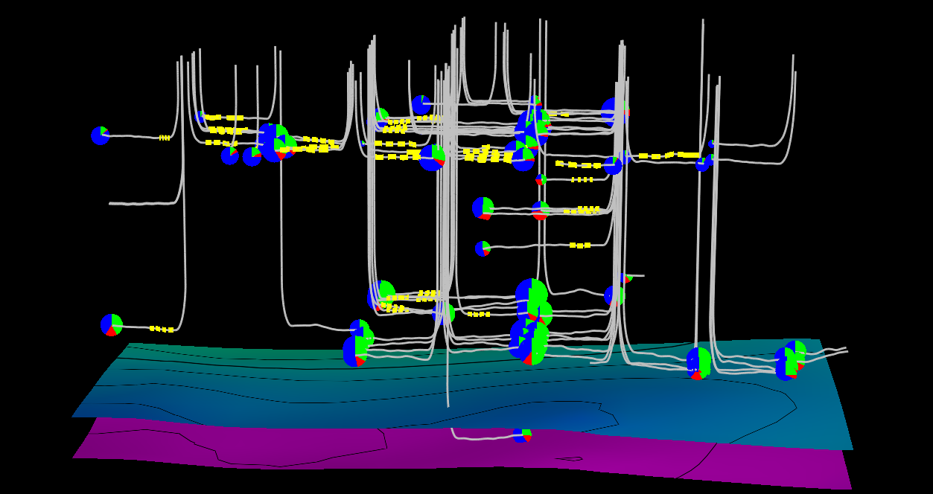
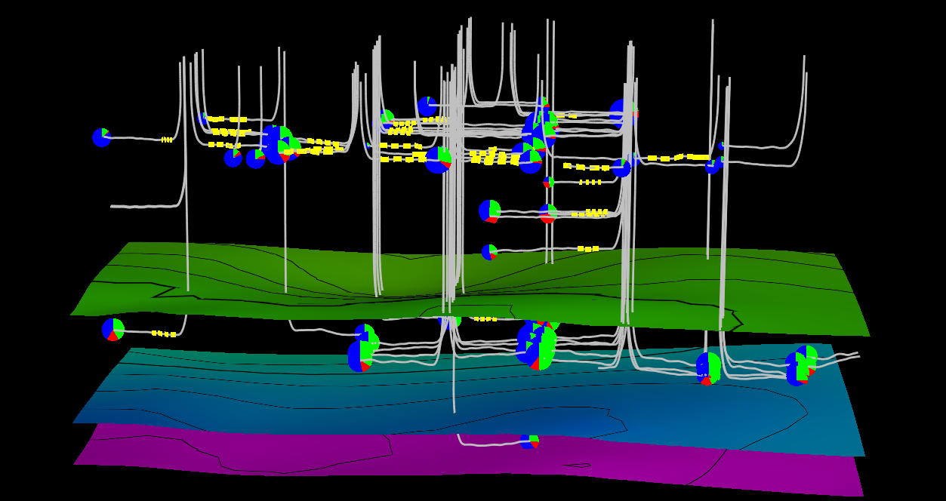
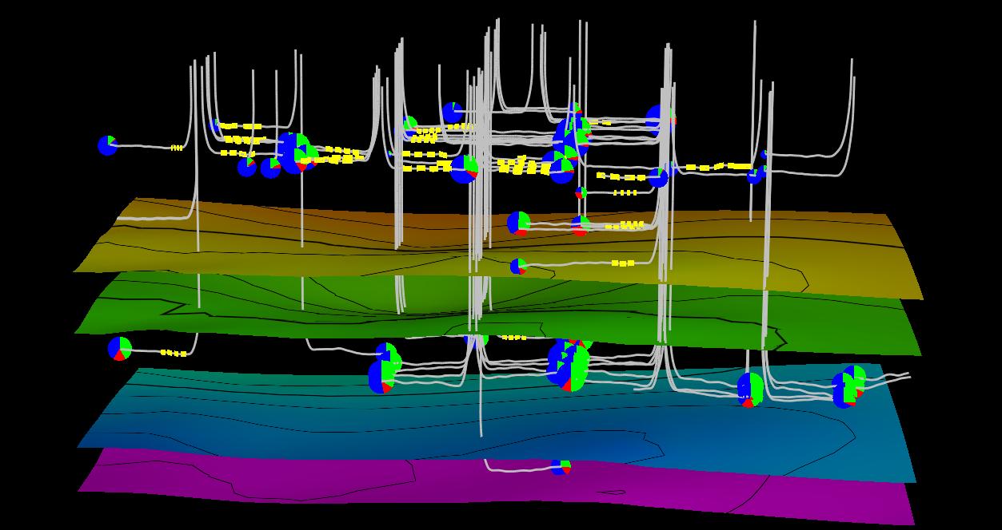
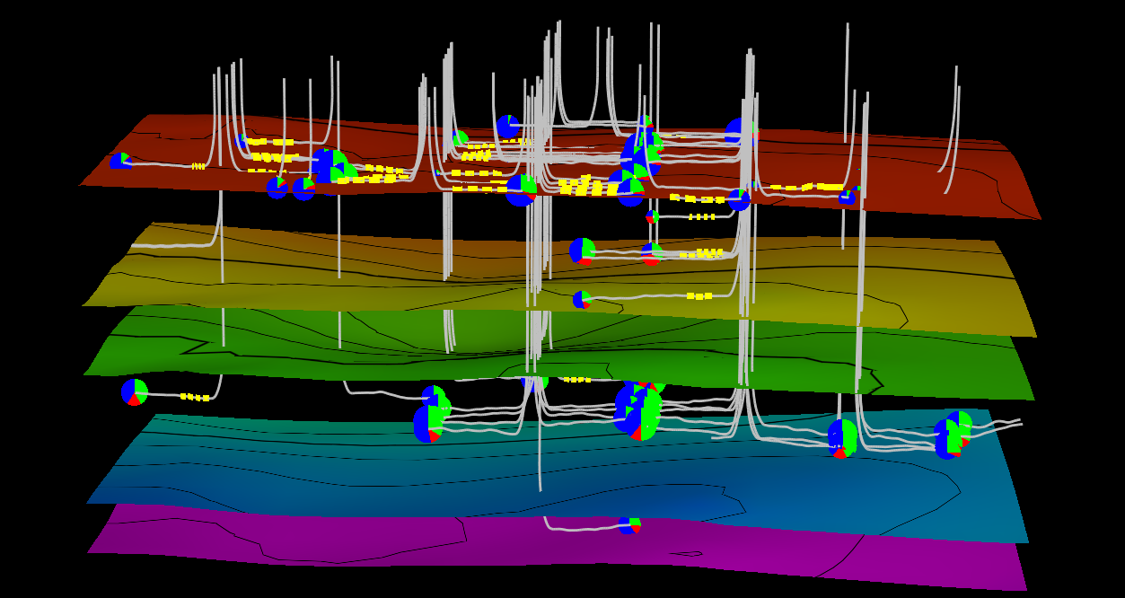
Summary
Shallow
Deep

Slide 16
Acknowledgements
A special thanks to the team at Southwestern Energy & my Penn State Advisor
Southwestern Energy’s Permian Basin Team
  Matt Boyce, PhD – Staff Geologist
  Cullen Hogan – Geophysicist
  Kyle Magrini – Staff Reservoir Engineer
  Demola Soyinka – Staff Geologist
Penn State Advisor
Patrick Kennelly, PhD

Slide 17
References
Blakey, Ron. Paleogeography Library Late Permian. Colorado Plateau Geosystems. 2010. Web. 9 Oct. 2015.
Boyce, Matt. Interpreted well log. Digital image. Southwestern Energy, 2013. 2 Dec. 2015.
Curth, Patrick J., James R. Courtier, Gary B. Smallwood, Rick Mauro, and Scot Evans. "Earth Model Assists Permian Asset Valuation." Oil & Gas Journal (2015). Web. 28 Nov. 2015.
Dynamic Graphics. "4D Quantitative Analysis." CoViz 4D Software. 2015. Web. 10 Dec. 2015.
Esri. "Exploratory Spatial Data Analysis (ESDA)." Geostatistical Analyst. Web. 9 Jan. 2016.
Esri. "Evaluating Interpolation Results." Geostatistical Analyst. Web. 9 Jan. 2016.
Ewing, B., Watson, M., McInturff, T., & McInturff, R. “Economic Impact Permian Basin's Oil & Gas Industry.” 1 August 2014. Web. 14 Nov. 2015.
Hogan, Cullen. Screenshot from JewelSuite Subsurface Modeling 2014.2. Computer software. Vers. 5.1.68.0. Halliburton. 4 Feb. 2016.
Hogan, Cullen. Screenshot from Transform. Computer software. Drilling Info. 6 Jan. 2016.
Krivoruchko, Konstantin, and Eric Krause. "Concepts and Applications of Kriging." Esri, 24 July 2012. Web. 10 Jan. 2016.
Krivoruchko, Konstantin. "Empirical Bayesian Kriging Implemented in ArcGIS Geostatistical Analyst." ArcUser. 2012. Web. 10 Nov. 2015.
Lampiris, Nikolaos. "Introduction to ESRI Geostatistical Analyst Using Interpolation Tools." GIS-box. 14 Oct. 2015. Web. 6 Jan. 2016.
Murchison Oil & Gas. "Geographic Footprint." 2010. Web. 9 Oct. 2015.
Shale Experts. "Permian Basin." 2015. Web. 13 Nov. 2015.

Slide 18
Thank You
Questions?

