Slide 1
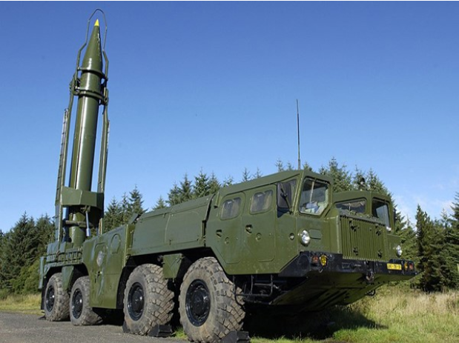
A Return to SCUD-Hunting with GIS
UNCLASSIFIED
Photo Credit: U.S. Army
Presented By: Alan Zollar
UNCLASSIFIED

Slide 2
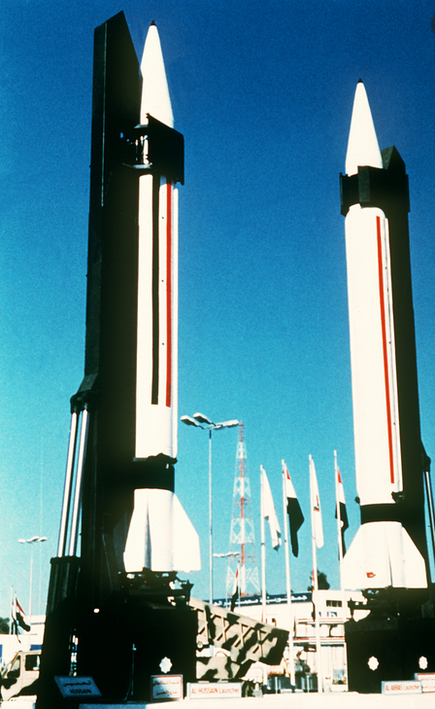
UNCLASSIFIED
Agenda
Why It Matters
Objectives
Background
Similar Studies
Proposed Methodology
Assumptions
Limitations and Mitigations
Anticipated Results
Project Timeline
Questions
References
Photo Credit: U.S. Army
UNCLASSIFIED

Slide 3
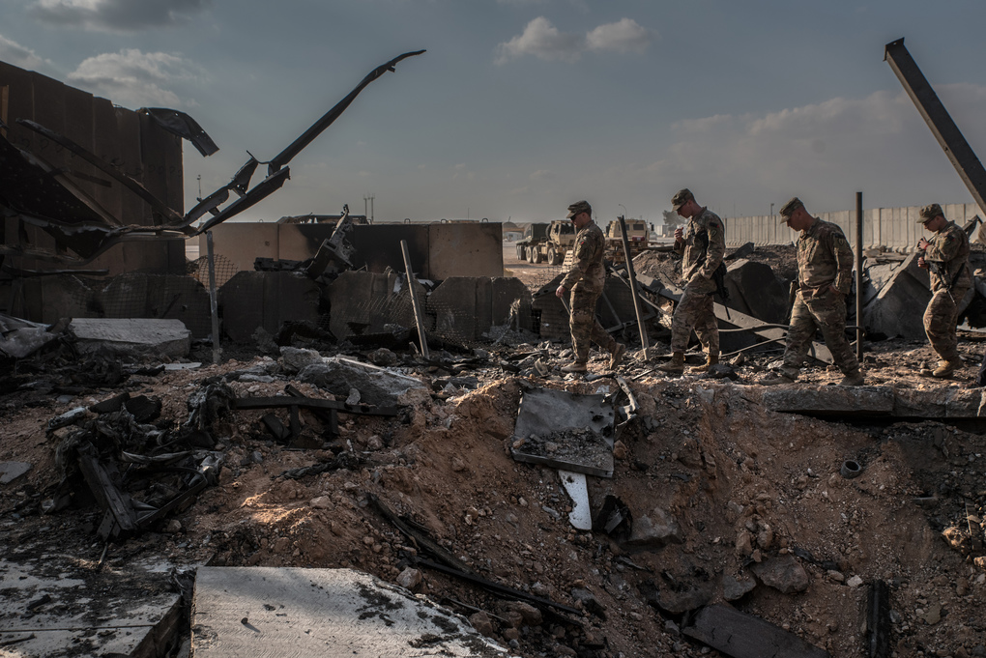
UNCLASSIFIED
Why It Matters
Photo Credit: The Seattle Times
UNCLASSIFIED
Notes:
Slide Credit: Alan Zollar; Applying GIS to Space-Based Early Missile Warning (2020)

Slide 4
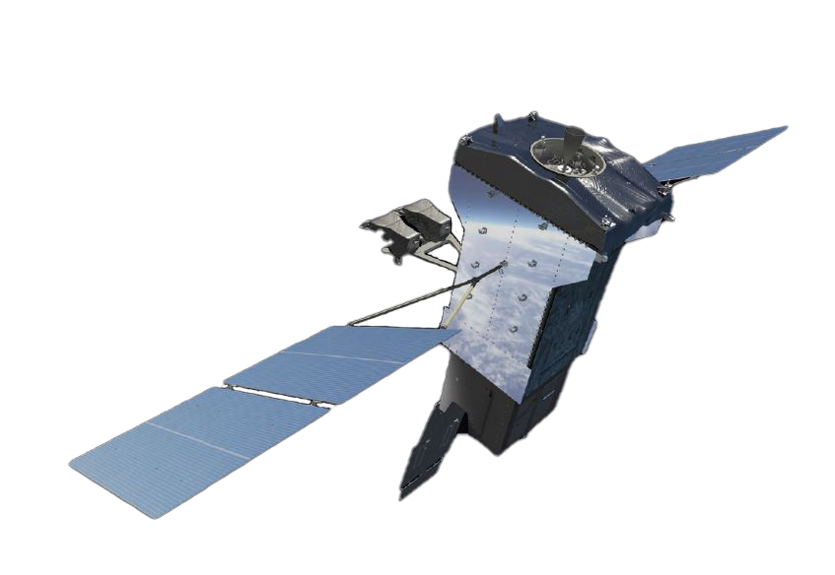
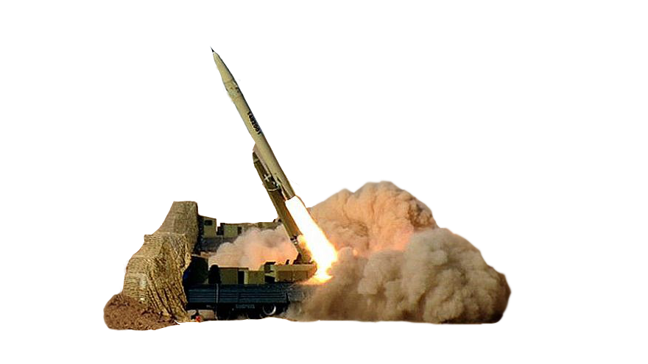
UNCLASSIFIED
Objectives
The Problem:
Current early missile warning technology focuses on post-launch detection and warning for ballistic missiles threats resulting in significantly decreased reaction time.
The Question:
How can GIS be injected into the early missile warning architecture to aid in predicting launch locations, ultimately getting left-of-launch?
UNCLASSIFIED
Notes:
Animation Credit: Alan Zollar; Applying GIS to Space-Based Early Missile Warning (2020)

Slide 5
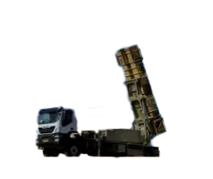
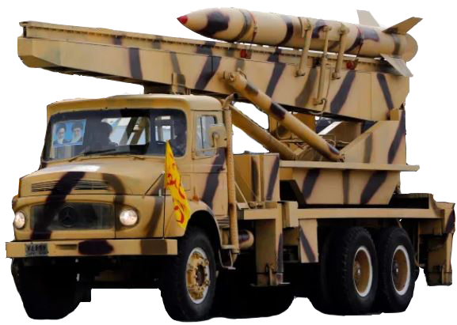
UNCLASSIFIED
Getting Left of Launch
The Proposal:
The objectives of this proposal are to gain an understanding of previous attempts to use GIS analysis to predict Transporter-Erector-Launcher (TEL) launch locations as well as synthesize the methods with those of similar studies under the lens of SCUD-hunting during the Gulf War for the development of a new, modern prediction tool.
The End State:
The final product is an effective tool designed to model a specific TELs physical parameters and employment in a designated Area of Operations (AO), identifying ideal launch locations for improved warning via refined surveillance and engagement.
UNCLASSIFIED
Notes:
Animation Credit: Alan Zollar; Applying GIS to Space-Based Early Missile Warning (2020)

Slide 6
UNCLASSIFIED
Background – The Gulf War
2 August 1990 – Iraq invades Kuwait prompting American troops to assemble in Saudi Arabia.
29 November 1990 – The U.N. sets the ultimatum for Iraqi withdrawal by 15 January 1991.
15 January 1991 – The deadline passes without Iraqi withdrawal.
17 January 1991 – The Gulf War begins with a Coalition air campaign targeting Iraqi infrastructure, communication equipment, and air defenses.
18 January 1991 – Iraq fires its first SCUD missiles on Israel and Saudi Arabia, initiating the “Great SCUD Hunt.”
24 February 1991 – Coalition forces begin a ground offensive to retake Kuwait.
25 February 1991 – An Iraqi SCUD missile destroys a barracks in Saudi Arabia, killing 28 Americans and wounding nearly 100 others.
28 February 1991 – Iraq accepts U.N. resolutions, bringing a close to combat operations and the Gulf War.
UNCLASSIFIED

Slide 7
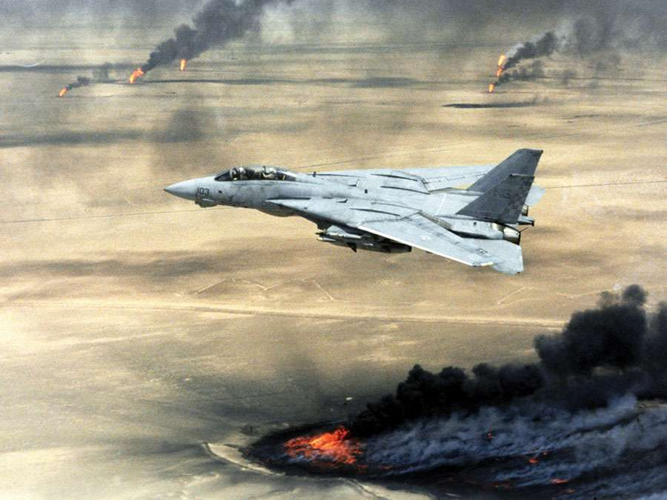
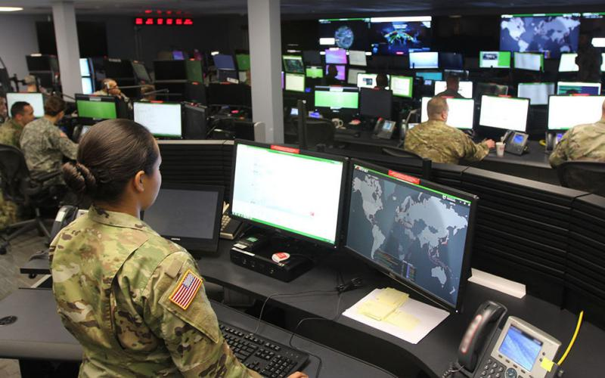
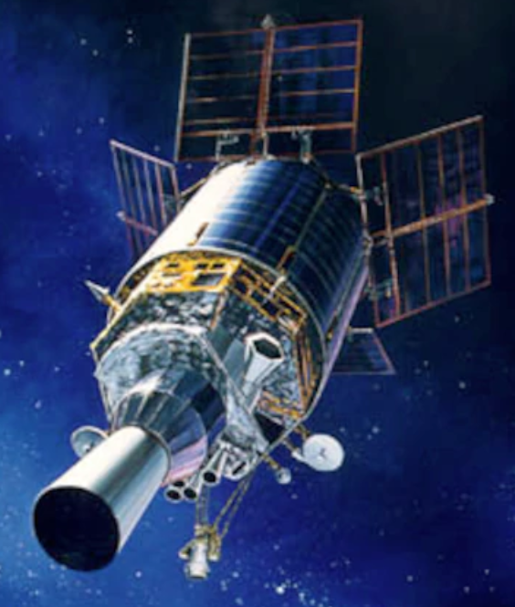
UNCLASSIFIED
Background – SCUD-Hunting
Efforts During the Gulf War
Air Patrols and Strikes
Detection and targeting through the Defense Support Program (DSP)
Efforts After the Gulf War
Project Stalker
TIGER
Upgrading the Space-based Early Missile Warning Architecture
Photo Credit: Signal Magazine
Photo Credit: U.S. DoD
Photo Credit: U.S. Air Force
Photo Credit: U.S. Air Force
UNCLASSIFIED

Slide 8
UNCLASSIFIED
Similar Studies
Modeling and Prediction of Future Urban Growth in the Charleston Region of South Carolina
Demonstrated adept identification and creation of variables from good sample collections.
Applied several approaches (logistical regression, rule-based model, and focus group).
Trained models yielded highly accurate predictions.
Using GIS as an Augur
Key takeaways necessary for mapping event probabilities:
A good sample of its known locations;
the correct variables to explain its presence or absence; and
the ability to create those variables.
GIS for Crime Analysis - Geography for Predictive Models
Demonstrated the impacts of smaller, less accurate sample data as well as fewer variables.
Trained model yielded less accurate crime mapping results with limited effectiveness.
UNCLASSIFIED

Slide 9
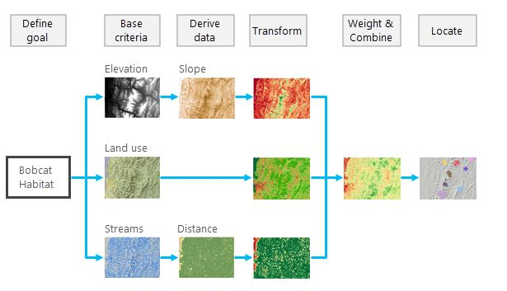
UNCLASSIFIED
Proposed Methodology
The Suitability Model Workflow
Define the problem.
Identify and derive the criteria.
Transform the values.
Weight and combine.
Locate.
Analyze.
A Basic Workflow Example for Bobcat Habitats.
Photo Credit: Esri
UNCLASSIFIED

Slide 10
UNCLASSIFIED
Proposed Methodology – A Suitable Model
Define
Base Criteria
Derive Data
Transform
Weight/Combine
Locate
Terrain
Terrain
Elevation
Slope
Road Systems
Transformed Terrain
Terrain Submodel
Land Use
Population
Infrastructure
Water Feature
Rivers
Physical Parameters
Physical Parameters
TEL Emplacement
Footprint
Transformed Physical Parameters
Physical Parameters Submodel
SCUD-B Launch Locations
Dimensions
TEL Range
Gradient
Max Slope
Weight
Missile Range
Missile Range
Aspect
Aspect
Tactics
Tactics
Viewshed
Visibility
Cover
Min Safe Dist.
Safety Buffer
Concealment
Transformed Tactics
Tactics Submodel
Roads
Routes
Time
TEL Mobility
UNCLASSIFIED

Slide 11
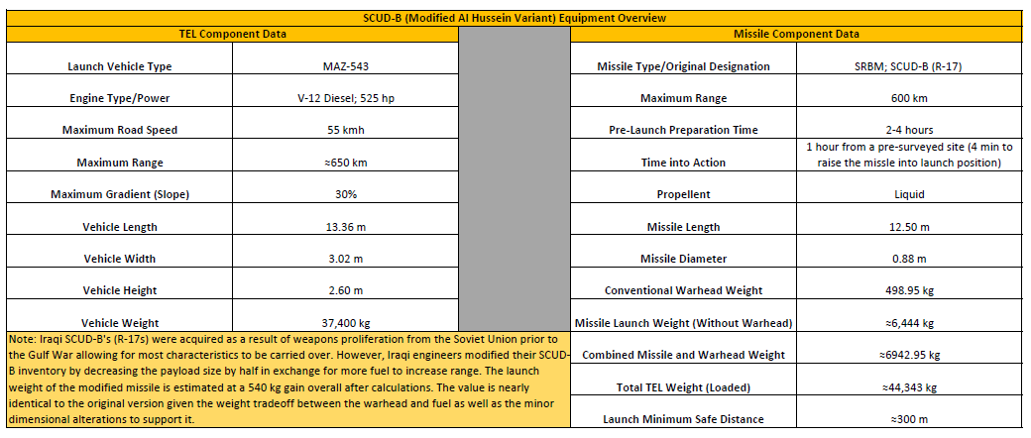
UNCLASSIFIED
Proposed Methodology – Key Characteristics
UNCLASSIFIED

Slide 12
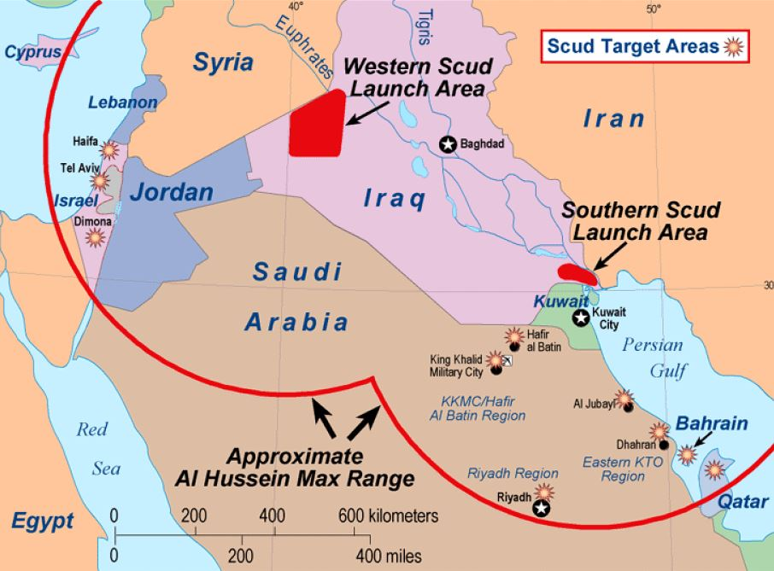
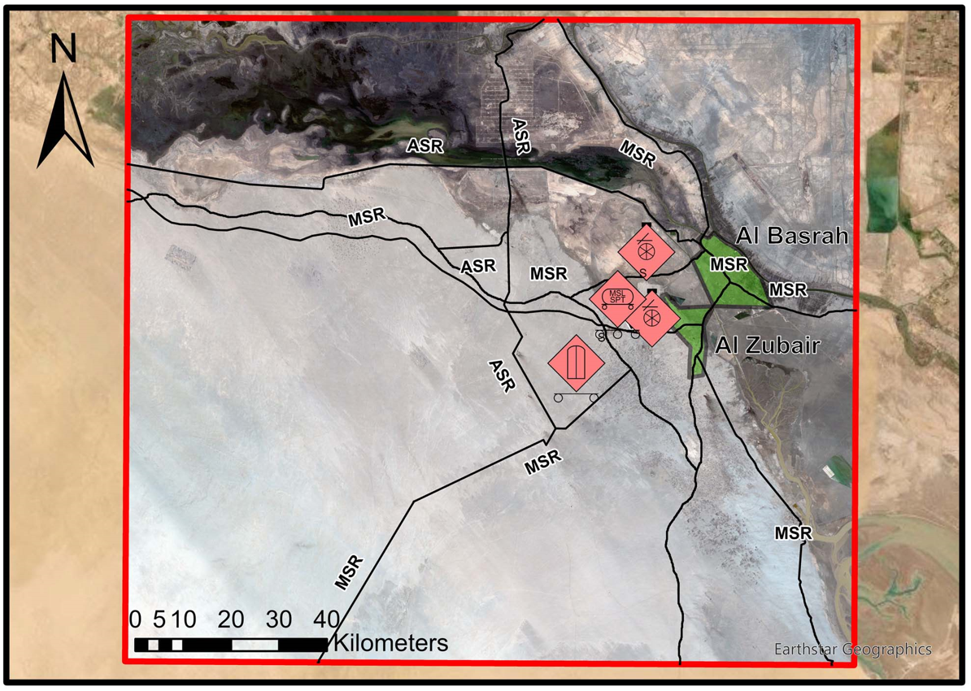
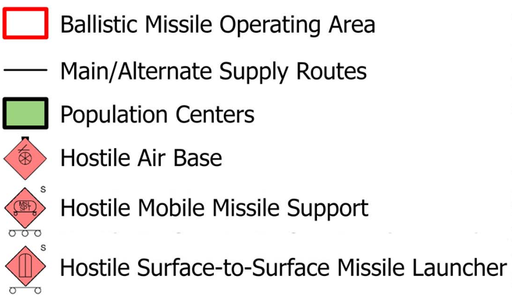
UNCLASSIFIED
Proposed Methodology – Building the Sandbox
Photo Credit: U.S. DoD
UNCLASSIFIED

Slide 13
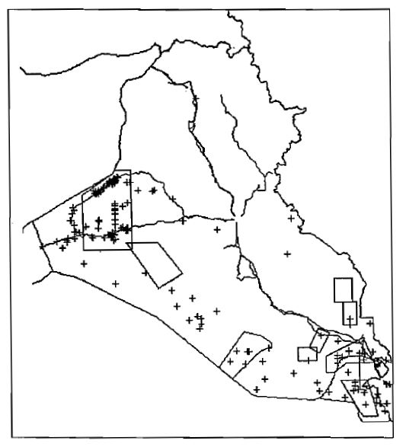
UNCLASSIFIED
Proposed Methodology – Building the Sandbox
Photo Credit: U.S. DoD
UNCLASSIFIED

Slide 14
UNCLASSIFIED
Assumptions
The Iraqis employed their SCUD equipment based on its physical parameters.
The Iraqi Army did not launch their missiles from dense population centers or key infrastructure.
Airports located in the southern AO were used for logistical support and resupply.
All SCUDs had to maintain a degree of proximity to their supporting infrastructure.
SCUDs had to move quickly to hideaway spots or back to their support areas to avoid Coalition air strikes in retaliation.
Given that the SCUDs had low top speeds, they likely did short distance hops via roads to compensate.
With the preponderance of shots made over night, the SCUDs were likely tethered to the roads for navigation and expedited movement.
UNCLASSIFIED

Slide 15
UNCLASSIFIED
Limitations
Dated Imagery and elevation data.
Coarse Coalition strike location data with a low confidence in accuracy.
Mitigations
Outreach for additional launch data from the National Geospatial-Intelligence Agency.
Application of the model under modern imagery and elevation data while taking note of environmental changes for comparison of results.
UNCLASSIFIED

Slide 16
UNCLASSIFIED
Anticipated Results
The Ideal
The model developed produces a competent and specific solution set of predicted launch locations within a reasonable degree of error, such as one square kilometer from a reference location (close enough for a pilot to search for and still find relatively quickly).
The Acceptable
The model produces a less accurate solution that generally identifies potential launch location areas within five square kilometers.
UNCLASSIFIED

Slide 17
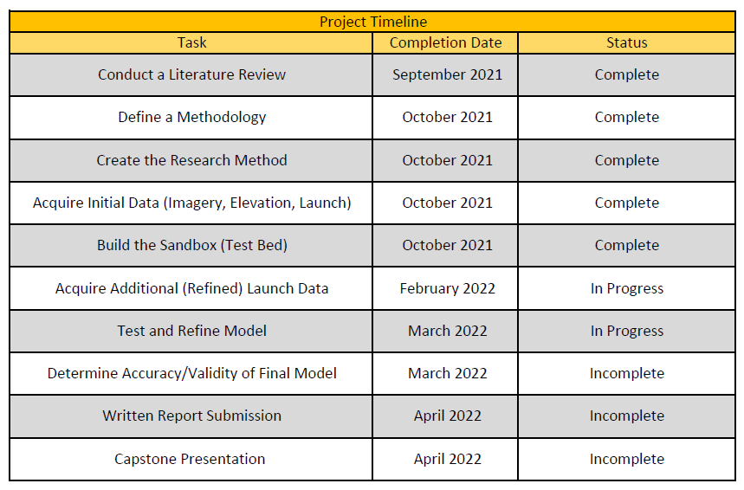
UNCLASSIFIED
Project Timeline
UNCLASSIFIED

Slide 18
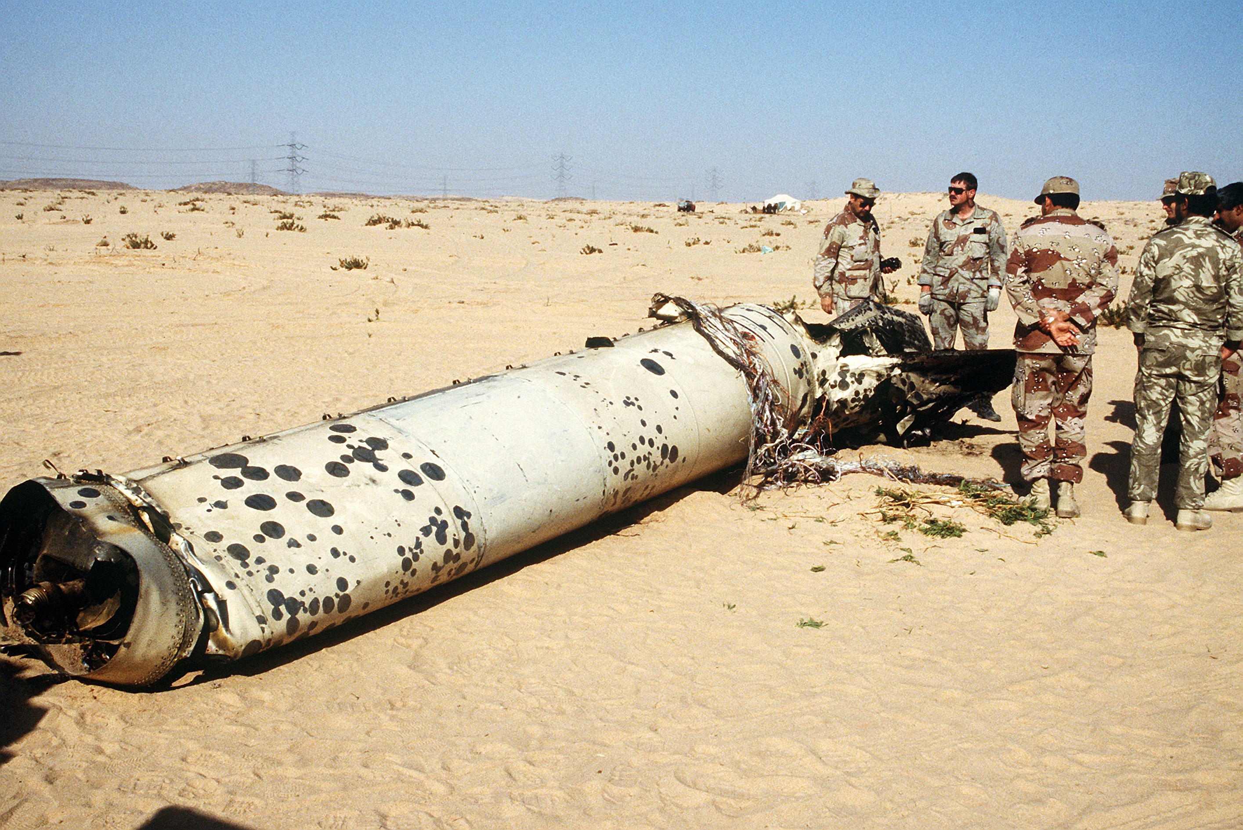
UNCLASSIFIED
Questions
Photo Credit: U.S. DoD
UNCLASSIFIED

Slide 19
UNCLASSIFIED
References
Allen, J., & Lu, K. (2003). Modeling and Prediction of Future Urban Growth in the Charleston Region of South Carolina: A GIS-based Integrated Approach. Conservation Ecology, 8(2). Retrieved September 1, 2021, from http://www.jstor.org/stable/26271983.
Cole, M., & Madry, S. (2006). Using GIS AS AN AUGUR. The Military Engineer, 98(640), 61-62. Retrieved September 1, 2021, from http://www.jstor.org/stable/44531493.
Esri. (2021). The General Suitability Modeling Workflow. The general suitability modeling workflow-ArcGIS Pro | Documentation. Retrieved October 15, 2021, from https://pro.arcgis.com/en/pro-app/latest/help/analysis/spatial-analyst/suitability-modeler/the-general-suitability-modeling-workflow.htm.
Esri. (2021). Understanding the Suitability Modeling Workflow. Understanding the suitability modeling workflow-Analytics | Documentation. Retrieved October 15, 2021, from https://desktop.arcgis.com/en/analytics/case-studies/understanding-the-suitability-modeling-workflow.htm#ESRI_SECTION1_7C9D35079E4A47929E6D53496D844769.
Encyclopædia Britannica, inc. (n.d.). Persian Gulf War Timeline. Encyclopædia Britannica. Retrieved October 21, 2021, from https://www.britannica.com/list/persian-gulf-war-timeline.
Ferreira, J., Joao, P., & Martins, J. (2012). GIS for Crime Analysis - Geography for Predictive Models. The Electronic Journal Information Systems Evaluation, 15(1), 36–49.
UNCLASSIFIED

Slide 20
UNCLASSIFIED
References
Hsu, E. (2002). Addressing Gulf War attack ops deficiencies ...: ARMY'S 'TIGER' SOFTWARE PROGRAM AIMED AT TRACKING ENEMY MISSILE LAUNCHERS. Inside Missile Defense, 8(23), 1-6. Retrieved September 1, 2021, from http://www.jstor.org/stable/24782877.
Keaney, T. A., & Cohen, E. A., 2 Gulf War Air Power Survey: Operations and Effects and Effectiveness (1993). Washington, D.C.; Department of Defense.
Kemp, H. C. (2017). Left of Launch: Countering Theater Ballistic Missiles (Issue brief). Atlantic Council.
Liang, J. (1997). SSDC DEVELOPS NEW SOFTWARE TO HELP LOCATE MOBILE MISSILE LAUNCHERS. Inside Missile Defense, 3(9), 36-37. Retrieved September 1, 2021, from http://www.jstor.org/stable/43971232.
Maxar. (2020, December). Signature Analyst. Maxar Resources. Retrieved October 18, 2021, from https://resources.maxar.com/data-sheets/signature-analyst.
Rosenau, W. (2001). Coalition SCUD-Hunting in Iraq, 1991. In Special Operations Forces and Elusive Enemy Ground Targets: Lessons from Vietnam and the Persian Gulf War. essay, RAND Corporation.
Stauder, R. (2014). Modeling Suitability. Esri. Retrieved October 18, 2021, from https://www.esri.com/about/newsroom/arcuser/modeling-suitability/.
SS-1C (Scud-B) Russian Surface to Surface Short Range Ballistic Missile. (2020). Retrieved September 4, 2020, from https://odin.tradoc.army.mil/Search/WEG/SS-1C%20(Scud-B)%20Russian%20Surface%20to%20Surface%20Short%20Range%20Ballistic%20Missile
UNCLASSIFIED

Slide 21
UNCLASSIFIED
References
STORY, W. (1995). Third World Traps and Pitfalls: Ballistic Missiles, Cruise Missiles, and Land-Based Airpower (pp. 19-32, Rep.). Air University Press. Retrieved September 1, 2021, from http://www.jstor.org/stable/resrep13964.8.
Vesser, D. A., Iraq’s Scud Ballistic Missiles (2001). Washington, D.C.; Department of Defense.
Watkins Lang, S. (2016, January 20). SMDC history: 25 years since first 'SPACE WAR'. https://www.army.mil/article/161173/smdc_history_25_years_since_first_space_war.
UNCLASSIFIED

