Slide 1
Leslie Zolman
Using GIS to Assess Areas
of Most Need
Advisor: George Chaplin

Slide 2
How can the areas of most need be located in a country, in a county or in a city?

Slide 3
Study Areas
Denver County, Colorado
Niger, Africa

Slide 4
Denver County, Colorado
Located in a developed world where rich, accurate data down to the parcel level is available

Slide 5
Niger, Africa
Located in a developing world where accurate data on a sub-country level is impossible, difficult, or costly to obtain

Slide 6
NGOs
Plan to provide aid and assistance in the two study areas
Denver – Outreach aid
Niger – Child sponsorship program

Slide 7
Objectives
Using GIS, analyze two disparate geographical regions: one in a developing world country and the other in a data rich region, to determine the areas of most need for health or aid outreach
Use the methodologies and results of the two analyzes to compare the strengths of GIS and data availability in these two different study areas
Compare the GIS approach to traditional survey or best guess approaches of traditional methodologies

Slide 8
Research Approach and Steps
Perform a literature review to gain insight into analysis and support analysis steps
Research data sets acquired and how they each affect the overall needs of the study area
Develop analysis steps and determine if all steps can be used for both study areas
Determine what analysis steps are specific to each study area
Compare the GIS approach to traditional survey or best guess approaches of previous methodologies

Slide 9
Past Uses of GIS in
Needs Assessments

Slide 10
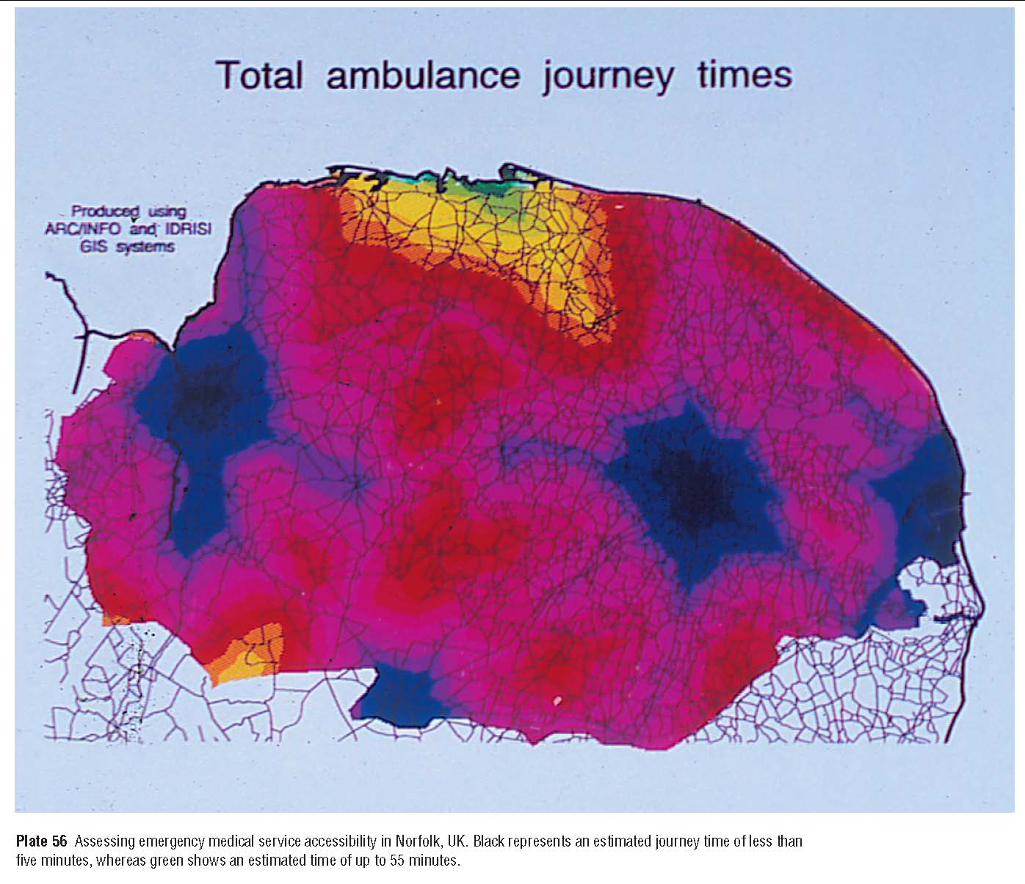
Emergency medical accessibility time in Norfolk, UK
Gatrell, A. & Senior, M. (2005). Health and Health Care Applications

Slide 11
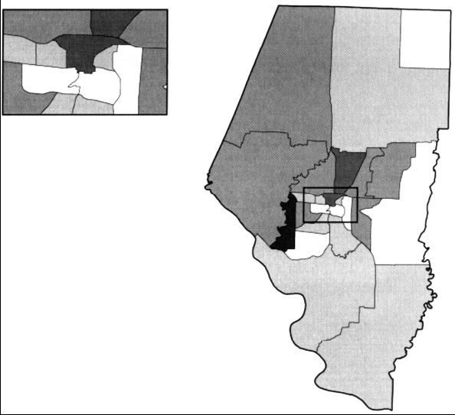
Missouri community health center utilization by households with incomes below 200% of the federal poverty level by census tract
Phillips, R., Kinman, E., Schnitzer, P., Lindbloom, E., & Ewigman, B. (2000). Using Geographic Information Systems to Understand Health Care Access. Archives of Family Medicine, Volume 9, Number 10

Slide 12
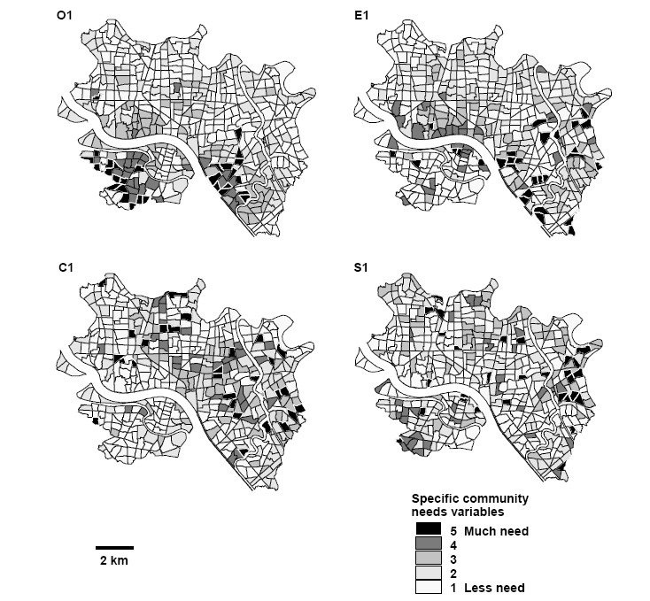
Tokyo community need indicator maps used to aid in decision-making
Kaneko, Y., Takano, T. & Nakamura, K. (2003). Visual Localisation of Community Health Needs to Rational Decision-making in Public Health Services. Health & Place, Volume9, Issue 3

Slide 13
Denver County Study Area

Slide 14
Data Needed
Church and aid locations
Shelter locations
HUD housing locations
Single parent family census data
Food stamp recipient locations
Crime hot spot analysis
Denver County parcel land value
Housing unit type census data

Slide 15
Denver Pilot Study
A pilot study was performed on portions of Denver County to determine the feasibility of using GIS to study allocation of need
Due to time constraints not all data sets were available for the analysis
A general workflow and analysis was developed that produced accurate results
The pilot study proved the ability of using GIS to study the allocation of need

Slide 16
The basic steps to the analysis
Symbolize polygon data into classes based on need level
Buffer point data – each buffer will represent the area of influence the point has
Clip polygon and polygon buffers to the study area
Convert vector layers into raster layers and generalize to standard resolution as needed
Reclassify raster layers into the classes used in step 1 above and assigned a need value
Combine raster layers that represent repetitive data using the Raster Calculator and reclassify the new raster output layer
Calculate the areas of greatest need using the Raster Calculator and all available data layers
Convert the calculation into a shapefile and symbolize to highlight the areas of greatest need

Slide 17
Data Used in Pilot Analysis
Layer | File Format | Source
Shelters | Excel | Google and Yellowpages.com search
HUD | Excel | HUD.gov apartment search
Churches | Excel | Google and Yellowpages.com search
FHH with Child | Shapefile | 2000 US Census
MHH with Child | Shapefile | 2000 US Census
Denver Parcels | Shapefile | Denver County FTP site

Slide 18
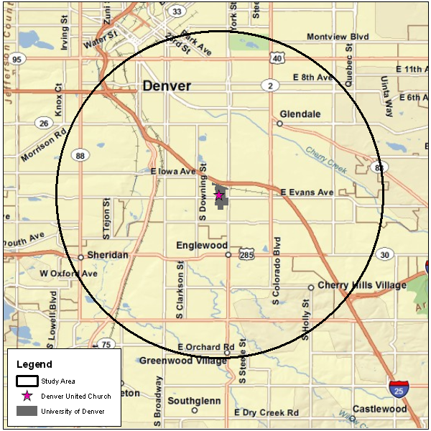
Area of Denver County included in the pilot study

Slide 19
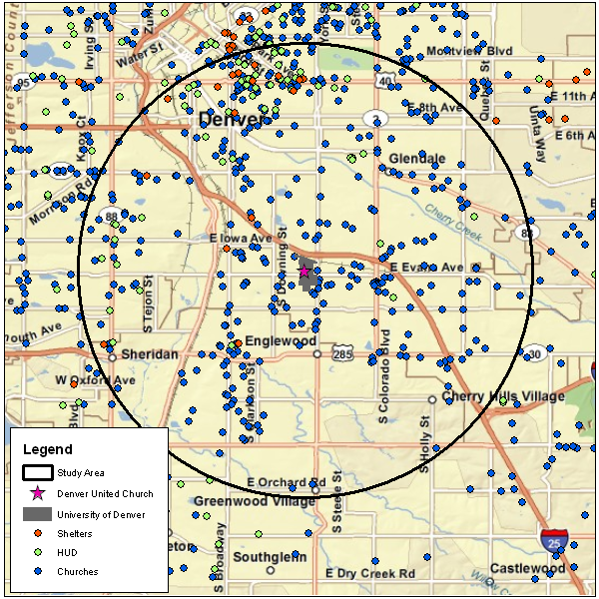
Locations of shelters, HUD housing, churches and aid locations

Slide 20
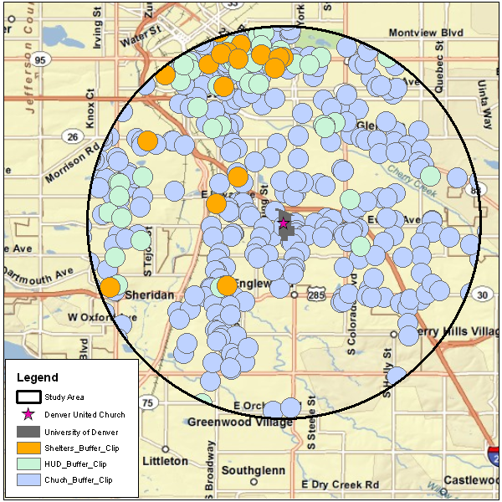
Point data buffered and clipped to study area

Slide 21
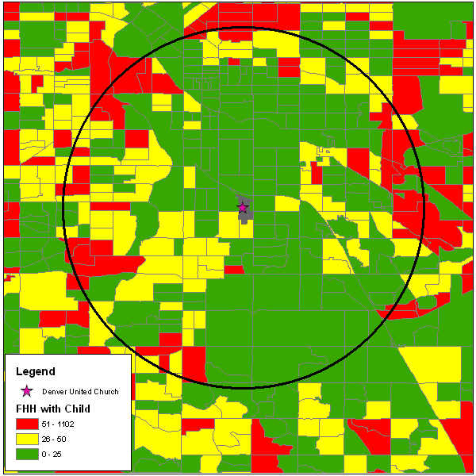
Single parent female head of household (FHH) by US Census block group

Slide 22
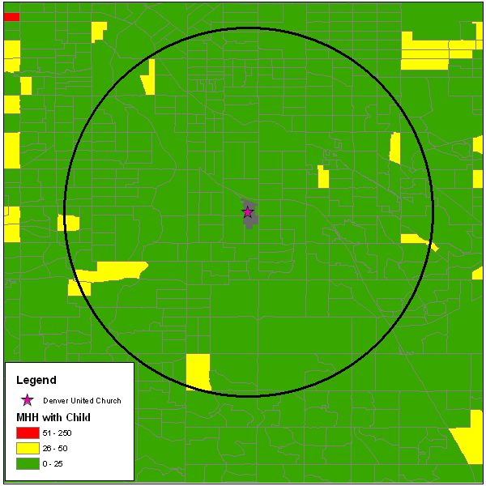
Single parent male head of household (MHH) by US Census block group

Slide 23
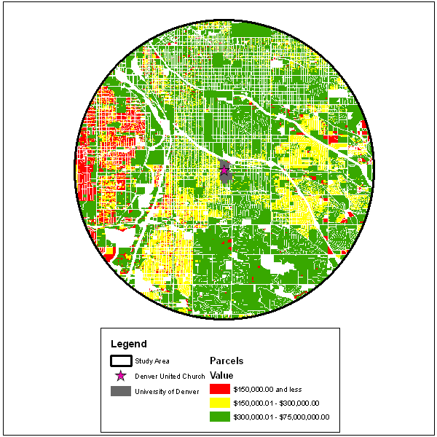
Property values clipped to study area

Slide 24
Classification of layers used in pilot analysis
Layer | Classification | Description
Shelters | 0 & 1 | 0 = no data area, 1 = buffer areas
HUD | 0 & 1 | 0 = no data area, 1 = buffer areas
Churches | 0 & -1 | 0 = no data area, -1 = buffer areas
FHH with Child | 0, 1 & 2 | 0 = 0-25, 1 = 26-50 and 2 = 51-250 single families per block group
MHH with Child | 0 & 1 | 0 = 0-25, 1 = 26-50 single families per block group
Denver Parcels | 1, 0 & -1 | -1 = over $300,000, 0 = $150,000-$300,000 and 1 = less than $150,000

Slide 25
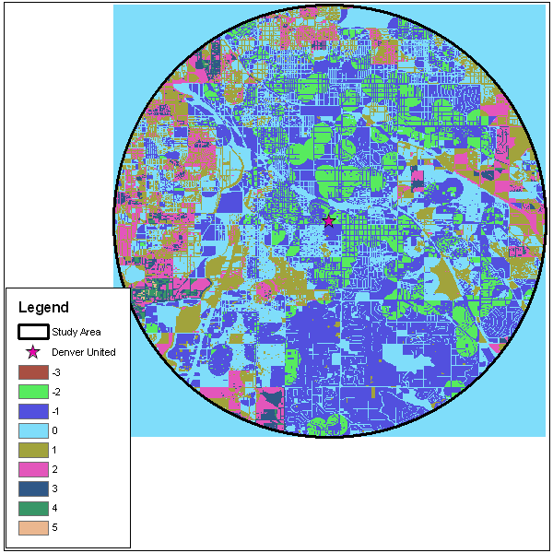
Results from Raster Calculator

Slide 26
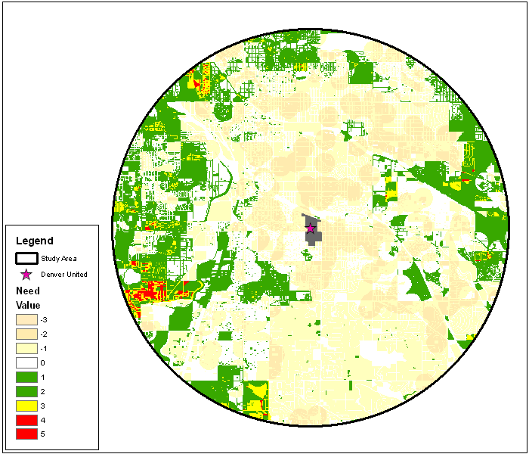
Final analysis showing areas of need

Slide 27
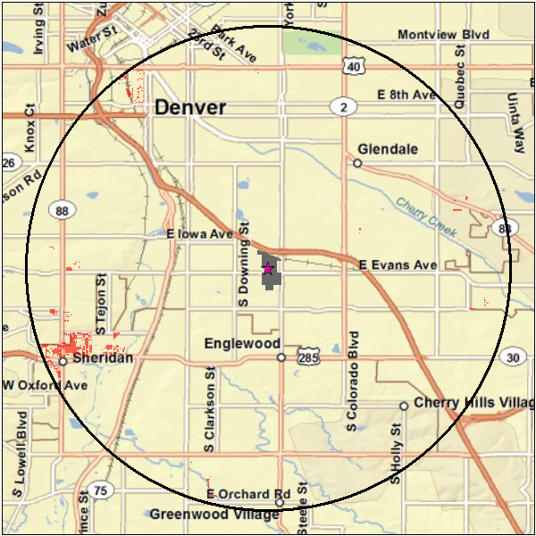
Final analysis showing areas of most need in red

Slide 28
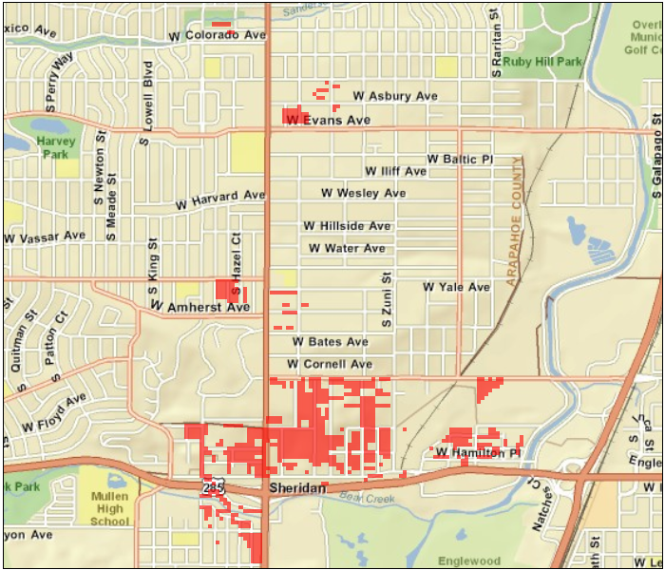
Western study area

Slide 29
Niger Study Area

Slide 30
Desired vs. Available Data
Niger data is impossible, difficult, or costly to obtain and therefore the data that will be used in the analysis is completely contingent upon the data availability

Slide 31
Desired Data
Infant mortality rate
Under five mortality rate
Life expectancy at birth
Health facility locations
Children suffering from malnutrition
School enrolment rates
Food security
HIV/AIDS – by age and sex
Orphan-hood
Adult literacy rate
Access to safe water
Human development index
Population below poverty line
Gross domestic product
Livelihood
NGO activity

Slide 32
Available Data
Childbirth deaths
Birth weight
Malnutrition cases reported
Children under 5 with malnutrition
Children with diarrhea in the last two weeks
Children attending school
Women 15-19 who know how to prevent HIV transmission
Children 0-14 years with one or both parents deceased
Access to safe water
Access to sanitation
Access to health care within 5km
Adult literacy rate
Livelihood zones –food security

Slide 33
Anticipated research results
Data used in the analysis will be contingent on data accessibility
Not all desired data will be available
Niger data will be on the region or state level
Denver data will be on a block group level or below
The analysis for each study area will follow the same basic steps with some small variations
When GIS analysis is compared to traditional methodologies it will be found to be superior

Slide 34
Questions?

