Slide 1
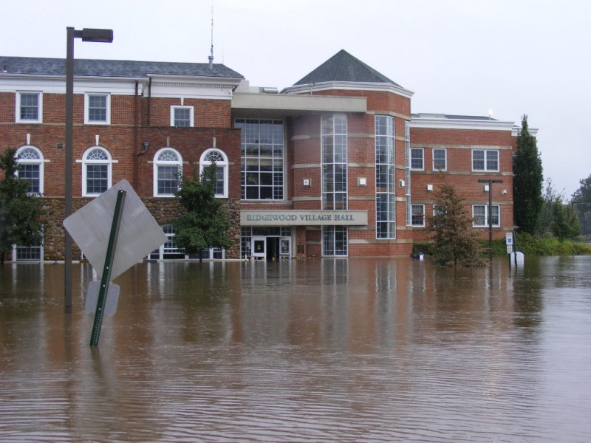
Fill in the gaps: object-based image analysis for emergency management, pilot study in Bergen County, New Jersey
Image source: https://patch.com/new-jersey/ridgewood/irene-strikes-bergen-county-3
Callie Zuck
596A, Fall 2 2017
Completed in partial fulfillment of an MGIS degree
Penn State University Graduate School

Slide 2
Background: Semi-automated OBIA for emergency management
Instead of manual digitization
Semi-automation raises efficiency
Classification results are well defined, useful for change detection
Many uses including disasters monitoring (Hussain et al, 2013)
Post-classification comparison: Two dates are classified separately
Minimizes problem of normalizing the images (Tsai et al, 2011)
Used to determine cost of repairs and critical infrastructures
(Al-Khudhairy et al, 2005)

Slide 3
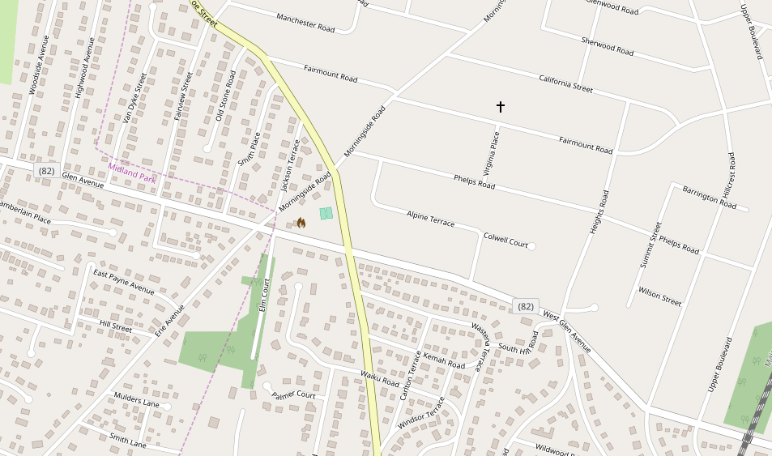
Background: Ideal locale
Large population
Infrastructure
Close proximity to a big city
Far enough from any big city
Dense area
Gaps and voids
Missing critical data
Image source: https://www.openstreetmap.org/#map=16/40.9930/-74.1238&layers=D

Slide 4
Research Question
Can the creation of a semi-automated process for the purpose of object-based image analysis sufficiently fill in any critical data gaps in dense urban areas?

Slide 5
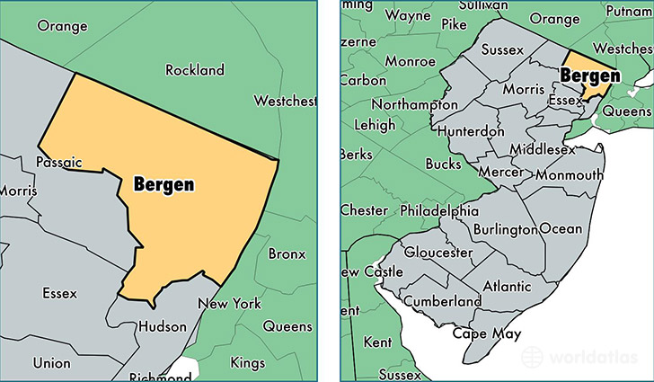
Study Area
Bergen County, New Jersey
Dense urban area
Population: 939,151 (Quickfacts, n.d.)
Area: 233 square miles of land
(Bergen County, 2017)
11 hurricanes in the past 6 years
Hurricane Irene
Hurricane Sandy
Image from: https://www.worldatlas.com/na/us/nj/c-bergen-county-new-jersey.html

Slide 6
Proposed Method: What is object-based image analysis?
OBIA builds on older characteristics that have been used for
decades (Blaschke, 2009)
Image segmentation
eCognition (bottom-up region-merging techniques)
Pixels are grouped during segmentation based on scale,
color, & shape
Object = more than one pixel
Image classification, spectral and textural characteristics (Luscier et al, 2006)
Objects have topology (Hussain et al, 2013)

Slide 7
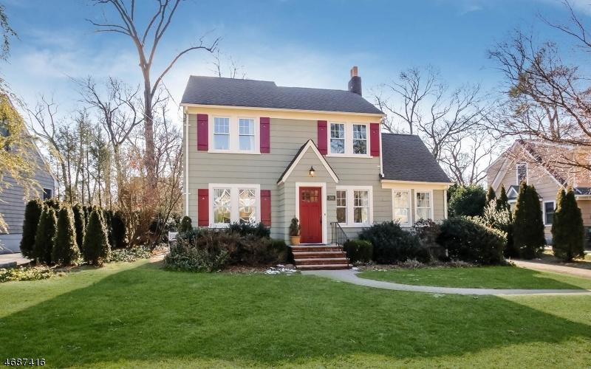
Proposed Method: OBIA for extracting buildings
Image from trulia.com
Lidar and multispectral photographs (Grigillo and Kanjir, 2012)
Resolution of 5m or less (Tsai et al, 2011)
High resolution imagery = high variability within classes (Johansen et al, 2010)
Best to use OBIA instead of pixel by pixel

Slide 8
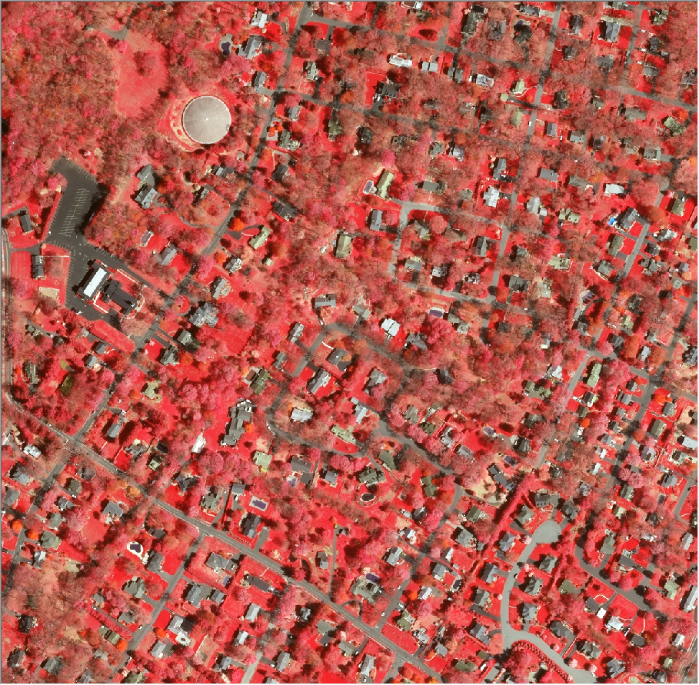
Proposed Method: Data to be Used
Lidar
Source: NJGIN
Approx. 100 GB
Imagery
Source: NJGIN
Multi-spectral digital orthoimagery
Collected using Microsoft UltraCam Falcon and Eagle
4 band (RGB and NIR)
Format: SID
Collected in Spring 2015
Resolution: 1 ft (0.3m)
Sample imagery (1 tile) from Bergen County. Displayed in false color RGB 4-1-2

Slide 9
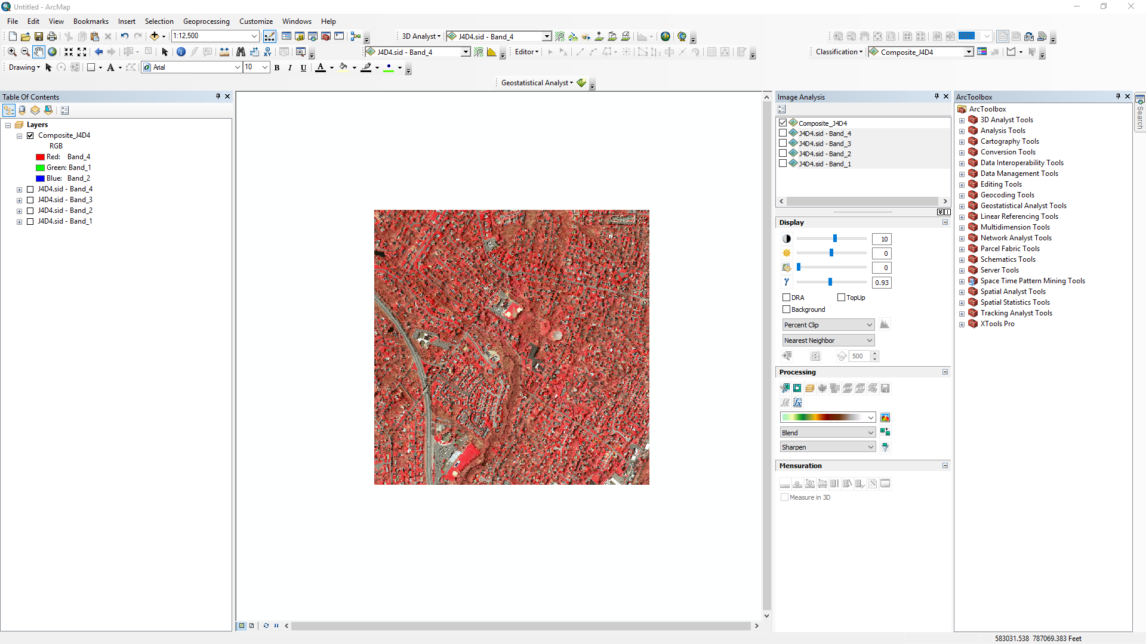
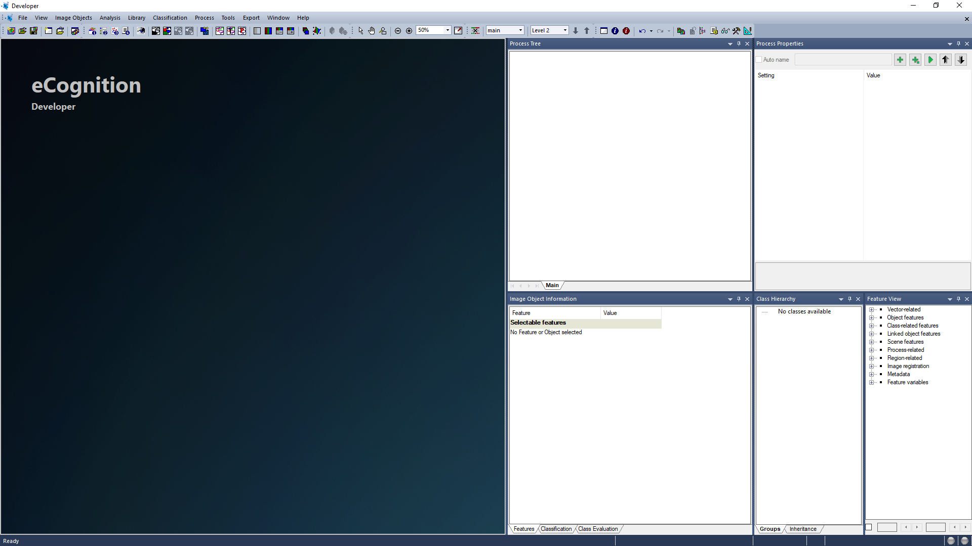
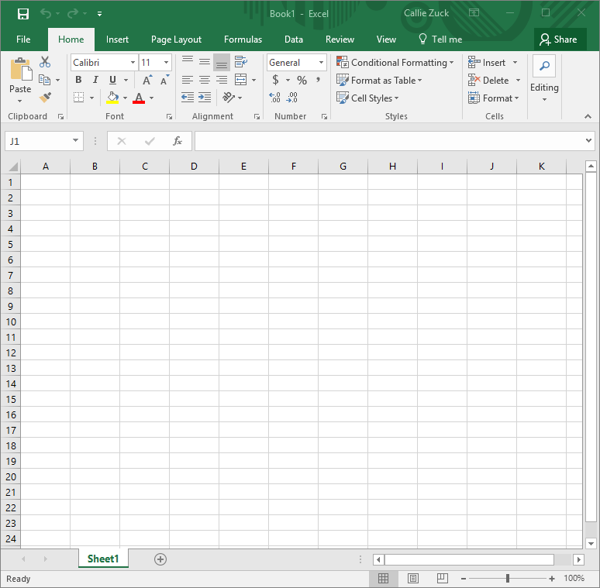
Proposed Method: Software Needed
ArcGIS 10.4.1
eCognition Developer 9.2
Microsoft Excel

Slide 10
Proposed Method: Processing & Analyses
1. Preprocess imagery
Spatial
Spectral
2. Preprocess lidar point cloud
DEM – ground returns
DSM – first returns
nDSM = DSM-DEM
3. Classify/identify structures and
buildings
Data (already preprocessed)
Ruleset creation
Multi-resolution segmentation
OBIA (Object based imagery analysis)
Object hierarchy
Export the classes
Sample areas
Execute ruleset
4. Accuracy assessment
Confusion matrix
Reference image vs. classified building footprints
Commission: % of reference points that were erroneously classified
Omission: % of reference points that were not classified when they should have been classified
What about shape accuracy?

Slide 11
Proposed Methods: Finishing Touches
5. Metadata creation
FGDC compliant
Documentation for future evaluation
Essential for contribution to data banks
6. Contribute to Openstreetmap
Community buy-in
Documentation
Review
Upload

Slide 12
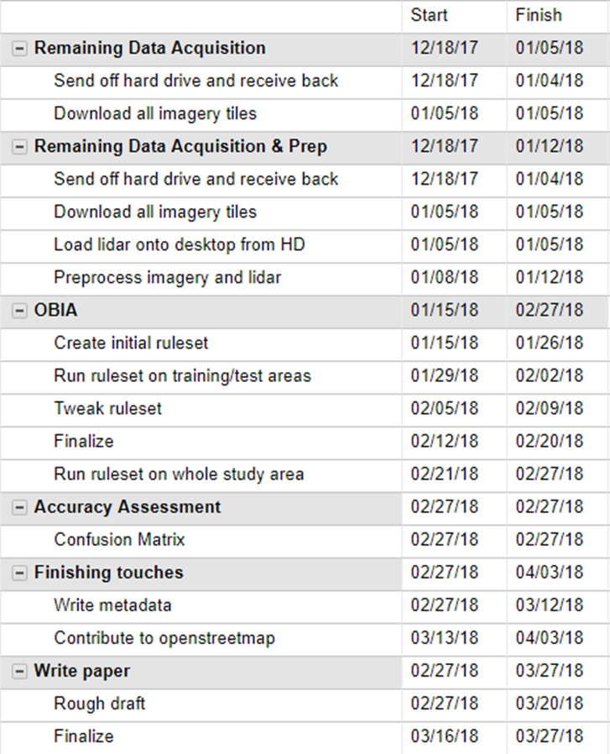
Timeline

Slide 13
Sources
Al-Khudhairy, D., Caravaggi, I., & Giada, S. (2005). Structural Damage Assessments from Ikonos Data
Using Change Detection, Object-Oriented Segmentation, and Classification Techniques.
Photogrammetric Engineering & Remote Sensing,71(7), 825-837. doi:10.14358/pers.71.7.825
Bergen County, New Jersey. (2017, December 18). Retrieved December 19, 2017,
from https://en.wikipedia.org/wiki/Bergen_County,_New_Jersey
Blaschke, T. (2010). Object based image analysis for remote sensing. ISPRS Journal of Photogrammetry
and Remote Sensing,65(1), 2-16. doi:10.1016/j.isprsjprs.2009.06.004
Grigillo, D., & Kanjir, U. (2012). Urban Object Extraction From Digital Surface Model And Digital Aerial
Images. ISPRS Annals of Photogrammetry, Remote Sensing and Spatial Information Sciences,I-3, 215-220.
doi:10.5194/isprsannals-i-3-215-2012
Hussain, M., Chen, D., Cheng, A., Wei, H., & Stanley, D. (2013). Change detection from remotely
sensed images: From pixel-based to object-based approaches. ISPRS Journal of Photogrammetry
and Remote Sensing,80, 91-106. doi:10.1016/j.isprsjprs.2013.03.006
Jiang, N., Zhang, J., Li, H., & Lin, X. (2008). Semi-automatic building extraction from high resolution
imagery based on segmentation. 2008 International Workshop on Earth Observation and Remote
Sensing Applications. doi:10.1109/EORSA.2008.4620311

Slide 14
Sources (cont.)
Johansen, K., Arroyo, L. A., Phinn, S., & Witte, C. (2010). Comparison of Geo-Object Based and
Pixel-Based Change Detection of Riparian Environments using High Spatial Resolution Multi-Spectral
Imagery. Photogrammetric Engineering & Remote Sensing,76(2), 123-136. doi:10.14358/pers.76.2.123
Luscier, J. D., Thompson, W. L., Wilson, J. M., Gorham, B. E., & Dragut, L. D. (2006). Using digital
photographs and object-based image analysis to estimate percent ground cover in vegetation plots.
Frontiers in Ecology and the Environment,4(8), 408-413. doi:10.1890/1540-9295(2006)4[408:udpaoi]2.0.co;2
New Jersey Hurricanes. (2017, November 26). Retrieved December 19, 2017,
from https://en.wikipedia.org/wiki/List_of_New_Jersey_hurricanes
Tsai, Y. H., Stow, D., & Weeks, J. (2011). Comparison of Object-Based Image Analysis Approaches to
Mapping New Buildings in Accra, Ghana Using Multi-Temporal QuickBird Satellite Imagery.
Remote Sensing,3(12), 2707-2726. doi:10.3390/rs3122707
QuickFacts. Retrieved December 15, 2017,
from https://www.census.gov/quickfacts/fact/table/bergencountynewjersey/PST045216

Slide 15
Thank you! Questions?

