Slide 1
Biking in Hennepin County
Citizen Engagement As a mobile solution
Aaron Chisholm
GEOG 596A
Pennsylvania State University

Slide 2
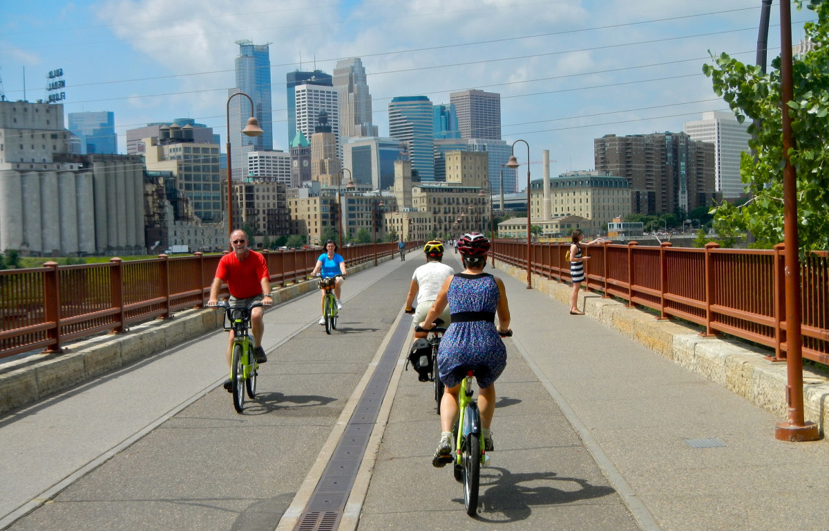
Agenda
Background
Start of an Idea
Hennepin County Facts
History of Biking and Biking Culture in Minneapolis
Minneapolis Bikeability Status
Future Plans
Current Mapping
Three Rivers Park District
Project Objectives
Proposed Strategy
Incident Reporting
Current Data Sources
Design
Build
Anticipated Results
Timeline
Conclusion
Questions
References

Slide 3
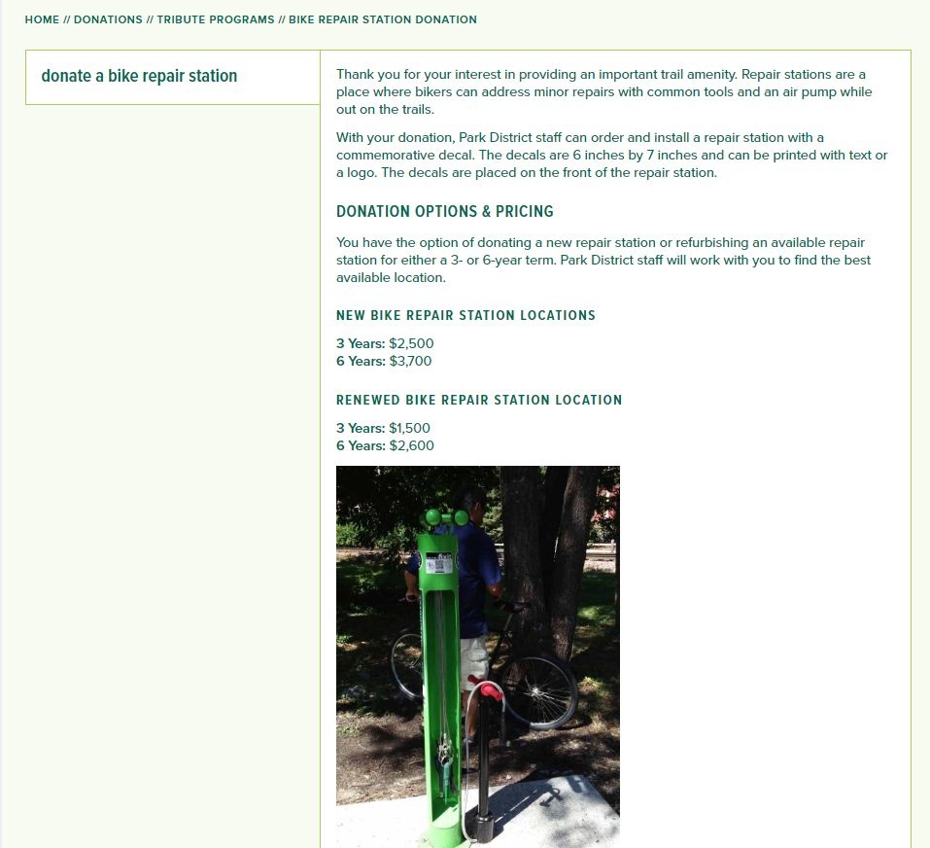
Bike Tune-Up Stations

Slide 4
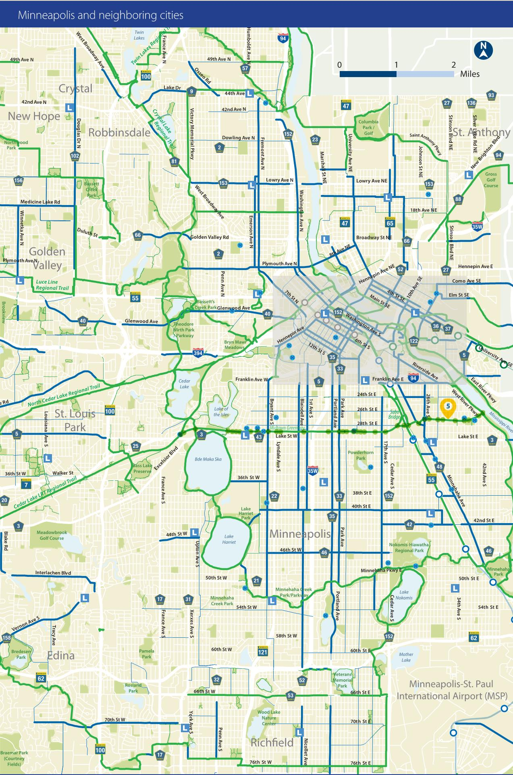
Hennepin County, MN
Population – 1,259,428
Biggest City – Minneapolis, MN (Population 422,331)
Bicycling accounts for 2.5% of all trips
Double the national Average
651 Miles of Bikeway system in Hennepin County
425 miles – Off-street bikeway
226 miles – On-street bikeway
One of the first bike share programs in the U.S.
Nice Ride
Nearly 2,000 bikes and 200 stations throughout the Twin Cities

Slide 5
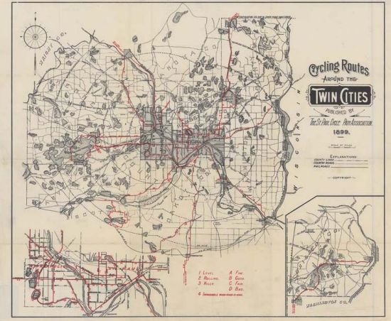
History of Biking in Minneapolis
First cycle paths were built in Minneapolis in 1895 only a year after first bicycle path in the U.S.
“Minneapolis has one of the best park systems in the US because of the planning that was done over 100 years ago”
“The original Minneapolis Park system laid the foundation for today’s trail system. Without the investment and foresight of past commissioners and superintendents the park and trail system would not be as vast as it is today.”

Slide 6
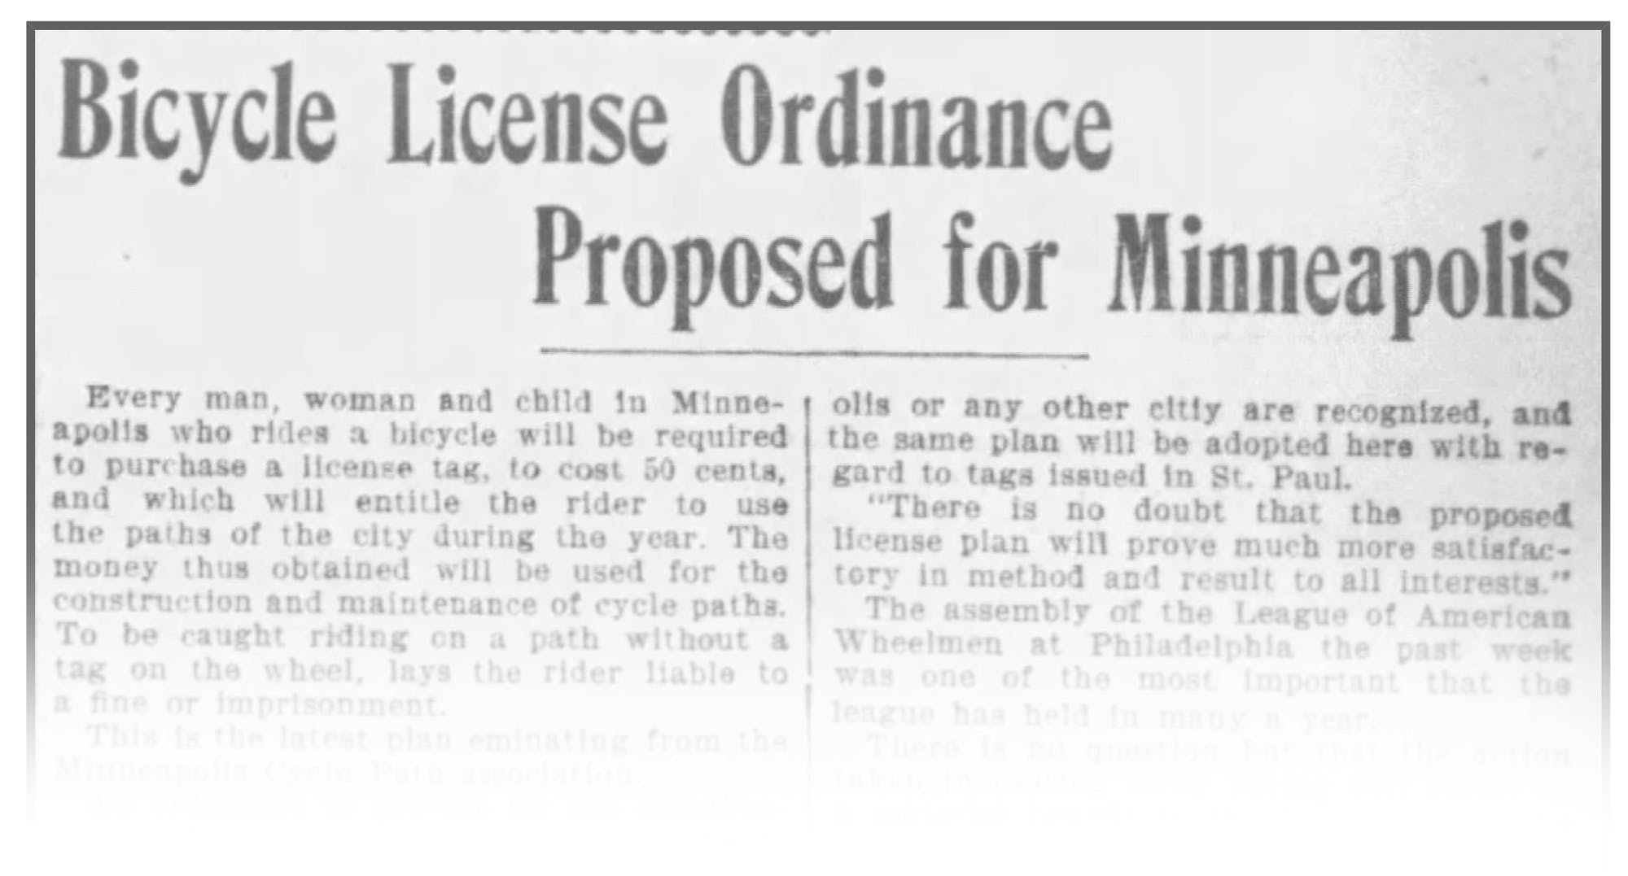
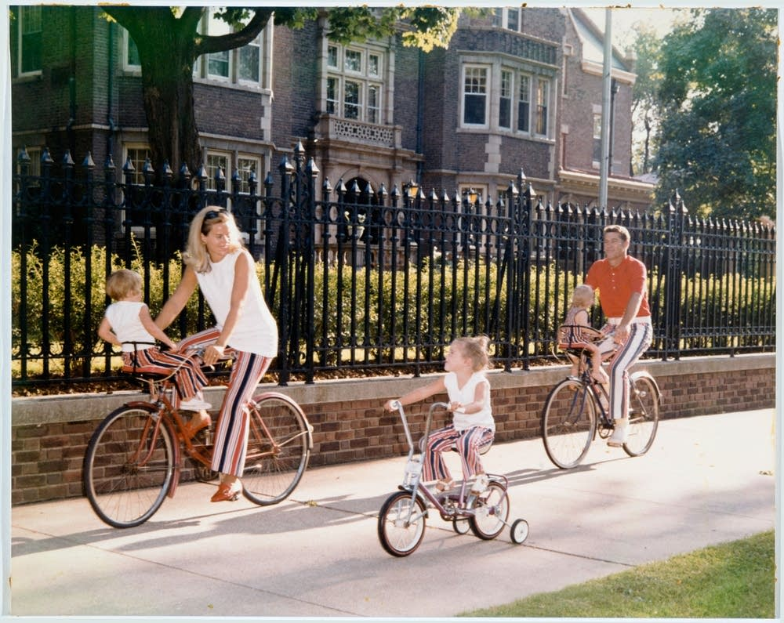
20th Century Biking in Minneapolis
Bicycle technology drastically improved throughout the beginning of the 20th century
1950’s – 1970’s bicycles changed as Americans adapted from an abundance of fossil fuels and the interstate system to a fuel shortage with a cultural shift to a need for multimodal transportation.
1991 – Congress passed the ISTEA (Intermodal Surface Transportation Equity Act) that provided the City of Minneapolis millions to build several key trails in the area.

Slide 7
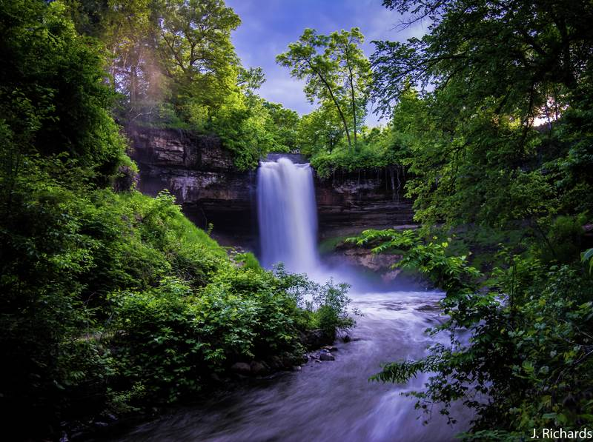
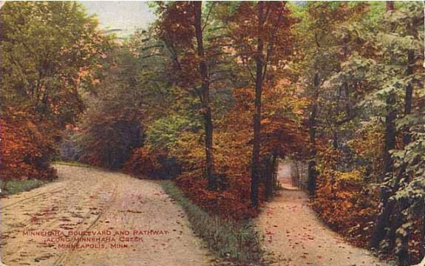
Bringing it all together – trail connectivity
Between 2000 – 2006 the Midtown Greenway was built utilizing an old Regional Railroad corridor providing a fairly vehicle free trail system through the heart of southern Minneapolis.
In 1994, the Stone Arch Bridge was converted into a pedestrian bridge utilizing Transportation Enhancement (TE) funds. This trail brings 1,300 daily commuters into downtown Minneapolis.
In 2001, the Minneapolis Park and Recreation Board (MPRB) finished reconstructing the Minnehaha Creek Trails that helped bridge the gap between Lake Harriet and Minnehaha Park which brings in millions of people each year

Slide 8
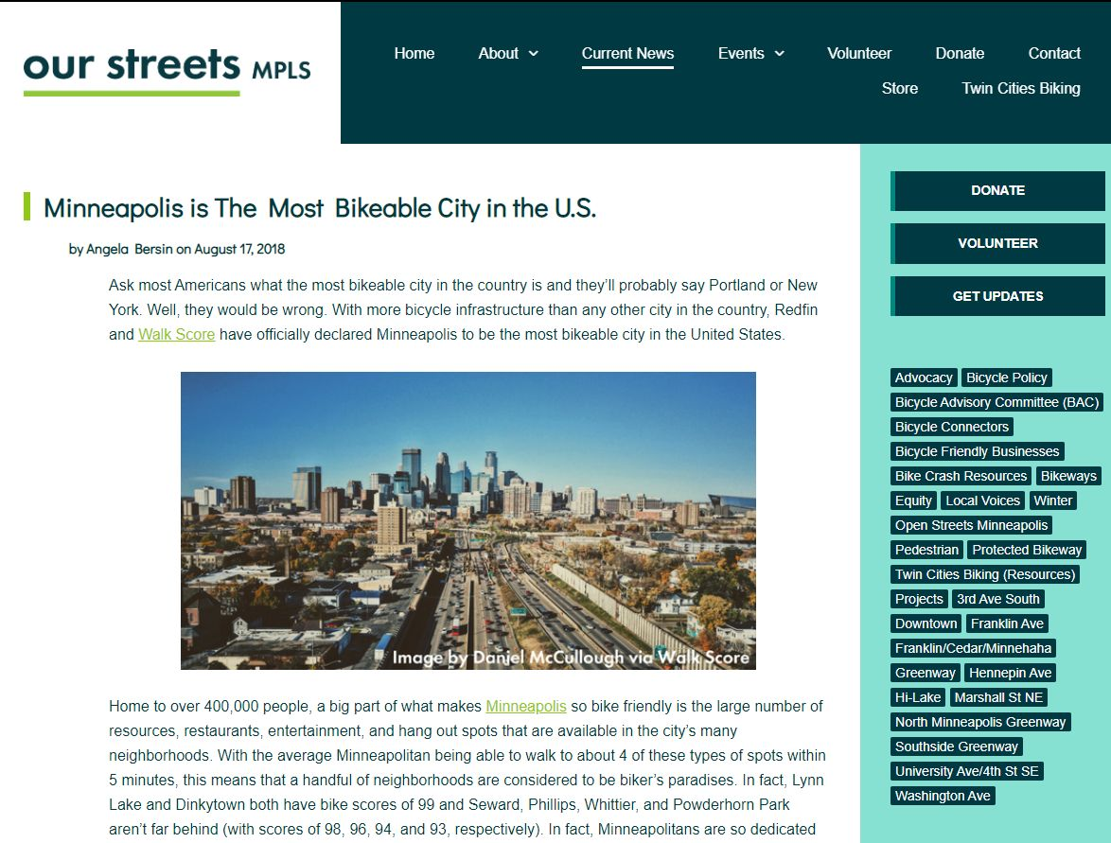
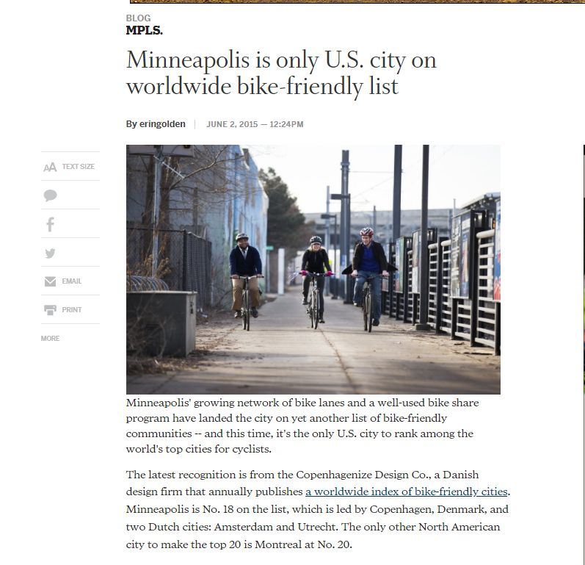
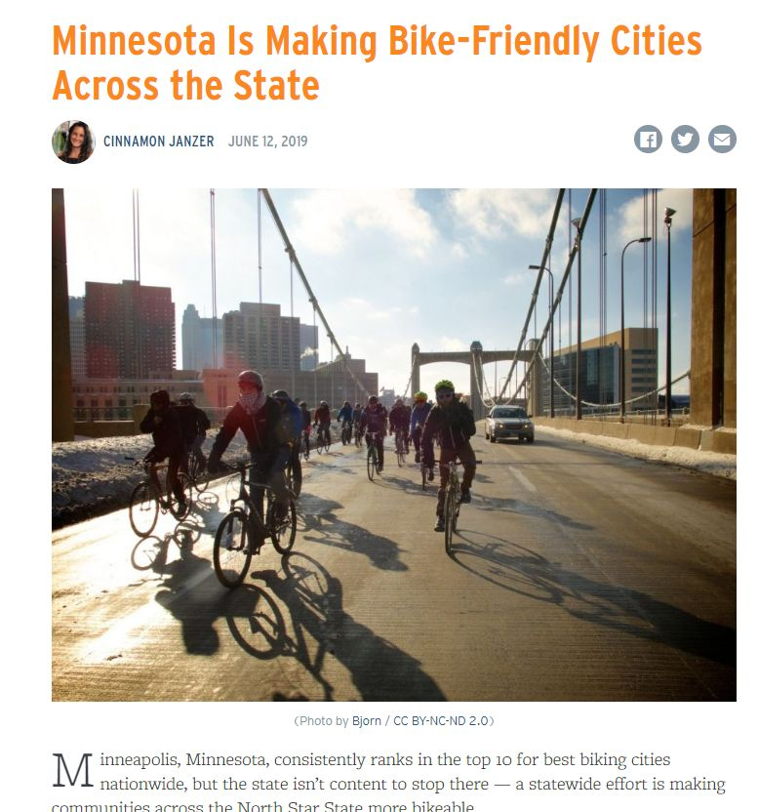
Biking in Minneapolis – U.S. Ranked
In the last few years, many sources have made Minneapolis, St. Paul and the Twin Cities region as one of the most bikeable cities in the U.S.
In an unsurprising correlation, Minneapolis and the Twin Cities region has almost made the top ten list for several years as being one of the healthiest cities in the U.S.
The Twin Cities is also one of the only cities to make a international list of bike-friendly cities in the world

Slide 9
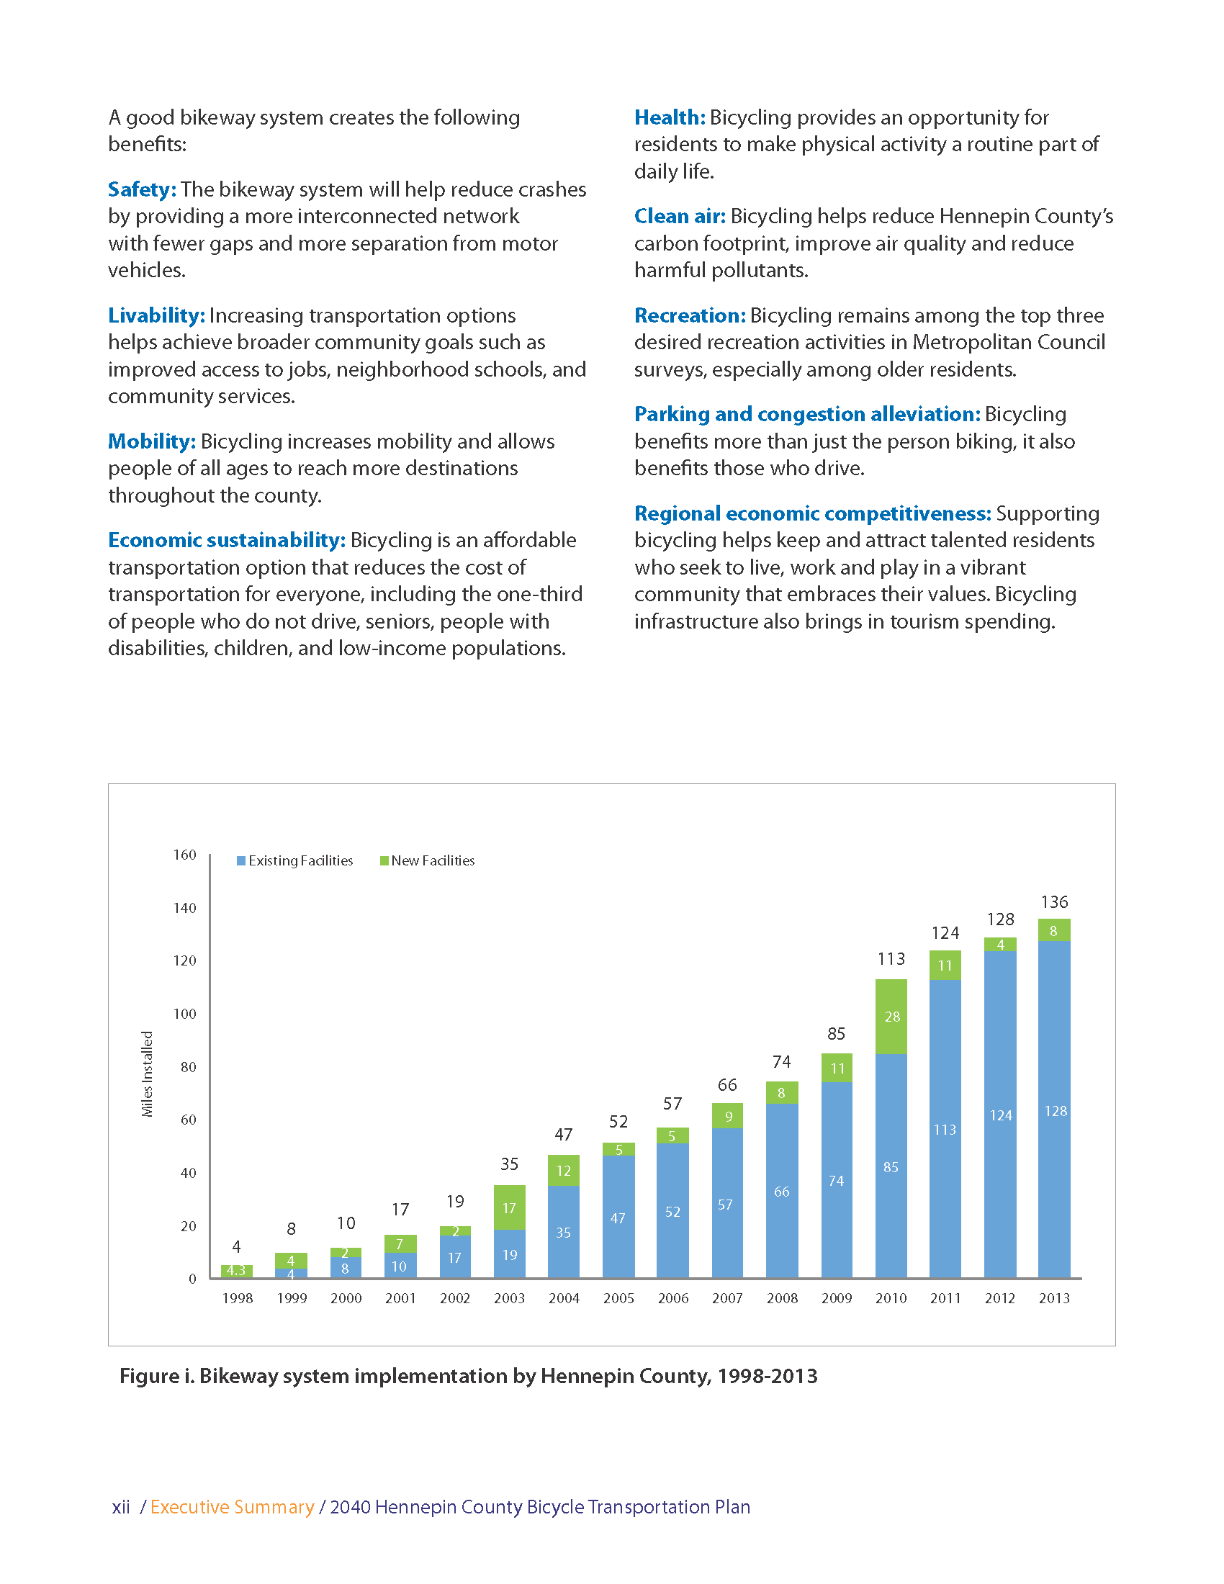
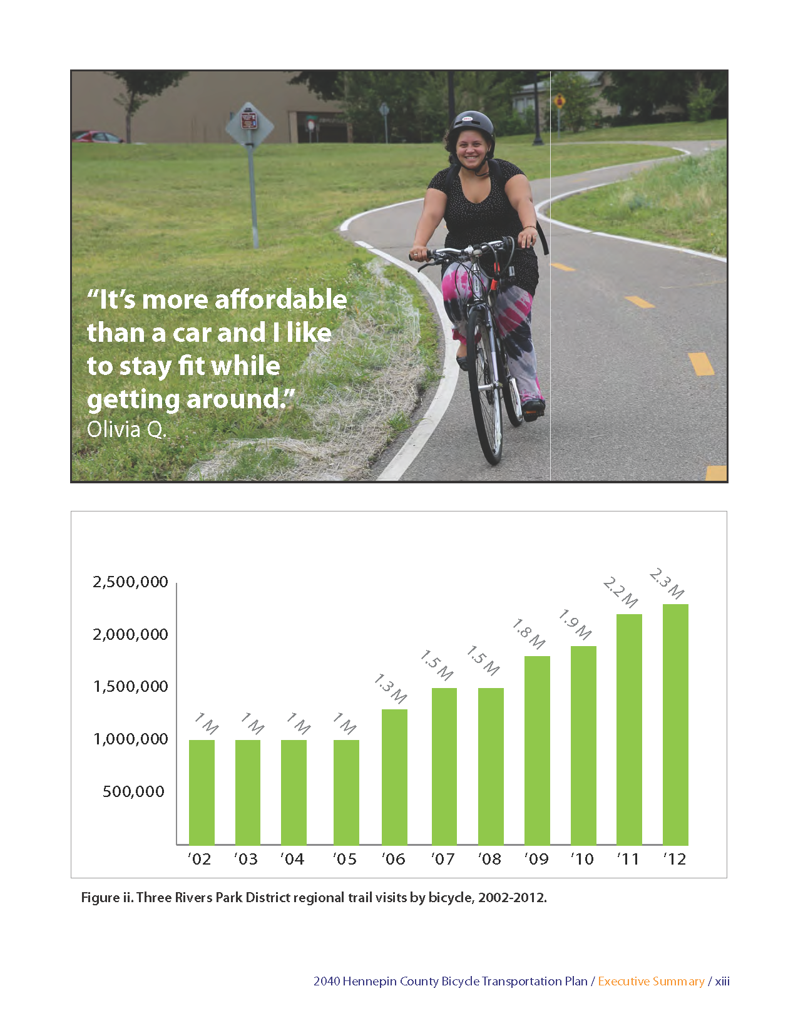
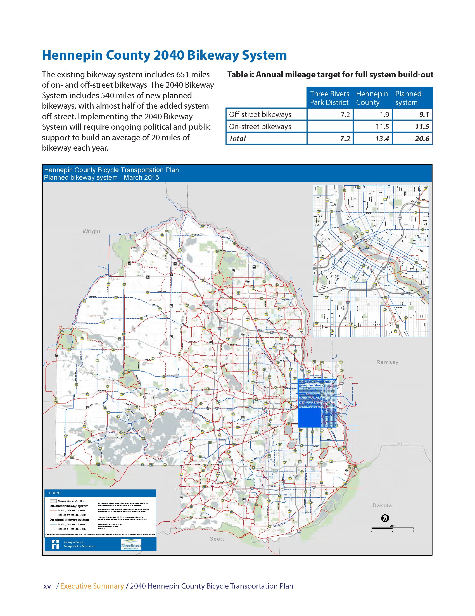
Plans to improve
The City of Minneapolis, Hennepin County and Three Rivers Park District teamed up in 2019 to update the 1997 Bicycle Plan with 2040 goals.
540 miles of new bikeway
Almost half will be off-street bikeway
Quadruple daily bicycle commuters from 12,000 to 48,000
Have a bikeway within .5 miles of 90% of homes within Hennepin County
Decrease bicycle crashes by half and promote a safe and comfortable county bikeway system

Slide 10
Current Mapping

Slide 11
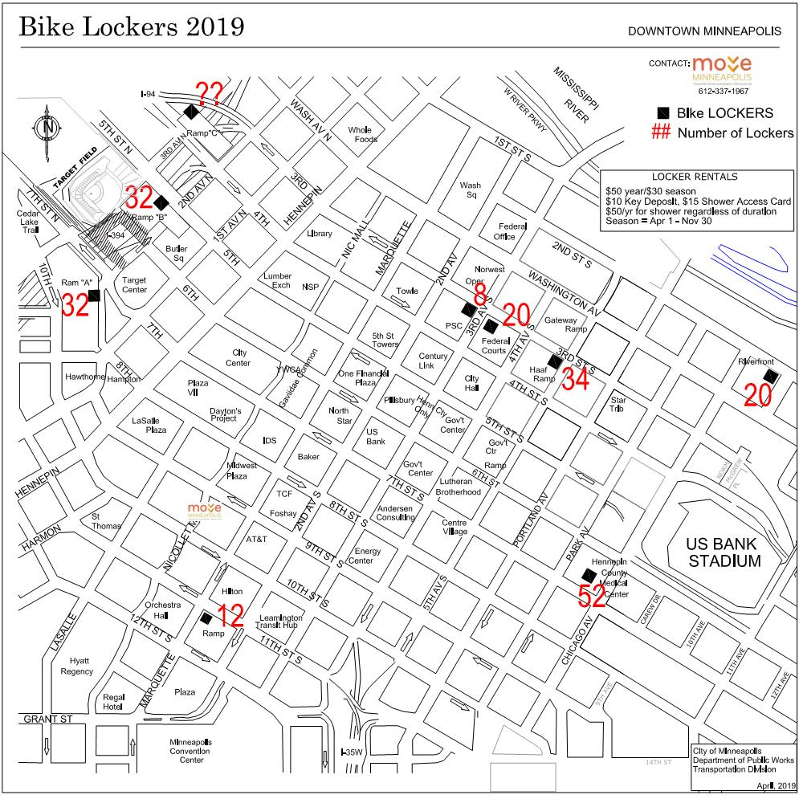
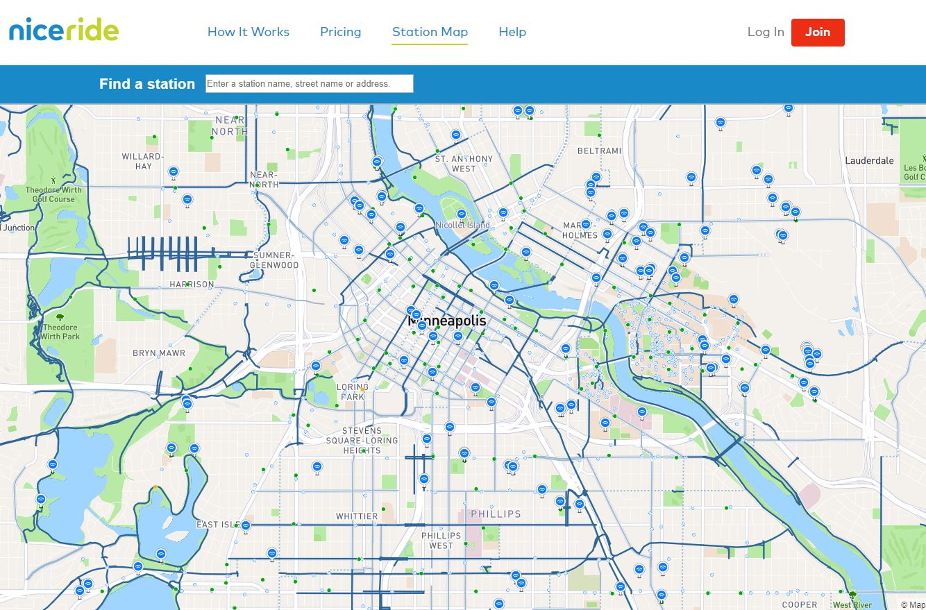
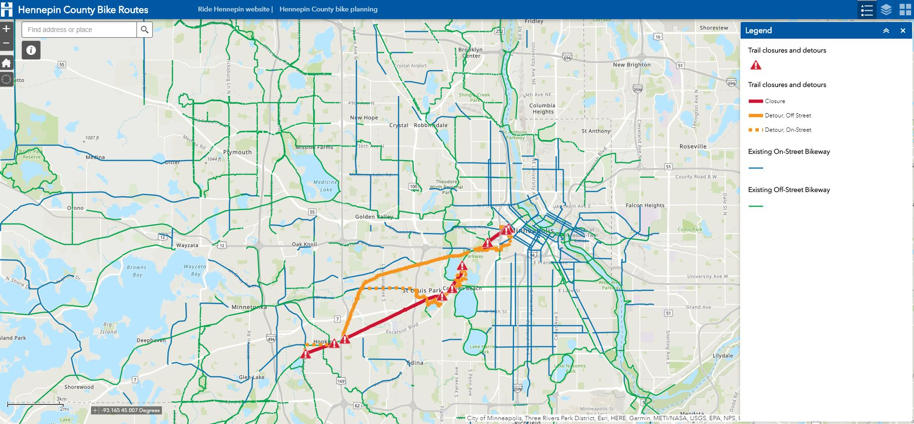
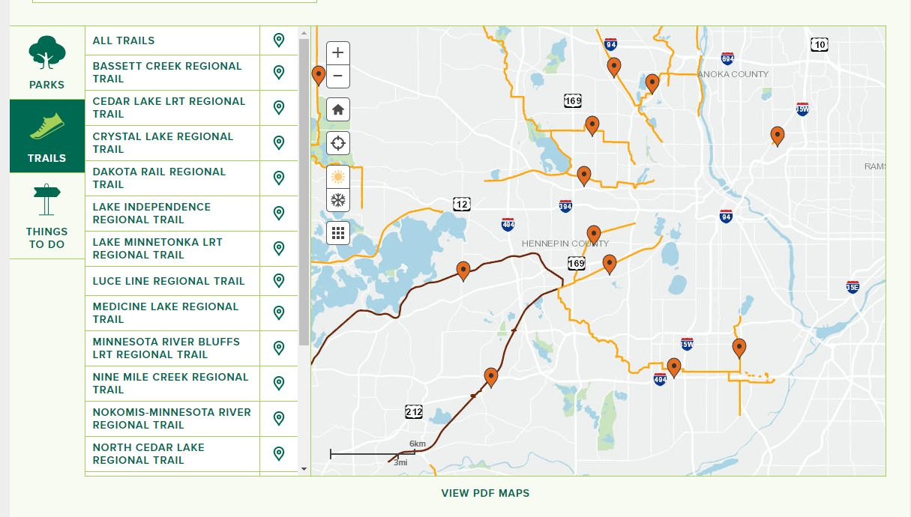
Current Mapping

Slide 12
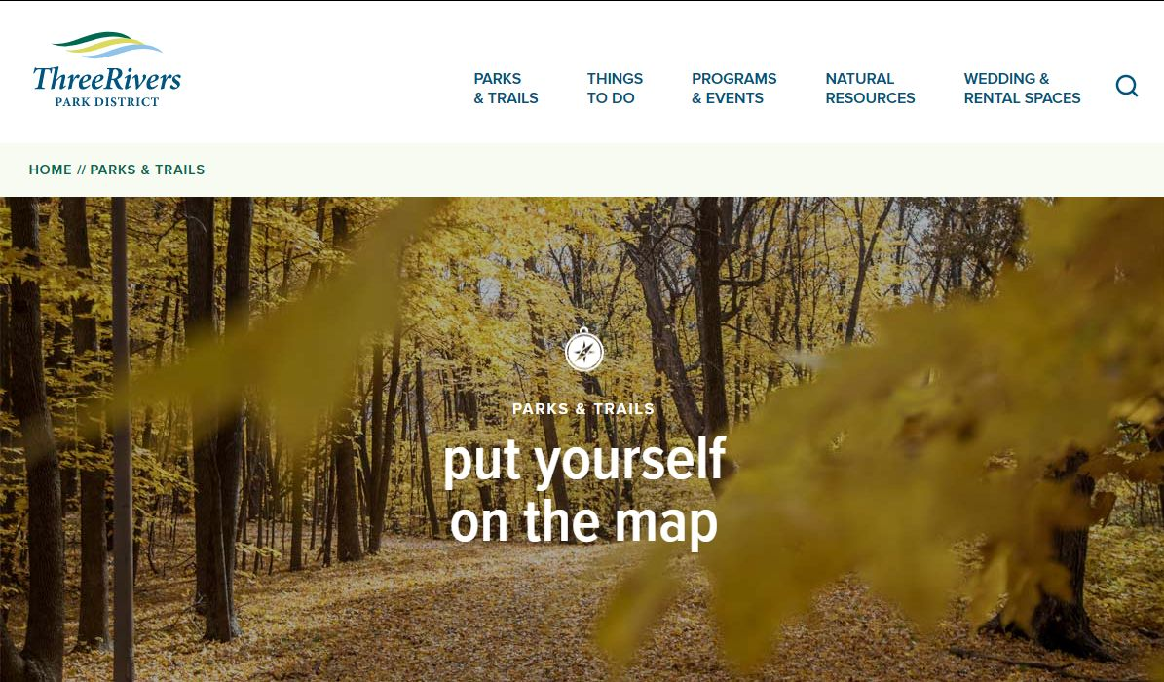
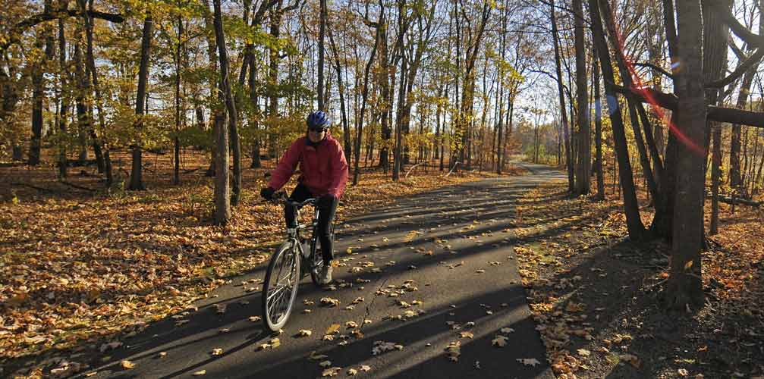
Three Rivers Park District
Contacted Kelly Grissman (Director of Planning) and Danny McCullough (Regional Trail System Manager)
Discussed the need to find a better way to report incidents on the trail network
Current means of recording ped/ped incidents or ped/car incidents is an excel spreadsheet
Expressed interest in utilizing a mobile application as a means for citizen engagement to report issues on the trail network

Slide 13
Project Goal
To design and possibly develop a mobile application that provides a means for community engagement and incident reporting while also bridging the gap between City, County, State and other government agencies in terms of displaying GIS data relating to biking in Hennepin County.

Slide 14
Objectives
Develop a means for reporting incidents on the trail network
Utilizing the Esri platform or something similar, provide a way for the public to report incidents on the mobile app that will record the location of the incident and type of incident
Design a mobile mapping platform for visualizing existing biking data in combination with possible data collection.
On and off street bike trails
Condition of the trail (open vs. closed)
Bike Repair Stations
Public Restrooms along trails
Parking near trails
Bike Skills Parks
City, County, and State Park boundaries within Hennepin County
Bike Lockers/Showers
Nice Ride docking stations

Slide 15
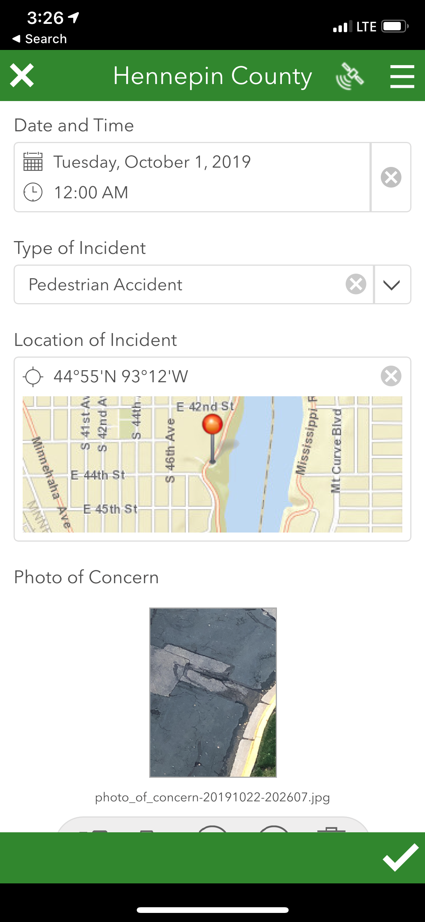
Methodology – Incident Reporting
Work with Three Rivers Park District to develop a series of questions, domains, and data that they would like to collect for incident reporting
Develop the report in Survey123 or other appropriate platform
Publish form for public use and test for design/performance issues

Slide 16
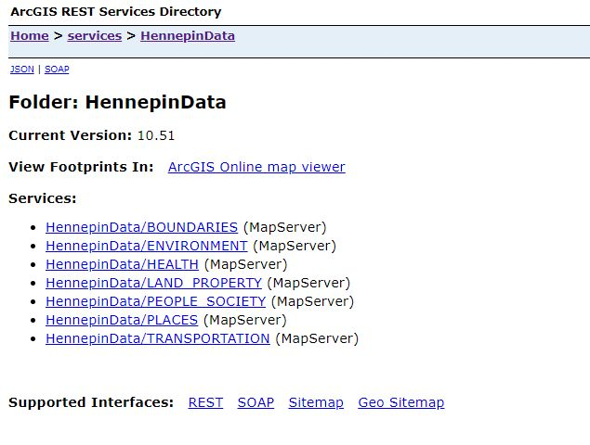
Methodology – Map View Data
Utilize current data sources maintained by Hennepin County, Three Rivers Park District, City of Minneapolis, and the State of Minnesota.
Combine existing data into ArcGIS online web format
Collect any data that needs to be collected via Collector for ArcGIS
Modify attributes to provide essential information to the public.
Host all data on ArcGIS online

Slide 17
Methodology - Design
Utilizing mockup software, design the interface to encapsulate the user experience.
Focus the design on four sections
Map View
Giving the user access to a seamless map design and ability to quickly and intuitively click on and off the layers they desire
Report an Incident
Give the user a simple way to report an incident. Utilizing Esri technology such as Survey123 or QuickCapture, provide a streamlined way to report incidents to the appropriate agency
About this App
Provide an educational section about the functionality of this app and the information behind the parks and trails systems of Hennepin County
Contact Us
Provide a means to give feedback, or contact the appropriate people for further information no the app or the parks and trail network

Slide 18
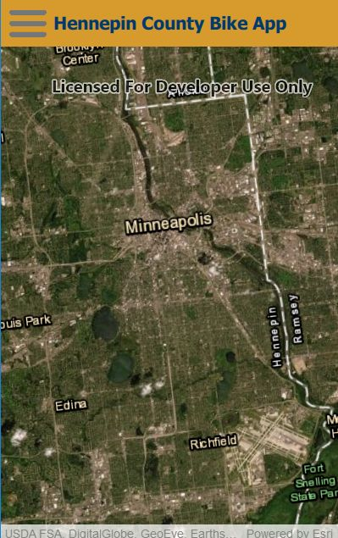
Methodology - Build
Utilizing AppStudio for ArcGIS, build a native mobile application utilizing the Esri platform
Build and customize the application in Qt Creator (C++ or Qt) language
Incorporate Esri webmaps and data along with functionality from Survey123, QuickCapture or another reporting platform
Ensure user interface is easy and intuitive

Slide 19
Anticipated Results
Provide Three Rivers Park district with deliverables for their evaluation and use:
Final process and workflows
Mockups of mobile application design
Survey123 form via excel document for Survey123 Connect
Data from web mapping application
Mobile application code (if developed)
Work with Three Rivers Park district on any questions or concerns they may have about the prototype

Slide 20
Timeline
Project Proposal
Development
Present at League of American Bicyclists Annual National Bike Summit – Washington D.C.
Project Revisions and Preparation
August – October 2019
November - December2019
Spring Semester 2020
March 15th – 17th 2020
Project Proposal
Design, develop, build project

Slide 21
Questions?

Slide 22
Bibliography
Bersin, A. (2018, August 17). Minneapolis is The Most Bikeable City in the U.S. Retrieved September 16, 2019, from https://www.ourstreetsmpls.org/minneapolis_is_the_most_bikeable_city_in_the_us.
BringMeTheNews. (2018, May 17). The most dangerous Minnesota cities for pedestrians and bikers. Retrieved October 15, 2019, from https://bringmethenews.com/minnesota-news/the-most-dangerous-minnesota-cities-for-pedestrians-and-bikers.
Brown, J. (2019, June 8). These Are the Most Bikeable Cities in the United States. Retrieved September 13, 2019, from https://www.rei.com/blog/cycle/here-are-the-most-bikeable-cities-in-the-united-states.
City of Minneapolis. (2011). Minneapolis Bicycle Master Plan. Minneapolis, MN. Retrieved from http://www.minneapolismn.gov/www/groups/public/@publicworks/documents/webcontent/convert_278621.pdf.
Draft Tournament. (n.d.). Minneapolis 2020. Retrieved October 20, 2019, from https://www.drafttournament.com/blog/portfolio/minneapolis/.
Golden, E. (2015, June 2). Minneapolis is only U.S. city on worldwide bike-friendly list. Retrieved September 16, 2019, from http://www.startribune.com/minneapolis-is-only-u-s-city-on-worldwide-bike-friendly-list/305861331/.
Hennepin County. (2019). Hennepin County Bike Routes. Retrieved October 16, 2019, from http://hennepin.maps.arcgis.com/apps/webappviewer/index.html?id=89b4fc93062f4db2a7fe6840ffe04ba5.
Hennepin County. (2015, April 14). Hennepin County 2040 Bicycle Transportation Plan. Retrieved from https://www.hennepin.us/-/media/hennepinus/residents/transportation/biking/bicycle-transportation-plan.pdf?la=en&hash=26ABAFD2C3476F5AD2CADF6EEB7DCDD509DE6295.

Slide 23
Bibliography
Janzer, C. (2019, June 12). Minnesota Is Making Bike-Friendly Cities Across the State. Retrieved September 16, 2019, from https://nextcity.org/daily/entry/minnesota-is-making-bike-friendly-cities-across-the-state.
Minnesota Department of Natural Resources. (2019, June 23). Bike Tune-Up Stations in Minnesota State Parks - Minnesota DNR. Retrieved October 20, 2019, from https://www.dnr.state.mn.us/tuneup/index.html.
Move Minneapolis. (2019). Bike Route Maps. Retrieved October 16, 2019, from https://moveminneapolis.org/bicycle/bike-route-maps/.
Niceride. (2019). Station Map. Retrieved October 18, 2019, from https://member.niceridemn.com/map/.
Shilton, A. C. (2019, March 13). The Best Bike Cities in America. Retrieved September 14, 2019, from https://www.bicycling.com/culture/a23676188/best-bike-cities-2018/.
Sisson, P. (2018, November 27). Inside Minneapolis's plan to tackle affordability-and climate change. Retrieved October 22, 2019, from https://www.curbed.com/2018/11/27/18113208/minneapolis-real-estate-rent-development-2040-zoning.
Szczepanski, C. (2019, October 4). National Bike Summit. Retrieved October 20, 2019, from https://www.bikeleague.org/summit.
Three Rivers Park District. (2019). Three Rivers Park District. Retrieved October 18, 2019, from https://www.threeriversparks.org/.
U.S. Census Bureau. (2019). U.S. Census Bureau QuickFacts: Hennepin County, Minnesota. Retrieved October 14, 2019, from https://www.census.gov/quickfacts/hennepincountyminnesota.

