Slide 1
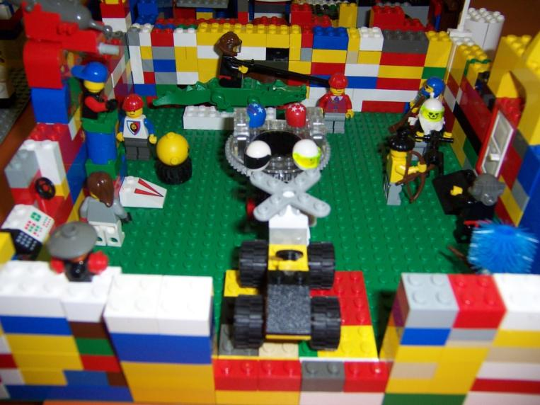
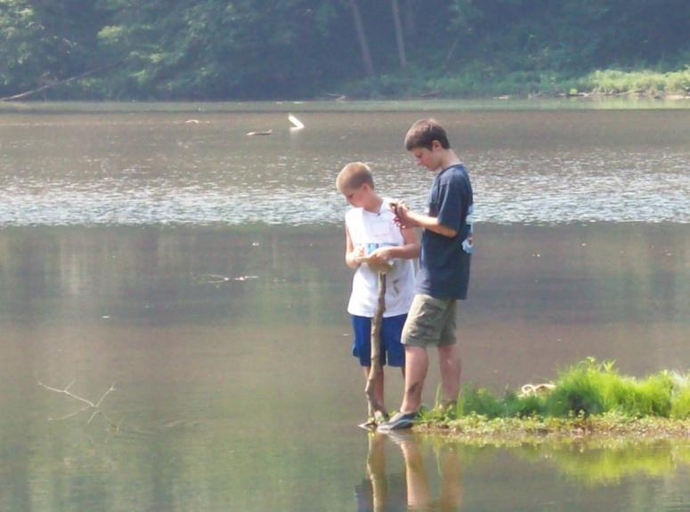
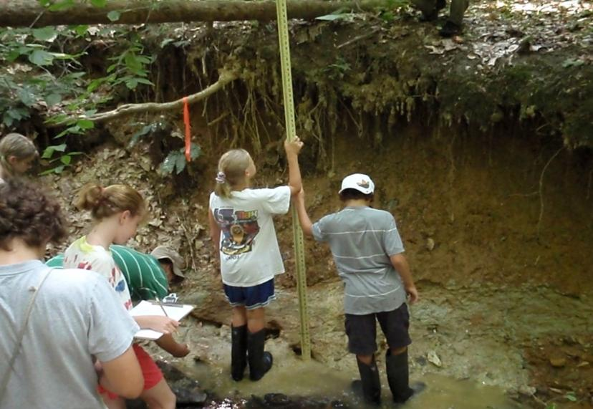
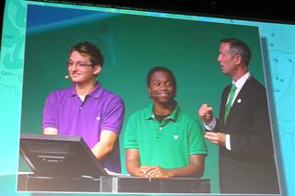
Making Education Spatial
The Relationship between Geospatial Technologies and the Nationwide STEM Movement
Notes:
Introduce- CALP, G&T, Collegeboard, Magnets, Charter-Homeland Security. More background- 14 years. Learned out of gutter. MGIS filled in many of the gaps.

Slide 2
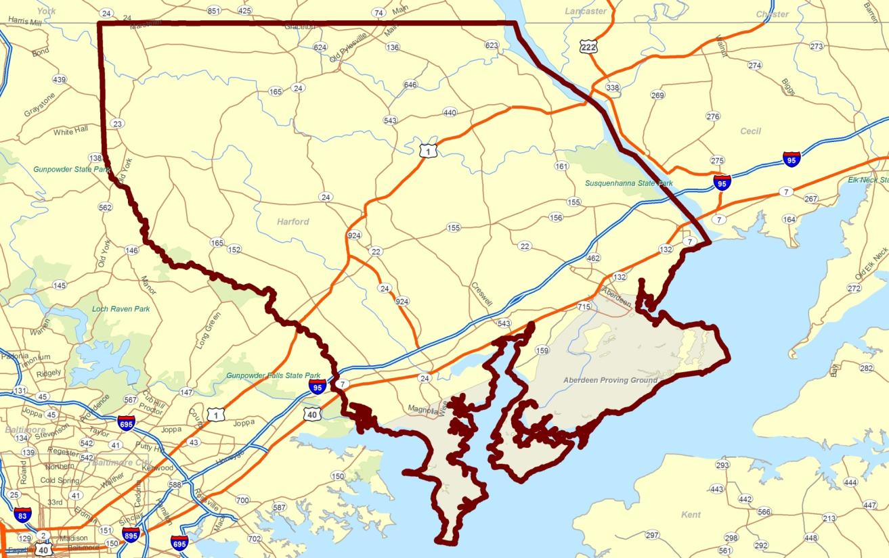
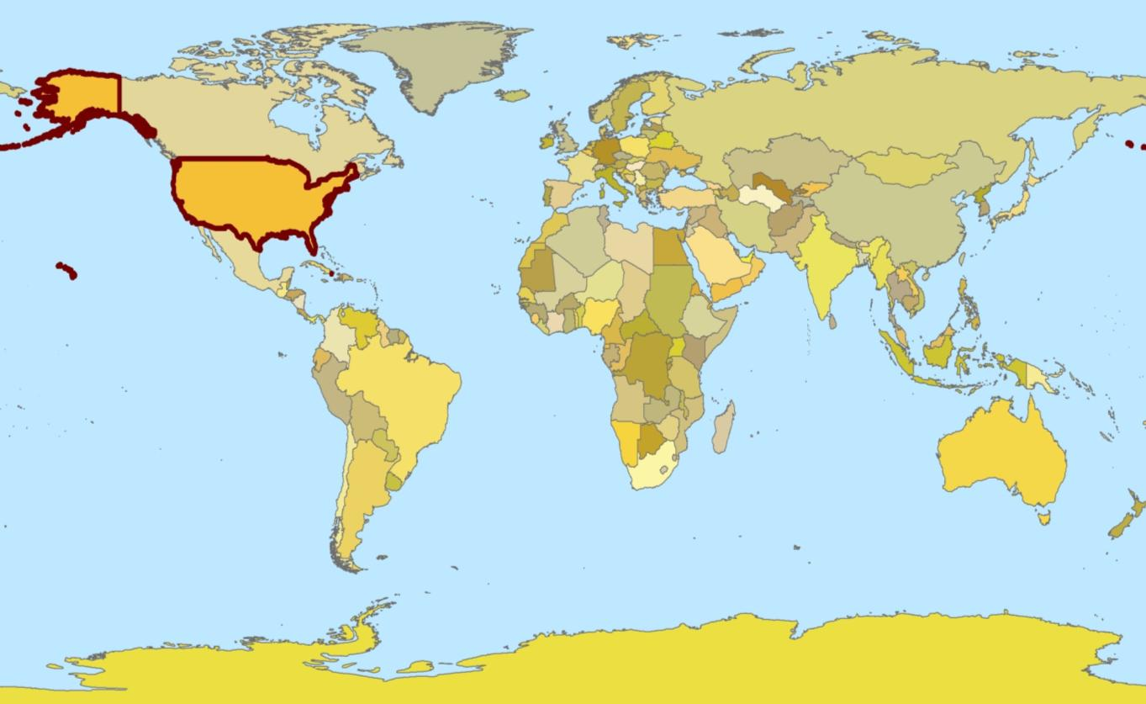
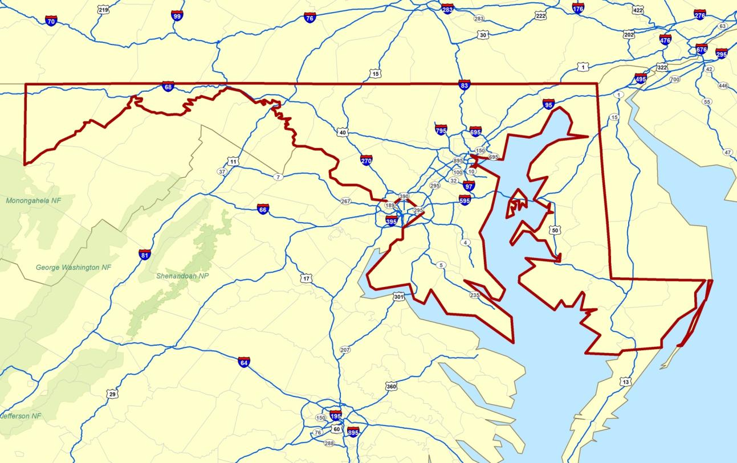
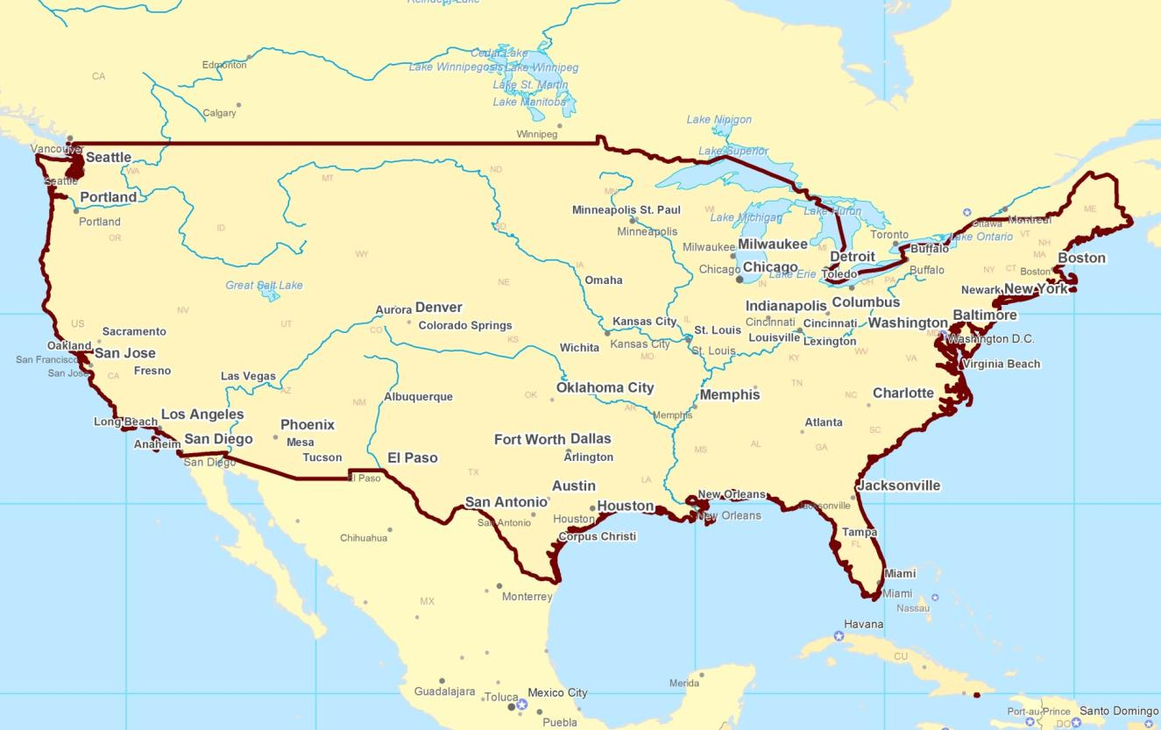
Where is Harford County?

Slide 3
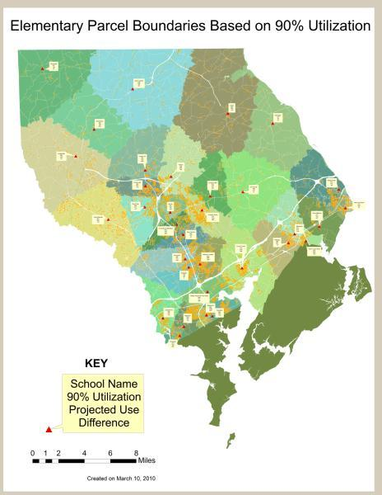
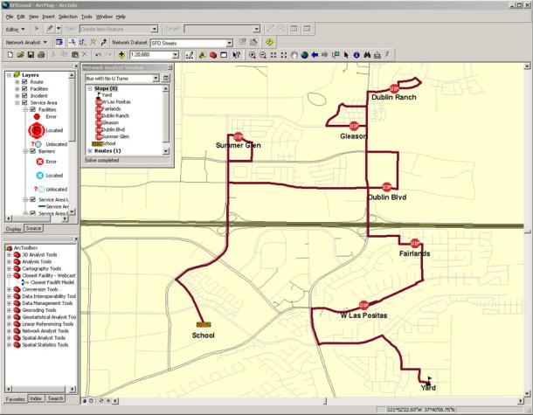
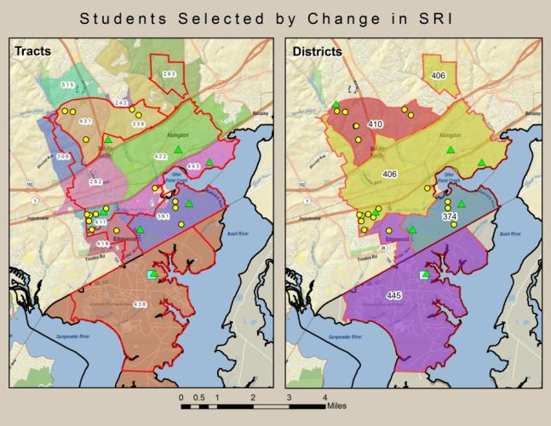
The Duality of GIS in Education
Logistical Support
Enrollment Projections
Redistricting
Bus Routing
Assessment Analysis

Slide 4
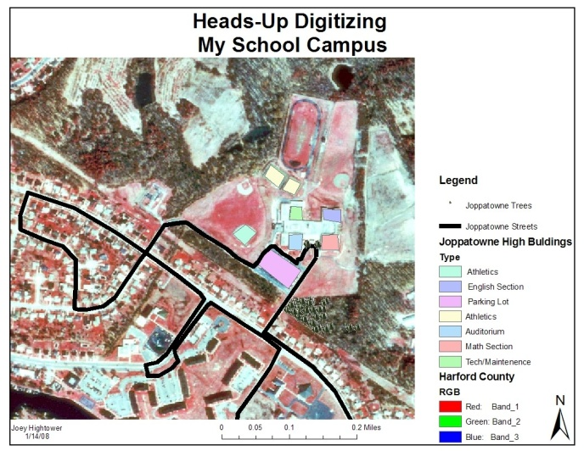
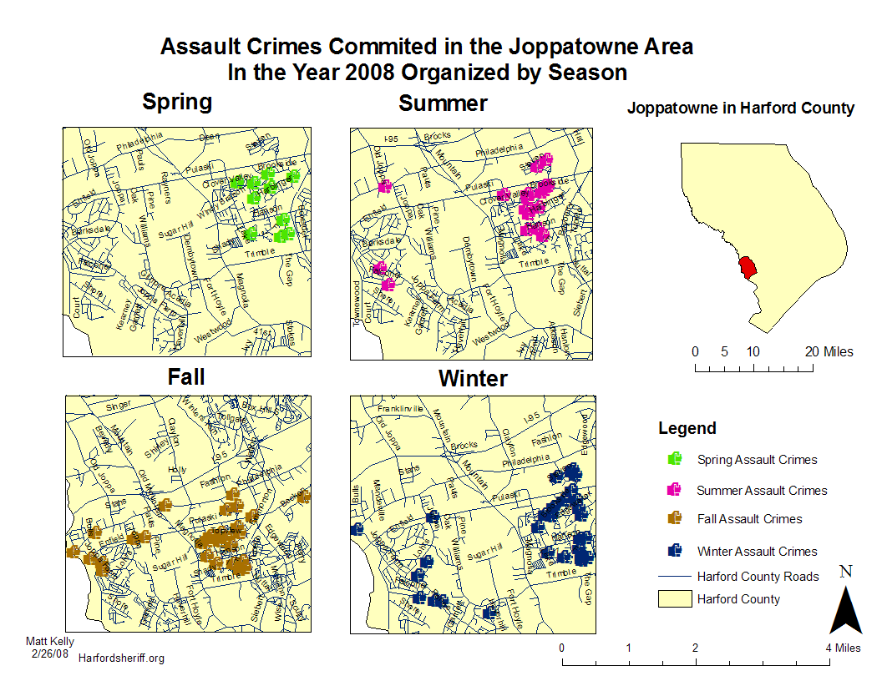
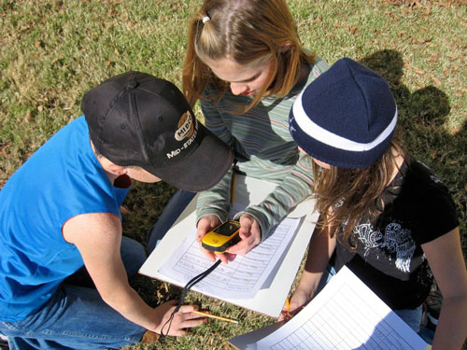
The Duality of GIS in Education
Curricular Support
Science
Technology
Engineering
Math
Notes:
Dr. Judith Ramaley of Winona State University coined the term STEM in 2001 when she worked for NSF. Prior to that it was called SMET.

Slide 5
The Educational Perspective of STEM
S
T
e
M
Notes:
I would have made the “e” smaller but you needed to be able to see it.

Slide 6
The True Intent of STEM
S T E M
How do you build a
more fuel efficient car?
How do you put
people on Mars?
How do you preserve
the Chesapeake Bay?
Notes:
Integrated.

Slide 7
MSPP: Building Statewide Capacity to Improve Teaching & Learning in STEM
ePortfolio & Web 2.0 Tools
Problem Based Learning
Geospatial Technologies
PD: Instructional Coaches, Learning Teams, & Academies
Best Practices Model and District STEM Initiatives
Notes:
STEM grant- includes ePortfolios, Web 2.0 tools, and Geospatial Technologies. Utilizes instructional coach model for professional development that is sustained throughout the year.

Slide 8
Research Review
University based and Geography focused
Diffusion of Innovation
Little consensus on solving major issues
Before “No Child Left Behind”
Spatial
  People with spatial ability are critical to the STEM workforce
  U.S. Public Education does little to recognize or develop spatial ability
  GIS develops spatial ability
Curriculum
  Teaching with GIS instead of about GIS
  Problem based interdisciplinary and standards based
  Local focus
Training
  Coaches
  120 Hours
  Sustained throughout the year
Sustainability
  Pre-service education
  Technology stability
  Firewalls, filters, and downloads
  Champions (a.k.a Geomentors)

Slide 9
Project Plan
Curriculum Development*
Curriculum Revisions
Curriculum Evaluation
Coaches Training
Summer Workshops*
Coaches work in schools with teachers implementing lessons
Summer Workshops
Teacher Pre-Assessment
Student Pre-Assessment
Student Post Assessment*
Teacher Post Assessment*
Interview/survey state coordinators*
Spring 2010
Summer 2010
Fall 2010
Winter 2011
Spring 2011
Summer 2011

Slide 10
Overview of Curriculum
Lesson Title | Estimated Time to Implement (min) | IEEIA Process
Settlement of the Chesapeake Bay Watershed | 45-60 | Root Cause Analysis: Defining the event, problem, and issue.
Where does the water go when it rains? | 45-60
Maryland Biological Stream Survey (MBSS) Data Analysis | 45-60
Seeing the Bay Through Their Eyes (Media Literacy focus) | 90-120 | Gaining Perspective: Who are the players and their view of the issue?
The Fine Art of Developing a Research Question | 45-60 | Developing the Research Question: The fulcrum point of research.
Mapping Our Green Umbrella (Citygreen Lesson 2) | 135-180 | Data Collection: Surveys, questionnaires, and opinionnaires
EXPLORING GREEN ALTERNATIVES Modeling Alternative Scenarios and Tree Growth with CITYgreen (Citygreen Lesson 3) | 45-60 | Data Interpretation: Making conclusions, inferences, and recommendations
From Powerpoint to ArcGIS Explorer | 90-120 | Share the Findings: Peer reviews, public comments, and publications
Watershed restoration macro to micro. | Determined by Action | Taking Action: Effective, responsible, and meaningful

Slide 11
Project Deliverables
Fully developed and tested curriculum
24 teams of teachers trained in the use of GIS
“Best Management Practices for Administering a State-wide GIS License”
Teacher and student data
Successful publication of findings and presentation at 2011 EdUC.

Slide 12
Potential Impact of Project
Notes:
GIS in Harford County middle schools. All 24 Maryland school systems using GIS. A new GIS professional development model for U.S. and the world.

Slide 13
References
Beeson, P. A. (2006). Uncovering the Secrets Behind the Successful Integration of GIS into the Core Curriculum. International Research in Geographical and Environmental Education, 15(3), 274-277. doi:10.2167/irgee196f.0
Brook, Erin A, and Eileen J Napoleon. Thinking Spatially Using GIS: Our World GIS Education, Level 1 (Our World GIS Education). Pap/Cdr/Un ed. Redlands: ESRI Press, 2008. Print.
Buss, A. R., & McClurg, P. A. (1999). Initiating the use of GIS technology in wyoming public schools through in-service workshopsFor full text: http://www.narst.org/. Retrieved from www.csa.com
Dascombe, B. (2006). Making Geographic Information Systems (GIS) Sustainable in Schools. International Research in Geographical and Environmental Education, 15(3), 265-267. doi:10.2167/irgee196d.0
Donaldson, D. P. With a little help from our friends: implementing geographic information systems (GIS) in K-12 schools. Social Education v. 65 no. 3 (April 2001) p. 147-50
Drennon, C. (2005). Teaching Geographic Information Systems in a Problem-Based Learning Environment. Journal of Geography in Higher Education, 29(3), 385-402. doi:10.1080/03098260500290934
Hammond, Thomas C.; Bodzin, Alec M. Teaching "with" Rather than "about" Geographic Information Systems. Social Education. v73 n3 p119-123 Apr 2009
Jay D Gatrell. (2004). Making Room: Integrating Geo-technologies into Teacher Education. The Journal of Geography, 103(5), 193-198. Retrieved February 20, 2010, from ProQuest Education Journals. (Document ID: 737636101).
Kerski, Joseph. The Implementation and Effectiveness of GIS in Secondary Education: Geographic Information Systems in Education. Mainz am Rhein (Germany): Vdm Verlag, 2009. Print.
Kidman, G. & Palmer, G. (2006). GIS: The Technology is There but the Teaching is Yet to Catch Up. International Research in Geographical and Environmental Education, 15(3), 289-296. doi:10.2167/irgee196i.0
Learning To Think Spatially. Washington D.C.: National Academy Press, 2006. Print.
Lee, Jongwon; Bednarz, Robert. Effect of GIS Learning on Spatial Thinking Journal of Educational Psychology. v33 n2 p183-198 May 2009
McClurg, P. A., & Buss, A. (2007). Professional development: Teachers use of GIS to enhance student learning. Journal of Geography, 106(2), 79-87. Retrieved from http://www.informaworld.com/openurl?genre=article&id=doi:10.1080/00221340701477831
Mctighe, Jay, and Grant Wiggins. Understanding by Design. Alexandria, VA: Association For Supervision & Curriculum Development, 1998. Print.
Scarborough, J. D. (2004). Strategic alliance to advanced technological education through enhanced mathematics, science, technology, and english education at the secondary level Retrieved from www.csa.com
Shaunessy, E., & Page, C. (2006). Promoting inquiry in the gifted classroom through GPS and GIS technologies. Gifted Child Today, 29(4), 42-53. Retrieved from http://www.prufrock.com/client/client_pages/prufrock_jm_giftchild.cfm
Shea, D. L., Lubinski, D., & Benbow, C. P. (2001). Importance of assessing spatial ability in intellectually talented young adolescents: A 20-year longitudinal study. Journal of Educational Psychology, 93(3), 604-614. Retrieved from www.csa.com
Walsh, S. J. (1992). Spatial education and integrated hands-on training: Essential foundation of GIS instruction. Journal of Geography, 91(2; 1-8), s1-8. Retrieved from www.csa.com
Webb, R. M., Lubinski, D., & Benbow, C. P. (2007). Spatial ability: A neglected dimension in talent searches for intellectually precocious youth. Journal of Educational Psychology, 99(2), 397-420. Retrieved from http://content2.apa.org/journals/edu/99/2/397

