Slide 1
Utility & Pipeline Data Model: PILOT Migration PROJECT
ARIN GREEN
596A CAPSTONE PROPOSAL
March 11, 2022

Slide 2
Overview
Introduction
Objectives
Proposed Methodology
Timeline
Anticipated Results
Background
Summary

Slide 3
INTRODUCTION
Bakersfield, CA
B.S. in Geology – CSUB (2014)
California Resources Corporation
MGIS Program

Slide 4
INTRODUCTION
CRC
Independent Oil and Natural Gas company
Acquisition of various assets throughout history
OneCRC Vision – to consolidate assets on a statewide level
Goals to improve data quality, completeness, accuracy

Slide 5
Pipeline Supply Chain
INTRODUCTION
Illustration of general pipeline supply chain (Try It Live Solutions, 2021). Image used for educational purposes only.

Slide 6
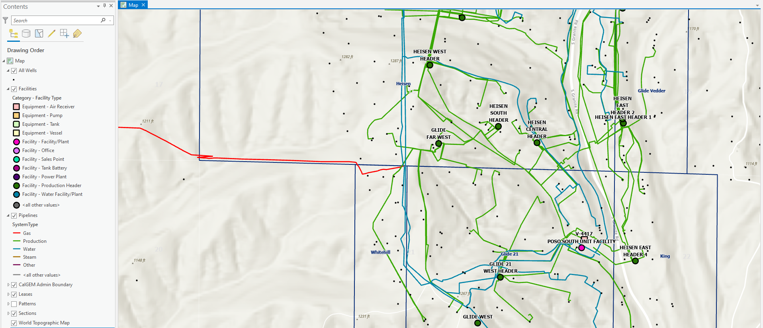
BACKGROUND
N
CURRENT CRC DATA – PIPELINES, FACILITIES AND EQUIPMENT

Slide 7
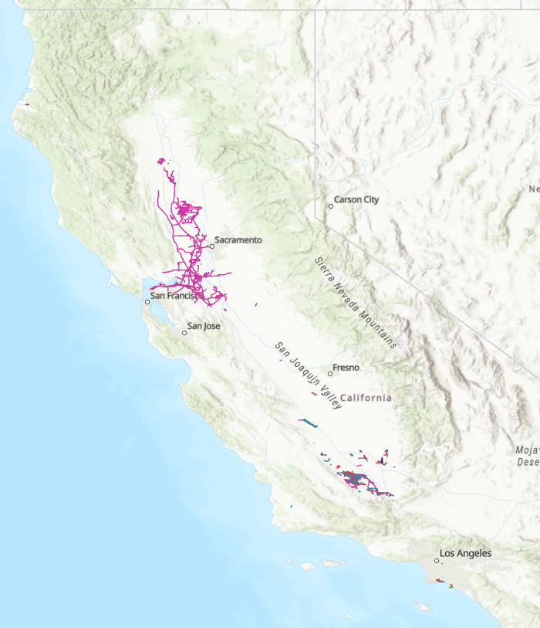
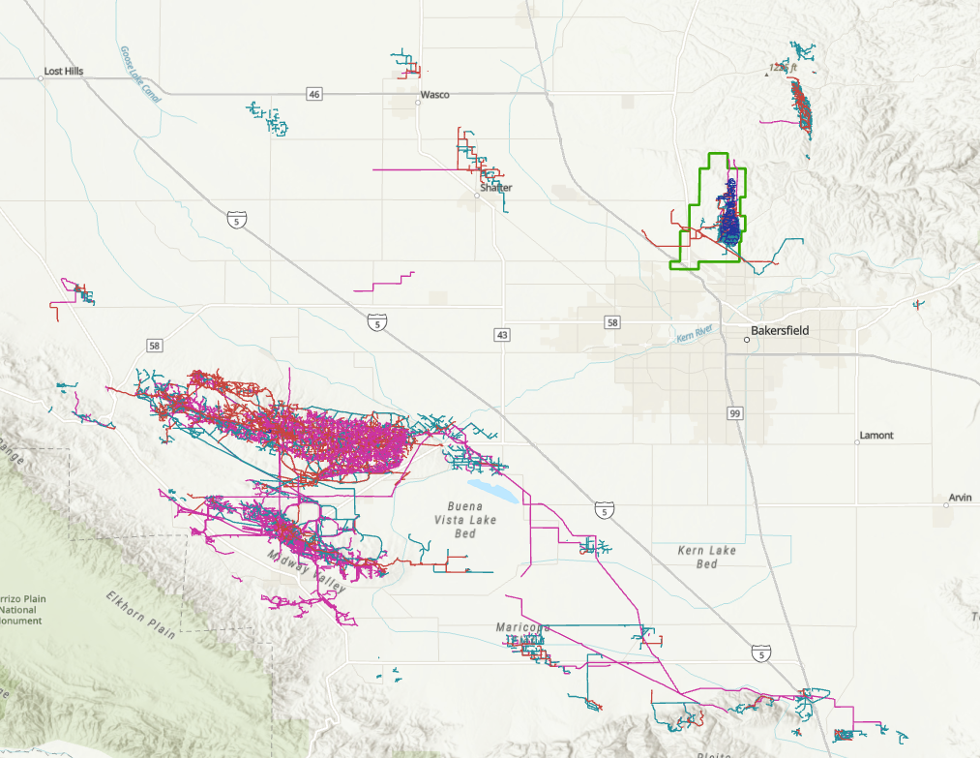
BACKGROUND
Pilot Area
N
N
CRC STATEWIDE PIPLINE DATA
PILOT AREA – KERN FRONT OIL FIELD

Slide 8
BACKGROUND
ESRI Gas and Pipeline Referencing Utility Network Foundation
Contains UPDM – the default ArcGIS data model for liquid and gas pipe systems
Data represented as a single pipe system with connected topology and linear referencing
Saves money and time
Built-in data management workflows, utility network configurations, and visualization tools
Ability to customize to organizational needs
Illustration of Pipeline & Utility Network representing real-world infrastructure (ESRI, n.d.). Image used for educational purposes only.

Slide 9
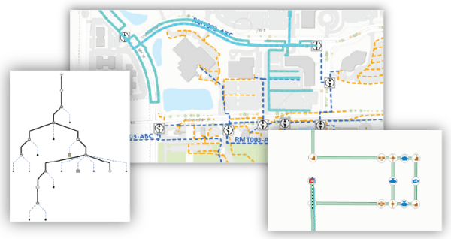
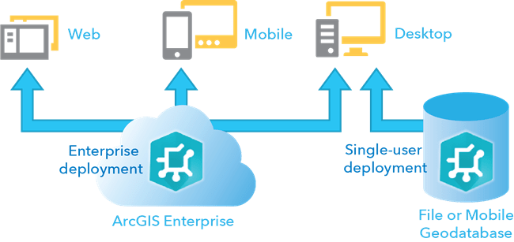
BACKGROUND
ESRI Gas and Pipeline Referencing Utility Network Foundation
UPDM Deployment
UPDM Visualization
Illustration of UPDM Deployment options and visualization tools (ESRI, n.d.). Image used for educational purposes only.

Slide 10
BACKGROUND
 | Existing Data Structure | UPDM
Basic Visualization
Standardized Data Model
Unified Utility Network
Connected Topology and Linear Referencing
Advanced Network Analysis
Preconfigured Rules to Define Network Behaviors
Preconfigured Maps and Visualization Tools for Desktop and Web Viewing/Editing
Designed for Optimized Functionality with Large Datasets

Slide 11
OBJECTIVES
Data Clean-up
Standardize existing data through validation rules and QC
Lessons Learned
GIS Visualization
Configure visualization tools to showcase the advanced functionality of the utility network
Determine best-practices and optimize automation workflows to streamline future QC and migration efforts
Pilot Project
Successfully migrate existing data to UPDM in pilot area

Slide 12
Proposed Methodology
Deploy ArcGIS Solution (contains UPDM)
Data Migration Map
Install Implementation Prerequisites
Create Python Project Environment
Install Utility Network Package and Data Loading Tools
Data validation / QC
Configure Data Model for Implementation
Build Prototype for Single-user Environment
Deploy to an Enterprise Environment
Customize Visualization Tools
Wrap-up / Prepare for Capstone Presentation (596B)

Slide 13
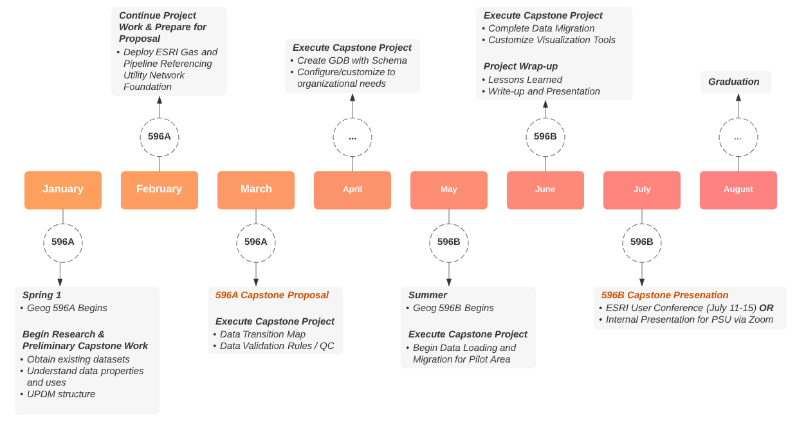
TIMELINE

Slide 14
ANTICIPATED RESULTS
Data Clean-up
QC’d and standardized datasets for pilot area
Lessons Learned
GIS Visualization
Set of map documents and web applications
Gain thorough understanding of the UPDM, editing and automation workflows, and analysis and visualization techniques
Pilot Project
Capstone will serve as pilot project for larger statewide migration

Slide 15
SOURCES
California Resources Corporation. (2022). About CRC. Retrieved on February 16, 2022, from https://www.crc.com/about-crc.
ESRI. (n.d.) ArcGIS Utility Network. Retrieved on January 23, 2022, from https://www.esri.com/en-us/arcgis/products/arcgis-utility-network/overview.
ESRI. (n.d.) Gas and Pipeline Enterprise Data Management Overview. Retrieved on January 24, 2022, from https://solutions.arcgis.com/gas/help/gas-pipeline-enterprise-data-management/get-started/overview.htm.
ESRI. (n.d.) Introduction to Gas and Pipeline Referencing Utility Network Foundation. Retrieved on January 23, 2022, from https://doc.arcgis.com/en/arcgis-solutions/latest/reference/introduction-to-gas-and-pipeline-referencing-utility-network-foundation.htm.
ESRI. (n.d.) What is a Utility Network? Retrieved on February 4, 2022, from https://pro.arcgis.com/en/pro-app/latest/help/data/utility-network/what-is-a-utility-network-.htm.
Try It Live Solutions. (2021). Getting to Know Gas and Pipeline Enterprise Data Management. Retrieved on February 4, 2022, from https://storymaps.arcgis.com/stories/02cf898e224b49be87babc1d7699201b.

