Slide 1
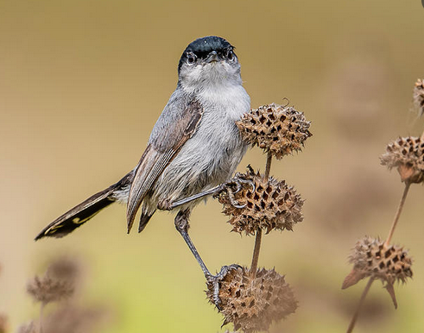
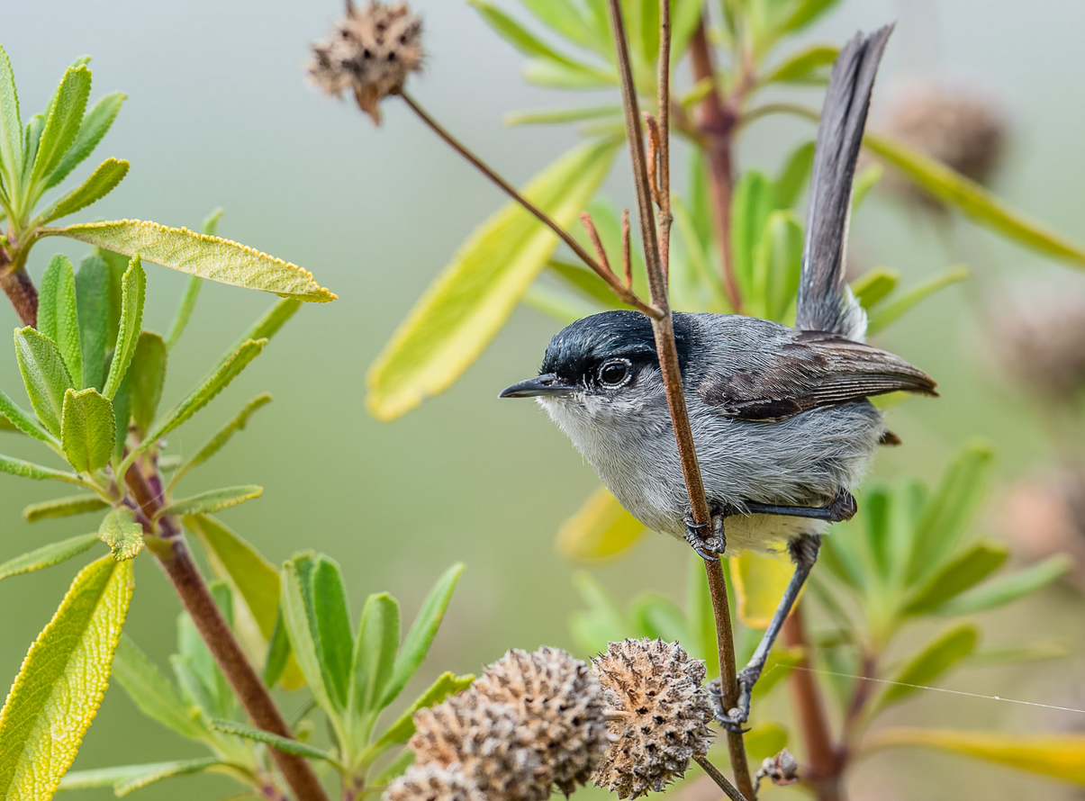
Mitigation Banking for Jurisdictional Waters and California Gnatcatcher Habitat in City of Lake Elsinore, Riverside County, California
Max Ketabi| Advisor: Charles Andrew Cole, Ph.D |Mar 9, 2022
GEOG 596A

Slide 2
Overview & Topic
Use of GIS to identify areas suitable for mitigation banking of potential jurisdictional waters and California Gnatcatcher (CAGN) habitats.
Notes:
Insert a map of your country.

Slide 3
Background
Definition: The term “mitigation bank” usually refers to a wetland, stream, aquatic resource, or a sensitive habitat that has been restored, established, enhanced, or preserved for the purpose of providing compensation for impacts to sensitive resources and habitats permitted under federal, state, or local regulations (EPA).
The entity that invests into and takes on such restoration work is usually referred to as “mitigation banker”.
Similar to commercial banks with cash assets which they can then loan to customers and loan seekers, a mitigation bank has mitigation credits as an asset which it can eventually sell to those who are trying to fulfill their permit requirements by offsetting certain mitigation debits.
Notes:
Insert a picture of one of the geographic features of your country.

Slide 4
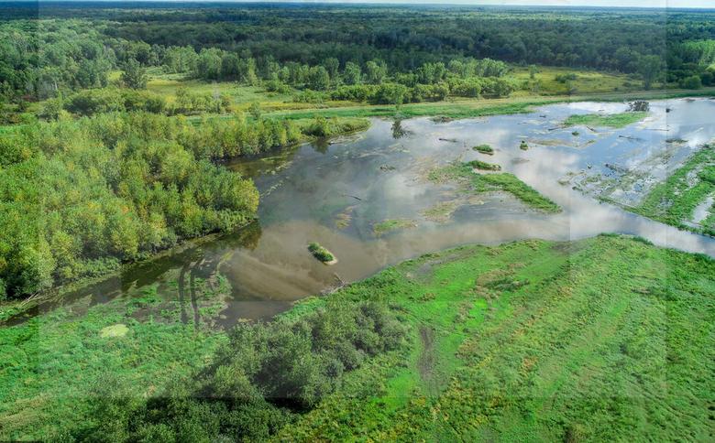
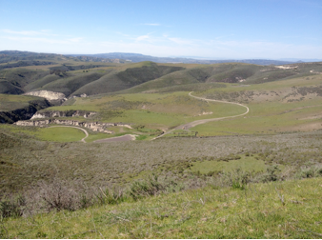
Background
Types: 1) Wetland or stream mitigation banks, and 2) Conservation banks.
Notes:
Insert a picture of one of the geographic features of your country.

Slide 5
Main Components
1) The bank site (Project Focus)
2) The bank instrument
3) The interagency review team
4) The service area (Project Focus)
Notes:
Insert a picture of one of the geographic features of your country.

Slide 6
Benefits
1) Protect Water Quality
2) Protect Biodiversity
3) Provide Economic Incentive to Protect Natural Resources
4) Save Time and Money
Notes:
Insert a picture of one of the geographic features of your country.

Slide 7
Drawbacks
1) Homogenizing the landscape
2) Affecting biodiversity negatively
3) Cannot replicate the original & natural habitat
4) Distance to impact area
Notes:
Insert a picture of one of the geographic features of your country.

Slide 8
History
1) initially recognized in the 1972 Clean Water Act (CWA)
2) wasn’t really developed until early 1980s
4) George H.W. Bush administration pushed for the concept of “no net loss” of wetlands across the country
Notes:
Insert a picture of one of the geographic features of your country.

Slide 9
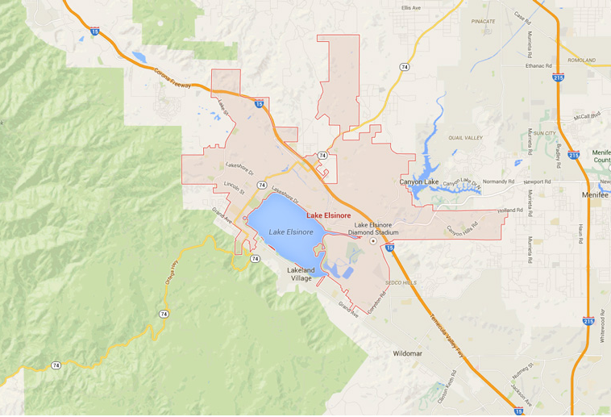
Study Area
City of Lake Elsinore in Riverside County, CA.
land area of 36.21 sq mi
water area of 5.48 sq mi
Notes:
Insert a picture of one of the geographic features of your country.

Slide 10
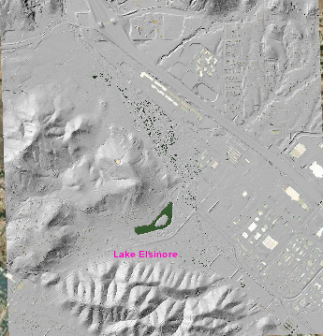
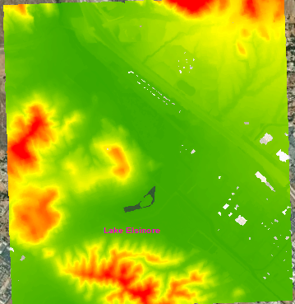
Data
Elevation: 2018 USGS Lidar: Southern CA Wildfires & USGS 3D Elevation Program (3DEP) 1 arc-second DEMs
Vegetation: Western Riverside County Update (2012)
Habitat Model: USGS Coastal California Gnatcatcher Habitat Suitability Model for Southern California (2015)
Public Lands: The California Protected Areas Database (CPAD)
Notes:
Insert a picture of one of the geographic features of your country.

Slide 11
Software
Potential programs to be used in this capstone project:
• ESRI ArcMap 10.7.1 (with 3D Analyst, Spatial Analyst, and LP360 extensions)
• ESRI Arc GIS Pro
• GeoCue’s LP360
• Google Earth
• Microsoft Excel
Notes:
Insert a picture of one of the geographic features of your country.

Slide 12
Methodology & Steps
The project will be divided into the following four main activities that each comprise sequences of steps:
1) Non-public lands identification,
2) Vegetation extraction,
3) Drainage delineation,
4) CAGN habitat identification & slope analysis, and
5) Mitigation bank service area determination
Notes:
Insert a picture of one of the geographic features of your country.

Slide 13
Project Timeline
Date | Milestone
March 28th, 2022 | Project Kick-off
April 10th, 2022 | Finalize Data Gathering
April 30th, 2022 | Complete Data Analysis
May 15th, 2022 | Draft Report
June 10th, 2022 | Finalize Report
June-December 2022 (depending on venue availability) | Presentation
Notes:
Insert a picture of one of the geographic features of your country.

Slide 14
Potential Presentation Venues
1) North American Association for Environmental Education’s Conference in Tucson, Arizona, October 11 –15 of 2022.
2) The Wildlife Society’s 29th Annual Conference which will be held in Spokane, Washington, Nov. 6 – 10, 2022.
3) California Native Plant Society’s Conference which takes place in San Jose, California, Oct 20 – 22, 2022.
4) The Association for Environmental Studies and Sciences (AESS) Conference, which takes place in Baltimore, MD, June 20-22, 2022.
Notes:
Insert a picture of one of the geographic features of your country.

Slide 15
Thank you!!
Notes:
Insert a picture of one of the geographic features of your country.

