Slide 1
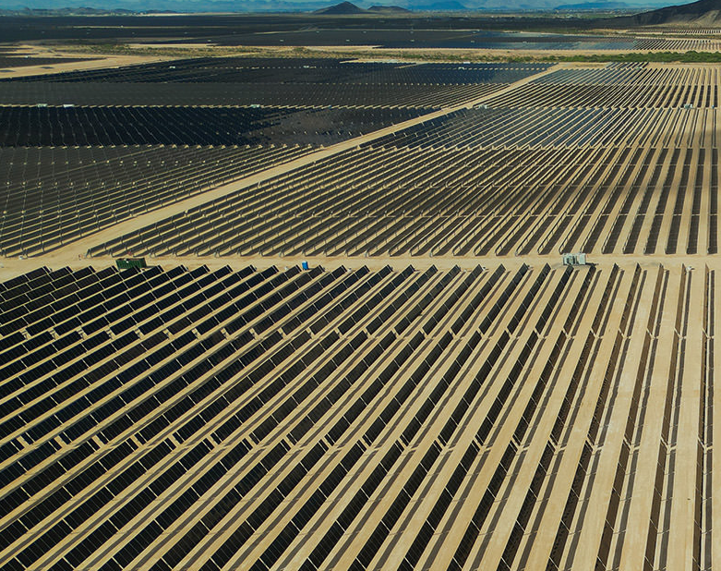

Capstone Project Proposal
Photovoltaic soiling loss modeling with Python Automation
Manuel Larsen Santos
Feb. 20, 2024
Pennsylvania State University
GEOG 870
©Longroad Energy Holdings

Slide 2
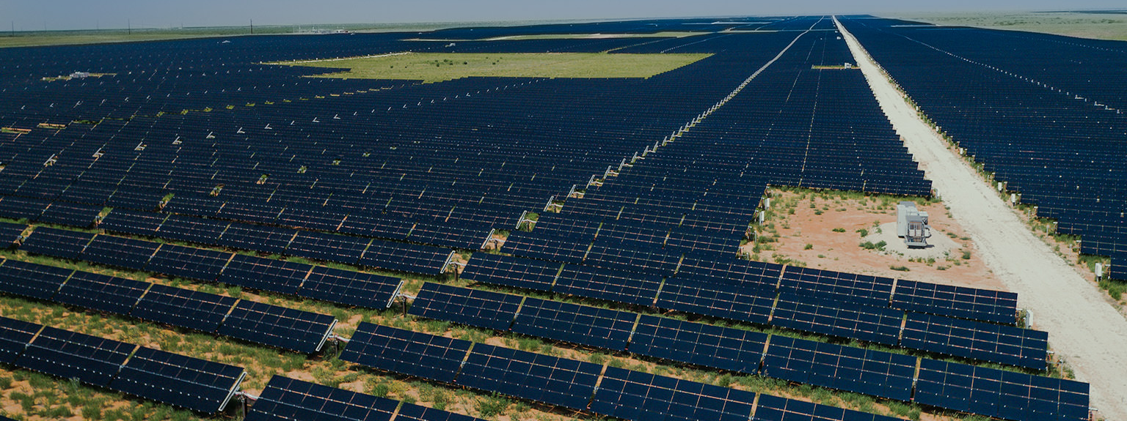
Goals/Objectives
©Longroad Energy Holdings
PV Soiling Loss Modeler (PVSLM)
A Python script tool for ArcGIS Pro that uses pvlib Python library functions to analyze solar irradiance and meteorological data with several soiling loss modeling techniques

Slide 3
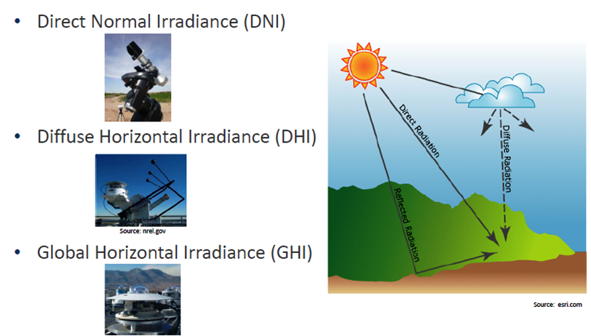
What is
Photovoltaic (PV) Energy?
The measure of how much solar irradiance is received in a location
Solar irradiance is measured in watts/m^2
Solar Panel, a.k.a. PV Module
(Vashishtha, 2012)

Slide 4
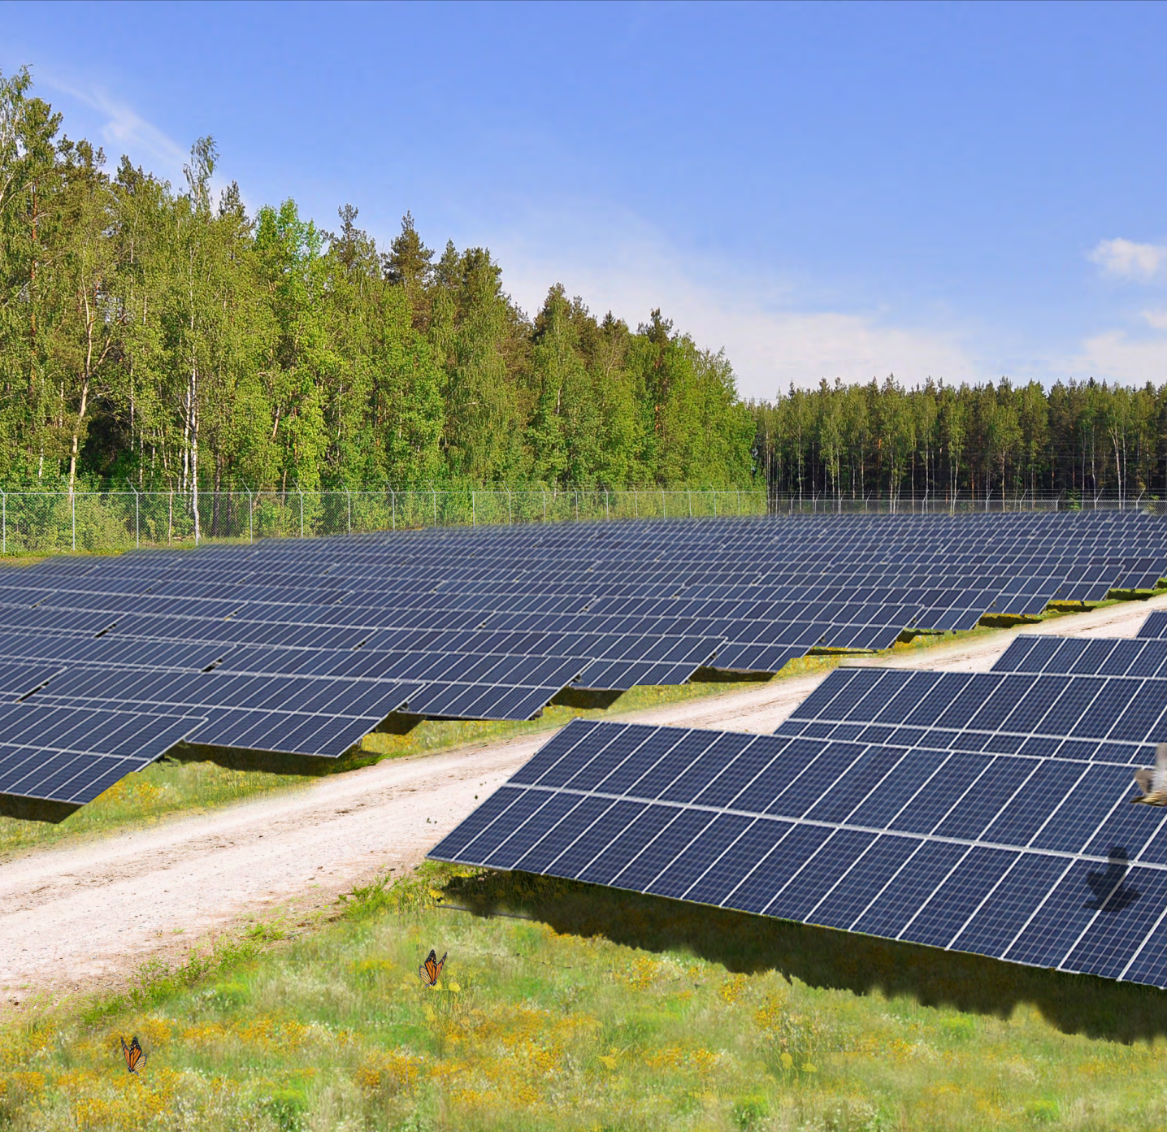
What is
PV Soiling Loss?
Energy generation losses caused by buildup of material blocking the solar panel surface
Impact varies by region (2-20% annual losses)
Greater losses in areas with:
  Low Precipitation
  High Pollution
  Dust Storms
  Agricultural Activity
  (Bessa, et al., 2021)
©Longroad Energy Holdings

Slide 5
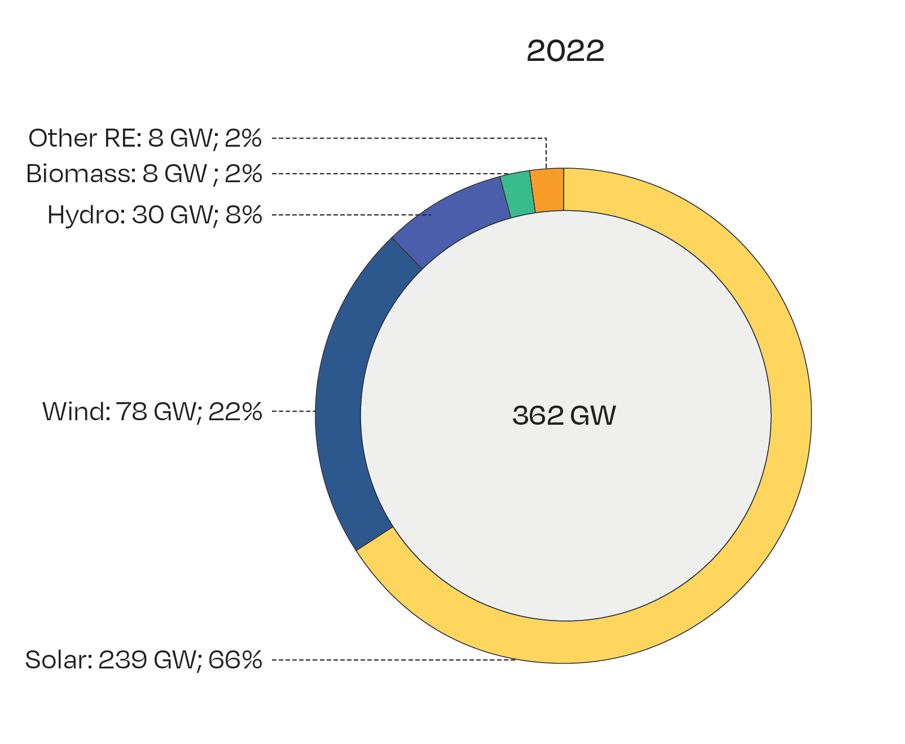
PV Energy for a Sustainable Future
NET RENEWABLE POWER GENERATING CAPACITY INSTALLED IN 2022
Fossil fuels make up about 80% of global energy demand (Ali, et al., 2019).
PV energy has reached nearly 1.2 Terawatts (TW) in installed global capacity, with an additional 341 Gigawatts (GW) built in the last year, yet still represents less than 5% of global consumption (Solar Power Europe, 2023).
(Solar Power Europe, 2023)

Slide 6
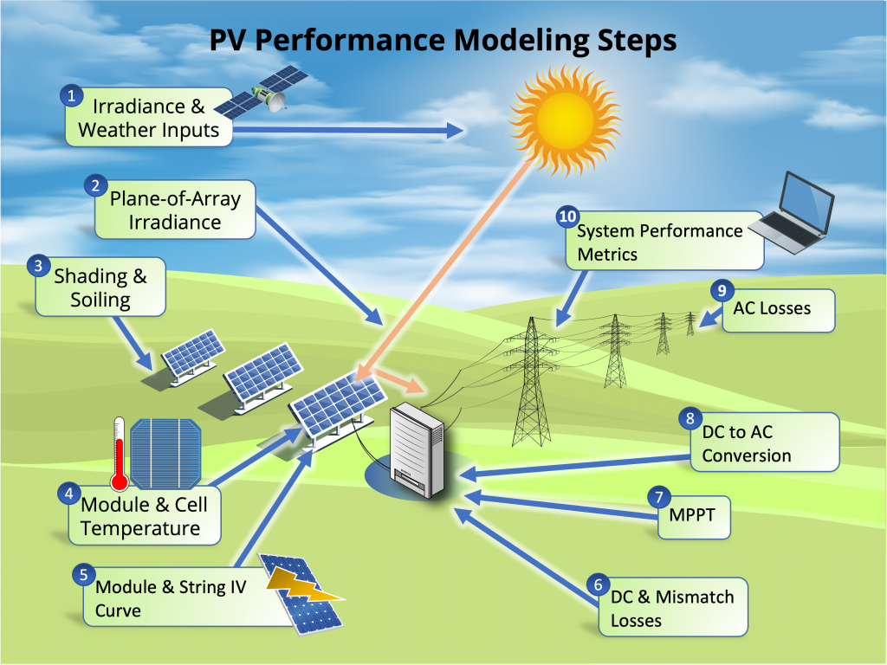
Factors Contributing to PV Energy Production Loss
  System engineering and environmental variables; primarily solar irradiance, temperature, and soiling (Borah, 2023).
  Main contributors to PV module soiling (Bessa, et al., 2021)
    Weather
    Pollution
    Local land characteristics
(Sandia National Laboratories, n.d.)

Slide 7
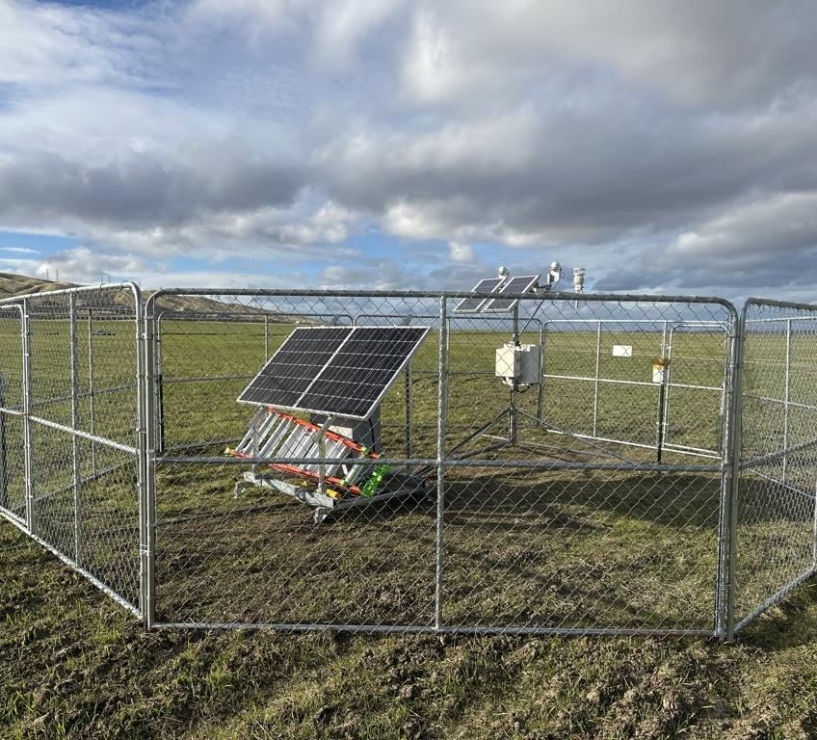
Existing Soiling Loss Models
  Collect on-site data
  Preliminary soiling loss modeling done without on-site data
  Common Soiling Models
    Kimber
    Humboldt State University (HSU)
©Longroad Energy Holdings

Slide 8
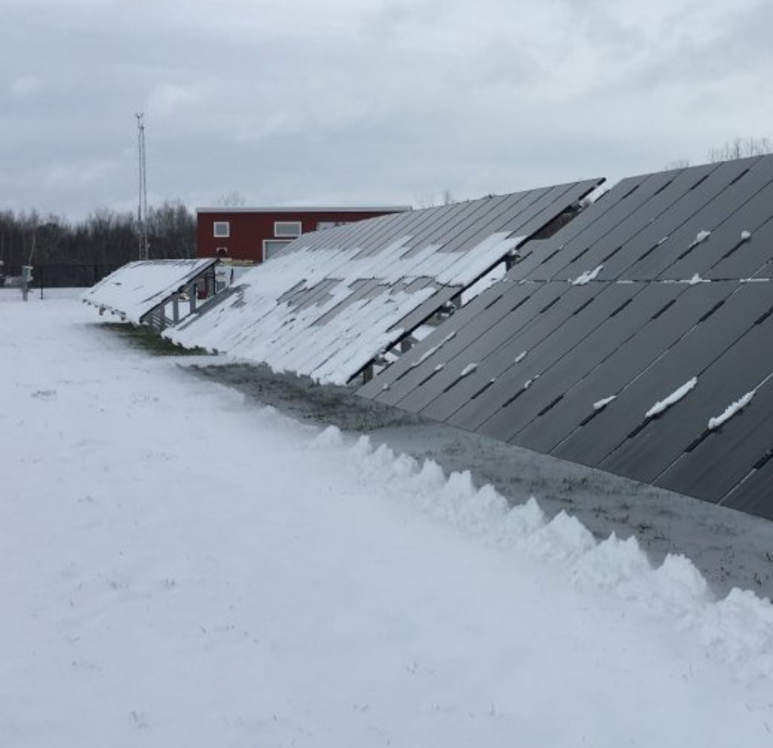
Snow Loss Modeling
  Snow buildup blocking PV module surface
  Snow accumulation on ground can also block PV module
  Common Snow Loss Models
    Townsend
    Marion
(Sandia National Laboratories, n.d.)

Slide 9
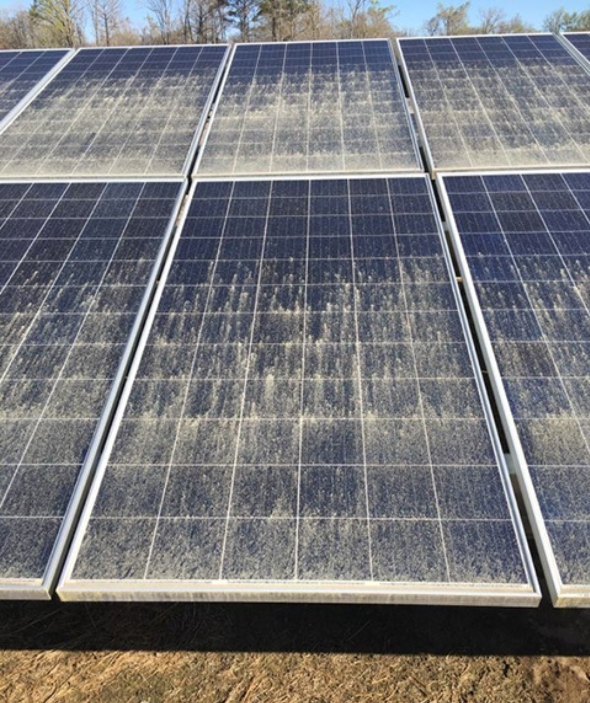
Ongoing Efforts for Refining Soiling Loss Modeling
Limitations of publicly available data
Cost of collecting on-site data
What about hail?
Mold growth on PV modules
No single accepted upon model
Difficulty of accessing data and applying models
Insufficient comparative analysis between models
(Hicks, 2023)

Slide 10
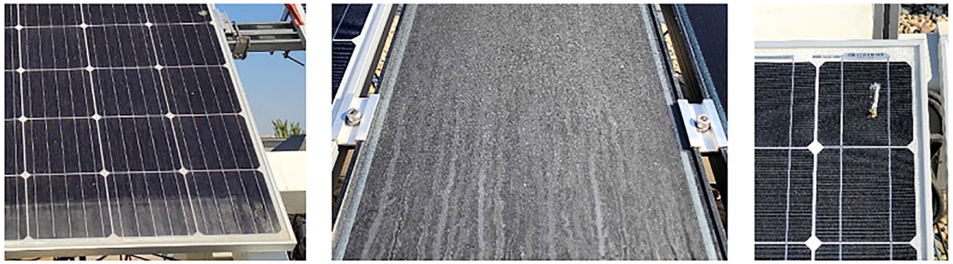
A New Soiling Loss Model Approach
(Bessa, et al., 2021)
PV Soiling Loss Modeler (PVSM)
A tool that streamlines soiling loss modeling workflow to allow solar resource analysts to apply several soiling models and snow loss models in one application
Multiple Soiling Loss Models and flexibility with input parameters

Slide 11
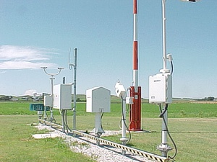
Data:
Weather Stations
Source of local meteorological data
Data from the National Oceanic and Atmospheric Administration (NOAA)
(NOAA, n.d.)

Slide 12
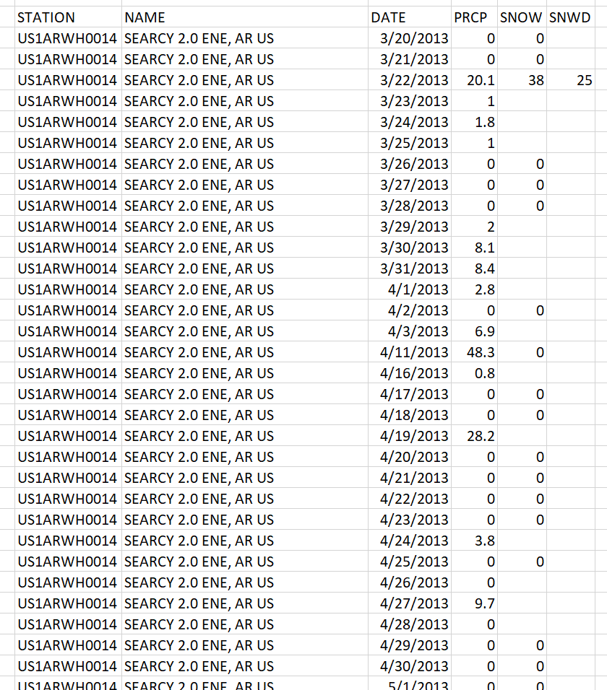
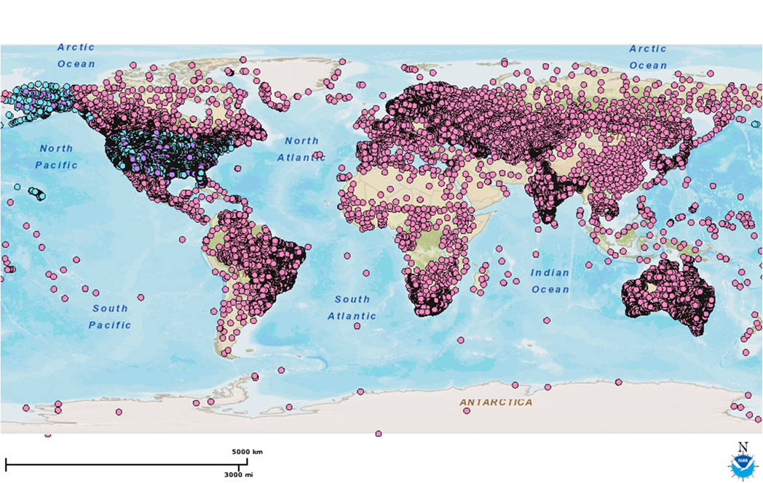
Data:
Global Historical Climatology Network Daily Summaries (GHCN-Daily)
Daily values for Precipitation, Snowfall, Snow-depth
Collected from weather stations by the National Centers for Environmental Information (NCEI)
Used in Kimber, HSU Soiling Models

Slide 13
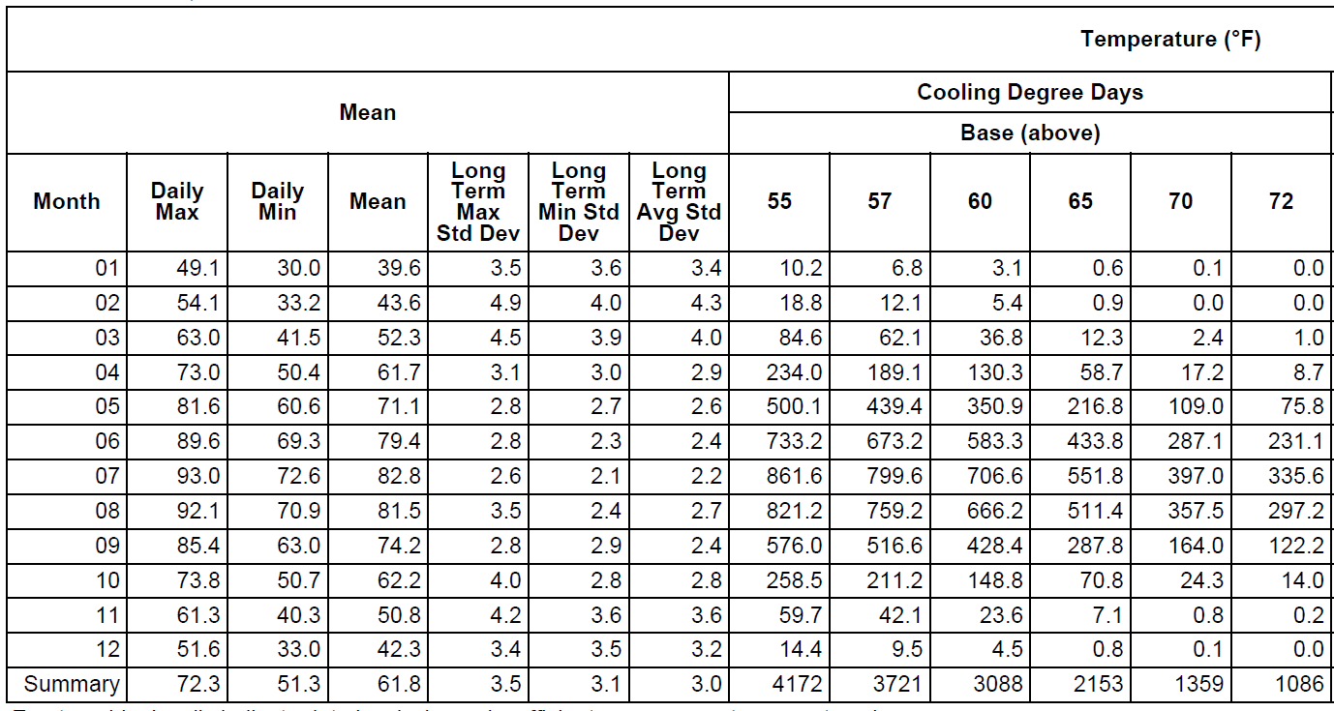
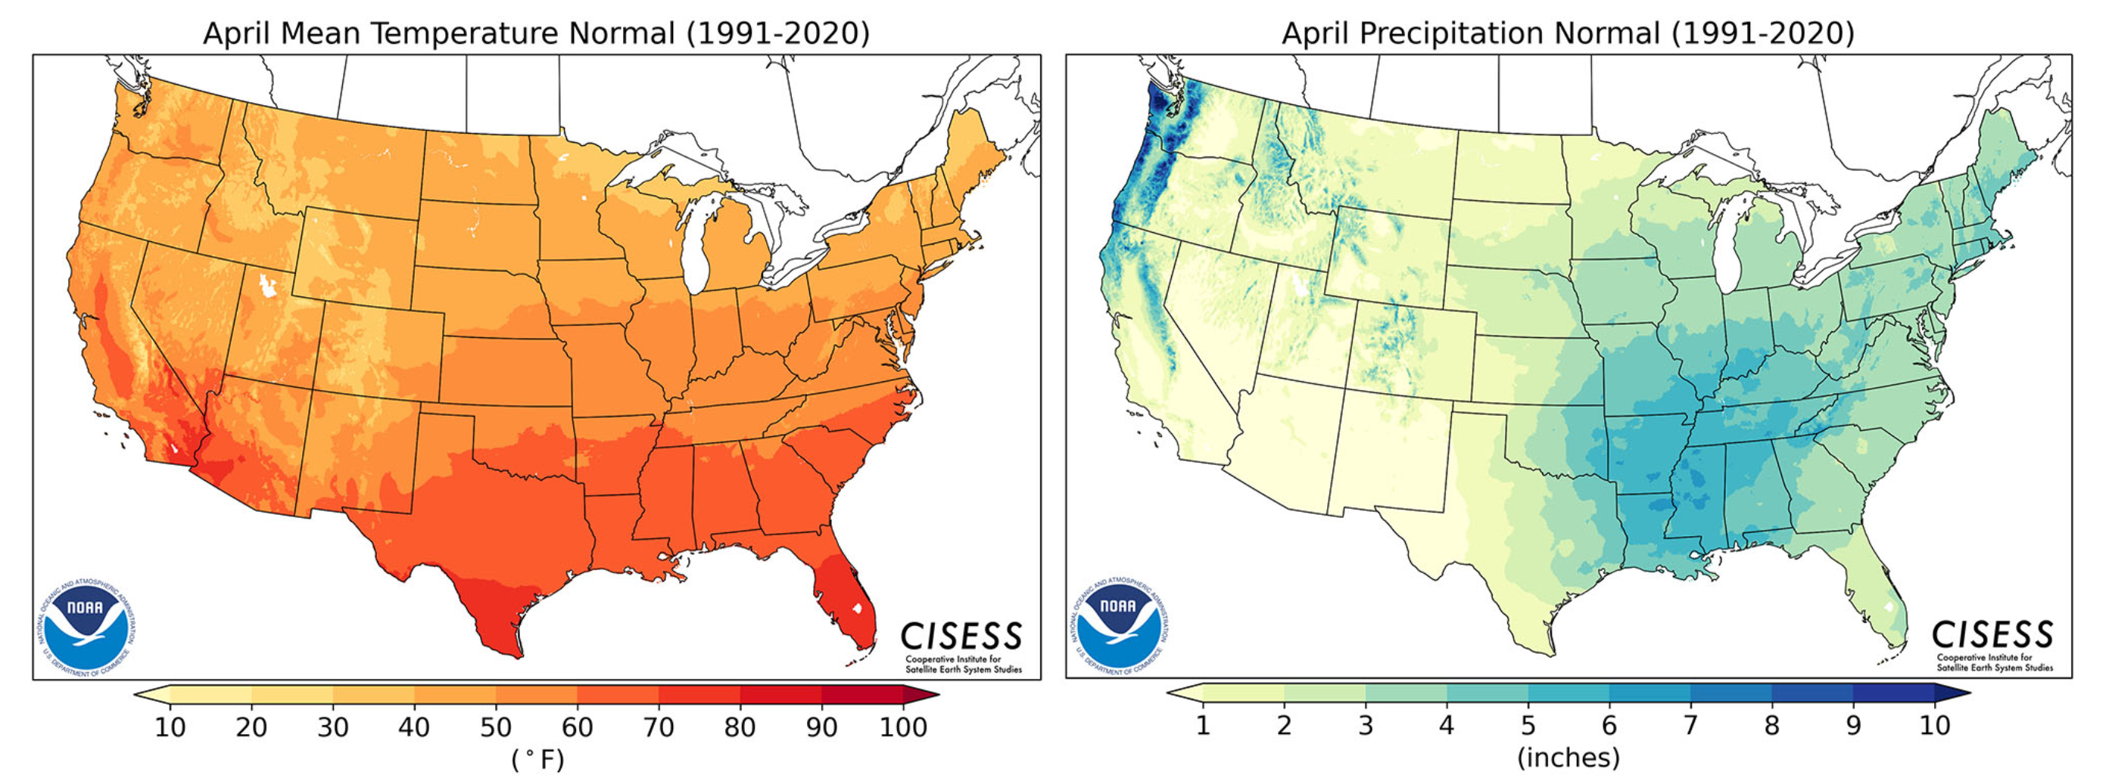
Data:
Monthly Climate Normals (MCN)
  30-years (1981-2010) of data aggregated for monthly average
  Compiled from weather stations by NOAA
  Temperature, and snowfall values used in Snow Loss modeling

Slide 14
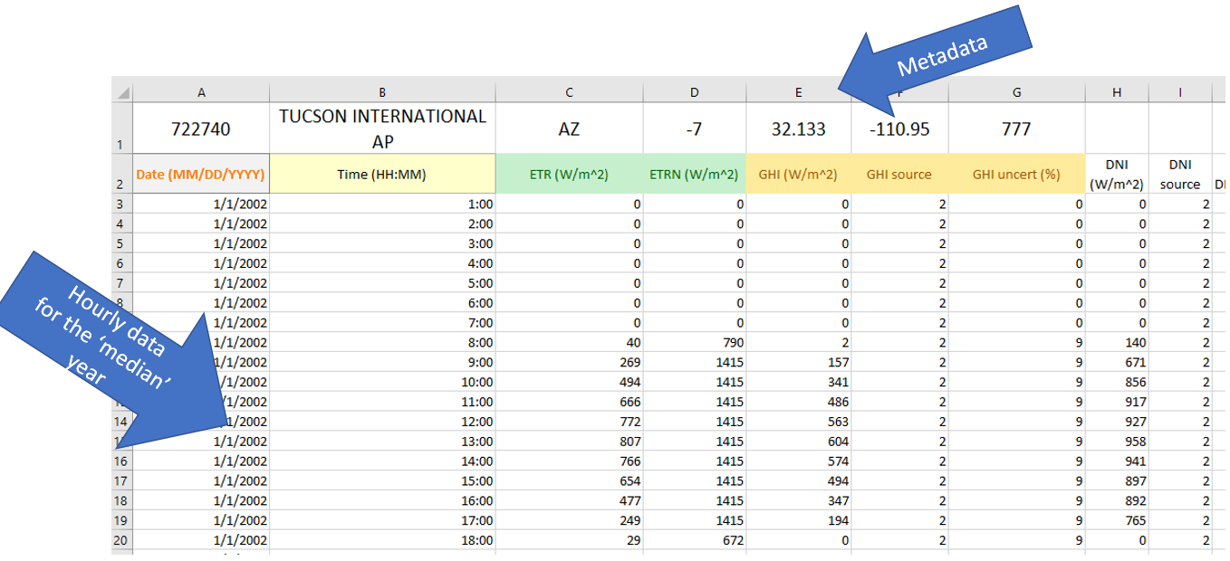
Data:
Typical Meteorological Year (TMY)
Half-hourly values for meteorological and solar irradiance data representing the most typical month of each year over the span of the available satellite data, starting in 1998
  January values may be from 2002, February values may be from 2012
Derived from LANDSAT data, prepared by the National Renewable Energy Laboratory (NREL)
GHI, DNI, DHI, temperature, dew point data used for snow loss modeling
(F. Holmgren, et al., 2018)

Slide 15
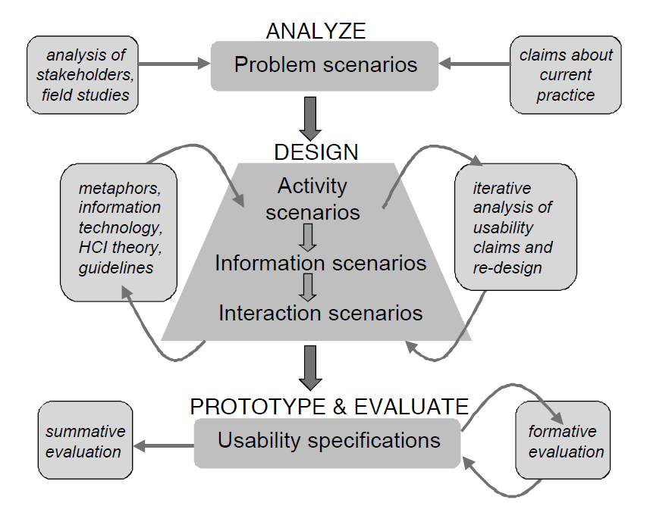
Methodology:
Needs Assessment
Persona Mapping
Persona Mapping
Identify and characterize users
Scenario-Based Design
Describe how the tool will be used to complete tasks
(Getto & Moore, 2017)
Scenario-Based Design
(Rosson & Carroll, 2002)

Slide 16
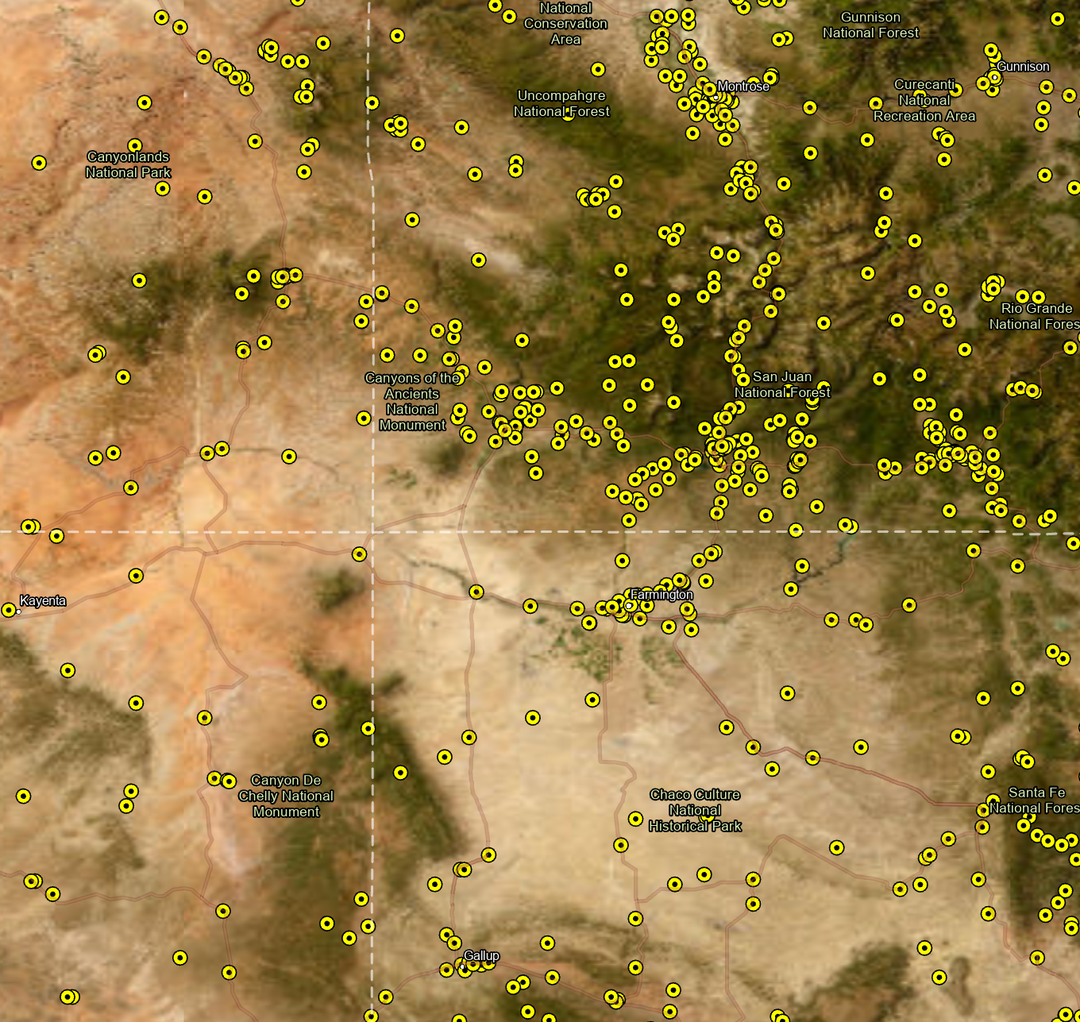

Methodology:
Python Script Development
Weather Station Selection
  Identify “Nearest” weather station to input coordinates
  Check that weather station has complete data
    All necessary meteorological data
    Data coverage back to 1998
  If not, check next closest weather station

Slide 17
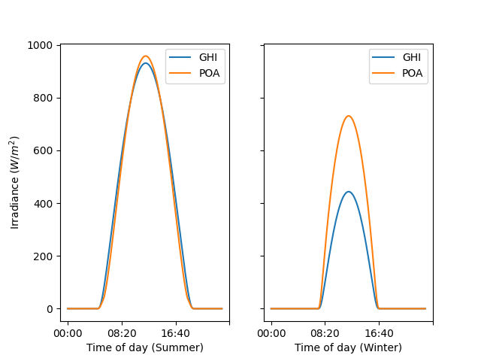
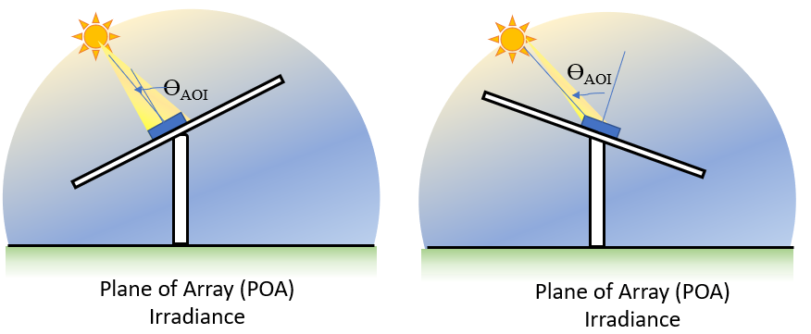
Methodology:
Python Script Development
(F. Holmgren, et al., 2018)
Plane of Array (POA) Calculation
  Solar irradiance received by PV module based on angle of module and position of the sun
  Two methods for calculation, Hay and Perez models
  Use pvlib Python functions

Slide 18
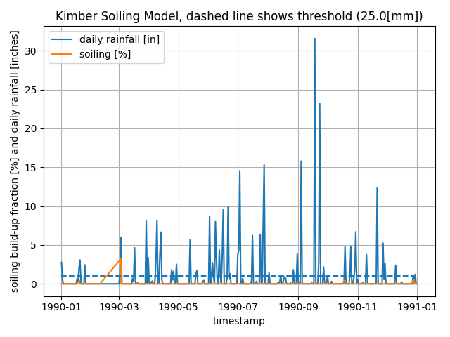
Methodology:
Python Script Development
Soiling Modeling with pvlib
  Kimber and HSU models
  Input Variables
    Rain Threshold
    Grace Period
    Soiling Rate
    Reset Value
(F. Holmgren, et al., 2018)

Slide 19

Methodology:
ArcGIS Pro Python Script Tool Development
Create a Python Script Tool in ArcGIS Pro
  Input Parameters:
    Coordinates for proposed PV site
    POA Transposition Model (Hay or Perez)
    Soiling Loss Model (Kimber or HSU)
      Rain Threshold
      Grace Period
      Soiling Rate
      Reset Value
    Snow Loss Model
    Generate Report Document

Slide 20


Methodology:
Useability Testing and Evaluation
Useability testing by solar resource engineers within organization
Cost/Benefit analysis

Slide 21

Methodology:
Resources Required
Laptop Computer – Windows 10
ArcGIS Pro Software
PyCharm Software
Python Libraries
  arcpy
  pvlib

Slide 22

Conclusion
PV Soiling Loss Modeler (PVSLM)
A tool to help solar resource analysts produce soiling models according to their specifications
Quickly compare results between modeling techniques
Facilitate understanding of environmental variables for energy production estimates of proposed PV sites

Slide 23
References
Ali, S., Taweekun, J., Techato, K., Waewsak, J., & Gyawali, S. (2019). GIS based site suitability assessment for wind and solar farms in Songkhla, Thailand. Renewable Energy, 132, 1360–1372. https://doi.org/10.1016/j.renene.2018.09.035
Bessa, J. G., Micheli, L., Almonacid, F., & Fernández, E. F. (2021). Monitoring photovoltaic soiling: Assessment, challenges, and perspectives of current and potential strategies. iScience, 24(3), 102165. https://doi.org/10.1016/j.isci.2021.102165
Borah, P., Micheli, L., & Sarmah, N. (2023). Analysis of soiling loss in photovoltaic modules: A review of the impact of atmospheric parameters, soil properties, and mitigation approaches. Sustainability, 15(24), 16669. https://doi.org/10.3390/su152416669
Getto, G., & Moore, C. (2017). Mapping personas: Designing UX relationships for an online coastal atlas. Computers and Composition, 43, 15–34. https://doi.org/10.1016/j.compcom.2016.11.008
Hicks, W. (2023). Nrel research finds rain not enough to wash pollen from solar panels. Retrieved February 20, 2024, from https://www.nrel.gov/news/program/2023/nrel-research-finds-rain-not-enough-to-wash-pollen-from-solar-panels.html
F. Holmgren, W., W. Hansen, C., & A. Mikofski, M. (2018). Pvlib python: A python package for modeling solar energy systems. Journal of Open Source Software, 3(29), 884. https://doi.org/10.21105/joss.00884
NOAA. (n.d.). NOAA observation systems. US Department of Commerce. Retrieved February 20, 2024, from https://www.weather.gov/about/observation-equipment
Rosson, M. B., & Carroll, J. M. (2002). Scenario-Based Design. In J. A. Jacko & A. Sears (Eds.), The human-computer interaction handbook: Fundamentals, evolving technologies, and emerging applications (pp. 1032–1050). Lawrence Erlbaum Associates.
Sandia National Laboratories. (n.d.). Plane of array (Poa) irradiance. PV Performance Modeling Collaborative (PVPMC). Retrieved February 6, 2024, from https://pvpmc.sandia.gov/modeling-guide/1-weather-design-inputs/plane-of-array-poa-irradiance/
Sandia National Laboratories. (n.d.). Pvpmc home. PV Performance Modeling Collaborative (PVPMC). Retrieved February 20, 2024, from https://pvpmc.sandia.gov/
Solar Power Europe. (2023). Global Market Outlook For Solar Power 2023—2027. https://www.solarpowereurope.org/insights/market-outlooks/global-market-outlook-for-solar-power-2023-2027-1
Vashishtha, S. (2012, April 26). Differentiate between the dni, dhi and ghi? https://firstgreenconsulting.wordpress.com/2012/04/26/differentiate-between-the-dni-dhi-and-ghi/

Slide 24
Capstone Project Proposal
Photovoltaic soiling loss modeling with Python Automation
Manuel Larsen Santos
Feb. 20, 2024
Pennsylvania State University
GEOG 870
©Longroad Energy Holdings

