Slide 1
Conveying Coastal Inundation Potential Associated with Extratropical Cyclones in the New York City Tri-State Area
Adrienne Leptich
GEOG 596A - Fall 2015
The Pennsylvania State University
Advisor: dr. patrick kennelly

Slide 2
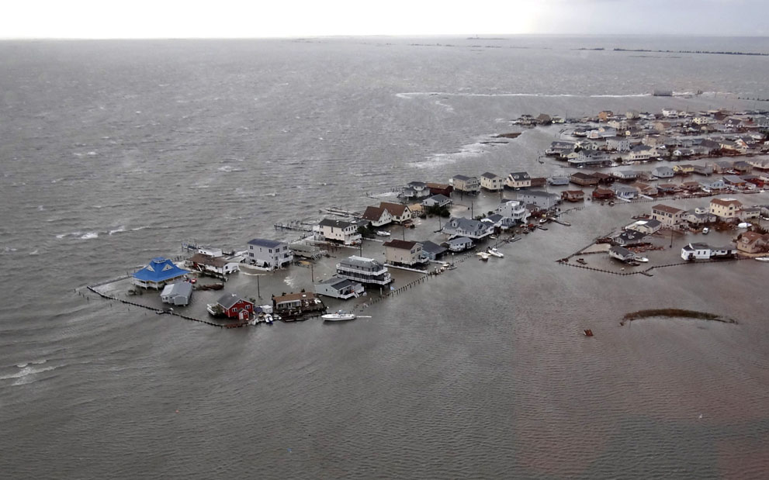
Overview
Background
Goals & Objectives
Proposed Methodology
Anticipated Results
Timeline
Summary
Tuckerton, N.J., inundated on Oct. 30 by the storm surge from Superstorm Sandy. Photo: U.S. Coast Guard

Slide 3
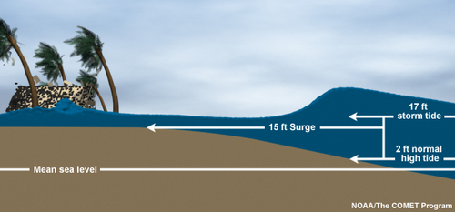
Background
Storm surge is often the greatest threat to life and property from a tropical or extratropical storm
Storm surge vs. storm tide
Complex hazard, difficult to convey without visualization tools
Image from NOAA
Notes:
Storm Surge -

Slide 4
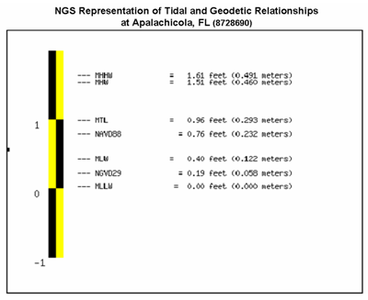
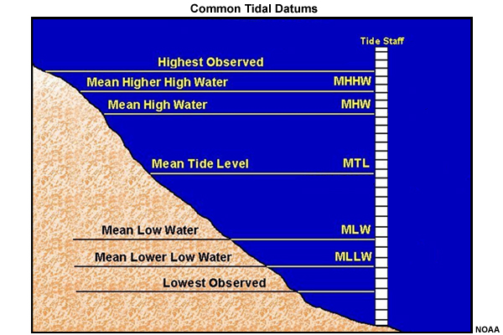
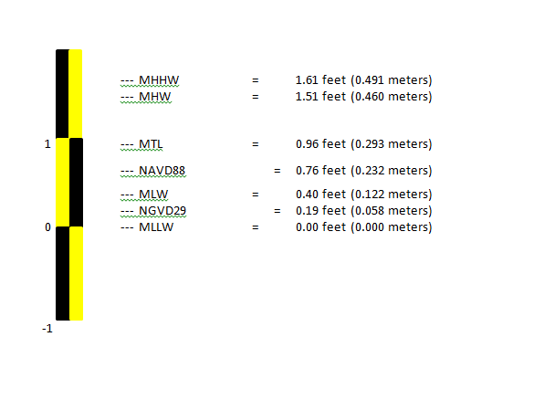
Vertical Datums
Plethora of tidal and geodetic datums
HAT
LAT
Images from NOAA

Slide 5
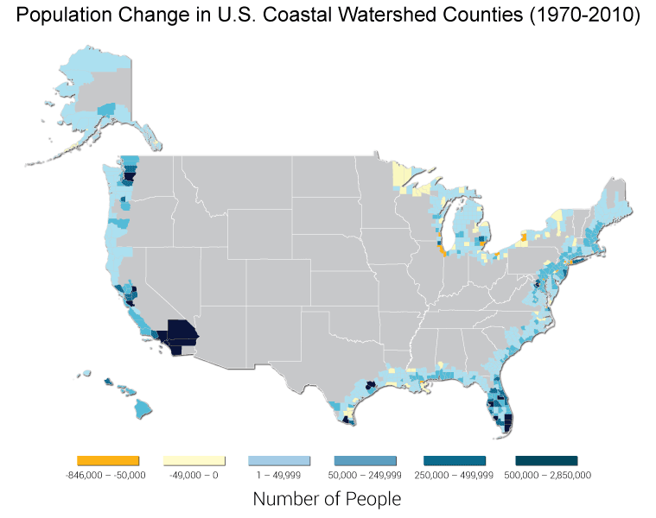
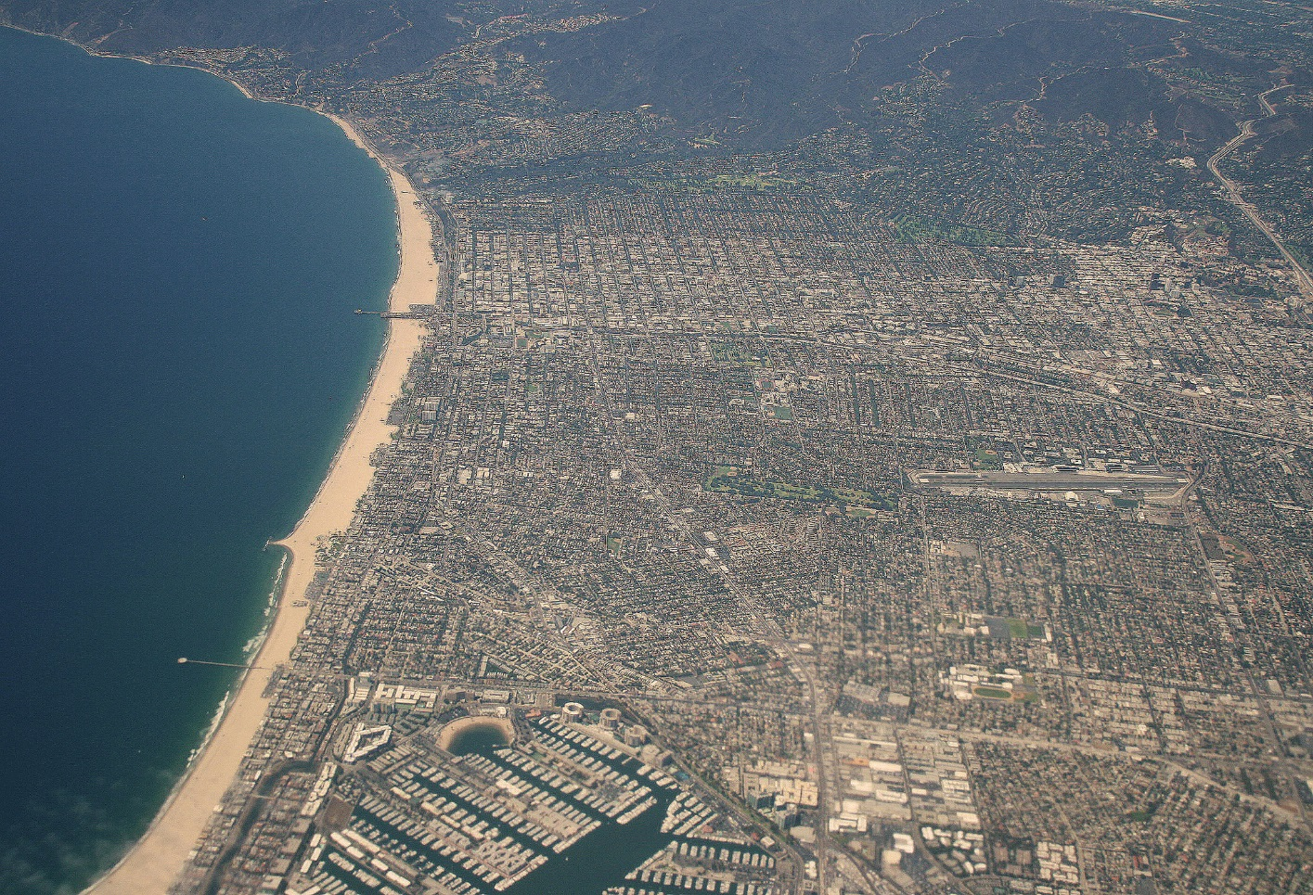
Population Density
Increasing population density along the U.S. Coast
Santa Monica, CA
Image from U.S. Department of Commerce
Source: The Third National Climate Assessment, 2014

Slide 6
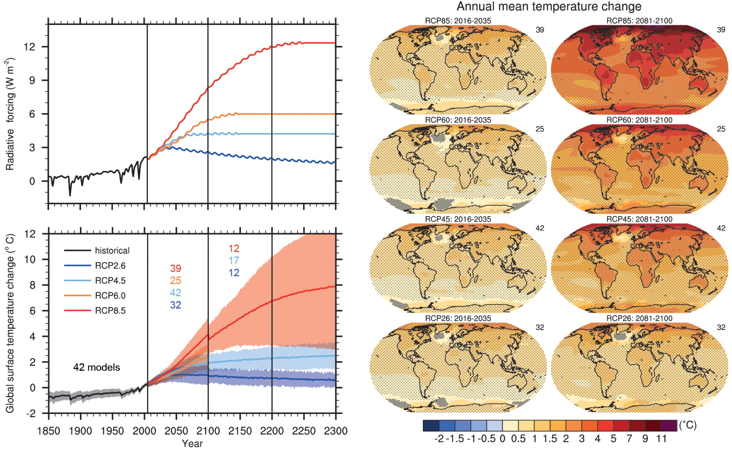
Climate Change & Sea Level Rise
Climate change is occurring!!
RCP (Representative Concentration Pathway) –projections of atmospheric greenhouse gas concentrations as a result of radiative forcings.
Each RCP consists of an ensemble (collection of models that show slightly different possible outcomes) of climate models
Source: Stocker et al. 2013
Notes:
The information on the next few slides gets a little dry so bear with me. They basically show that climate change is occurring and will continue through the rest of this century and likely beyond which is projected to cause rise in global MSL
According to the Intergovernmental Panel on Climate Change (IPCC) – climate change is occurring which will result in global MSL rise depending on the amount of warming that will occur on earth.
The IPCC has developed four scenarios called RCP’s or representative concentration pathways. The RCP’s are projections of atmospheric greenhouse gas concentrations which result from radiative forcing and GHG emissions and represent a broad range of climate outcomes. Each RCP is represented in a different color on the graphs on the left side and are an average of many climate model runs (aka ensemble) with different slightly conditions or physics within each model to represent a range of plausible outcomes. Each RCP could also result from different combinations of economic, technological, demographic, policy and institutional futures. For example, RCP4.5 (light blue) could be considered as a moderate mitigation scenario that focuses on technological improvements and a shift to service industries (an industry that produces services rather than goods) but does not aim to reduce GHG emissions.
Top left
Total global mean radiative forcing (or the change in energy in the atmosphere due to GHG emissions) for the 4 RCP’s.
Bottom left - global annual surface air temperature anomalies relative to the 1986-2005 time frame
In both graphs, the solid blue line represents RCP2.6 and is indicative of low GHG emissions while the solid red line represents RCP8.5 and is the result of high GHG emissions.
The colored numbers are the number of models contained in the respective RCPs. So for example RCP8.5, the red solid line, represents the mean of 39 different simulations through 2100 and 12 model simulations between 2100-2300.
Discontinuity at 2100 are due to different numbers of models performing the extension runs (2100-2300) beyond the 21st century and have no physical meaning.
Right – annual mean T change for each RCP from 2016-2035 left & 2081-2100 (20 year base periods)
Notice that in all scenarios the artic is warming the most. Expect melting….increase sea level.

Slide 7
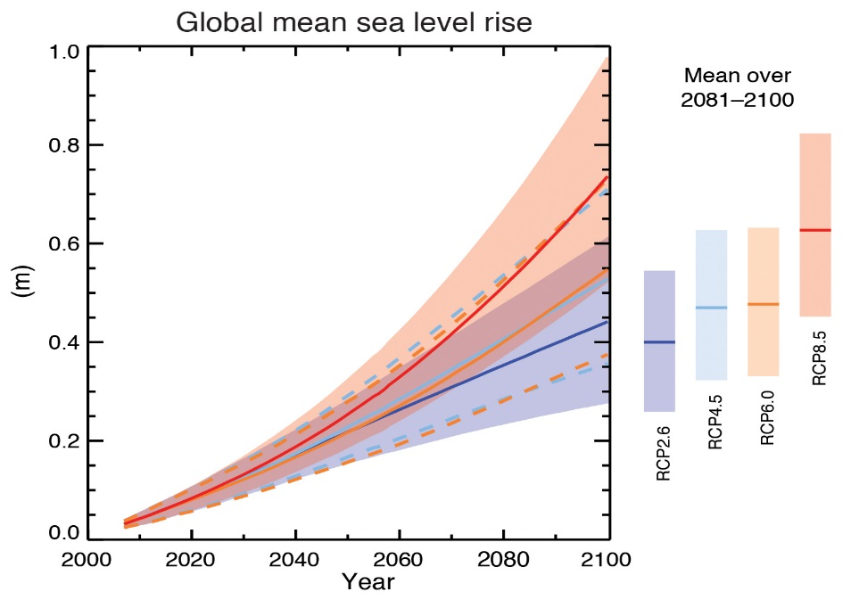
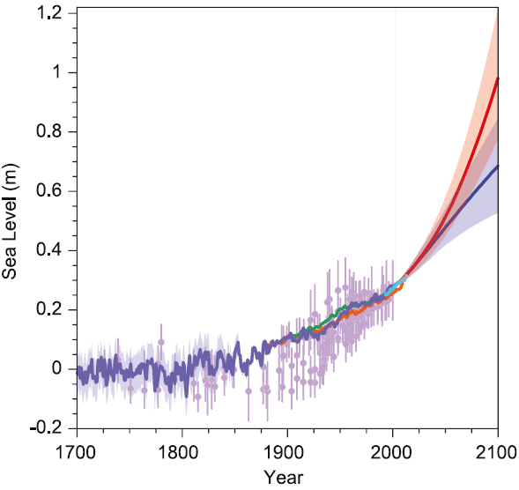
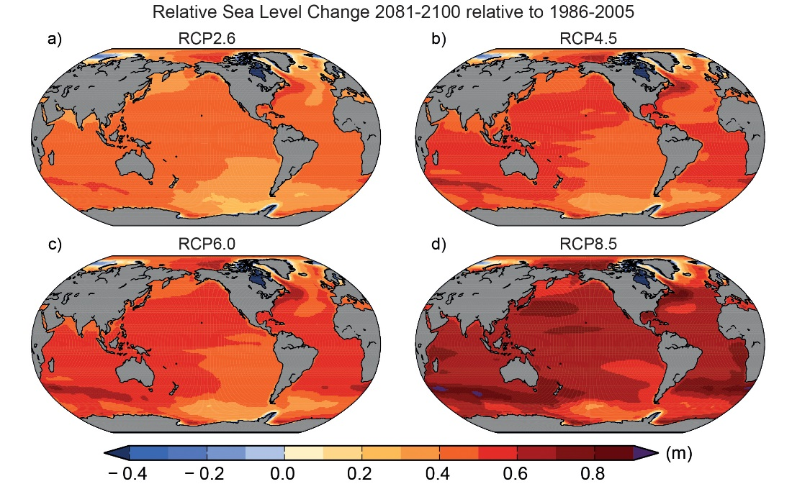
Climate Change & Sea Level Rise
Sea Level Rise is inevitable
Source: Stocker et al. 2013
Source: Stocker et al. 2013
Source: Stocker et al. 2013
Notes:
Image Left - Global MSL past and future through end of century
Light purple - Paleoclimatology sea level data.
Paleo data – data gathered from natural recorders of climate variability, such as tree rings, ice cores, fossil pollen, ocean sediments, coral and historical data
Blue, green, orange – tide gauge data
Light blue – altimeter data (measures the altitude of an object above a fixed level)
Dark purple – estimated MSL based on paleo, tide and altimetry data
Red solid line – mean SLR projected from the worst case RCP – very high GHG emissions.
Blue solid line – mean SLR projected from the best case RCP – low GHG emissions.
Red and blue shaded areas surrounding solid lines – “likely ranges” – some standard deviation from the mean to account for uncertainty in global climate change and modelling the contributions to global MSL.
middle – blown up global MSL projection through 2100
Orange & light blue solid lines are the means of the 2 moderate level RCP’s. very similar projections in global SLR. RCP 6.0 only models through 2100, RCP 4.5 goes through 2300 (previous slide)
Dashed lines same as shaded areas – “likely ranges”
Bars on the right – avg of each RCP and associated “likely ranges” between 2081-2100
Right – global map sea level change between 2081-2100 relative to 1986-2005 period for each RCP.
Point of all of this is that an increase of sea level will result in a higher frequency of coastal flood events.
Also, there is speculation that the severity of tropical and extratropical storms will increase, however the IPCC has low confidence in this although large-scale atmospheric circulation patterns are likely to change

Slide 8
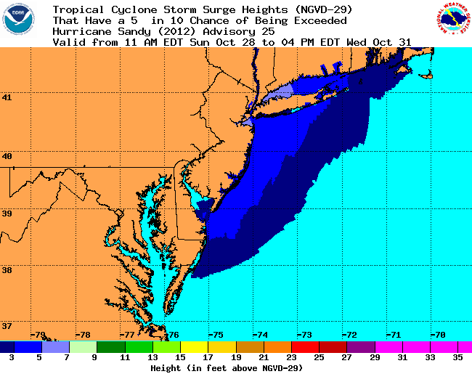
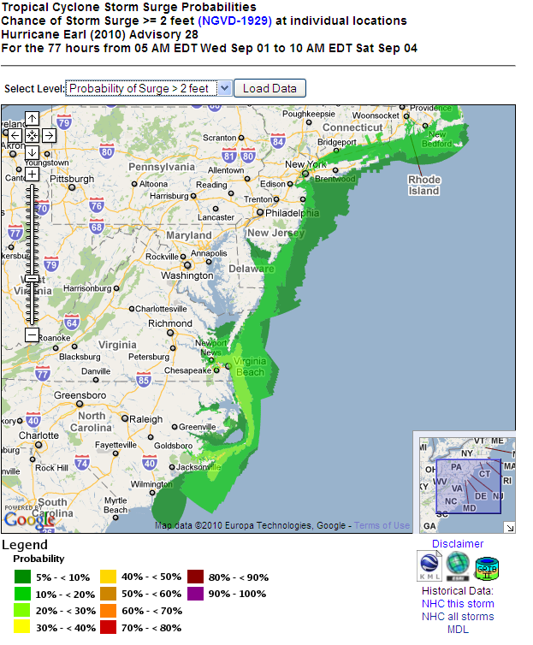
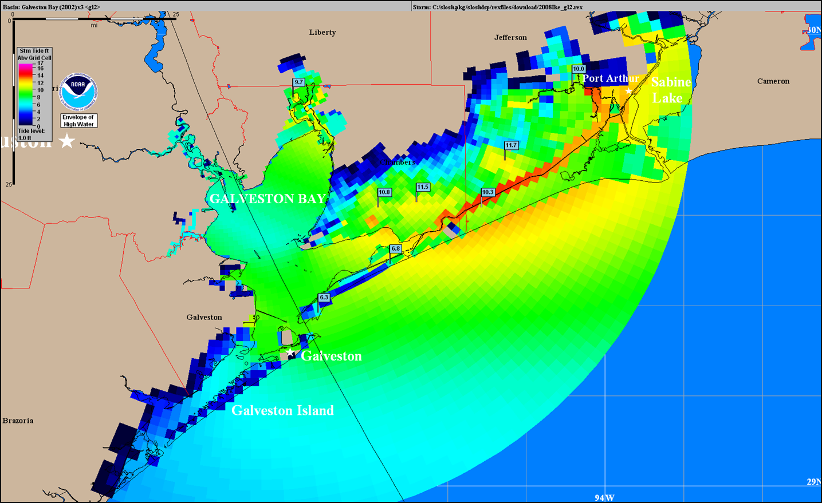
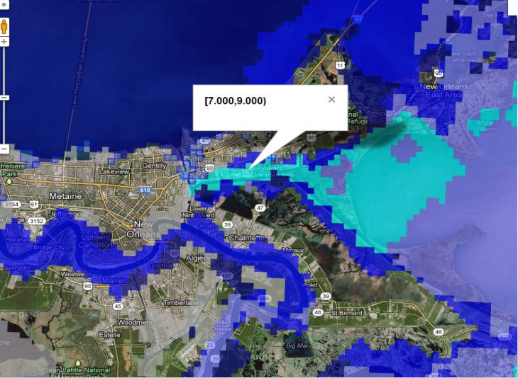
Tropical Cyclones
The National Hurricane Center has various tools to convey storm surge/tide.
Resolution is generally 625 meters.
Only available when a watch or warning is issued
P-Surge
Above NGVD29
Source: National Weather Service
PHISH
Above Ground
SLOSH
Above Ground or NAVD88
Source: National Hurricane Center
Source: NOAA
Source: Gibbs
Notes:
SLOSH – Sea Lake and Overland Surge from Hurricanes (80s?)
P-Surge – Probabilistic Surge (2011?)
PHISH – Probabilistic Hurricane Inundation Surge Height (2015?)
SLOSH – NAVD88
P-Surge – NGVD29

Slide 9
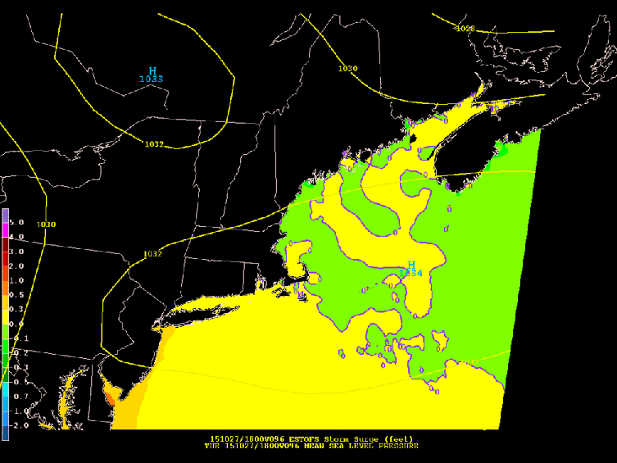
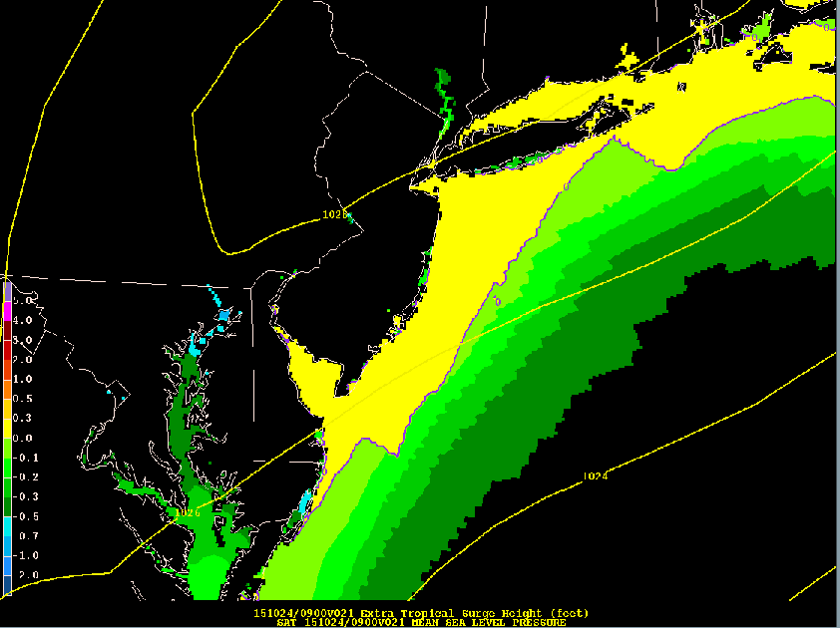
Extratropical Cyclones
Can also cause life threatening storm surge
ESTOFS – 2.5km resolution
Above MSL
ETSS – 5km resolution
Above MSL
Can simulate tides, but not waves, river effects or overland flooding
Cannot simulate tides, waves, river effects or overland flooding
Source: National Weather Service
Source: National Weather Service
Neither model can communicate overland impacts
Source: National Weather Service
Source: National Weather Service
Notes:
ETSS – Extratropical Storm Surge
ESTOFS – Extratropical Surge and Tide Operational Forecast System
These graphics only in MSL

Slide 10
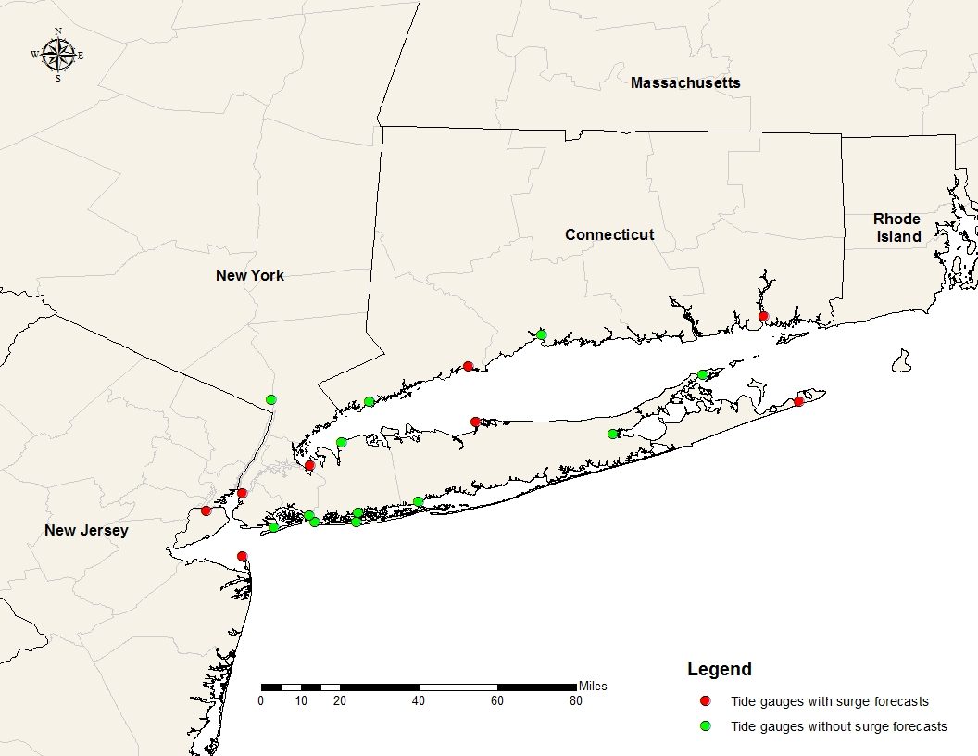
Extratropical Cyclones
Source: ArcMap
Notes:
Image shows the locations of tide gauges contained in study area (show in a few slides).
Red – gauges with surge forecasts
Green – gauges without surge forecasts (SUNYSB model surge, but the past few years significantly underforecasting)

Slide 11
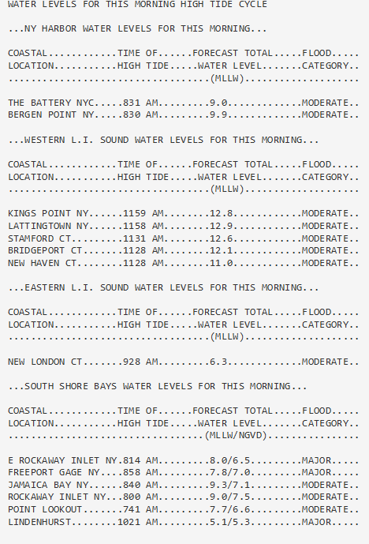
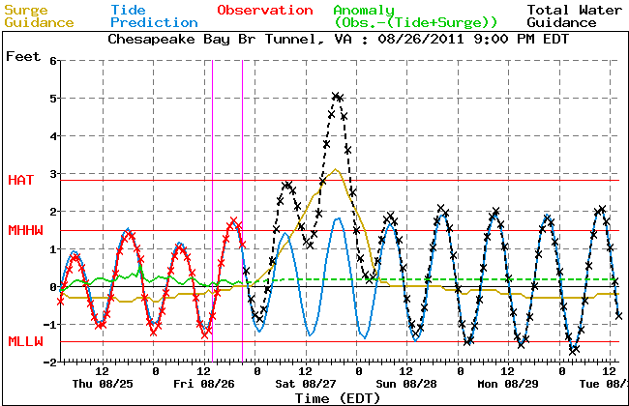
Extratropical Cyclones
Current products used during webinars
Feedback from Hurricanes Irene and Sandy
ETSS model
Source: National Weather Service
Source: National Weather Service

Slide 12
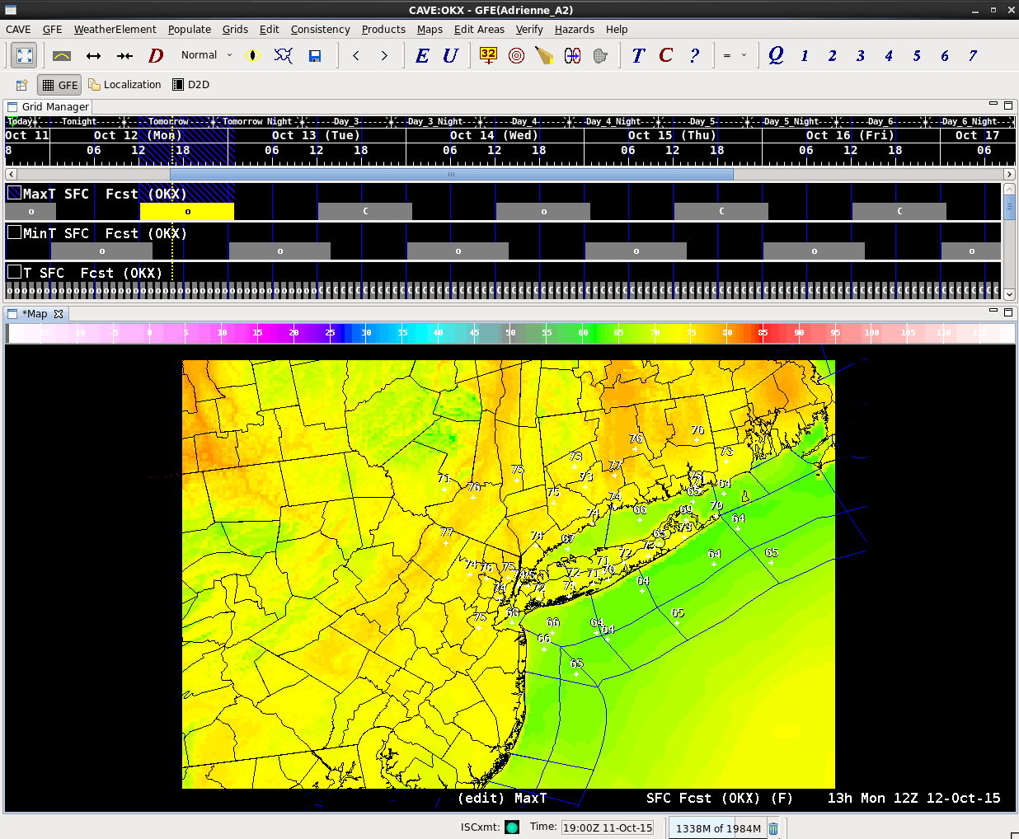
Goals/Objectives
Implement storm surge, astronomical tide, and storm tide grids in the Graphical Forecast Editor (GFE)
Extract storm tide grid from GFE, for use in ArcMap
Create inundation raster
Develop a web-based graphical visualization tool to convey potential inundation from storm tide associated with extratropical cyclones.
Source: National Weather Service
Notes:
GFE – Graphical Forecast Editor – used by forecasters to create a weather forecast.
1st goal – implement SS, astro tide and storm tide grids in GFE
2nd goal – write a script to export the storm tide grid to PC for use in ArcMap where an inundation raster will be created
3rd goal – develop a web-based graphical vis tool to convey potential inundation from storm tide associated with extratropical cyclones

Slide 13
Study Area
Source: ArcMap
Notes:
Map of the NWS NYC area of responsibility, my study area for this project.
Location of office - eastern long island

Slide 14
Methodology & Anticipated Results
Obtain a high resolution digital elevation model (3m DEM)
Implement storm surge, astronomical tides and storm tide grids in GFE
Export storm tide grid from GFE (netCDF) to PC (python script)
Convert netCDF to a raster file
Project and resample raster to match horizontal resolution and vertical datum of DEM
Extrapolate values along the immediate coast overland
Calculate potential inundation
Display inundation raster on web-based satellite basemap

Slide 15
Timeline
November -
December 2015
Obtain 3 meter Digital Elevation Model data
January -
February 2016
Write script to push netCDF file to PC
March -
May 2016
Draft final paper and presentation
June -
July 2016
Turn in Final Paper
Present at the Esri International User Conference in San Diego, CA
Set up Surge and Astronomical Tide grids in GFE
Perform calculations and analysis in ArcMap
Develop model in modelbuilder
Develop web-based visualization tool

Slide 16
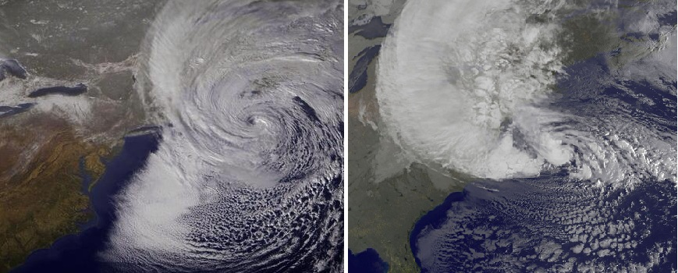
Summary
Storm surge and storm tide confusion
Vertical datums are confusing too
Increasing coastal population density and sea level rise
NWS surge products - too many vertical datums
Tide gauges
Feedback from Irene and Sandy
Implement GFE grids
Develop web-based graphical visualization tool
Images from NASA

Slide 17
References
ArcMap (version 10.3). 2015. Windows. Redlands, CA: Environmental Systems Research Institute (ESRI).
Common AWIPS Visualization Environment (version 14.4.2-5). 2015. Linux. Silver Spring, MD: Raytheon Technical Services Company LLC.
Moser, S., et al. (2014). "Coastal zone development and ecosystems." Climate change impacts in the United States: The third national climate assessment: 579-618.
National Hurricane Center. 2011. "Tropical Cyclone Storm Surge Probabilities (2 - 25 feet) - Examples." Last Modified April 11, 2011 Accessed October 5, 2015.
National Oceanic and Atmospheric Administration. 2015b. "Storm Surge and Coastal Inundation - Models and Observations." Accessed October 2. http://www.stormsurge.noaa.gov/models_obs_modeling.html.
National Weather Service Meteorological Development Laboratory. 2011. "Probabilistic Hurricane Storm Surge." Last Modified September 14, 2011 Accessed October 2, 2015. http://nws.weather.gov/mdlsurge/psurge/archive.php?S=Sandy2012adv25&Ty=e50&Th=50&Z=z7.
National Weather Service Meteorological Development Laboratory. 2013. "Extratropical Water Level Guidance User Manual." Last Modified November 13 Accessed October 8, 2015. http://www.nws.noaa.gov/mdl/etsurge/.
Gibbs, Justin. 2013. "NWS Tropical Products and Services 2013 Review and Preview." Accessed October 11, 2015. https://www.preparingtexas.org/Resources/documents/2013%20Conference%20Presentations/NWS%20Tropical%20Products%20and%20Services.pdf.
National Weather Service New York NY. 2010. Coastal Hazard Message.
Ocean Prediction Center. 2015a. "ESTOFS Storm Surge Model Guidance - US Northeast Coast (F00-F96)." Last Modified February 17 Accessed October 4. http://www.opc.ncep.noaa.gov/Loops/ESTOFS_NE_SRG/ESTOFS_NE_f001-f096.php.
Ocean Prediction Center. 2015b. "ETSS Storm Surge Model Guidance - Lower Northeast Coast (F00-F96)." Last Modified June 30 Accessed October 4. http://www.opc.ncep.noaa.gov/Loops/SURGE_LONORTH/SURGE_LONORTH_96_HR.php.
Stocker, T.F., D. Qin, G.-K. Plattner, L.V. Alexander, S.K. Allen, N.L. Bindoff, F.-M. Bréon, J.A. Church, U. Cubasch, S. Emori, P. Forster, P. Friedlingstein, N. Gillett, J.M. Gregory, D.L. Hartmann, E. Jansen, B. Kirtman, R. Knutti, K. Krishna Kumar, P. Lemke, J. Marotzke, V. Masson-Delmotte, G.A. Meehl, I.I. Mokhov, S. Piao, V. Ramaswamy, D. Randall, M. Rhein, M. Rojas, C. Sabine, D. Shindell, L.D. Talley, D.G. Vaughan, and S.-P. Xie. 2013. "Technical Summary." In Climate Change 2013: The Physical Science Basis. Contribution of Working Group I to the Fifth Assessment Report of the Intergovernmental Panel on Climate Change, edited by T.F. Stocker, D. Qin, G.-K. Plattner, M. Tignor, S.K. Allen, J. Boschung, A. Nauels, Y. Xia, V. Bex and P.M. Midgley, 33–115. Cambridge, United Kingdom and New York, NY, USA: Cambridge University Press.

Slide 18
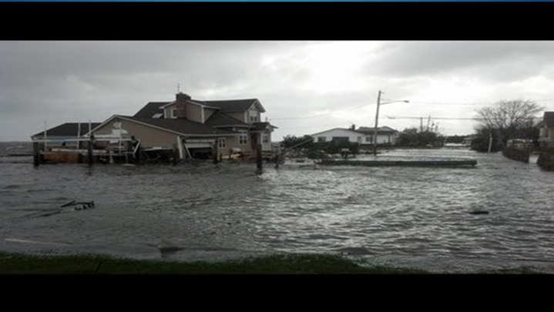
QUESTIONS?
Source: kentchemistry.com via youtube.com

Slide 19
