Slide 1

Why Social Work Needs Web Mapping
Taking Care of California’s Foster Children
Geog 596A – Capstone Project Proposal
Ann Masangcay
The Pennsylvania State University
November 3rd, 2015

Slide 2

Personal Introduction
Ann Masangcay
BS Human Services, California State University, Fullerton, 1992
Straight Talk, La Mirada
Home Helping Hands
YMCA, Project Care
Florence Crittenton Services
Essential Skills Program
Olive Crest
Redlands Community Hospital

Slide 3




Social Work Toolkit before the Internet
I am a PEOPLE PERSON.
I don’t need
computers !

Slide 4
Background
Social Work Slow to Adopt Technology
Social Work Departments Rarely Use GIS for Research
Amy Hilliard – Why does Social Work Need Mapping? (2006)
Lars Eggerston – Used Multinomial Logistic Regression Statistics (2008)
Mei-Po Qwan – GIS for Social Research Using Quanitative/Qualitative Data (2006)
Most Research is Dated – Have the Conclusions Changed?

Slide 5
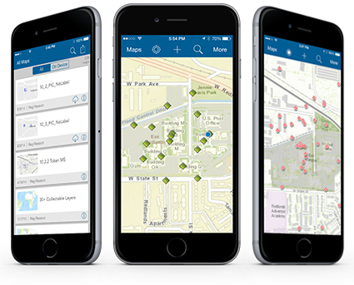
Social Work Toolkit 2015
Social Workers are Using Smart Phones
GPS Routing
Email
Contacts
  Let’s Add Mobile Geospatial Technologies
  Collector for ArcGIS
  Case Notes
  Referrals
  Maps and Apps
  Disaster Response

Slide 6
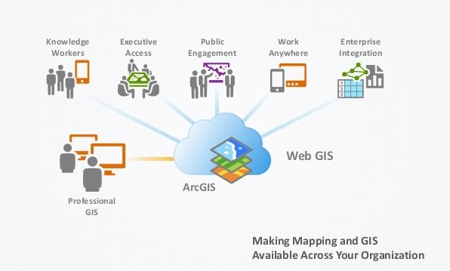
GIS with your smart phone

Slide 7
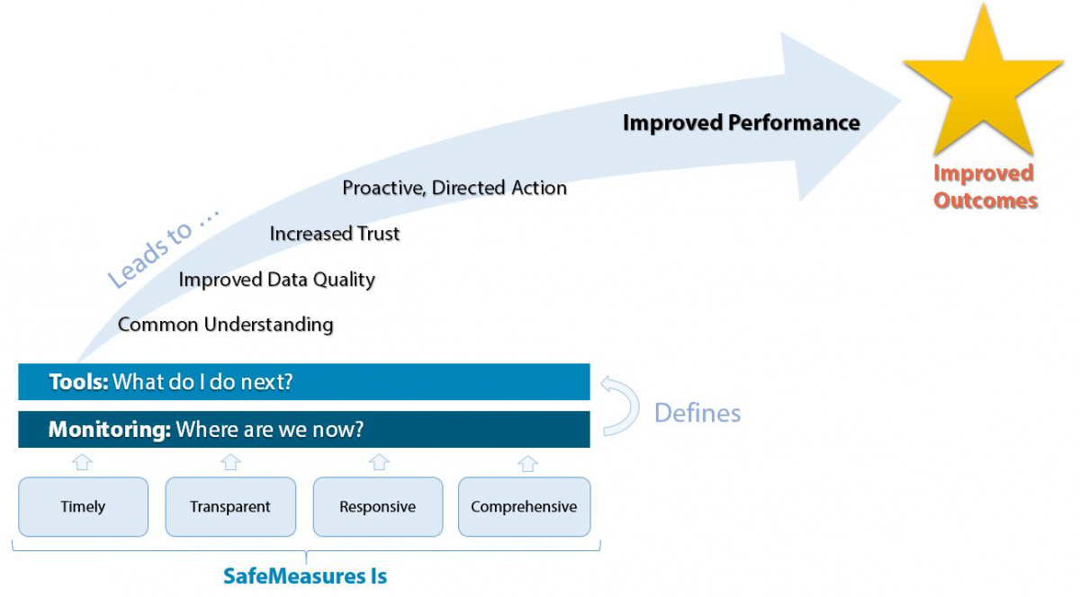
SafeMeasures®
National Council on Crime and delinquency

Slide 8
SafeMeasures® App in Action
Santa Barbara Fire, 2009
App Shows Fire Perimeter and Foster Children Near the Incident

Slide 9
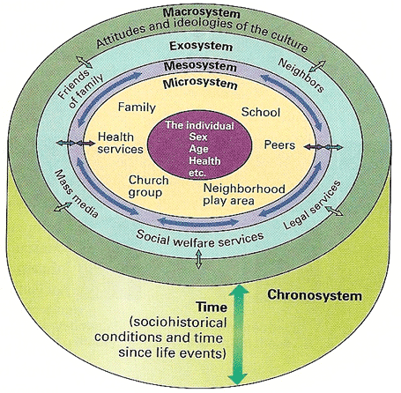
Ecological Systems Theory for Social Work 1979
Dr. Urie Bronfenbrenner

Slide 10
Waldo Tobler’s 1st Law of Geography
"Everything is related to everything else, but near things are more related than distant things.“
Waldo Tobler

Slide 11
Goals and Objectives
Goals– demonstrate the value of web mapping and analysis in three primary aspects of social work: research, case management, and planning/decision-making
Objectives
Data Conversion – Successfully convert and upload relevant foster care data for analysis and use in Esri’s ArcGIS Online
Geostatistical Analysis using Quantitative and Qualitative Data
Investigate and Report on the Use of GIS in Social Work and Disaster Response
Summary Report on the Costs and ROI of using online GIS in Social Work

Slide 12
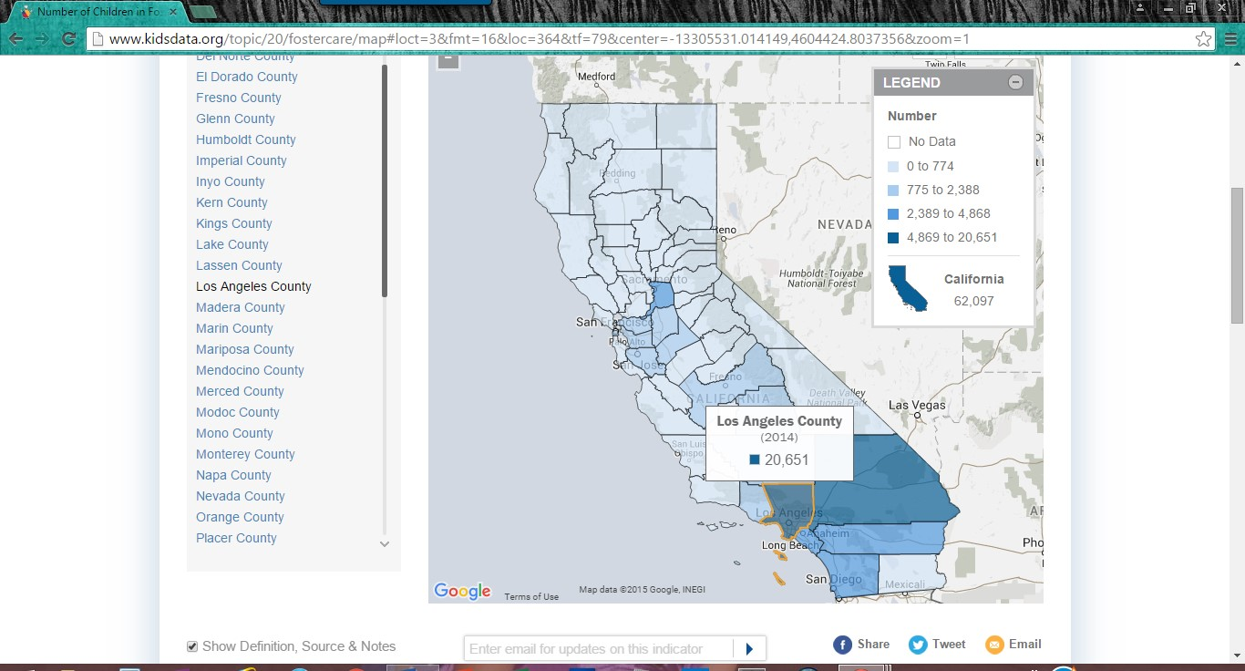
Kidsdata.org – Data regarding kids in California
Is the high number of foster kids in LA County just directly proportional to the population?
62,097 – Number of foster children in California, 2014
Counties with Largest Number of Foster Children
20,651 – Los Angeles
4,869 – San Bernardino
4,721 – Riverside
3,497 – San Diego

Slide 13
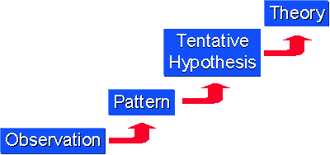
Proposed Methodologies
INDUCTIVE RESEARCH
is more open ended
and exploratory
Extract authorative social work data online
Perform geostatistical analysis using ArcGIS for Desktop (ArcGIS Pro vs. ArcMap)
  Geostatistical Model
  Specific Tools and Functions TBD
Cost and ROI Analysis
Present Findings and Recommendations via Story Map

Slide 14
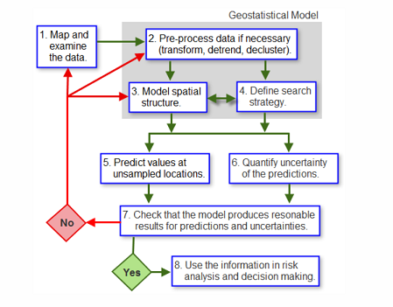
Geostatistical Model
Unknowns
Will the geostatistical processes available with ArcGIS for Desktop work with social work data?
Can ArcGIS Pro complete all the analysis or must ArcMap tools be needed?
Which specific analysis functions should be employed and why?

Slide 15
Project Timeline – 15 Weeks
Start December 1st
  Data Collection and Second Literature Review – 2 weeks
  Data Conversion and Quality Check – 4 weeks
  Data Analysis and Conclusions - 2 weeks
  Final Report Draft and Revisions– 4 weeks
  Final Power Point Presentation Development – 2 weeks
Final Presentation in Geographies of Child Abuse Session at AAG March 29 – April 2, 2016

Slide 16
Anticipated Results
Why does Social Work Need Web Mapping?
Social Work Research using ArcGIS and Spatial Statistics
Case Management – ArcGIS and Mobile
Social Work Policy
Disaster Response
Return on Investment (ROI)

Slide 17
References
Eggerston, L. (2008). Primary Factors Related to. Child Welfare • Vol. 87, #6, 71-90.
Felke, T. P. (2015). The Use of Geographic Information Systems (GIS) in Conducting a Needs Assessment of Seniors in Collier County. Advances in Social Work Vol. 16 No. 1 (Spring 2015),
140-153.
Fitch, D. (2015). A Conceptual Framework for Information Technology in Social Work. Advances in
Social Work Vol. 16 No. 1 (Spring 2015), 25-30.
Hillard, A. (Spring/Summer 2007). Why Social Work Needs Mapping. Journal of Social Work Education, Vol. 43, No. 2, 205-221.
Klein, S., & Merritt, D. H. (2014). Neighborhood racial & ethnic diversity as a predictor of child welfare. Children and Youth Services Review 41, 95-105.

Slide 18
References Cont.
National Council on Crime and Delinquency. (2015). Mapping a Plan for Disaster Readiness:Using GIS Technologies With Child Welfare Data. Retrieved from National Council on Crime and Delinquency: http://www.nccdglobal.org/sites/default/files/pdf/mapping_a_plan.pdf
Qwan, M.-P., & Knigge, L. (2006 ). Doing Qualatative Research with GIS: An Oxymoronic Endeavor? Environment and Planning A, Vol 38, No 11, 1999-2002.
Steinburg, S. L., & Steinburg, S. J. (2015). GIS Research Methods:Incorporating Spatial Perspectives. Redlands: Esri Press.

Slide 19

Questions?

