Slide 1
Developing a
GIS System
for
Rail Marketing Agents
May 14, 2013
T. Allen Morgan (presenter)
Frank Hardisty (advisor)
Norfolk Southern Website
Photos and Sounds (N.D.)

Slide 2
GIS Development – Overview
Define the problem - marketing department’s GIS needs
Discuss mapping history
Delineate recent events leading to current geospatial needs
Develop a solution based on a user driven GIS system
Dissect the Enterprise GIS base in order to utilize its attributes
Deliver a marketing GIS to meet user needs

Slide 3
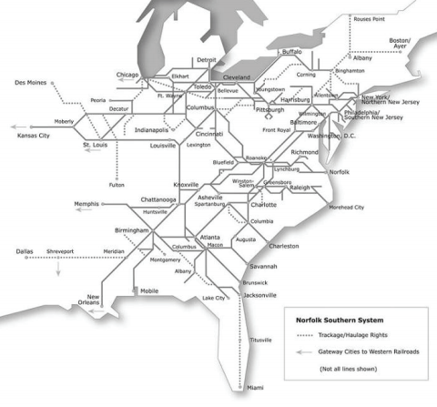
GIS Development – Defining The Problem
Marketing needs - acquiring access to geospatial data
Marketing currently has no GIS designed for their department
Only small or incomplete data sets (static maps) are available
Agents need access to geospatial data in the information age
Geospatial data helps us stay competitive and meet regulations
CDN (N. D.)

Slide 4
GIS Development– Mapping History
Mapping history
Norfolk & Western created a land management subsidiary in 1901
Mapping responsibilities were split between their land company and the engineering department
The land management company and engineering began using GIS tools in the mid 90’s
Fitzpatrick (N. D.)

Slide 5
GIS Development– Recent Events
Events since 2000 - an accelerated need for geospatial capabilities
Maximizing locomotive efficiency with geospatial technology, 2003
Adopting a geospatially driven traffic system called UTCS, 2005
Progressing OTC/PTC Positive Train Control, 2006
Digitizing the track network with LIDAR technology, 2008
Adapting to the Rail Safety Improvement Act of 2008; all class 1 railroads to install PTC by 2015
Creating an enterprise GIS group to meet corporate geospatial goals, 2010 (NS Website, Financial Reports, N. D.)

Slide 6
GIS Development Schedule
Summer 2012 |  | Developing group GIS concept
September 2012 |  | Meet with Administration - acquire permission Granted permission to develop coal transport GIS
October 2012 |  | Meet with Enterprise GIS group in Atlanta Perform system review - examine GIS architecture Determine process for developing department GIS
November and December 2012 |  | Develop plan for building a marketing GIS Develop plan for test, quality assurance and delivery
January through July 2013 |  | Build the system - gather data, develop software/files, test, perform quality assurance and implement
How will a marketing GIS help the department?
What will it cost the department?

Slide 7
EGIS Architecture
Inputs
Internal Geodatabases
Tracking and Asset Inventory System
Operating Data
Test
QA
Prod
Inputs
Positive Train Control
Core GIS
Migration
Outputs
Migration
Transportation
Engineering
Marketing
Downstream Applications to the Traffic Control Signaled System
Engineering
Map Server
Maintenance of Way
Marketing Dept User
Field Agent

Slide 8
GIS Development – User Group Needs
User group interviews and prototyping
Three user groups defined
Planning analysts
Marketing agents
Transportation coordinators
Fort, Bob (Dec 5, 2005)

Slide 9
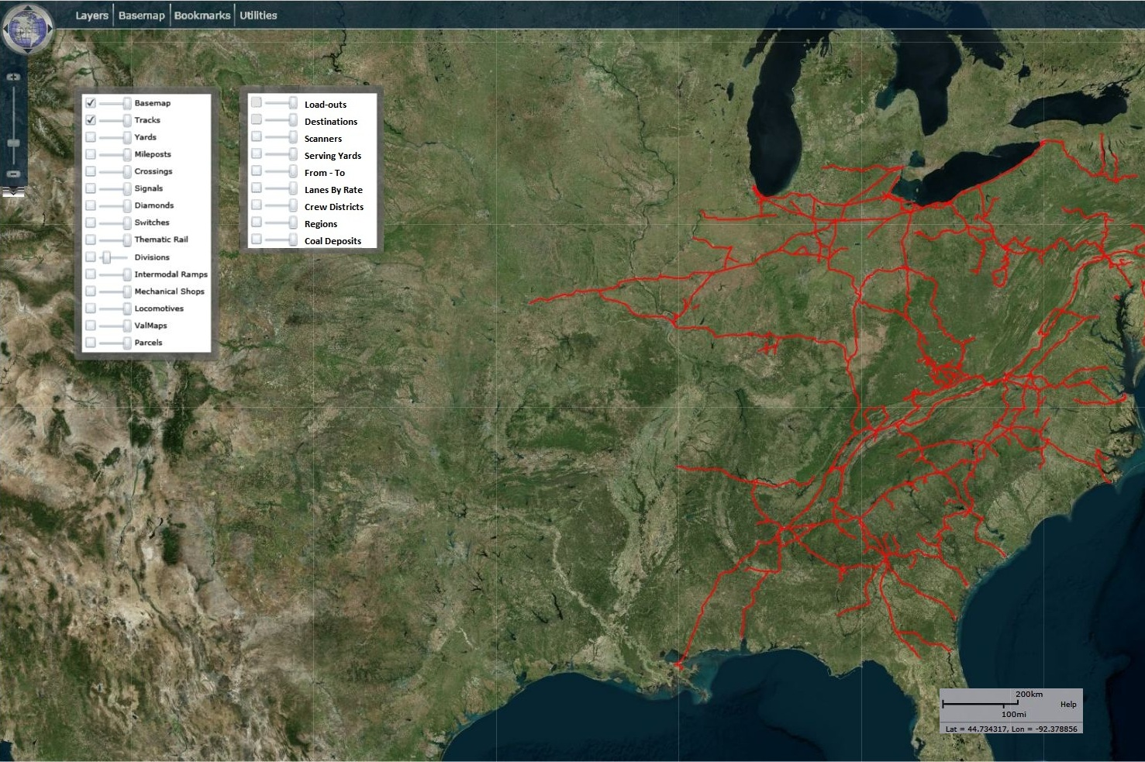
GIS Development – Prototyping

Slide 10
GIS Development – Planning Analyst Needs
Planning analysts
Need to determine types of coal by region and location - origins
Need a layer indicating power plant regions - destinations
Need stats on each origin & plant including coal type, coal quality, heat rate, max train size, max volume potential, etc.
Need to determine revenue per unit based on lane or route
Need to know interchange locations along each route

Slide 11
GIS Development – Marketing Agent Needs
Marketing agents
Need route planning capabilities
Need a crew district layer for determining number of crews per route, rates per route, and total mileage
Need customer profiles, geographic customer data and proximity of destinations to origins

Slide 12
GIS Development – Transportation Coordinator Needs
Transportation coordinators
Need geographic data including origins, destinations, routes, and major serving yards; ability to measure track feet at each location
Need geospatial data including ruling grades, power needs, and areas with unique rail road constraints
Need a layer of scanners to determine proximity of scanners to customers and running times from scanner location to customer
Need ability to use layer caches to zoom in to specific locations to view individual tracks in designated areas, customer locations, etc.

Slide 13
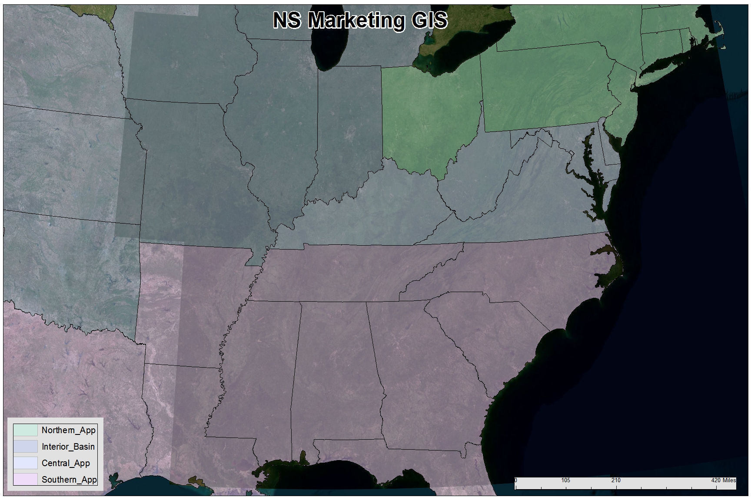
GIS Development – Map Layers

Slide 14
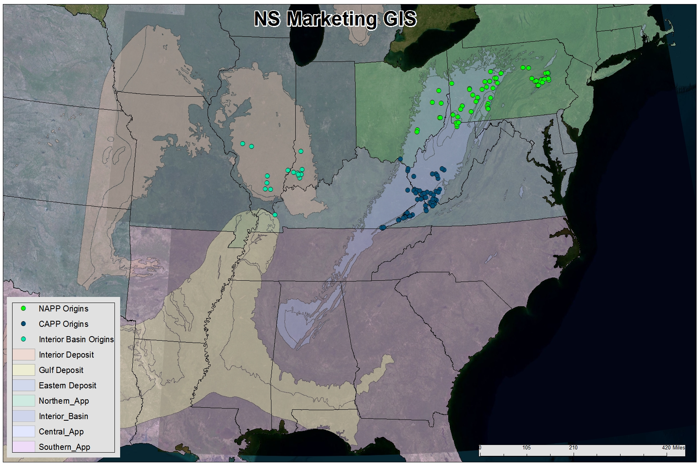
GIS Development – Map Layers

Slide 15
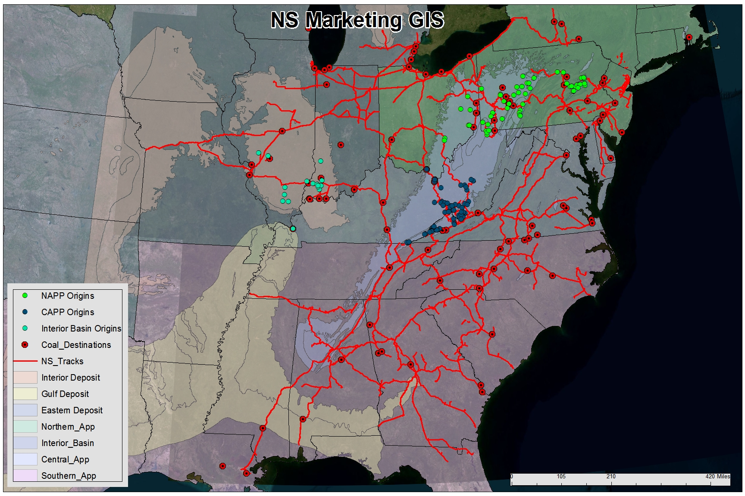
GIS Development – Map Layers

Slide 16
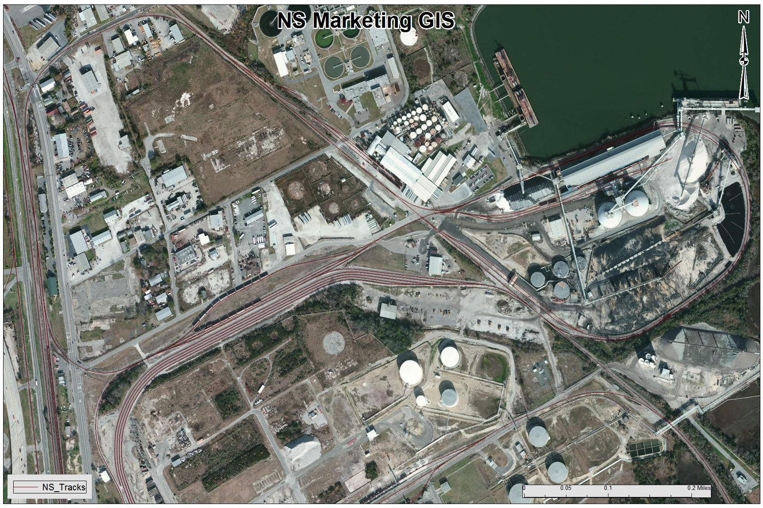
GIS Development – Map Layers

Slide 17
GIS Development – User Centered Design
The design plan must begin with the user in mind
The marketing GIS must reflect the needs of each user group
Continued success for a marketing GIS will depend on listening to and acting on suggestions and needs of users
Ideally, the process used in developing a department GIS tool will provide a model for other marketing user facing software
Fort, Bob (Dec 5, 2005)

Slide 18
Thank You

Slide 19
GIS Development – References
CDN (N. D.). Norfolk Southern: Not A Buying Opportunity - Seeking Alpha. April 30, 2013. http://static.cdn-seekingalpha.com/uploads/2012/11/1669031_13533444850148_0.png
Fitzpatrick, Edwin A. (N. D.). N&W Historical Society Archives. May 08, 2013. http://www.nwhs.org/archivesdb/selectdocs.php?Source=Edwin%20A.%20Fitzpatrick
Kirk, Terry – Manager of GIS Systems, Pocahontas Land Corporation (2013, April 12). Personal Interview.
McGehee, Dr. Stuart; McGuire, Eva (2001). A Century of Stewardship: The History of Pocahontas Land Corporation, 1901 to 2001 – 100th Anniversary, a Subsidiary of Norfolk Southern. Copyright Pocahontas Land Corporation, Bluefield, WV.
Norfolk Southern Website (N. D.). Norfolk Southern Photos and Sounds. April 28, 2013. http://www.nscorp.com/nscportal/nscorp/Media/Photo%20Gallery/
Norfolk Southern Website (N. D.). Financial Reports: Investor Book. May 7, 2013. http://www.nscorp.com/nscportal/nscorp/Investors/Financial_Reports/Investor%20Book/technology.html
Fort, Bob (December 5, 2005). Norfolk Southern Website, News Releases. April 28, 2013. http://www.nscorp.com/nscportal/nscorp/Media/News%20Releases/2005/ny_airbrake.html
NS Real Estate (N. D.). NS Real Estate Track Map. April 30, 2013. http://realestate.nscorp.com/nscrealestate/RealEstate/Contact_Us/Contacts_by_Territory/contact_map.gif

