Slide 1
Ground-Level Ozone Forecasts in the Mid-Atlantic using the Analog Ensemble
Presented by:
Mark A. Prettyman
GEOG 596A
Fall 2019
Advisor:
Dr. Guido Cervone, Ph.D.
Associate Professor of GeoInformatics,
Meteorology, and Atmospheric Science

Slide 2
Agenda
Background
  Ground-Level Ozone
  Problem
  Solution
  Goals & Objectives
Methodology
  Data
  Technology
  Analysis & Methods
Expected Results / Timeline
Conference Venue

Slide 3

Background
Who is “Mark A. Prettyman”?
Environmental Scientist for Delaware Division of Air Quality
Lead Scientist on ground-level ozone.
  Estimate emissions
  Analyze emissions data
  Develop regulations

Slide 4
Question 1:
Who likes to breathe clean air?

Slide 5
Ground-Level Ozone
  Not directly emitted
  Primary precursur pollutants
    Nitrogen oxides (NOx)
    Volatile organic compounds (VOCs)
  National Ambient Air Quality Standard (NAAQS) for ozone
    Current NAAQS finalized in 2015
    0.070 parts per million (ppm)
    “3-yr average of the 4th highest daily maximum 8-hour ozone concentration”
  Delaware is part of a multi-state “nonattainment area.”

Slide 6
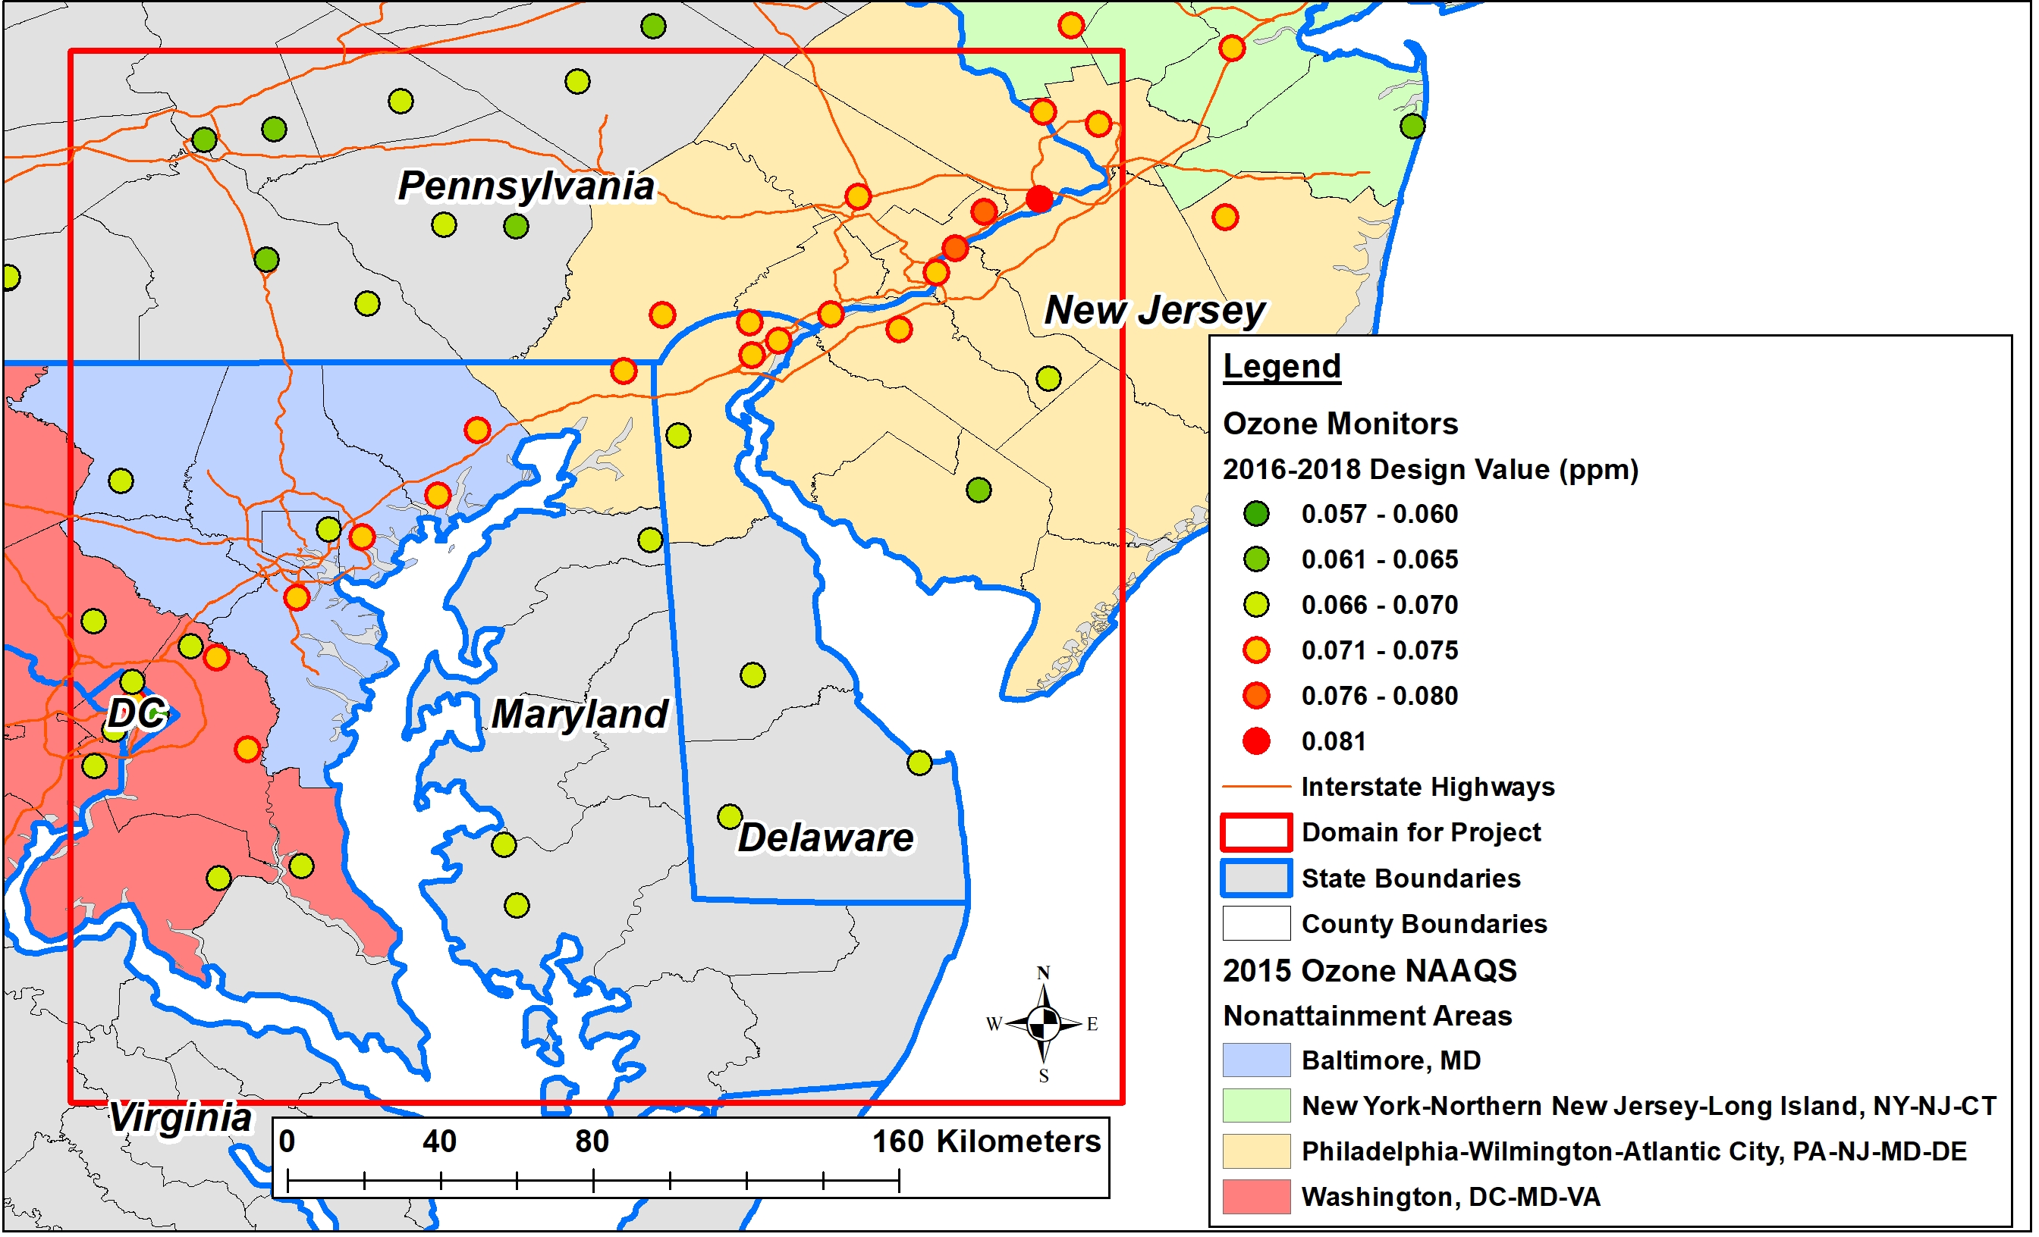
PROJECT DOMAIN
(275km x 275km)

Slide 7
Question 2:
Wouldn’t you like to know when air quality is bad?

Slide 8
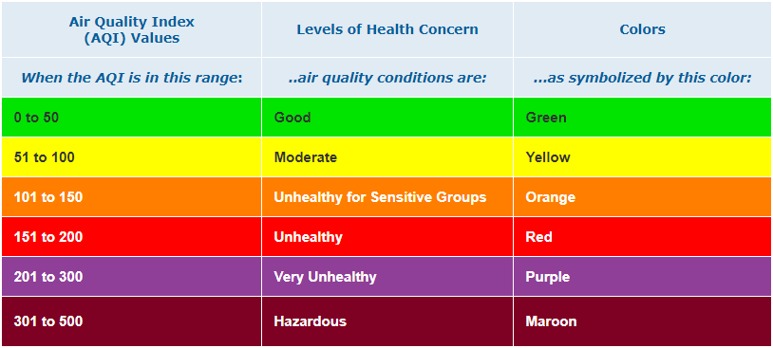
Air Quality Index (AQI)
Public notification of bad air quality
AQI is a range
Color coded for simplification
“Code Orange” or worse is a violation of NAAQS
Source:
Air Quality Index Basics (EPA, n.d.-b)

Slide 9
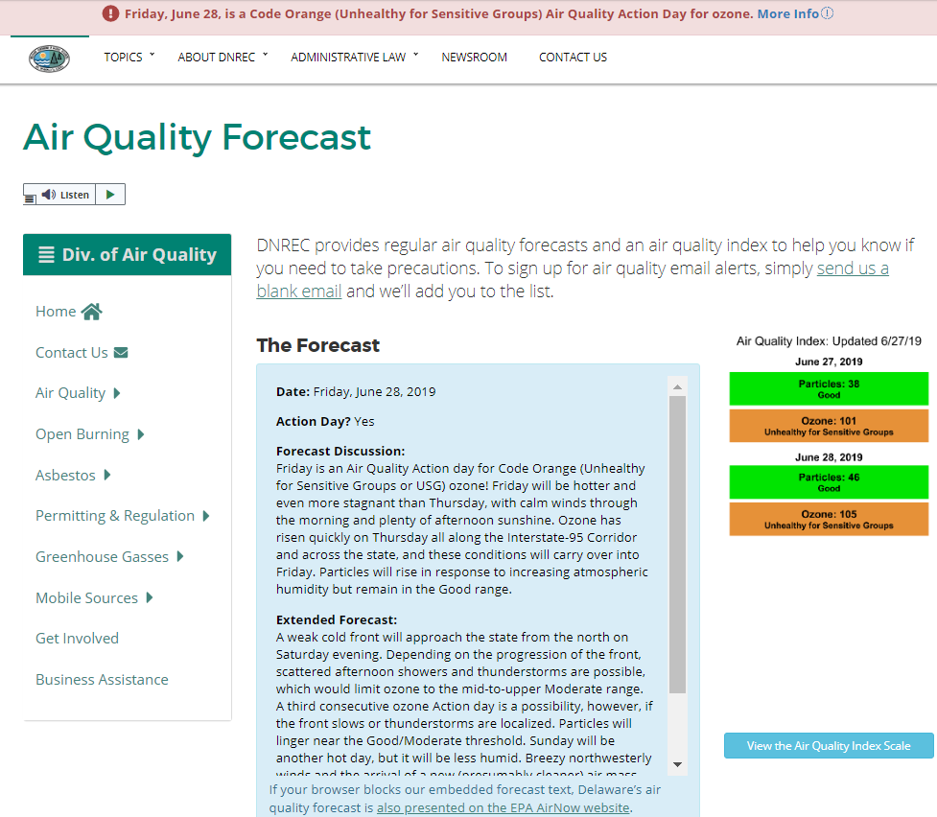
Delaware
Air Quality Forecast
Website
June 27, 2019
Source: https://dnrec.alpha.delaware.gov/air/ quality/forecast/

Slide 10
Problem
Typical forecasts:
  Deterministic
  Lots of computational resources
  Lots of time
Examples include:
  Comprehensive Air quality Model with extensions (CAMx)
  Weather Research and Forecasting (WRF) system
Day-ahead forecast of AQI relies on
  Deterministic modeling
  Meteorology
  Emissions trends
Forecasting is scientific, but not very accurate.

Slide 11
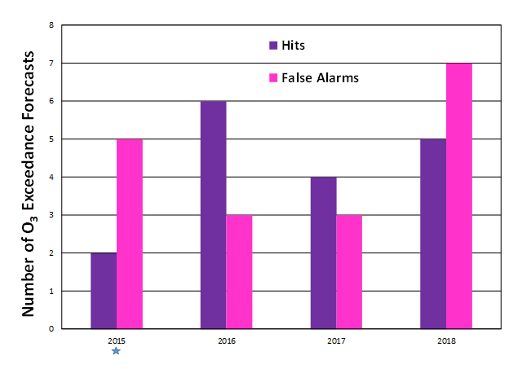
Forecasts for Delaware by PSU Meteorologists
Hit =
Forecasting an observed ozone exceedance
False Alarm = Forecasting an ozone exceedance which is not observed.

Slide 12
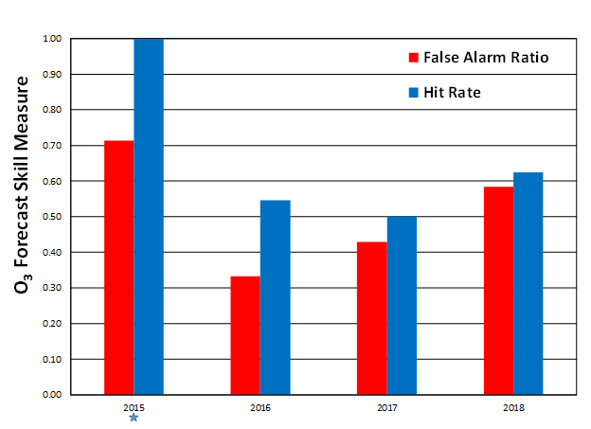
Forecasts for Delaware by PSU Meteorologists
Hit Rate of 1 =
Forecasting every observed exceedance
FAR of 1 =
Forecasting an exceedance when none where observed

Slide 13
Solution
Dr. Luca Delle Monache - Analog Ensemble or AnEn
Uses past observations correlated with deterministic forecasts in the past
Probabilistic forecast
Used to forecast:
  Temperatures
  Wind speeds
  Wind & solar power generation forecasts
  Air quality (particulate matter and ozone)

Slide 14
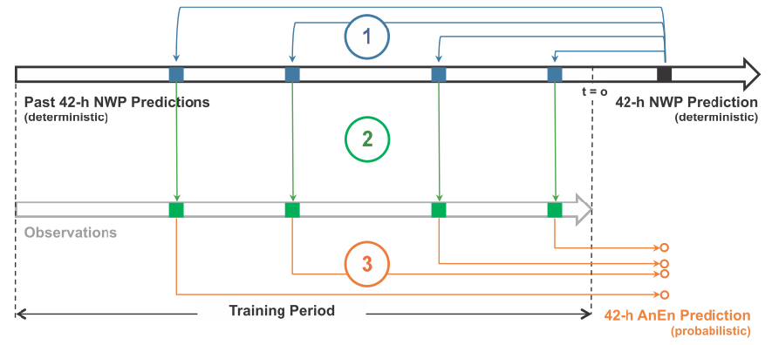
The Analog Ensemble (“AnEn”) Technique
Source: Delle Monache, et al., 2013

Slide 15
Goals & Objectives
What can drive a better ozone forecast:
“expertise” or “data”?

Slide 16
Methodology
R package to run AnEn
  Forecast day-ahead hourly ozone
    Calculate 8-hr ozone concentrations
      Max 8-hr ozone per day
        Calculate AQI
          Compare AnEn AQI to historic AQI forecasts

Slide 17
Data
4 years of data to be obtained:
  2015-2018 deterministic meteorological data (NOAA)
  2015-2018 observed hourly ozone concentrations (EPA)
2015-2017 met data = Training Period
2015-2017 ozone data = ozone “analogs”
2018 ozone data = data verification

Slide 18

Technology

Slide 19
Analysis & Methods
AnEn factors to consider:
  Number of analogs
  Length of search period
  Search parameter weighting factors
Forecast attributes for assessing performance:
  Continuous Ranked Probability Score (CRPS)
  Reliability
  Resolution

Slide 20
Expected Results
AnEn ozone forecasts will be close to observed values.
But how close?
What about daily min and max?
What about summer peaks in ozone?
Source: Delle Monache, et al., 2018

Slide 21
Expected Results
Will the AnEn technique
forecast day-ahead AQI values
better than historical forecasts?
To find out...

Slide 22
Conference Venue
2020 Hawai’i Symposium
University Consortium for Geographic Information Science (UCGIS)
Hawaii Pacific University, Honolulu, Hawai’i
May 28 - June 1, 2020
November 15, 2019: Proposal deadline

Slide 23
Timeline
7 Months Until the Symposium
1 month - data prep for processing in R
2 months - initial runs, assessing factors used
2 months - analysis of results
2 months - preparation of paper & presentation

Slide 24
References
AirNow, (n.d.). Air Quality Index (AQI) Basics. Retrieved on September 12, 2019 from https://airnow.gov/index.cfm?action=aqibasics.aqi
American Lung Association. (2019). State of the Air 2019. Retrieved October 23, 2019, from https://www.lung.org/assets/documents/healthy-air/state-of-the-air/sota-2019-full.pdf
Delle Monache, L., Alessandrini, S., Djalalova, I., Wilczak, J., & Knievel, J. C. (2018). Air Quality Predictions with an Analog Ensemble. Atmospheric Chemistry and Physics Discussions, 1–36. https://doi.org/10.5194/acp-2017-1214
Delle Monache, L., Eckel, F. A., Rife, D. L., Nagarajan, B., & Searight, K. (2013). Probabilistic Weather Prediction with an Analog Ensemble. Monthly Weather Review, 141(10), 3498–3516. https://doi.org/10.1175/MWR-D-12-00281.1
Delle Monache, L., Nipen, T., Liu, Y., Roux, G., & Stull, R. (2011). Kalman Filter and Analog Schemes to Postprocess Numerical Weather Predictions. Monthly Weather Review, 139(11), 3554–3570. https://doi.org/10.1175/2011MWR3653.1
Delaware Division of Air Quality (2018). 2018 Delaware Ambient Air Monitoring Network Description for Criteria Pollutants. Retrieved on September 19, 2019 from http://www.dnrec.delaware.gov/Air/Documents/DE%20mon%20net%20desc%202018.pdf
Developmental Testbed Center (n.d.). WRF-NMM Users Page. Retrieved on September 12, 2019 from https://dtcenter.org/wrf-nmm/users/
EPA (n.d.-a). Air Quality Design Values. Retrieved on September 19, 2019 from https://www.epa.gov/air-trends/air-quality-design-values
EPA (n.d.-b). Air Quality Index (AQI) Basics. Retrieved on September 22, 2019 from https://airnow.gov/index.cfm?action=aqibasics.aqi
EPA (n.d.-c). Ground-level Ozone Basics. Retrieved on September 12, 2019 from https://www.epa.gov/ground-level-ozone-pollution/ground-level-ozone-basics#effects

Slide 25
References (cont.)
EPA (n.d.-d). Pre-Generated Data Files - Tables of Hourly Data. Retrieved on September 7, 2019 from https://aqs.epa.gov/aqsweb/airdata/download_files.html#Raw
Hu, W., Cervone, G., Clemente-Harding, L., and Calovi, M. (2019). Parallel Analog Ensemble. Zenodo. http://doi.org/10.5281/zenodo.3384321
Huff, A., & Ryan, W. (2018). State of Delaware Final Report: Ozone Observations and Forecasts in 2018. Retrieved on September 12, 2019 from http://www.dnrec.delaware.gov/Air/Documents/annual-ozone-reports/DE_Ozone_2018_Final-Report_Final.pdf
Hylton, M (2016). The AQI Equation. Message posted to https://forum.airnowtech.org/t/the-aqi-equation/169, retrieved on September 21, 2019.
Junk, C., Delle Monache, L., & Alessandrini, S. (2015). Analog-Based Ensemble Model Output Statistics. Monthly Weather Review, 143(7), 2909–2917. https://doi.org/10.1175/MWR-D-15-0095.1
National Ambient Air Quality Standards for Ozone, 80 Fed. Reg. 65292 (October 26, 2015) (to be codified at 40 CFR Parts 50, 51, 52, 53, and 58)
NOAA (n.d.). North American Mesoscale Forecast System (NAM). Retrieved on DATE from https://www.ncdc.noaa.gov/data-access/model-data/model-datasets/north-american-mesoscale-f
Ramboll Environ (n.d.). CAMx. Retrieved on September 18, 2019 from http://www.camx.com/ orecast-system-nam
Shahriari, M., Cervone, G., Clemente-Harding, L., & Delle Monache, L. (2020). Using the analog ensemble method as a proxy measurement for wind power predictability. Renewable Energy, 146, 789–801. https://doi.org/10.1016/j.renene.2019.06.132

Slide 26
Thank you!
*Special thanks to Dr. Cervone and his students in the Geoinformatics and Earth Observation Laboratory!
Mark A. Prettyman
Delaware Division of Air Quality
mark.prettyman@delaware.gov

