Slide 1
Open Source Social Media: @Russia-@Ukraine #Conflict
@tysonquink – Aug 5
2.7K
1.2K
…

Slide 2
Agenda
What is social media data and its value?
Russians in Ukraine
Project approach and methodology
Architecture
Anticipated results
Project challenges
Project timeline
Questions

Slide 3
Project genesis & hypothesis
Edward Snowden
National reaction to NSA leaks
Do our actions mirror our concerns
Business models revolve around free content
At what level can we use social media content to identify patterns and trends geospatially?
-Russia – Ukraine as the focus

Slide 4
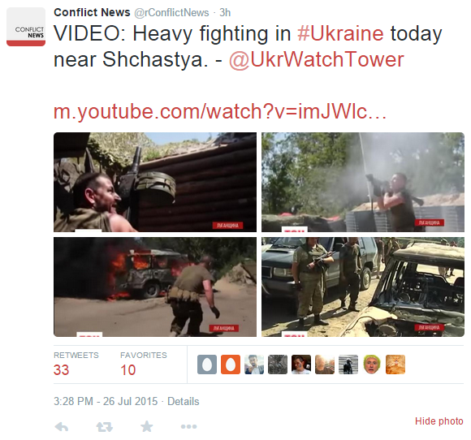
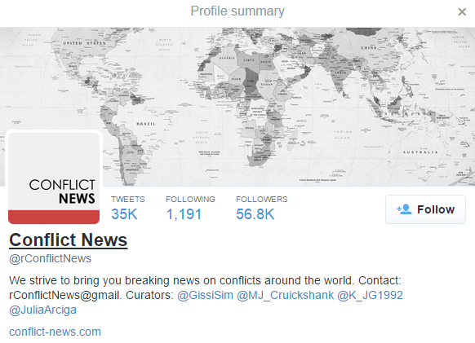
Social media

Slide 5
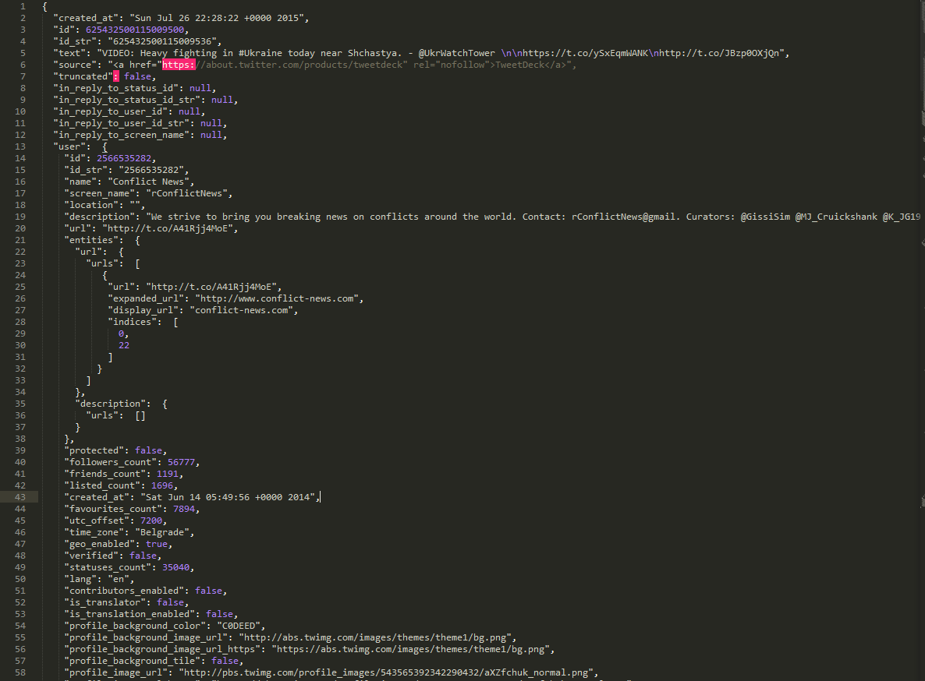
RAW SOCIAL MEDIA Data
"created_at": "Sun Jul 26 22:28:22 +0000 2015"
"id": 625432500115009500
"text": "VIDEO: Heavy fighting in #Ukraine today near Shchastya. - @UkrWatchTower \n\nhttps://t.co/ySxEqmWANK\nhttp://t.co/JBzp0OXjQn
"followers_count": 56777,
"friends_count": 1191,
"listed_count": 1696,
"created_at": "Sat Jun 14 05:49:56 +0000 2014",
"favourites_count": 7894,
"utc_offset": 7200,
"time_zone": "Belgrade",
"geo_enabled": true,
"profile_image_url": "http://pbs.twimg.com/ profile_images/543565392342290432/aXZfchuk_normal.png"
326 lines comprise this one tweet

Slide 6
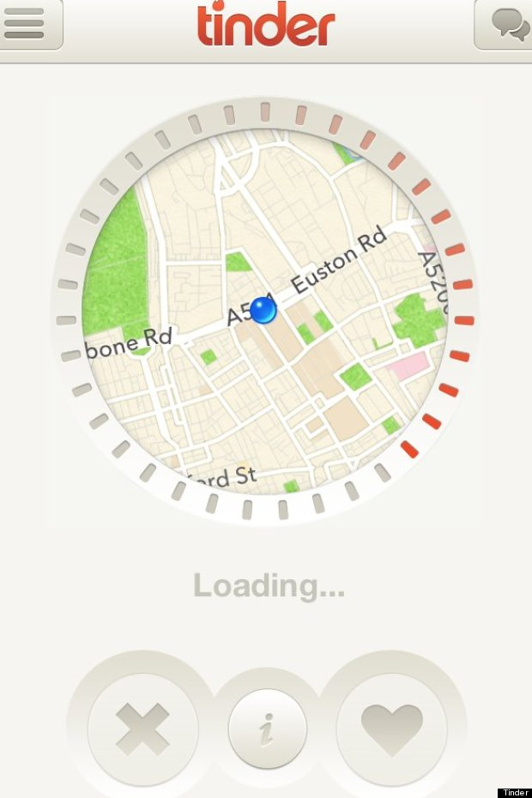
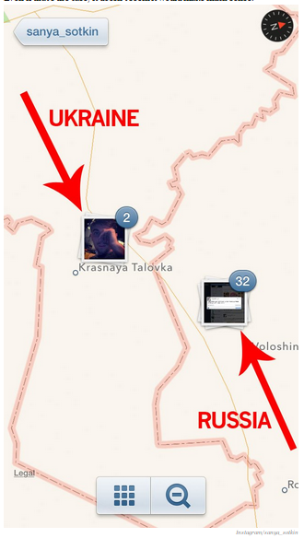
Use cases
Personal Use
Business Intelligence
Military & Government

Slide 7
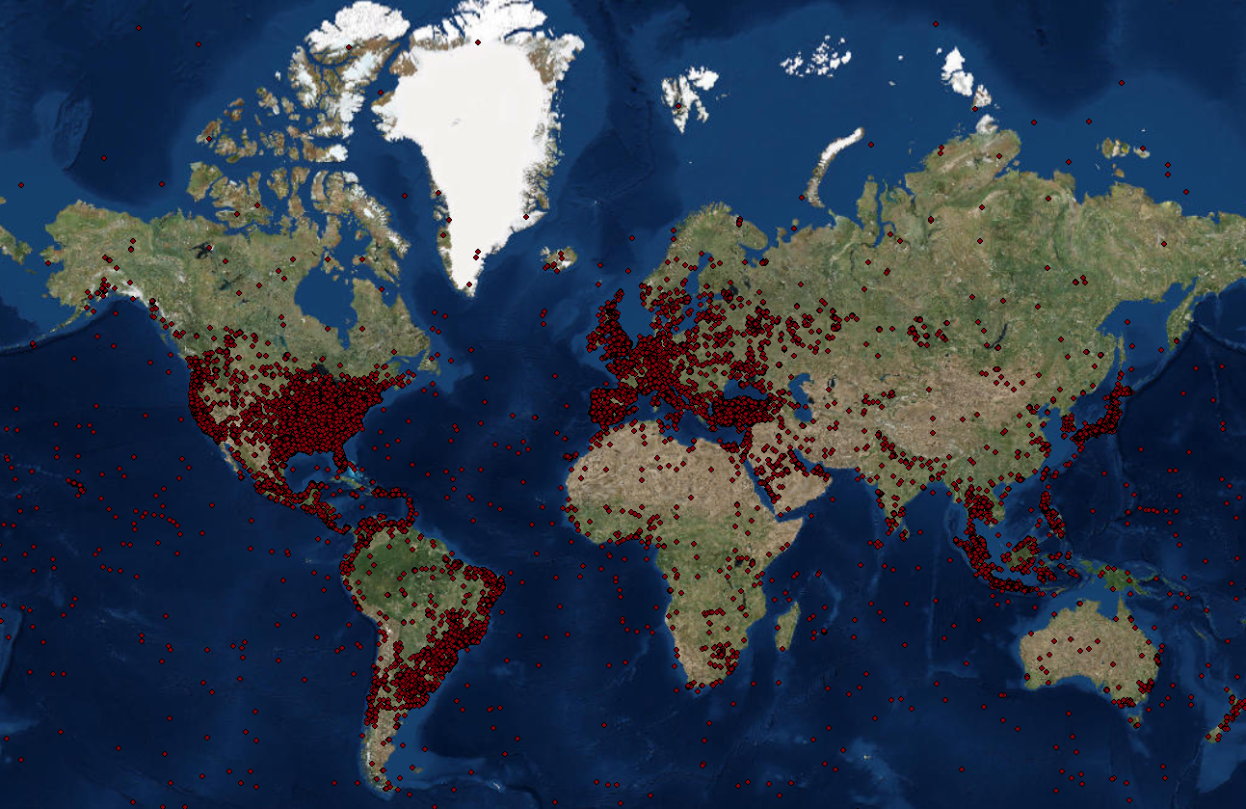

Slide 8
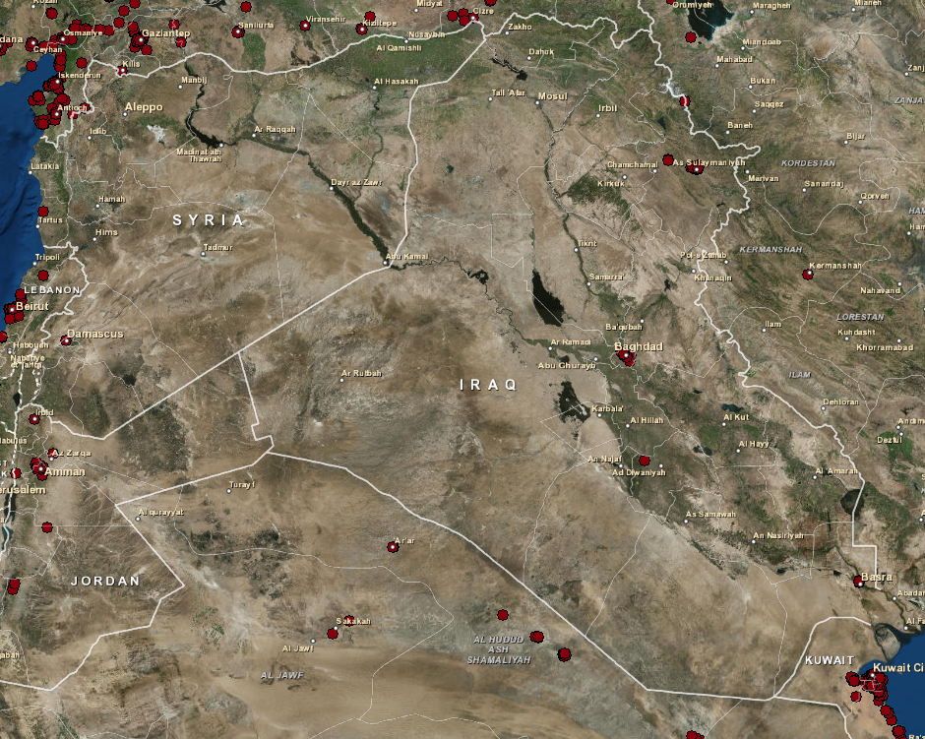
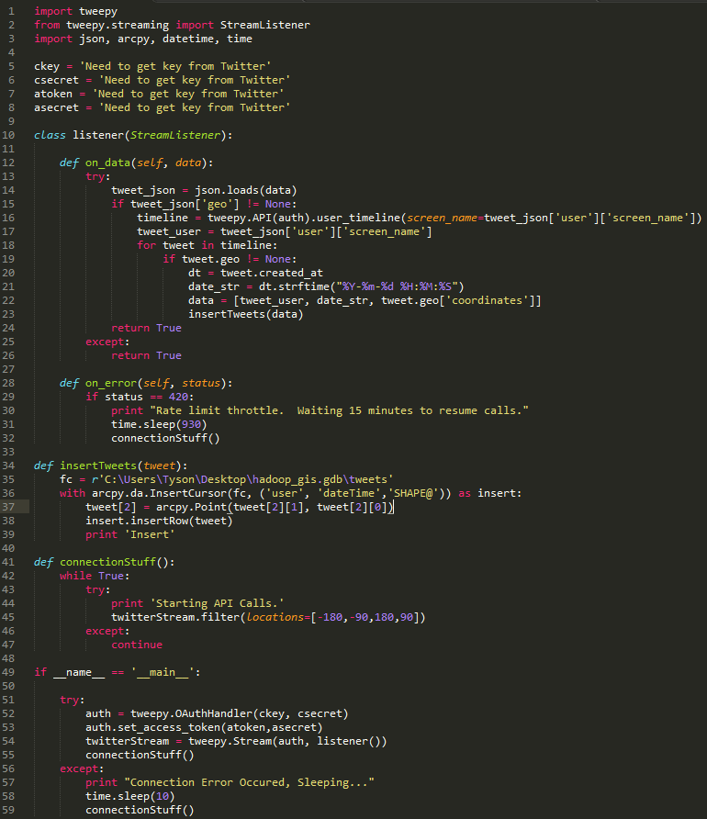
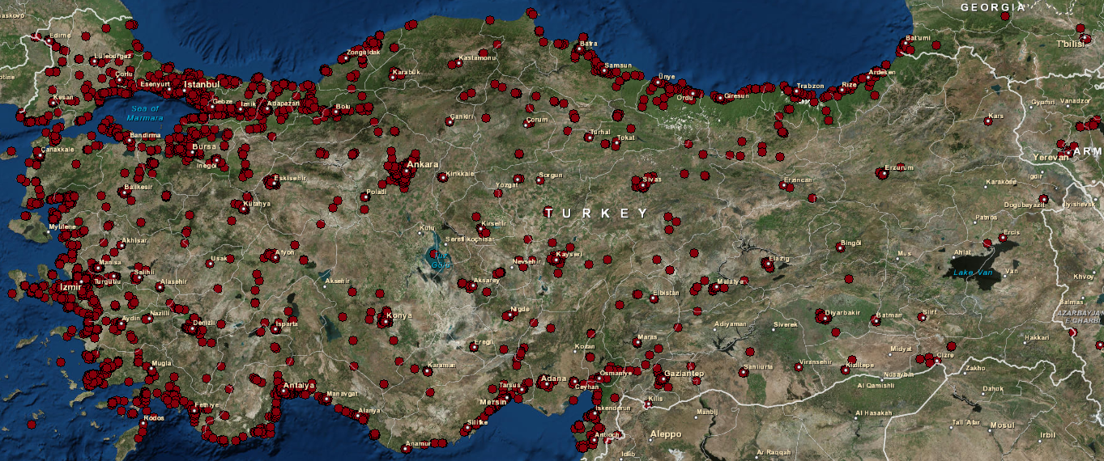
social media User map

Slide 9
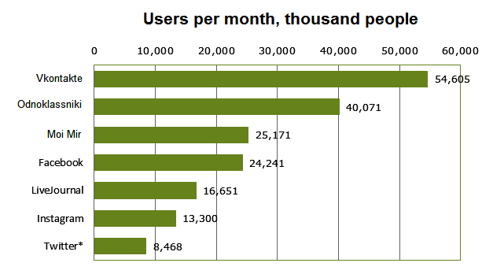
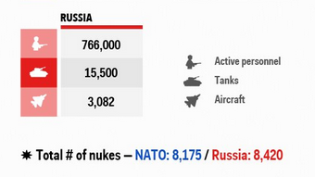
Why Russia-Ukraine?
23 FEB-19 MAR 2014 - Annexation of Crimea by Russian Federation
26 FEB 2014 -Present – Russian Intervention in Ukraine
88% of Twitter users are on mobile devices
Russia’s Population: 146.2M
Social Media links to Russian’s soldiers operating in Ukraine

Slide 10
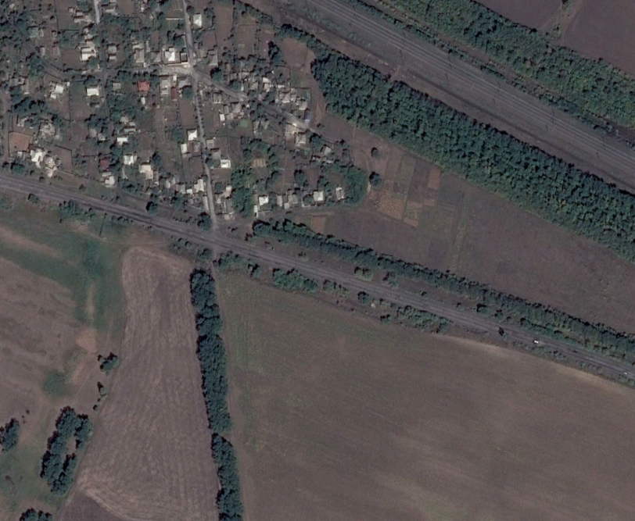
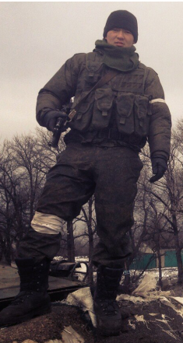
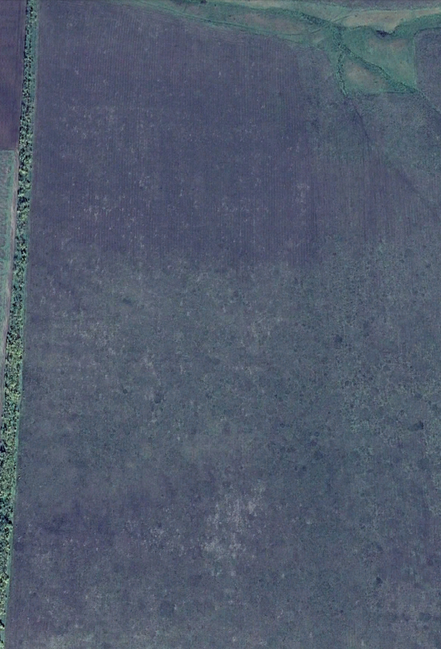
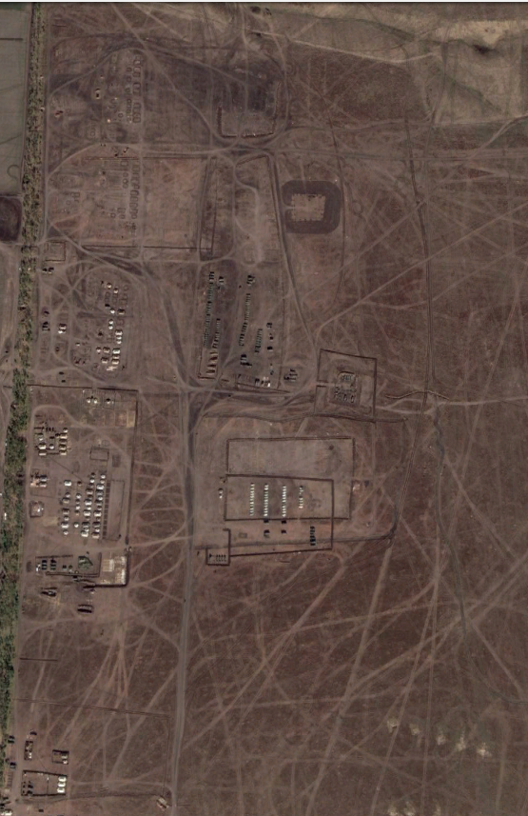
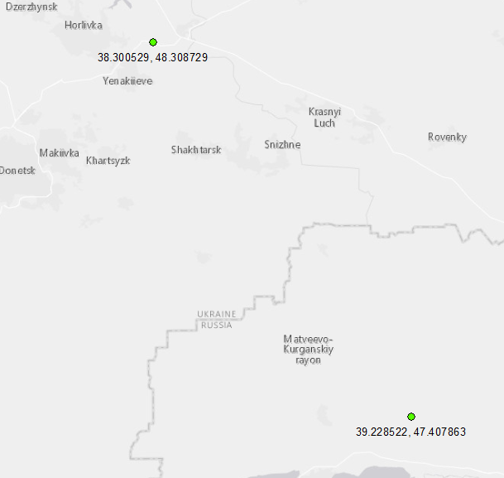
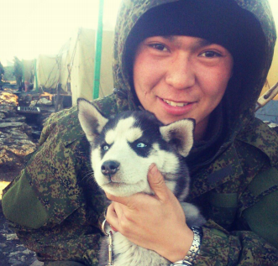
Russia-Ukraine
Bato Dambayev
37th Motorized Infantry Brigade
Coordinates:
48.308729,
38.300529
October 19, 2013
October 9, 2014
Coordinates:
47.407863,
39.228522

Slide 11
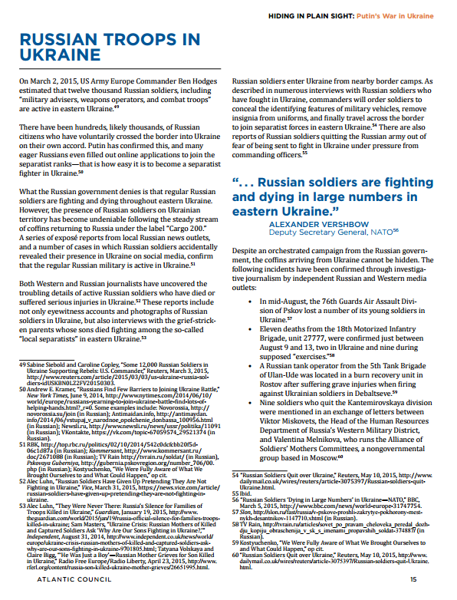
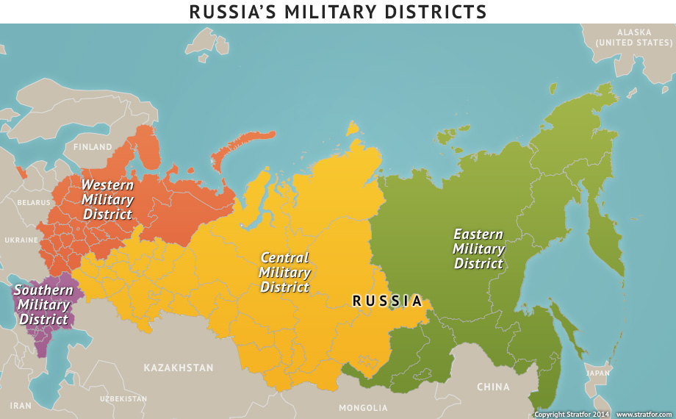
Project approach
Use these locations to identify data collection strategies
Identify units & locations through open source channels
Reported Location
Home Garrison

Slide 12
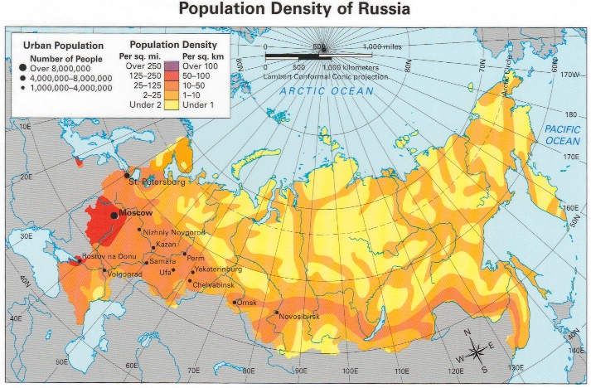
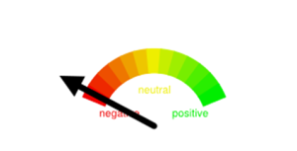
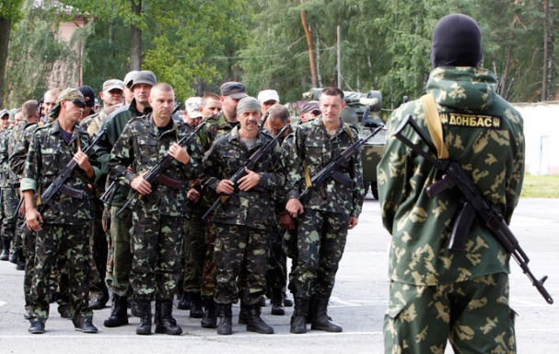
Project methodology
Spatial & Temporal Analysis
Sentiment Analysis
Text Mining
Objective
Southern US
Can military or intelligence precursors be identified through social media?
=
The Rest of US
Mapping Time
Volume
=
Time

Slide 13
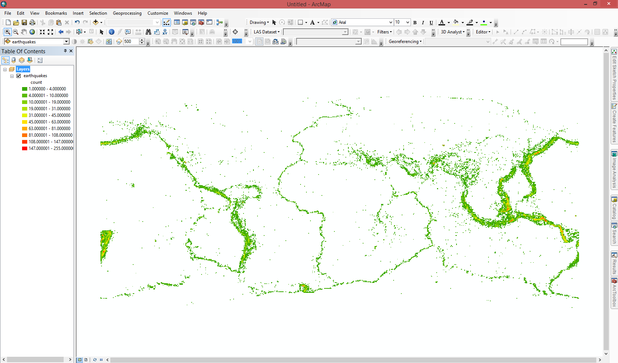
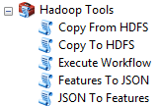
architecture

Slide 14
Anticipated results
Verify that social media data can be used as a tool to identify precursors for possible troop movements
Develop a solution that could be used on a larger scale

Slide 15
Ideal circumstances
Social Media Firehose for the entire country
Knowing the language
Linking open source data with other information
Fully-automated system

Slide 16
Open source benefits and challenges
Benefits
Information is provided freely without risk
Global picture of events
Multiple perspectives
User networks
Cultural insights
Challenges
“I do not speak Russian” ------ “Я не говорю по-русски”
Volume, Velocity and Variety of Social Media Data
Getting access to the right data
Filtering the relevant data
Deception
Don’t want to become CNN
Data price too high

Slide 17
Project timeline
August – September 15:
Setup processing environment
Acquire data
October-November 15:
Analyze Data
Develop findings
December15 or Spring 16:
Present results at conference TBD

Slide 18
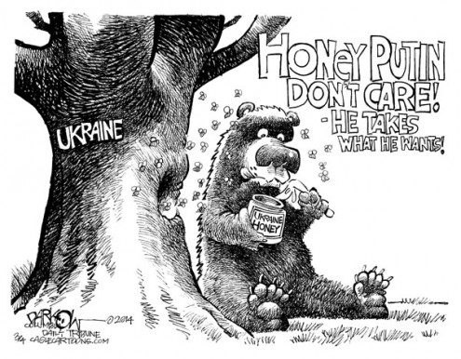
questions

Slide 19
References
Castillo, W., (2015). Air Force Intel uses ISIS ‘moron’ post to track fighters. Retrieved June 15, 2015 from http://www.cnn.com/2015/06/05/politics/air-force-isis-moron-twitter/
GNIP, (2015). Combing Location and Social Data. Retrieved June 14, 2015 from https://gnip.com/industries/geo/
Musolesi, M. & Rossi, L. (n.d.). It’s the Way you Check-in: Identifying Users in Location-Based Social Networks. Retrieved June 14, 2105 from http://www.ucl.ac.uk/~ucfamus/papers/cosn14.pdf
Pontes, T., Vasconcelos, M., Almeida, J., Kumaraguru, P., & Almeida, V. (n.d). We Know Where You Live: Privacy Characterization of Foursquare Behavior. Retrieved June 14, 2015 from http://homepages.dcc.ufmg.br/~marisav/lbsn.pdf
Szoldra, P., (2014). A Russian Soldier's Instagram Posts May Be The Clearest Indication Of Moscow's Involvement In East Ukraine. Retrieved on June 14, 2015 from http://www.businessinsider.com/russian-soldier-ukraine-2014-7
Thome, D., Bosch, H., Kruger, R., & Ertl, T. (n.d.). Using Large Scale Aggregated Knowledge for Social Media Location Discovery. Retrieved on June 14, 2015 from http://goo.gl/mIvIYp
http://blog.cloudera.com/blog/2012/09/analyzing-twitter-data-with-hadoop/
http://esri.github.io/gis-tools-for-hadoop/
https://www.iconfinder.com/icons/483480/foursquare_network_online_service_icon#size=128
http://blogs.denverpost.com/opinion-cartoons/2014/03/04/cartoons-day-russian-invasion-ukraine/42733/14/
http://www.1searchmarketing.com/services/business-intelligence/
http://www.jeffbullas.com/2015/04/08/33-social-media-facts-and-statistics-you-should-know-in-2015/
http://www.russiansearchtips.com/category/social-media-in-russia/
http://www.businessinsider.com/putin-russias-military-strength-is-unmatchable-2015-2
https://en.wikipedia.org/wiki/Demographics_of_Russia
https://dl.dropboxusercontent.com/content_link/OAOemtkNQY3o8C2CdSTngxRNHwA2eJn9FxuzZH1vFRCbcOyFcBGdKJoHksjzYxnA
http://blog.journals.cambridge.org/2013/05/talking-tweets-sentiment-analysis-in-twitter/
https://analyticsuspicions.files.wordpress.com/2013/02/college-savings-payment-tweets-sentiment-analysis.png?w=300&h=153

