Slide 1
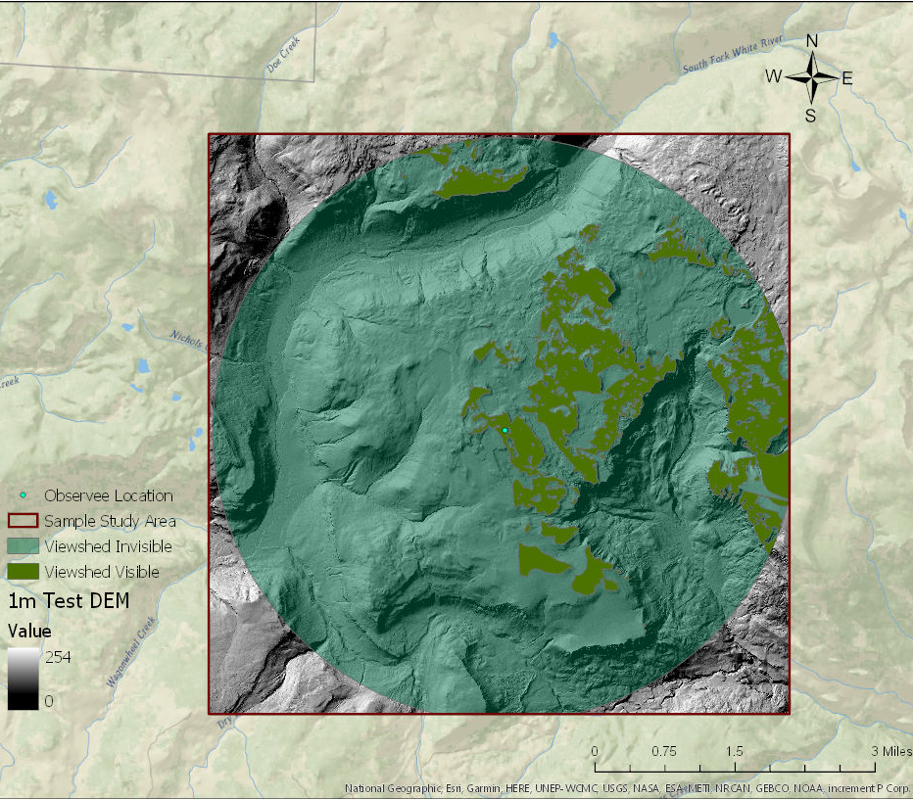
DEM Resolution Effects on Visibility
By: Kimberly Quirk

Slide 2
Outline
Background
What is Viewshed Analysis
Why Does Resolution Matter
The Challenge of Defining Terrain Groupings
Study Requirements
Objectives
Optimal Study Environment
Study Parameters
Workflow
Viewshed Analysis Pilot Results
Viewshed Pilot Results
Resolution Change Pilot Results

Slide 3
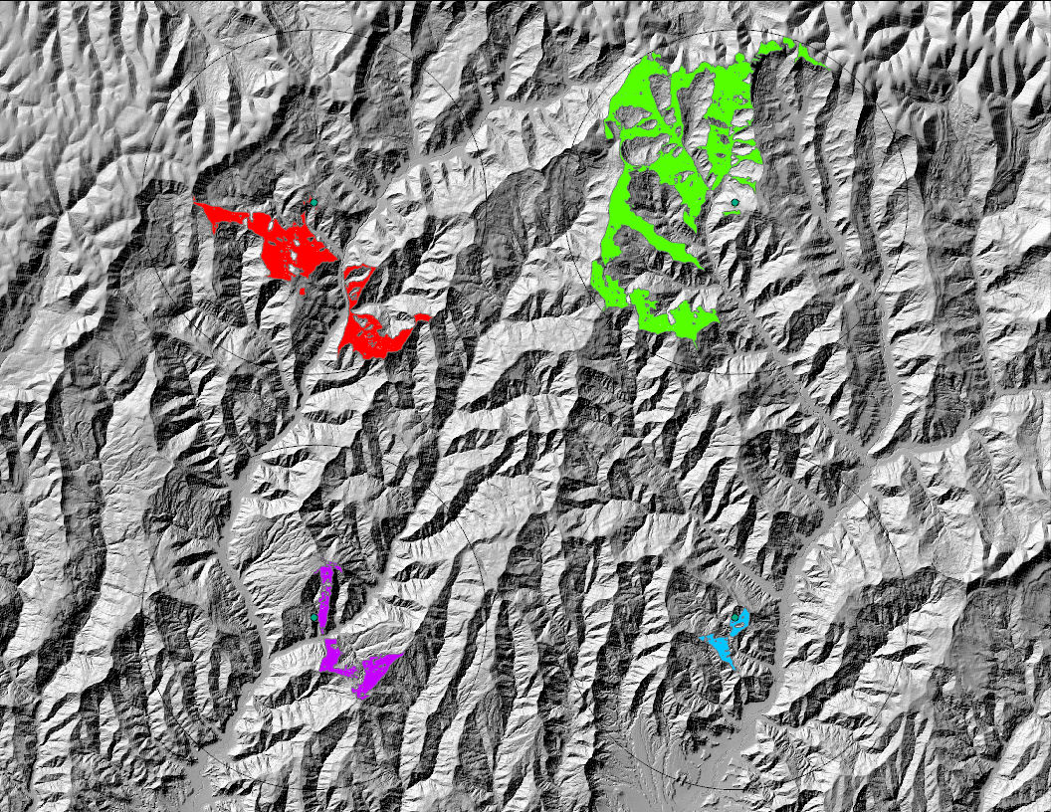
What is Viewshed Analysis?
Typically shows two results: visible or not visible (Miller, 2011)
Usually use Bare-Earth DEMS (Miller, 2011)
Unlike many viewshed analysis methodologies, this study does not look for the ideal placement for Observee (highest place with the best view)
This analysis uses the terrain based on point location instead of ideal locations

Slide 4
Why Does Resolution Matter?
1:3,000
1m Resolution
10m Resolution
30m Resolution
90m Resolution
Individual cell (pixel) size shrinks as resolution improves
Viewshed Analysis determines visibility at the cell level

Slide 5
The Challenge of Defining Terrain Groupings
Hammond, 1954. Reproduced here for educational purposes only.
Mountains, plains, and hills fit into several groups.

Slide 6
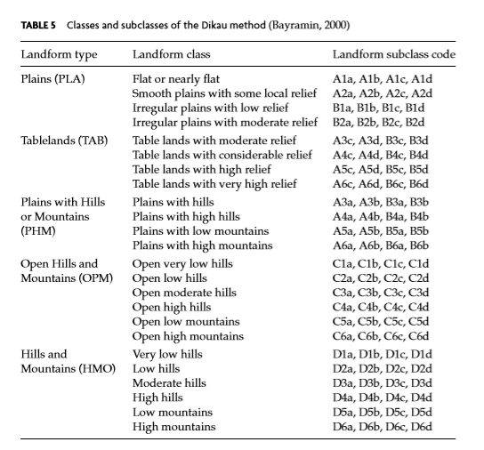
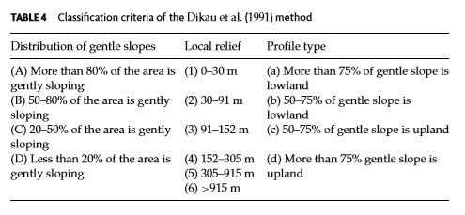
Additional Terrain Grouping Challenges
MacMillan and Shary, 2008. Reproduced here for educational purposes only. Dikau et. al. introduce elevation to further break down these classes.

Slide 7
Objective
To understand the effects of a DEM’s resolution on viewshed analysis:
How will visibility change as a DEM’s resolution changes?
Ex: Will higher resolutions reveal different pockets of visibility / invisibility than courser data?
Will patterns of visibility / invisibility be consistent across terrain types?
Ex: Will a higher resolution DEM change visibility, regardless of if the terrain is mountainous or flat?

Slide 8
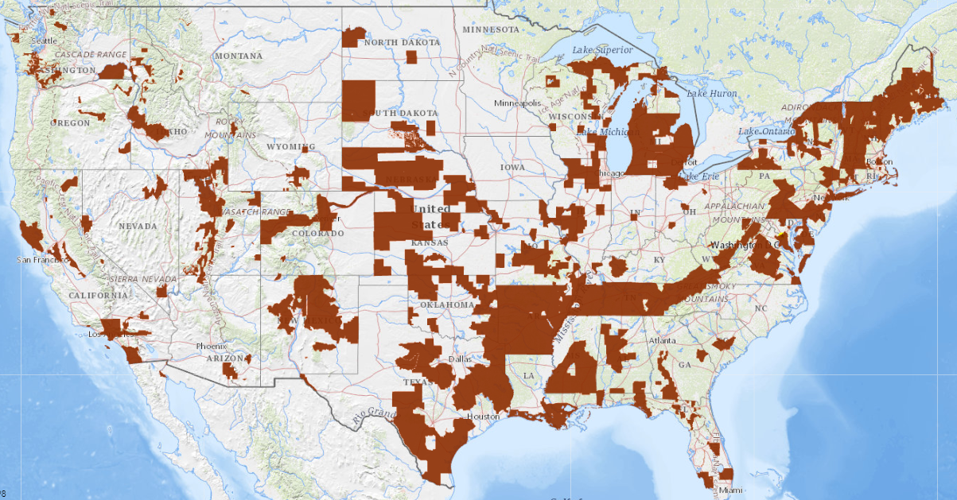
Optimal Study Items
Test several resolutions across a broad spectrum
Use the 1m DEM to determine study areas for all resolutions
Test several terrains to check for patterns
Test several regions within the United States to confirm consistency and best capture the various characteristics of terrain types
USGS National Map: Areas with 1m DEMs: https://viewer.nationalmap.gov/advanced-viewer/

Slide 9
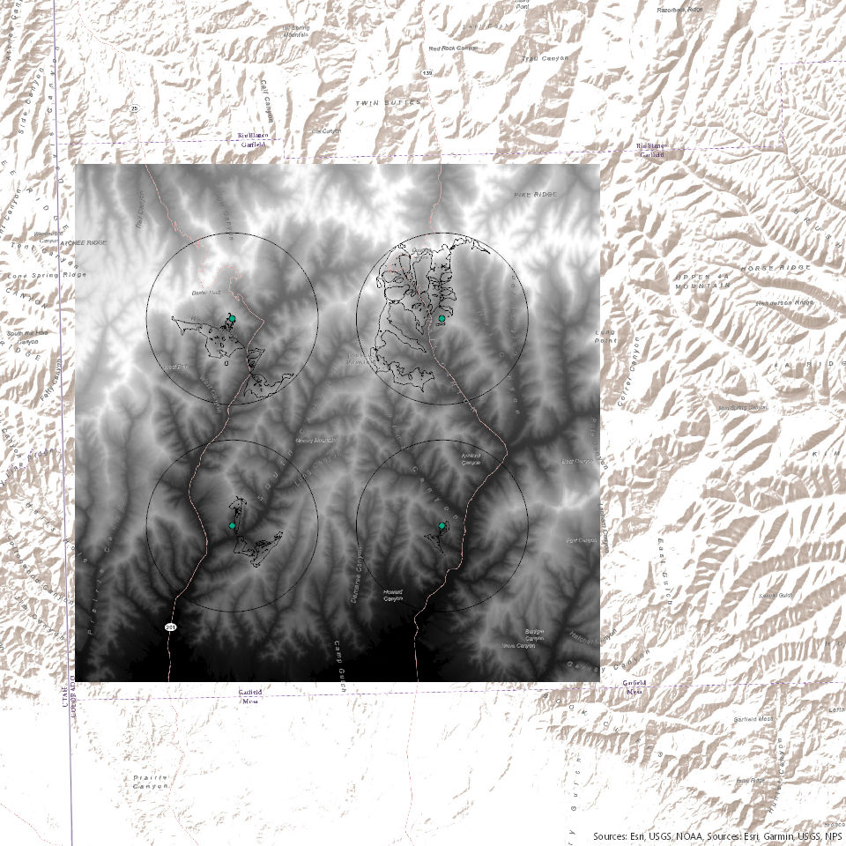
Viewshed Parameters
The Viewshed:
360 degrees per point
5km radius
4 Points
Do not overlap
30km X 30km Study Area

Slide 10
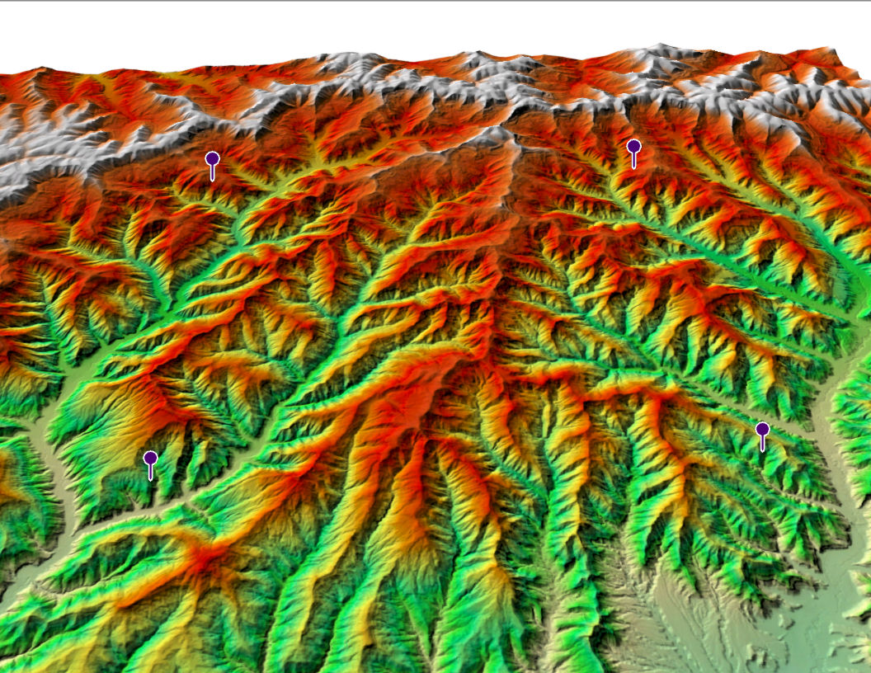
Stratified Sampling
Areas will be grouped into different terrain types
Must have continuous 1m data for a 30 km X 30 km box
Areas may look continuous at this scale, but may still have holes
4 Points are evenly distributed in sample area to prevent overlaps
USGS 1m DEM Index: https://www.usgs.gov/core-science-systems/ngp/3dep/3dep-product-metadata

Slide 11
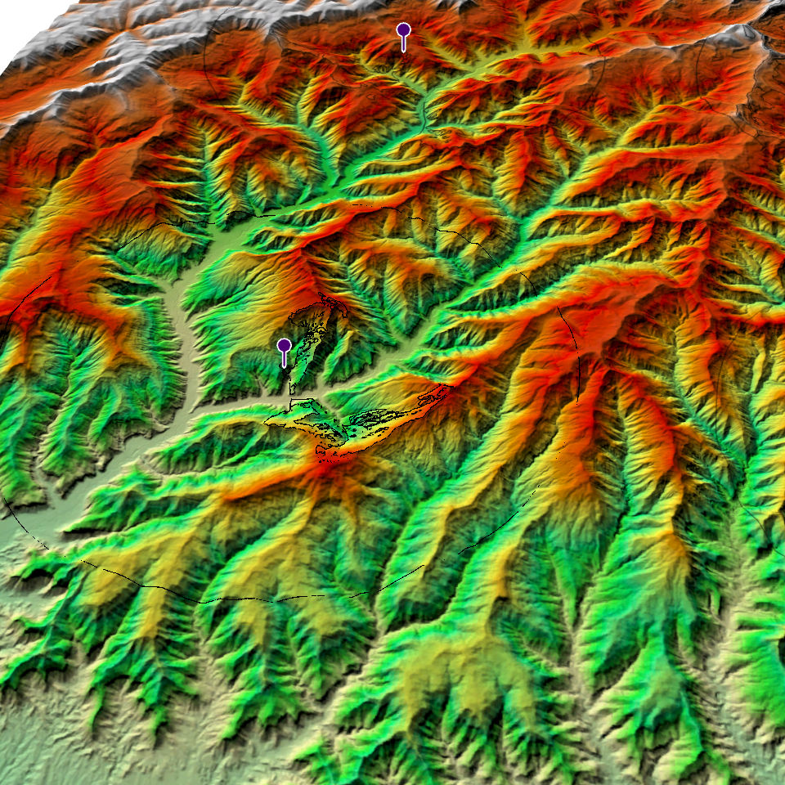
West Colorado Study Area

Slide 12
Workflow
Collect DEMs: USGS and CGIAR-CSI
1m, 10m, 30m, and 90m (STRM) DEMs
Check for Quality
Use ArcPro to visually scan the area
Create a hillshade to show the quality of the DEM
Insert four-point feature class that will be the observee points
Clip to study area square and project to appropriate UTM
If Needed: convert from IMG to TIF and Mosaic tiles
Preprocess Data
Run the Viewshed Tool
Use two observee heights: .5m and 1.71m
Create Visibility Viewsheds
Analyze the Data and Collect Results

Slide 13
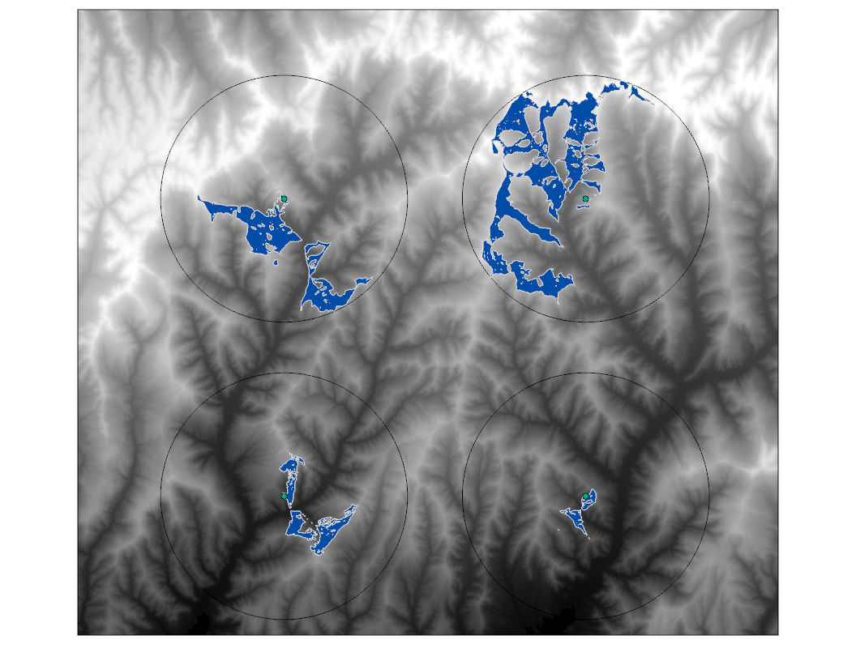
1m Standing
1m Laying

Slide 14
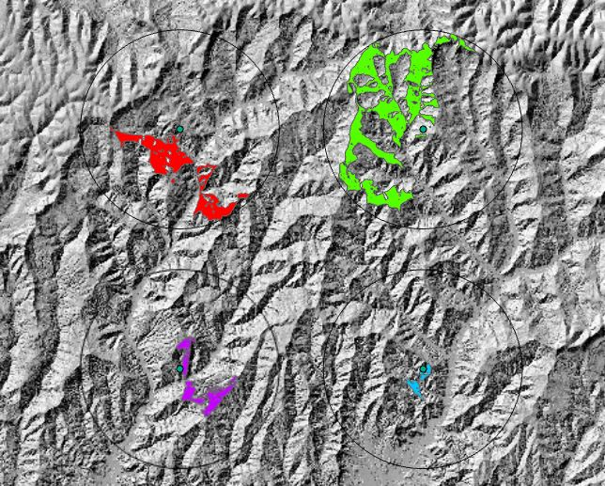
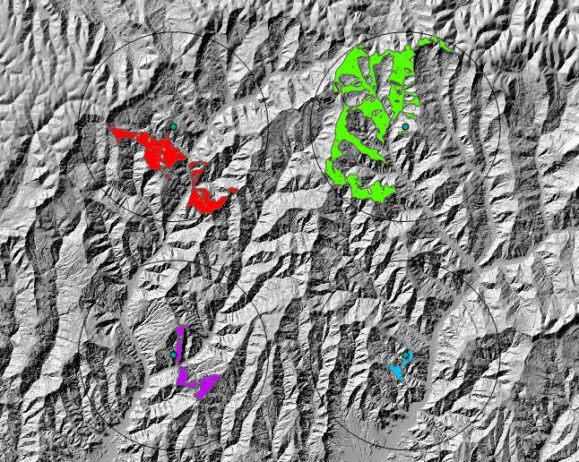
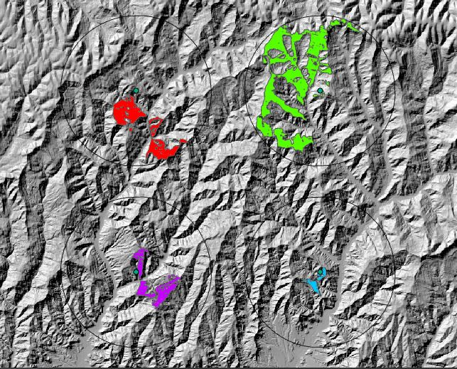
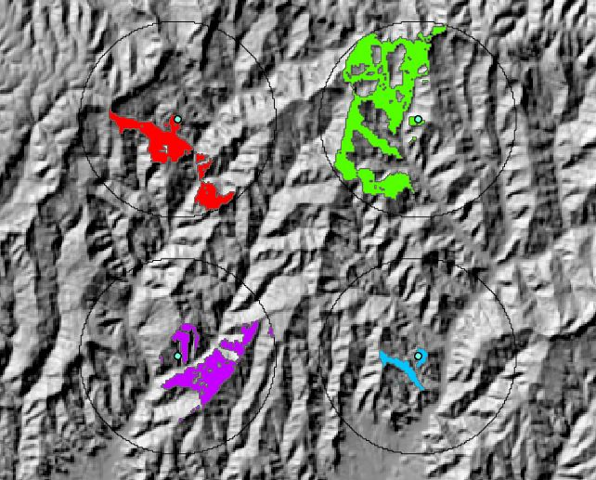
Pilot Viewshed Analysis
1m Standing
10m Standing
30m Standing
90m Standing

Slide 15
Pilot Viewshed Analysis
Viewshed Results
Viewshed Resolution Changes

Slide 16
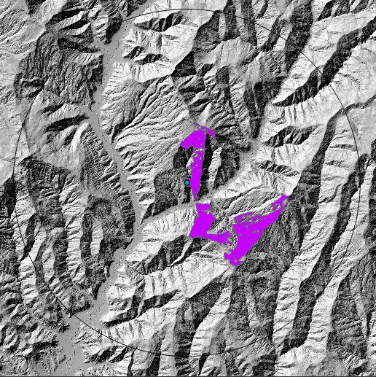
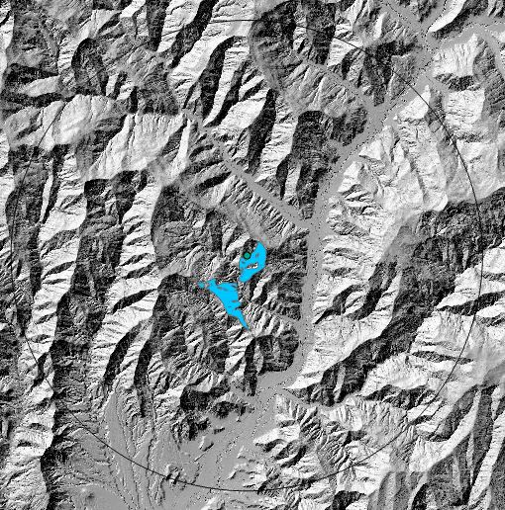
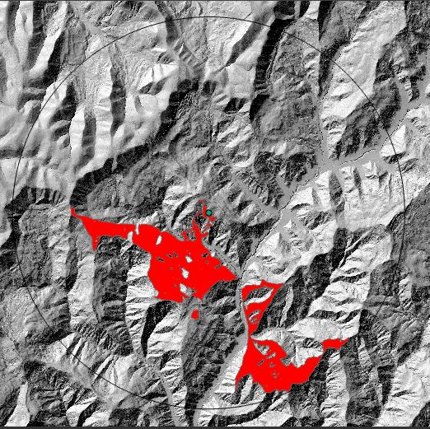
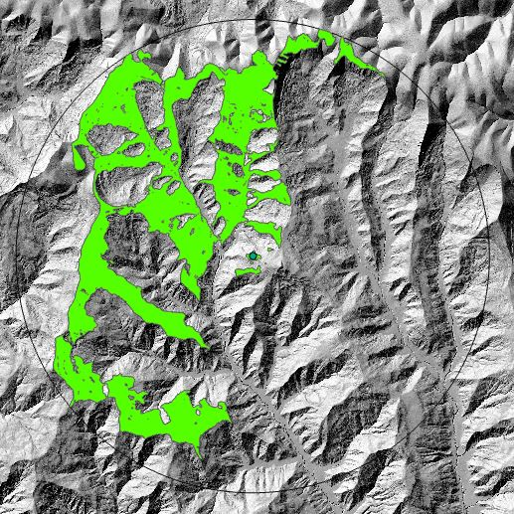
1m Results
Pt 1
Pt 2
Pt 3
Pt 4

Slide 17
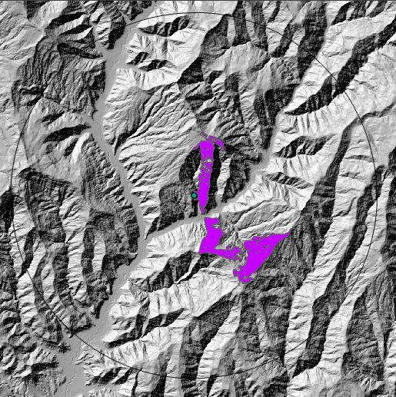
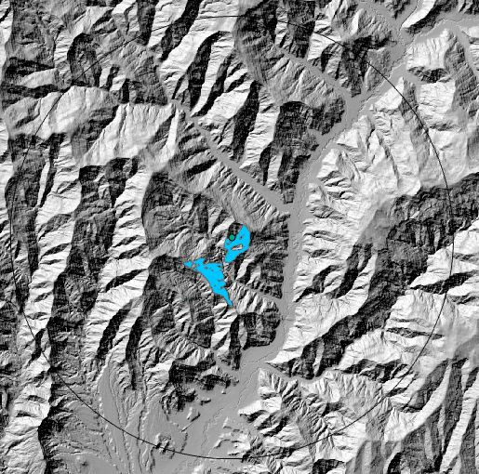
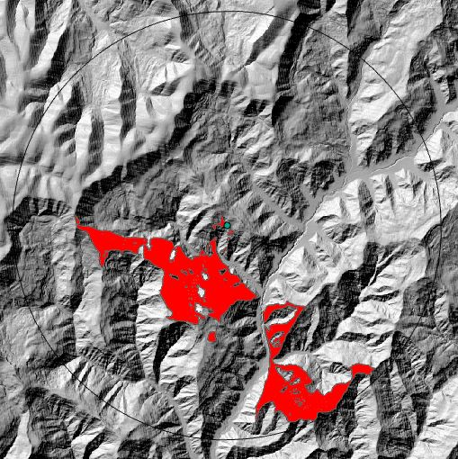
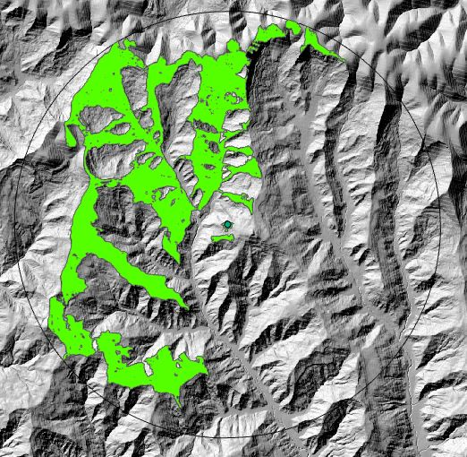
10m Results
Pt 1
Pt 2
Pt 3
Pt 4

Slide 18
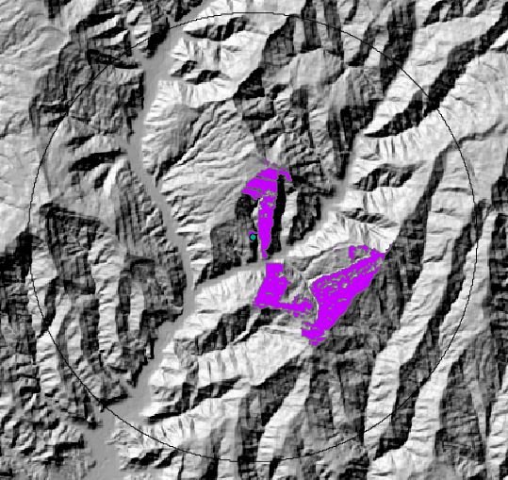
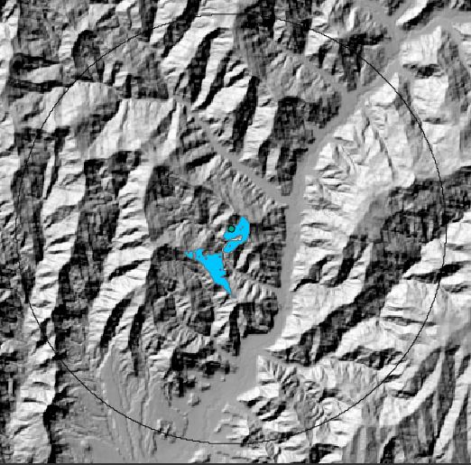
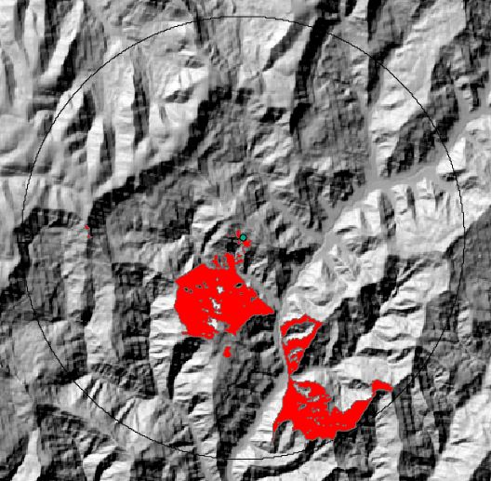
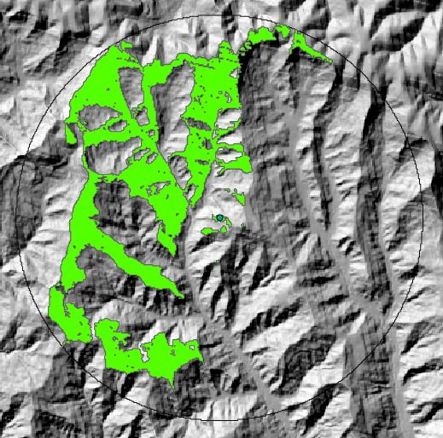
30m Results
Pt 1
Pt 2
Pt 3
Pt 4

Slide 19
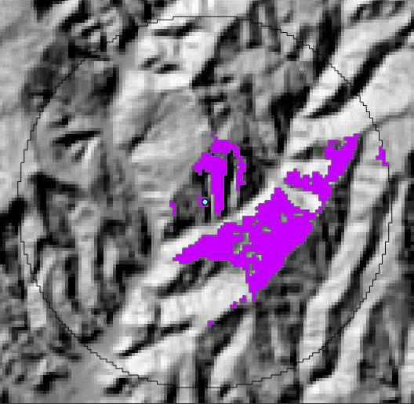
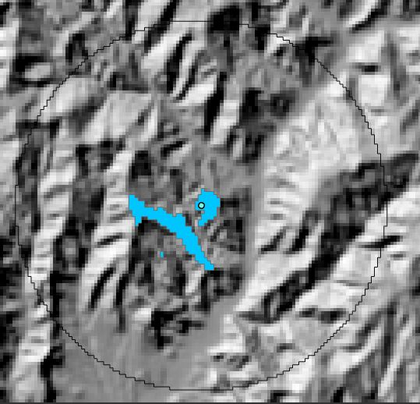
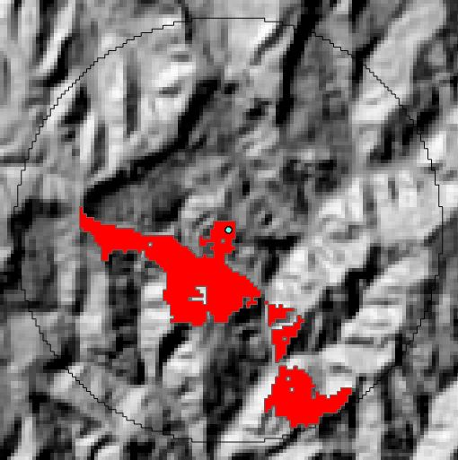
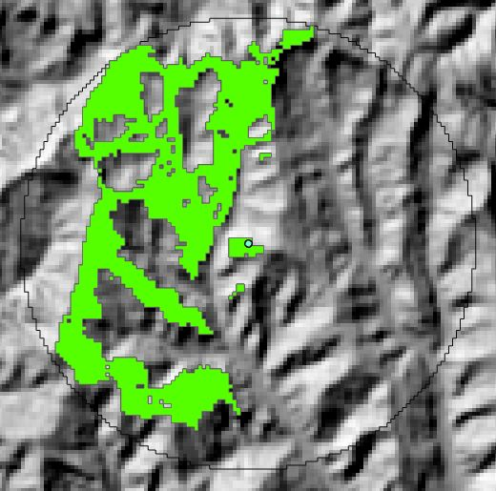
90m Results
Pt 1
Pt 2
Pt 3
Pt 4

Slide 20
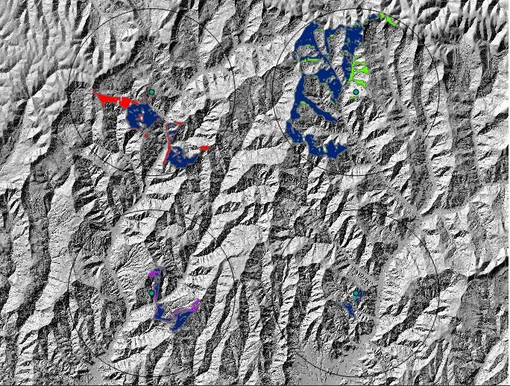
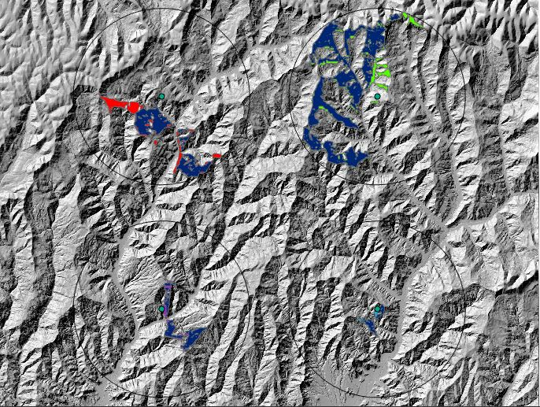
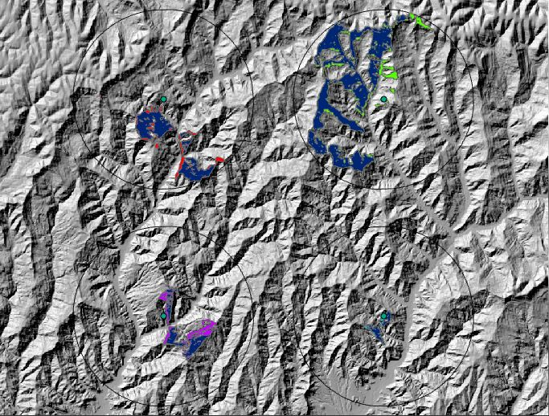
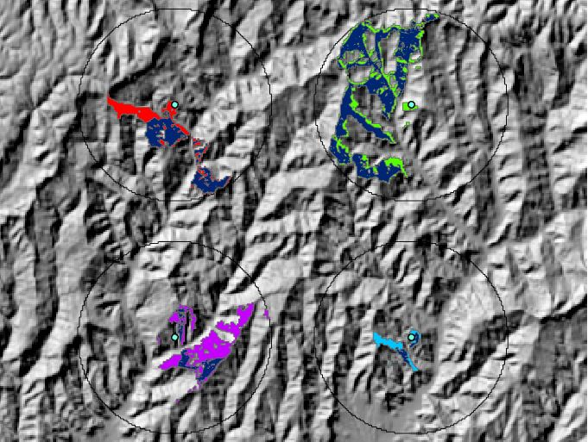
The Changes
1m
10m
*Blue indicates areas captured on all resolution
30m
90m

Slide 21
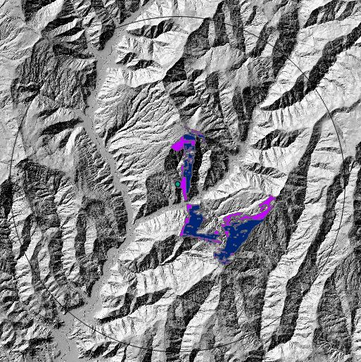
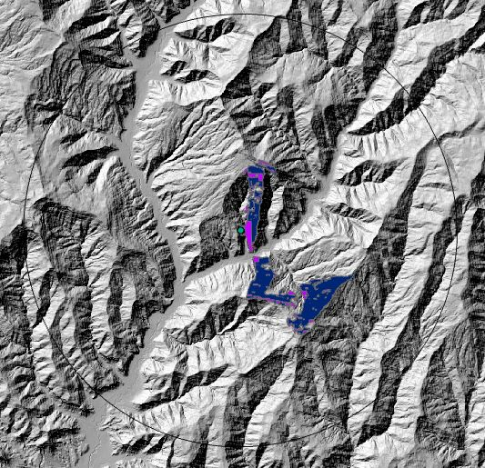
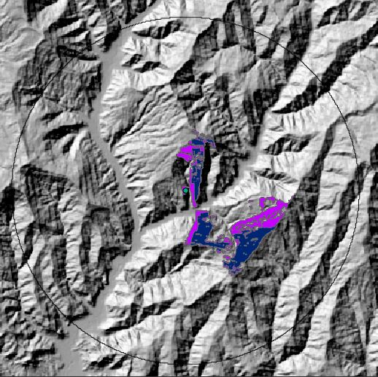
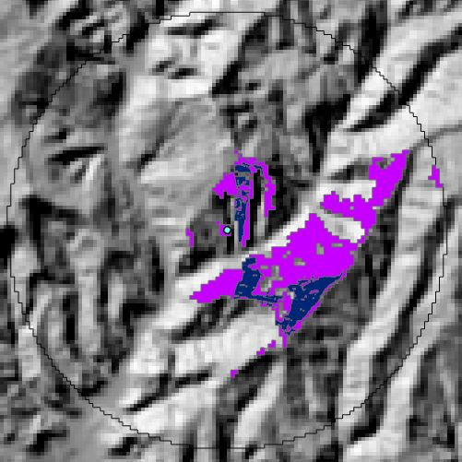
Point 1 Change
1m
10m
*Blue indicates areas captured on all resolution
30m
90m

Slide 22
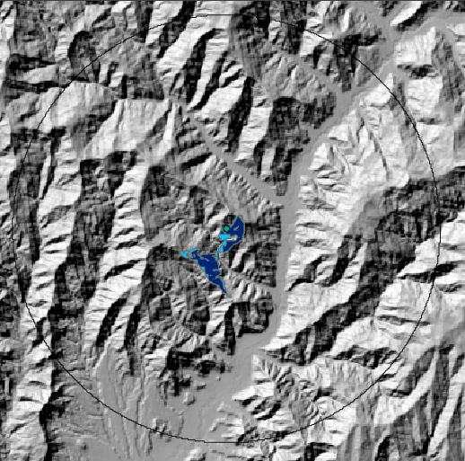
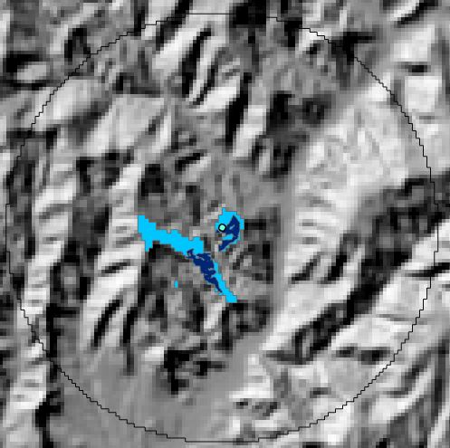
Point 2 Change
1m
10m
*Blue indicates areas captured on all resolution
30m
90m

Slide 23
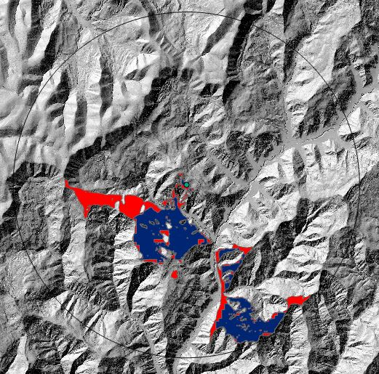
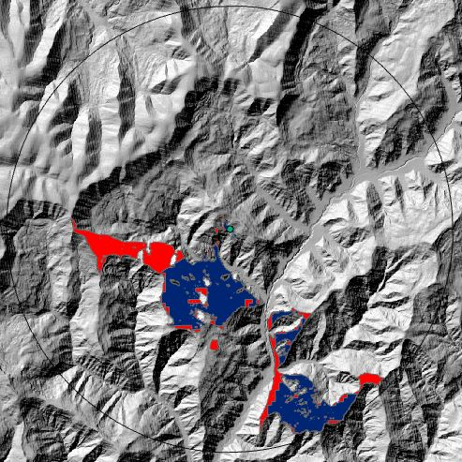
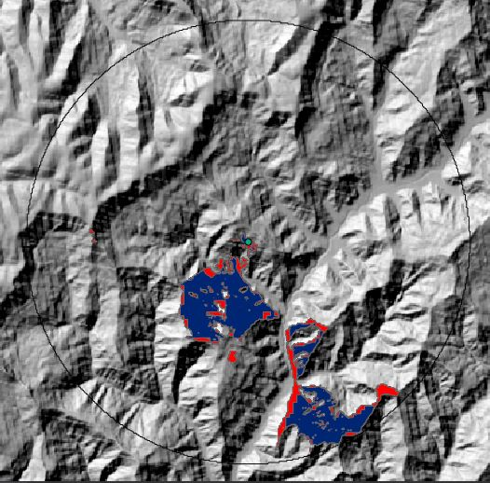
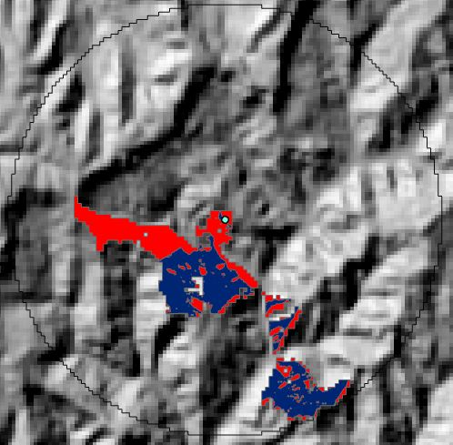
Point 3 Change
1m
10m
*Blue indicates areas captured on all resolution
30m
90m

Slide 24
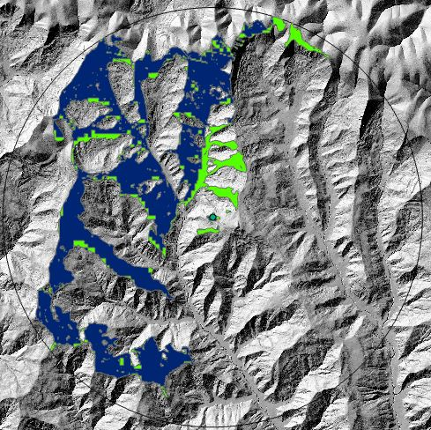
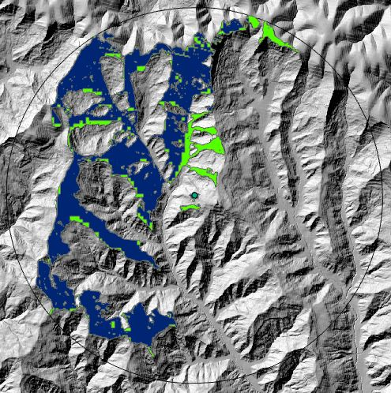
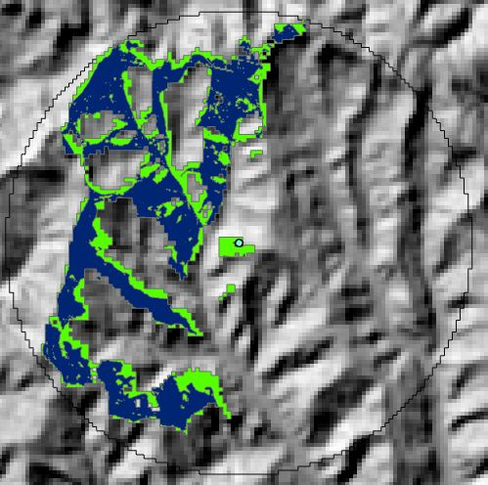
Point 4 Change
1m
10m
*Blue indicates areas captured on all resolution
30m
90m

Slide 25
Project Timeline
Final determination of terrain types to be used, sample locations, and number of samples
Prepare DEMs for the tool.
Create Study’s rectangle
Create the Individual Viewsheds
Complete Slides and Prep to Brief
Submit Final Report
December
January
February
March
May
January
Late January
February
April
Download DEM Data and perform visual checks and hillshade DEMs
Run DEMs through the tool
Analyze Results
Present at Mountain Cartography Workshop - ICA

Slide 26
References
Hammond, Edwin H. (1954). Small-Scale Continental Landform Maps. Annals of the
Association of American Geographers, 44(1), 3-42. https://www.jstor.org/stable/2561113
MacMillan, R. A. and Shary, P.A. (2008). Chapter 9 Landforms and Landform Elements
in Geomorphometry. Developments in Soil Science, 33, 227-254. https://doi.org/10.1016/S0166-2481(08)00009-3
Miller, Matthew L. (2011). Analysis of Viewshed Accuracy with Variable Resolution
LiDAR Digital Surface Models, and Photogrammetrically-Derived Digital Elevation Models. Virginia Polytechnic Institute and State University. https://pdfs.semanticscholar.org/d6c8/67904dfff3a50b3e709640fee0e052f766b5.pdf
Thelin, Gail P. and Pike, Richard J. (1991). Landforms of the Conterminous United
States—A Digital Shaded-Relief Portrayal. U.S. Department of the Interior U.S. Geological Survey. https://pubs.usgs.gov/imap/i2206/i2206_pamphlet.pdf
Thompson, James, Bell, Jay, and Butler, Charles (2001). Digital elevation model
resolution: effects on terrain attribute calculation and quantitative soil-landscape modeling. Geoderma, 100(1-2), 67-89. DOI: 10.1016/S0016-7061(00)00081-1

