Slide 1
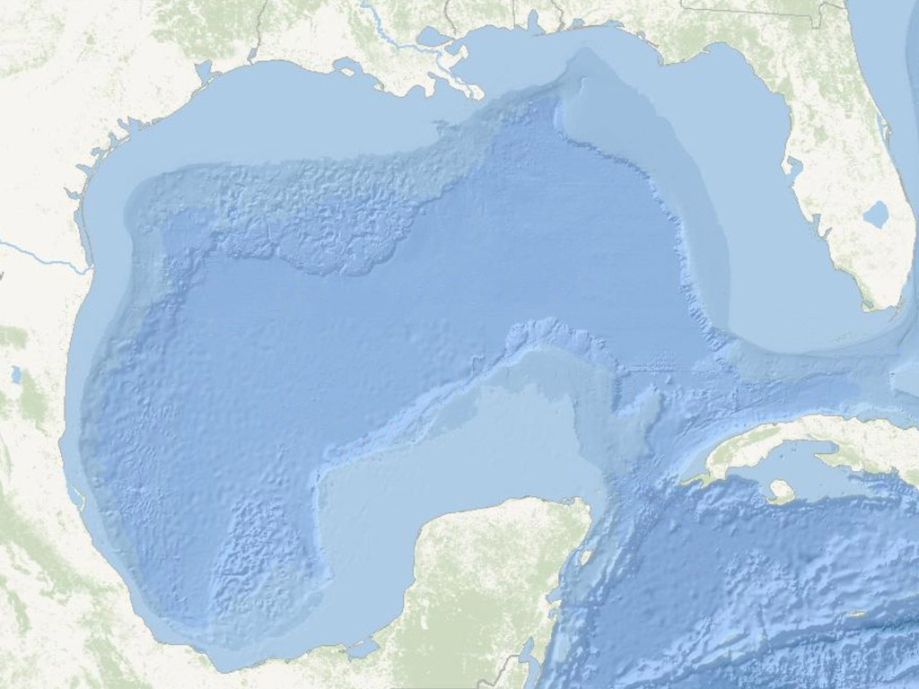
Changes in Abundance of Groundfish Species in the Northern Gulf of Mexico
Jeff Rester
Capstone Project
Master’s of Geographic Information Systems
Pennsylvania State University
September 20, 2011
Advisor: Dr. Frank Hardisty
Notes:
For my Capstone Project, I examined historical distributions of four fish species to see if they had changed over the past 25 years due to changes in the shrimp fishery and fishery management practices. An outline of my project is that I used fishery independent data to examine species’ distributions, compared the distributions between two time periods, and examined fish lengths to see if the size structure in the fish population had changed.

Slide 2
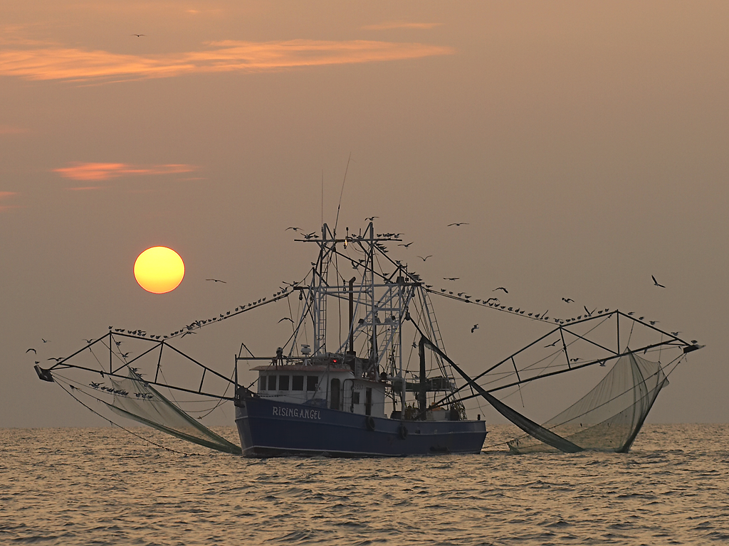
The U.S. shrimp fishery targets shrimp across a large portion of the continental shelf in the northern Gulf of Mexico. The fishery is one of the largest and most valuable in the U.S. with approximately 249 million pounds of shrimp caught in the Gulf of Mexico in 2009 with a dockside value of over $325 million.
Notes:
The U.S. shrimp fishery targets shrimp across a large portion of the continental shelf in the northern Gulf of Mexico. The fishery is one of the largest and most valuable in the U.S. with approximately 249 million pounds of shrimp caught in the Gulf of Mexico in 2009 with a dockside value of over $325 million.

Slide 3
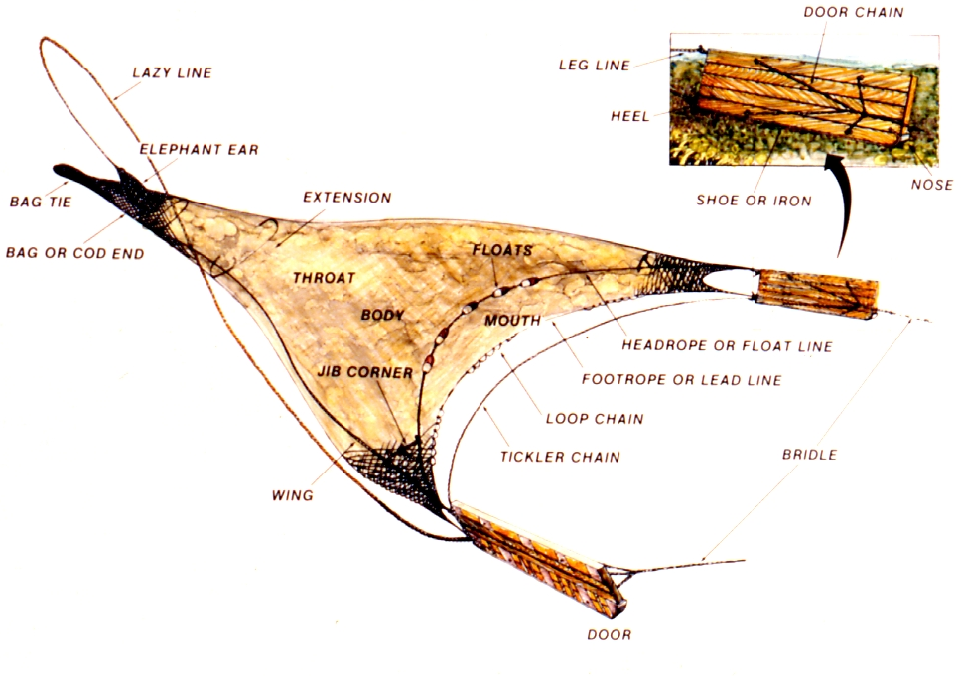
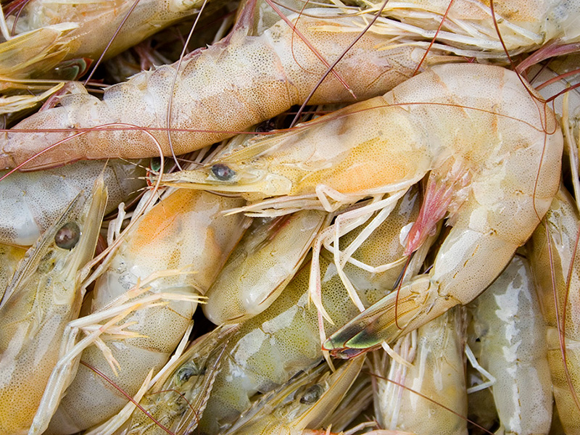
Shrimp Fishery
Shrimp are captured using otter trawls towed on the bottom. These trawls capture other demersal organisms and approximately 4.5 kg of bycatch are caught for every 1 kg of shrimp.
Otter Trawl
Notes:
Shrimp are captured using otter trawls towed on the bottom. Shrimpers use single, double or quad rigged trawls towed behind their vessels. These trawls capture other demersal organisms and current bycatch estimates are that approximately 4.5 kg of bycatch are caught for every 1 kg of shrimp. Bycatch estimates can vary seasonally and geographically across the Gulf of Mexico. Historical bycatch estimates have been as high as 10 kg of bycatch for every 1 kg of shrimp caught.

Slide 4
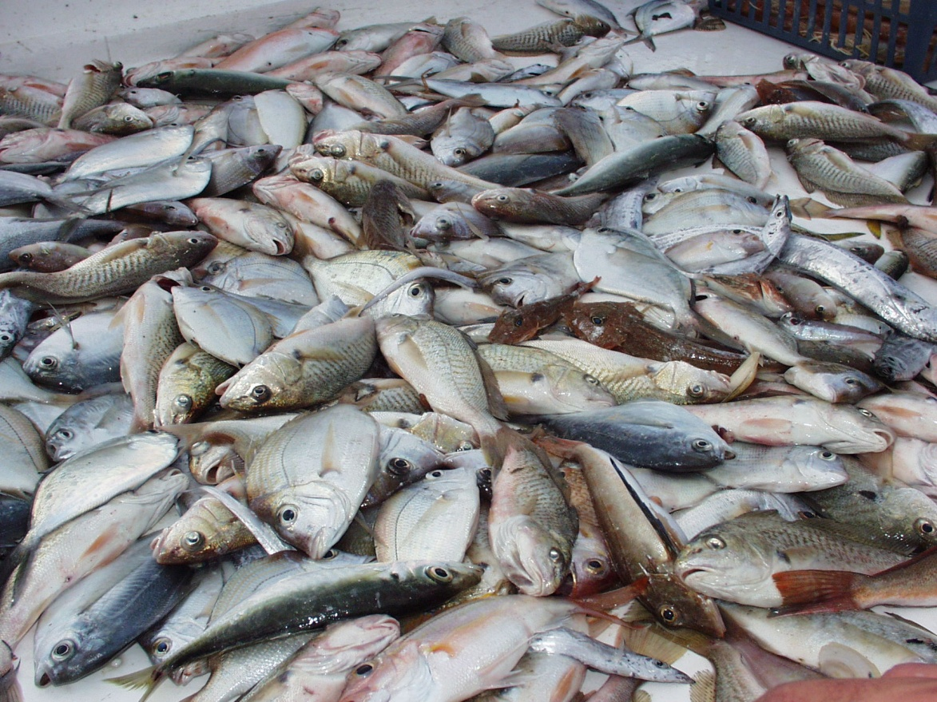
Bycatch
Bycatch are the unintended fish, invertebrates, and other organisms that are caught along with the targeted shrimp. Much of the bycatch caught in the shrimp fishery is usually returned to the
water dead.
Four fish species
compose
approximately 75%
of the shrimp
trawl bycatch.
Notes:
Bycatch are the unintended fish, invertebrates, and other organisms that are caught along with the targeted shrimp. Much of the bycatch caught in the shrimp fishery is usually returned to the water dead.
The four species I will examine (Atlantic croaker, spot, silver seatrout, and sand seatrout) compose approximately 75% of the shrimp trawl bycatch.

Slide 5
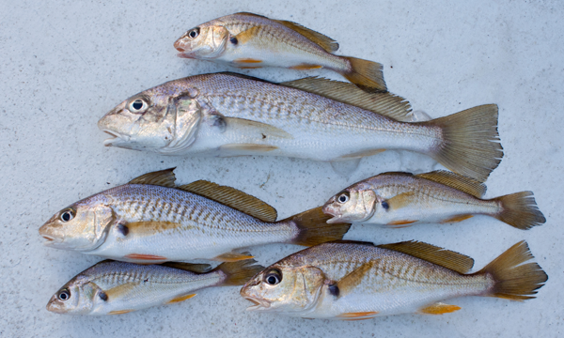
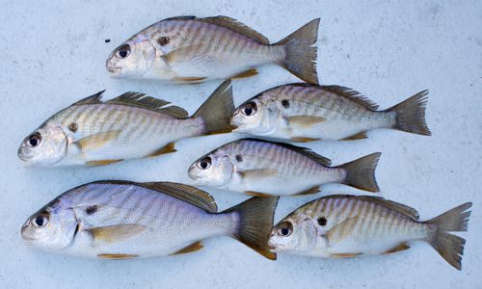
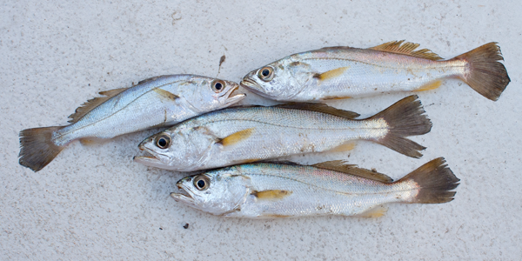
Groundfish Species
Notes:
These groundfish species all belong to the drum family, Sciaenidae, and have similar life histories. The Atlantic croaker in the upper left is the most abundant fish in the shrimp bycatch. Spot are very similar to Atlantic croaker. Sand seatrout and silver seatrout look very similar and the only definitive way to tell them apart is the number of rays in their anal fins. Sand seatrout tolerate freshwater more than silver seatrout and are found within estuaries while silver seatrout are not found in estuaries and prefer saltier water.

Slide 6
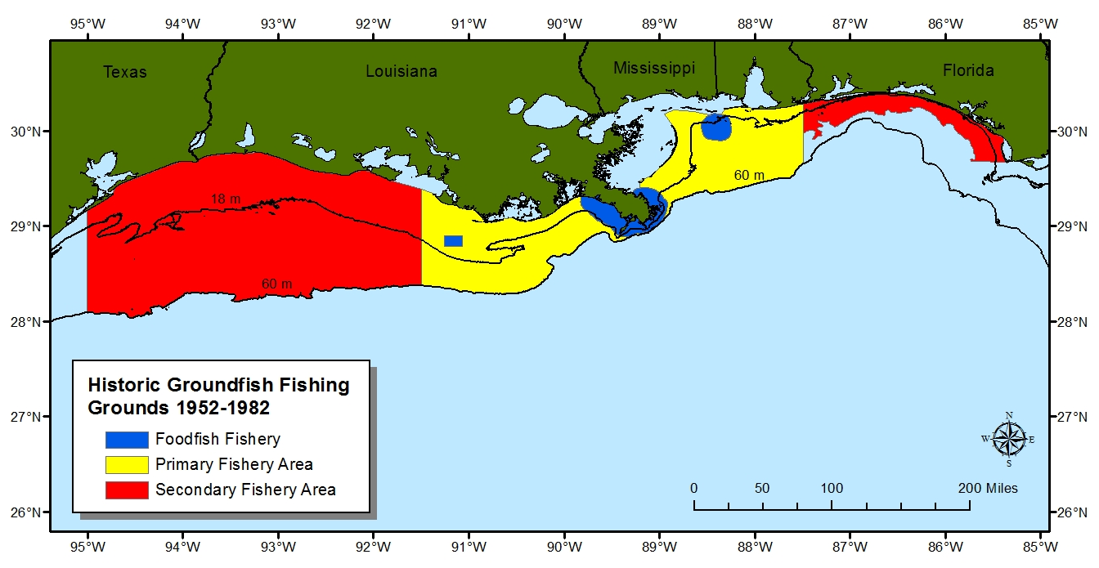
Groundfish Fishery
Notes:
Besides bycatch, groundfish have been affected by a directed industrial fishery and a foodfish fishery. The industrial fishery began using shrimp trawl bycatch for pet food in 1952. After a few years, boats began directly targeting groundfish. The foodfish fishery began in 1967 and targeted larger, adult Atlantic croaker that were sold whole. The foodfish fishery ceased in the late 1970s due to a variety of economic factors as well as declining catch per unit effort of adult fish. The industrial fishery ceased around 1982. Landings in the groundfish fishery peaked in 1974 at approximately 48,000 metric tons. This paled in comparison to the amount of bycatch captured by the shrimp fishery in the 1970s which was estimated at approximately 300,000 mt of groundfish in the primary fishery area alone.

Slide 7
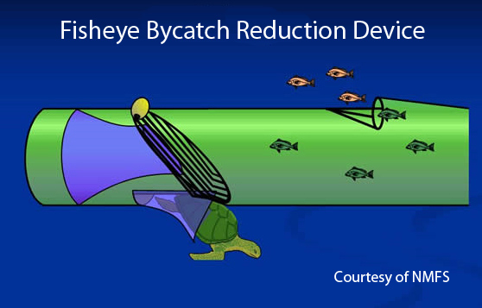
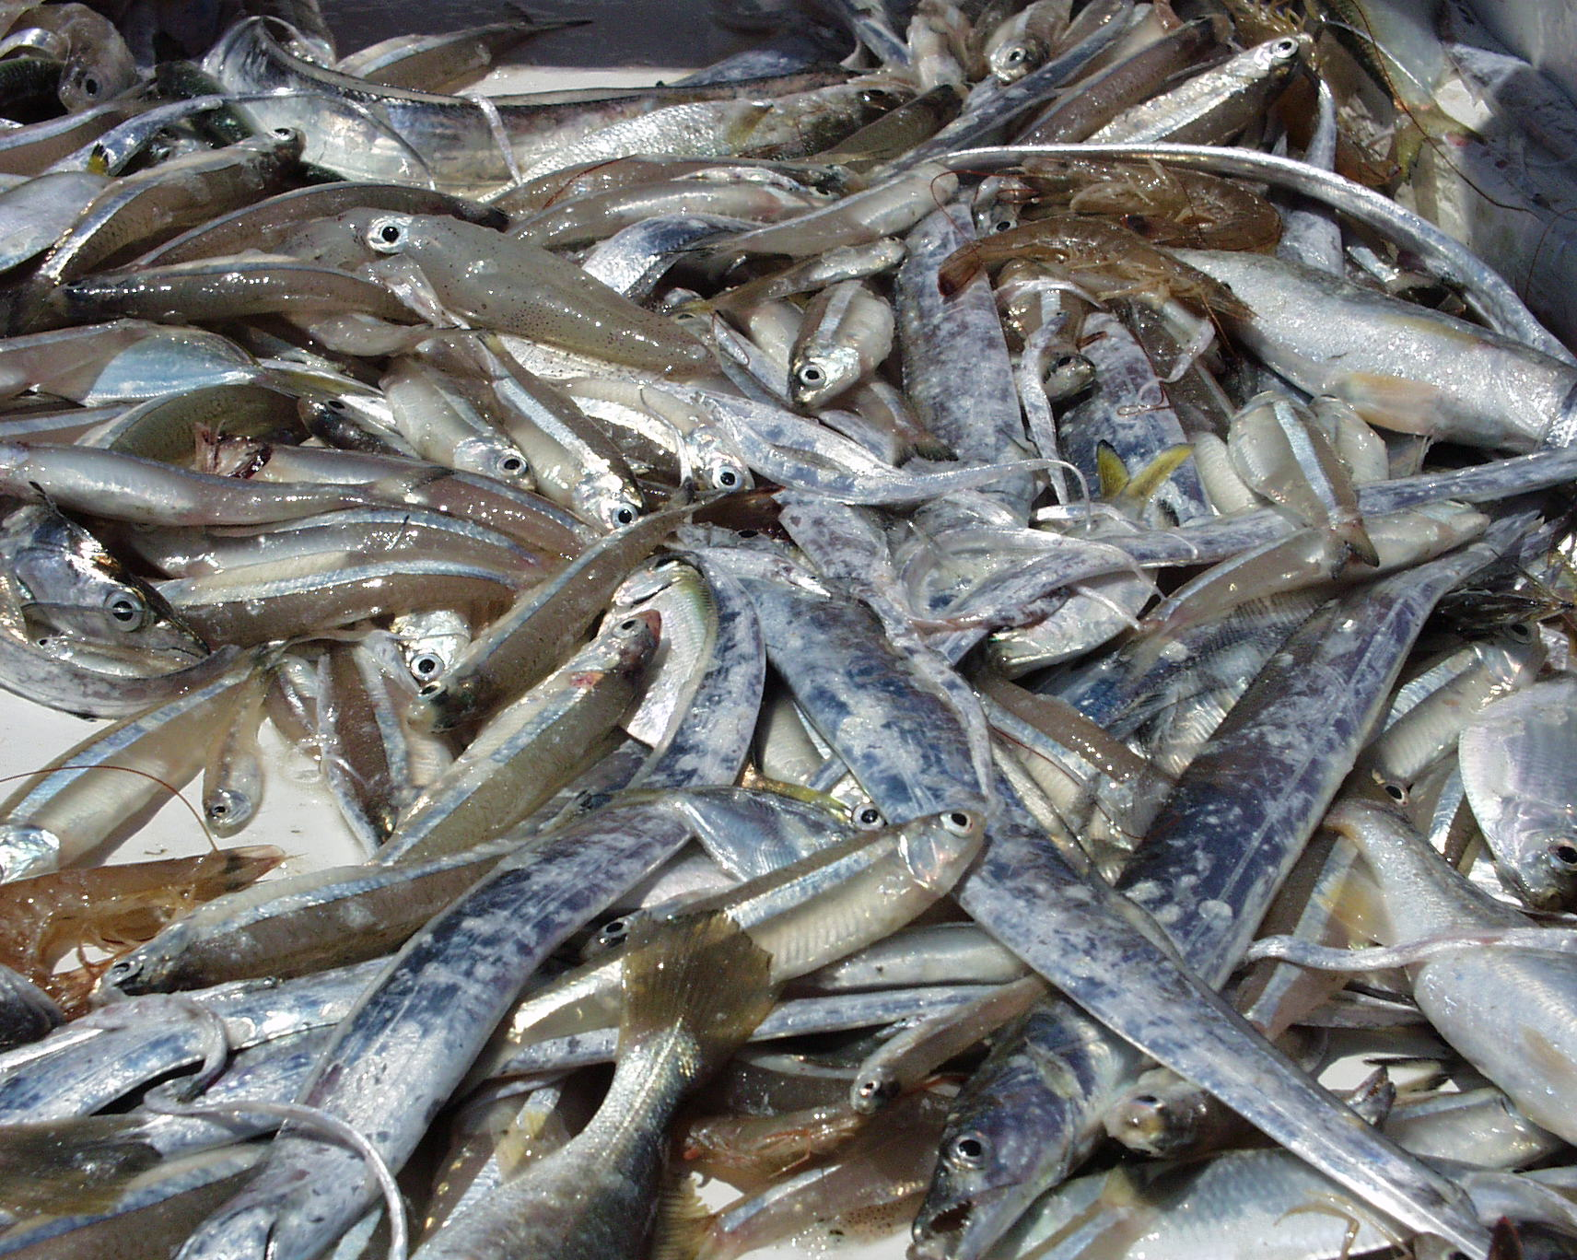
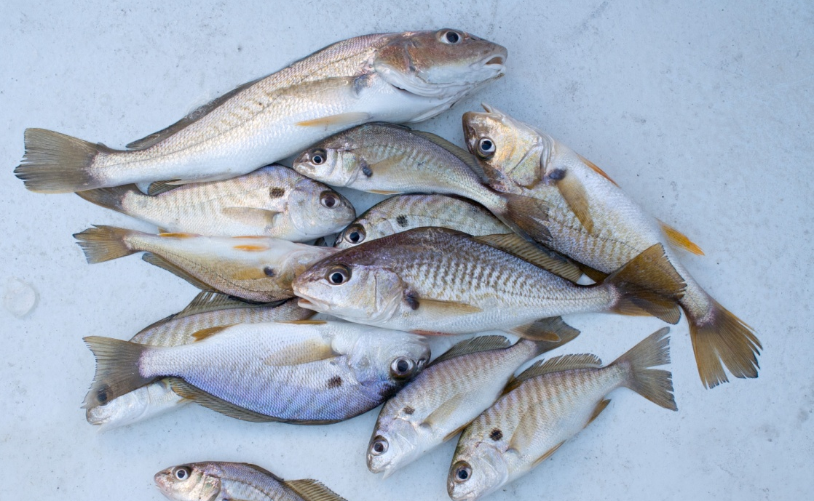
Bycatch Reduction Devices
Notes:
While the directed groundfish fishery ceased operations in the early 1980s, bycatch continued to be a problem for the shrimp fishery. In order to alleviate the bycatch problem, fishery managers developed bycatch reduction devices that allowed fish to escape the trawls while still retaining the shrimp. In 1998, regulations required that shrimp vessels operating in federal waters of the Gulf of Mexico must use bycatch reduction devices (BRDs) in their nets to reduce the amount of finfish bycatch that they capture while trawling.
Explain BRD.
Original BRD regulations called for a 40% reduction in finfish bycatch. The amount of bycatch reduction varies from species to species. While the efficiency of BRDs in releasing finfish from the net is less than 40%, a significant number of fish are now released alive.

Slide 8
Notes:
A dramatic decline in shrimping effort and the number of fishermen participating in the fishery has occurred since 2002. Imported shrimp, rising fuel costs, and several active hurricane seasons have taken their toll on the Gulf of Mexico shrimp fishery. The number of days fished has decreased approximately 60% since 2002.

Slide 9
Objectives
Examine catch per unit effort (number per hour) data from a fishery independent survey from 1987 to 1998 and 1999 to 2009 to determine if abundance levels have changed since the implementation of bycatch reduction devices.
Examine the spatial variation between the periods to determine if and where changes have occurred.
Use species length data to compare average sizes in various areas between the two periods to see if the fish are larger or smaller.
Notes:
The cessation of the directed groundfish fishery in the early 1980s, the requirement of bycatch reduction devices in all shrimp trawls in 1998, and the decrease in shrimping effort by 60% have had some type of unknown effect on groundfish populations in the Gulf of Mexico.
The objectives of this project were to examine catch per unit effort (number per hour) data from a fishery independent survey with 1987 to 1998 representing an early period and 1999 to 2009 representing a late period to determine if abundance levels have changed since the implementation of BRDs.
I also wanted to examine the spatial variation between the periods to determine if and where changes have occurred.
I used species length data to compare average sizes in various areas between the two periods to see if the fish were larger or smaller. Since fish continue to grow as they age, the fish length frequency data will show if fish are surviving to an older age.

Slide 10
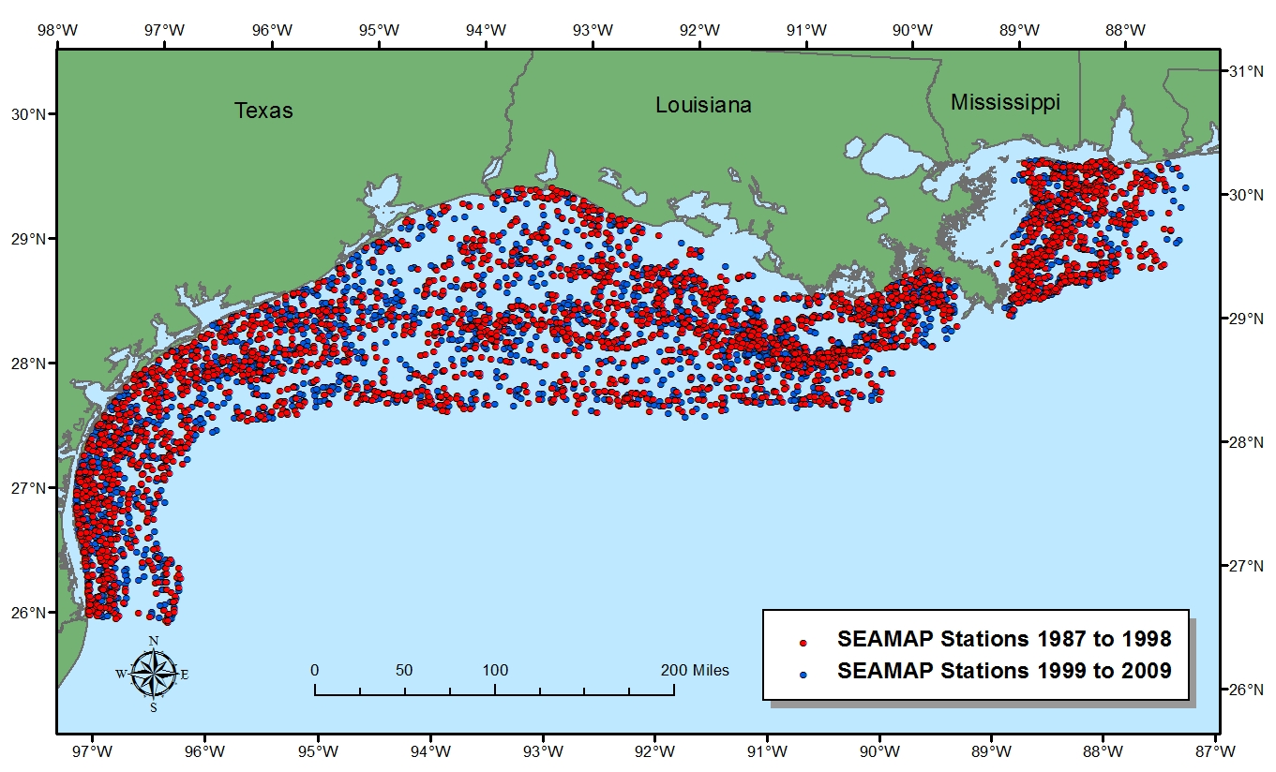
SEAMAP Station Locations
Notes:
I used catch data from the Southeast Area Monitoring and Assessment Program’s (SEAMAP) Summer Shrimp/Groundfish Survey (Survey). The Survey is a standardized fishery independent data collection survey that has taken place annually since 1982. Techniques were modified slightly during the first few years of the Survey, but the methods have not changed since 1987. The sampling involves day/night sampling at sites chosen randomly in areas stratified by depth and area. A 13.1 m trawl net is used to sample shrimp and demersal finfish. All species of fish and invertebrates caught in the trawl are identified to species, enumerated, and weighed. Lengths of up to 25 individuals of every species are also measured at each station. Approximately 300 to 400 trawl samples are conducted annually in waters from 10 to 100 m from Mobile Bay, Alabama to Brownsville, Texas. To avoid potential sources of uncertainty, the survey is conducted during June and July each year using standardized survey design, techniques, gear, and vessels.
The 1987 to 1998 time period contained 3,076 stations. The 1999 to 2009 time period contained 2,557 stations.
Atlantic croaker were the most abundant species during both time periods with 39% of the stations catching at least one croaker during the early time period while 55% of the stations in the recent period caught at least one croaker.
Silver seatrout were the least abundant species during the early time period where they were caught at 17% of the stations. Spot were the least abundant species during the recent period where they were caught at 29% of the stations.

Slide 11
Methods
Standardized the catch rates (number per hour) at each station to allow comparisons between stations.
Analyzed the data distribution and global trends using the Exploratory Spatial Data Analysis tools within ArcMap.
Log transformed (natural log of the catch rate + 1) the data to approach a more normal distribution.
Examined various interpolation methods.
Ordinary kriging with a spherical model provided the most robust interpolation method.
Notes:
Trawl tow times were standardized on a sixty minute tow time. To do this, the catch rate of each species was divided by the quotient of the minutes fished divided by 60. If 15 fish were caught in 30 minutes, the standardized catch rate would be equal to 30 fish caught per hour.
I used the Exploratory Spatial Data Analysis tools within ArcMap to examine the data distribution and global trends. Histograms examined the frequency distribution of the data. QQ Plots examined normality and a Trend Analysis examined data trends.
While normality is not a requirement for geostatistical analysis, the structure of the spatial distribution is harder to model in highly skewed distributions. Since zeroes accounted for 45 to 83% of the observations for some species, the data were highly skewed. This is typical with fisheries data where you commonly encounter a high number of zero catches and a few high catches. Therefore, the data were log transformed (natural log of the catch rate + 1) to approach a more normal distribution.
Various interpolation methods were examined including IDW, simple kriging, ordinary cokriging, and ordinary kriging to see which method produced the best prediction map. These methods rely on the fundamental geographic principle that things that are closer together tend to be more alike than things that are farther apart. Different models (circular, spherical, gaussian, etc.), lag sizes, number of lags, and minimum and maximum number of neighbors to use in the interpolation were all varied to optimize the model. Using the various cross validation techniques within Geostatistical Analyst, I found that ordinary kriging with a spherical model was the most robust interpolation method. I used 12 neighbors at a minimum for predicting values.

Slide 12
Methods
Compared the highly skewed catch data between the time periods using a Mann Whitney U test.
Compared fish lengths between the time periods using a t-test.
Notes:
A Mann Whitney U is equivalent to a t-test, but does not assume that the data are normally distributed. The catch data from both time periods are combined together and then ranked in order from highest to lowest. The rankings are then sorted back into their respective time periods and compared to determine if the means of the time periods are different.
I used a t-test to compare the fish lengths. Contrary to the catch data, the fish length data were normally distributed so a t-test to assess whether the means between the time periods were statistically different was applicable.

Slide 13
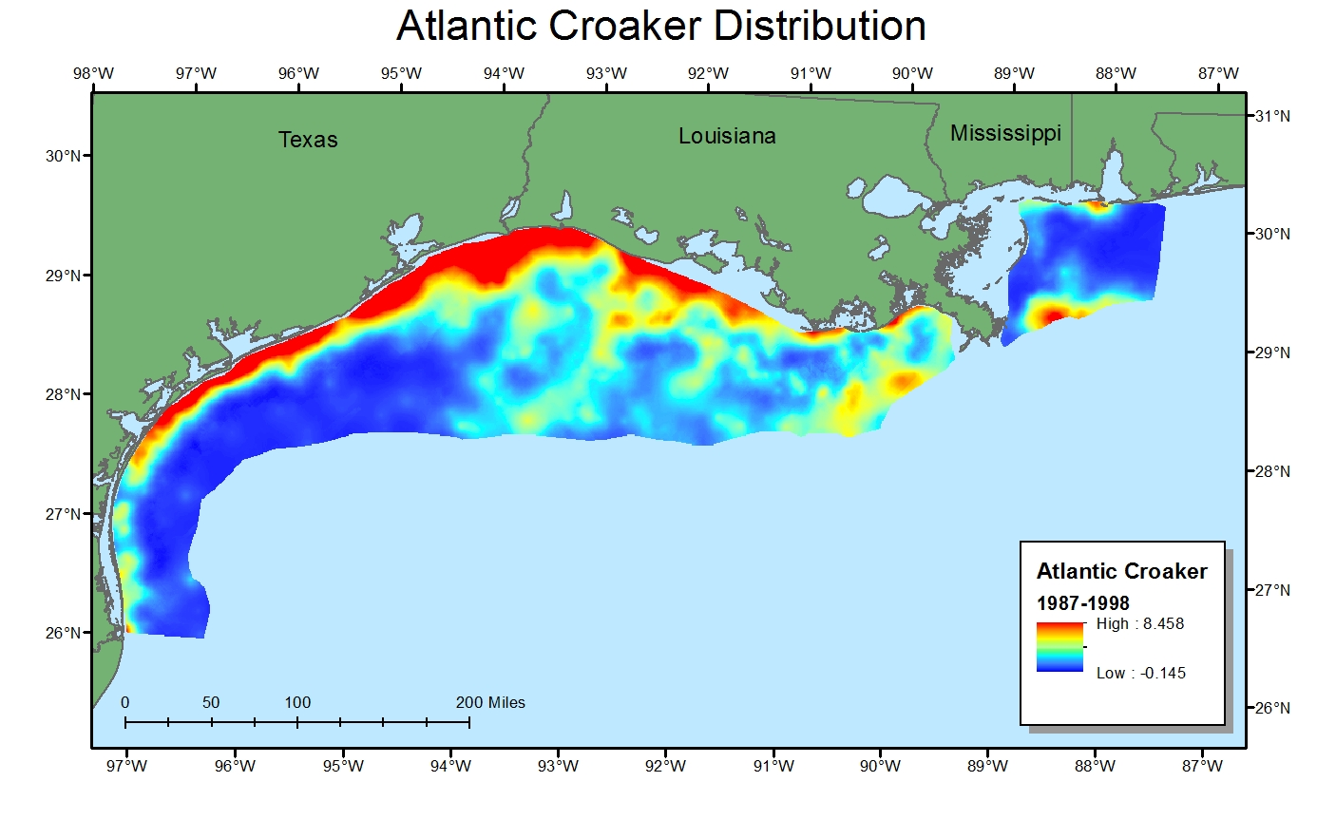
Notes:
For Atlantic croaker, highest abundances were found in the inshore area. The is to be expected since Atlantic croaker are estuarine dependent and spend their early stages in estuaries.

Slide 14
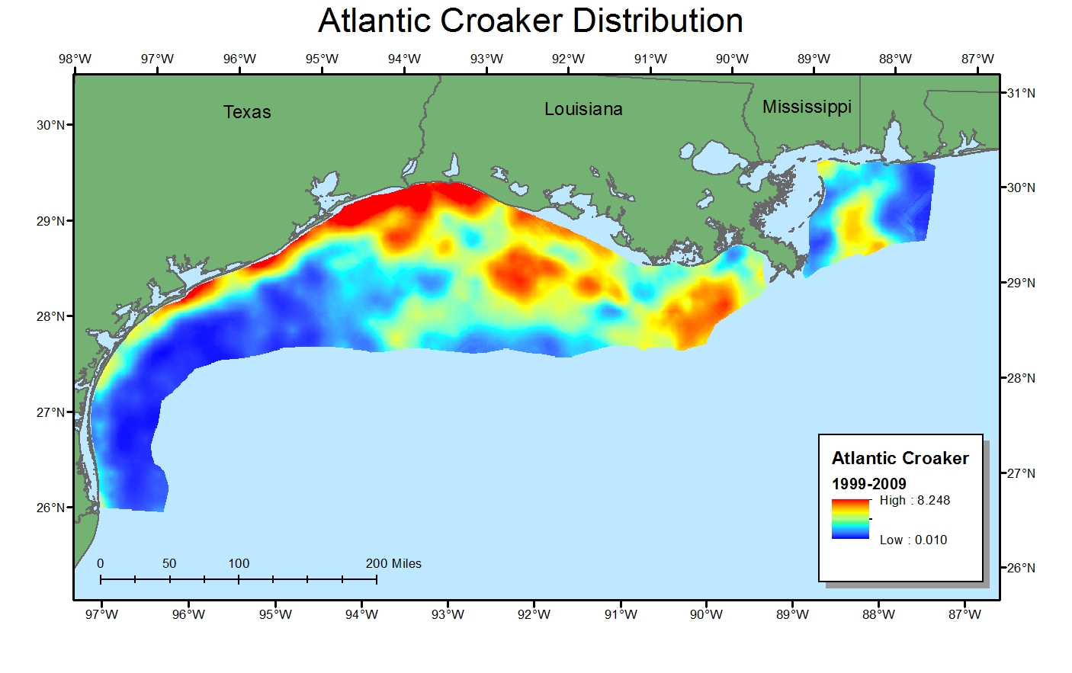
Notes:
Adult Atlantic croaker are found further offshore and it appears that you are starting to see higher abundances of Atlantic croaker in the later time period.

Slide 15
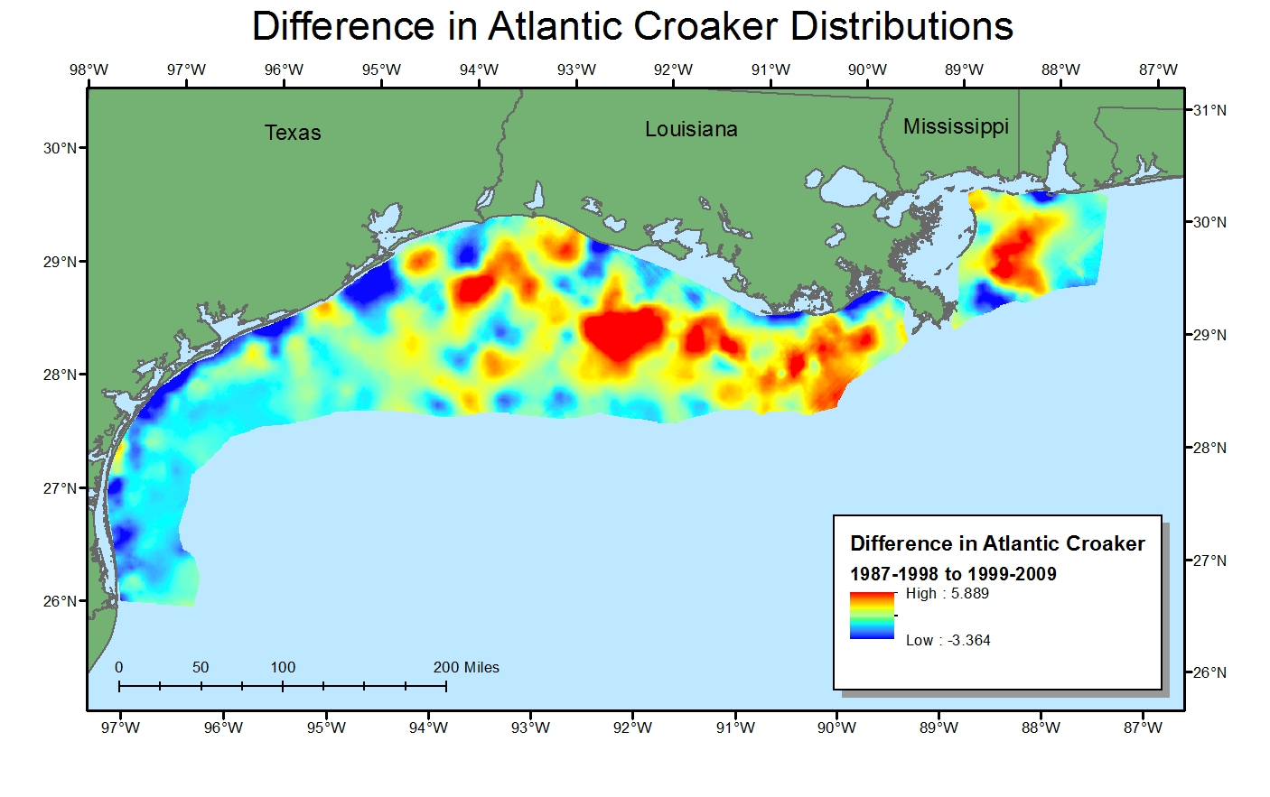
Notes:
I used the Raster Calculator to subtract the different prediction maps. Areas in red show higher abundance in the later time period while blue notates higher abundances in the early time period.

Slide 16
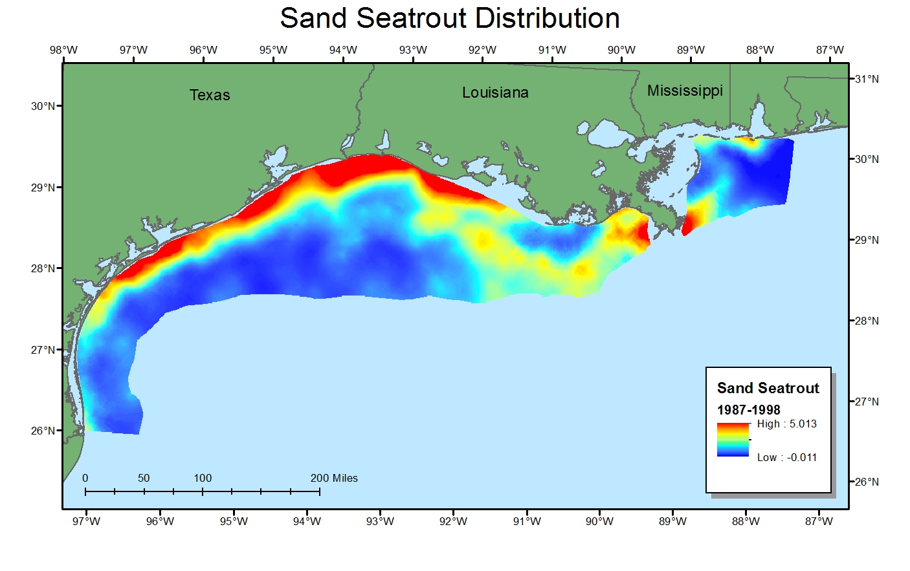

Slide 17
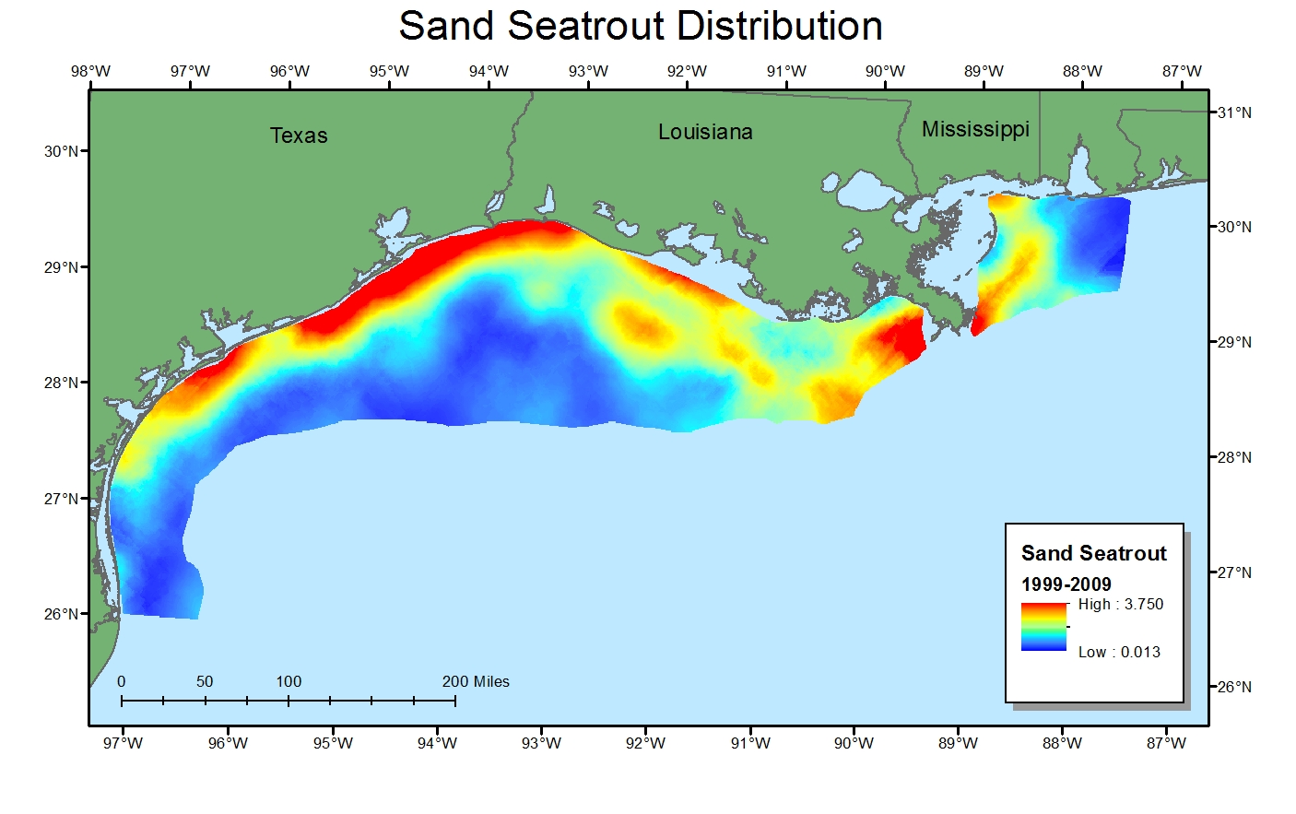

Slide 18
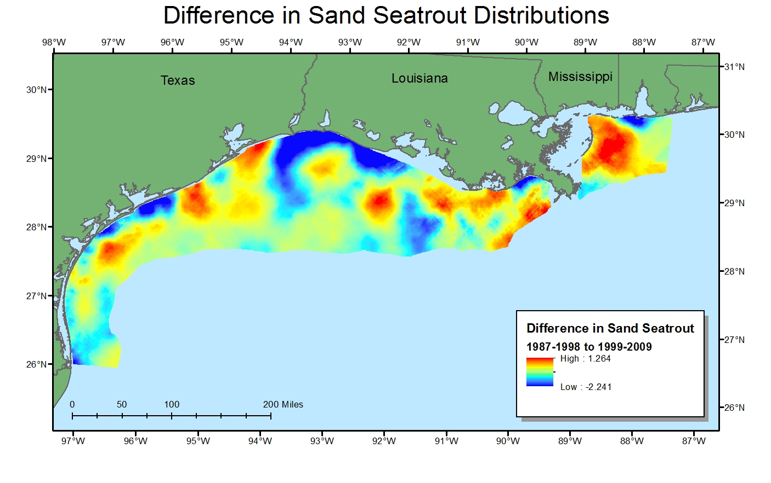
Notes:
Note that sand seatrout show increased abundances south of Mississippi, west of the Mississippi River, off central Louisiana, and off Texas.

Slide 19
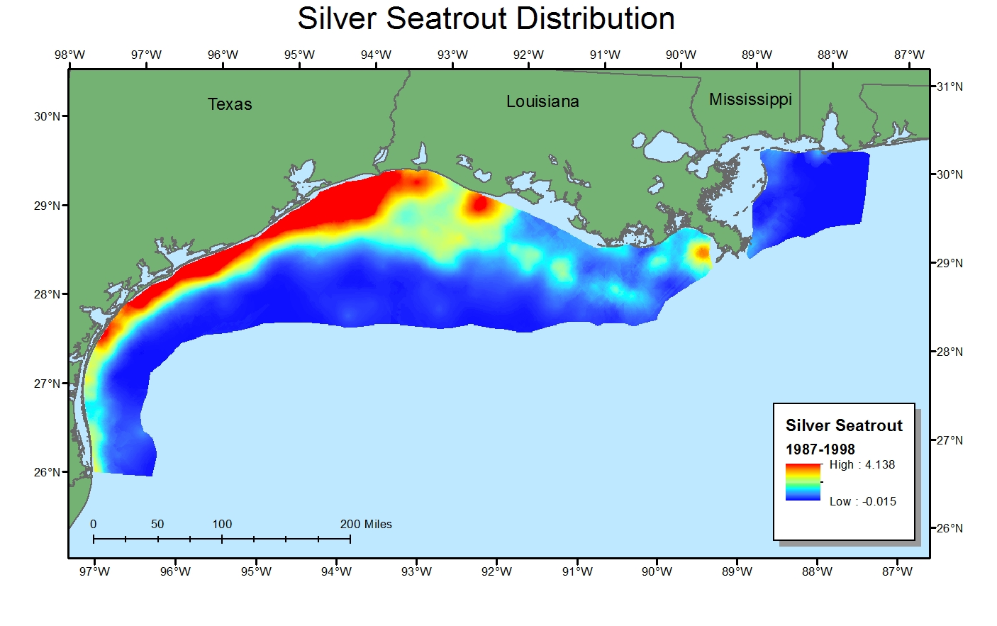
Notes:
Silver seatrout do not tolerate freshwater and are do not use estuaries during their juvenile life stage. You generally do not see high abundances near the Mississippi River because of the reduced salinities associated with it.

Slide 20
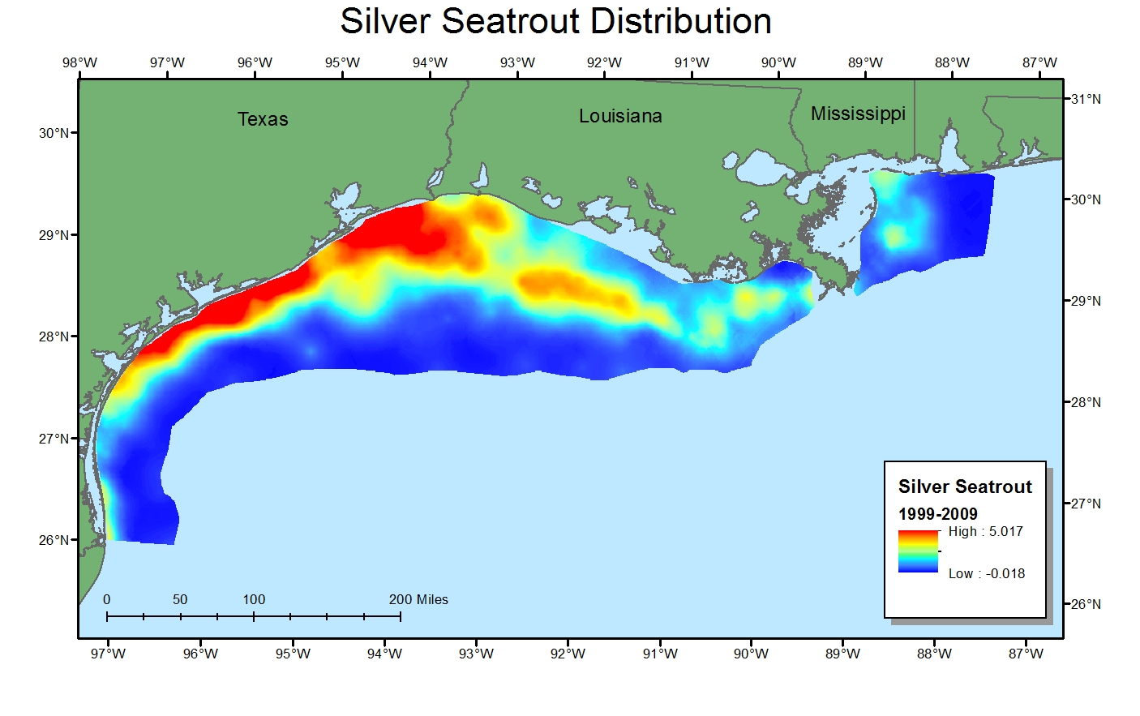

Slide 21
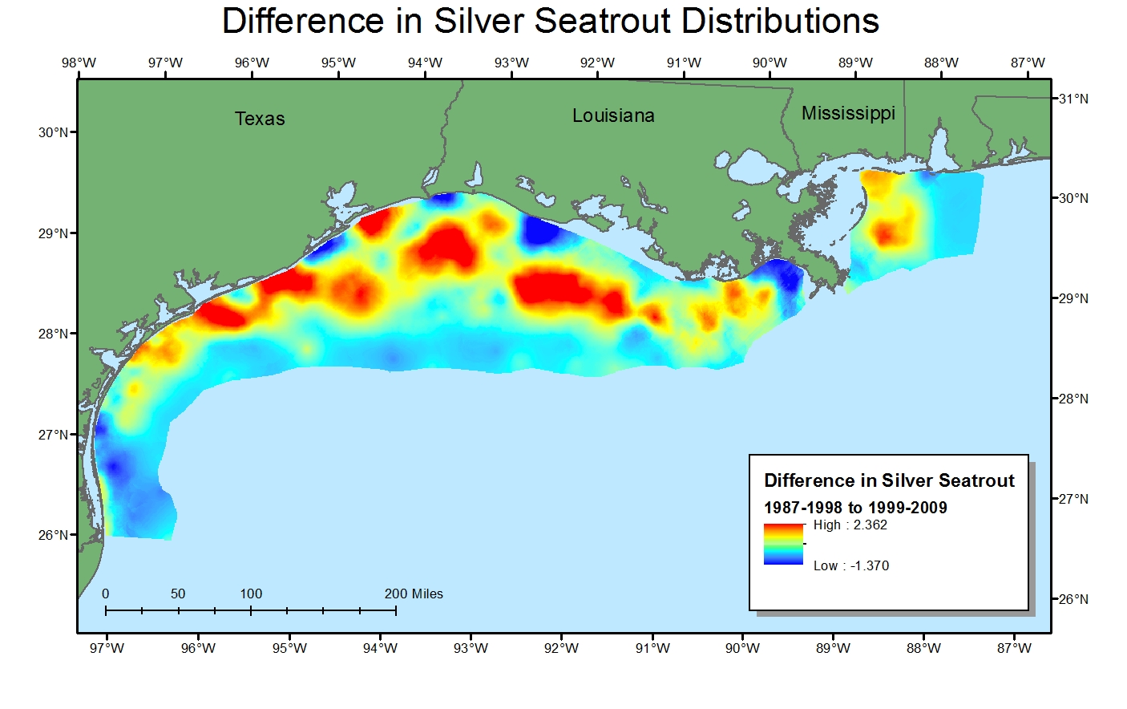
Notes:
There seem to be higher abundances in the mid depth areas off Texas and Louisiana and even some off Mississippi.

Slide 22
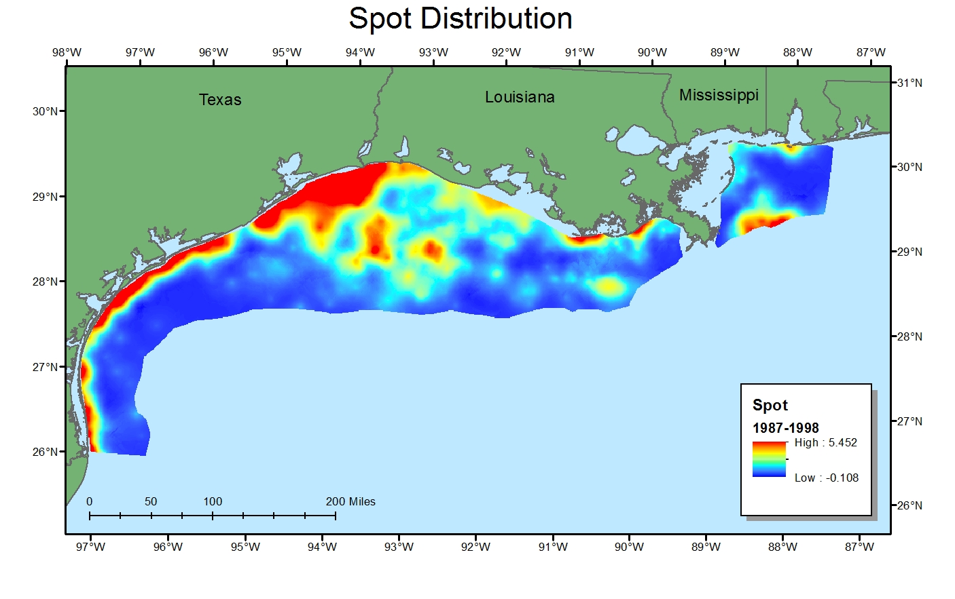

Slide 23
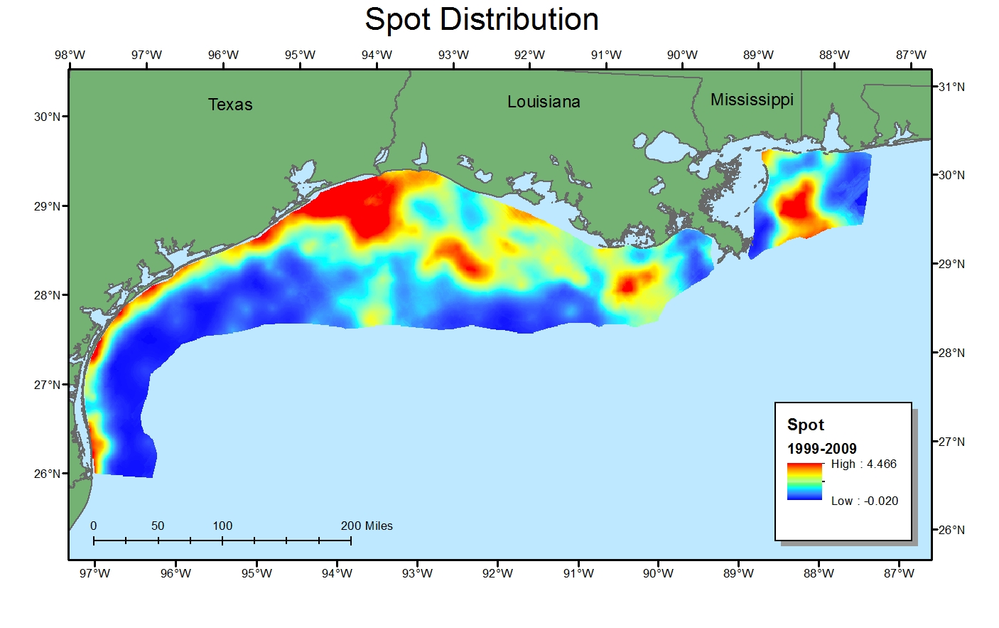

Slide 24
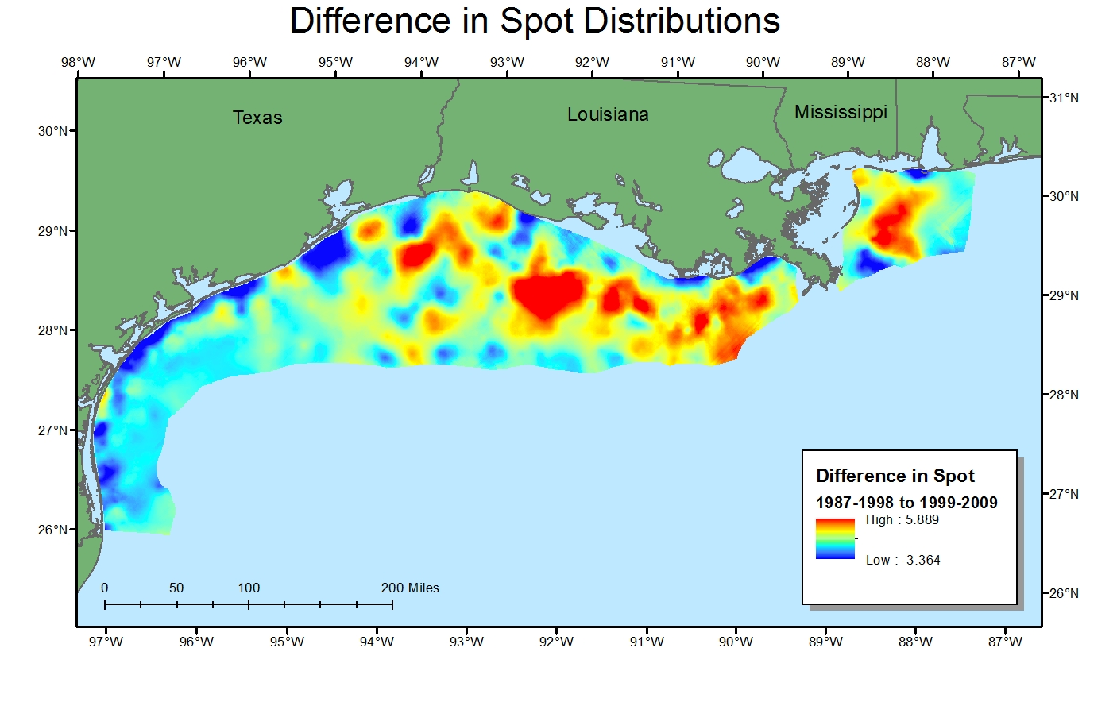
Notes:
Spot seemed to increased also around these mid depth areas.

Slide 25
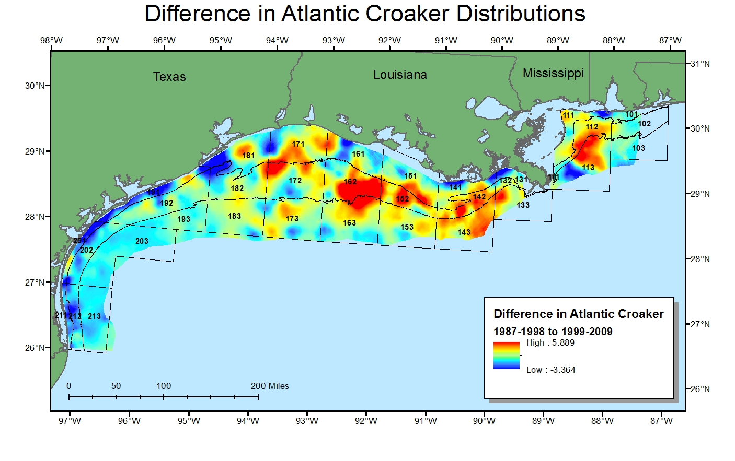
Notes:
To see if the apparent differences between the time periods are significant, the data were imported into the R statistical program. Fishery managers manage the shrimp fishery based upon statistical zones and depth within the statistical zones. The statistical zones are numbered 10 through 21. I then numbered the depth zones from 1 to 3 moving from inshore to offshore. The areas are between the coastline and 10 fathoms (represented by the 18 m contour), between 10 fathoms and 20 fathoms (represented by the 35 m contour), and beyond 20 fathoms. The catch rates within each depth stratum and statistical zone were compared to determine if catch rates changed between the two periods. Length measurements were also compared to determine if the size structure of the fish population has changed.

Slide 26
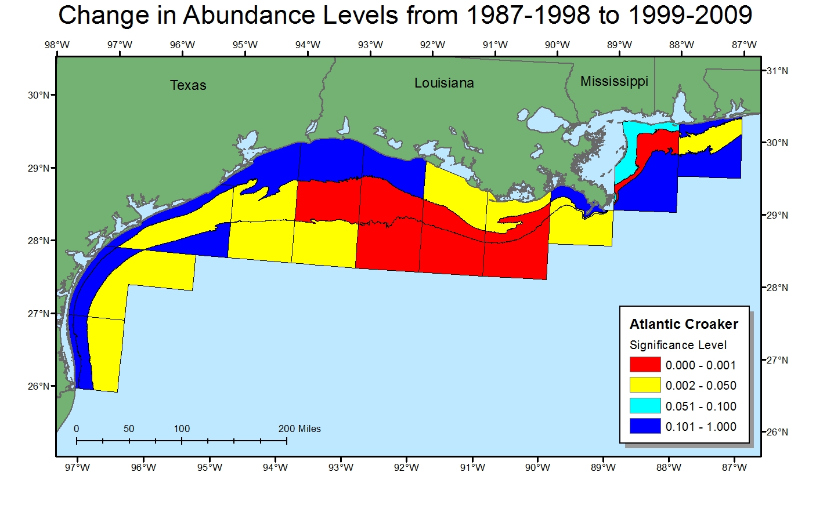
Notes:
The map shows the p values for the Mann Whitney U test comparing the early and late periods for Atlantic croaker. The yellow and the red areas are areas that are considered significantly different between the before and after periods. In the early period in zone 11 in the area between 10 and 20 fathoms, the mean was 3.44 fish caught per hour. The mean increased to 589 fish per hour in the after period. In zone 14 in the area between 10 and 20 fathoms, the mean increased from 285 to 1,308 fish per hour, while in the offshore area deeper than 20 fathoms, the mean increased from 92 to 523 fish caught per hour.

Slide 27
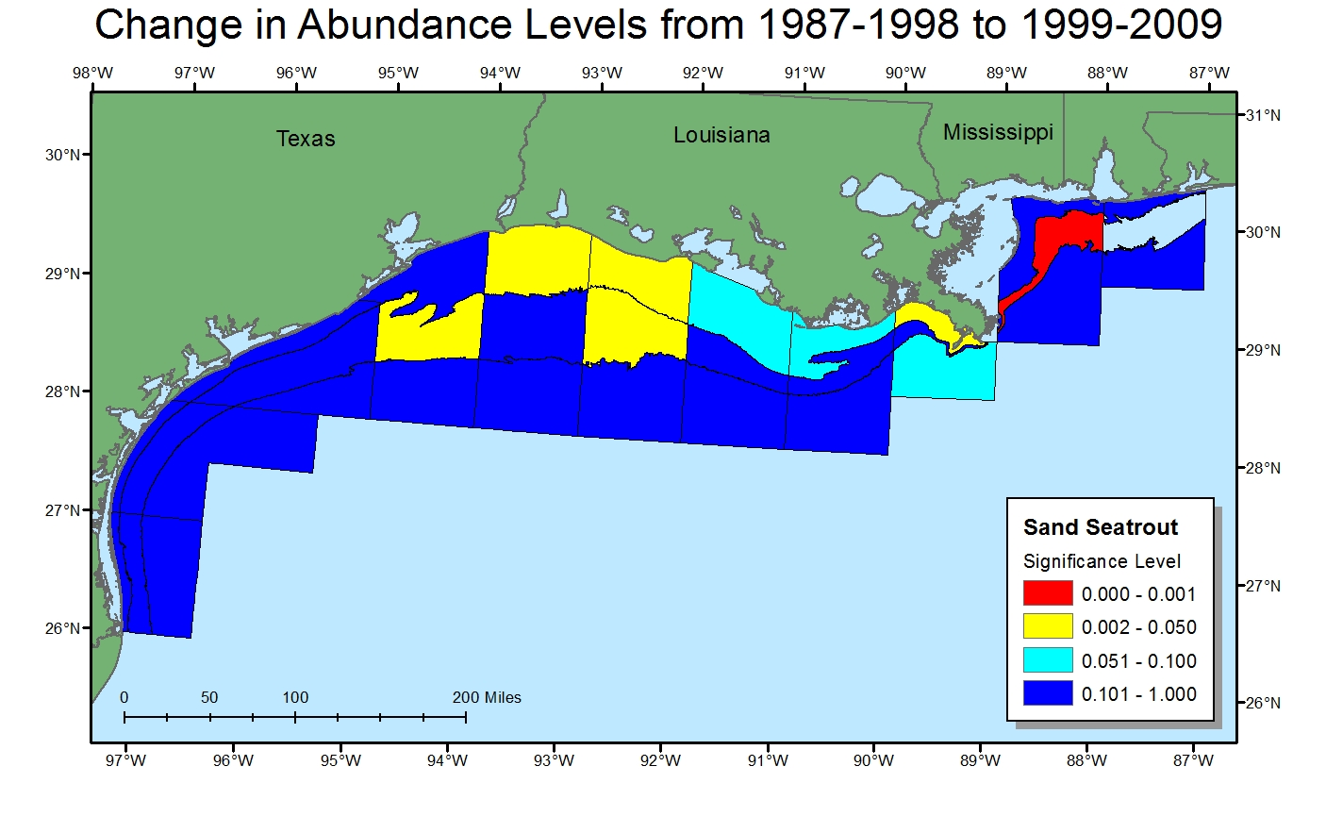
Notes:
The hollow area does not have enough samples to allow a comparison.

Slide 28
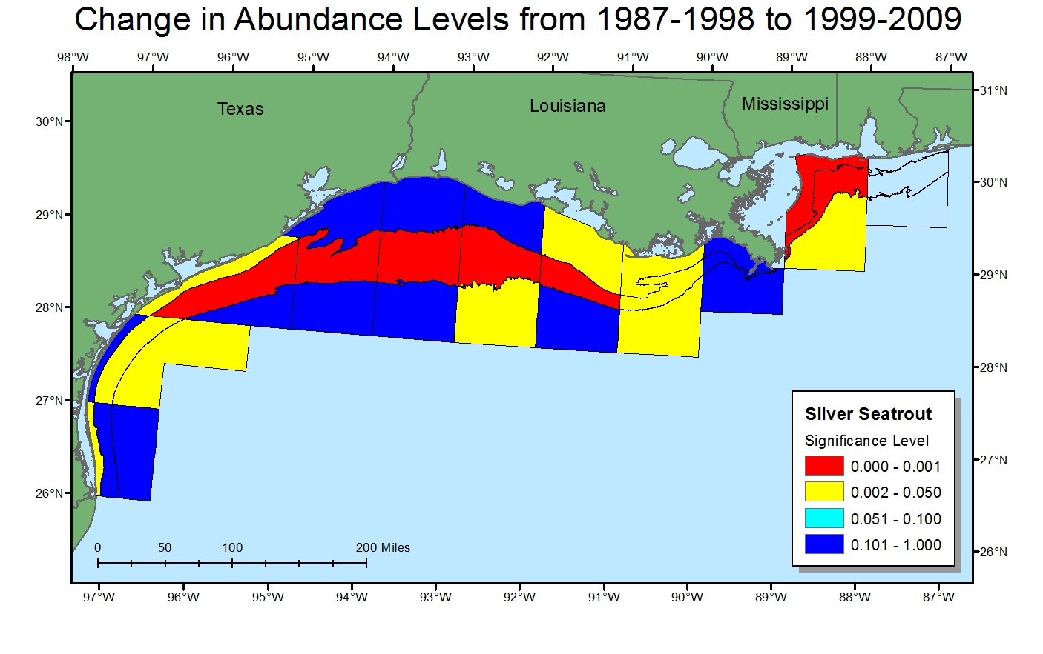

Slide 29
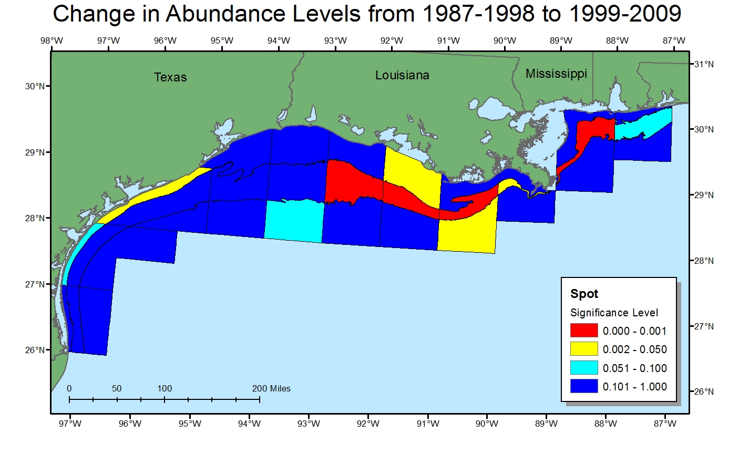

Slide 30
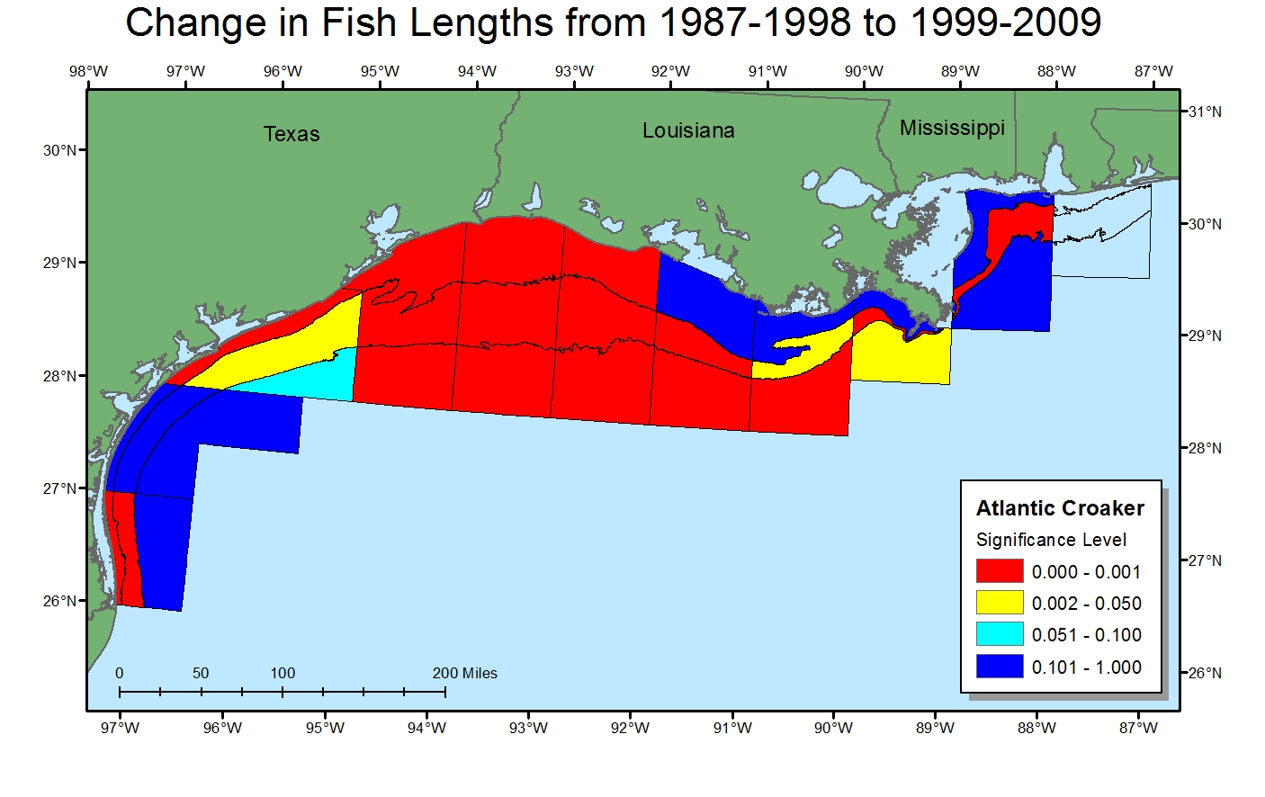
Notes:
I also wanted to examine fish lengths to determine if the species are getting larger since mortality should be decreasing. Using t-tests to compare the before and after time periods, what I found was that there were quite a few significant differences in the average fish lengths. The differences were not what I expected though since in the majority of the cases where a significant difference occurred, the average size decreased.

Slide 31
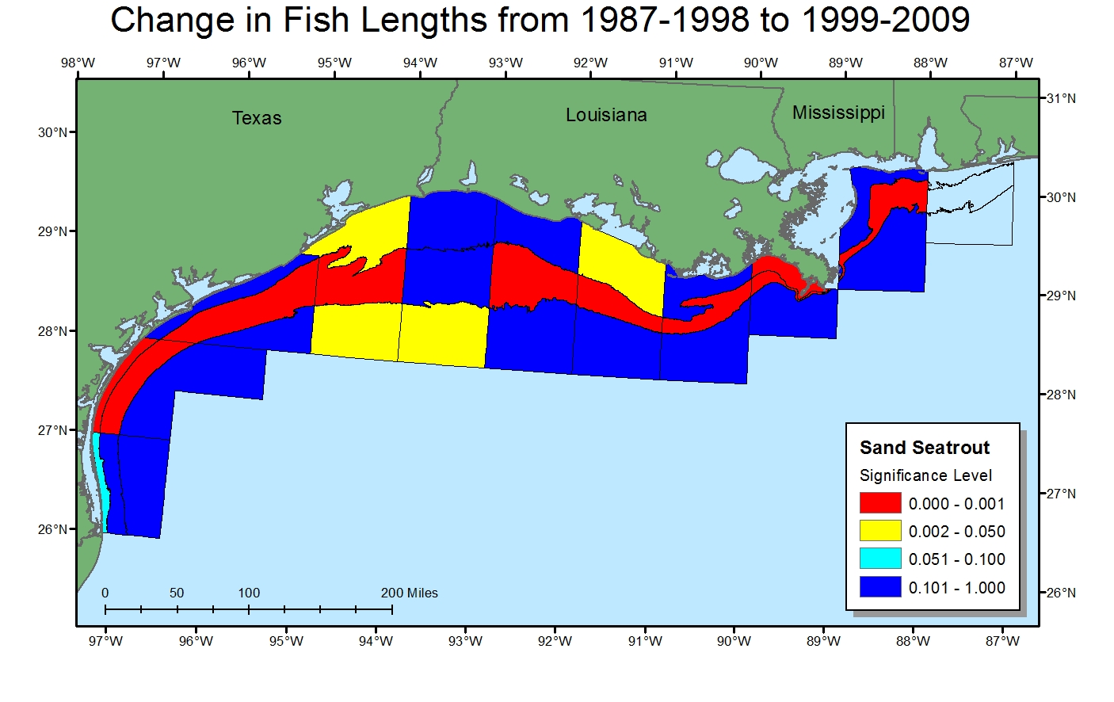
Notes:
Possible explanations for the decrease in average length for all species is that since the species are now more abundant, there is increased competition for limited resources. Therefore, growth rates possibly have declined.

Slide 32
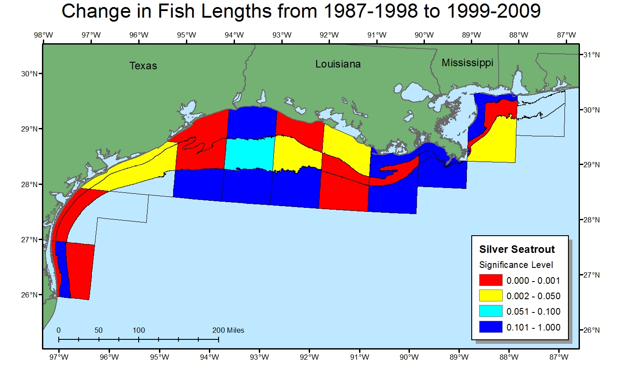

Slide 33
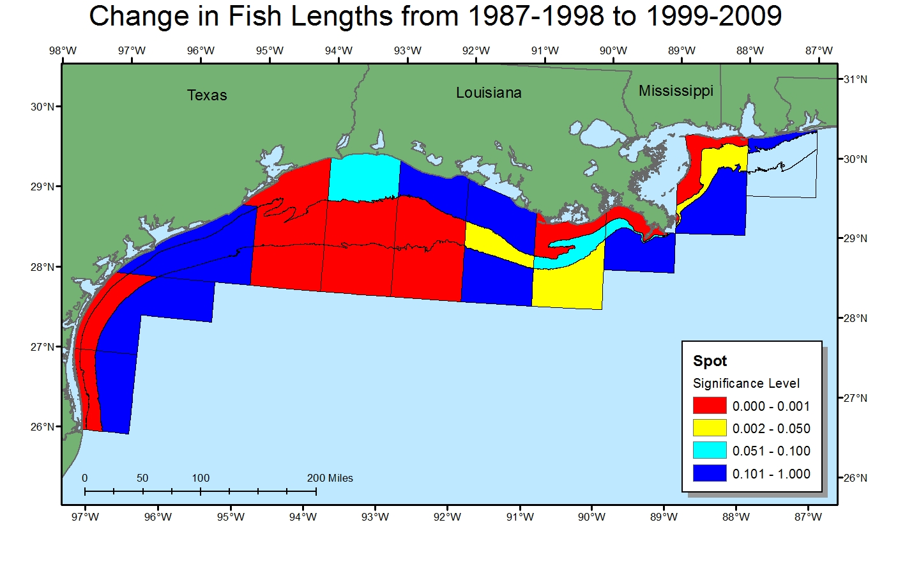

Slide 34
Remaining Work
Examine possible reasons why some species seem to be increasing in some areas, but not others.
Investigate density dependence to see how it could affect the size distribution of fish.
Examine the weight per hour of fish caught to determine if biomass has increased or decreased.
Multiple regression analysis.
Notes:
Before my formal presentation, I will examine possible reasons why some species seem to be increasing in some areas, but not others.
I will further investigate density dependence in marine fish to see how density dependence could affect the size distribution of fish. Also investigate carrying capacity to determine how it may affect the size distribution. I may examine the weight per hour of fish caught to see if the biomass has changed between the two periods or if biomass has increased along with the number of individuals.
While it has been 13 years since bycatch reduction devices were instituted and 10 years since a major decline in shrimping effort, the dataset still may not be large enough to show changes in species length. Atlantic croaker can live for approximately 8 years.
Later this year I will be submitting this work for publication so I will investigate a multiple regression to provide additional clues on what is taking happening.

