Slide 1
STAR A Search Tool for Allocating Resources For Radiological Emergency Response
Ben Sher
596A

Slide 2
Outline
Introduction and Motivation
Design Requirements
Data Requirements
Distance Calculation Options
STAR Application Design
Project Plan
Challenges, Opportunities and Conclusions

Slide 3
Introduction
Nuclear radiation is invisible and only detectable with special radiation equipment.
Radioactive isotopes can easily be spread by the use of a radiological dispersion device (RDD), also known as a dirty bomb.
A nuclear dirty bomb is an ideal weapon for spreading death and mayhem on U.S soil.

Slide 4
Introduction
The DOE has a Search Response Team (SRT).
SRT is a national level capability that provides assets to conduct complex search operations.
The SRT deploys manpower and equipment to conduct aerial, vehicle, and foot search operations to locate a radiological source.

Slide 5
Introduction
When the SRT is activated a Search Mission Plan must be developed.
A search mission plan includes:
Creating search teams.
Assigning equipment and defining search routes.
Detailed coverage of nearby drivable areas, buildings and walk able space.

Slide 6
Motivation
Current search mission plans do not provide estimated times of completion for any given search.
GIS can support an effective search mission plan by using GeoProcessing tools, a custom built ArcEngine application, and multiple spatial and non-spatial databases.

Slide 7
Key Design Requirements
Provide an estimated time of completion for the mission.
Demonstrate the highest level of confidence that 100% of an area has been searched.
Take into consideration different search techniques depending on the region and according to the types of search equipment that are used.

Slide 8
Design Requirement Details
Estimate how long it will take to perform the mobile search of all drivable space.
Estimate how long it will take to search all buildings.
Assume that all water features are unsearchable and account for their areas.

Slide 9
Design Requirement Details
Assumes all the remaining space not searched by the mobile and by building pedestrian searches or classified as a body of water still needs to be searched by foot. A time calculation of the remaining area is performed.
The end result should be an accurate estimate for how long a search mission will take for search teams to complete.

Slide 10
Data Requirements
HSIP (Homeland Security Infrastructure Program)
Roads
It is necessary to map out all the drivable space and determine the time required to the drive the area.
Water features
Radiation is insulated by water, therefore it is not necessary to search bodies of water, these should be identified by the STAR application.

Slide 11
Data Requirements
Claritas Building Points
Includes all United States Business Points in one layer, regardless of their type.
Building Footprints w/heights, provided by NGA
Allows an approximation to be made about how long it will take to search buildings.
Imagery
Digitizing buildings that fall within the search radius can be done on the fly in the STAR application.

Slide 12
Street Distance Calculation Options
RouteSmart
ArcGIS extension that performs an automated distance and time calculation routes in the search area using the Chinese Postman approach.
RouteSmart is expensive and not open to development.

Slide 13
Street Distance Calculation Options
Custom Development
Develop code for the STAR application that utilizes attributes of the street data to determine the number of lanes that exist in each road feature.
The number of lanes that exist on each road feature determines the number of times each road feature needs to be driven during the mobile search.

Slide 14
Street Distance Calculation Options
Custom Development
The total road length distance of the search will be calculated.
The total search time will be calculated from the total distance of the search assuming an average speed of 5 mph.

Slide 15
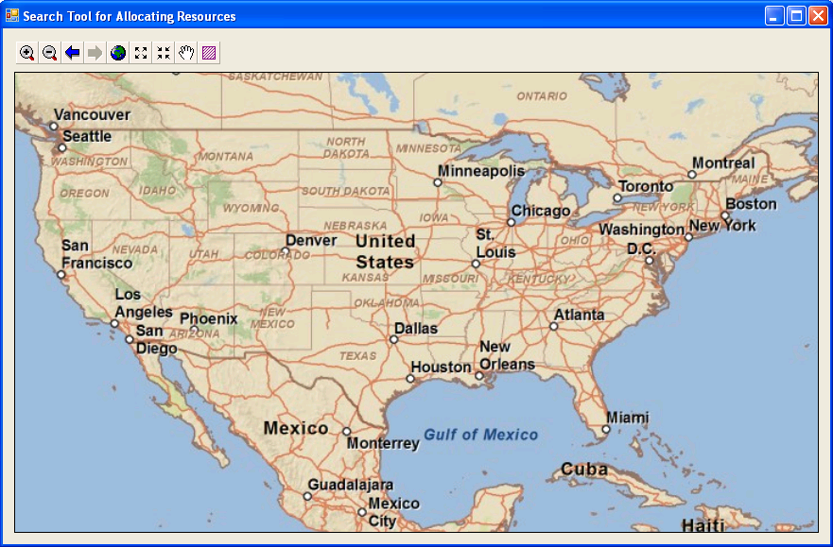
STAR Proposed Design
Easy-to-use ArcEngine application .
Consists of a map window with basic navigation tools and single click tool to launch the STAR application.
Contains HSIP streets & water features, Building Footprints and a basemap provided by ArcGIS Online.
STAR Application Button

Slide 16
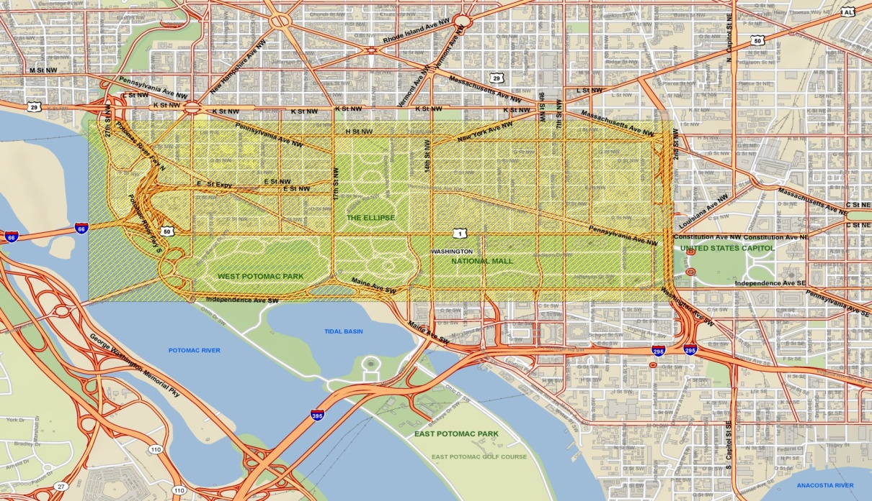
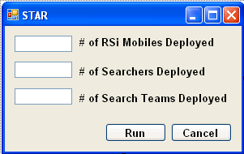
STAR Proposed Design
User will zoom to search area and select the Area of Interest (AOI).
GUI will open that prompts user to select how many teams will be deployed by foot and in RSi mobiles.
(AOI)

Slide 17
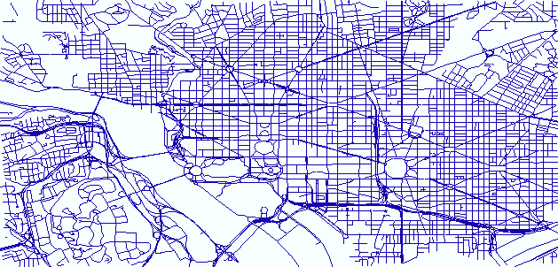
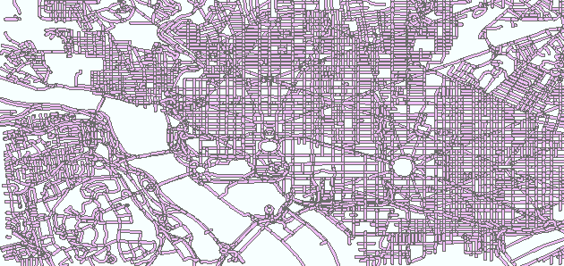
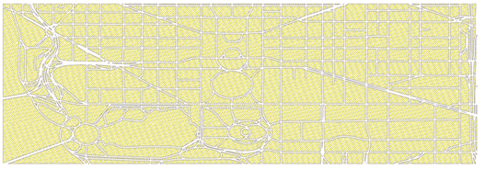
STAR Proposed Design
Calculate the total road distance to be driven based on the number of times a road has to be driven.
Divide the total road distance by the average RSi mobile speed of 5mph, to get the total drive time.
Buffer the roads.
Create a new clip of the search area that removes the buffered roads.
Original Road Layer
Buffered
Road
Layer
New clip area

Slide 18
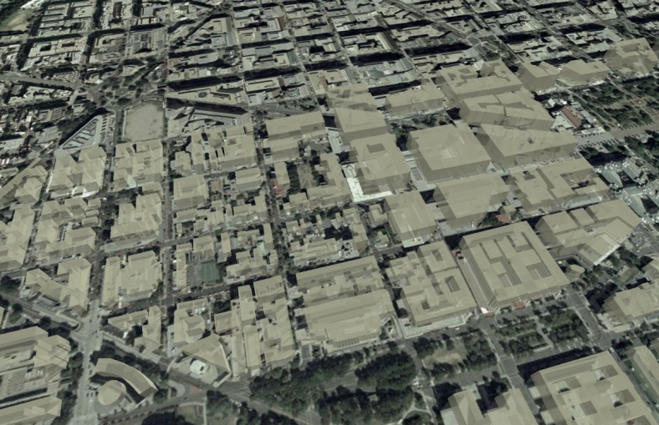
STAR Proposed Design
For each building in the search area divide the building height by an height of 10 feet to approximate # of floors.
Multiply the ground area x the number of floors to get the total area of the building.
Divide the total area of the building by the average pedestrian search speed to get the total building search time.
Example Building Info:
Ground Level Area = 5364 m²
Height = 24m
Number of Floors = Height/Floor Height 24/4 = 6 Floors
Total Area = Ground Level Area x Number of Floors 5364 m² x 6 = 32184 m²
Search Time = Total Area/(Minimal Detection Distance x Speed) 32184 m² /(6 x 1) = 1.5hrs

Slide 19
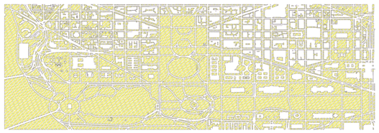
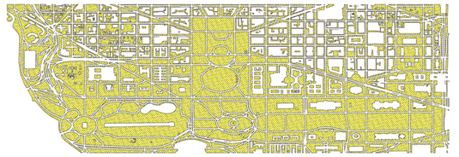
STAR Proposed Design
Create new clip of the search area which removes all the building footprints from the search area.
Water features are not going to be searched, so clip all the water features from the search area.
All the area remaining is assumed to be searchable only by foot. Calculate the area that remains and divide by the standard pedestrian search time.

Slide 20
STAR Proposed Design
Final results of STAR application:
Total searchable area = Current area total + Building Area Total + Mobile Survey Total
Total search time = Time required to search total area + total time to search all buildings + total time to complete mobile survey.
For the number of teams that are deployed, separate the search area into areas that will equally divide the mission area up by the search time required.
Will help to effectively deploy teams in search areas that will take the same amount of time to complete as the other teams.

Slide 21
Project Plan
Effectively structure all data.
Decide whether to purchase RouteSmart or begin custom development for calculating road distances and times.
Begin design and development of the ArcEngine component of the STAR application.
Test the GeoProcessing concepts being used in the STAR application for a pre-staged event at Super Bowl XLIV in Miami.

Slide 22
Challenges and Conclusions
Effectively create an application that adequately prepares search teams for going out in the field and estimates when their return is expected.
Data accuracy and available data extents are possible challenges to success.
Features that have no available data that should be searched by the mobile system must be accounted for or the STAR application won’t be as effective.
The STAR application is designed to support the entire nation, and maintaining such large datasets is very difficult for any agency to accomplish.

Slide 23
References
Zimmerman, Peter D., and Cheryl Loeb. "Dirty Bombs: The Threat Revisited." Defense Horizons 38 (2004): 1-11. Health Physics Society. 12 Jan. 2004. Web. 15 Dec. 2009. <http://www.hps.org/documents/RDD_report.pdf>.
Karon, Tony. "Person of the Week: Jose Padilla." TIME. TIME, 14 June 2022. Web. 20 Dec. 2009. <http://www.time.com/time/pow/article/0,8599,262269,00.html>.
Kimery, Anthony L. "Searching for 'dirty bombs'" World Net Daily. World Net Daily, 13 Jan. 2003. Web. 24 Dec. 2009. <http://www.wnd.com/news/article.asp?ARTICLE_ID=30084>.
"Homeland Infrastructure Foundation-Level Data Working Group." Homeland Infrastructure Foundation-Level Data Working Group. Web. 27 Dec. 2009. <http://www.hifldwg.org/>.

