Slide 1

Exploring Veterans Transportation Experiences to Veterans Affairs Facilities
Martha Snyderwine - MGIS Candidate
Dr. Alexander Klippel, Graduate Advisor
September 22, 2011

Slide 2
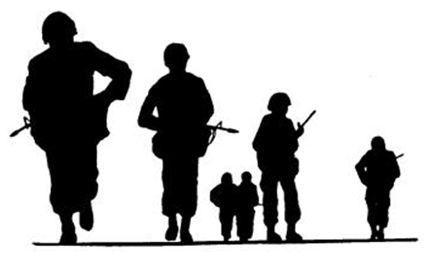
Outline
Background
Goals and Objectives
Proposed Methodology
Project Timeline
Anticipated Results
References

Slide 3
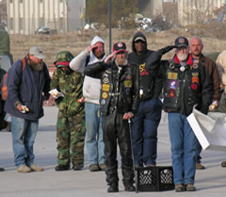

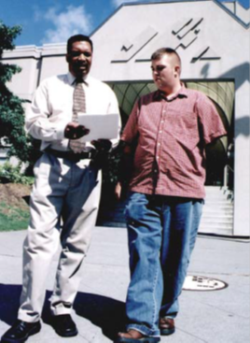
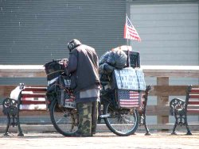
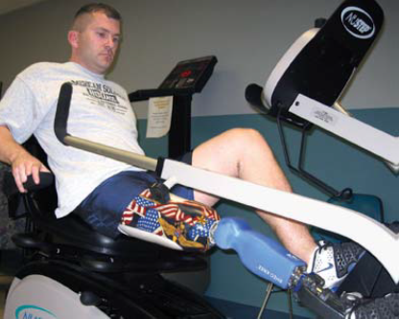




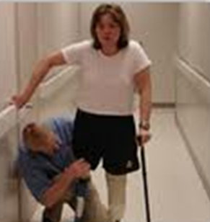

Background (1)
Veterans Affairs (VA) mission
  To fulfill President Lincoln's promise “To care for him who shall have borne the battle, and for his widow, and his orphan” by serving and honoring the men and women who are America’s veterans
Notes:
Tammy Duckworth (born March 12, 1968) was formerly [1] Assistant Secretary for Public and Intergovernmental Affairs in the United States Department of Veterans Affairs,[2] and formerly the director of the Illinois Department of Veterans Affairs.[3][4] Duckworth is an Iraq War veteran and former U.S. Army helicopter pilot whose severe combat wounds cost her both of her legs and damaged her right arm
VA serves approximately (~) 23 million veterans for health services, benefits, and burials
Nearly ¼ qtr of the nations homeless are veterans, and over 50% are Vietnam Era Vets
~ half of VA’s budget is entitlements, VHA and VBA total in 2010 was $58Million
Veterans Health Administration (VHA) provided care to ~8 million across their 21 Veteran Integrated Service Network (VISNs) which include 153 VA medical centers and 787 community based outpatient clinics (VAMCs and CBOCs)
Travel benefits are included in the VHA services for eligible veterans
VA travel benefits program costs were ~$816 million in Fiscal Year (FY) 2010.
Veterans Benefits Administration (VBA) also provides Automobiles and Specially Adaptive Equipment Program (ASAE) for a subset of disabled veterans and members of the Armed Forces

Slide 4
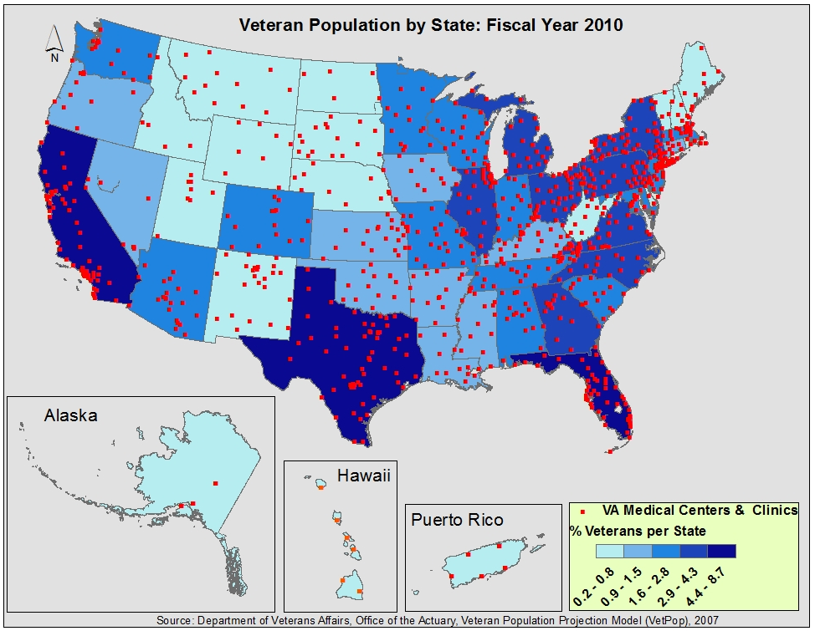
Background (2)
~10% of US population
Notes:
~40% live in rural areas as of 2009*

Slide 5
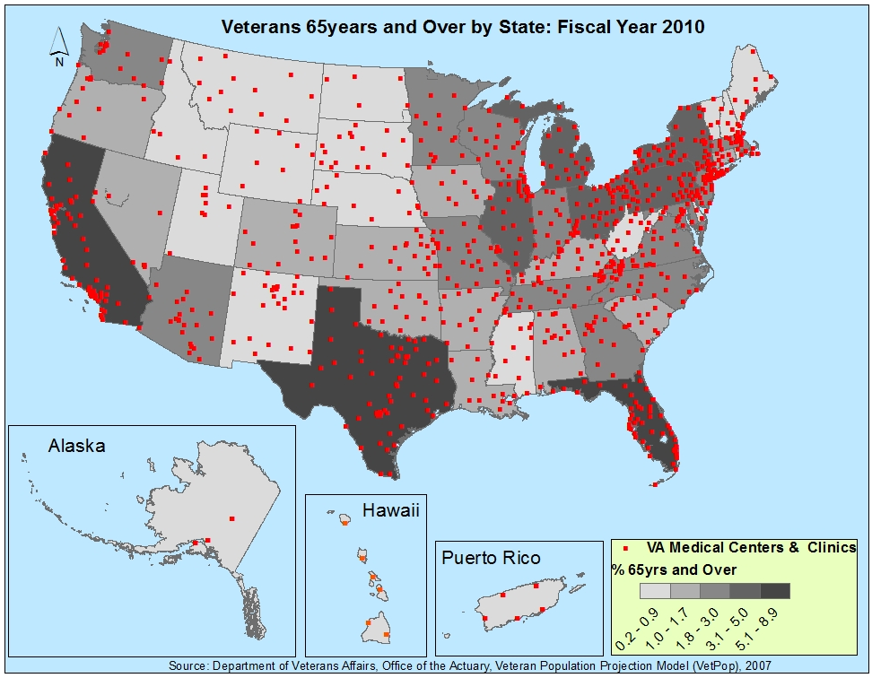
Background (3)
Notes:
~40% are 65 years of age and older

Slide 6
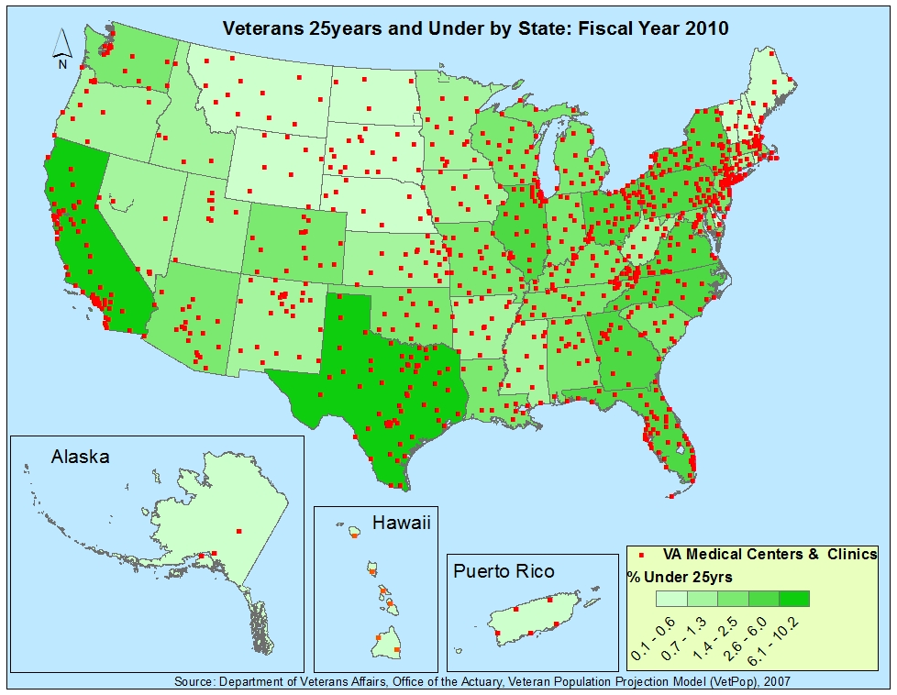
Background (4)
Notes:
Issues facing VA*
Many veterans may not be receiving care due to challenges associated with distance to access care.
Majority of younger veterans are more likely to live in rural areas and evidence shows that veterans living in rural areas are more likely to receive lower quality care.
Missing appointments or waiting until serious illnesses occur could lead to increased costs.
Optimal basis for medical center selections, deployment of telemedicine, and/or mobile health services. Currently network analysis is performed based on zip codes. Address accuracies are an ongoing challenge. Garbage in garbage out, veterans move.
From FY 2006 to FY 2010 VHA medical costs increased by ~55%
Due to increasing Illness rates for Vietnam era veterans coupled with a higher rate of injuries for veterans from the Middle East conflicts (Iraq and Afghanistan) VA is anticipating increased costs from their VHA costs of ~$45 billion in FY2010.
In summary huge concern for Improving quality of care and managing costs.

Slide 7
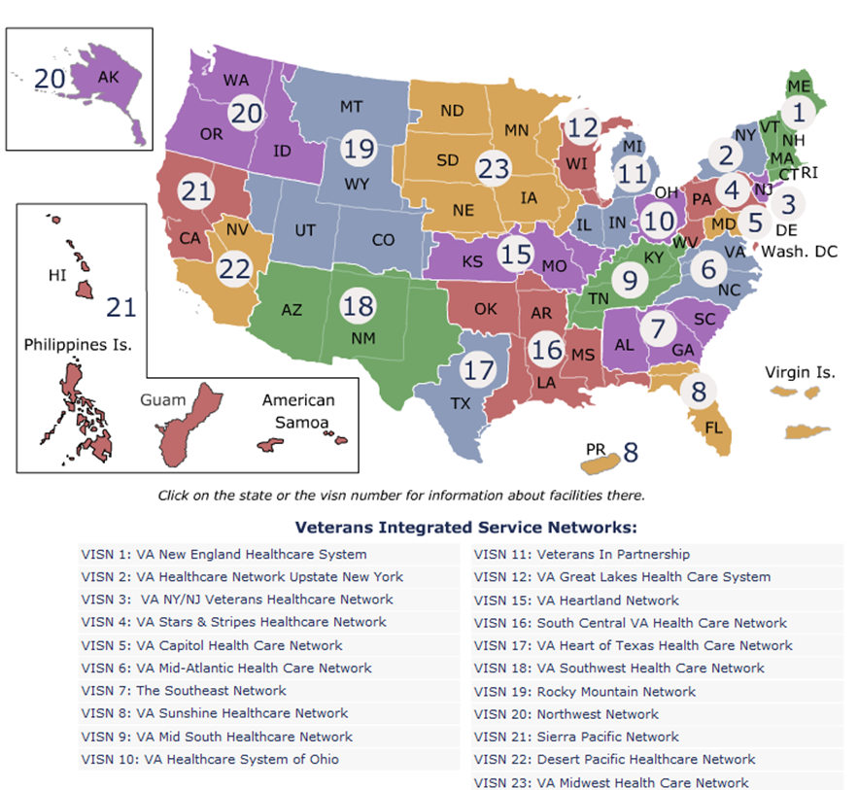
Background (5)
Finding out about VA medical facilities
  myHealtheVet: http://www.myhealthevet.va.gov
  eBenefits: https://www.ebenefits.va.gov/ebenefits-portal/ebenefits.portal
  Mapping capabilities are limited
Notes:
VA facility locator features limited to textual listing and a choice to display the location on maps from either Yahoo, MapQuest, or Google
Not all locations include a mapping choice
Mapping service only opens a new window without carrying forward the location forcing users to enter that information manually
Mapping capabilities are limited
Information on travel benefits and eligibility under the Frequently Asked Questions (FAQs) tab which is under the Contact Us tab.
Not all locations include a mapping choice.
If a map choice is offered a user selecting this will be provide a map centered on the location with the address in text format. If a map is offered it includes a url to the map provider and selecting this link only provides a map of the continental United States without retaining the location information. Users have to enter that information manually. I also searched both sites to learn about veterans travel benefits. This proved fruitless from either eBenefits or MyHealtheVet. Through trial and error I discovered a Frequently Asked Questions (FAQs) tab under the Contact Us tab. The FAQs does support searching and I found information on eligibility for travel benefits and options for seeking travel assistance. This information was rather complex and imagined could be difficult to navigate. For veterans deemed eligible for VHA treatment, the following subset are considered eligible for travel reimbursement

Slide 8
Goals and Objectives
Illustrate a proof of concept for expanding VA website offerings
Gain an improved understanding of veterans’ travel experiences
Generate information that could enhance scheduling of veterans for care and treatment
Improve analytics for medical facility site selection
Collect information that can be shared for possible opportunities with external partners
      Veterans Service Organizations (VSO)
      State or regional transit systems

Slide 9
Proposed Methodology (1)
Develop thin client web based tool for capturing veterans experiences traveling to Veterans Health Administration (VHA) facilities
  Capture anonymous responses
    Zip code starting point and medical center destinations
    Transport modes (auto, rail, bus, VSO, etc)
    Travel times
    Travel distances
    General feedback

Slide 10
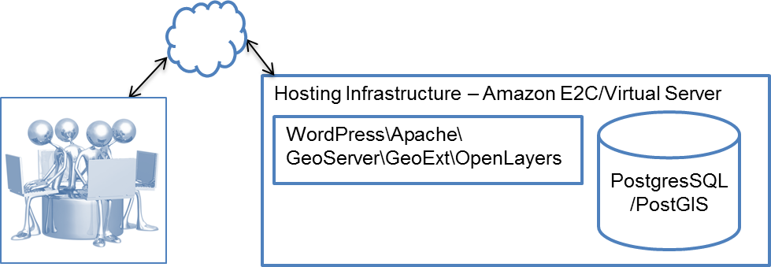
Proposed Methodology (2)
Utilize free and open source software and data to the greatest practical extent
  OpenSource/Cloudmade for base layers (road, rail, bus, cities, states)
      Alternatives
          Google Maps
          ArcGIS Online
  Veterans Affairs for medical facility layers

Slide 11
Proposed Methodology (2)
Start by extending WMS thin client for illustrating VHA medical facility locations with capability to edit layers and measure distances
Develop hosting on Amazon’s Elastic Cloud Computing (E2C)
    Educational grant $100 credit
    Host either based on Windows or Linux
    Alternative: private virtual hosting at minimal cost
Finalize survey approval
    Received workplace Internal Review Board (MIRB) approval
    Complete PSU IRB as required

Slide 12
Proposed Methodology (3)
Design and Build Web Feature Service (WFS )
    Content Management System – WordPress
    PostGIS geodatabase for storing base layers and survey responses
Limited user testing with focus groups
    Recruit multi-age veteran population from family, friends, and co-workers
    Alternatively create a focus group of pseudo veterans
    Collect responses for a specific time frame
Prepare presentation for AAG 2/2012 annual meeting

Slide 13
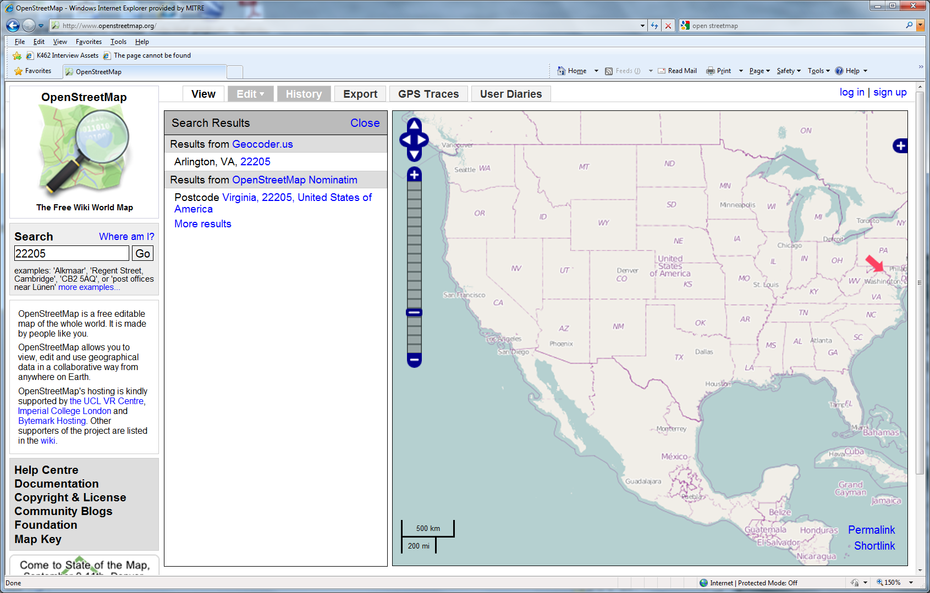

Proposed Methodology (4)
Conceptual Mockup
Please complete the consent form
Enter your starting zip code to continue
Veteran
Travel
Survey
Welcome to the Veteran Travel Survey, please log in to start
Enter zip code
Help
Privacy
Disclaimer
Missed Appointment
Select icon & respond to survey questions
Kept Appointment

Slide 14
Anticipated Results
Use responses to create statistics and travel time layer estimates
    Travel times (actual and averages) by zip code and facility destination
    Travel distances (actual and averages) by zip code and facility destination
    Generate actual and illustrative travel time visualizations with ArcGIS 10 Network Analysis tool
Generate summary of lessons learned
    Experiences building a WFS
    Conducting user testing

Slide 15
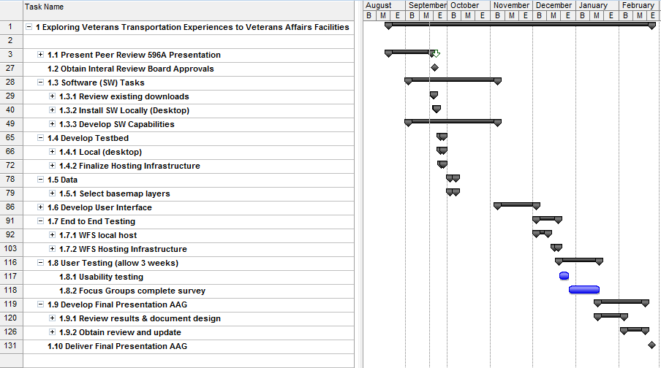
Proposed Project Timeline

Slide 16
Acknowledgements
Dr. Alexander Klippel – graduate advisor
Beth King – academic advisor
Art Hamerschlag – subject matter mentor and former VHA Chief of Staff
Dr. Frank Hardisty – technical advisor
Patricia Joyce – systems engineer and mentor
Regina Ryan – technical mentor and geospatial systems engineer
My immediate family veterans
  Robert Snyderwine, Sr – WWII
  Paul Hazlett – Korean War
  Paul Snyderwine – Cold War
  John Snyderwine – Gulf War
  Michael Maistros – Gulf War

Slide 17
References
Burkhardt, Jon; Rubino, J; Yum, J (2010). Improving Mobility For Veterans, Transit Cooperative Research Program. Dated 5/24/2011. Accessed 07/8/2011. http://www.trb.org/TCRP/Blurbs/Improving_Mobility_for_Veterans_165243.aspx.
Department of Veterans Affairs (2010). Open Government Plan, pages 24-25; dated 06/25/2010 2010, Accessed 07/30/2011 http://www.va.gov/OPEN/docs/open_govt_plan.pdf
Department of Veterans Affairs (2011) . Facility Locator; No date. Accessed 7/30/2011. http://www2.va.gov/directory/guide/home.asp?isFlash=1
Department of Veterans Affairs (2011). Beneficiary Travel Frequently Asked Questions (FAQs). Dated 9/15/2009. Accessed, 07/30/2011. http://www.va.gov/healtheligibility/Library/FAQs/BeneTravelFAQ.asp
Department of Veterans Affairs (2011). Beneficiary Travel Frequently Asked Questions (FAQs) Answers. Dated 9/15/2009. Accessed, 07/30/2011. http://www.va.gov/healtheligibility/Library/FAQs/BeneTravelFAQ.asp#eligible.
Department of Veterans Affairs (2010). Demographics Veteran Population 2007. Dated October 21, 2010. Accessed 09/16/2011. http://www.va.gov/VETDATA/Demographics/Demographics.asp
Department of Veterans Affairs (2010). Veterans Affairs Strategic Plan FY 2010 – 2014. Dated June 2010. Accessed 09/16/2011. http://www.va.gov/op3/Docs/StrategicPlanning/VA_2010_2014_Strategic_Plan.pdf.
Department of Veterans Affairs (2006). Veterans Affairs Strategic Plan FY 2006 – 2011. Dated 2006. Accessed 01/2009. Note: website is no longer available. Pdf available upon request. http://www.va.gov/op3/docs/VA_2006_2011_Strategic_Plan.pdf.
National Coalition for Homeless Veterans (2011). Facts & Media > Background & Statistics. No date. Accessed 09/16/2011.
http://www.nchv.org/background.cfm
Schooley, Benjamin; Horan, Thomas; Lee, Pamela; West, Priscilla (2011). Rural Veteran Access to Healthcare Services: Investigating the Role of Information and Communication Technologies in Overcoming Spatial Barriers. Perspectives in Health Information Management (Spring 2010): 1-20. Dated 2011. Accessed 07/30/2011. http://perspectives.ahima.org/index.php

