Slide 1
Designing an Open Source Web Application for Visualizing Aquifers
Mitchell Sodek
Advisor: Dr. Pat Kennelly
Penn State University
Geog 596A Summer 2015

Slide 2
Outline
Groundwater background and needs
Project proposal
Current practices
Existing map applications
Methodology and framework
Challenges and opportunities
Timeline and presentation venues
References

Slide 3
Groundwater Conservation Districts (GCD)
Manage groundwater on a local level (99 Districts)
Register and identify wells
Permit and meter wells
Spacing and production requirements
Aquifer modeling and modeled available groundwater
Each is unique with varying rules but same underlying mission
Tax or fee-based funding

Slide 4
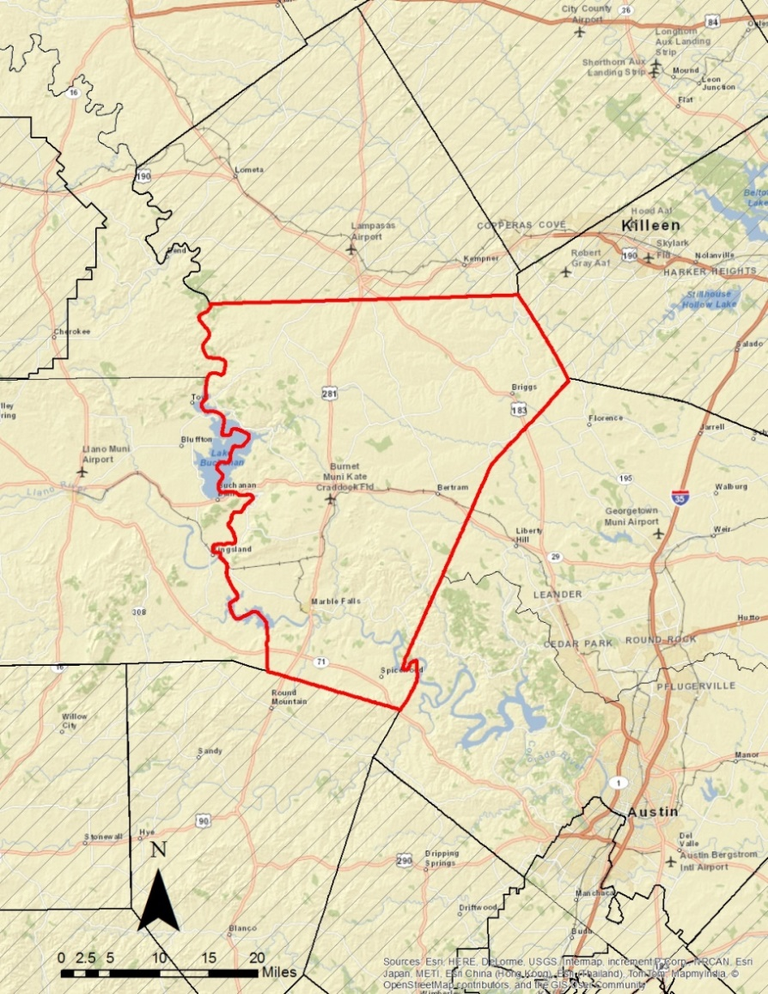
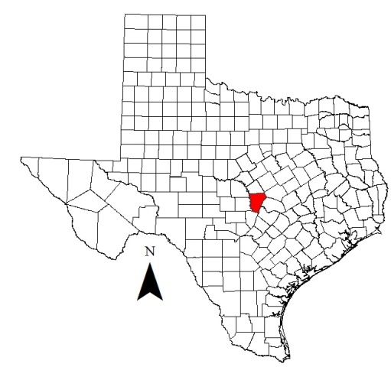
Central Texas Groundwater Conservation District
Central Texas GCD
Tax-based
Burnet County
pop 50,000
1,021 sq. miles
6 aquifers -> sub-aquifers
Science-based policy

Slide 5
What is an aquifer?
A saturated permeable geologic unit that can transmit significant quantities of water (Freeze and Cherry, 1979)
May be bounded by impermeable layer(s)
Wells, springs, seeps, pits, lakes, creeks, and rivers are fed by aquifers
Surface
Aquifer 1
Confined
Layer
Aquifer 2
Aquifer 3
Source: Regional District of Nanaimo

Slide 6
Who needs aquifer data?
Groundwater District
Public
Vital for managing an aquifer
Multiple aquifers overly each other
Production assigned by aquifer
New wells can be designed with greater accuracy
Educating the general public
Well owners want to know from which aquifer they produce
New proposed well owners want to know the depth and cost
Drought contingency plans

Slide 7
Current Challenges
Aquifer data exist but are not easily attainable for the public
A professional is needed to compile data, analyze, and interpret the results
Specialized software is needed to visualize the underlying aquifers

Slide 8
Project Proposal
Develop an open source web-based mapping application that will generate user customized aquifer data in a cross section format.

Slide 9
Objectives
Utilize open source software to create a responsive web map design that functions within a browser on any device
Create custom cross section graphs generated from raster surface elevation values representing the various aquifer layers
Develop a simple, powerful, and user friendly interface/experience for a wide number of public users
Employ a design that can be easily duplicated and one that is scalable for additional data and features

Slide 10
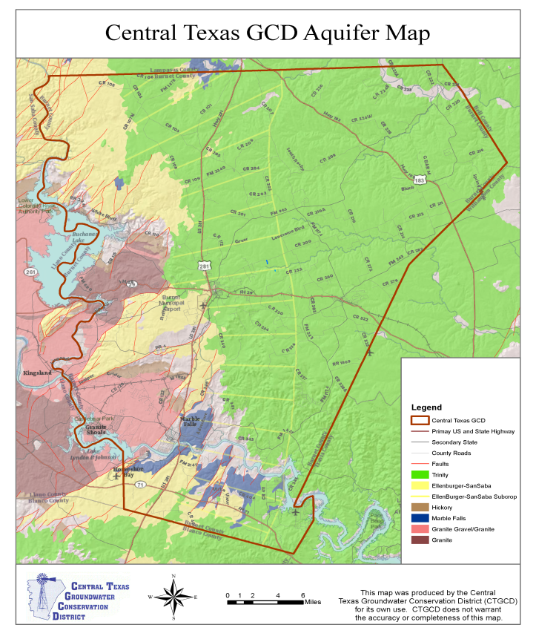
Traditional Geology and Aquifer Maps
Static, fixed scale
Predetermined cross sections
Narrow focus
Extent, top or bottom of aquifers, thickness, or pieziometric surface
Source: Edwards Aquifer Authority
Source: Central Texas Groundwater Conservation District

Slide 11
Cross Sections
A slice of the underground structure
Widely used in the hydrogeologic sciences
Vertical axis is elevation values
Horizontal axis is distance along the cross-sectional line often using the map’s scale
Source: Texas Water Development Board 2009,

Slide 12
Related Applications
Numerous web and phone applications for running, biking, hiking
Display route on map
Create elevation graph based on route
Derived from DEM
Source cnet.com: imapmyride iPhone app

Slide 13
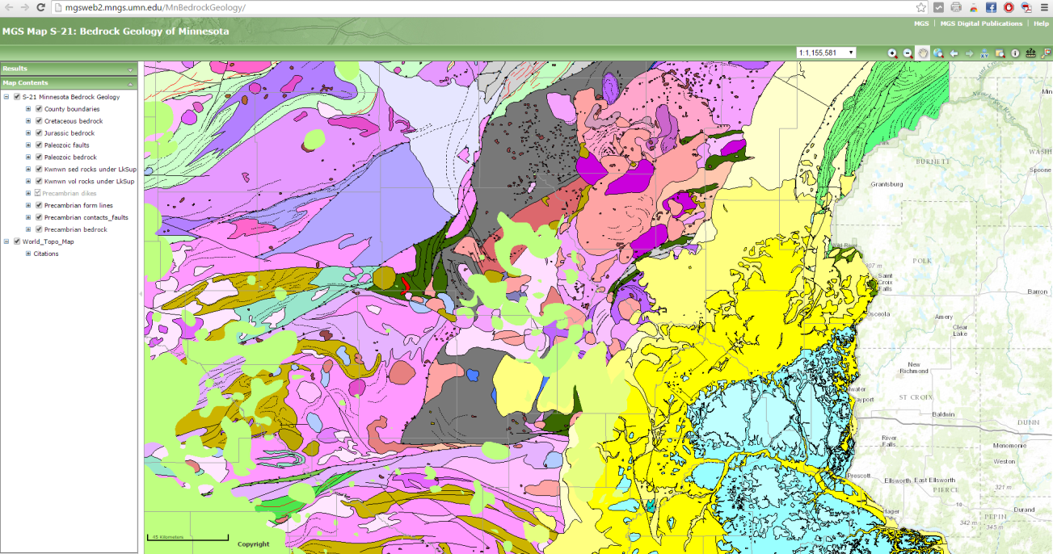
Related Web Maps
Source: USGS Texas Geology Web Map Viewer
Surface Geology
Vector Polygons
Identify tool
Source: Minnesota Geological Survey

Slide 14
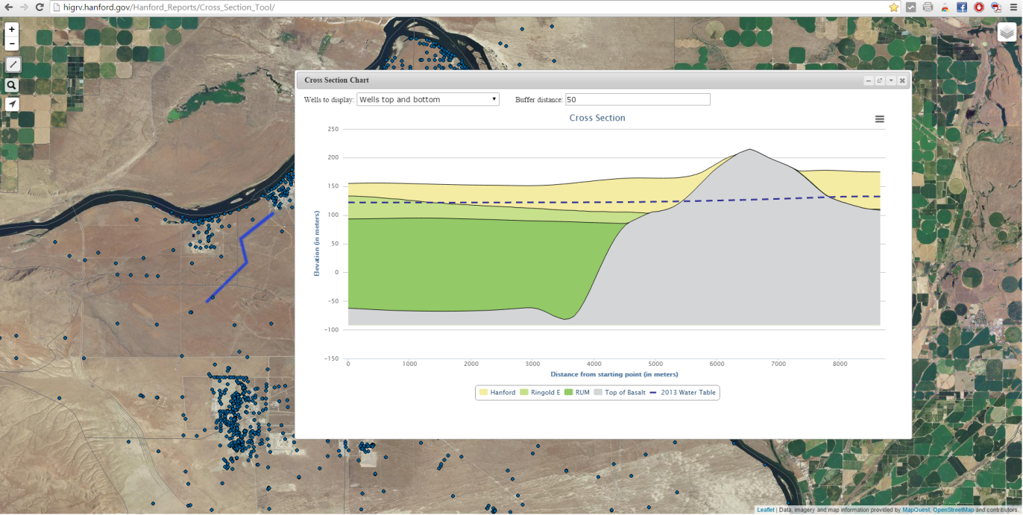
Related Web Maps
Source: Intera Highplains Aquifer
Subsurface Aquifers
Raster
Identify Tool
Cross Section Polyline
Source: US Department of Defense Hanford Site

Slide 15
Subsurface Layers
Multiple Raster Layers
Source: Texas Water Development Board
Llano Uplift and Northern Trinity Groundwater Availability Models
Format: Raster
Resolution: ¼ mile x ¼ mile
Raster value represents bottom of layer/top of next

Slide 16
Methodology
1300’
1150’
1100’
1050’
900’
For a given point, each raster contains one z (elevation) value that corresponds to the bottom of that layer
A stratigraphic column can then be drawn
800’
700’
500’
400’

Slide 17
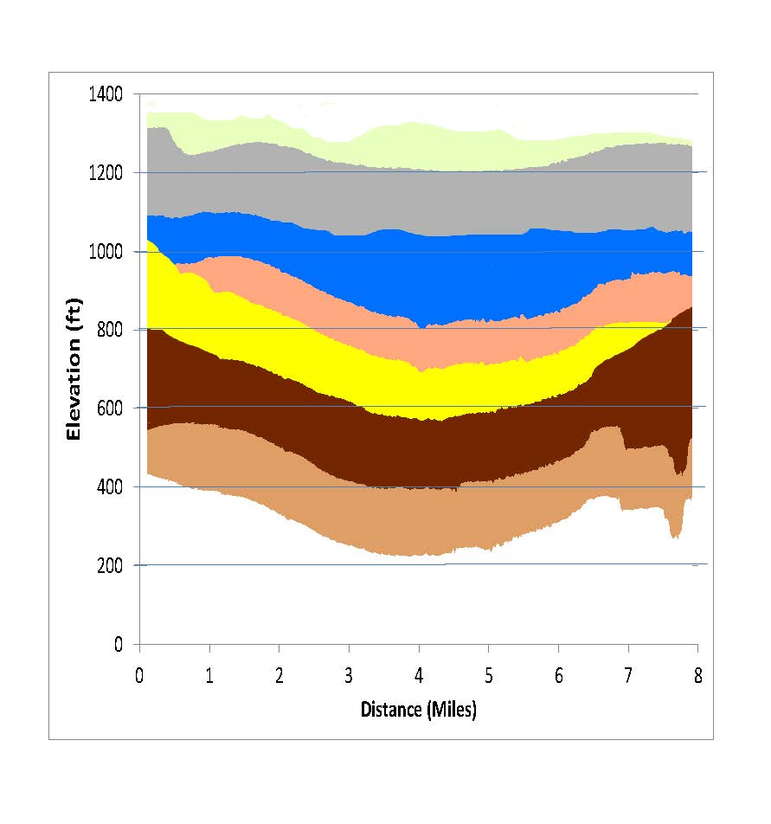
Application Function
There are two types of formats data can be displayed
Single point on map
Click
Location services
Polyline drawn to generate a cross section

Slide 18
Project Framework
PostgreSQL/PostGIS
Spatial database
Geoserver
Web Map Service
Leaflet
Front end mapping platform
Lightweight
Javascript plugin tool library

Slide 19
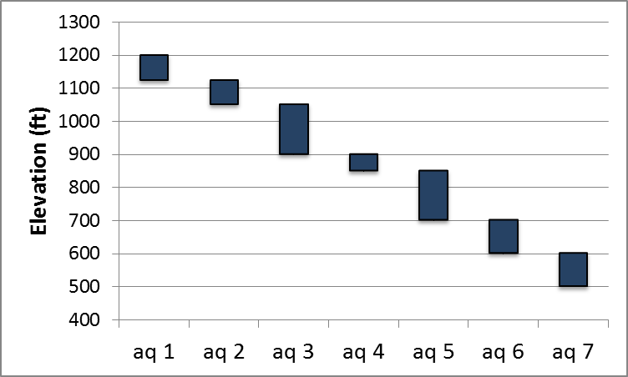
Anticipated Results
Zoom
Place and Address Search
Draw Polyline Tool
Point Marker Tool
x
1300

Slide 20
Challenges
Opportunities
Wide user group
Keep design simple
Offer help screen
Coding
Javascript
CSS
Highchart
Graphics display
Screen size
Printable
Easily duplicated for other areas
Location services using GPS from mobile devices
Framework built for other data sets
Wells
Water levels
Water quality
Brackish water

Slide 21
Timeline
Data compilation and formatting
July –Aug 2015
Database and server construction
Sept 2015
Web application coding
Sept-Dec 2015
Application testing
Dec 2015
Project report
Dec 2015–Jan 2016
Presentation
Spring 2016

Slide 22
Possible Presentation Venues
Association of American Geographer's conference
March 29- April 2, 2016 San Francisco, CA
Texas Water Conservation Association conference
March 2-4 2016 Woodlands, TX
Texas Alliance of Groundwater Districts quarterly meeting
March 2016

Slide 23
References
Central Texas Groundwater Conservation District, Maps, Retrieved on June 16, 2015 from http://www.centraltexasgcd.org/maps-2/
Elliott, M, 2011, “Use your iPhone to find or track bike routes” Retrieved on July 7, 2015 from http://www.cnet.com/how-to/use-your-iphone-to-find-or-track-bike-routes/
Freeze, R. A., & Cherry, J. A. (1979). Groundwater.
High Plains Aquifer System-Water Levels Time Series, Retrieved on June 12, 2015 from http://hpasgam.intera.com/
Minnesota Geological Survey, Online Map Services, Retrieved on June 15, 2015 from http://www.mngs.umn.edu/service.htm
Regional District of Nanaimo, Watersheds and Aquifers 101, Retrieved on July 16, 2015 from http://www.rdn.bc.ca/cms.asp?wpID=2415
Texas Water Development Board, 2009, “Groundwater Availability Model for the Hill Country Portion of the Trinity Aquifer System, Texas”
The Edwards Aquifer Website, Gregg Eckhardt, Retrieved on June 17, 2015 from http://www.edwardsaquifer.net/geology.html
United States Department of Energy Hanford Site, Annual Reports, Retrieved on June 12, 2015 from http://higrv.hanford.gov/Hanford_Reports/Cross_Section_Tool/
United States Geological Survey Texas Science Center, Texas Geology Web Map Viewer, Retrieved on June 5, 2015 from http://txpub.usgs.gov/dss/texasgeology/

