Slide 1
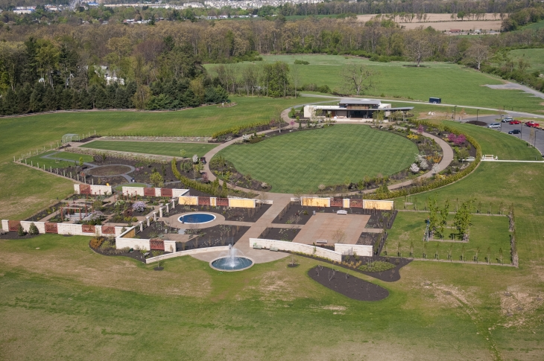
Implementing a Geospatial Database at the Arboretum at Penn State
GEOG 596A: Capstone Project
James Spayd
August 4, 2015
Advisor: Professor Ken Tamminga

Slide 2
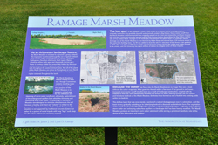
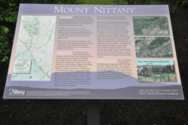
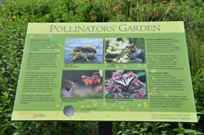
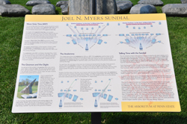
Presentation Overview
History of PSU Arboretum
Goals
Timeline
Data Collection Methods
Data Storage (Current/Future)
Application Development
Future Considerations
Interpretative Signs

Slide 3
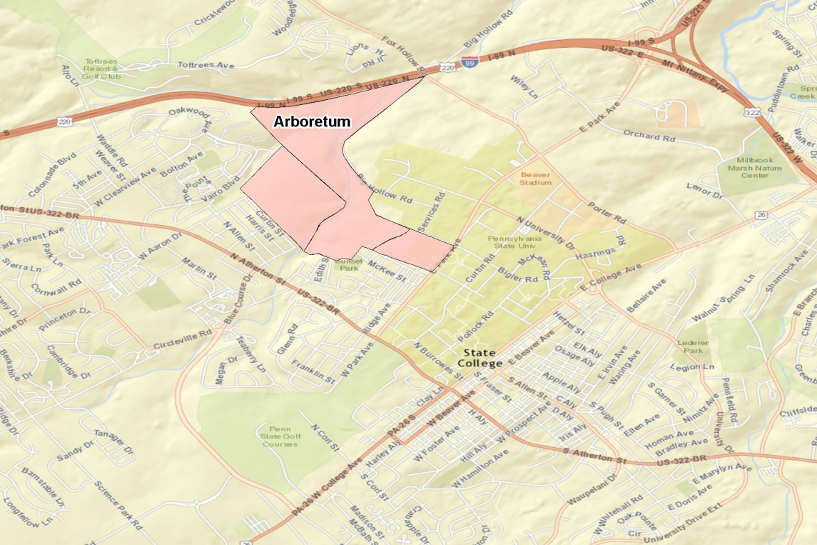
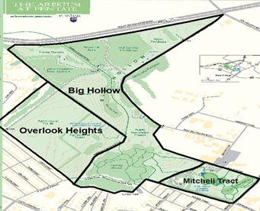
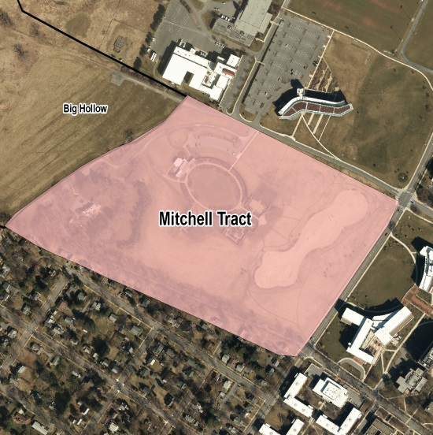
Study Area
Arboretum at Penn State
(400 acres)
Big Hollow
(232 acres)
Overlook Heights Upland (90 acres)
Mitchell Tract
(73 acres)
The main focus of this project is the mapping of the H.O Smith Botanical Gardens located on the Mitchell Tract
Big Hollow and Overlook Heights Currently managed as Pennsylvania natural areas.

Slide 4
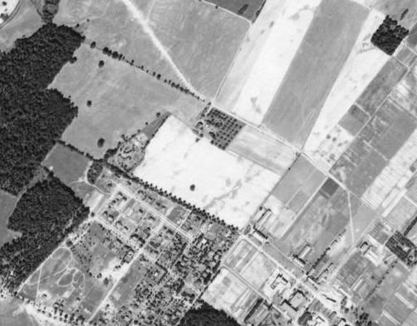
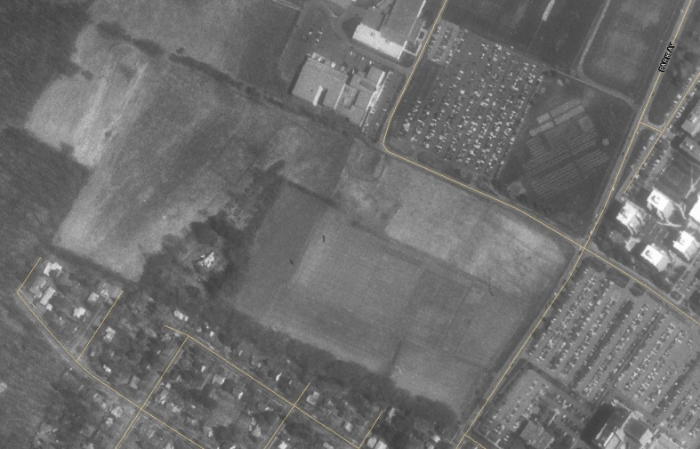
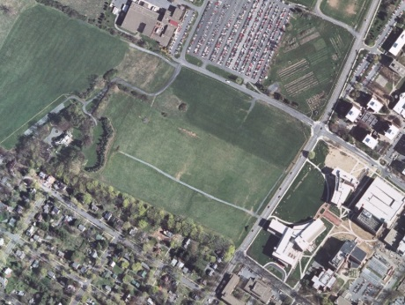
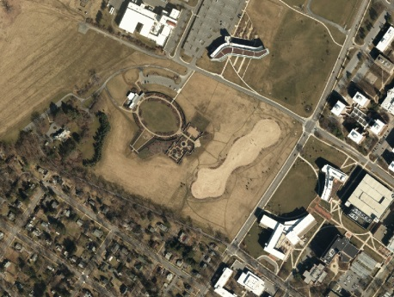
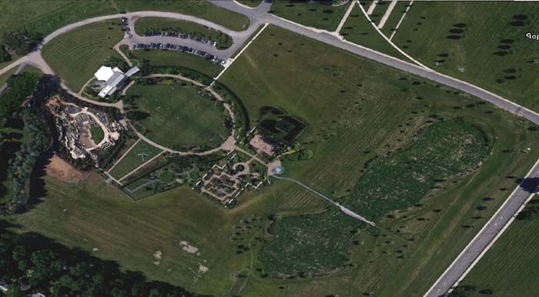
1938
1993
2005
2012
2014

Slide 5
Goals and Outcomes
PRIMARY GOAL
MISSION
The mission of The Arboretum at Penn State is to engage the academic strengths of the University in promoting scholarship and education about plants and their history and importance on earth.
VISION
The Arboretum at Penn State strives to be a place of beauty and renewal, a venue for the arts, and a pathway to discovery and enrichment for all who visit.
CORE VALUES
Above all else, the staff and supporters of The Arboretum at Penn State are dedicated to excellence, emphasizing the quality of collections, materials, function, and design.
Mission, Vision, and Core Values from The Arboretum at Penn State website (http://arboretum.psu.edu/)
Expected Outcomes from Primary Goal
Create a spatial system, from planting to online mapping
Create base maps of gardens, lands, and facilities
Map memorial/commemorative items
Spatially enable plant accession database (Lat/Long all plant centers)
Migrate existing database from BG Base to Iris BG
Create desktop application of memorial/commemorative items
Create desktop application of all plant accessions locations
Create mobile application of all plant accessions locations

Slide 6
Timeline
5/1/15 - 5/31/15
Populate ArcGIS Public Garden Data Model w/Base Data
5/13/15 - 6/30/15
Digitize Commemorative Items (Trees, Benches, Plaques)
5/13/15 - 6/30/15
Digitize Initial Base Maps (Lawns, Walkways, Buildings, Walls)
6/1/15 - 6/30/15
Setup ArcGIS Collector App.
7/3/15
Meet with Arboretum Web Developer
7/1/15 - 7/31/15
Expected 2015 Imagery - PSU OPP
7/1/15 - 7/31/15
Setup Arrow GPS Booster and RTK System
2015
05
06
07
08
09
10
11
12
2016
02
03
2016
5/1/15 - 12/31/15
Data Collection/Coordinated with ARB Staff
8/4/15 - 9/1/15
Build Prototype Applications Commemorative Items
31 days
Migration of Accession Database from BG Base to Iris BG
49 days
8/9/15
49 days
9/1/15 – 10/1/15
Gather Prototype Feedback
30 days
10/1/15 - 11/1/15
Build Full Application
245 days
1 day
1/1/16 - 3/31/16
Construct Mobile Application
31 days
31 days
1 day
29 days
36 days
41 days
91 days

Slide 7
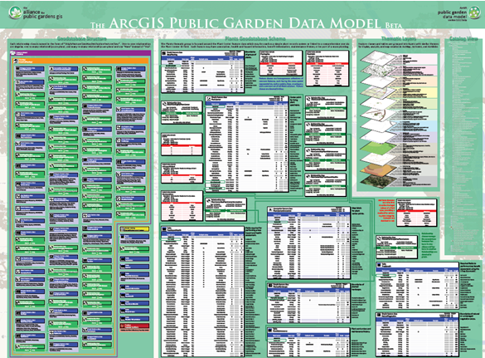
Comparative Review
Arnold Arboretum (Harvard)
Database – BG Base
Collection Method – various (survey, hand held)
GIS Data - Alliance for Public Gardens data model
UC Davis
Database – Iris BG
Collection Method – iPad
GIS Data - Alliance for Public Gardens data model
Hoyt Arboretum (Portland, OR)
Database – Iris BG, Iris BG mapping component
Collection Method – azimuth and distance from known point
GIS Data – esri in house model
Denver Botanical Gardens
Database – BG-Base\BG-Map
Collection Method – GPS data with a Trimble GeoXT
GIS Data - NA
Longwood Gardens
Database – BG-Base
Collection Method – iPad Garden Notepad +
GIS Data - Alliance for Public Gardens data model
Norfolk Botanical Gardens
Database – Iris BG (switch from BG-Base\BG-Map)
Collection Method – hand held WindowCE, Digitizing,
GIS Data –Iris Map

Slide 8
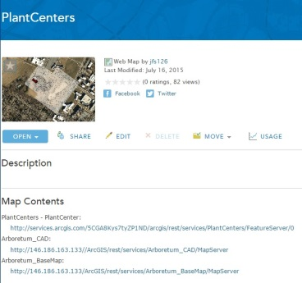
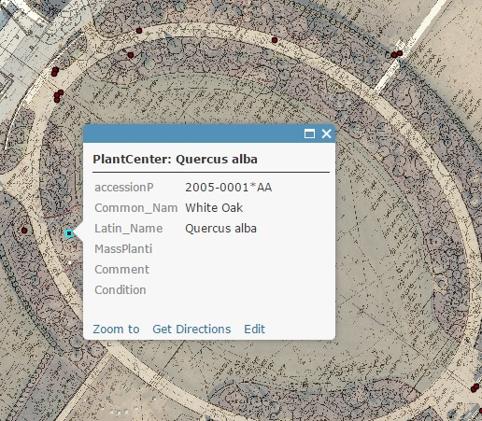
Data Collection Methods
Digitize
Gardens, structures
Commemorative items (benches, trees, plaques)
Mobile Data Collection
ArcGIS collector app
iPad
Arrow GPS Booster (next slide)
Aerial photography/CAD
(base map navigation)
Join Point to Database
Extract from online
Link to accession database
by Accession ID

Slide 9
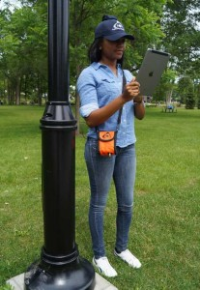
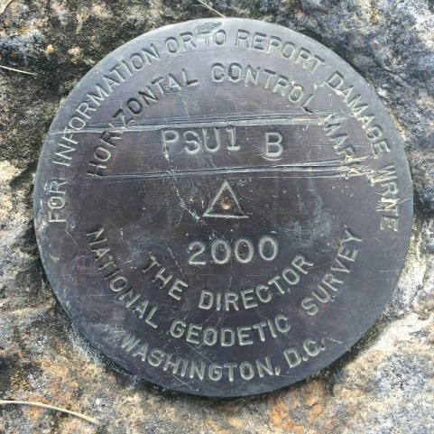
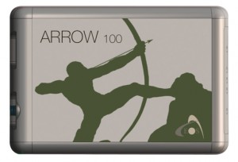
GPS Booster Arrow 100 GNSS Receiver by EOS Positioning Systems
Key Features
Full GNSS : GPS/GLONASS/Galileo/BeiDou/QZSS
iOS compatible
60cm real-time accuracy
Supports Esri software
Accuracy checked against
Geodetic Control Stations
(State College, Black Moshannon)
Still testing to improve performance
Improved - 2.5 meters to sub meter.

Slide 10
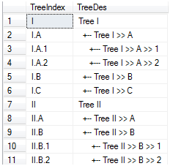
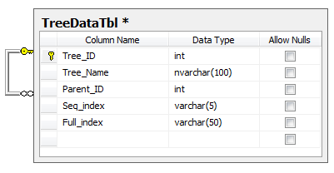
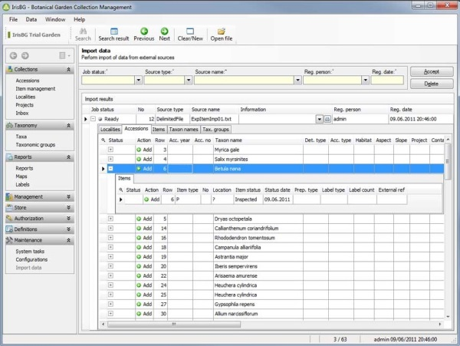
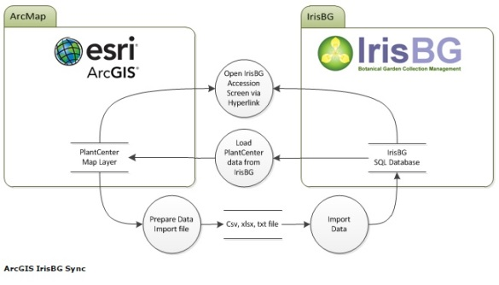
Database Migration
Current
Query Based Interface (Not User Friendly), Lacks Good Spatial Functionality
Future
GUI Interface (User Friendly), Excellent Spatial Functionally (esri) , Integrated with
ArcGIS Public Garden Data Model, Mapping Component, Good Support

Slide 11
Data and Version Documentation
This Database will grow with the Growth of the Arboretum.
Many different people will be involved over time.
The key to successfully accomplishing this, is good documentation.

Slide 12
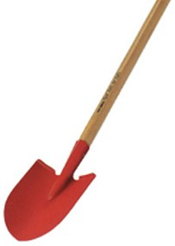
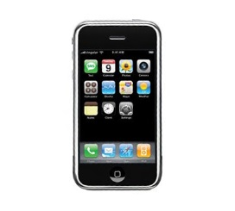
Application Needs Assessment (personas of potential application users)
Arboretum Staff
Internal mechanism to maintain the day-to-day operations. (update/move accessions, measure areas for planting or burning, quickly make maps)
Development Staff
Show off Donated Items to Donors and Potential Donors
Students
University and K – 12
Volunteers
Extension of the Staff, Uses Applications to Assist Visitors or Help with Daily Operations
Public Visitor
Main Target for Mobile Application - Enhance the Visitors Experience with Navigation and Plant Knowledge
Online Visitor
Main Target for Desktop Application - Virtually Visit the Arboretum, Have Experience as if They are Actually on the Garden Grounds

Slide 13
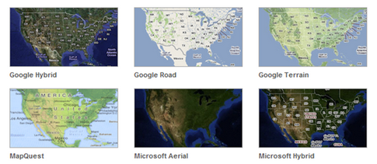
Application Layers and Functionality
Base Layers:
Arboretum polygon base maps
Arboretum Imagery 2012
Arboretum Imagery 2010
Arboretum Imagery 2005
Google, Bing, esri Base maps
ArcGIS Public Garden Data Model:
Accession database
(plant points Lat/Long)
Mass plantings
Benches
Plaques
Signs
Path and access lanes
Water streams\ponds
Roads (used for geocoding)
Tools and Functions:
Ability to view plant ,query ,read attributes
Download plant locations as shapefile/geodatabase/excel/CSV
Make and download map w/ title
Search commemorative items by Donor and Honoree
Search plants by Accession ID, Common Name, Scientific Name
Navigation functions:
Zoom to plant by Accession ID, Common Name, Scientific Name
Featured tours
(see layer of all conifer, maple, lilac, etc.)
Destinations
(zoom to Meadow Marsh, Strolling Garden, etc.)

Slide 14
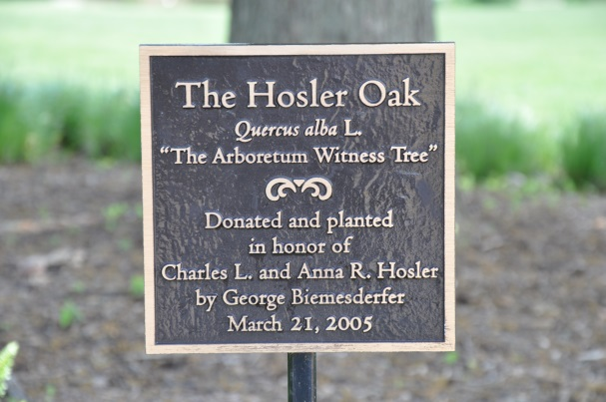
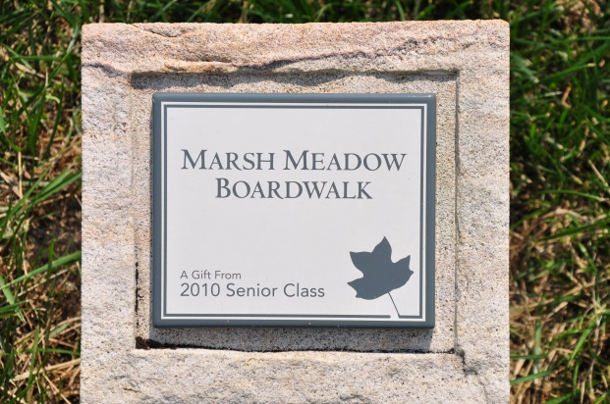
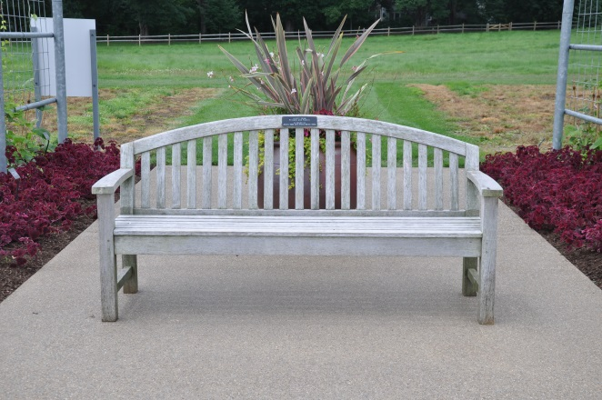
Commemorative Items
Trees
Plaques
Benches
1. Large Items, Digitize
2. Pictures
3. Thank You to Sponsors
(potential for more sponsors)

Slide 15
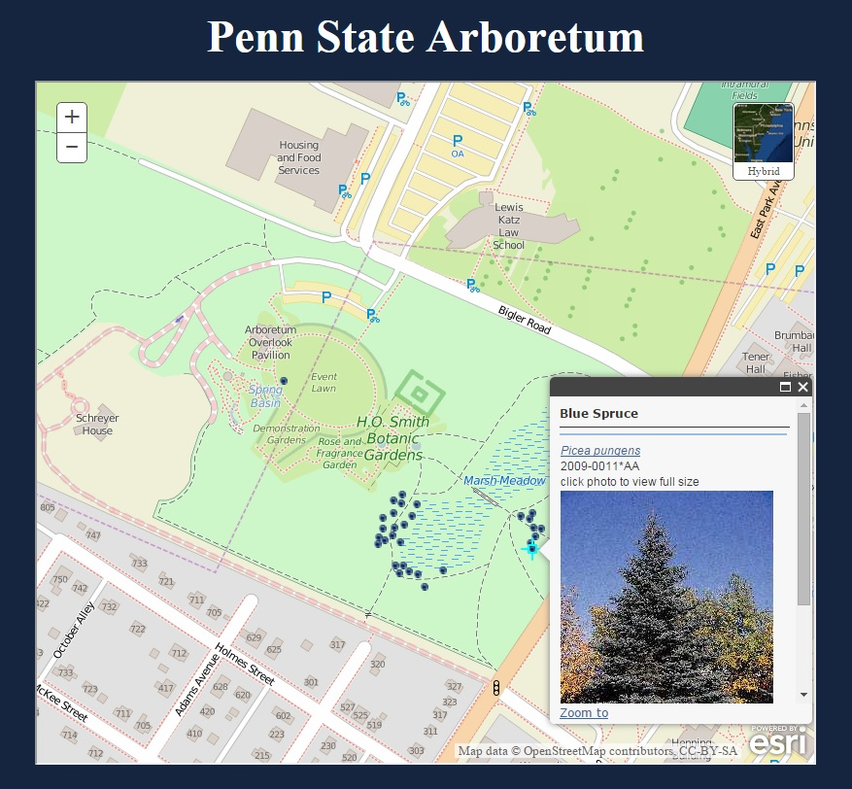
Prototype A
Simple Design
Google Maps JavaScript API and KML
Identify with Species Information and Picture

Slide 16
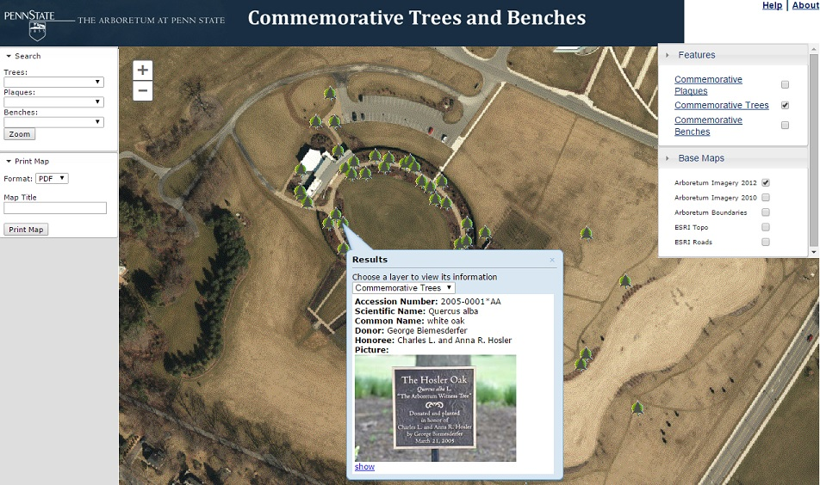
Prototype B
More Complex design
ArcGIS JavaScript API and ArcGIS server
Perform Simple Queries and Print Maps

Slide 17
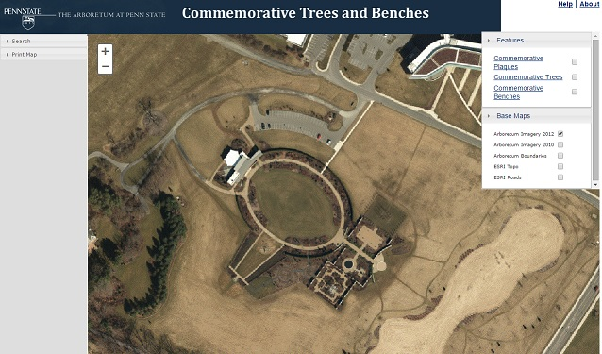
Evaluate Beta Applications/Full Accession Application Discussion
5 Scenarios Tests (likes, dislikes, and usability)
1. Toggle Features and Base maps 4. Print Usability
2. Zoom and Navigation Functions 5. Overall look and feel
3. Search Usability
Factor in likes, dislikes, and usability into final application of all plant accessions

Slide 18
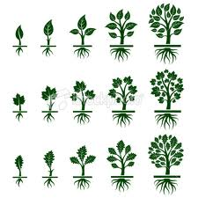
Future Considerations
new aerial photography on a yearly base from PSU OPP (digitize new features – Children’s Garden)
Methods for better point accuracy
Collect New Plants, Commemorative items
Expand to New Areas (Big Hollow, Overlook Heights)
Remove ArcGIS component by using Feature Services at Penn State (for editing)
Mobile app (ability to tour the Arb Grounds – Hand held knowledge)

Slide 19
References
Alliance for Public Gardens GIS (2015), Retrieved 1 July, 2015 from http://publicgardensgis.ucdavis.edu/
EOS Positioning Systems (2015), Retrieved 27 July, 2015 from
http://www.eos-gnss.com/arrow-100/
ESRI. ArcGIS Online for Public Gardens (2015), Retrieved 7 July, 2015 from http://solutions.arcgis.com/parks-gardens/help/arcgis-online-for-public-gardens/
Penn Pilot (2015), Retrieved 9 July, 2015 from http://www.pennpilot.psu.edu/
Pennsylvania Spatial Data Access (PASDA) (2015), Retrieved 6 July, 2015 from http://www.pasda.psu.edu/
Sasaki Associates Inc. (1999), Preliminary Master Plan for the Penn State Arboretum Urban Forest Management
The Arboretum at Penn State (2015), Retrieved 9 July, 2015 from http://arboretum.psu.edu/

Slide 20
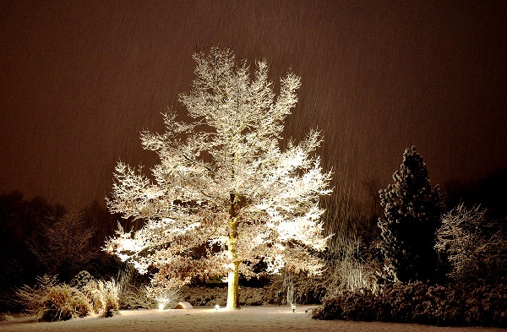
Acknowledgements
Ken Tamminga
Doug Miller
Beth King
Maurie Kelly
Ryan Baxter
Arboretum Staff
Alisha Barton
Shari Edelson
Patrick Williams
Kathleen Reeder

Slide 21
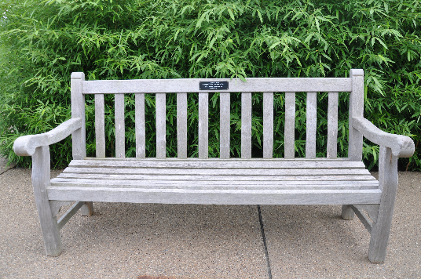
Questions??????????

