Slide 1
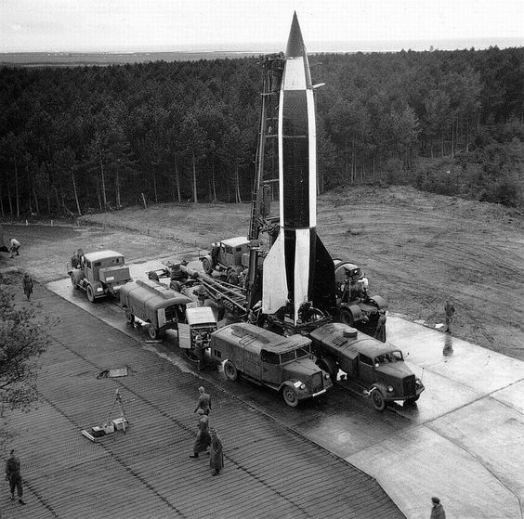
Geospatial predictive modeling of the V-2 Ballistic Missile
Andrew Stangl, MGIS Candidate
Todd Bacastow, PhD, Advisor
The Pennsylvania State University
GEOG 596A, Spring 2016
Notes:
My name is Andrew Stangl and today I’ll be presenting an overview of my capstone project which aims to develop a geospatial predictive model for the locations of wartime launch sites used by V-2 ballistic missile launch crews during the Second World War.

Slide 2
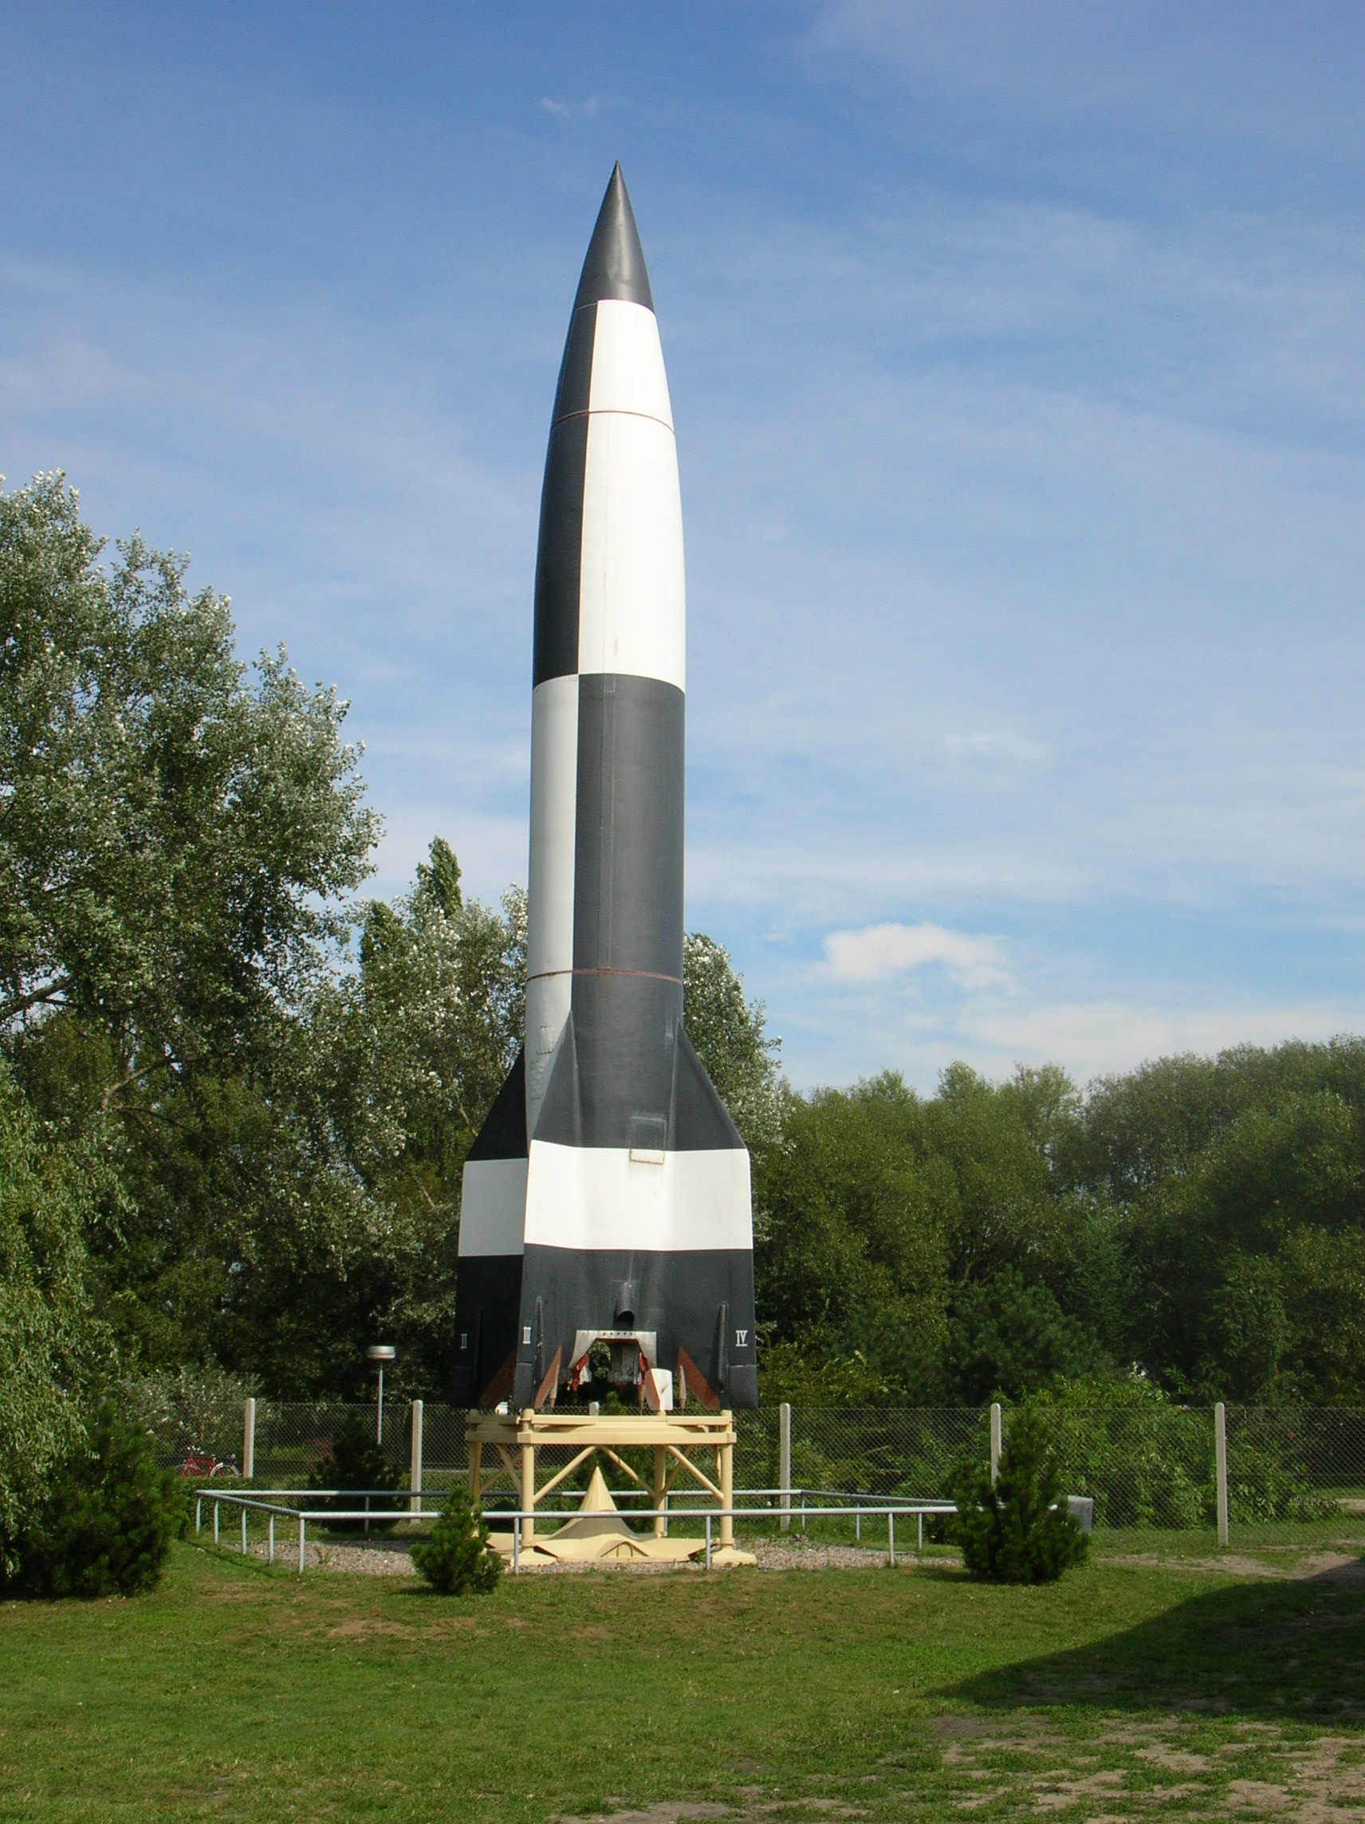
Presentation Outline
Project background
Goals and Objectives
Proposed research method
Anticipated results
Project timline
V-2 on display at Peenemünde museum
Notes:
First I will provide an overview of the project and what I hope to accomplish through additional research and the importance of this project. I will then discuss the method I have selected for this project, contrast it with another method I considered, and share the overall outcomes I expect to achieve. I’ll conclude this presentation with a look ahead at my plans for completing my project during the Spring 1 semester in 2017.

Slide 3
Project background
The V-2 missile is the progenitor for all modern mobile missile systems
We have extensive knowledge of the V-2 system, operations, and operational limitations; information all ideally suited to modeling
Signature Analyst will be used to create a geospatial predictive model from available and user created geospatial data layers
A new look at historical data to explain decision making from discovering spatial patterns associated with the V-2’s combat campaign
These spatial patterns may provide insight into other mobile missile operations
Notes:
First some background on the V-2 itself. The V-2 was the world’s first mobile ballistic missile and the progenitor for all modern mobile missile systems. It was capable of delivering a 1-ton warhead to a distance of almost 300 kilometers (186 miles). Despite great efforts and resources levied against it, no countermeasures were ever developed against the V-2 and the Allied powers never succeeded in stopping a single V-2 from launching. What they did do however is consume valuable time, energy, and resources that might have been put to better use. The V-2 threat only ended when the launch sites were overrun.
Approximately 70 years later, we have extensive knowledge of the system, its development, launch site locations, technical limitations, and other geospatial data layers suitable for predictive modeling.
As such, I’ve selected Digital Globe’s Signature Analyst software as a means by which I intend to create a geospatial predictive model using datasets that I will supply to the program. From these datasets called “factors” in Signature Analyst, the program will take into consideration a supplied sample dataset of event, in this case V-2 launch sites within a defined Area of Interest (AOI), and will show where an event is most likely to occur based on an advanced statistical technique known as geospatial preference modeling. This technique works under the assumption that human behavior and other events are influenced by a wide range of environmental, cultural, and social factors.
Ultimately my project is intended to contribute a new perspective and method of analyzing the historic V-2 campaign and if successful, this may provide a basis for creating geospatial predictive models of other mobile missile systems.

Slide 4
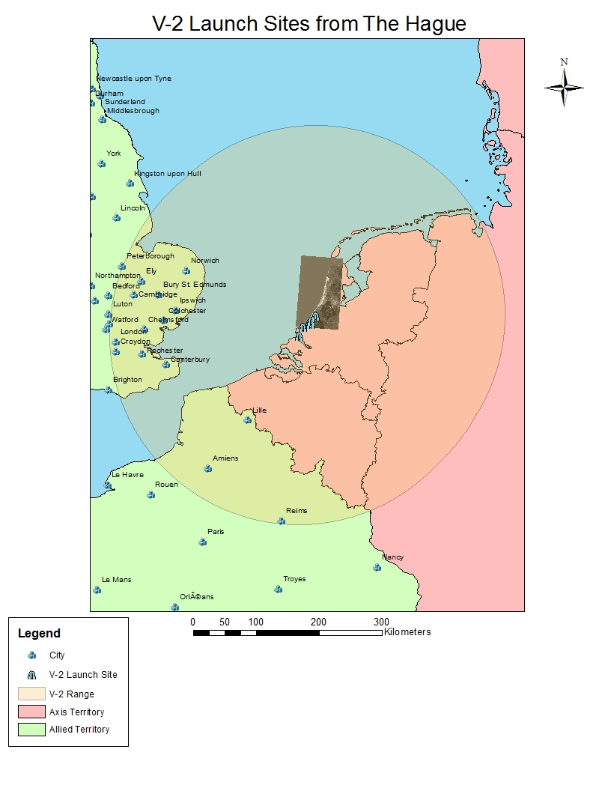
Limitations for V-2 launch sites
Target must be in range of the system (300 kilometers)
Roads must be at least three meters wide
System must be within 30 meters of a road
Access to rail station within 20 kilometers
Elevation must be low; less than 5%
Notes:
From their launch sites in The Hague, V-2 missile units could target many British cities, but their overall objective was to strike London in retribution (vengeance) for the Allied bombing raids against German cities. From the literature review I conducted, I identified five limiting factors for selecting a V-2 launch site and launching the V-2. This included information obtained from the V-2 operator’s manual used by the launch crews. If the geospatial predictive model Signature Analyst generates holds, these factors should emerge as significant variables when selecting a V-2 launch site.

Slide 5
Goals and objectives
Goal: Develop a geospatial predictive model that accurately predicts the locations of V-2 launch sites
Goal: Contribute a new perspective and method of analyzing the historic V-2 campaign
Objective: Test spatial Bayesian probability as an area limitation analysis method
Notes:
My project has two goals and one objective for accomplishing both. My first goal is to create a geospatial predictive model that accurately predicts the locations of V-2 launch sites. Assuming I reach this goal, I would then use the results from the analysis which generated the model to provide unique information and insight into the V-2 campaign in a way not previously done.
The success of both goals depends on my objective of testing spatial Bayesian probability as an area limitation analysis method. Bayesian probability theory provides a mathematical framework for performing inference, or reasoning, using probability. This method is inherent within the inductive analysis performed by Signature Analyst.

Slide 6
Proposed research method
Collect or create spatial data layers such as V-2 wartime launch sites in The Hague, road and rail data, urban areas, elevation data
Determine real and self-imposed operational limits on the V-2
Discover and classify map or maps to obtain terrain data from 1944-45 in and around The Hague
Use Signature Analyst software to test Bayesian probability as a means of developing a geospatial predictive model
Compare historical information on the V-2 with results from Signature Analyst to determine the model’s accuracy
Notes:
I considered using a Boolean logic method and a Bayesian method to create a geospatial predictive model for this project. A Boolean logic approach would have involved overlaying several spatial data layers and selecting only the areas which overlapped. This straightforward “true” or “false” deductive method would have been simpler but rested on the assumption that the data layers I selected for the analysis were all important factors in selecting a launch site for the V-2. This deductive approach, unlike the inductive approach, would not discover previously unknown relationships between variables that might influence the selection of a V-2 launch site.
The Bayesian approach I selected for this project because uses an inductive method to discover relationships between factors and their influence on events. This allows previously unknown or unconsidered patterns to emerge which can then be analyzed and studied to explain the relationship by a subject matter expert.
This means I will need to obtain or create spatial data layers such as V-2 wartime launch site locations in and around The Hague, road network and rail network data, demographic data, and elevation data.
I will also need to obtain terrain data by classifying one or more maps to break out urban areas from forested areas, water, grassland, etc.
With all of this information, I intend to use Digital Globe’s Signature Analyst software, which uses a Bayesian method to analyze relationships between variables, to create a geospatial predictive model.
Once complete, I will compare the results generated by Signature Analyst to real historical data to determine the accuracy of the model.

Slide 7
Signature Analyst
Digital Globe proprietary software designed to show where an event is most likely to occur, risks and opportunities, and how to best deploy resources
Relies on geospatial preference modeling which assumes that human behavior and other events are influenced by a wide range of environmental, cultural, and social factors
Capable of both inductive and deductive modeling, though favors inductive modeling due to software capabilities
Produces a statistical locations map as an output showing the liklihood of future events based on user supplied datasets
Notes:
As I discussed earlier, Signature Analyst uses a Bayesian approach to perform statistical analysis, which unlike the Boolean logic method, shows the likelihood of an event (in this case, V-2 launch site) occurring at a given location. The analysis performed by Signature Analyst is intended to manage finite resources and highlight previously unrecognized opportunities or insight. This is another reason I chose the software, given the enormous resources poured into counter the V-2 during World War 2 and the debate that occurred at the time about how best to allocate resources. (Anecdote about Eisenhower)
Signature Analyst is capable of ingesting a wide range of factors to include, environmental, cultural, and social factors which would be difficult, if not impossible, to incorporate into a Boolean logic based approach.
While Signature Analyst is capable of deductive modeling, it strongly favors the inductive approach, which is what I intend to use in this project.
Signature Analyst's’ output from all of the ingested data is a statistical locations map, or “hot spot” map, intended to show the likelihood of an event occurring with the user-defined area of interest.
Later in the presentation I’ll show an example output from Signature Analyst that I created using some of the data layers of acquired for this project.

Slide 8
Literature review
V-2 literature focused on technical and operational aspects of the system in broad context
Predictive modeling against Iraqi SCUDs and theoretical work against mobile missile operations
Geospatial predictive modeling using Signature Analyst in other projects
Notes:
During the literature review, I focused on three main avenues of research. I first conducted a literature review of the V-2 system and its operational deployment from 1944-1945. I then reviewed several documents that focused on the experience gained from hunting Iraqi SCUDs during the Gulf War and how analysts might go about effecting hunting mobile missile units in the future.
After more than 70 years, we have extraordinary insight into the V-2 missile itself, having captured its key designers and managers, to include Dr. Wehner Von Braun and Colonel Walter Dornberger, who provided the foundational knowledge for America’s nascent missile and space programs. The most useful information on the limitations of the V-2 missile came from the field operator’s manual for the system which specified operational restrictions and best practices. None of this however answered the fundamental question of how the operational units themselves selected launch sites, which all had to be individually selected and pre-surveyed. Even had this knowledge been available, there is no guarantee that it would have been followed exactly given the uncertainties of war.
My review of the work accomplished with respect to creating a geospatial predictive model for predicting mobile missile launch sites suggests very limited work related to my project has been undertaken. Each article I reviewed recognized the problem and called for better integration of information with at least two recognizing the value of area limitation studies, but overall a belief that technology will eventually progress to the point where persistent surveillance will make tracking mobile missiles a non-issue dominated the articles. Only one article came close to calling for something resembling a geospatial predictive model but stopped short of explaining how such a model would be created or what data would or should feed the analysis.
Finally, I reviewed several articles and projects that used the Signature Analyst software which helped me better understand the software’s capabilities, limitations, and how other users interpreted its outputs.

Slide 9
Signature Analyst examples
Reviewed three projects on different issues that each used Signature Analyst to develop a predictive model
All three stressed that their models show probability of future events, not absolute certainty
The availability of data influences the accuracy of the model and relies on the user to modify inputs as previously unknown relationships and patterns are discovered
Notes:
To better understand Signature Analyst and how it could fit my project, I reviewed three different projects that used Signature Analyst to develop a geospatial predictive model. These projects looked at the spread of plants in a river basin, the potential locations for future migrant boat crossing in the Caribbean, and identifying geospatial patterns associated with Al-Qaeda in the Maghreb. All three stressed the importance of data, its selection by the user, and the final model showing probability, not absolute certainty.
In addition to showing me practical examples of using Signature Analyst, these projects also helped me to identify other datasets that may be useful for my project, such as demographic data.

Slide 10
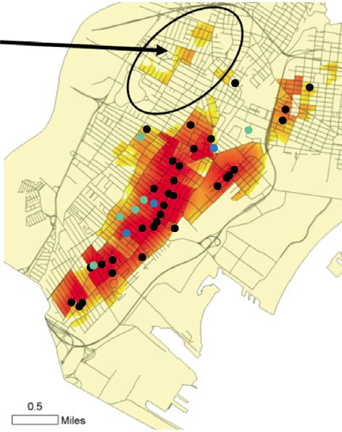
New Jersey shootings case study
Why does this area have a high likelihood
for shootings?
Black dots indicate real shootings in Jersey City
The darker the red, the higher likelihood for a future shooting
More than 500 geospatial factors were included in the analysis
Model accuracy unfortunately verified shortly after
Notes:
This case study traces the use of Signature Analyst against real crime data from Jersey City, New Jersey. The goal is to help law enforcement improve their operations by anticipating the locations of future shootings. The geospatial statistical modeling application helped to anticipate the future by identifying areas in which future criminal acts are most likely to occur based on similar past criminal acts. The black dots are the locations of shootings in Jersey City between December 2008 and March 2009.
The darker the red, the higher the likelihood for a shooting to occur after march 2009. There is one shooting that fell outside the high likelihood areas. This shooting becomes part of a special analysis to determine how it was different and, if relevant, will be used to improve the model.
The more homogeneous analysis events are, the better the model narrows the area of likelihood. If drug-related shootings, gang retribution shootings, domestic violence, and armed robbery shootings are lumped together, the results are less accurate in forecasting future locations of events, than if events are analyzed separately. This is part of the special methodology, learned in the military and intelligence community, that can be transitioned to domestic law enforcement.
On the night of June 8th, a shooting occurred in one of the areas where no shootings had occurred in the previous
eight months, yet was identified only days before as a high likelihood shooting area (please see Figure 6). This was a
very unfortunate way to demonstrate the value of geospatial statistical modeling.

Slide 11
Signature Analyst for the V-2
A sample of 20-30 known V-2 launch sites will serve as the dependent variable (events)
Spatial datasets are the independent variables (factors) which may be added and updated to the software as they are acquired
The Area of Interest (AOI) for this project will be The Hague and the surrounding area as defined in a 1944 map acquired from the Municipality of The Hague
Notes:
My use of Signature Analyst to create a geospatial predictive model for the V-2 will incorporate a sample size of about 20-30 known V-2 launch sites, which will serve as the dependent variable (events) and the datasets I’ve acquired, built, or will build will be the independent variables (factors) in Signature Analyst. My AOI will be limited to The Hague and the area in the immediate vicinity of the city, as defined by a map I acquired of this area from 1944.

Slide 12
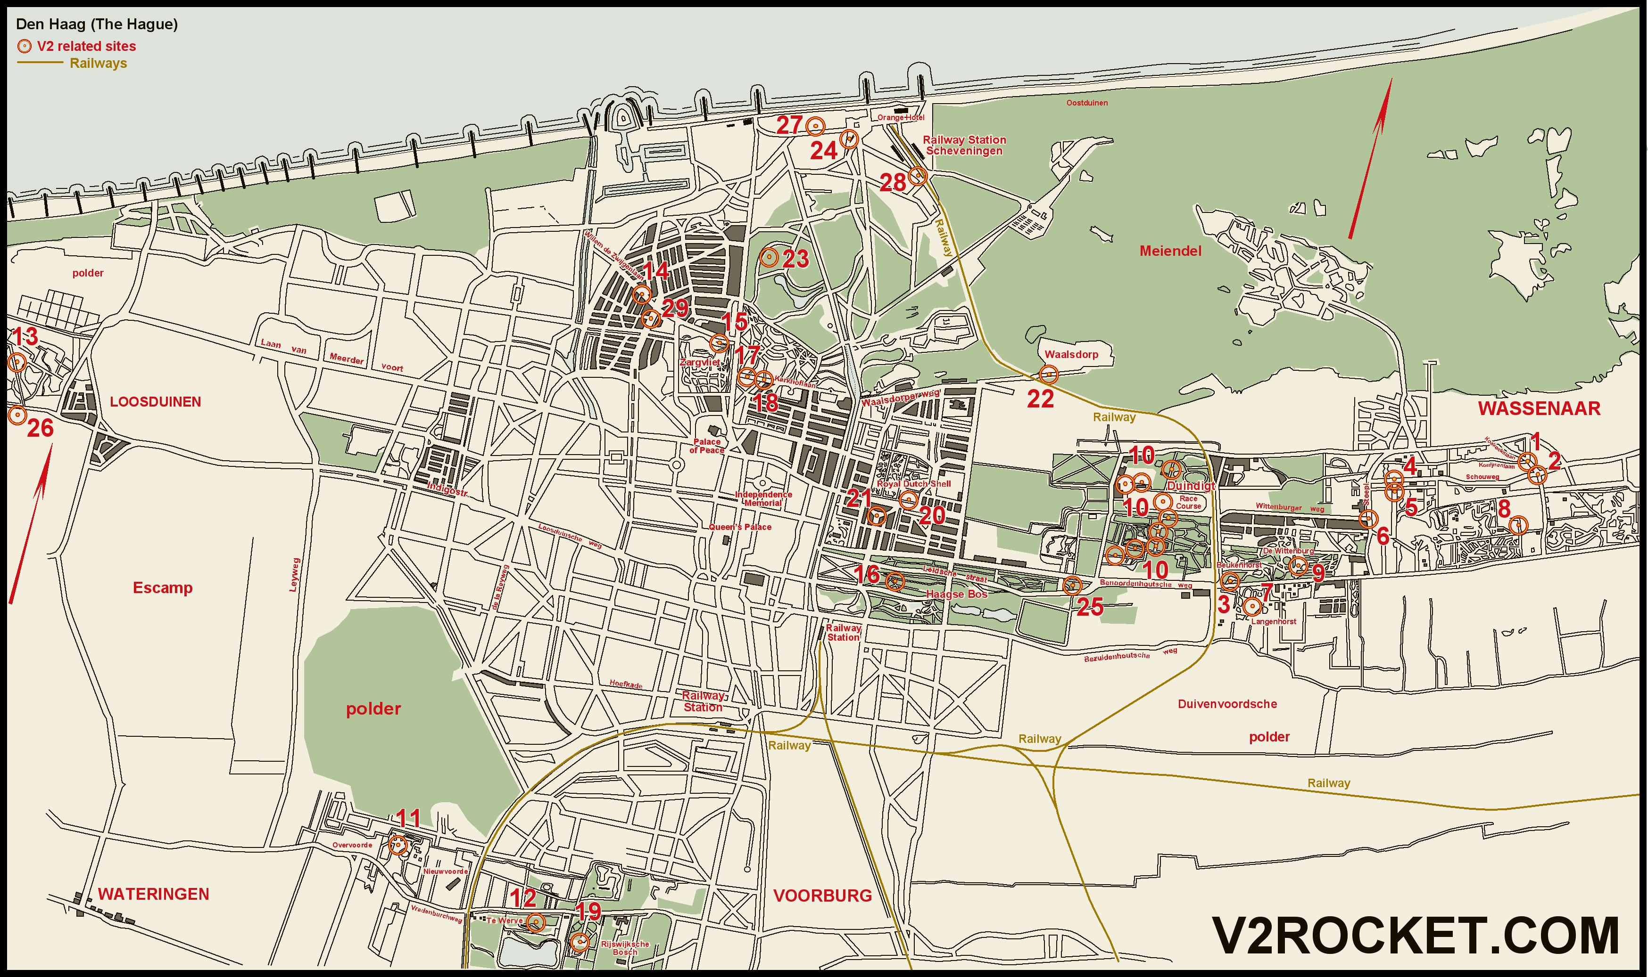
V-2 wartime launch sites in The Hague
Notes:
This partial map of The Hague shows numerous launch sites throughout, many of which have been pinpointed to street intersections. This helps to address the problem of acquiring data by reducing my AOI to The Hague and the area surrounding the city, which has a sufficient number of launch sites from which to sample. I will then be able to discuss the accuracy of the model by examining the probability it assigned to the areas which had launch sites that were not included in the sample.

Slide 13
SA with loaded events and datasets
Notes:
This is SA with several factors, events, and an AOI loaded that covers the area around the Hague. My intention is to add/refine more factors, reduce the AOI to just The Hague and the area around it, and include additional events (V-2 launch site locations) in the sample.

Slide 14
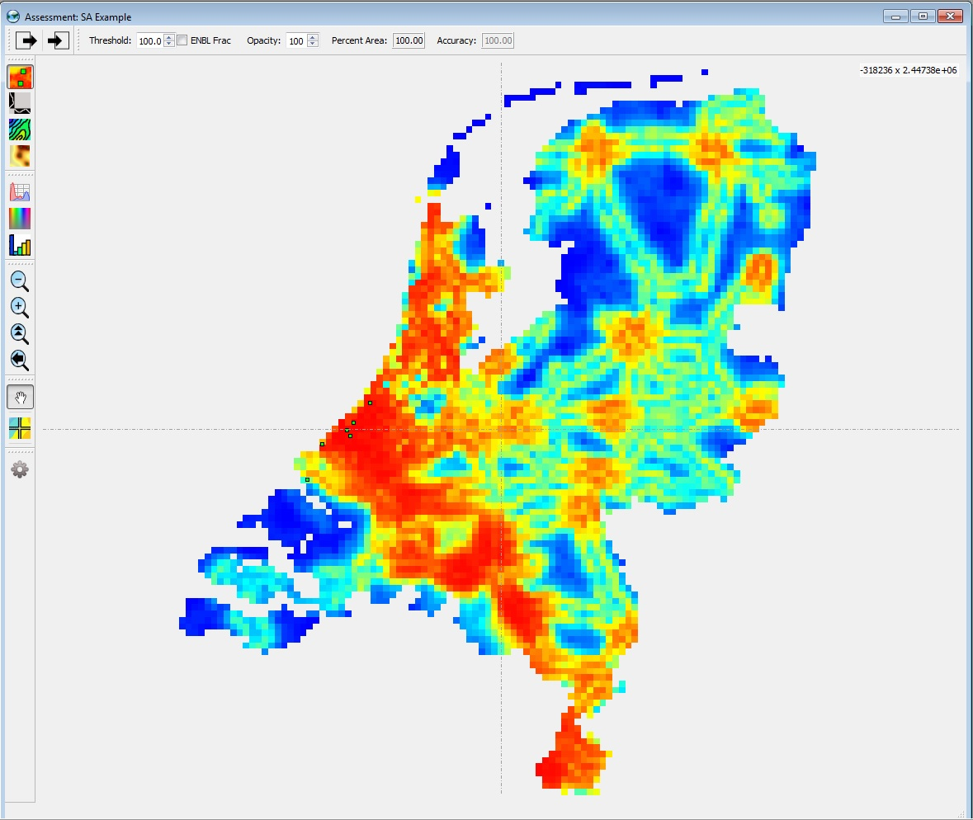
Example SA heat map output
Notes:
From the initial data layers I provided into SA, this was the output from running the assessment. Much of what I’m seeing in the heat map actually makes a lot of sense based on the data I provided, but the existing data needs to be refined and additional data layers added before running the final assessment. I’m actively working to acquire data and conducting research that includes acquiring the various features that can be digitized from a map (I recently acquired a very nice map of The Hague from 1944-45 from The Hague’s municipal government), as well as other physical and cultural elements that will fall within my final AOI.

Slide 15
Challenges and Limitations
Obtaining and/or building datasets from 1944/45
Creating data from projecting and digitizing hard copy map(s)
Signature Analyst methodology requires a baseline of spatial data layers that characterize the environment within an area of interest
Signature Analyst assumptions about geospatial data within a given AOI
Notes:
My biggest challenge so far with this project has been obtaining or creating the datasets that mostly originate fro 1944-45. This has been particularly challenging for road and rail data, which will almost certainly need to be digitized from hard copy maps. I am also making the assumption that elevation data has not changed much since 1944-45. I anticipate obtaining or creating datasets to consume much, if not most, of my time working on this project.
As I’ve previously mentioned, Signature Analyst is highly reliant on the user to supply a sufficient number of spatial datasets for it to create and accurate geospatial predictive model. The detail of the data is also important, which seems obivous, but important to note that data limitations would directly impact the output and accuracy of the model.
The probability of a future event occurring within the defined AOI in Signature Analyst rests on the assumption that geospatial characteristics of events used in the model will be significantly similar to future events. Based on my knowledge of the V-2, this assumption should be valid for my project.

Slide 16
Anticipated results
A means to accurately predict V-2 missile launch site locations
The application of Bayesian probability to solving real world problems
New patterns and historical insights into WWII V-2 launch operations not previously considered
Notes:
Given the amount of information available about the V-2 system and its wartime operations, I expect to supply a sufficient number of datasets (factors) for Signature Analyst to consider so that it assigns a high degree of probability to locations of V-2 launch sites in The Hague that were not included in the sample as potential launch sites for the system. The extent to which Signature Analyst succeeds combined with the utility of the results will determine the extent to which Bayesian probability successfully addresses this real world problem.
Finally, I expect Signature Analyst to identify relationships or patterns between or among the dependent and independent variables that were not previously known or considered important.

Slide 17
Project timeline
Task | Estimated Completion Date | Status
Acquire V-2 launch site location data | February 2016 | Complete
Acquire elevation data | February 2016 | Complete
Conduct literature review | March 2016 | Complete
Determine V-2 operational constraints | March 2016 | Complete
Finalize research method | May 2016 | In-progress
Acquire needed data from 1944-45 | August 2016 | In-progress
Use SA to test Bayesian probability | September 2016 | Incomplete
Determine accuracy of model | October 2016 | Incomplete
Produce written project report | February 2017 | Incomplete
Present at NGA Headquarters | March-April 2017 | Incomplete
Notes:
I’ve acquired a considerable amount of data on the V-2 system and its operational constraints through my literature review and some additional data, such as a 1944 map of The Hague from that city’s municipal council. I am still working to acquire additional data sets that will function as factors in Signature Analyst, however by limiting myself to studying The Hague and the area around it, I have substantially reduced the my data problem as I was initially looking at a much larger AOI encompassing much of Germany and parts of France, Britain, and the Netherlands.
After acquiring the data I need and running the analysis in Signature Analyst, I will compare the output with the locations of the launch sites that were not included in the sample. This will allow me to evaluate the effectiveness of Bayesian probability as an area limitation analysis method. I will then evaluate and explain the relationships between the events (dependent variable) and the factors (independent variable) and determine the overall accuracy of the model. I plan to compile this information into a formal report which will become the basis for my final project presentation that I hope to give at NGA’s headquarters in Springfield at the conclusion of the Spring 1 semester in 2017.

Slide 18
Questions and Comments?
Notes:
At this time, I am happy to take any questions and comments.

Slide 19
References
1. Bitzer, John A., and Ted A. Woerner. A4-Fibel. Army Ballistic Missile Agency Redstone Arsenal: German-Canadian Museum of Applied History, 1997.
2. Brailsford, Sally C. "Modeling Human Behavior - an (id)entity Crisis?" Proceedings of the Winter Simulation Conference 2014 (2014).
3. De Groot, M. (2010, August 24). Spatial History Project. Retrieved February 29, 2016, from https://web.stanford.edu/group/spatialhistory/cgi-bin/site/pub.php?id=51
4. Dungan, T. D. V-2: A Combat History of the First Ballistic Missile. Yardley, Penn.: Westholme, 2005.
5. EarthExplorer. (n.d.). Retrieved February 29, 2016, from http://earthexplorer.usgs.gov/
6. Fulghum, D. A. (1995). New intelligence link speeds mobile SCUD hunt. Aviation Week & Space Technology, 142(18), 23.

Slide 20
References continued
7. Hallex, Matthew. Chinese Mobile Ballistic Missiles: Implicat Ions for U.S. Counterforce Operations. Thesis. George Washington University, 2010. Washington, D.C.: Center for Strategic and International Studies.
8. Holland, Benjamin, Lisa Kuchy, and Jason Dalton. "Migrant Boat Mini Challenge Award: Analysis Summary a Geo-temporal Analysis of the Migrant Boat Dataset." 2008 IEEE Symposium on Visual Analytics Science and Technology (2008). 29 Apr. 2016.
9. Marks, Gerby. IDENTIFYING GEOSPATIAL SIGNATURES OF AL-QAEDA IN THE MAGHREB. The Pennsylvania State University, Fall 2010. 29 Apr. 2016.
10. Olshausen, Bruno A. "Bayesian Probability Theory." 1 Mar. 2004. Web. 3 May 2016.
11. Owen, Karen. PREDICTIVE ANALYSIS OF INVASIVE SPECIES - THE CASE OF PHRAGMITES AUSTRALIS (COMMON REED) ALONG THE RAPPAHANNOCK RIVER BASIN. Proc. of ASPRS 2009 Annual Conference, Baltimore, Maryland. 1-9.
12. Pew, Richard W., and Anne S. Mavor. Modeling Human and Organizational Behavior: Application to Military Simulations. Washington, D.C.: National Academy, 1998.

Slide 21
References continued
13. Stanley, Robert W., II. Attacking the Mobile Ballistic Missile Threat in the Post-Cold War Environment. New Rules to an Old Game. Thesis. AIR UNIV MAXWELL AFB AL SCHOOL OF ADVANCED AIR AND SPACE STUDIES, 2006. Fort Belvoir: DEFENSE TECHNICAL INFORMATION CENTER, 2006.
14. Thompson, Mark, et al. "The Great Scud Hunt." Time 160.26 (2002): 34. Academic Search Alumni Edition. Web. 28 Apr. 2016.
15. "V2ROCKET.COM - The A-4/V-2 Resource Site - The V-2 Rocket." V2ROCKET.COM - The A-4/V-2 Resource Site - The V-2 Rocket. Web. 29 Feb. 2016.
16. Zaloga, Steve, and Jim Laurier. V-1 Flying Bomb, 1942-52: Hitler's Infamous "doodlebug" Oxford, U.K.: Osprey Pub., 2005.
17. Zaloga, Steven J., and Robert Calow. V-2 Ballistic Missile 1942-52. Oxford: Osprey, 2003.
18. Zaloga, Steve, Hugh Johnson, and Chris Taylor. German V-weapon Sites 1943-45. Oxford: Osprey, 2007.

