Slide 1
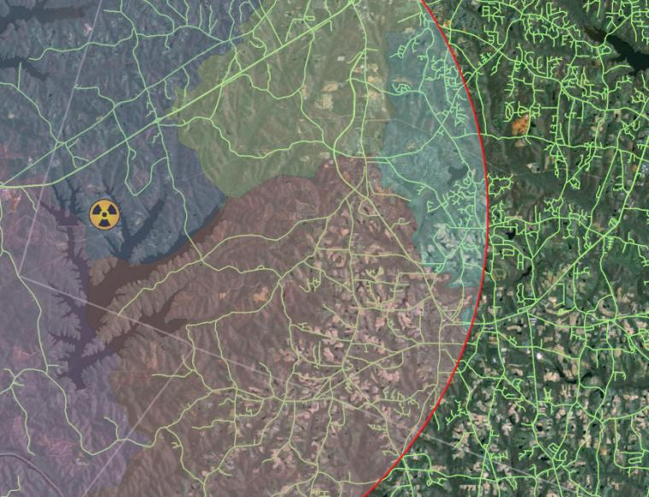
Demographic and Spatial Analysis of
North Carolina's Nuclear Plants
Mike Team
Raleigh, NC
GIS Masters Candidate
Advisor – Frank Hardisty, Ph.D.
Notes:
1
1
1

Slide 2
Overview
Background and study goals
Demographic Analysis
Spatial Analysis methods and results
Benefit Cost Analysis
Notes:
2
2
2

Slide 3
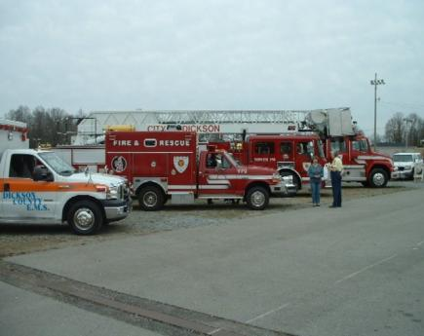
Study Goals
Notes:
3
3
3

Slide 4
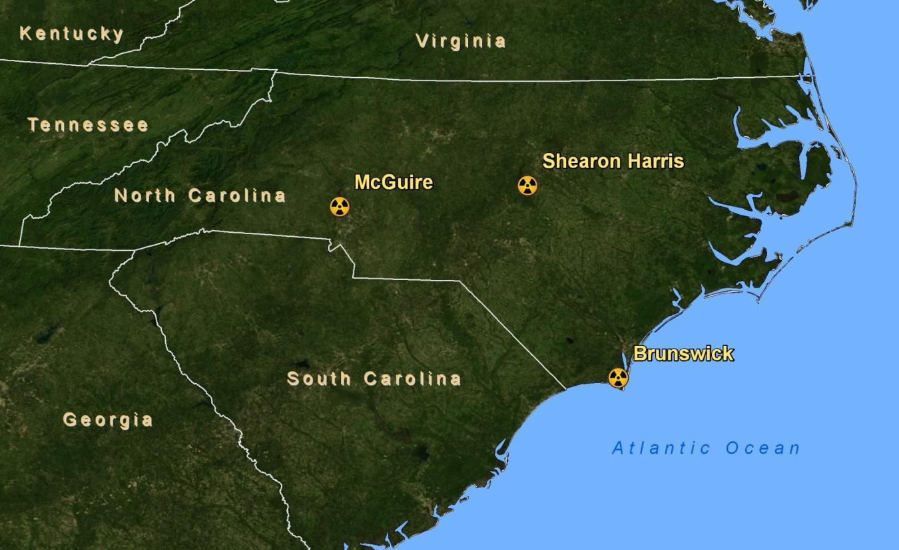
North Carolina Reactors
Show map of regional reactor sites
Notes:
4
4
4

Slide 5
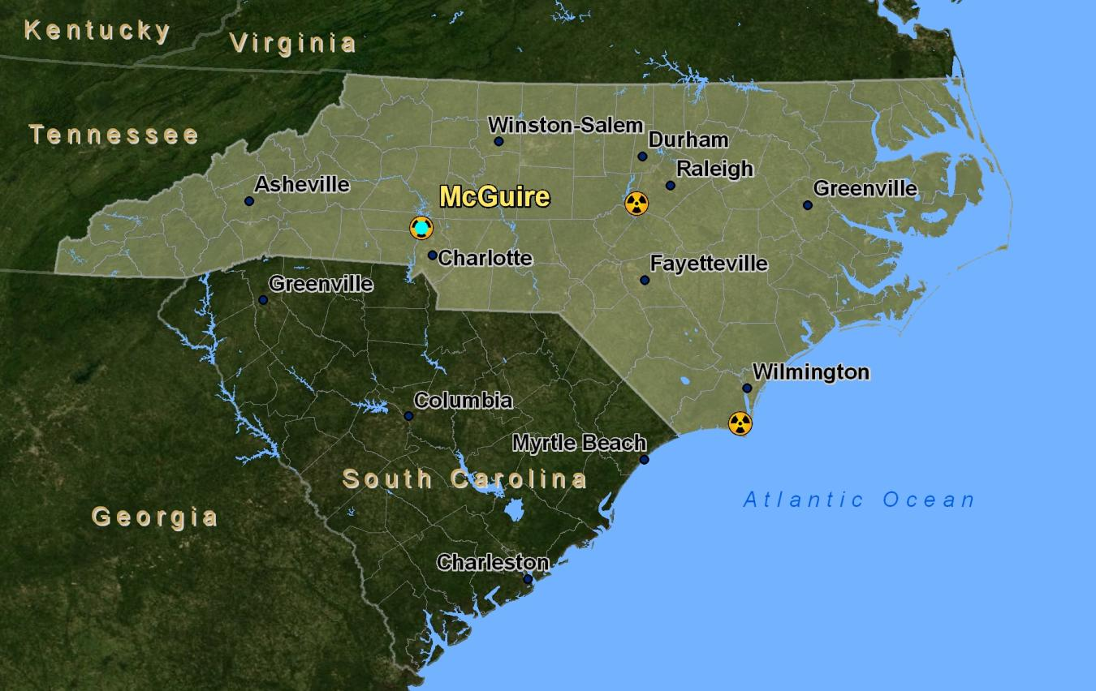
North Carolina Reactors
Notes:
5
5
5

Slide 6
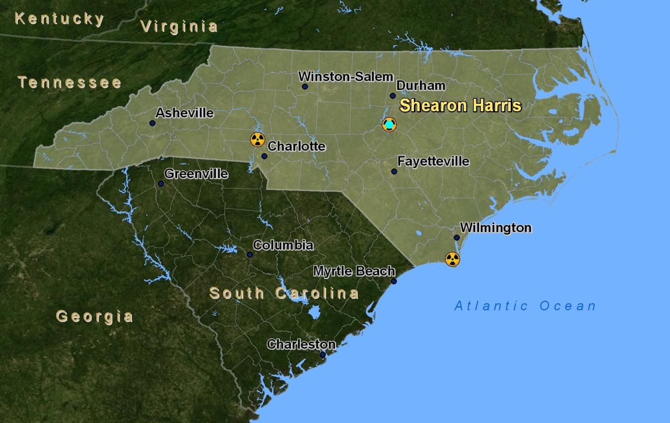
North Carolina Reactors
Notes:
6
6
6

Slide 7
North Carolina Reactors
Notes:
7
7
7

Slide 8
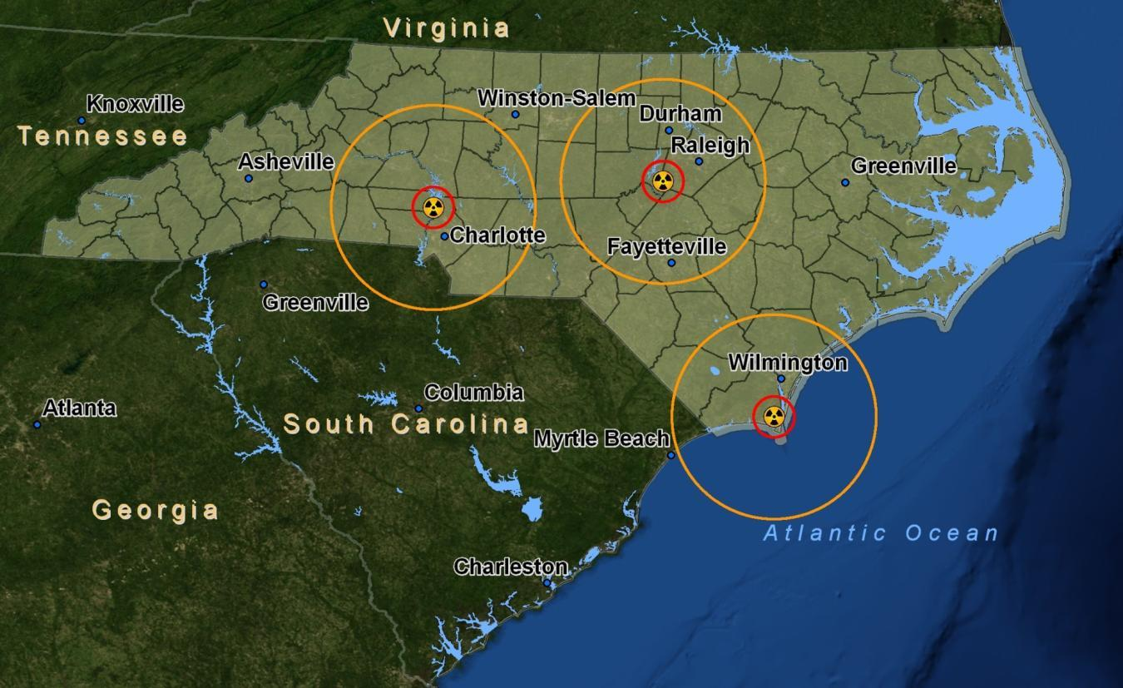
Emergency Planning Zones
Notes:
8
8
8

Slide 9
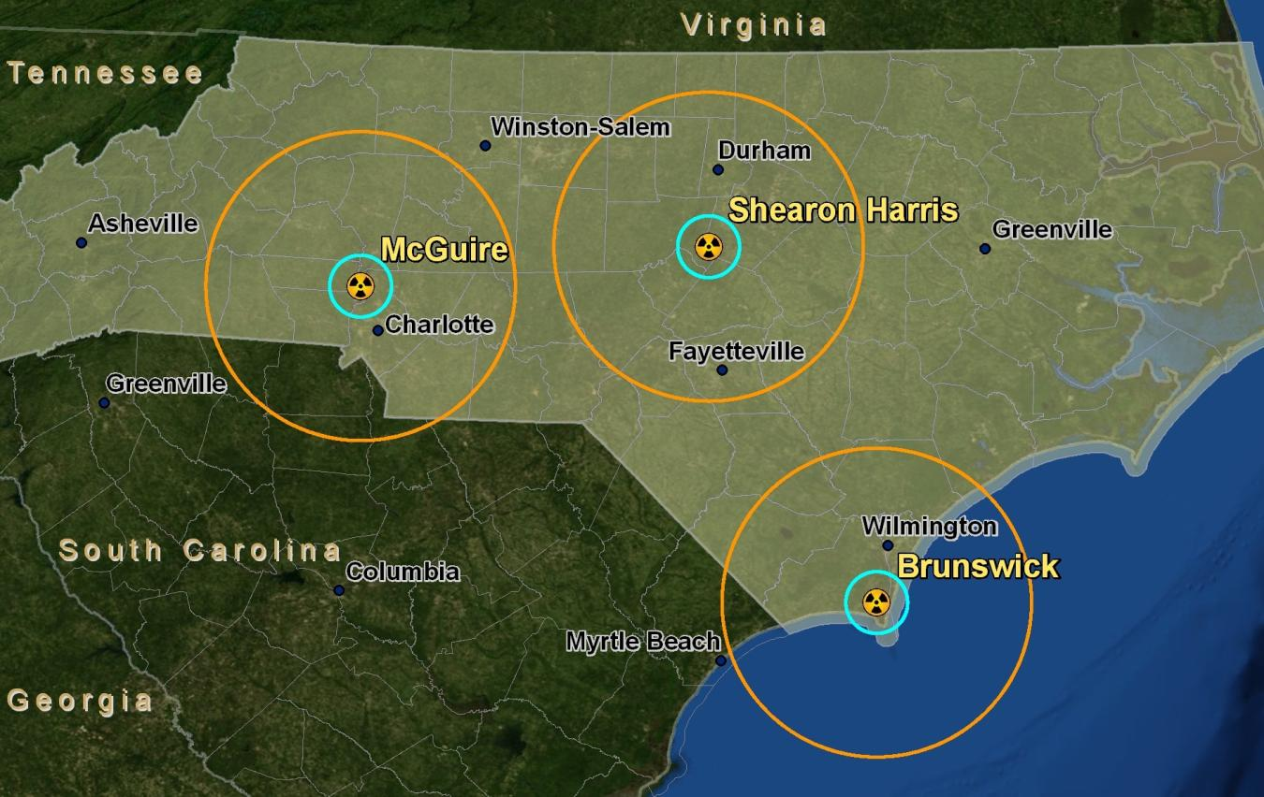
Emergency Planning Zones
Notes:
9
9
9

Slide 10
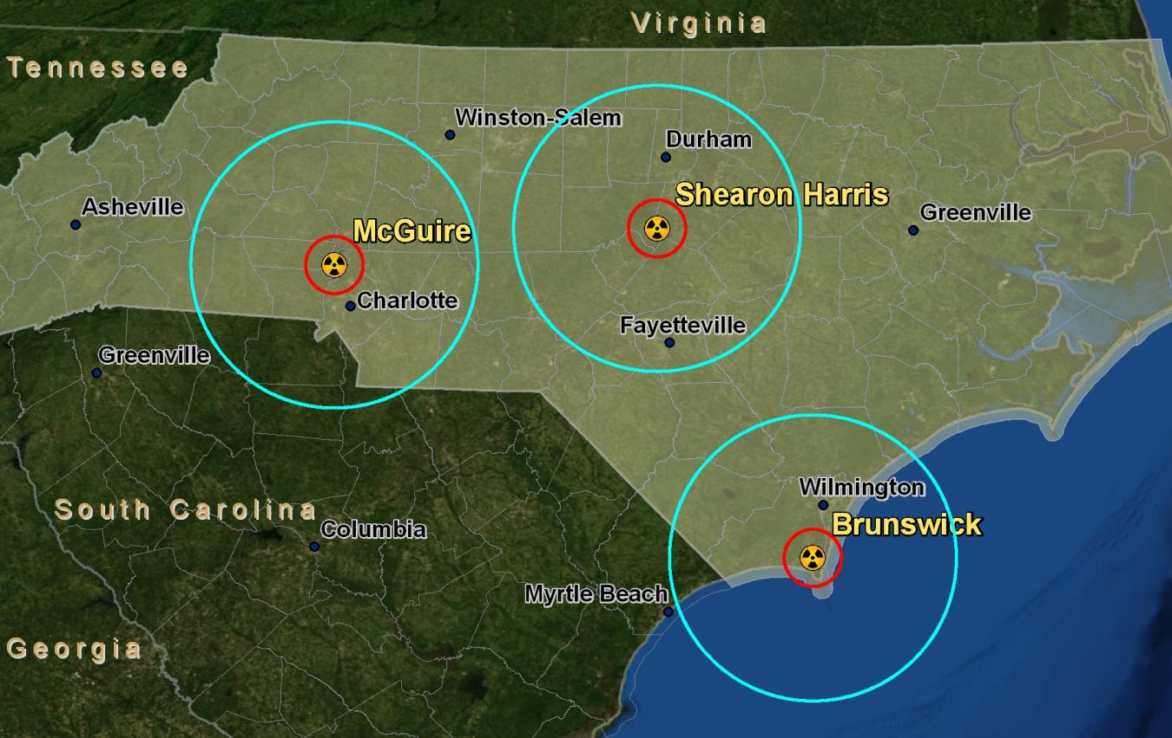
Emergency Planning Zones
Notes:
10
10
10

Slide 11
Population Data Sets
US Census – 2000
Best "count" of US Population
Available free to the public
10 year old data set
Notes:
11
11
11

Slide 12
Population Data Sets
Estimated Population Data – 2008
Estimate of US Population - based on 2000 census
US Gov't provides estimates to county level
Private data available for a fee
Notes:
12
12
12

Slide 13
Population Data Sets
LandScan Ambient Data – 2008
Compiled by Oak Ridge (TN) National Labs
Raster data – 30" x 30" (.0083 Decimal Degrees)
Free with approved registration
Notes:
13
13
13

Slide 14
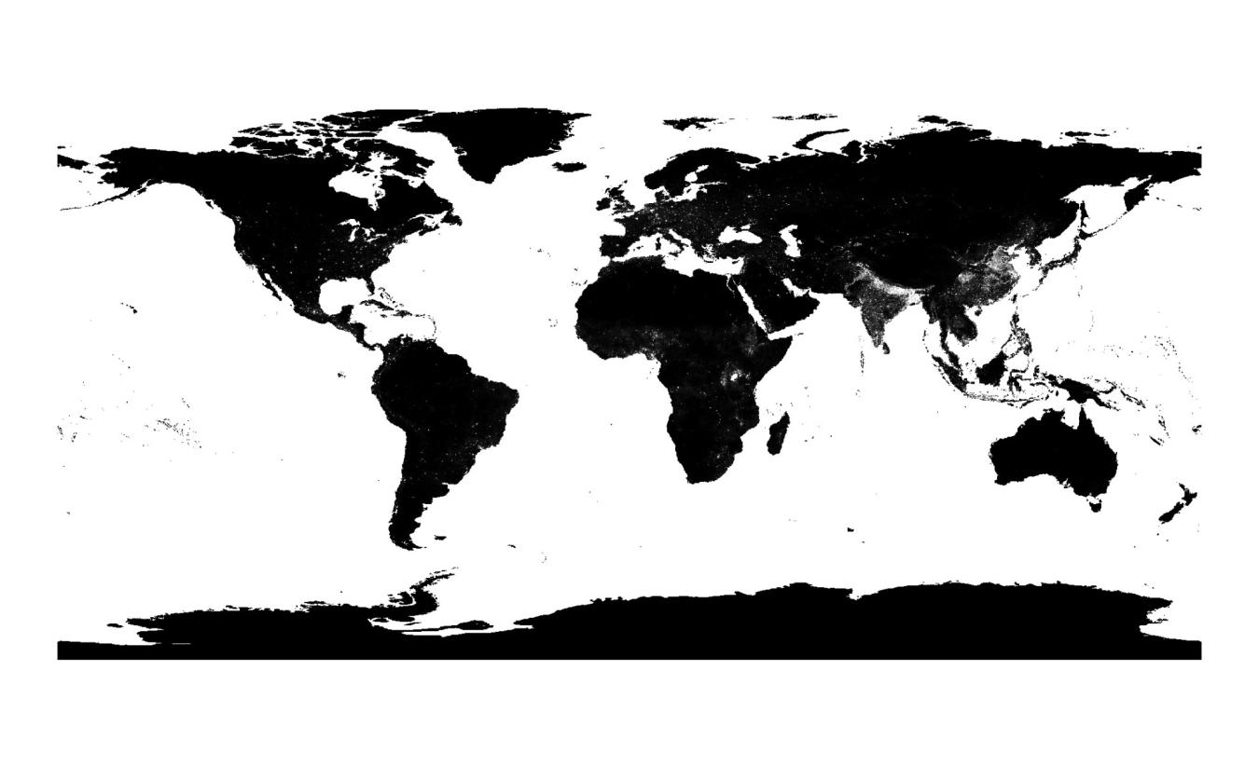
LandScan Ambient Population Data
Notes:
14
14
14

Slide 15
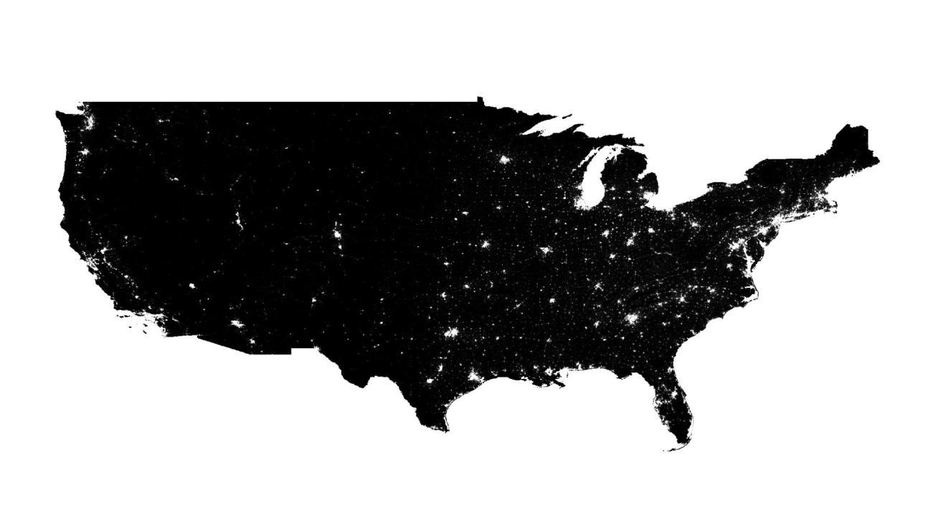
LandScan Ambient Population Data
Notes:
15
15
15

Slide 16
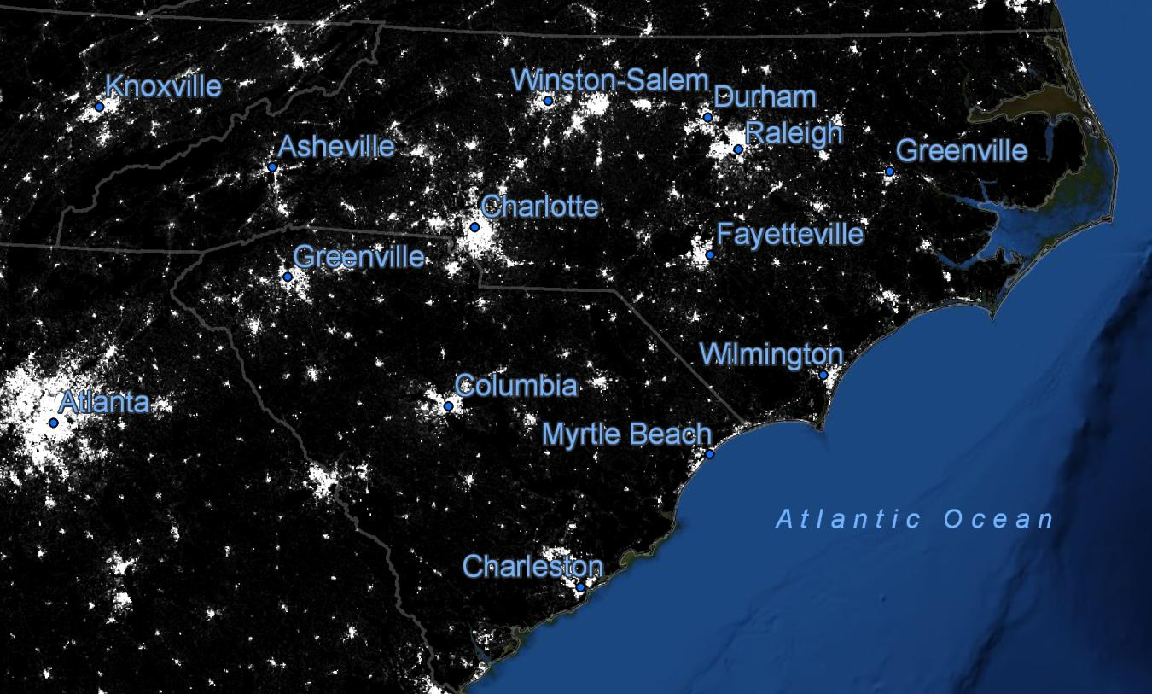
LandScan Ambient Population Data
Notes:
16
16
16

Slide 17
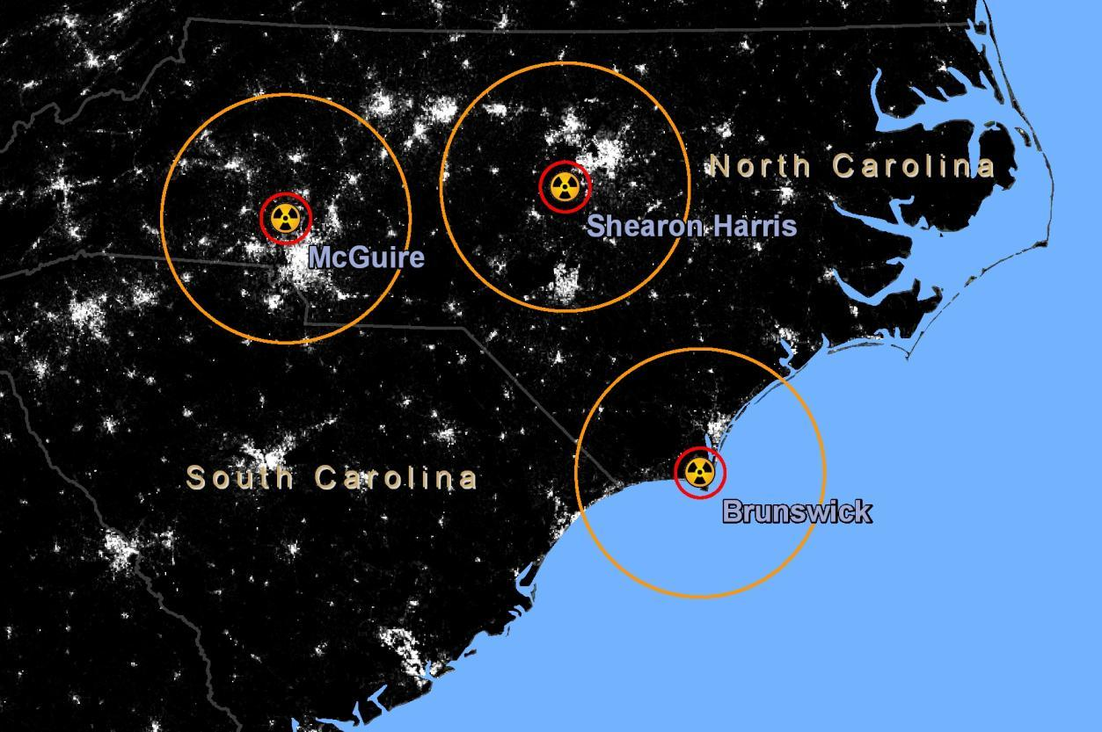
Population Analysis
Notes:
17
17
17

Slide 18
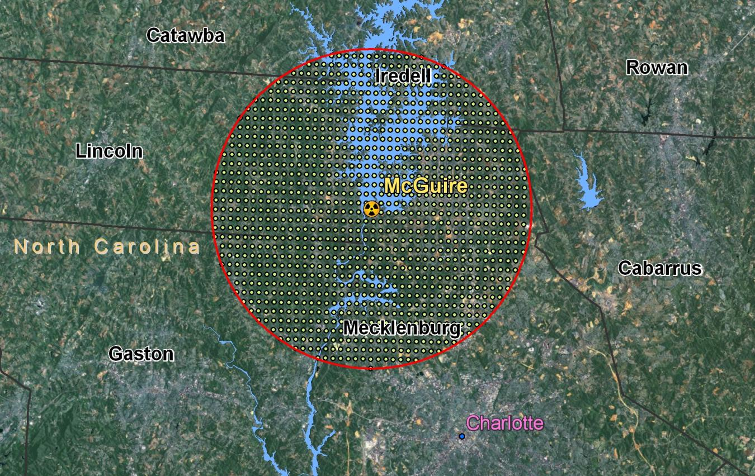
Population Analysis
Notes:
18
18
18

Slide 19
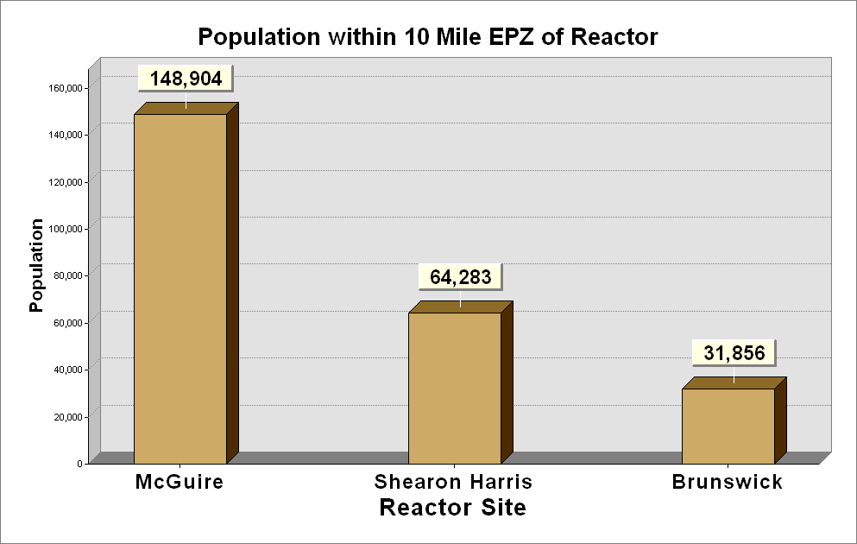
Population Analysis
Notes:
19
19
19

Slide 20
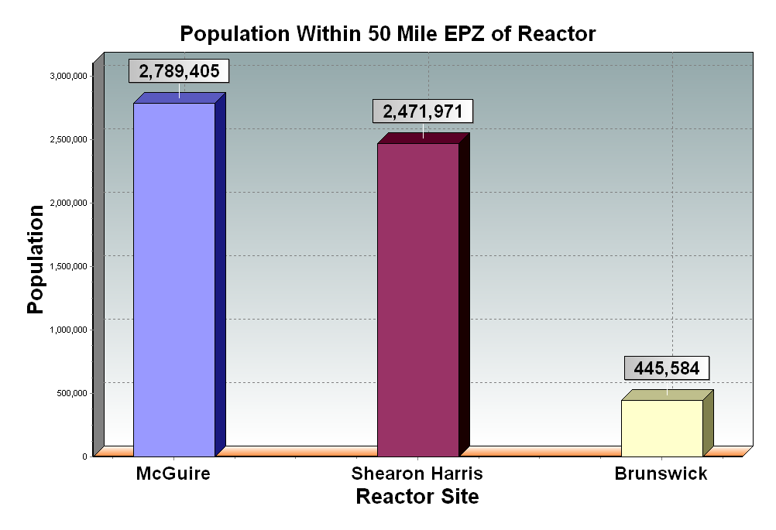
Population Analysis
Notes:
20
20
20

Slide 21
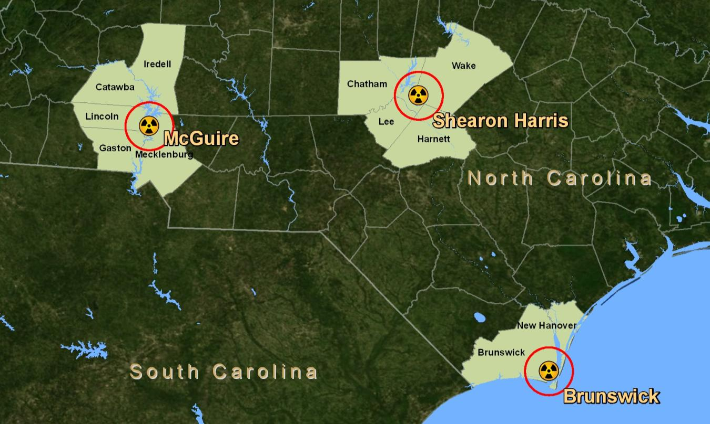
Counties Within 10 Mile EPZ
Notes:
21
21
21

Slide 22
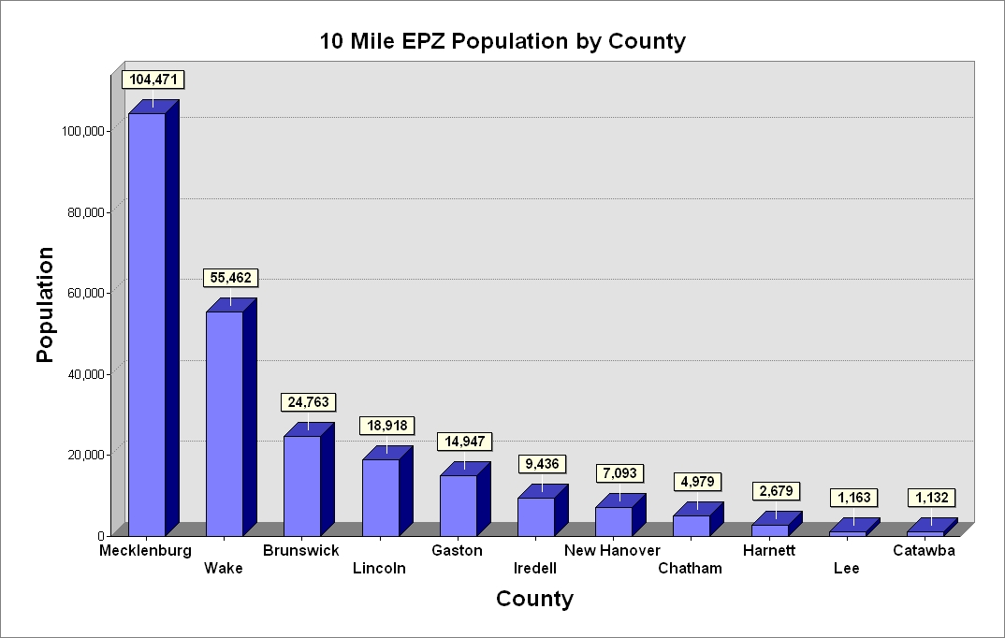
Counties Within 10 Mile EPZ
Notes:
22
22
22

Slide 23
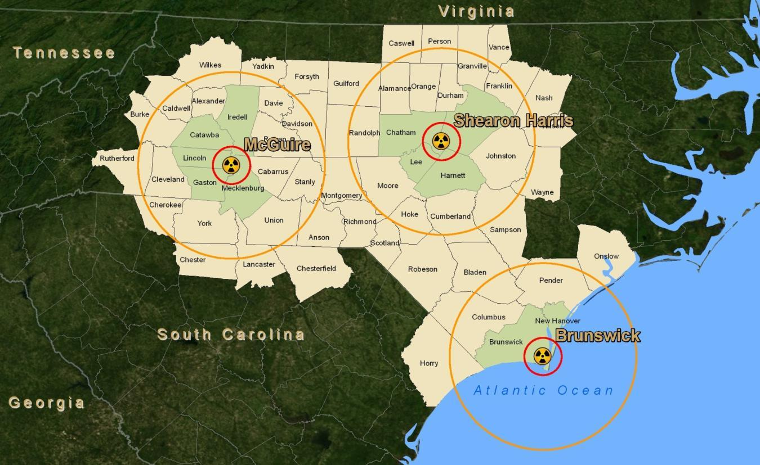
Counties Within 50 Mile EPZ
Notes:
23
23
23

Slide 24
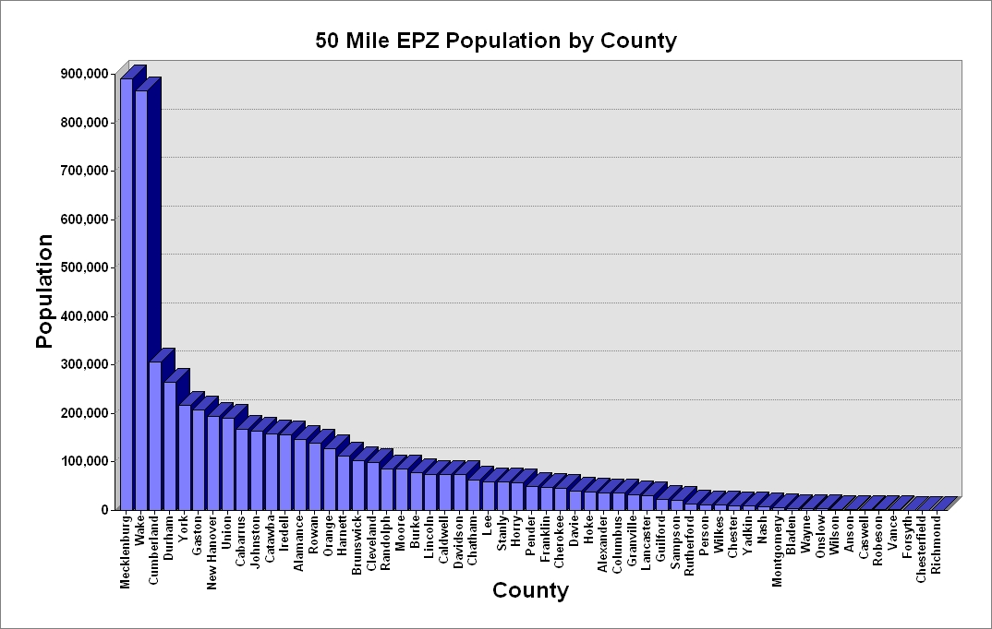
Counties Within 50 Mile EPZ
Notes:
24
24
24

Slide 25
Population Change – 2000 to 2008
County | 2000 Census Count | 2008 Census Estimate | % Change
Brunswick | 73,143 | 103,160 | 41.04
Catawba | 141,685 | 157,079 | 10.86
Chatham | 49,329 | 63,077 | 27.87
Gaston | 190,365 | 206,679 | 8.57
Harnett | 91,025 | 112,030 | 23.08
Iredell | 122,660 | 155,359 | 26.66
Lee | 49,040 | 59,091 | 20.50
Lincoln | 63,780 | 74,746 | 17.19
Mecklenburg | 695,454 | 890,515 | 28.05
New Hanover | 160,307 | 192,538 | 20.11
Wake | 627,846 | 866,410 | 38.00
Totals | 2,264,634 | 2,880,684 | 21.36
Notes:
25
25
25

Slide 26
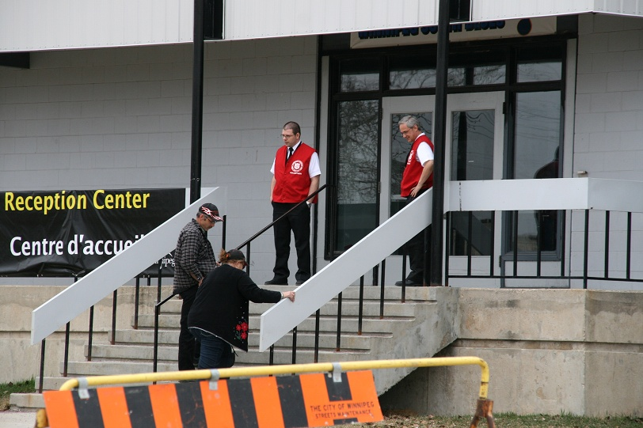
Reception Centers
Notes:
26
26
26

Slide 27
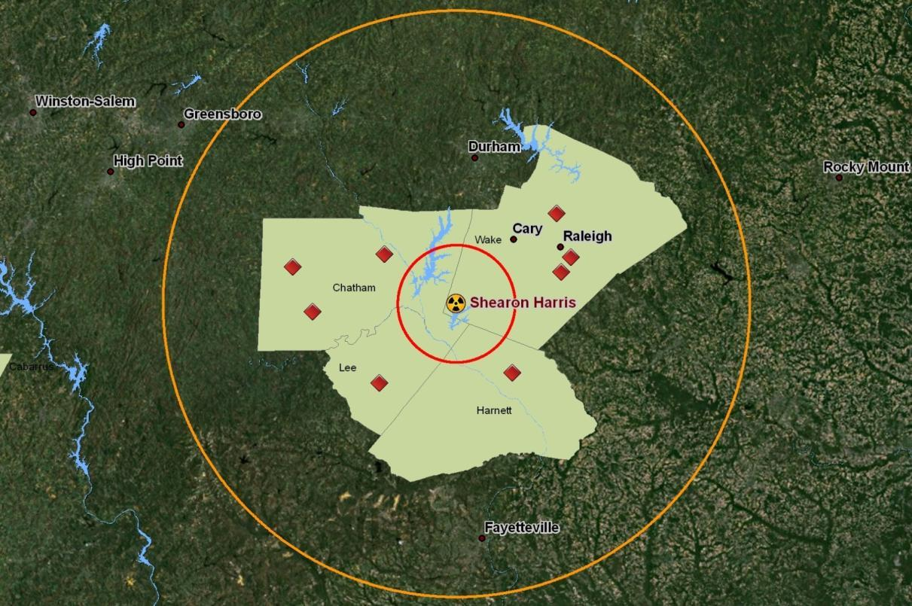
Reception Center Allocation
Notes:
27
27
27

Slide 28
Reception Center Allocation
Cost Weighted Distance
Raster calculation
Calculates best path based on 'travel cost'
Weights assigned subjectively
Notes:
28
28
28

Slide 29
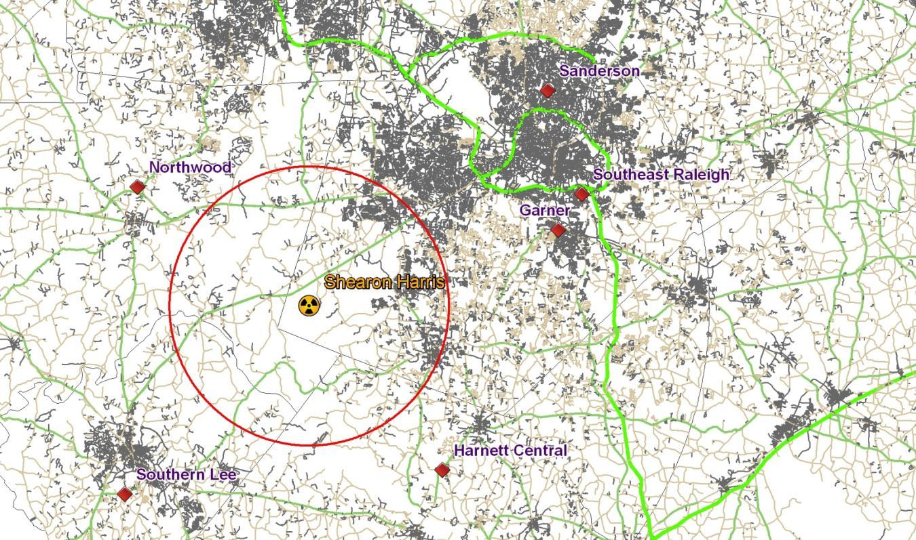
Reception Center Allocation
Cost Weighted Distance
Notes:
29
29
29

Slide 30
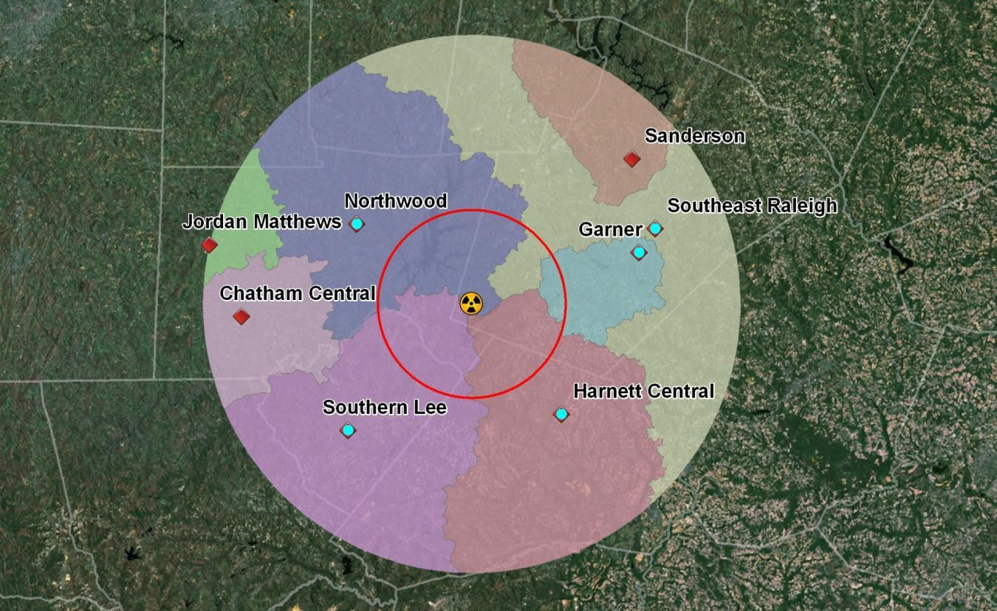
Reception Center Allocation
Cost Weighted Distance
Notes:
30
30
30

Slide 31
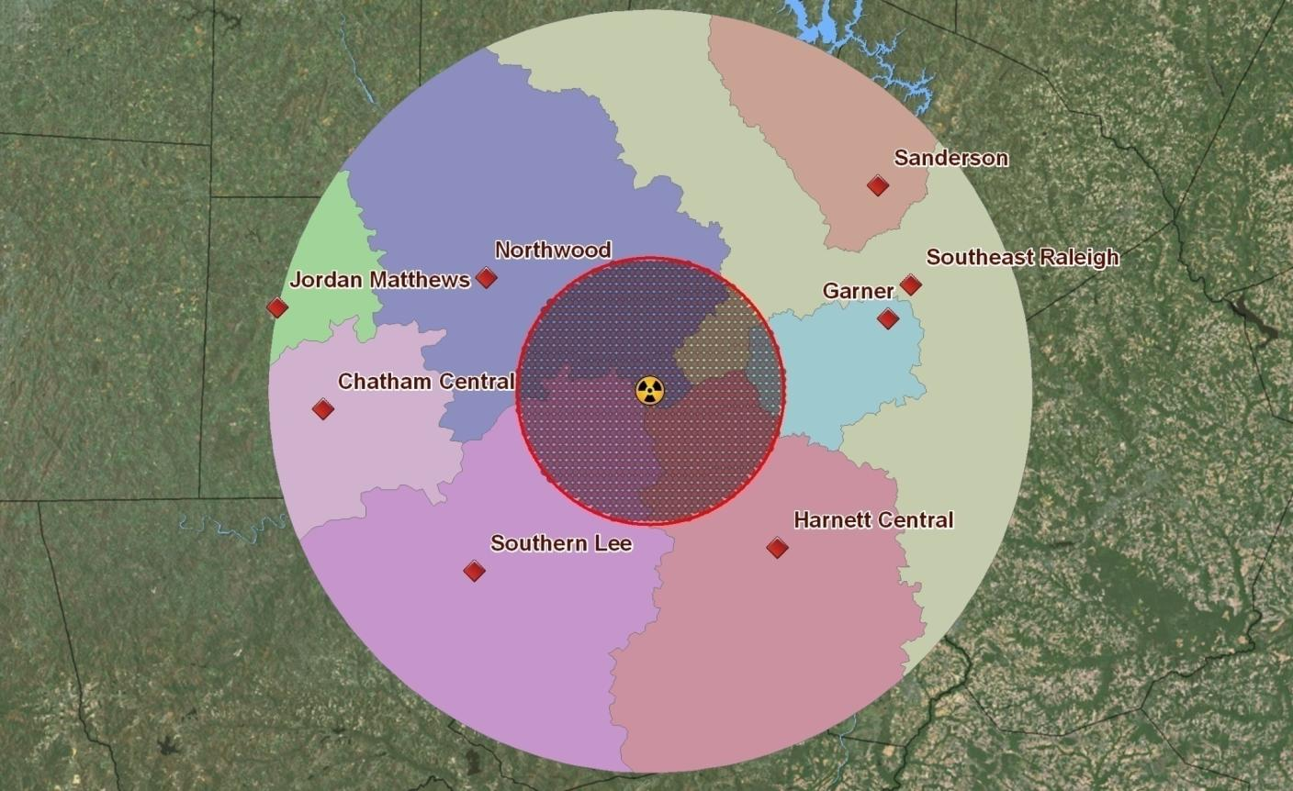
Reception Center Allocation
Notes:
31
31
31

Slide 32
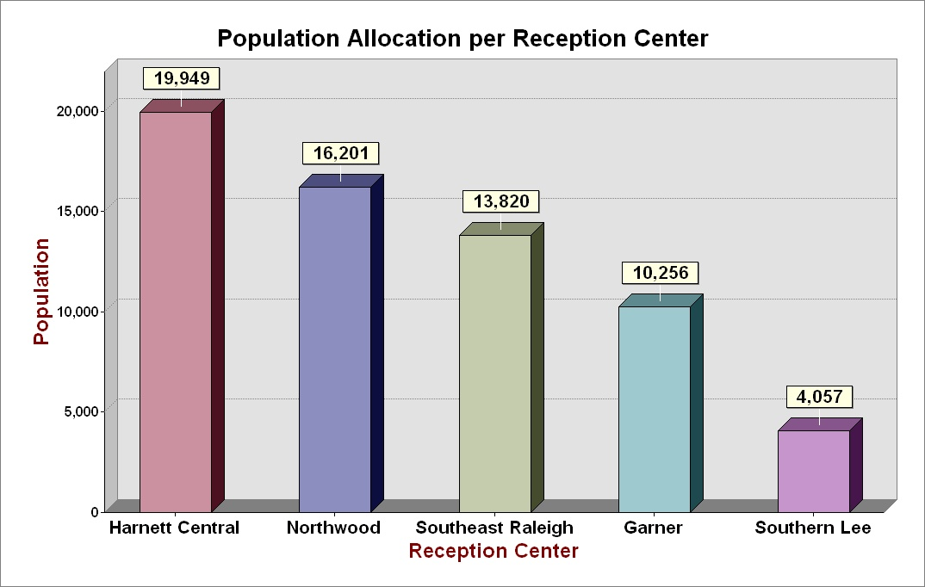
Reception Center Allocation
Notes:
32
32
32

Slide 33
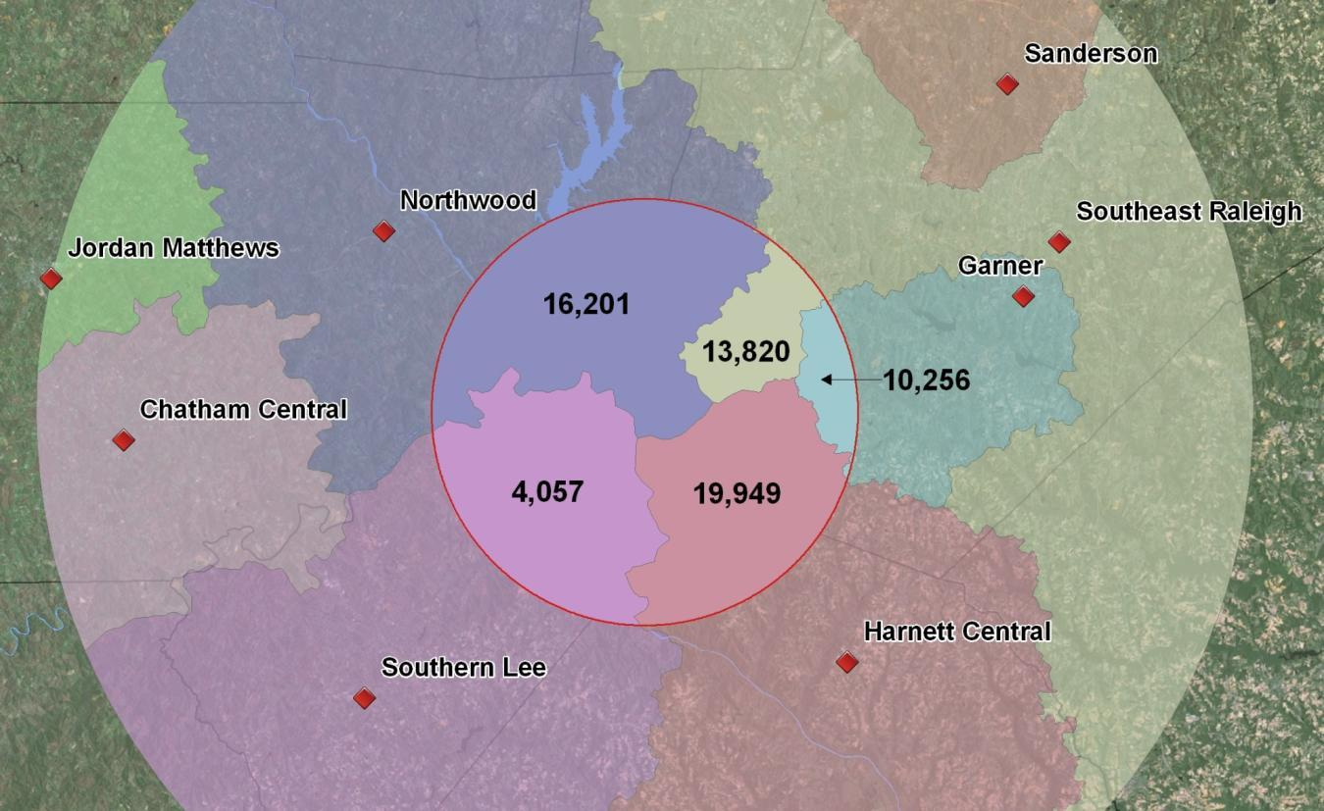
Reception Center Allocation
Notes:
33
33
33

Slide 34
Benefit Cost Analysis
Comparing Energy Output with Population
Notes:
34
34
34

Slide 35
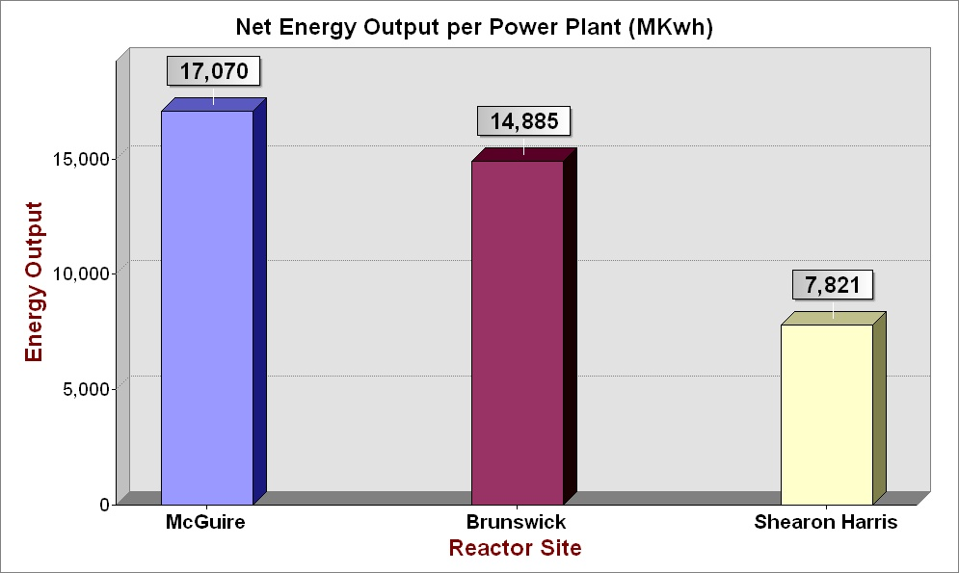
Benefit Cost Analysis
Comparing Population with Energy Output
Notes:
35
35
35

Slide 36
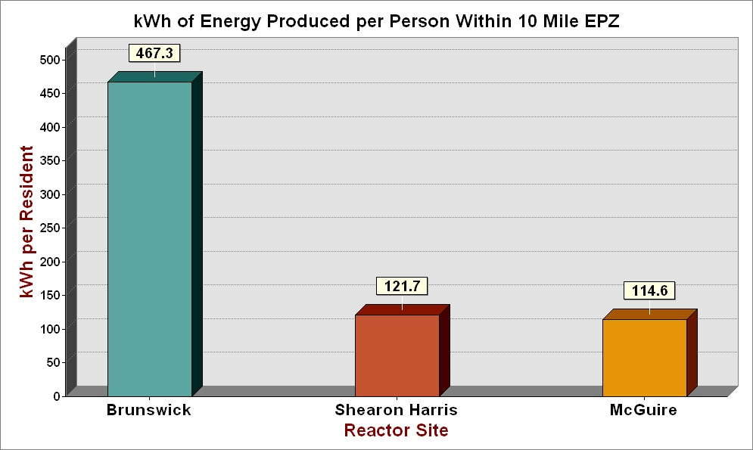
Benefit Cost Analysis
Comparing Population with Energy Output
Notes:
36
36
36

Slide 37
Conclusion
Population Data Set Options
Demographic Analysis Data
Reception Center Allocation
Benefit Cost Assessment
Notes:
37
37
37

Slide 38
Conclusion
Population Data Set Options
Demographic Analysis Data
Reception Center Allocation
Benefit Cost Assessment
Notes:
38
38
38

Slide 39
Thank you
Notes:
39
39
39

Slide 40
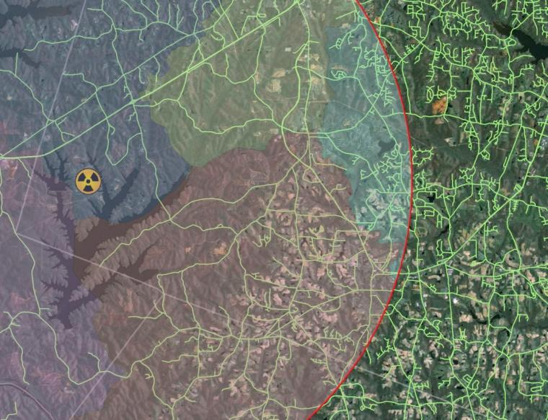
Demographic and Spatial Analysis of
North Carolina's Nuclear Plants
Mike Team
Raleigh, NC
GIS Masters Candidate
Advisor – Frank Hardisty, Ph.D.
Notes:
40
40
40

Slide 41
Notes:
41
41
41

