Slide 1
BERMVis: A Rich Internet Application for Coastal Monitoring
Quaye Trimble
Penn State University
Master of Geographic Information Systems
Frank Hardisty
Capstone Advisor
Penn State University

Slide 2
Presentation Overview
Project Objectives
Background and Significance
Design and Methods
Timelime
Results/Next Steps
Challenges

Slide 3
Project Objectives
Determine the feasibility of and prospects for using a Rich Internet Application (RIA) to:
Disseminate Coastal Information
Expose Analysis Capabilities
Project Objectives

Slide 4
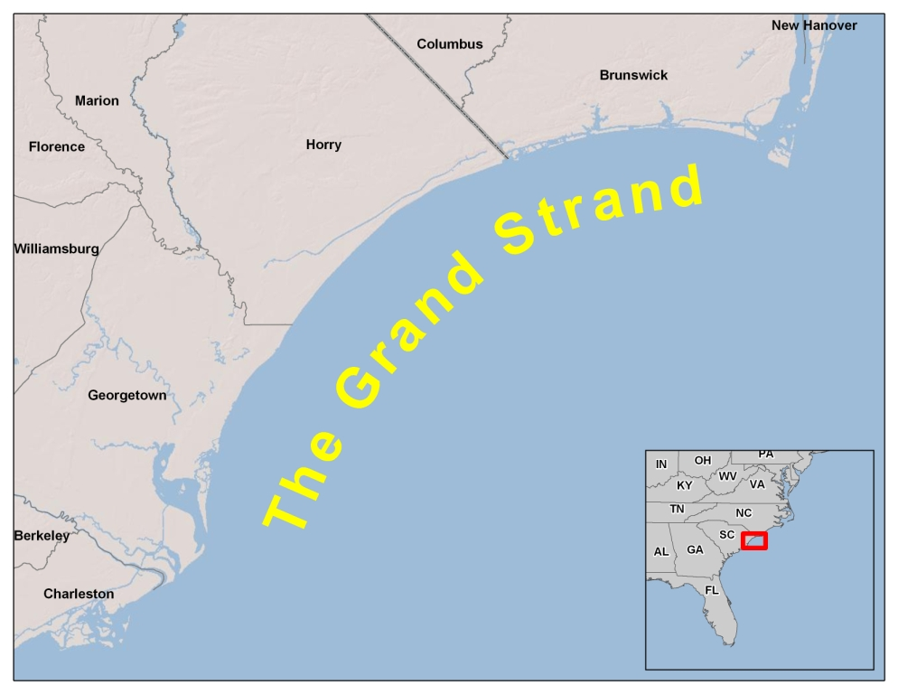
The Grand Strand
Background and Significance

Slide 5
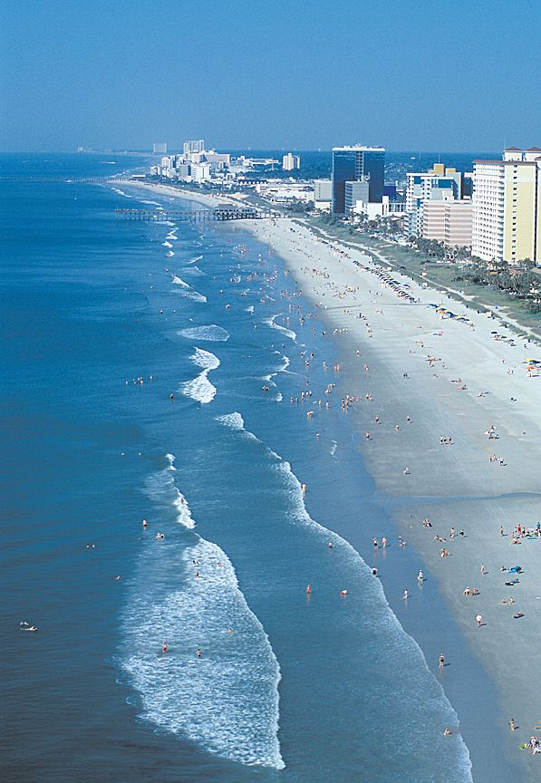
The Grand Strand
60 miles of coastline
215 days of sunshine
102 golf courses
Outlet Malls, Shops, Theaters, Nightclubs
14.6 Million
S.C. Parks, Recreation & Tourism Dept
S.C. Climatology Department
Background and Significance

Slide 6
Why is this project important?
Local Awareness
Unique System
Background and Significance

Slide 7
Why is this project important?
(current work flow)
TIME
DATA COLLECTION
TIME
JAN
FEB
MAR
APR
MAY
JUN
JUL
AUG
SEP
OCT
NOV
DEC
ANALYSIS
REPORTING
Background and Significance

Slide 8
Why is this project important?
(work flow with RIA)
TIME
DATA COLLECTION
TIME
JAN
FEB
MAR
APR
MAY
JUN
JUL
AUG
SEP
OCT
NOV
DEC
ANALYSIS/REPORTING
Background and Significance

Slide 9
Why a Rich Internet Application?
Internet 2nd to TV for news (Pew Research Center, 2008)
Technology has matured
Background and Significance

Slide 10
Project Objectives
Determine the feasibility of and prospects for using a Rich Internet Application (RIA) to:
Disseminate Coastal Information
Expose Analysis Capabilities
Project Objectives

Slide 11
Research Questions
Which characteristics?
Which analysis?
What data?
Can it be done?
Design and Methods

Slide 12
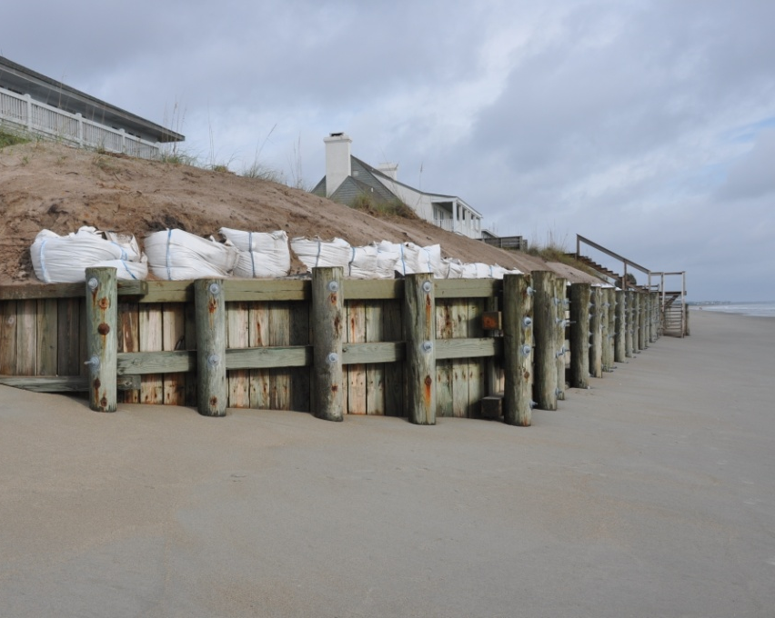
Research Question #1
What coastal characteristics are of the greatest interest to stakeholders?
Processes of Accretion
Processes of Erosion
Design and Methods

Slide 13
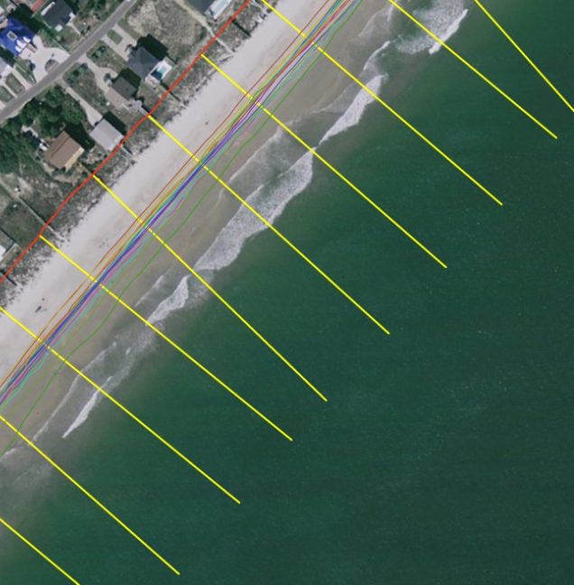
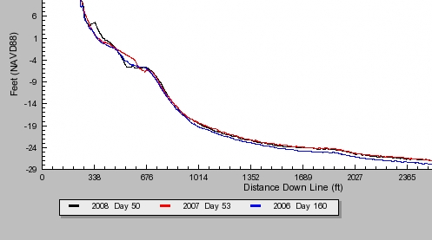
Research Question #2
What analysis can be done?
Shoreline Change
Beach Volume Change
Design and Methods

Slide 14
Research Question #3
What data is available in support of questions 1 & 2?
Meteorological/Ocean-ographic Data
Baseline Shoreline
Monthly Shorelines
Beach Benchmarks
Annual Beach Profiles
Coastal Lidar
Aerial Photography
Beach Cameras
Design and Methods

Slide 15
Functionality
"jump" to spatial extent of features
Display meteorological/oceanographic data
Display digital time-lapse images of key locations
Perform shoreline rate-of-change analysis
Approximate vegetation density
Calculate volumetric change rates
Design and Methods
Notes:
Now, using the outcome of the research questions I was able to define the application functionality which includes...
"jump"
spatial bookmarks of locations along the coast where scientific observations are made including:
beach systems
weather stations
near shore and offshore buoys
beach cameras
beach systems (beach names)
incorporated cities and towns contribute money to research so
beaches are split by political boundaries
weather station at Apache Pier
display meteorological data
SCDNR real-time local weather conditions
air temperature, wind speed and direction, barometric pressure, relative humidity and rainfall totals
collected every 15 minutes 24 hrs/day
buoys from the NDBC
display oceanographic data
National Data Buoy Center (NOAA)
wind speed/direction and wave height
4 near shore
1 offshore
beach cameras
display time-lapse images
- Center for Marine and Wetland Studies at CCU maintains 4 cameras in coastal communities
- 10mp cannon cameras w/ CPU and modem to transfer image over www
shoreline change rate
from an established baseline, the tool will generate orthogonal transects by beach system at a user defined separation to calculate rates of change
will go into the processes in more detail shortly
baseline significance:
Tourism increased in the 80's and development pushed seaward more than ever.
In 1990, South Carolina’s legislators took action which resulted in the Beachfront Management Act which protects South Carolina’s beaches by increasing the state’s jurisdiction and encouraging development to move landward.
The State's jurisdiction is definable by erosion rates which are derived from the baseline location (the crest of the primary oceanfront sand dune)
The higher the erosion rate, the farther landward the state’s jurisdiction.
SC Code of Laws – Beach Front Management Act

Slide 16
Shoreline Change Rate: Transects
Design and Methods

Slide 17
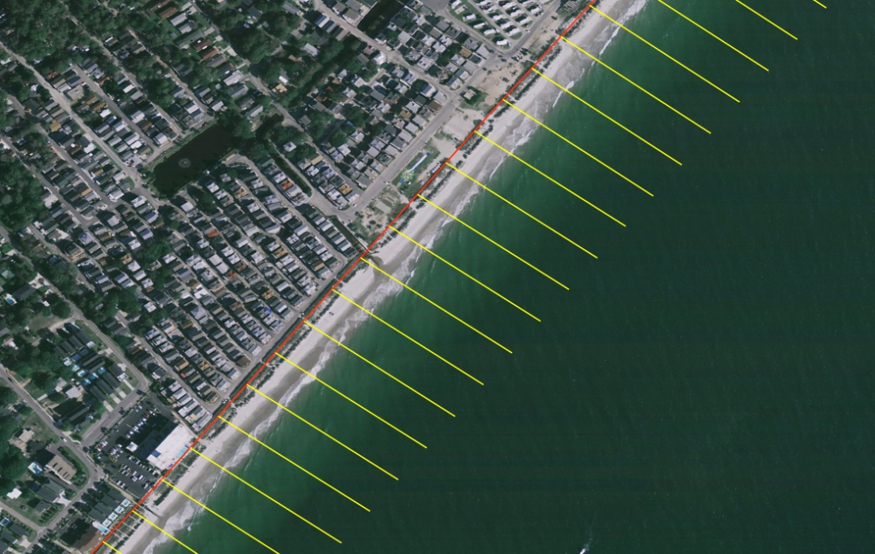
Shoreline Change Rate: Transects
Design and Methods

Slide 18
Shoreline Change Rate: Distance
Design and Methods

Slide 19
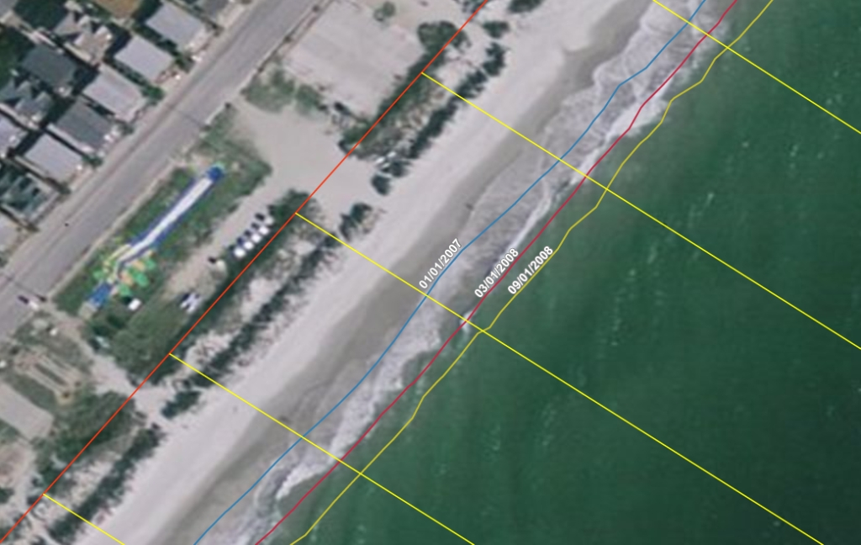
Shoreline Change Rate: Distance
10.3 m
15.2 m
16.9 m
Design and Methods

Slide 20
Shoreline Change Rate: Statistics
Design and Methods

Slide 21
Shoreline Change Rate: UI
Design and Methods

Slide 22
Shoreline Change Rate: UI
Rate of Change (m/yr)
23
24
25
26
27
28
Transect ID
Design and Methods

Slide 23
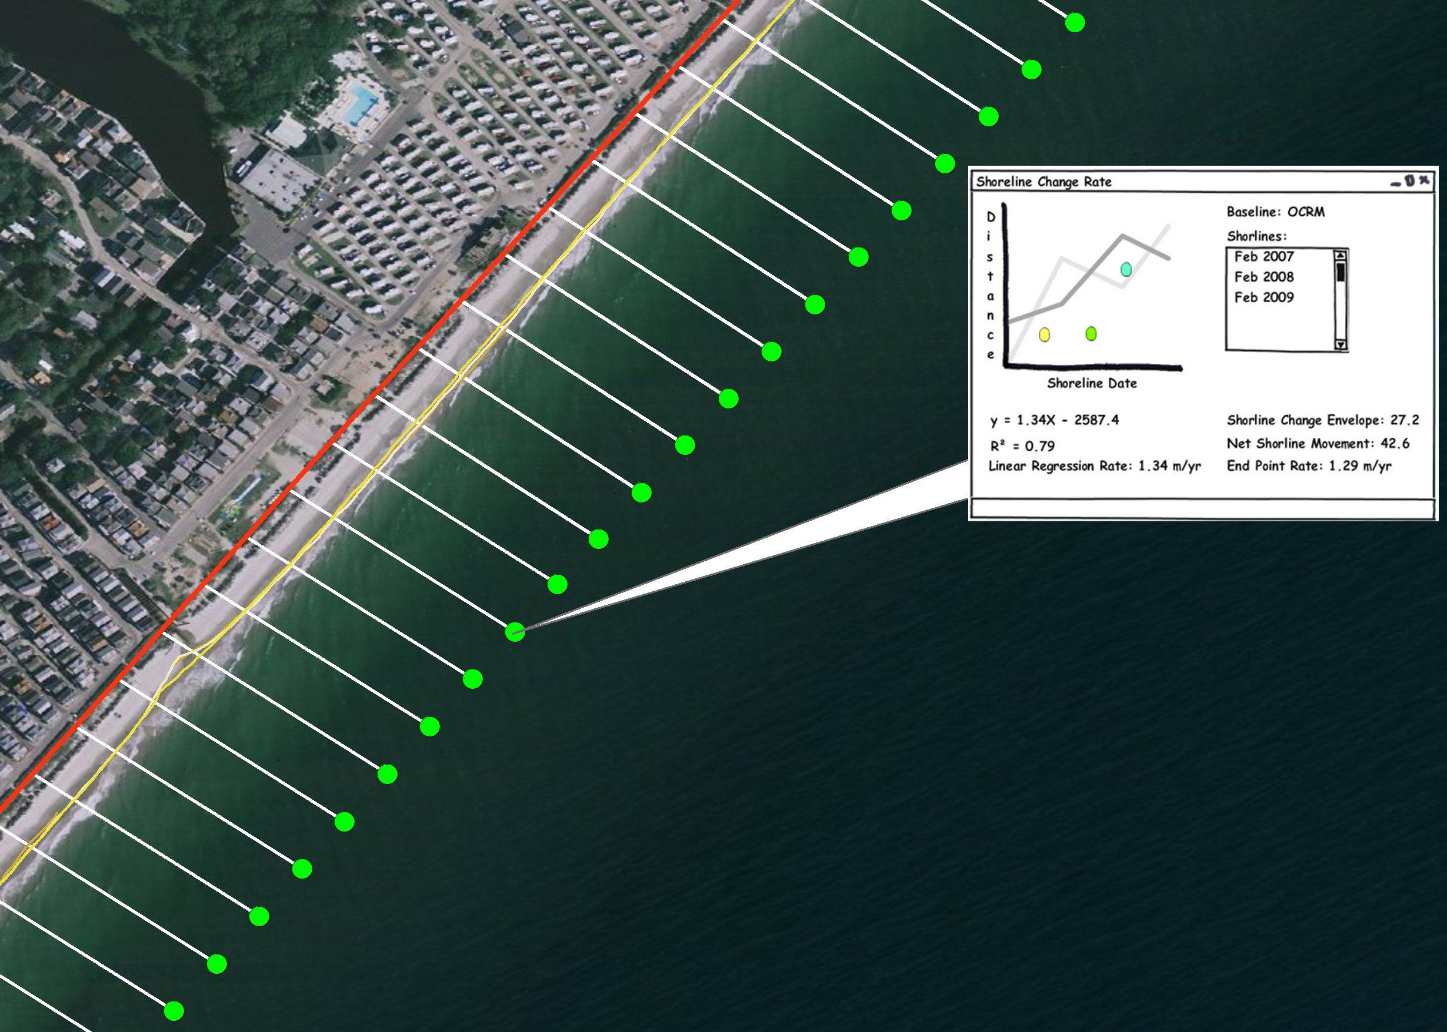
Shoreline Change Rate: UI
Design and Methods

Slide 24
Software/Database Components
Python and ESRI's geoprocessor, version 9.3
ArcGIS Server API for Flex, version 1.3
Microsoft SQL Server 2000/ArcSDE
SDS compliant (version 2.6) ESRI Geodatabase
Design and Methods

Slide 25
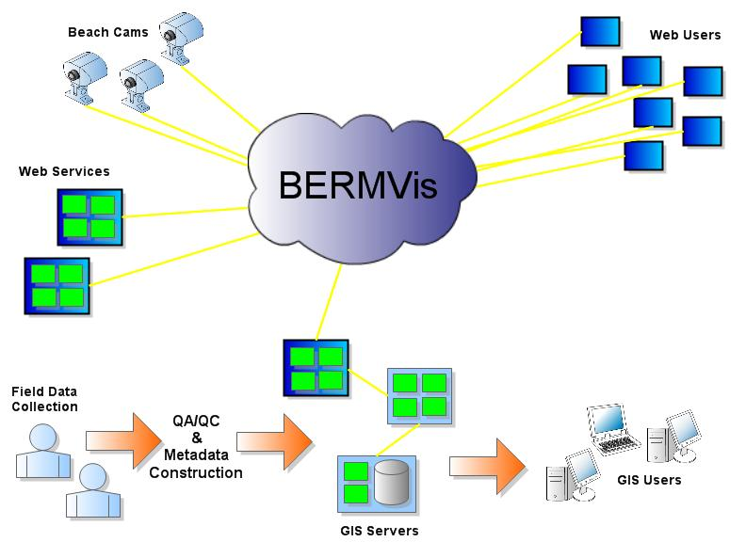
System Components
Design and Methods

Slide 26
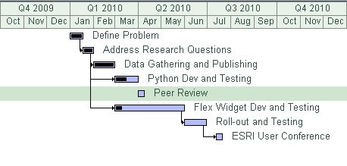
Timeline
Timeline

Slide 27
Results/Next Steps
Problem/Analysis/Data
Functionality
Geoprocessing - 80% Complete
Statistical Analysis (NumPy)
Chain into Single Model (Model Builder)
Widget Development (Sample Flex Viewer)
Testing, Testing and More Testing
Results/Next Steps

Slide 28
Research Question #4
Can a robust custom geoprocessing task be performed through a RIA?

Slide 29
Challenges
Learning Curve
Project Timeline
Challenges

Slide 31
Acknowledgments
Sterling Quinn – Penn State World Campus
Clayton McCoy – SC Sea Grant Extension Program
Frank Hardisty – Penn State World Campus
Gerry Gabrisch – ArcScripts Contributor
Dan Patterson – ArcScripts Contributor

Slide 32
Sources Cited
The Digital Shoreline Analysis System (DSAS) version 4.0
http://woodshole.er.usgs.gov/project-pages/dsas/version4/index.html
The South Carolina Department of Parks, Recreation & Tourism website
http://www.discoversouthcarolina.com/see-do/islands-coast/myrtle-beach-grand-strand.aspx
South Carolina Code of Laws – Beach Front Management Act
http://www.scdhec.gov/environment/ocrm/science/docs/SCAC/SC Code of Laws_Beachfront Management Act.pdf
National Ocean Service - Coastal Trends Report Series
http://oceanservice.noaa.gov/programs/mb/pdfs/coastal_pop_trends_complete.pdf
Pew Research Center for the People & the Press
http://people-press.org/report/479/internet-overtakes-newspapers-as-news-source
2007 – 2008 Grand Strand Beach Nourishment Study, Year 1 Report
https://bcmw.coastal.edu/sites/default/files/GSRY1_Report.pdf

