Slide 1
Real Time Spray monitoring system
For Use in Industrial Vegetation Management
Joseph Wilde
The Pennsylvania State University

Slide 2
Presentation Overview
Goals and Objectives
Project Background
System Requirements
System Components
Cost Analysis
Managerial Benefits
Additional Uses / Capabilities

Slide 3
Goals and Objectives
Develop real time spray monitoring system
Build / design required hardware interfaces
Design a geospatial database to store all transmitted data
Develop a data access webpage to query reports and maps from the database

Slide 4
Project Background
Tracking and proving herbicide application activity on a large property is difficult
GPS can be used as means to prove services rendered in an area of dispute
Cellular data transfer allows for minimal operator interaction and training

Slide 5
System Requirements
Functional Requirements
Provide Active Vehicle Location (AVL) service
Create a system that functions in all service areas
Monitor application hardware in real time
Maintain historical application records
Provide activity reporting capabilities
Develop data access webpage to spatial data
Business Requirements
System cost should not inhibit use
Seamless integration into work environment
No additional burden on field crews

Slide 6
System Components
Cellular Modem
Application Hardware
Spatial Database
Packet Handling Service
Data Access Front End

Slide 7
System Components Cellular Modem
CalAmp LMU-4100 Series
GPS Enabled
Cellular data transfer
Easily Programmable
Digital I/O Interface

Slide 8
System Components Cellular Modem - Modem Firmware
Sleep / wake logic for power conservation
Capture digital signals from hardware
Ignition
Spray state
Flow rate
Application type
As determined through the custom wiring harness installed in each piece of equipment
Transmit system state on predetermined events
Time or transition based events

Slide 9
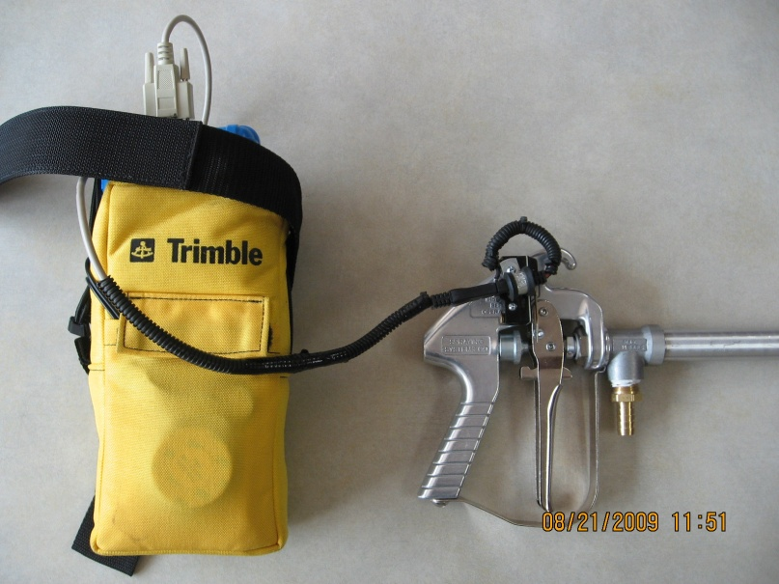
System Components Application Hardware
Raven Industries Flow Meter
Hand spray gun with custom wiring harness and waist battery pack

Slide 10
System Components Spatial Database
Data stored in PostgreSQL relational database
PostGIS spatial extensions provide GIS capabilities
Debian based server for speed and reliability

Slide 11
System Components Spatial Database - Database Schema
Schema rendered through OpenOffice.org-Base

Slide 12
System Components Packet Handling Service
Listens for incoming modem transmissions
Parses binary data into useable format
Checks for transmission errors
Inserts validated data into database
Implemented in Python

Slide 13
System Components Data Access Webpage
Secure web-based portal
Real time system information
Application rate, GPS location, vehicle speed, etc
Full historic query capability
By date, vehicle, application type, etc.

Slide 14
System Diagram

Slide 15
Internal Costs One Time Development Investment
Item | Cost
Modem Firmware | $500.00
Wiring Harness | $750.00
Database Design | $6,500.00
Packet Handling Service | $1,500.00
Data Access Front End | $2,750.00
Total: | $12,000.00
Internal costs based on hourly rate of $25/hr
Note that these costs refer to system development and are incurred one time. Individual setup costs are discussed in External Costs below.

Slide 16
External Costs Reoccuring Hardware Investment
Item | Per-Unit Cost
CalAmp LMU-4100 | $331.00
Data Handling | $4.00 / month
Data Usage | $2.00 / megabyte
Modem cost is incurred once
Data handling fee is a flat rate per month regardless of modem use
Data usage varies on frequency and amount of information being sent

Slide 17
Managerial Benefits
Equipment Inventory
Real Time Monitoring
Job Progress Monitoring
Progress Report Capabilities
Automatic Data Deliverables

Slide 18
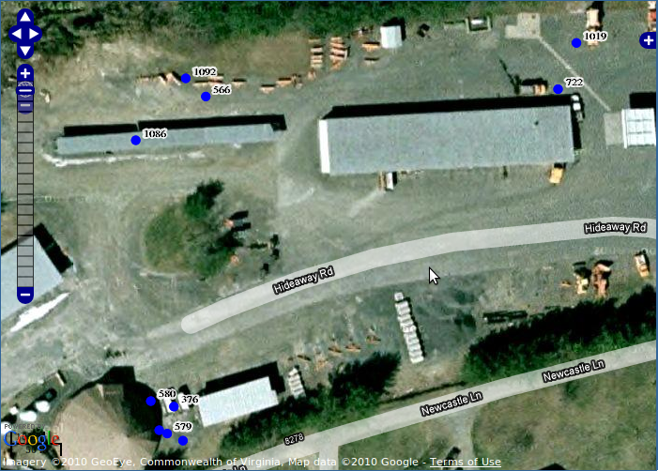
Managerial Benefits Equipment Inventory
Up to the minute AVL information
Efficient fleet mobilization planning
No manual input required to maintain vehicle location database

Slide 19
Managerial Benefits Real Time Spray Monitoring

Slide 20
Managerial Benefits Job Progress Monitoring
Overall Site progress
Application details
Configurable zoom levels provide access to variable levels of job progress information

Slide 21
Managerial Benefits Progress Report Capabilities
Visual estimates of site completion
Graphs and charts depicting sites worked
Work completed summarized by:
Operator
Service Area
Date
Etc…

Slide 22
Managerial Benefits Automatic Data Deliverables
Simple data exports on web front end
Supports a variety of common data formats
ESRI Shapefiles
Google KML files
Garmin GPI files for NUVI navigation

Slide 23
Future Markets
Basic fleet tracking
Department of Transportation / railroad right of way management
Infrastructure mapping
Using toggle switches to mark assets

Slide 24
Additional Capabilities
Accelerometer-based collision reporting systems
Automatic alerts for accidents
Integrated ambient weather sensors
Dictate whether conditions are right for spraying
Pressure / tank volume sensors
Provide audio/visual queues to operators

Slide 25
Resources
DeAngelo Brothers, Inc
Project sponsored in full by Dbi for use in the Industrial Vegetation Management division.
Applocation Systems, Inc
Calamp distributer. Provided initial technical support for modem communications.

Slide 26
End
Questions / Comments?

