Slide 1
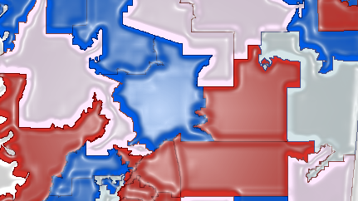
Drawing Fair Legislative Districts Based on Territorial Communities to Achieve Partisan Symmetry
By Robert Winkler
Penn State University

Slide 2
Agenda
Background: Overview of gerrymandering
  Racial gerrymandering vs partisan gerrymandering
  Proliferation of safe seats
New Criteria Proposed to Address the Issue
  Efficiency Gap: Measure for identifying partisan gerrymandering
  Territorial Communities: Basis for creating legislative districts
Research Objectives: Use new criteria and methodologies to:
  Identify where partisan gerrymandering has occurred using a reliable measure that could be accepted by the courts
  Create new legislative redistricting maps in targeted states
  Case Study: Mississippi
Process/Methodology: Data and tools
Expected Results
Timeline

Slide 3
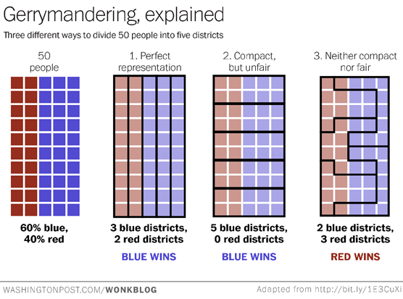

Slide 4
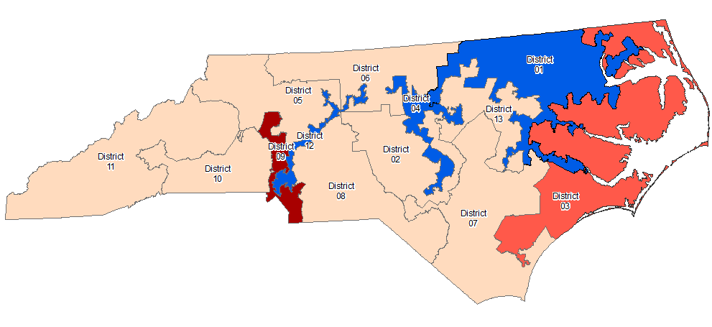
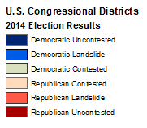
Gerrymandering Example

Slide 5
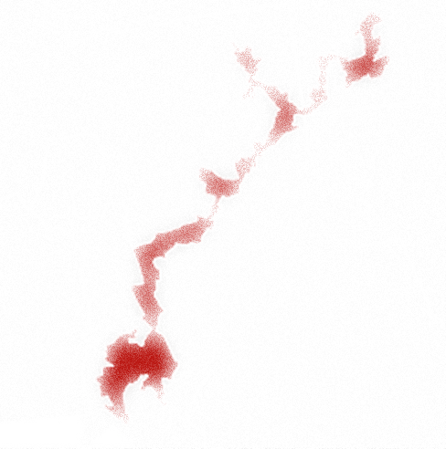
Racial Gerrymandering vs Partisan Gerrymandering
Deprives racial groups of representation by:
  “Packing” as many as possible into one district
  “Cracking” group across multiple districts
Voting Rights Act of 1965
Courts have overturned many redistricting plans
Attempts to give one party an unfair advantage using same methods (packing & cracking)
Based on a number of demographic factors, including:
  Education level
  Socioeconomic status
  Race
Supreme Court has never overturned a partisan gerrymander

Slide 6
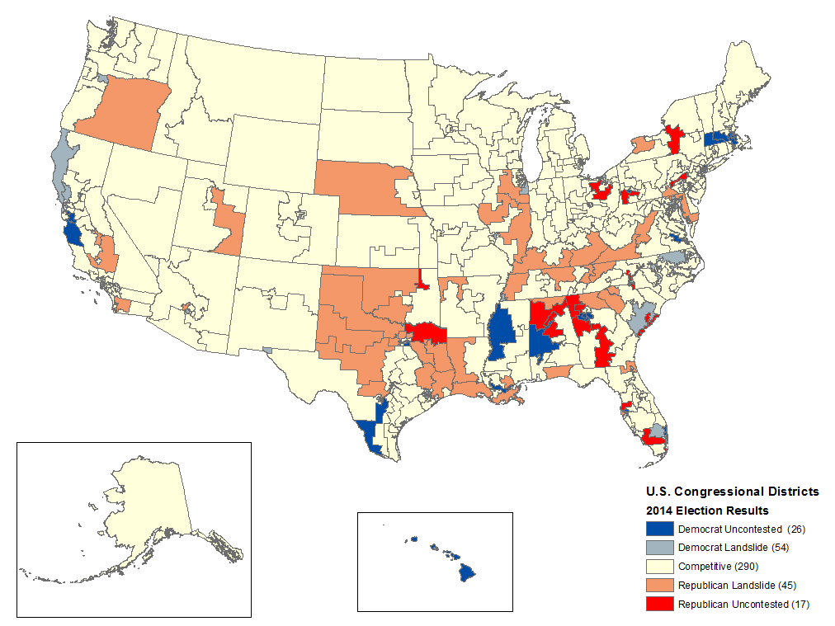
“Safe” Congressional Districts in 2014

Slide 7
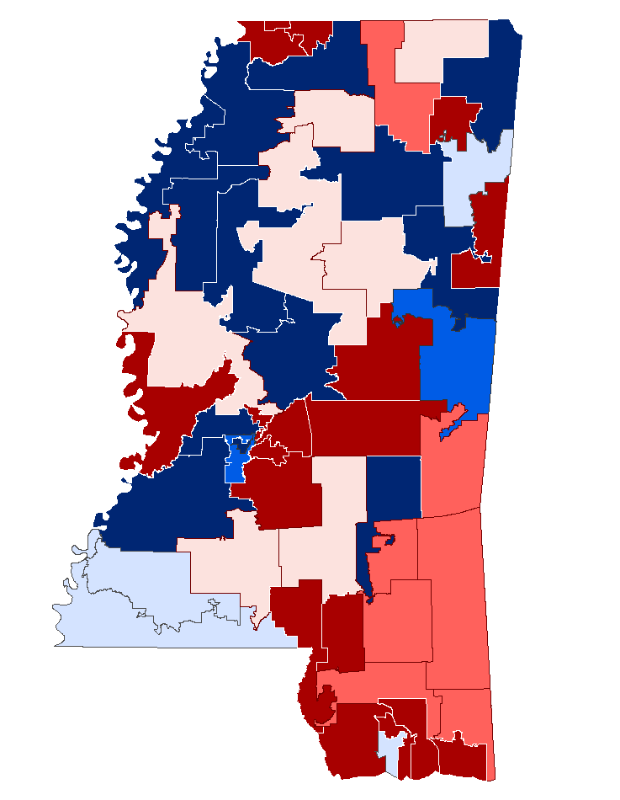
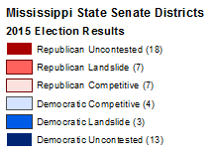
“Safe Seats” in the Mississippi Senate

Slide 8
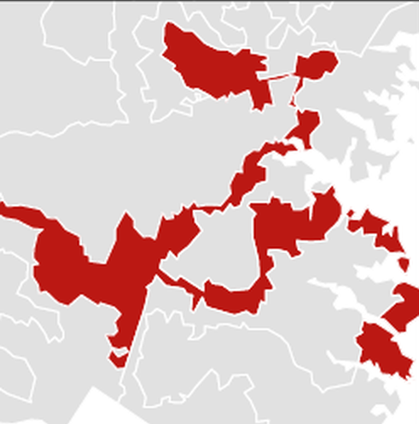
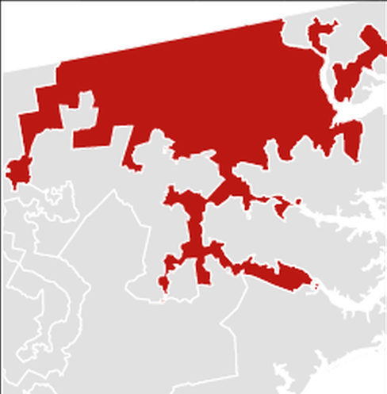
Partisan Gerrymandering
Need a reliable measure of partisan fairness
Partisan Bias: Need to assume each party wins 50% of vote in order to calculate
What about Partisan Symmetry?

Slide 9


New Criteria
Nicholas Stephanopoulos
University of Chicago
Eric McGhee
Public Policy Institute of California
Partisan Gerrymandering and the Efficiency Gap
  Stephanopoulos and McGhee
  82 University of Chicago Law Review, 831 (2015)
Redistricting and the Territorial Community
  Stephanopoulos
  University of Pennsylvania Law Review, Vol. 160, p. 1379, 2012

Slide 10
Efficiency Gap
Wasted votes:
  Cast for losing candidate
  Cast for winning candidate in excess of 50% needed to win
Efficiency Gap = |Wasted Votes for Party A – Wasted Votes for Party B|
Total Number of Votes Statewide
Efficiency Gap (equal population) = Seat Margin – (2 × Vote Margin)
0 = 10% - (2 x 5%) Partisan Symmetry

Slide 11
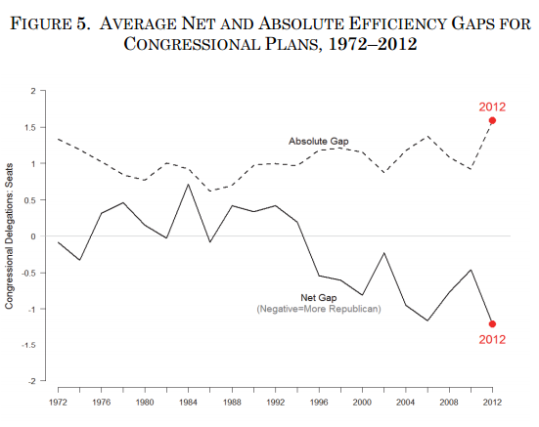
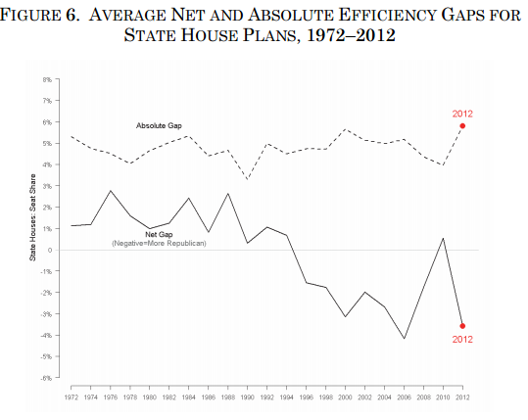
A Recent Spike in Partisan Asymmetry
Source: Stephanopoulos, Nicholas and McGhee, Eric, (October 1, 2014). “Partisan Gerrymandering and the Efficiency Gap.”
82 University of Chicago Law Review, 831 (2015); U of Chicago, Public Law Working Paper No. 493. Available at SSRN: http://ssrn.com/abstract=2457468

Slide 12

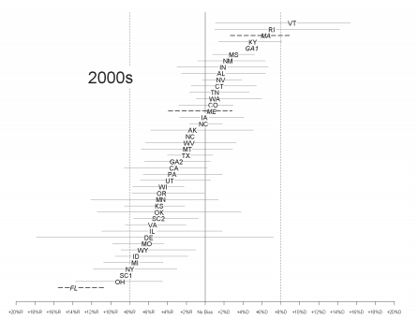
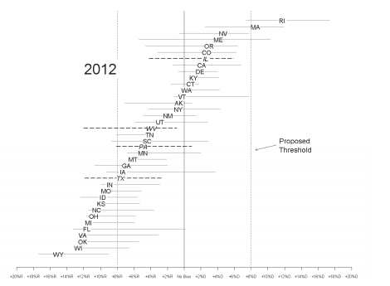
Efficiency Gap Proliferation
Source: Stephanopoulos, Nicholas and McGhee, Eric, (October 1, 2014). “Partisan Gerrymandering and the Efficiency Gap.”
82 University of Chicago Law Review, 831 (2015); U of Chicago, Public Law Working Paper No. 493. Available at SSRN: http://ssrn.com/abstract=2457468

Slide 13
My Case Study: Mississippi
2015 Election
Data Sources:
  Secretary of State http://www.sos.ms.gov for election results
  Mississippi Automated Resources Information System (MARIS) http://www.maris.state.ms.us for district shapefiles
Efficiency Gap (equal population) = Seat Margin – (2 × Vote Margin)
  State Senate: 11.54% – (2 x 6.09%) = -0.6348% (advantage to Democrats)
  State House: 9.0164% – (2 x 4.5102%) = -0.0041% (advantage to Democrats)

Slide 14
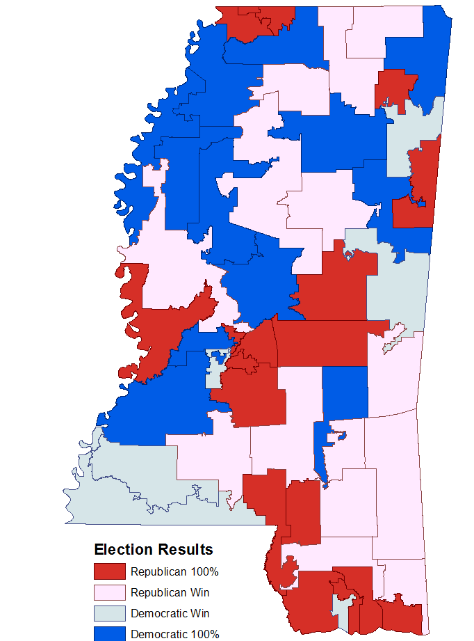
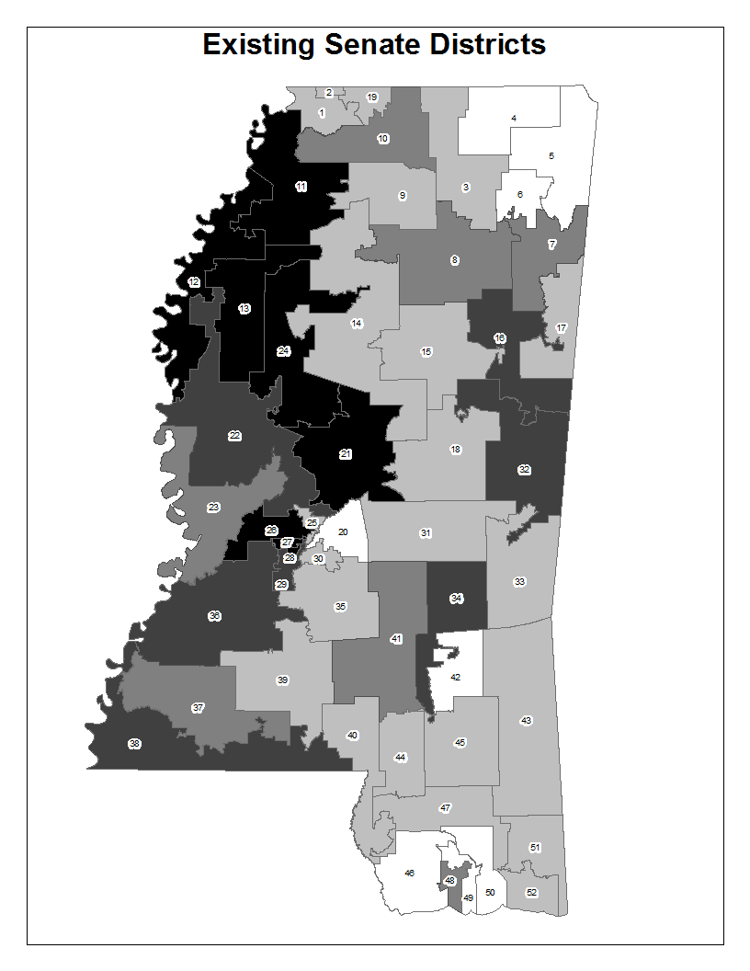
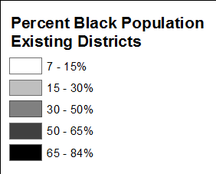
Mississippi State Senate Districts

Slide 15
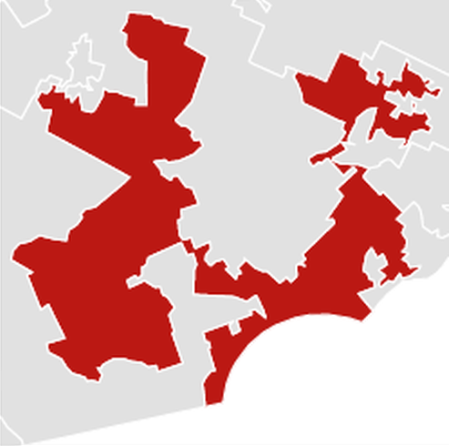
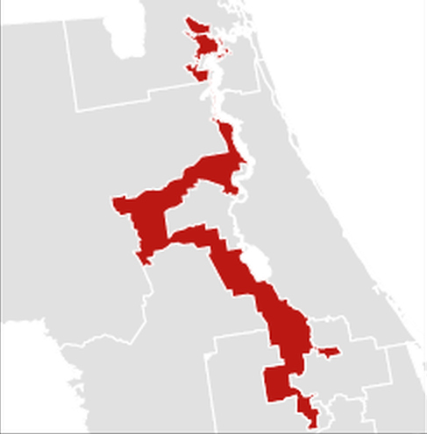
Compactness
Polsby-Popper Compactness = 4πA/P²

Slide 16
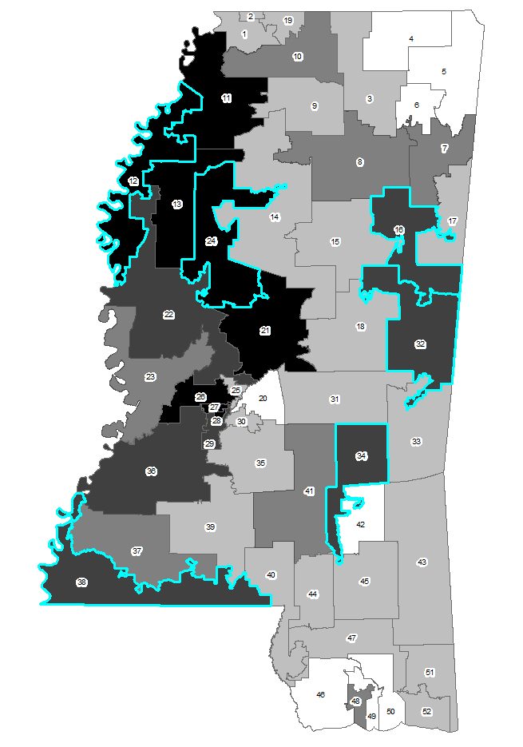
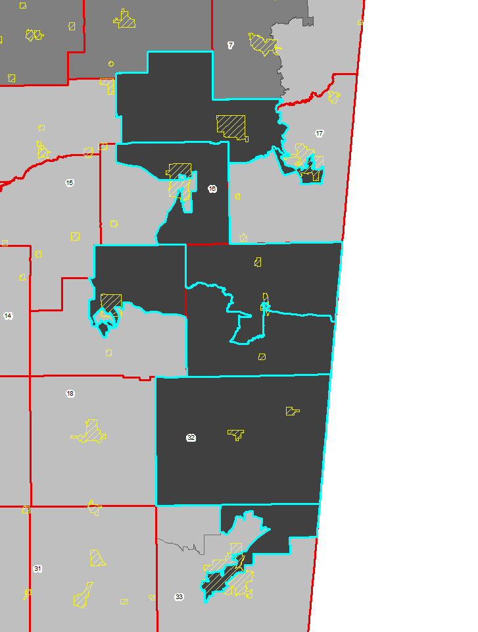
Least Compact Senate Districts in Mississippi

Slide 17
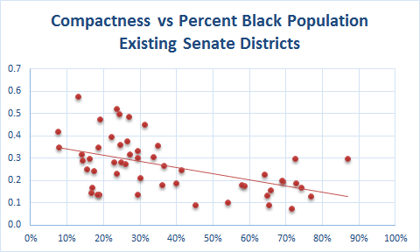
Compactness Correlations

Slide 18
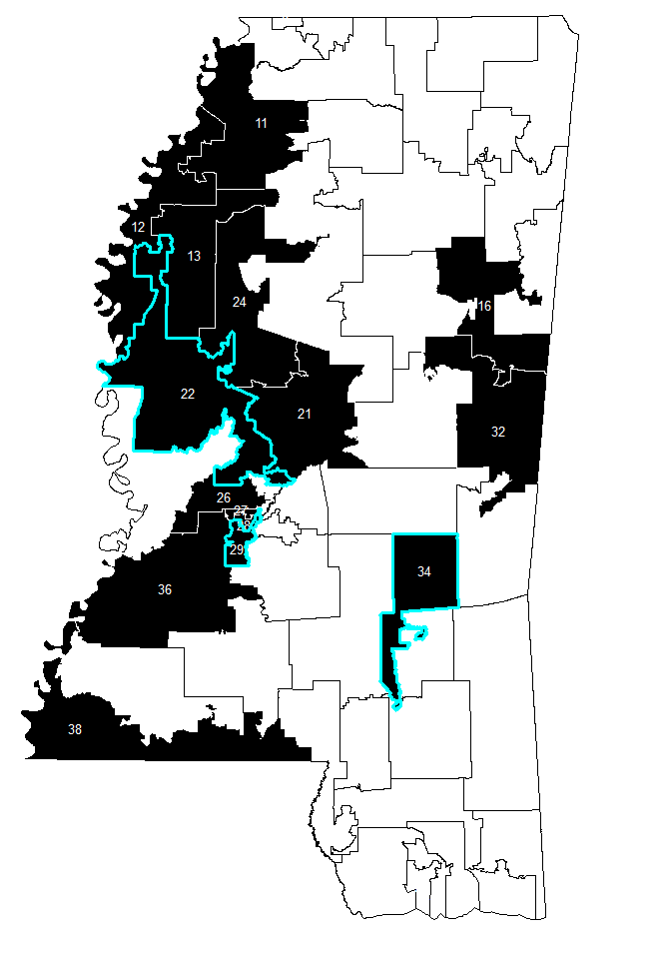
Majority-Minority Districts
Voting Rights Act provision
Population Shifts
  2000 Census
    Total Population: 3,280,857
    White Population: 2,014,221
    Black Population: 1,191,918
    Percent Black: 36.3%
    Majority-Minority Districts: 12
  2010 Census
    Total Population: 2,967,297
    White Population: 1,754,684
    Black Population: 1,098,385
    Percent Black: 37.0%
    Majority-Minority Districts: 15

Slide 19
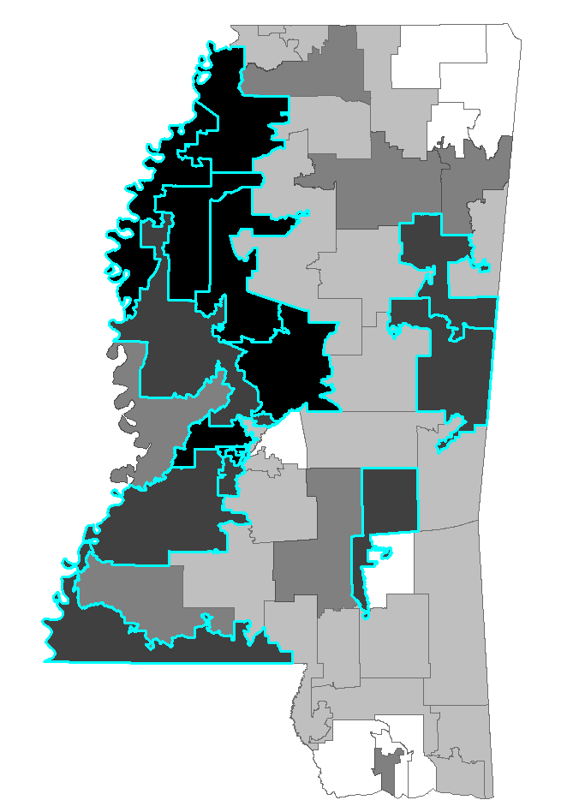
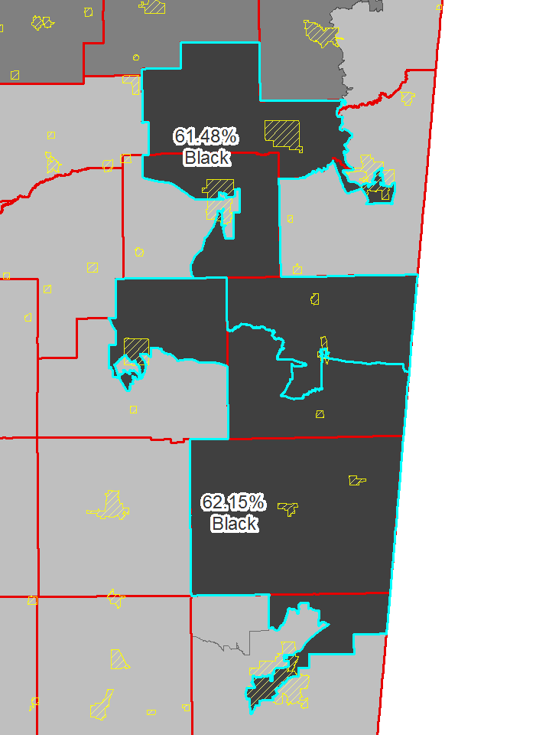
Majority-Minority Districts in Mississippi State Senate

Slide 20
Communities of Interest vs Territorial Communities
Cited by courts as valid criterion for preservation in redistricting
Not necessarily geographically rooted
Can form on the basis of any shared concern
Often the shared concern is simply race or ethnicity
Proposed by Stephanopoulos as criterion for preservation in redistricting
Geographically rooted
Tend to share the same local governments, local news sources, local employers, local markets, and local schools.

Slide 21
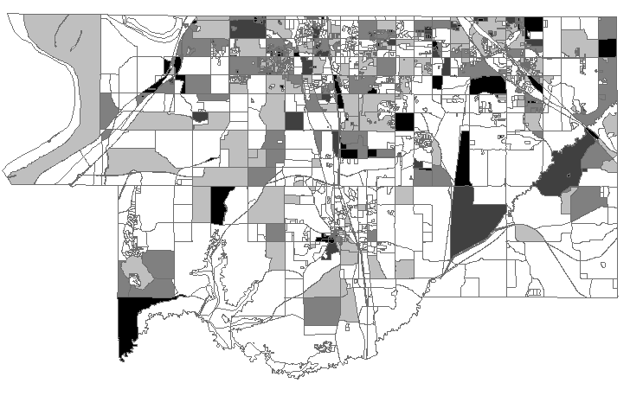
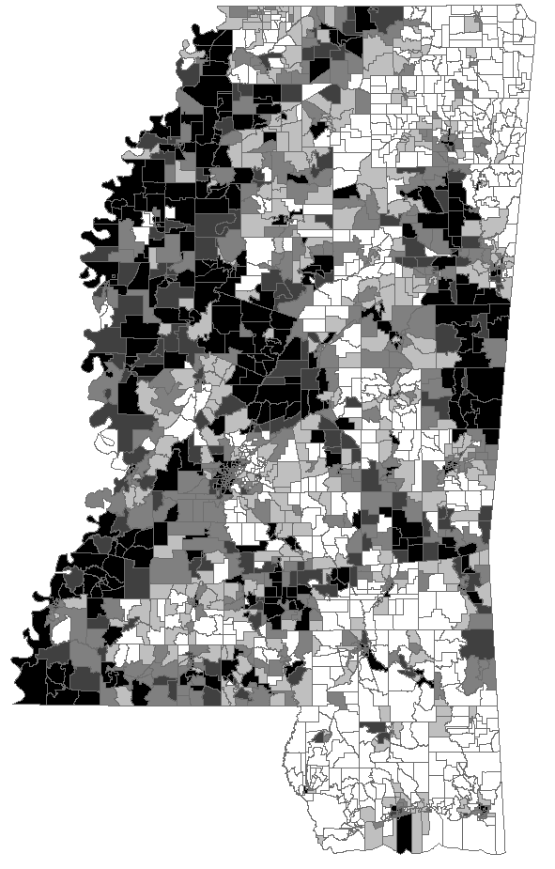
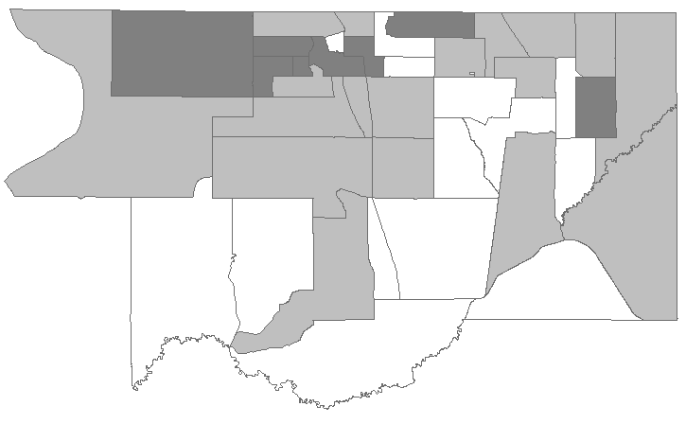
Voting Units
Census Blocks in DeSoto County, Mississippi
Voting Precincts in DeSoto County, Mississippi
Voting Precincts in Mississippi

Slide 22
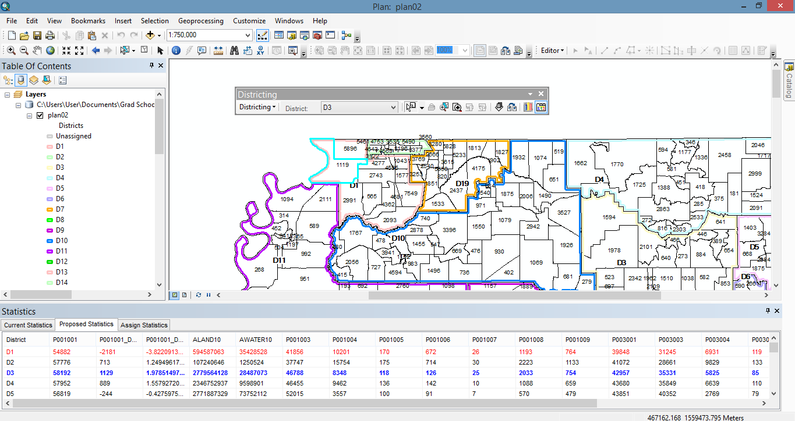
Districting for ArcGIS Add-On

Slide 23
Redistricting Procedure Fundamentals
Assign units (precincts or wards) to districts
Try to make district boundaries conform to other Territorial Community boundaries
Ensure districts are equal in population (+/-5% from ideal)
If district was majority-minority, it has to remain majority-minority
Try to ensure new district boundary is still inhabited by incumbent legislator

Slide 24
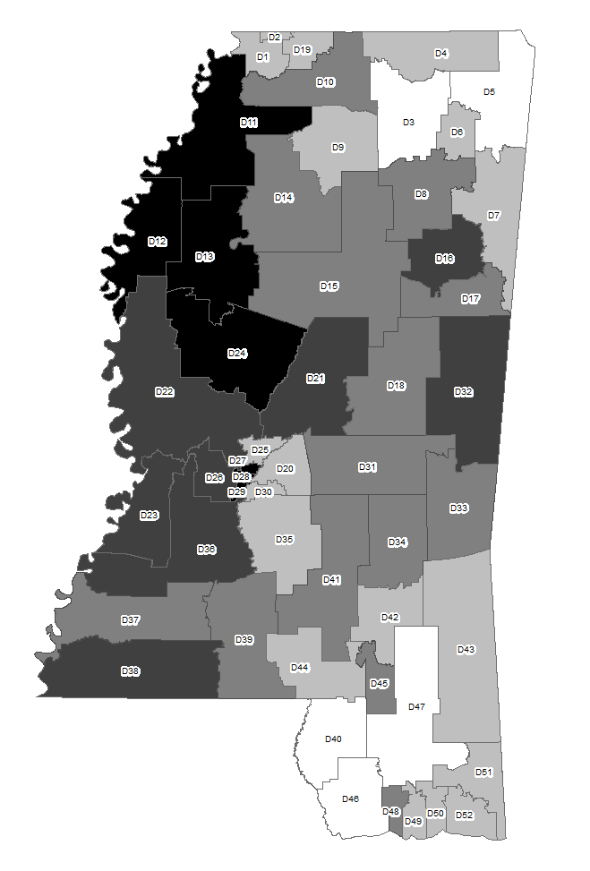
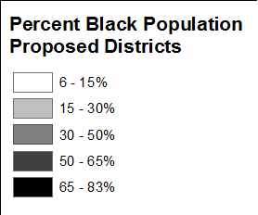
Existing Approved Districts vs My Proposed Districts

Slide 25
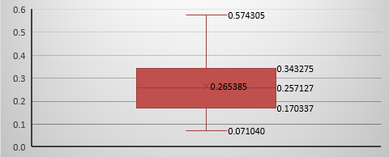
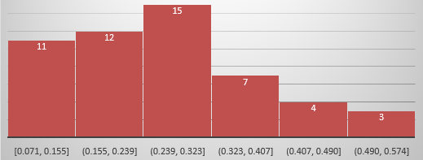
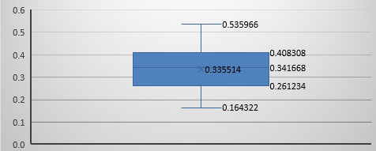
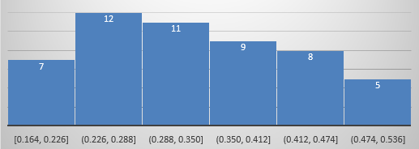
Existing Approved Districts
Case Study Results
Highest Deviation 2,791 (59,854) 4.89%
Lowest Deviation -2,784 (54,279) -4.88%
Smallest Deviation 31 (57,094) 0.05%
Average Deviation 1,613 2.82%
Least Compact 0.071040 (PCT Black 71.6%)
Most Compact 0.574305 (PCT Black 13.1%)
Average Compactness 0.265385
My Proposed Districts
Highest Deviation 2,164 (59,227) 3.79%
Lowest Deviation -2,092 (54,971) -3.67%
Smallest Deviation 10 (57,073) 0.018%
Average Deviation 820 1.44%
Least Compact 0.164322 (PCT Black 59.1%)
Most Compact 0.535966 (PCT Black 55.9%)
Average Compactness 0.335514

Slide 26
Next Steps
Calculate partisan symmetry of new Mississippi State Senate districts
  Need to break election results down to precinct level – over 1,900 precincts
  Many precinct boundaries changed after 2010 Census, so need to obtain new shapefiles from county officials
Carry out similar redistricting for a state with clear signs of partisan gerrymandering
  North Carolina General Assembly
Present at Conference
  ESRI Southeast User Conference in Nashville (May 2017)
  SCAUG (South Central Arc User Group) in Baton Rouge (March 2017)
(December 2016)
(Jan - Feb 2017)

Slide 27
Sources
Altman, Micah and McDonald, Michael (July 29, 2010). “The Promise and Perils of Computers in Redistricting.” Duke Journal of Constitutional Law and Public Policy, Vol 5:69 (2010). http://scholarship.law.duke.edu/cgi/viewcontent.cgi?article=1026&context=djclpp
Chen, Jowei and Rodden, Jonathan (2013). “Unintentional Gerrymandering: Political Geography and Electoral Bias in Legislatures.” 8 Quarterly Journal of Political Science, 239 (2013). http://www-personal.umich.edu/~jowei/florida.pdf
Draper, Robert (October 2012). “The League of Dangerous Mapmakers.” The Atlantic. http://www.theatlantic.com/magazine/archive/2012/10/the-league-of/309084
League of United Latin American Citizens v. Perry, 2006. U.S. Supreme Court. 548 US 399 (2006). https://supreme.justia.com/cases/federal/us/548/399/
Levitt, Justin (n.d.). “All About Redistricting”. Loyola Law School. Available at http://redistricting.lls.edu/states-MS.php#institution
Sandra Little Covington vs The State of North Carolina. (U.S. District Court for Middle District of North Carolina, 2016). http://electionlawblog.org/wp-content/uploads/covington.pdf
Stephanopoulos, Nicholas (July 31, 2011). “Redistricting and the Territorial Community.” University of Pennsylvania Law Review, Vol. 160, p. 1379 (2012). Available at SSRN: http://ssrn.com/abstract=1777276
Stephanopoulos, Nicholas and McGhee, Eric, (October 1, 2014). “Partisan Gerrymandering and the Efficiency Gap.” 82 University of Chicago Law Review, 831 (2015); U of Chicago, Public Law Working Paper No. 493. Available at SSRN: http://ssrn.com/abstract=2457468
Wattson, Peter S. (n.d.). “How to Draw Redistricting Plans That Will Stand Up in Court.” Senate Counsel, State of Minnesota. Available at http://www.senate.leg.state.mn.us/departments/scr/REDIST/Draw/draw.pdf
Whitford vs Gill (n.d). The Campaign Legal Center. Available at http://www.campaignlegalcenter.org/case/whitford-v-gill

Slide 28
Questions?

