Slide 1
Classification of Riparian Buffers in Oregon Using Several Object Based Image Analysis Platforms
Troy Wirth
MGIS Capstone Project Proposal
Advisor: Dr. Douglas Miller
Thanks to: Cheryl Hummon (ODA), John Byers (ODA), Meta Loftsgaarden (OWEB)

Slide 2
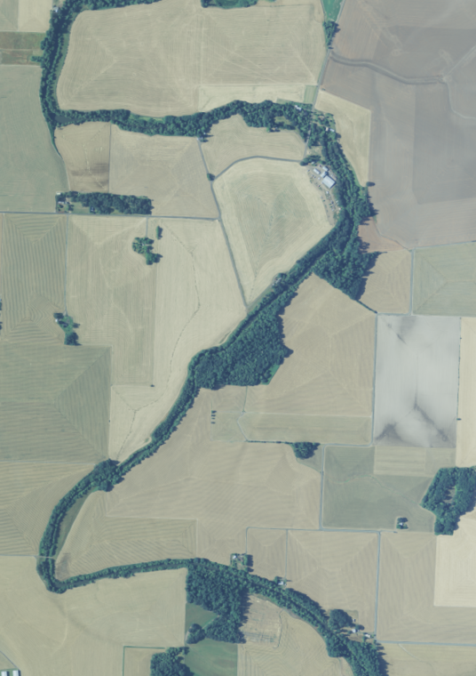
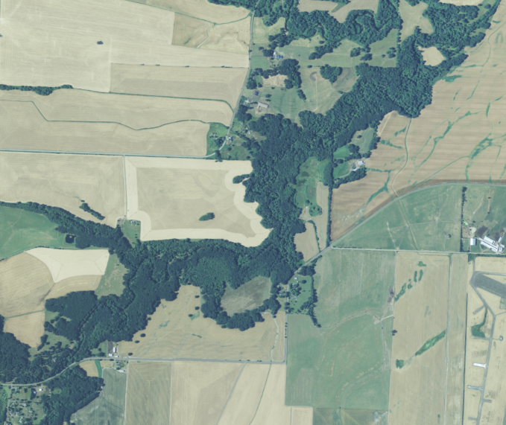
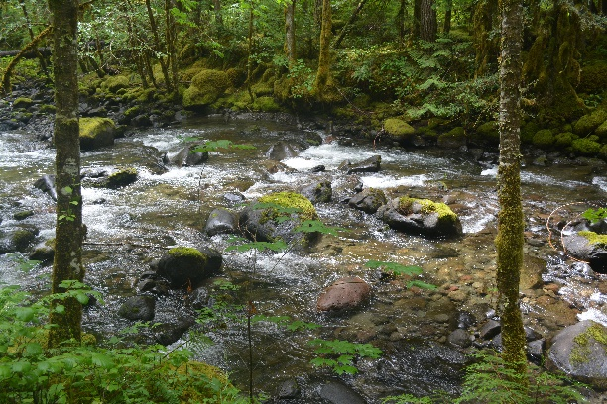
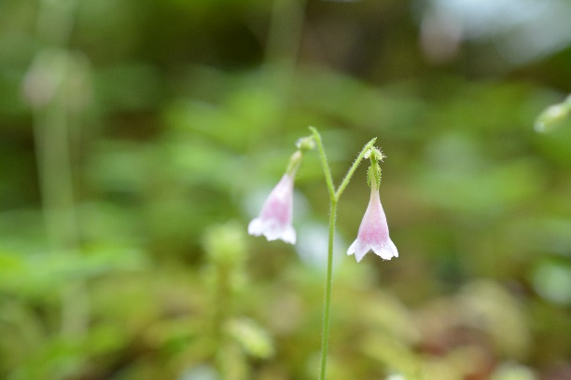
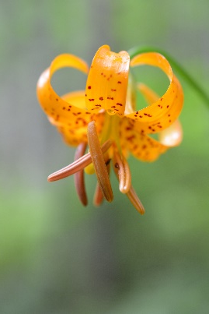
Benefits of Riparian Buffers
Ecosystem services
High biodiversity
Wildlife corridors
Water quality
Temperature
Stabilize streambanks
Filtration (Kuglerovà et al. 2014).

Slide 3
ODA Focus Areas
The Oregon Department of Agriculture (ODA) Focus Area approach
https://www.oregon.gov/ODA/shared/Documents/Publications/NaturalResources/WaterFocus4.pdf

Slide 4
Assessing Riparian Buffers
Streamside Vegetation Assessment (SVA)
ODA SVA Classes
Tree – native or invasive > 15 ft
Tree Ag – orchards, farmed trees > 15 ft
Shrub – native or invasive 3 – 15 ft
Shrub Ag – young orchards, berries etc. 3-15 ft
Grass – native or invasive < 3 ft
Grass Ag – pasture, crops, stubble etc.
Bare – no vegetation due to natural conditions
Bare Ag – no vegetation due to agricultural activities
Ag infrastructure – farm houses, buildings, roads
Water

Slide 5
Objectives
Develop a Geographic Object Based Image Analysis methodology to:
Identify land cover classes of interest for SVA
Repeatable / Automated
Accurate
Assess different platforms
ODA SVA Classes | Project Class
Tree – native or invasive > 15 ft | Trees (> 15 ft)
Tree Ag – orchards, farmed trees > 15 ft | Trees (> 15 ft)
Shrub – native or invasive 3 – 15 ft | Shrubs (3-15 ft)
Shrub Ag – young orchards, berries etc. 3-15 ft | Shrubs (3-15 ft)
Grass – native or invasive < 3 ft | Grass (< 3 ft)
Grass Ag – pasture, crops, stubble etc. | Grass (<3 ft)
Bare – no vegetation due to natural conditions | Bare ground
Bare Ag – no vegetation due to agricultural activities | Bare ground
Ag infrastructure – farm houses, buildings, roads | Infrastructure, roads
Water | Water

Slide 6
What is geobia?
“Geographic Object-Based Image Analysis (GEOBIA)…developing automated methods to partition remote sensing imagery into meaningful image-objects, and assessing their characteristics through spatial, spectral and temporal scales, so as to generate new geographic information in GIS-ready format.” (Hay & Castilla 2008)
Draws upon the established methodologies of segmentation, edge detection, and classification procedures (Blaschke 2010)
May be more accurate than pixel based methods

Slide 7
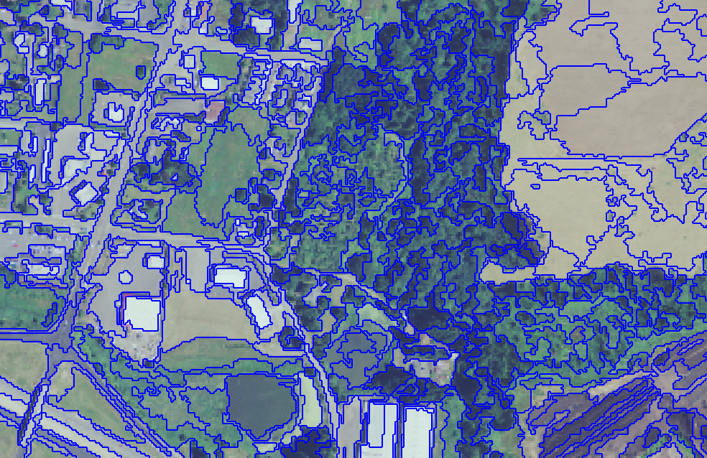
segmentation
Identifies homogeneous regions
Multiple algorithms
Scale
Attributes

Slide 8
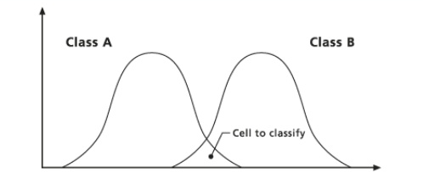
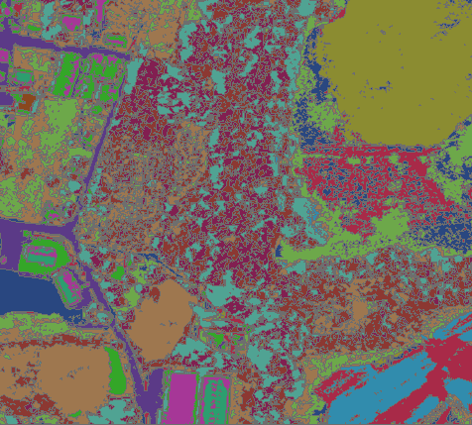
classification
Training areas
Classification Algorithms
Maximum Likelihood
Support Vector Machine (SVM)
ISO Cluster
Object Attributes

Slide 9
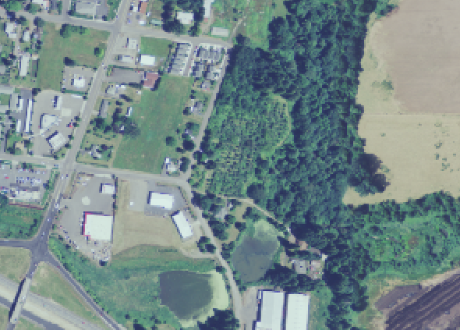
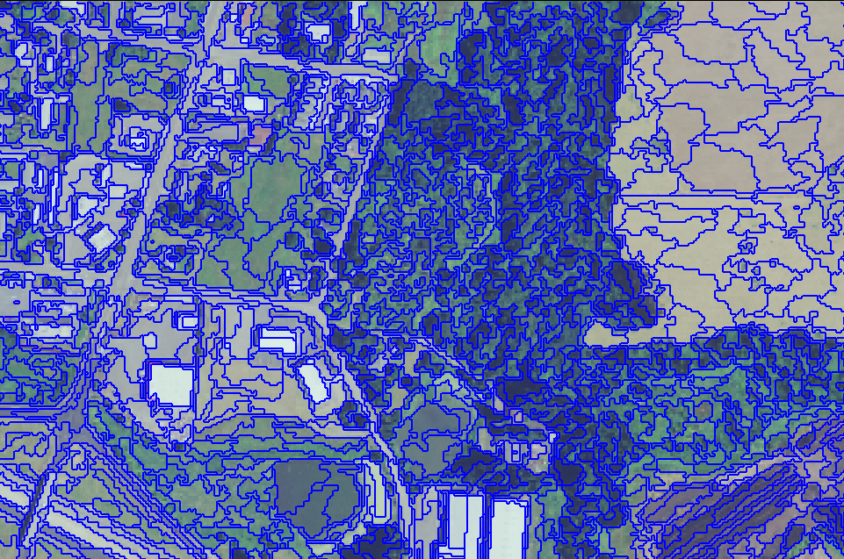
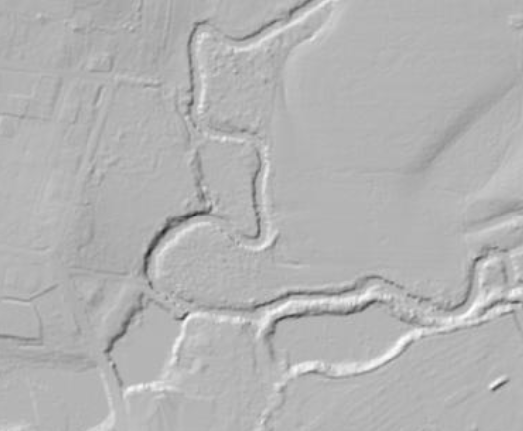
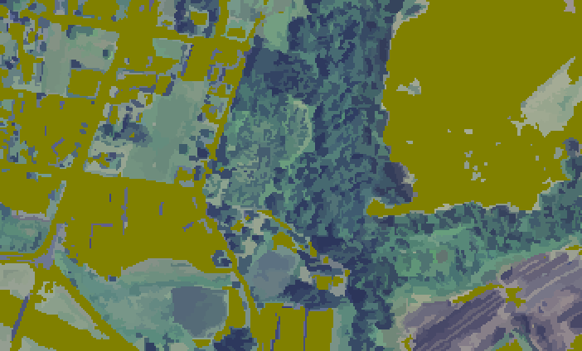
GEOBIA Workflow
SEGMENTED IMAGE
INPUT
Segmentation
Algorithm
Algorithm
Parameters
Classification
Supervised
Unsupervised
Methodology
Object Manipulation
CLASSIFIED IMAGE

Slide 10
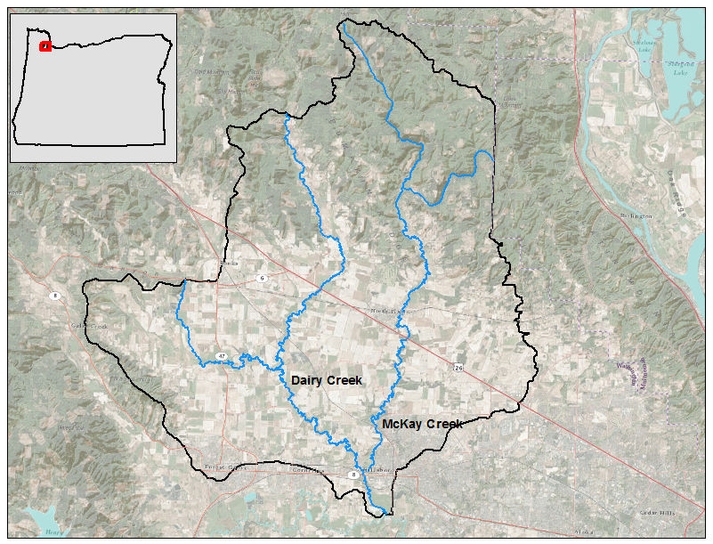
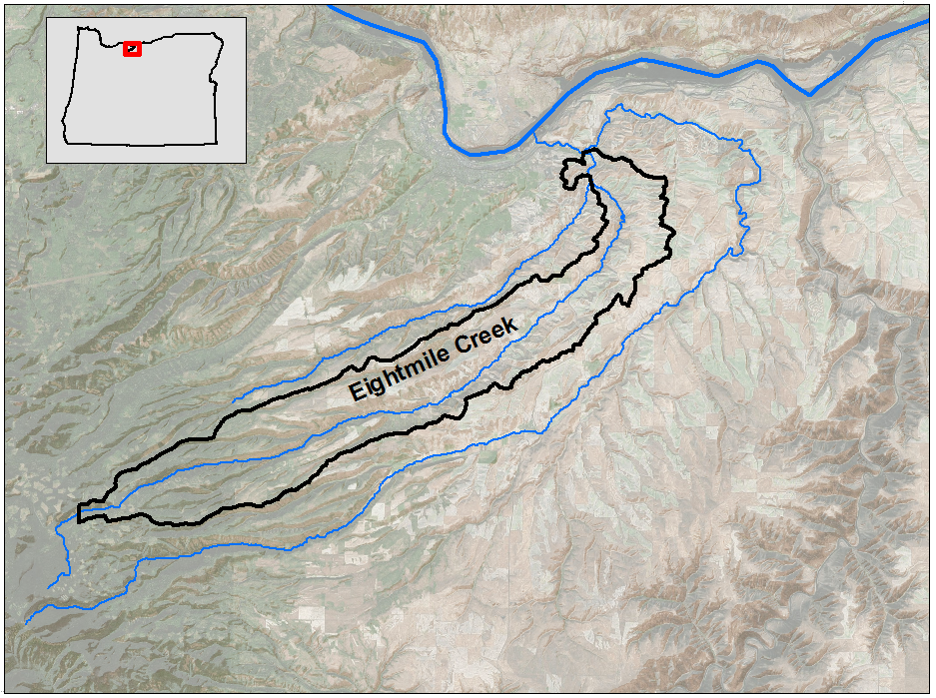
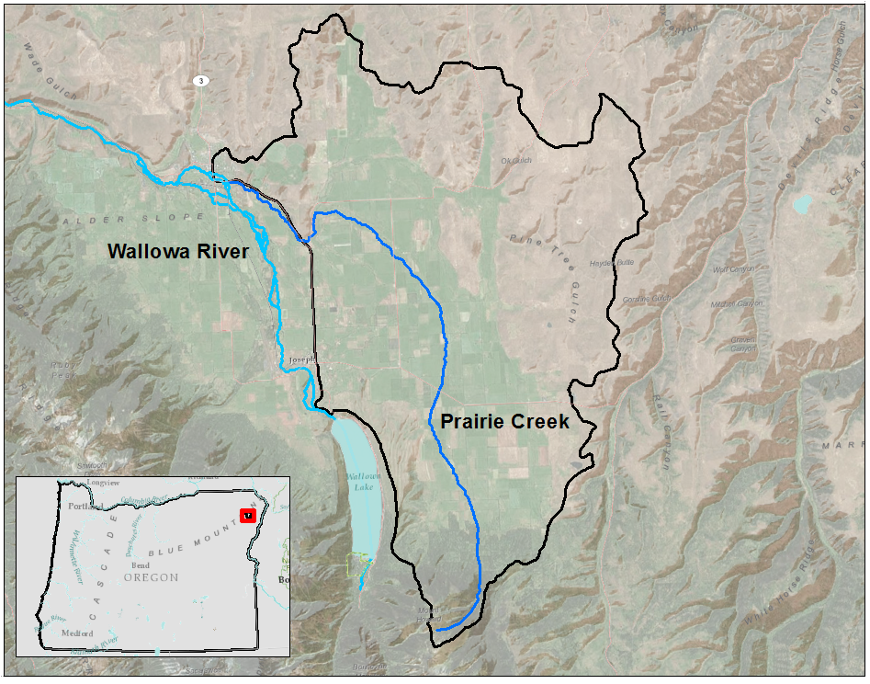
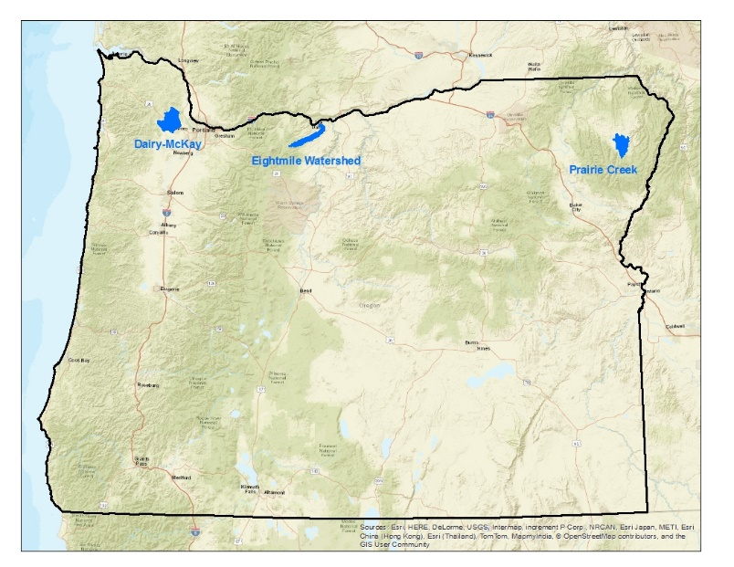
Study areas
Dairy-McKay
Eight Mile
Prairie Creek

Slide 11
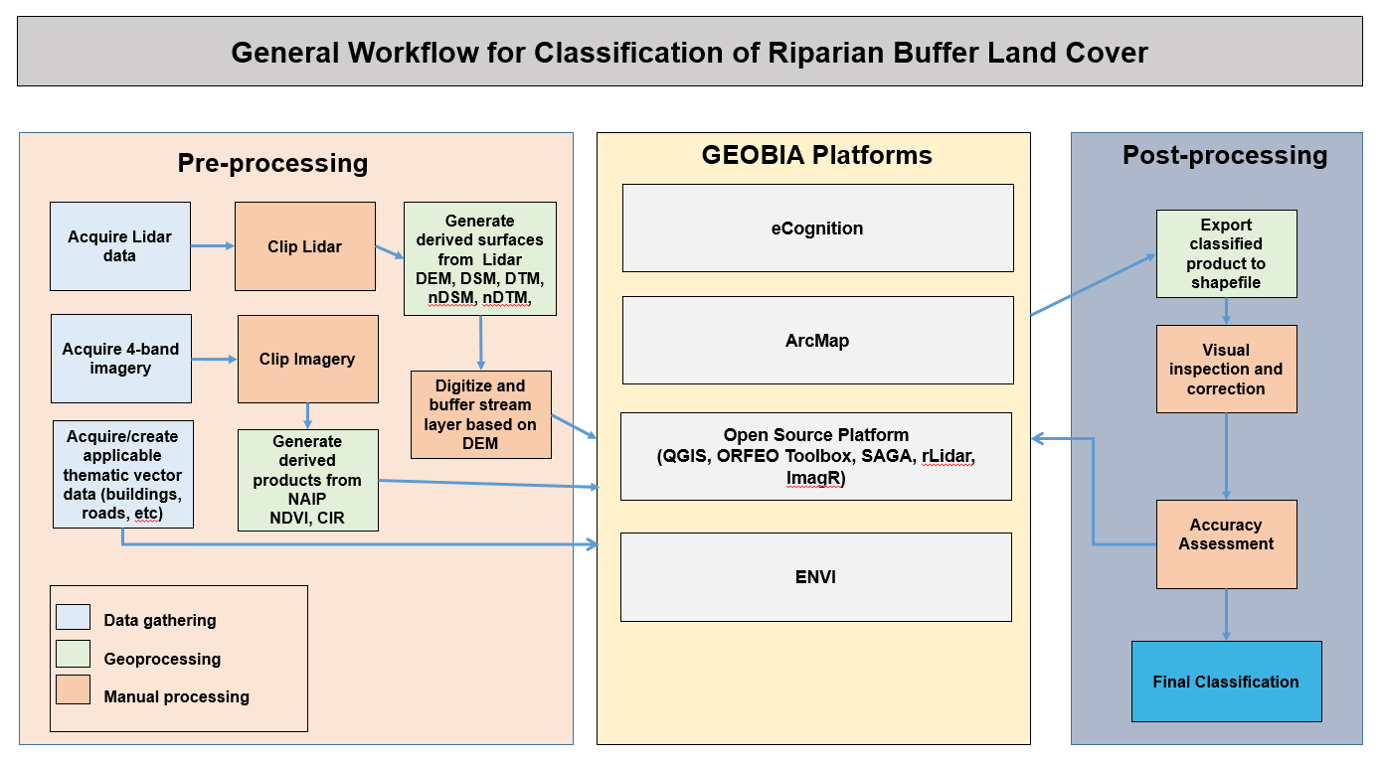

Slide 12
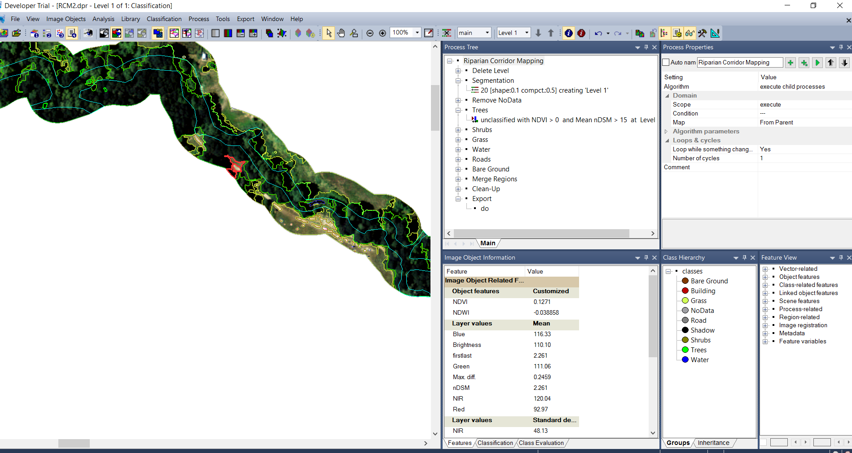
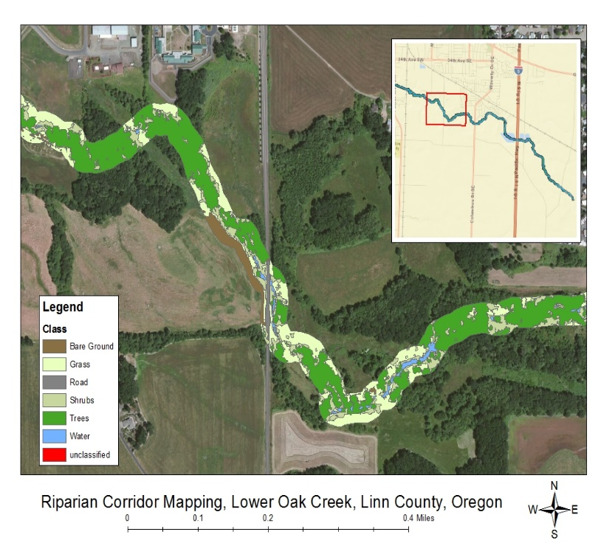
Ecognition

Slide 13
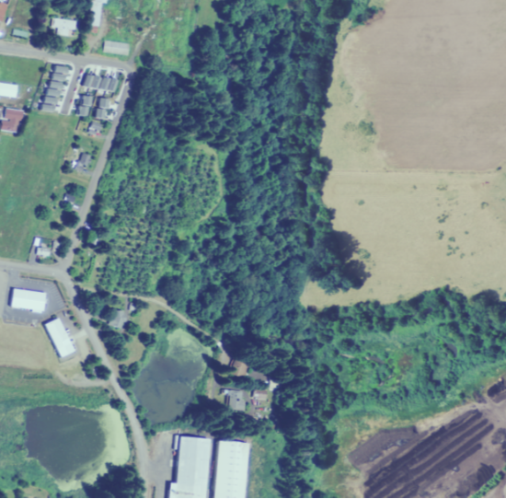
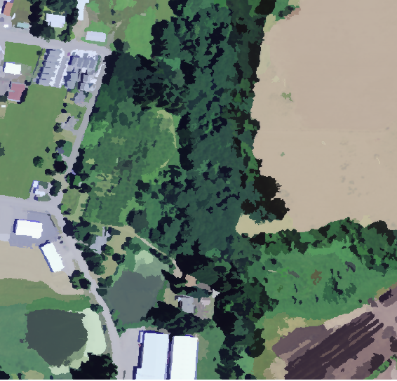
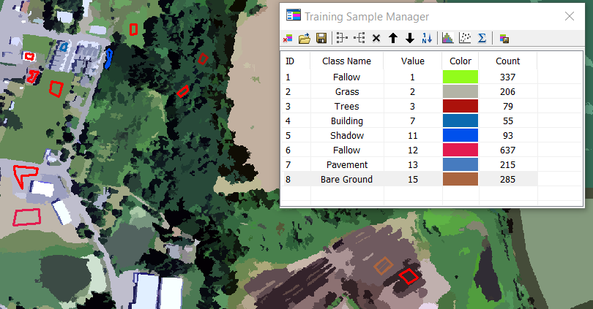
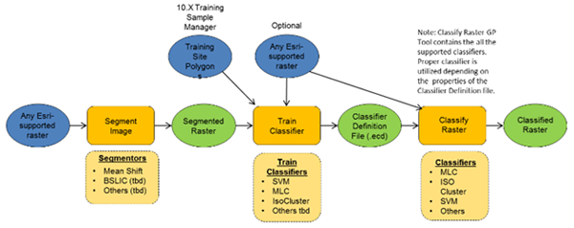
ArcGis
NAIP Imagery
Segmented Image
(mean shift)
Creating training Polygons

Slide 14
ArcGis
Training Information
(signature file, ESRI Classifier Definition file),
Segment Attributes
Classified
Raster
Convert to
Polygons
Segmented Image
Additional Raster (DEM)

Slide 15
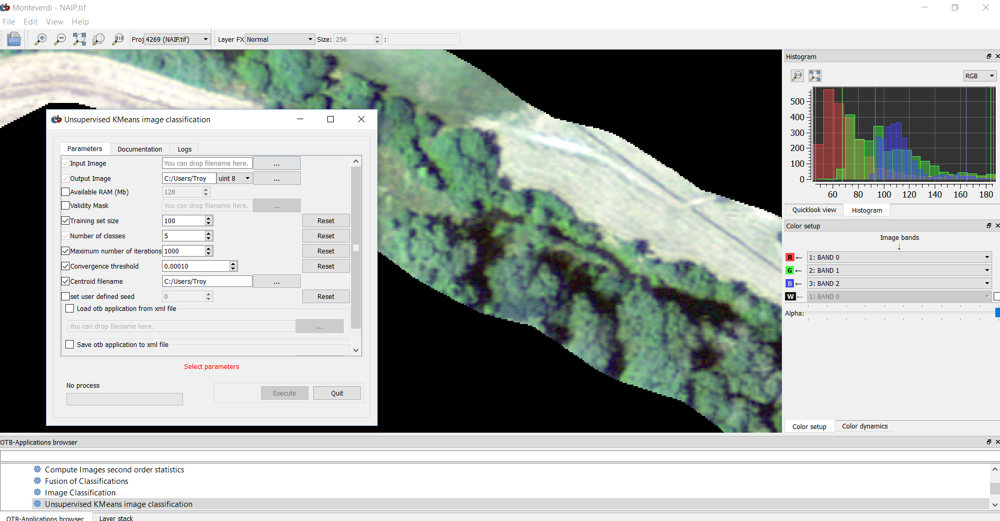
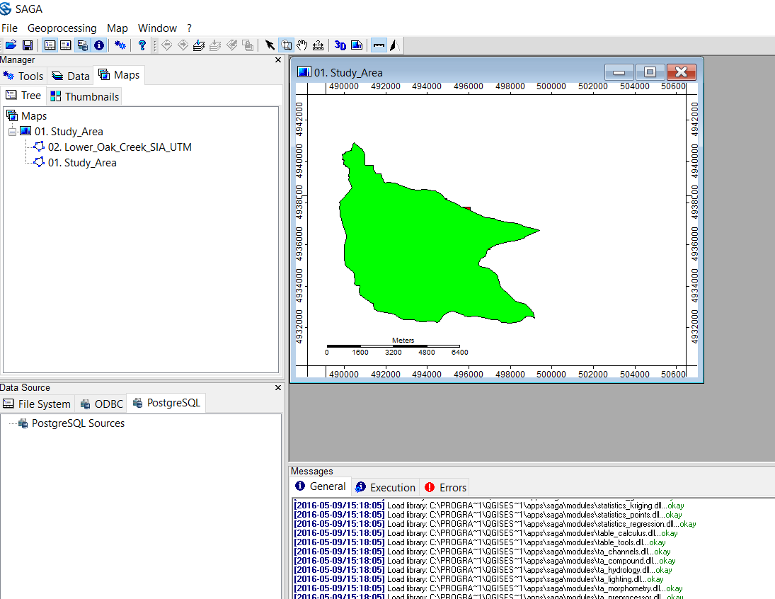
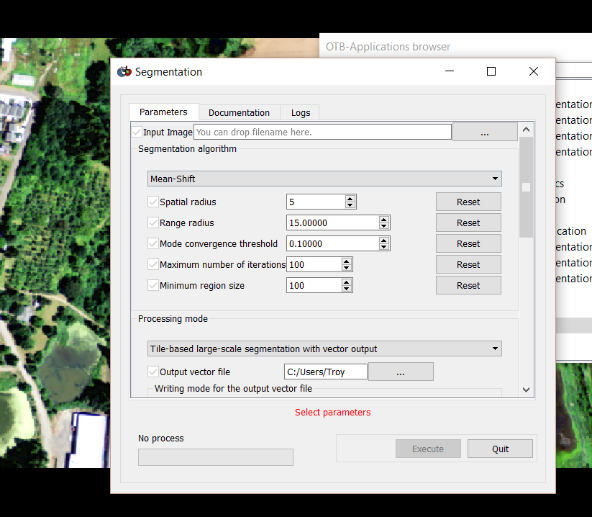
Orfeo toolbox
SAGA GIS

Slide 16
Platform Comparison
Usability – How easy the platform is to install and use its interface
Complexity – How many steps are needed to perform the analysis
Accuracy - Accuracy of the final products will be compared

Slide 17
accuracy
 | Manual Classification | eCognition | ArcGIS | ORFEO Toolbox
Bare
Grass
Shrubs
Trees
Water
Infrastructure
Roads
Overall Accuracy Kappa Coefficient

Slide 18
Final products
Feature classes of land cover along areas of interest in each Focus Area and methodology
Feature class of areas/types of change for the Dairy-McKay Focus Area.
Final report describing the methodologies and documenting processing steps and workflow
Suggestions for future assessment of riparian areas using GEOBIA methodology

Slide 19
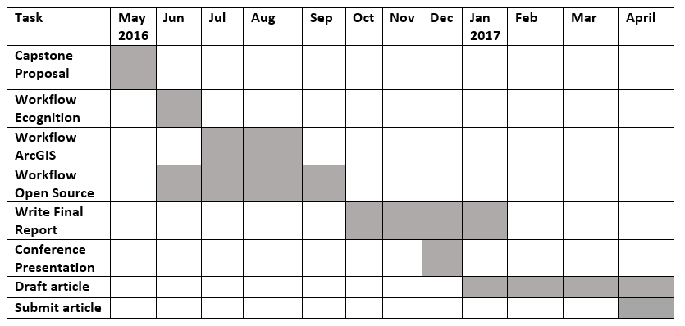
Project timeline

Slide 20
References
ArcMap 10.3.1. ESRI, Redlands, California
Blaschke, T. 2010. Object based image analysis for remote sensing. ISPRS Journal of Photogrammetry and Remote Sensing. 65: 2-16.
eCognition Developer 9. Trimble Inc. Munich, Germany
Hay, G.J. and G. Castilla. 2008. Geographic object-based image analysis (GEOBIA): a new name for a new discipline. In Blaschke T, Lang S, Hay GJ (eds) Object-based image analysis spatial concepts for knowledge-driven remote sensing applications. Springer, Berlin, Heidelberg and New York, pp.75-90
Johansen, K., Phinn, S., Witte, C. 2010. Mapping of riparian zone attributes using discrete return LiDAR, QuickBird, and SPOT-5 imagery: Assessing accuracy and costs. Remote Sensing of Environment 114: 2679-2691
Kuglerovà, L., Ågren, A., Jansson, R., Laudon, H. 2014. Toward optimizing riparian buffer zones: Ecological and biogeochemical implications for forest management. Forest Ecology and Management 334:74-84.
O’Neil-Dunne, J., MacFaden, S., and A. Royar. 2014. A versatile, production-oriented approach to high-resolution tree-canopy mapping in urban and suburban landscapes using GEOBIA and data fusion. Remote Sensing 6: 12837-12865
OTB Development Team. 2016. The ORFEO Tool Box Software Guide, Updated for OTB-5.2.1. Centre National D’etudes Spatiales (CNES). 788 p.
Stefanski, J., Mack, B., Waske, B. 2013. Optimization of object-based image analysis with random forests for land cover mapping. IEEE J. Sel. Top. Appl. Earth Obs. Remote Sens. 6: 2492-2504.
Wasser, L., Chasmer, L., Day, R., and A. Taylor. 2015. Quantifying land use effects on forested riparian buffer vegetation structure using LiDAR data. Ecosphere 6(1): 1-17
Water Quality Management Program Streamside Vegetation Assessment Tool - User’s Guide, Version 1 (November 4, 2013). Oregon Department of Agriculture, Salem, Oregon.

